Slide 1

Calories Burnt Prediction using Machine Learning Techniques
By
ANANYA CHOUDHARY (08015002821)
PRIYA RAJ KASHYAP (09815002821)
AMAN KUMAR (22015002821)
MAHARAJA SURAJMAL INSTITUTE OF TECHNOLOGY
C-4, Janakpuri, New Delhi-58
Affiliated to Guru Gobind Singh Indraprastha University, Delhi
December, 2024

Slide 2
Objective:
To predict the calories burnt by a person by taking his/her 7 parameters namely, gender, age
height, weight, duration of exercise, heart rate, and body temperature.
Data Sets:
Two datasets calories.csv and exercise.csv are taken from kaggle online dataset repository.
Calories dataset contains 7 features associated with unique id of a person, whereas exercise
dataset represents corresponding calories burnt of a person.

Slide 3
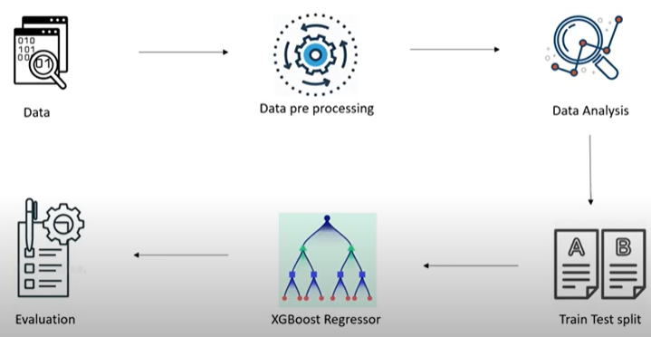
Methodology:
To predict the calories burnt by a person by taking his/her 7 parameters namely, gender, age
height, weight, duration of exercise, heart rate, and body temperature.
Fig: work flow of the model

Slide 4
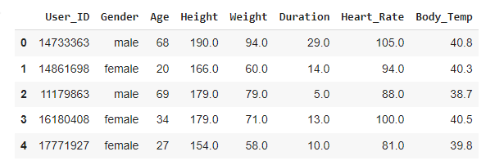
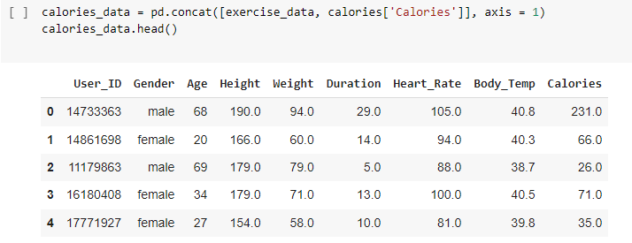
1. Data collection:
Data collected from online repository of kaggle datasets.
Data collection is the primary stage of the project and is collected through the online repository that contains 25000 instances having 7 features.
Fig: calories.csv dataset
Fig: calories.csv dataset concatenated with exercise.csv dataset

Slide 5
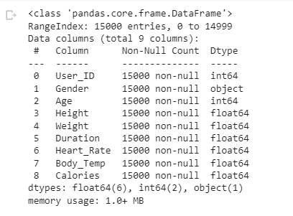
2. Data Pre-processing:
The categorical data of gender features are changed to numerical values. Also the missing
values of a feature in a record are replaced with mean of the respective feature.
Fig: made the dataset with zero null values

Slide 6
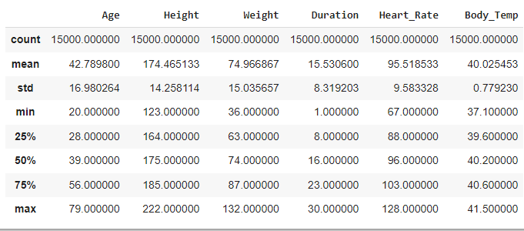
3. Data Analysis:
The data are analyzed through various data visualization method like distplot and describe.
Fig: statistical destribution of dataset

Slide 7
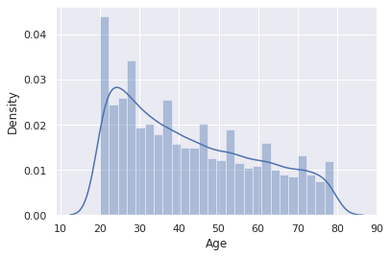
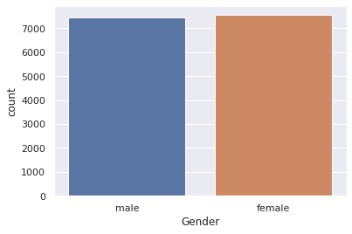
Fig: description of dataset using describe method of data visualization seaborn library

Slide 8
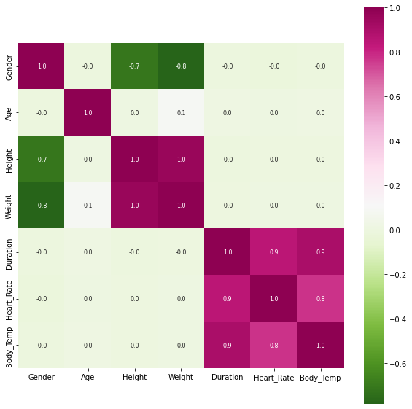
Fig: heatmap of dataset

Slide 9
4. Train-test split:
The entire data are split into training and testing set by using method train-test split.
In which 80 percent of data are used for training while rest are used for testing and
validation.
5. Training the model :
The model is trained with XGBoost Regressor and MLP Regressor respectively.
6. Evaluation:
The evaluation is done by taking 7 real-time parameters in GUI interface made through
tkinter package of python and tested by the trained models of XGBoost and MLP.
MLP-Regressor is showing good accuracy by minimizing the absolute mean error.

Slide 10
Results and Conclusions:
This project helps to predict the calories burnt after exercise by taking 7 physical parameters
namely, gender, age, height, weight, duration of exercise, heart rate, and body temperature
of a person. The dataset is taken from an online dataset repository. Two regression models
are used to train the dataset MLP-Regressor and XGB-Regressor. The absolute mean error for
both models is 1.8 and 2.07 respectively.
There are positive correlations among some features of the datasets. duration is positively
correlated with body temperature and heart rate while height and weight are negatively
correlated with each other.
The youth participation in exercise datasets is more as compared to the other age groups.

Slide 11
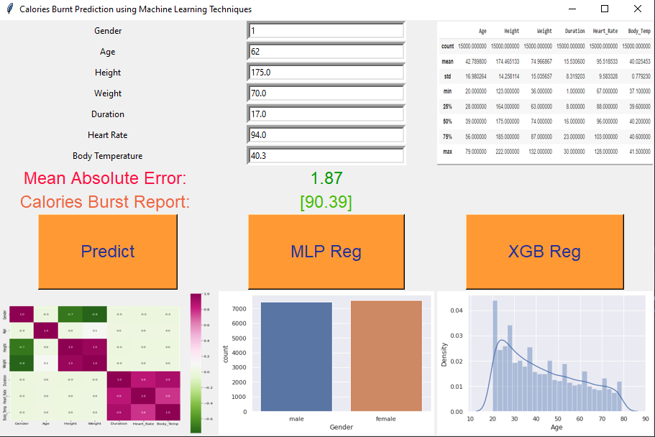
Fig: Result of Calories Burnt Prediction Tool made with python tkinter package

Slide 12
References:
Ram, Chandra (2022): Calories Burnt Prediction using Machine Learning Techniques. figshare.
Journal contribution. https://doi.org/10.6084/m9.figshare.21671420.v1

