Slide 1

Predicting The Likelihood of Insurance Charges
By Aman negassi

Slide 2

If there is one thing to know about the United States Health System, it is that is constantly being regulated. It has spilled onto the political arena where one side is arguing for deregulation and the other arguing further regulation. The U.S. Health System is a mix of public and private, for-profit and non-profit insurers and healthcare providers. The United States Federal Government provides funding for programs. There is Medicare which is for adults age 65 and older and some people with disabilities as well as for various programs for veterans and low-income people, including Medicaid and the Children’s Health Insurance Program. In 2018, nearly 92 percent of the population was estimated to have coverage leaving 27.5 million people uninsured. With the dataset provided, I analyze it as well as perform models to compare the costs among regions as well as see how much the factors impact the costs.

Slide 3
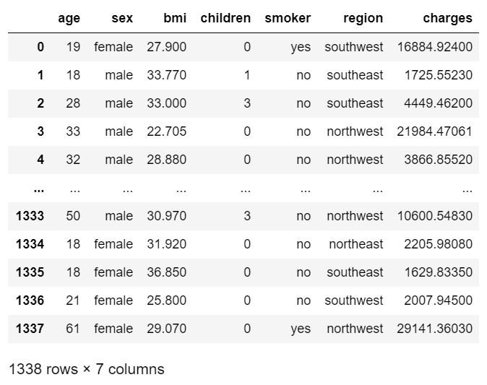
This is the dataset used. The factors in determining the charges are the age, sex, bmi, children, whether you are a smoker or not, and region in the United States. The region is split into 4 locations: northeast, northwest, southeast, southwest .A useful reference for families.

Slide 4
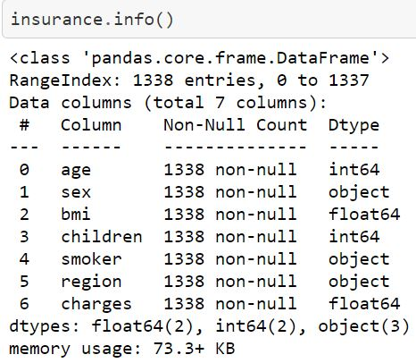
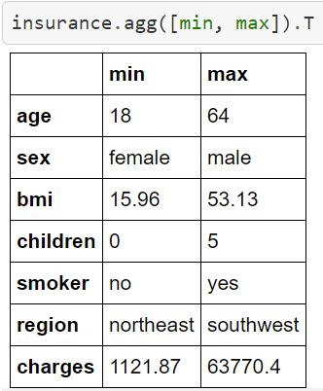
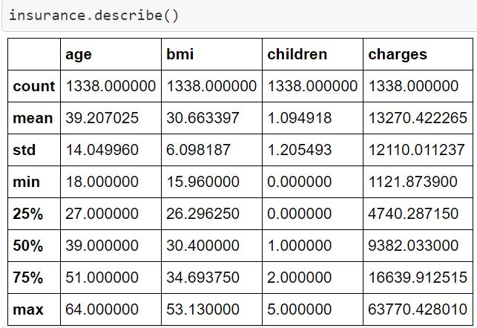
Exploratory Data Analysis
N
On the left are the columns classified by data types. Followed by that is the minimum and maximum values for each column. On the right is the summary statistics for the columns that are numerical.

Slide 5
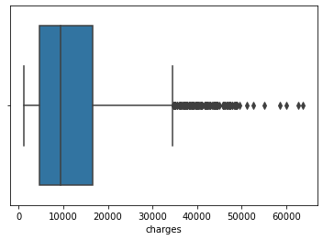
After performing the boxplot, I found the average charges was around $10,000.The outlier seems to start between $30,000-$40,000.

Slide 6
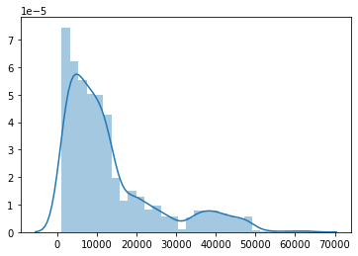
This is the distribution plot of the charges. It skews to the left.

Slide 7
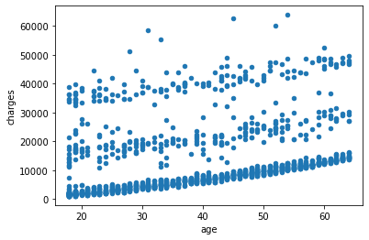
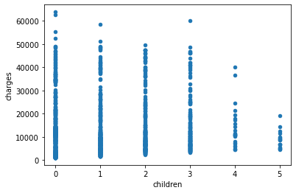
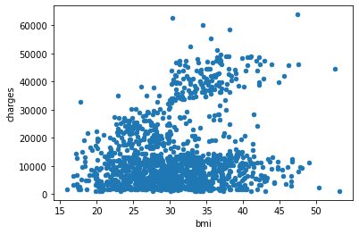
I utilize scatterplots for correlation among the column variables. When taking the scatterplot of the age and charges, as a person gets older, they are likely to pay more in health insurance. Looking at children and charges, we see you are likely to pay less in health insurance as you have more children. With the bmi, the insurance is likely to go up the higher the bmi. Although after a certain point, it does not seem to make a difference.

Slide 8
Methods
Linear Regression: As I was conducting Exploratory Data Analysis, Regression had to be utilizing when fitting the column variables. It is also used when building another model that uses both continuous and categorical variables. I also applied the predict to the prediction.
Train_Test_Split: I split the numerical and categorical variables while picking 60% of the data for the training set. Before, I build a random number generator. I separate the variables from the target variable which is charges to determine charges. I create dummy variables, so I am able to utilize the categorical variables turning them into numerical.
Preprocessing.OneHotEncoder: All the variable encoder is doing here is converting our categorical variables to binary. We have three categories, which have two, three, and four possible entries. The encoder uses one binary for each possible response in each category; for example, 'sex' has two columns: one that says yes or no to the individual having 'male' in 'sex', and one that says yes or no to the individual having 'female' in 'sex'. This makes the third category, where we have four possible categories, directly comparable to the others.

Slide 9
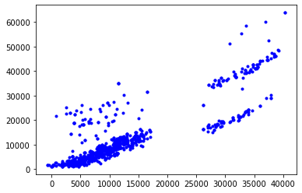
I built a random number generator followed by picking 60 % of the data for my training set before I will fit the model. It’s through the train_test_split and preprocessing that I perform linear regression and utilize the predict method. With the plot, I took the linear regression and subtracted from the traing set for the target variable charges.

Slide 10
References
https://www.kaggle.com/annetxu/health-insurance-cost-prediction
https://www.commonwealthfund.org/international-health-policy-center/countries/united-states
https://github.com/Aman101160/Data-Science-Portfolio/blob/master/Predicting_Health_Insurance_Costs.ipynb
https://github.com/Aman101160/Data-Science-Portfolio/blob/master/InsurCostPredPreProcessing%26TrainingDataDevelopment.ipynb

