Slide 1
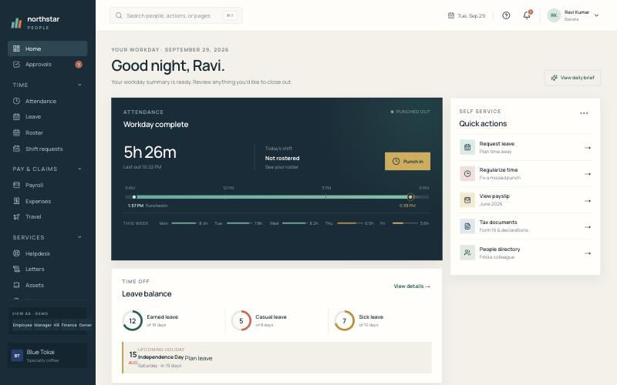
NORTHSTAR PEOPLE
Our own HR platform for Blue Tokai, Got Tea & Suchali's
A proposal to move off PeopleStrong in phases — starting with a low-risk pilot.
For HR leadership review · September 2026
Notes:
Open by saying this is already a working product, not a slide-ware idea. The aim today is a pilot decision, not a big-bang switch.

Slide 2
The proposal in one slide
We built a complete HR platform that we own. We want to prove it on one brand before replacing PeopleStrong.
3
25+
2
0
brands on one platform
HR modules working
apps
licence fee per employee
each fully isolated
web, API and database
web + iOS/Android
we pay only to run it
The ask
Approve a pilot on one smaller brand: run attendance, leave and the service desk live, and run payroll in parallel with PeopleStrong for two cycles. Decide on the full switch only after the numbers match.
Northstar People · HR proposal · 2
Notes:
Keep the ask small and safe: pilot plus parallel payroll. Nobody's salary depends on the new system until it has matched PeopleStrong twice.

Slide 3








Everything HR runs today, in one place
Built and working end to end — records, approvals, notifications and audit trail included.
Core HR
Time
Pay
Service desk
Employee records, directory, org chart, CSV import, documents
GPS + selfie attendance, biometric devices, leave, roster, corrections
India payroll (PF, ESI, PT, TDS), payslips, expenses with receipt scan, travel
Helpdesk with SLAs, HR letters, assets, exit and full-and-final
Talent
Engagement
Insight
Platform
Onboarding checklists, courses & certificates, hiring & referrals, KPIs
Surveys & eNPS, quick polls, recognition wall, announcements
16 analytics reports, group dashboard, risk & compliance checks
Multi-brand, company SSO, roles & permissions, audit, automations
Northstar People · HR proposal · 3
Notes:
This is feature parity with what we use in PeopleStrong today, plus things built for our cafés: roster rules, selfie attendance, receipt scanning.

Slide 4

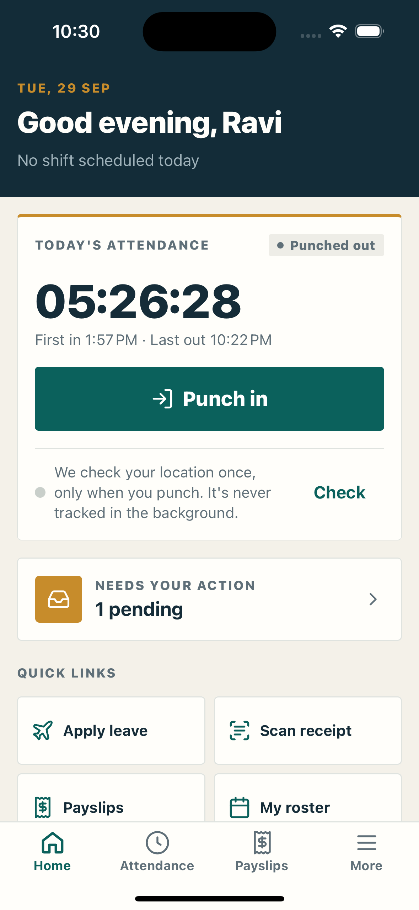
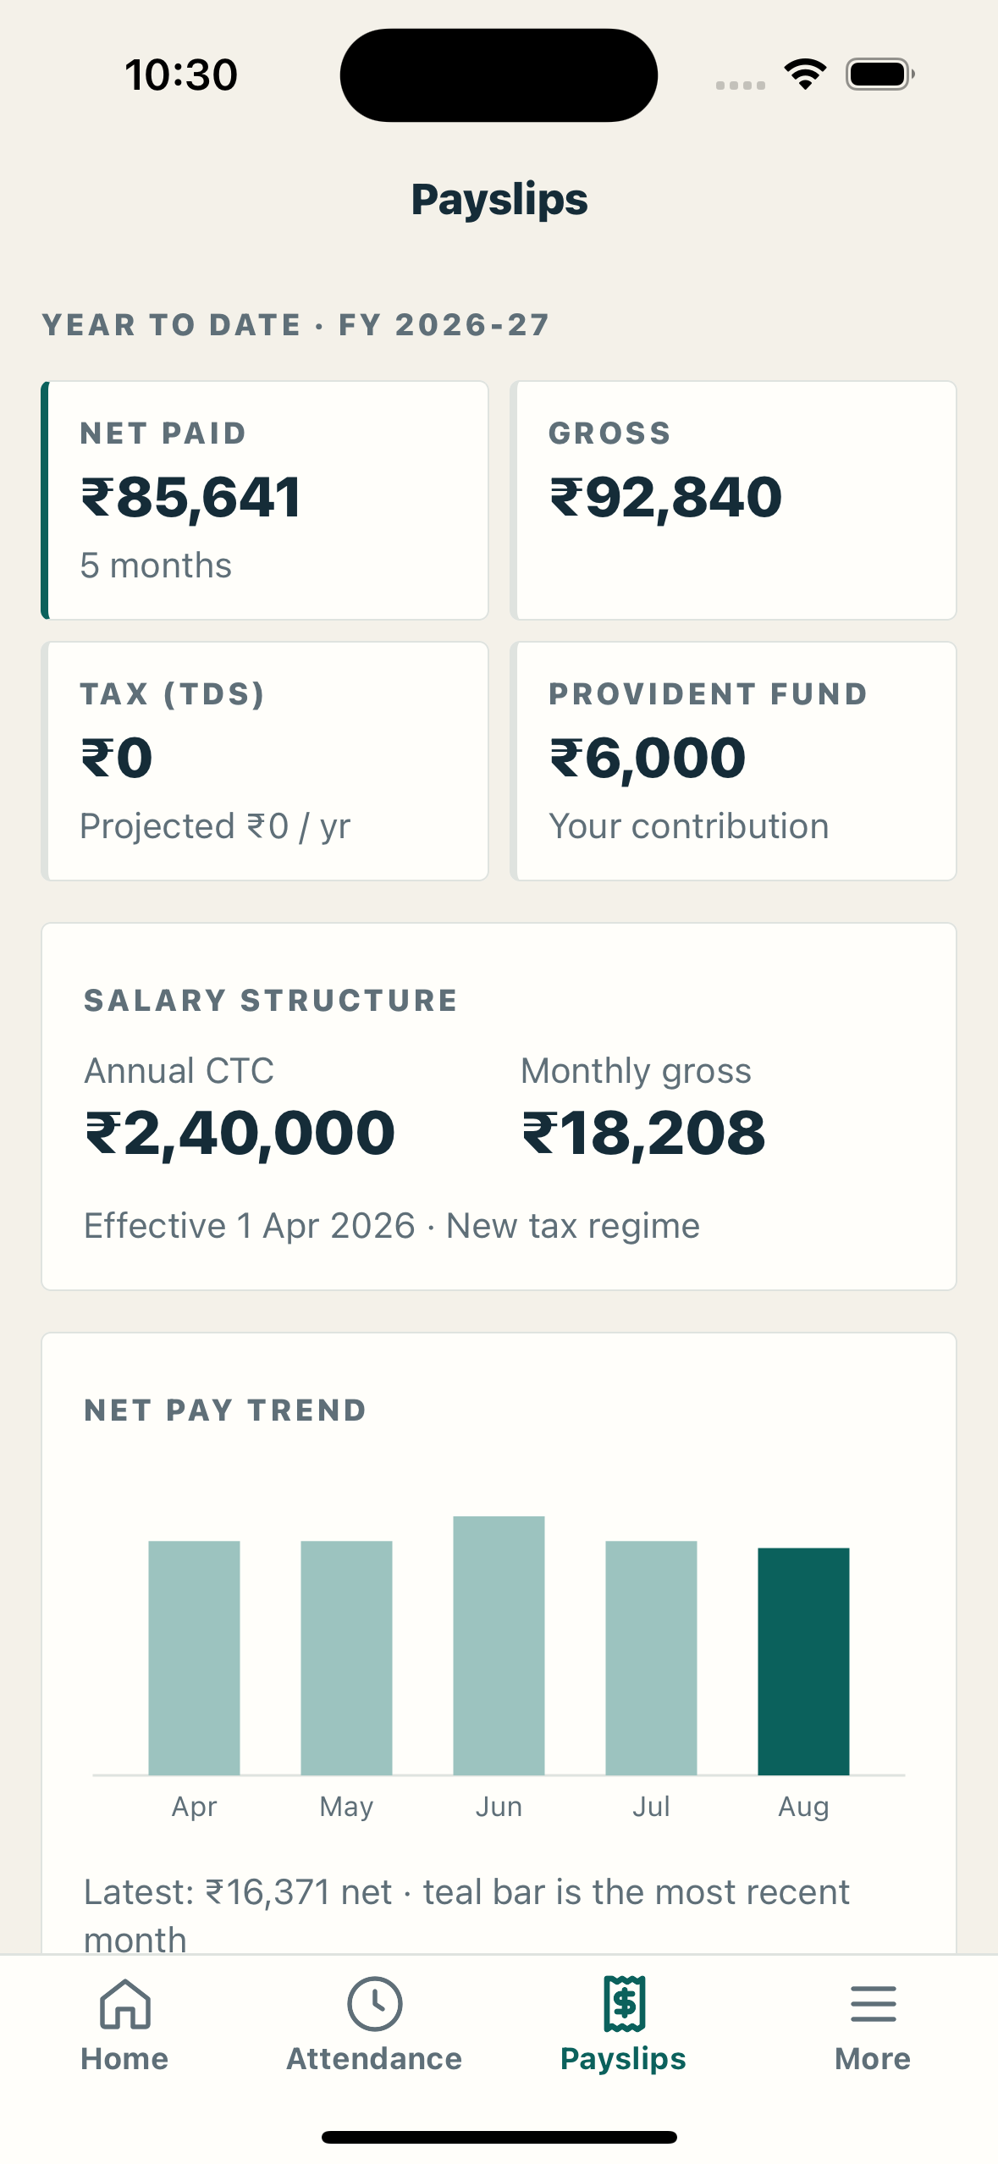




Employees get a fast, simple app
Web and a native iOS/Android app (React Native) on the same data.
Punch in where you work
Location checked against the café's geofence; a live selfie with blink check when outside the site.
Snap a bill, get a claim
Receipt scan fills merchant, date, amount and GST; duplicates are flagged automatically.
Payslips in your pocket
Year-to-date pay, PF, tax projection and every payslip, shareable as a document.
Leave, roster, approvals
Apply leave, see this week's shifts; managers approve from the phone.
Push notifications
Approvals, payslips and roster changes arrive instantly, with quiet hours.
Northstar People · HR proposal · 4
Notes:
Show the phone live if possible. Point out that location is checked only at the moment of punching, never tracked in the background.

Slide 5
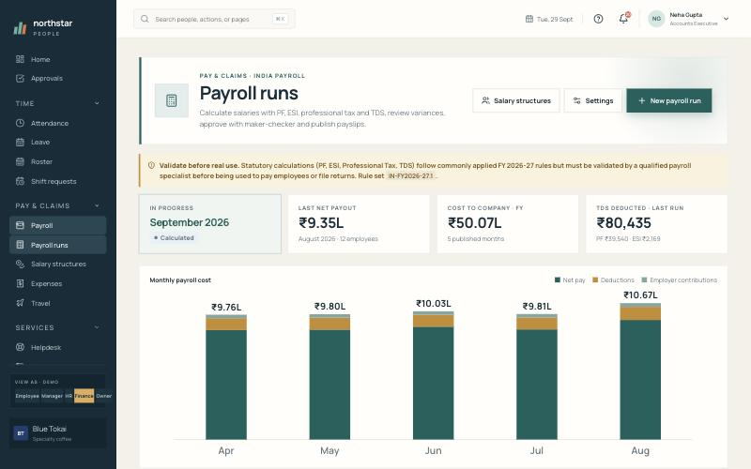
Payroll that finance can trust
India payroll engine with statutory rules, controls and every file finance needs.
Statutory rules
PF (₹15,000 ceiling), ESI (≤ ₹21,000), professional tax by state, TDS projection — versioned rule set FY 2026-27.
Maker-checker
The person who submits a run can't approve it. Variance flags for >10% pay changes, missing structures, new joiners.
Files out
Bank transfer, PF ECR, ESI, PT summary, payroll register, Tally XML journal — reconciled to run totals.
Employees see it
Published payslips with full breakdown, on web and mobile.
Honest caveat: statutory calculations must be validated by a payroll specialist and matched against PeopleStrong for two cycles before we pay anyone from it.
Northstar People · HR proposal · 5
Notes:
Be upfront: payroll is the highest-risk area, which is exactly why the plan is a parallel run.

Slide 6

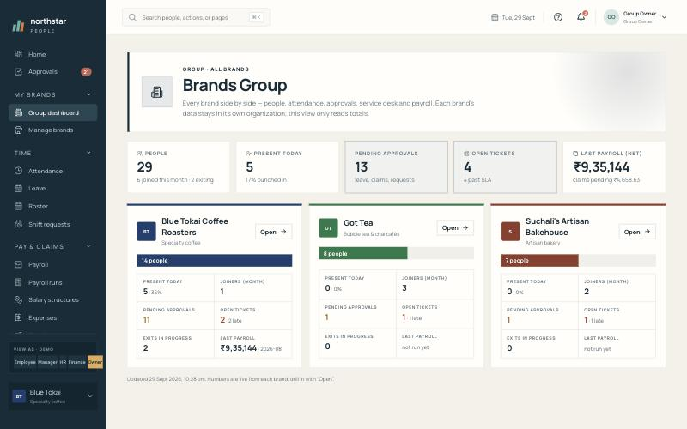



One platform, every brand — kept apart
Blue Tokai, Got Tea and Suchali's each run as a separate organisation; the owner sees them side by side.
Data stays inside each brand
Enforced by the database itself (row-level security), not just by screens.
Own look and login link
Each brand has its colours, logo and sign-in page — employees never see other brands.
New brand in a minute
Super admin adds a brand, switches modules on/off and appoints its HR admin.
Group dashboard
Headcount, attendance, approvals, tickets and payroll for all brands in one view.
Northstar People · HR proposal · 6
Notes:
This is something we'd otherwise pay for three times or configure awkwardly. Future brands cost nothing extra to add.

Slide 7
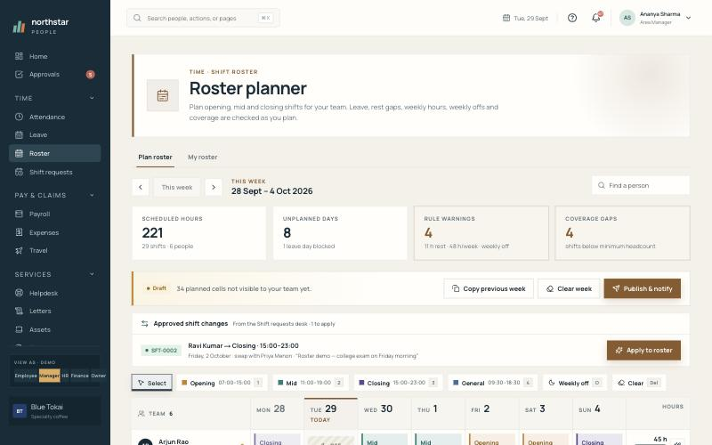




Built for how our cafés actually run
Shift-based teams, many outlets, and attendance that can't be gamed.
Roster planner with labour rules
Warns on 48+ hours a week, under 11 h rest, missing weekly off and thin coverage before publishing.
No buddy punching
Geofence, live selfie with blink check, and review of punches from the same phone or impossible travel.
Works with existing devices
ZKTeco / eSSL biometric terminals push punches straight in.
Shift swaps in two taps
Approved swap requests apply to the roster automatically.
Northstar People · HR proposal · 7
Notes:
Store managers feel the difference most here: roster warnings before publishing, and trustworthy attendance for payroll.

Slide 8
Security: what's in place, what's left
An internal white-box review found 22 issues (1 critical, 2 high); fixes are in progress. No system is unbreakable — we monitor.
In place today
Before go-live
Brand data isolated by the database (row-level security on a least-privilege role)
Company single sign-on — MFA enforced by our identity provider
Append-only audit trail: no one can edit or delete history
Rate limiting, security headers, strict file-upload checks
Security Center: live readiness checks and blocked-request monitoring
Maker-checker on payroll approval and bank payouts
Close the remaining review findings (e.g. retire the old legacy API, second approval for bank-detail changes)
Encrypt PAN and bank details at rest
Independent penetration test by a CERT-In empanelled auditor
Production hosting in India with encrypted backups and point-in-time recovery
Upgrade framework versions flagged by the dependency audit
Northstar People · HR proposal · 8
Notes:
Credibility comes from being honest here. The list on the right is the go-live gate; we won't move real payroll before it's done.

Slide 9
Owning vs renting — the trade-offs
PeopleStrong is a mature product. The question is fit and control, not features alone.
Area | PeopleStrong (rent) | Northstar (own)
Data ownership | Held by the vendor; export on request | Our own database, in our cloud account
Fit to our processes | Configure within the product | Change anything — roster rules, selfie policy, forms
Multiple brands | Extra setup / licences | Built in; new brand at no extra licence
Cost model | Per-employee licence, rises with headcount | Hosting + upkeep; flat as we grow
Statutory updates | Vendor maintains | We must maintain (named owner + yearly review)
Support & uptime | Vendor SLA | Internal owner + on-call developer
Amber = responsibilities that move to us. They're manageable, but they're real and must be staffed.
Northstar People · HR proposal · 9
Notes:
Acknowledge what PeopleStrong does well. The amber rows are our cost of ownership and are included in the cost slide.

Slide 10
What we'd save — fill in our real numbers
Replace the blanks with the PeopleStrong contract and a hosting quote before this goes to finance.
A · PeopleStrong today
B · Running Northstar
Yearly saving
Licence: ₹ ____ per employee / month
× ____ employees × 12
+ add-on modules: ₹ ____
+ yearly price increase: ____ %
= ₹ ________ per year
Cloud hosting (DB, app, storage): ₹ ____
SMS / email / push: ₹ ____
Upkeep: ____ developer (part-time)
Yearly pentest + payroll review: ₹ ____
= ₹ ________ per year
−
=
₹ ________
Grows with every new outlet and brand, because there's no per-employee licence.
Also count one-time costs honestly: data migration, a parallel payroll period and staff training.
Northstar People · HR proposal · 10
Notes:
Don't guess the PeopleStrong number in the room — use the actual invoice. The saving scales with headcount, which is the strongest argument as we open more outlets.

Slide 11
Risks and how we handle them
The plan is built so that no employee is affected until each risk is closed.
Risk | How we handle it
Payroll mistakes | Two parallel cycles matched to the rupee + payroll specialist sign-off before first live run
Statutory changes (PF, ESI, PT, TDS) | Named owner; versioned rule set; yearly review with our CA / compliance partner
Data migration from PeopleStrong | Import employee, leave-balance and salary data from exports; reconciliation report per brand
Security | Close review findings, external pentest, backups with restore drills, Security Center monitoring
Support after go-live | Internal HRIS owner + developer on-call; helpdesk inside the product for issues
Adoption | Mobile app first, short training per role, pilot feedback before the next brand
Northstar People · HR proposal · 11
Notes:
Pre-empt objections. Every risk has an owner and a gate.

Slide 12

Rollout plan
Indicative timings — we move to the next phase only when the previous one is signed off.
1
2
3
4
Pilot
Smaller brands live
Blue Tokai
Exit PeopleStrong
6–8 weeks
4–6 weeks
8–10 weeks
at renewal
One smaller brand (Got Tea or Suchali's). Attendance, leave, helpdesk live. Payroll in parallel for 2 cycles.
Payroll switched after sign-off. Expenses, onboarding, learning, surveys turned on.
Outlet-by-outlet move with biometric devices connected; parallel payroll again.
Final data export and archive; licence not renewed.
Northstar People · HR proposal · 12
Notes:
Timings depend on how fast HR can validate payroll and migrate data. The PeopleStrong exit is tied to the contract renewal date so we never pay twice for long.

Slide 13
What we need from HR
Four decisions to start the pilot.
1
Pick the pilot brand
2
Share the PeopleStrong contract
and a named HR owner for it
cost, renewal date and data-export terms
3
Line up a payroll specialist
4
Approve a small budget
to validate the statutory rules and sign off the parallel runs
production hosting, external pentest, training
Live demo available now — each brand has its own sign-in page, plus a super-admin console for all brands.
Northstar People · HR proposal · 13
Notes:
End with the demo: open a brand sign-in page, punch in on the phone, show the group dashboard and the super admin console.

