Slide 1

"Unveiling Consumer Insights: A Predictive Model Analysis of Buying Behavior Influencers"
Amandeep Singh
Email- amandeep.1.singh@kcl.ac.uk
March 2024

Slide 2
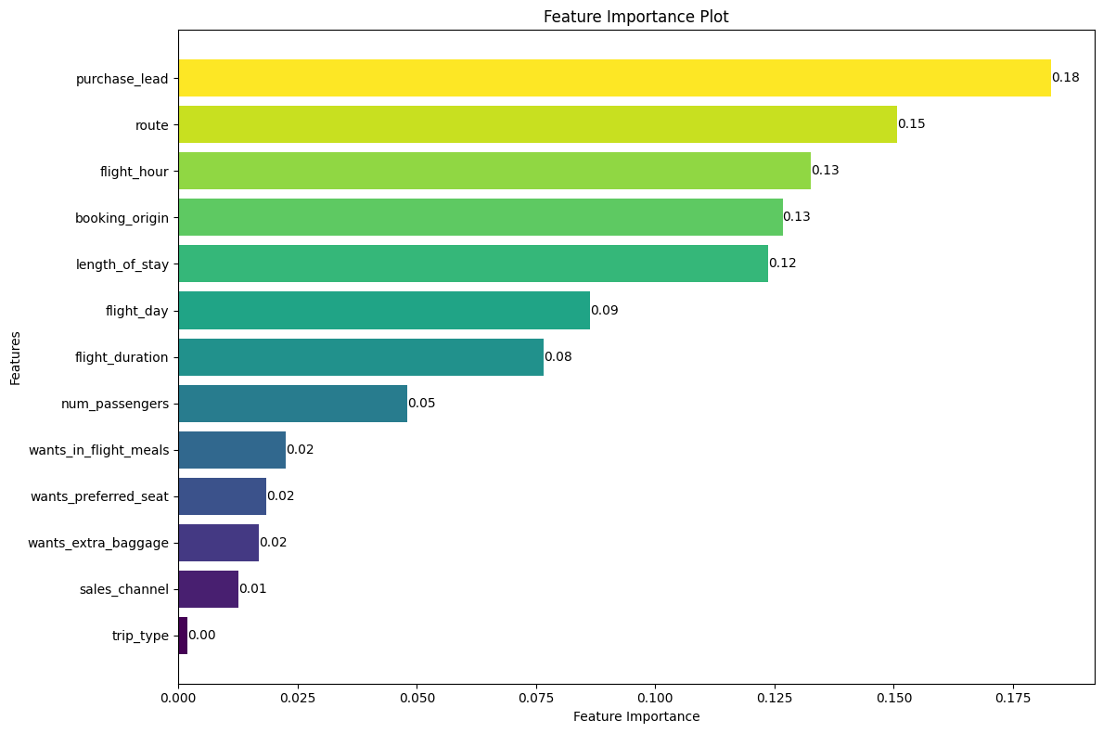
Utilizing a Predictive Model to Uncover Influential Buying Behavior Factors
Model Performance Metrics
Trained Dataset: Random Forest Classifier
Accuracy: 85.51%
Precision Score: 56.88%
AUC Score: 0.537
Top 6 Features
Purchase Lead
Route
Flight Hour
Booking Origin
Length of Stay
Flight Day

