Slide 1
Digital Marketing for Political Parties
Formulating effective strategies to engage voters and win elections.

Slide 2
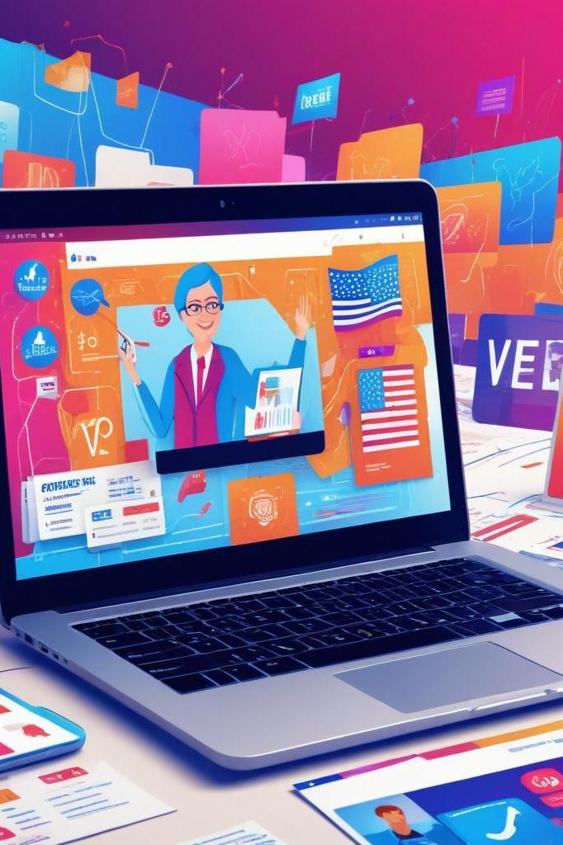
Introduction
In the digital age, successful political campaigns leverage innovative marketing strategies to connect with voters, shape opinions, and enhance electoral outcomes. This presentation covers essential elements of a powerful digital marketing approach for political parties.

Slide 3
01
Digital Presence

Slide 4
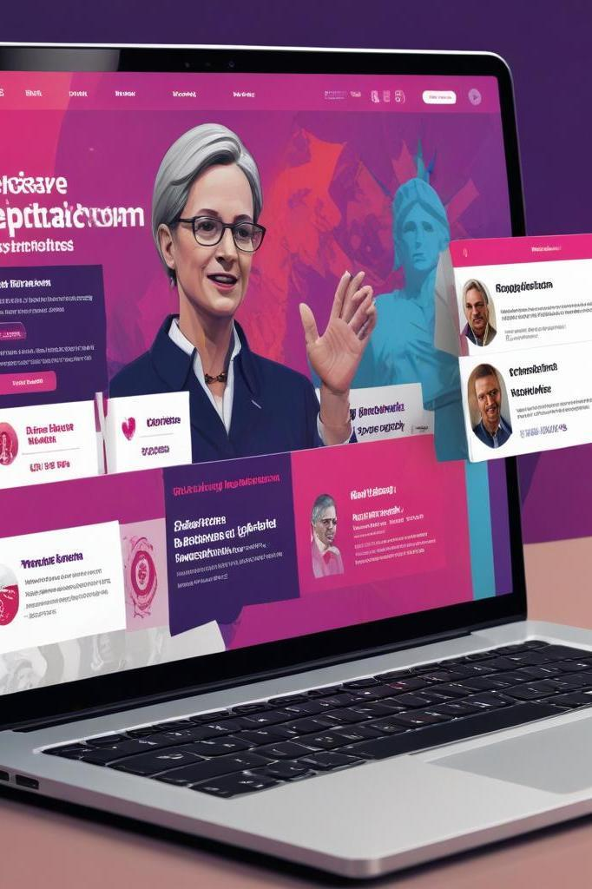
Official Website & Mobile App
An official website serves as the central hub for a political party, providing crucial information about policies, updates, and ways for supporters to get involved. A dedicated mobile app can enhance engagement by allowing users to receive real-time notifications, access party news, and easily donate to campaigns. SEO optimization is critical to ensure visibility on search engines, enabling potential voters to find the party's platform easily.

Slide 5

SEO Optimization
SEO optimization is vital for political parties to increase their visibility online. By optimizing the website with relevant keywords related to political issues and policies, the party can improve its search engine rankings. This involves creating quality content, utilizing meta tags, and building backlinks. Higher visibility on search engines leads to increased traffic to the party's website and a greater chance of engaging with undecided voters.

Slide 6
02
Social Media

Slide 7
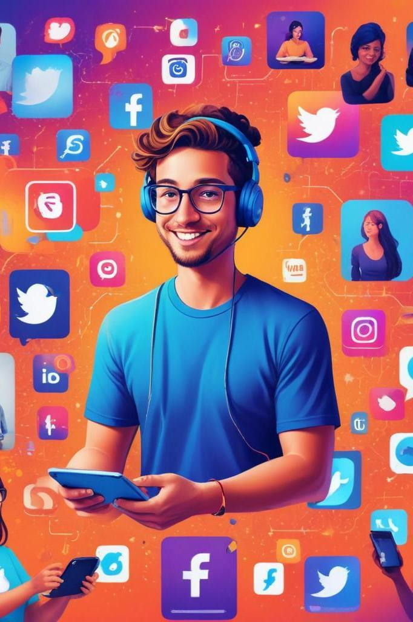
Platform-Based Strategy
A successful social media strategy involves tailoring content for each platform to maximize engagement. On Instagram and YouTube, the focus is on creating visually appealing reels and inspiring video clips. Twitter (X) is used for quick, real-time updates and to engage in trending topics. Facebook and WhatsApp serve as crucial tools for grassroots campaigns, allowing for effective communication and interaction with supporters through direct messages and group discussions.

Slide 8
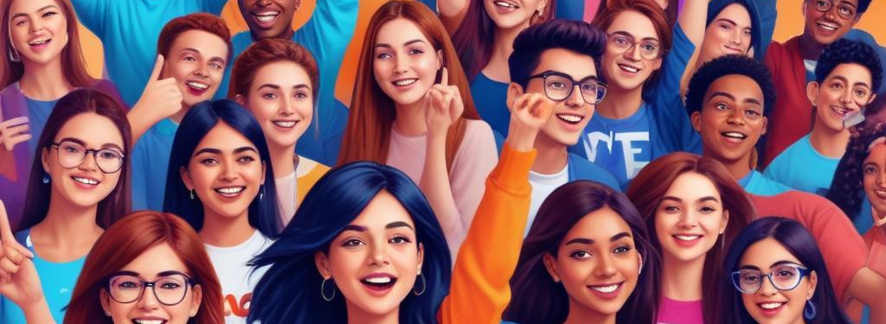
Hashtag Campaigns
Hashtag campaigns are effective tools for spreading political messages and rallying support. By creating memorable and relatable hashtags, such as #VoteForChange, parties can encourage sharing and participation among their audience. Viral trends can significantly amplify the reach of campaign messages, allowing for broader visibility and engagement, especially among younger demographics who actively participate in social media.

Slide 9
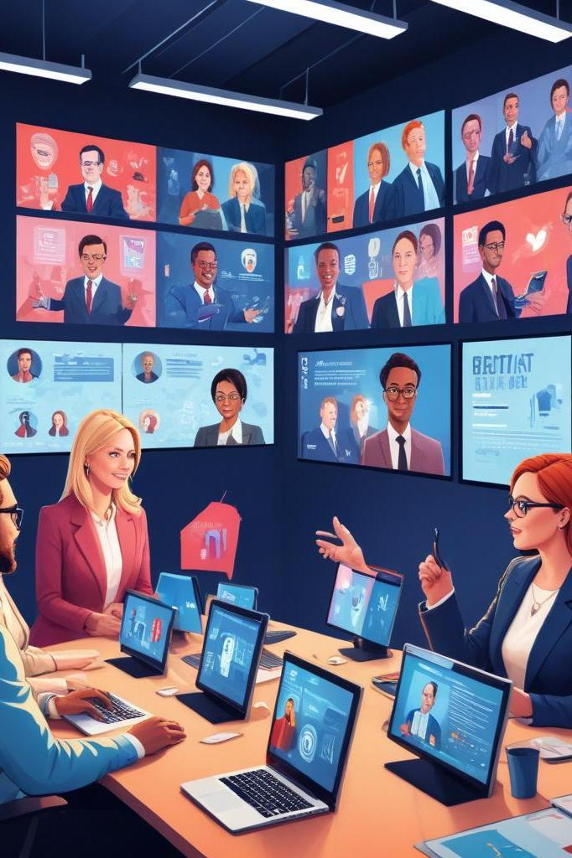
Conclusions
Implementing effective digital marketing strategies is crucial for political parties in modern elections. By focusing on building a strong digital presence and leveraging social media, parties can connect with voters, share their messages widely, and ultimately enhance their chances of electoral success.

Slide 10
Thank you!
Do you have any questions?
+91 620 421 838

