Slide 1

Real-Time Smart Alert System for IoT Devices
AMAN JAIN (U01599358)
METCS 665

Slide 2

Introduction
A system to manage real-time alerts for IoT devices.
Automatically identifies critical events and sends notifications.
Enhances response time and reliability in IoT ecosystems.

Slide 3

PROJECT STRUCTURE
Key Modules:
IoT Device Simulator: Generates real-time test data.
Event Manager: Logs events (Event Sourcing Pattern).
Notification Manager: Sends dynamic alerts (Observer Pattern).
Alert Manager: Escalates alerts (Strategy Pattern).
Flow:
IoT devices → Event Manager → Notification Manager → Alert Manager.
Highlights:
Modular and scalable design.
Implements advanced design patterns for maintainability.

Slide 4
DESIGN PATTERN
Event Sourcing Pattern:
Logs events immutably for debugging and auditing.
Provides a replay mechanism for past events to diagnose system behavior.
Observer Pattern:
Implements a dynamic notification system.
Observers (e.g., EmailNotifier, SMSNotifier) receive updates from NotificationManager in real time.
Decorator Pattern:
Adds dynamic behavior to notifications (e.g., formatting, priority tagging).
Enhances the flexibility of the notification system without altering core logic.
Strategy Pattern:
Manages configurable alert escalation strategies (e.g., CriticalAlertStrategy, WarningAlertStrategy).
Dynamically selects the appropriate alert behavior based on event severity.

Slide 5
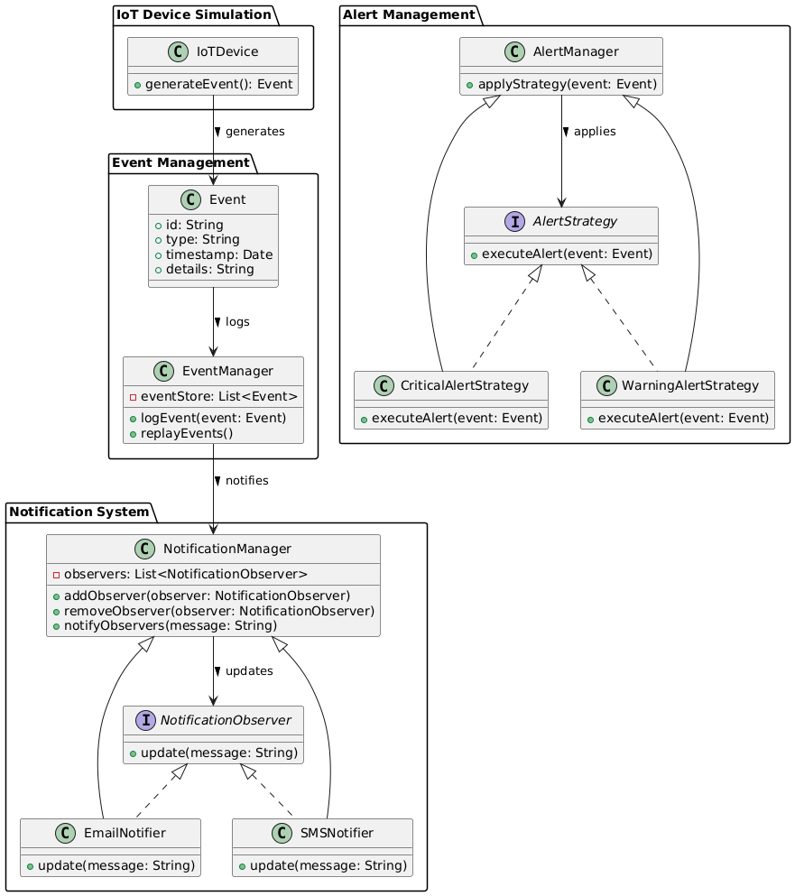
UML DIAGRAM

Slide 6

DEMO

Slide 7

Challenges and Learnings
Challenges:
Handling real-time event data efficiently.
Configuring SpotBugs and resolving warnings.
Learnings:
Importance of modular design.
Best practices for testing and debugging.

Slide 8

FUTURE WORK
Enhanced Notification Channels:
Add support for push notifications and voice calls.
Predictive Analytics:
Implement machine learning to predict potential device failures.
Real-Time Dashboards:
Create live dashboards for monitoring IoT device status and alerts.
Scalability:
Integrate with cloud platforms to handle larger IoT ecosystems.
Advanced Alert Strategies:
Add customizable strategies based on user-defined rules.

Slide 9

Thank you

