Slide 1
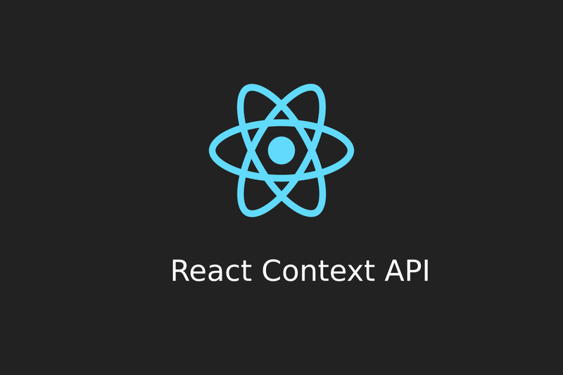

Slide 2

Why Use Context?
Simplifies state management in React apps.
Avoids prop drilling (passing data through multiple levels of components).
Useful for global data such as user authentication status, theme settings, etc.
What is React Context API?
The React Context API is a way to manage state globally across your application
without having to pass props manually through every level of the component tree.

Slide 3
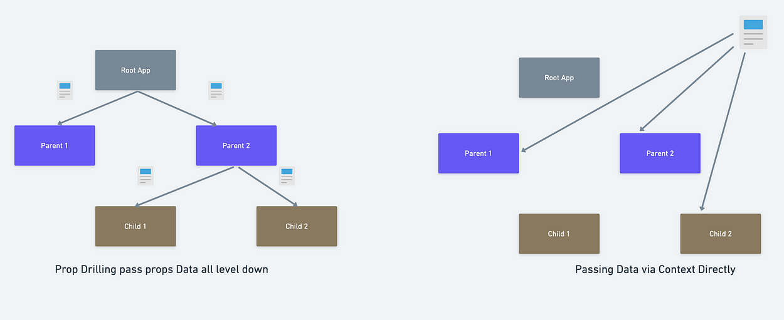

Slide 4
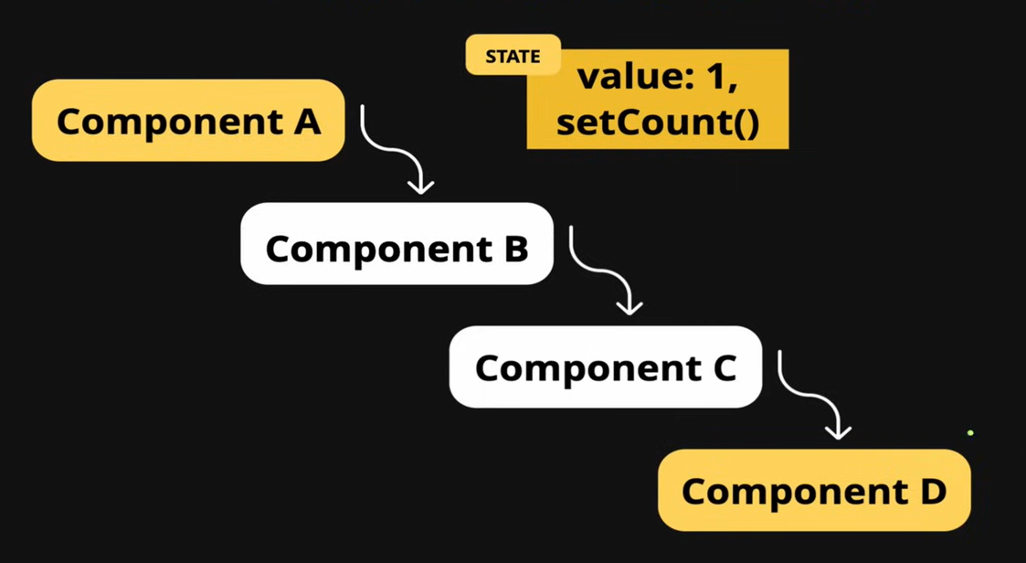

Slide 5
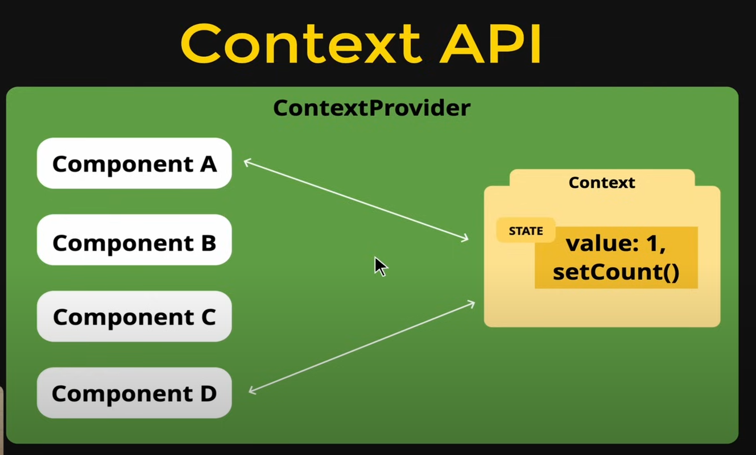

Slide 6
Steps to Create and Use Context API
1. Create the Context.
React.createContext();
2. Create a Provider Component.
<MyContext.Provider value={{ state, setState }}>
</MyContext.Provider>
3. Wrap your App with the Provider.
<MyContext.Provider value={{ state, setState }}>
{children}
</MyContext.Provider>
4. Consume the Context in child components. useContext(MyContext);

Slide 7
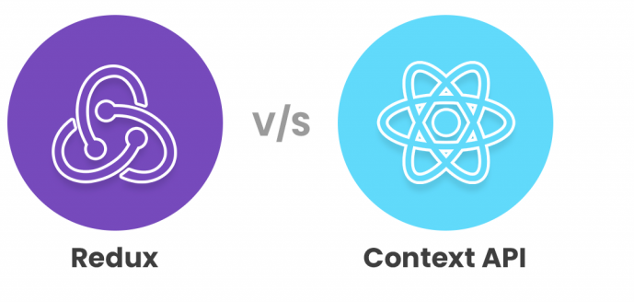
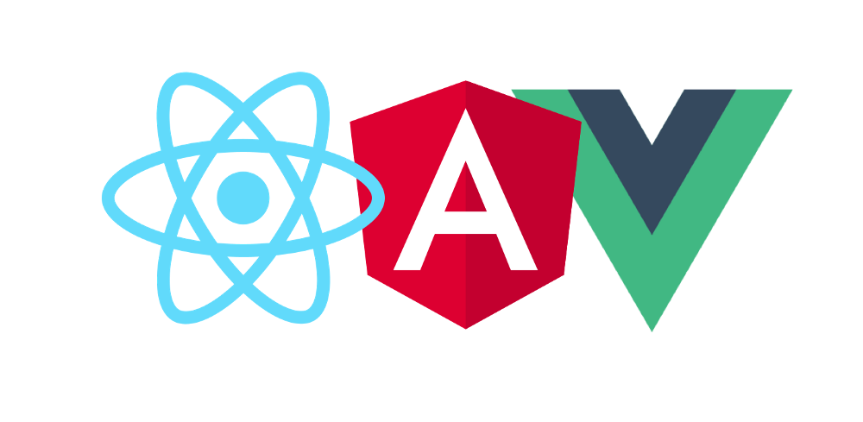

Slide 8
Any Questions?

