Slide 1
CST 8102
Operating System Fundamentals (GNU/Linux)

Slide 2
Linux File Permissions
In Linux, what a user can access (file and/or directory) or use (commands and/or scripts and/or utilities) depends on:
  users they log in as or are currently working on the system as what group(s) that particular account belongs to
  which file/directory the user in question is trying to access
  what rights are associated with the file/directory in question
At every level, in all situations, the exception to the rule is the root / SuperUser account.

Slide 3
Linux File Permissions
Linux considers the root / SuperUser account the only account who’s access for files and directories is irrelevant.
The root / SuperUser account has access to everything by default !

Slide 4
Linux File Permissions
user@localhost: ~$ ls -l /home/user1
drwxrwxr-x 2 user1 user1 4096 Nov 01 12:10 scripts
drwxrwxr-x 2 user1 user1 4096 Nov 01 13:30 projects
-rw-rw-r-- 2 user1 user1 565 Nov 03 14:23 contract
-rw-rw-r-- 1 user1 user1 565 Nov 03 14:23 schedule
Note on file types
The beginning character indicates Linux file types. The two most commonly encountered file types are ordinary files and directory files.

Slide 5
Linux File Permissions
Rights and File attributes
  Rights
    10 bytes total
    file type (first byte)
    access modes (remaining 9 bytes)
  Links
    number links to this file or directory
  File Owner
    user who owns the file/directory
    based on owner UID

Slide 6
Linux File Permissions
  Group Name
    group who owns the file/directory
    based on owner GID
  File Size
    size (in bytes or K) of the file/directory
  Date/Time Modified
    date and time when last created/modified/saved
  File Name
    actual file/directory name

Slide 7
Linux File Permissions
Linux recognizes and identifies several file types, which is identified in the first letter of the first field of information about the file
  - (dash)
    indicates a simple/ordinary file
  b
    indicates block device special file
  c
    indicates character device special file
  d
    indicates a directory

Slide 8
Linux File Permissions
  l
    indicates a symbolic link
  p
    indicates a named pipe or FIFO

Slide 9
Linux File Permissions
Thus, each Linux file and/or directory uses 9 bits for determining File Access Privileges, separated into 3 bytes of information each for:
  user/owner access rights
  group access rights
  other access rights
In actual fact, there are 12 bits available for File Access Privileges, but the first 9 are generally enough for most purposes.<number>

Slide 10
Linux File Permissions
Permissions/rights allow for controlling access to files, directory or its content and whether they can be executed/used
System will verify rights to a file or a directory when a user is trying to access or use it

Slide 11
Linux File Permissions
In Linux, 3 types of access permissions or privileges can be associated with a file
  read (r)
    [File] can view file content (with application)
    [Dir] can view directory content
  write (w)
    [File] can modify file content
    [Dir] can add & remove (delete) files and directories
  execute (x)
    [File] can be executed
      Note: Binary files require only the execute permission; script files require both read and execute permissions.
    [Dir] change into a directory with the cd command

Slide 12
Linux File Permissions
All 3 permissions can then be applied to each of 3 types of file users
  User
    owner/creator of the file
  Group
    group which owns the file, to which user must belong to gain associated rights
  Others
    anyone else not User or not a part of Group

Slide 13
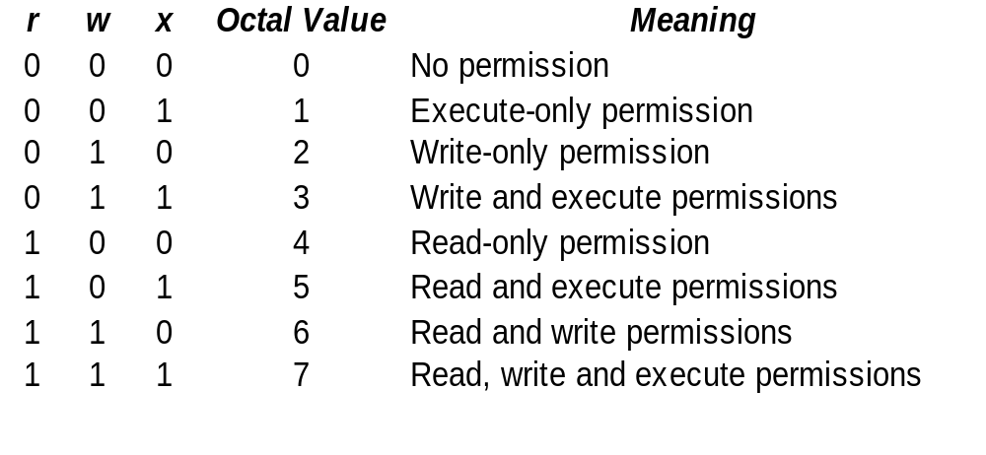
Linux File Permissions

Slide 14
Linux File Permissions
Permissions can be represented in two ways:
Symbolic mode
  r(read)
  w(write)
  x(execute)
Absolute or octal mode
Each permission type (r,w,x) has a numerical value. The values are summed up for each user type to create the permission block.
  r(read) r - - 100 2^2 = 4
  w(write) - w - 010 2^1 = 2
  x(execute) - - x 001 2^0 = 1

Slide 15
Class Exercise
-rwxrwxrwx
  This symbolic mode is equivalent to the following octal mode: ______
  The user has the following permissions: _____
-rwxr-xr--
  This symbolic mode is equivalent the following octal mode: ________
  The group has the following permissions: ____
-rwxrw-r-x
  This symbolic mode is equivalent the following octal mode: _________
  Everybody else has the following permissions: ______

Slide 16
Changing Permissions
File permission can be modified with the chmod (change mode) command.
The chmod command can be used in two ways:
  by using symbolic mode
    chmod [ugoa]<<+-=><rwx>> <object>
      Who u user
      g group
      o other
      a all (ugo=all)
      Operator + set
      = set explicitly and remove all other
      - remove
      Permission r read
      w write
      x execute

Slide 17
Changing Permissions
  by using absolute mode
    The chmod command's absolute mode uses numbers to specify permissions:
      one for the user
      one for the group
      one for the others
    All three must be specified on the command line and. Thus, absolute mode always sets the entire permission block.
    chmod <xyz> <object>
      Example: chmod 644 myfile
    Note: Omitted digits will be replaced by leading zeros: chmod 7 myfile is equivalent to chmod 007 myfile

Slide 18
Changing Permissions
Changing permissions on multiple objects
  -R: recursively sets same permissions on all objects (files and directories likewise)
Examples:
  The following commands will do exactly the same: assign full access permissions to everyone for file1
    chmod 777 file1
    chmod a+rwx file1
    chmod ugo+rwx file1
    chmod a=rwx file1
    chmod ugo=rwx file1

Slide 19
Default Permissions
Default permissions
Linux uses default permissions when a user logs in. Every time a file or directory is created, it is assigned a default set of permissions.
The initial mode for files is 666 and for directories is 777.
  For files:
  default permission = 666 - umask
  For directories:
  default permission = 777 – umask
  Note: The calculations need to be done logically

Slide 20
Default Permissions
Modifying umask settings
Displaying the umask setting
  umask
    To display your current umask setting.
Changing the umask setting
  Using octal notation
    umask 044
  Using symbolic notation
    umask u+w
    umask a=rw
    umask ug+rw,o+r

Slide 21
Class Exercises
To create a default file mode of rw-r--r–
the umask will be _________.
To create a default file mode of rw-rw-rw-
the umask will be __________.
To create a default file mode of ---------
the umask will be __________.

Slide 22
Class Exercises
New File ~umask 022
the file permissions will be _________.
New File ~umask 011
the file permissions will be __________.
New Dir ~umask 011
the Dir permissions will be __________.

Slide 23
Changing Permissions
More examples
  umask 022
  touch file2
  chmod 652 file2
  chmod u+x,g-x,o+r file2
  chmod ug=r,o-w file2

Slide 24
Change File Ownership
The chown command only allows file owner or root to change the owner of a file.
  chown newowner file
  -R: to change the owner of a directory and all its subdirectories and files.
  It can be also used to change group:
    chown .newgroup filename
  To change both owner and group:
    chown newowner.newgroup filename
    chown newowner:newgroup filename

Slide 25
Change Group Ownership
Use chgrp command to change the group owner of a file or directory
  chgrp newgroup file
  -R: to change the group of a directory and all its subdirectories and files.
Note:
  Being a regular user, you can use chown or chgrp command to change group if you are a member of that group. To change file’s owner, you have to be root to use chown command to do it.

Slide 26
Minimum permissions
Minimum permissions needed to perform copying, moving and deleting
  To delete a file the user requires
    for the directory: write(w) and execute (x)
    for the file: None
  To copy a file the user requires
    for the source directory: execute (x)
    for the target directory: write(w) and execute (x)
    for the file: read (r)

Slide 27
Minimum permissions
  To move a file the user requires
    for the source directory: write(w) and execute (x) for the target directory: write(w) and execute (x)
    for the file: None

