Slide 1
Group Commands
A group command is a list of commands either executing in a subshell or the current shell
  (list) group command
    The list of commands is executed in a subshell
    Example:
      (pwd; whoami; ls)
  { list; } group command
    The list of commands is executed in the current shell.
    The list must be terminated with a semicolon
    Example:
      { pwd; whoami; ls; }

Slide 2
Group Commands
    $ a=10
    $ echo $a
    $ 10
    $ (a=20)
    $ echo $a
    $ 10
    $ { a=20; }
    $ echo $a
    $ 20

Slide 3
Understanding Loop Theory
A loop is a condition that causes a specific set of statements to be repeated.
Statements repeat until a condition terminates the loop.
An iteration refers to the number of complete passes the loop makes.
If a loop repeats 4 times, it has completed 4 iterations.

Slide 4
Understanding Loop Theory
Advantage – allows you to enter data without knowing the exact amount of data that needs entering.
Used in menu-based programs.
Poor programming logic design can cause infinite loops.
An infinite loop executes without end – can be terminated with the kill command.
Disadvantage of infinite loop – consumes excessive processing time.

Slide 5
The while Loop
The while loop syntax in bash shell:
  while condition
  do
  statements
  done
If condition is true Do statements execute.
If condition is false loop terminates and program flow continues with subsequent statement.

Slide 6
The while Loop Example
    stop=N
    while [ $stop != “y” ]
    do
      who
      ls
      read –p “Do you want to stop? (Y/N)” stop
    done
    echo “Stopping …”

Slide 7
The while Loop
Can be used to test exit status of a command.
Useful for determining if a command succeeded or failed.
Example: to copy a file if it exists:
  while ! cp fileX.txt fileY.txt
  do
    echo “Attempting to copy…”
    sleep 10
  done

Slide 8
The while Loop
Use the break command to end a loop prematurely.
Example:
  ((count=1))
  while true
  do
    if [ $count –gt 3 ]
      then
        break
      fi
  done

Slide 9
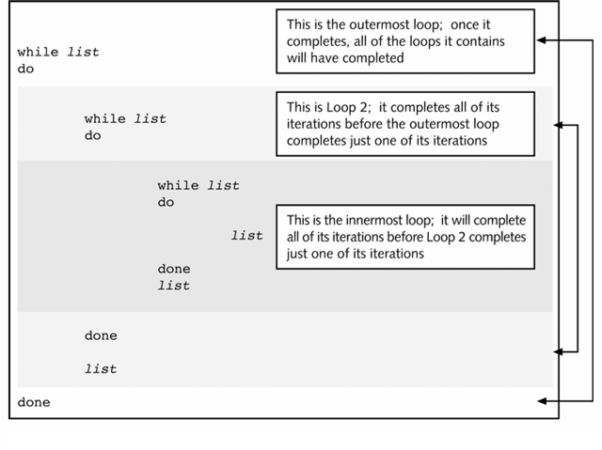
Nested while loops

Slide 10
Nested while loop Example
  ((x=1))
  while [ $x -le 3 ]
  do
    ((y=1))
    while [ $y –le 3 ]
    do
      echo $x $y
      ((y++))
    done
    ((x++))
  done

Slide 11
The until Loop
The until syntax in the shell:
  until condition
  do
    statements
  done
If condition is false Do statements execute.
If condition is true loop terminates.

Slide 12
The until Loop Example
  stop=N
  until [ $stop = “y” ]
  do
    who
    ls
    read –p “Do you want to stop? (Y/N)” stop
  done
  echo “Stopping …”

Slide 13
The for Loop
The for statement syntax in bash shell takes two forms:
  Word list form:
    for variable in list
    do
      statements
    done
  Arithmetic expression form:
    for ((variable=starting-value; variable operator value; change value))
    do
      statements
    done

Slide 14
The for Loop Example 1
  for myvar in 2 4 6 8
  do
    ((power=$myvar ** 2))
    echo $myvar “to the second power is” $power
  done

Slide 15
The for Loop Example 2
for i in {0..10..2}
do
echo "Welcome $i times"
done
Welcome 0 times
Welcome 2 times
Welcome 4 times
Welcome 6 times
Welcome 8 times
Welcome 10 times

Slide 16
The for Loop Example 3
for ((num=1; num <= 10; num++))
do
  ((power=$num ** 2))
  echo $num “to the second power is” $power
done

Slide 17
Sending Both Output and Error Messages to
Different Files
You want a file to save the output from a program but you don’t want use the same file to save error messages
  $ myscript 1> messages.out 2> message.err
  Or more commonly:
  $ myscript > messages.out 2> message.err
  In the constructs 1> and 2> the number is the file descriptor, so 1 is STDOUT and 2 is STDERR. When no number is specified, STDOUT is assumed.

Slide 18
Sending Both Output and Error Messages to the same File
&> or >& is a shortcut that simply sends both STDOUT and STDERR to the same place
    $ myscript >& outfile
    or
    $ myscript &> outfile
    or
    $ myscript > outfile 2>&1

Slide 19
Throwing Output Away
If you don’t want to see output at all
    $ myscript &> /dev/null
    or
    $ myscript >/dev/null 2>&1

Slide 20
The find command
It allows you to search for files in the filesystem.
It locates the files in the directory tree based upon the criteria specified in the options
The general form of find command:
  find path expression
    The current directory is used if path is not specified
    Expression is comprised of options, tests and actions
  Examples:
    find –mtime +90
      The -mtime option takes an argument to specify the timeframe for the search. (+90) we indicate that we’re looking for a file modified more than 90 days ago. (-90) for less than 90 days. Use neither a plus nor minus to mean exactly 90 days.

Slide 21
The find command
    find . –size +10k
  Like the numeric argument to -mtime, the -size option is a numeric argument can be preceded by a minus sign, plus sign, or no sign at all to indicate less than, greater than, or exactly equal to the numeric argument.
    find / -name “*.mp3”
      To find all mp3 files
    find –type d
      To find all directories in current location
    find / -user hann 2> /dev/null
      To find all files owned by “hann”, and ignore errors

Slide 22
cut command
The cut command allows you to strip text out of files and display the cut text on the screen or redirect it to another file.
Syntax: cut options filename
  Options
    -d: is used to identify the delimiter
    -f: is used to identify which field you want
Examples:
    cut -d: -f1 /etc/passwd
    cut -f1 /etc/passwd
    cut -d: -f1,3 /etc/passwd

