Slide 1
Welcome to CST8218 Web Enterprise Application Programming
Professor Todd Kelley
Office: T315
E-mail: kelleyt@algonquincollege.com
Office Hours: By Email Appointment

Slide 2
Agenda
Course Overview
Enterprise Applications
Java Enterprise Edition

Slide 3
Course Overview
Hybrid Course Format
Each week there will be
Two hours of lecture (like this one)
roughly one hour of online hybrid activities
watch video, do online tutorial, blackboard quizzes, etc
two hours of lab time
mixture of exercises and assignments
team project

Slide 4
Evaluation
Hybrid Activities/Quizzes 5%
Assignments 35%
Lab Activities 5%
Practical Assessments 10%
Midterm Test 15%
Final Examination 30%

Slide 5
Assignments
See the Submission Requirements beside the Course Outline on Brightspace
You will demonstrate your work, as well as submit it before the deadline
Missing or skipping the demonstration incurs a large penalty, up to 100% of the entire assignment mark
Late assignments incur a large penalty, up to 100% of the entire assignment mark

Slide 6
Tips for Success
Assignments are large bodies of work that cannot reasonably be completed in one or two sessions, even long sessions
Get started early
Get clarification and help early
Make good use of Lab Periods

Slide 7
Tips for Success (cont'd)
Rule One: 15 minute rule
if you are banging your head against the wall and not making progress for 15 minutes, you need to
take a break, move on to another part of the assignment, switch to other course work, come back to it later
sleep on it
seek help from a peer
seek help from the instructor

Slide 8
Tips for Success (cont'd)
Rule Two: Don't leave it to the last few days before the due date
Rule One is not feasible without Rule Two
Get started early, read through and understand the focus of the assignment and the tasks, as soon as you can
Keep up with the course pace (every week, you're expected to put in about 5 hours of time in addition to Hybrids Activities, Lectures, and Labs)

Slide 9
Tips for Success (cont'd)
Like anything else, to become competent in the programming domain, you need to put in time, preferably on a daily basis, working with the material.
Ques -- Who do you want doing your brain surgery: a person who has taken pride in spending many hours practising the craft and learning, or the person who figured out how to minimize the time and effort required to get their credentials?

Slide 10
Excessive Help
Beware of receiving excessive help
Getting the right amount of help when it’s needed is important
It’s just as important to not get too much help
Do it yourself: reading documentation, figuring out how to apply what you read, and solving apparent inconsistencies/problems

Slide 11
Don’t take shortcuts in Labs
Like excessive help, shortcuts are bad
Suppose you are training for a marathon
your coach wants you to run a ten kilometer training route
You feel overloaded and find a shortcut on the route to reduce it to one kilometer
You saved so much time doing it your way!
The short cut took so much less time and effort: where’s the problem?

Slide 12
Plagiarism
Cheating is unacceptable
Exchange ideas, but not code or text: don’t plagiarize
The person you copy from is in just as much trouble as you
Adherence to acceptable standards of academic honesty is an important aspect of the learning process at Algonquin College. Academic work submitted by a student is evaluated on the assumption that the work presented by the student is his or her own, unless designated otherwise. For further details consult Algonquin College Policies AA18(http://www2.algonquincollege.com/directives/files/2011/01/AA-18-Academic- Dishonesty-and-Discipline.PEC_.Approved.-Oct.27.2010.pdf) and E43 (http://www2.algonquincollege.com/directives/files/2011/05/E431.pdf)

Slide 13
Enterprise Applications
What is an Enterprise Application?
Microsoft Excel?
Microsoft Outlook?
Google?
Facebook?
Gmail?

Slide 14
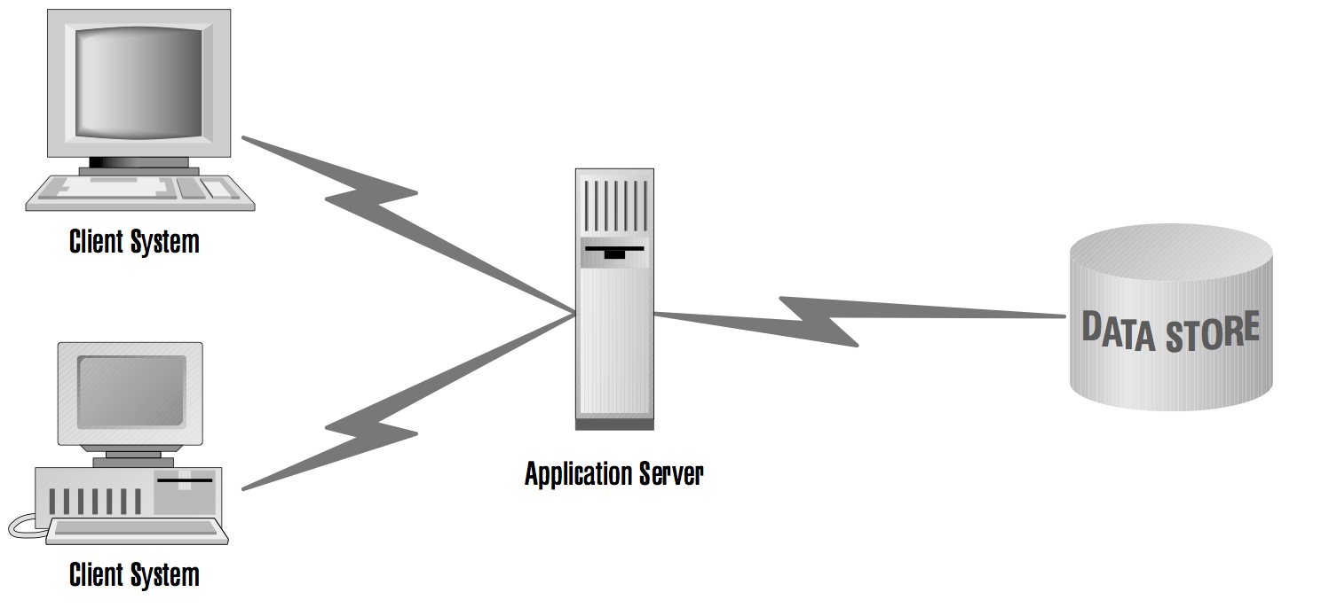
Enterprise Architecture

Slide 15
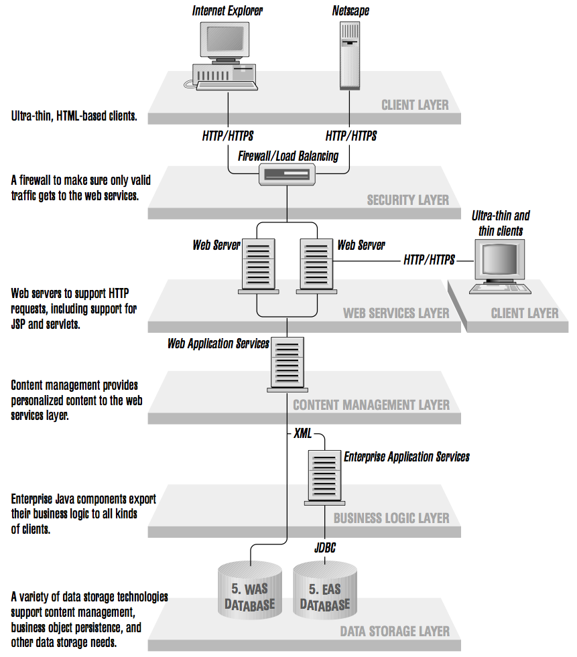
Enterprise Architecture

Slide 16
Enterprise Applications
Many simultaneous users
Multithreading
Ten thousand simultaneous users won't be in the same place
Networking
Remote Method Invocation (RMI)
Deal with Persistent Data
Databases
Concurrent Database Access
Object Relational Mapping (ORM)

Slide 17
Enterprise Programming Technologies and Techniques
Java EE (Java Enterprise Edition)
Includes Java Standard Edition
Includes Application Server
Glassfish (free and Oracle versions)
JBoss (Redhat)
many others
An Application Server is something like a template for an Enterprise Application
When we deploy our application to an Application Server, our Java code fills in the blanks in the template (very roughly speaking)

Slide 18
Enterprise Programming Technologies and Techniques Cont’d
Tomcat
Web Container
Needs JAVA_HOME (JRE)
Can run servlets and JSP
Cannot run Enterprise Java Beans (in other words, it’s not a JEE Application Server)
Can run Javabeans
A Javabean is a POJO that follows naming conventions for properties

