Slide 1
Java EE Resources
Deitel Textbook Chapters 29, 30, (and 31)
Java EE Tutorial
http://docs.oracle.com/javaee/7/index.html
Lynda.com
http://www.lynda.com/Java-tutorials/Java-EE-Essentials-Enterprise-JavaBeans/170059-2.html
http://www.lynda.com/Java-tutorials/Java-EE-Essentials-Servlets-JavaServer-Faces/124399-2.html

Slide 2
Java EE
JEE addresses the need for distributed, transactional, and portable applications
Provides the speed, security, and reliability of server-side technology
Java EE platform is developed through the Java Community Process (the JCP), which is responsible for all Java technologies
XML deployment descriptors are now optional:
Developers enter the information as an annotation directly into a Java source file, and the Java EE server will configure the component at deployment and runtime
Dependency injection can be used in EJB containers, web containers, and application clients.
Dependency injection allows the Java EE container to automatically insert references to other required components or resources, using annotations.

Slide 3
Java EE programming model
Java programming language
the Java virtual machine
portability, security, and developer productivity these provide, form the basis of the application model
Enterprise applications are inherently complex
accessing data from a variety of sources and distributing applications to a variety of clients
To better control and manage these applications, the business functions to support these various users are conducted in the middle tier
The middle tier represents an environment that is closely controlled by an enterprise’s information technology department.
dedicated server hardware and has access to the full services of the enterprise

Slide 4
Distributed Multitiered Applications
Application logic is divided into components according to function
applications are generally considered to be three-tiered applications because they are distributed over three locations:
client machines,
the Java EE server machine,
and the database or legacy machines at the back end.

Slide 5
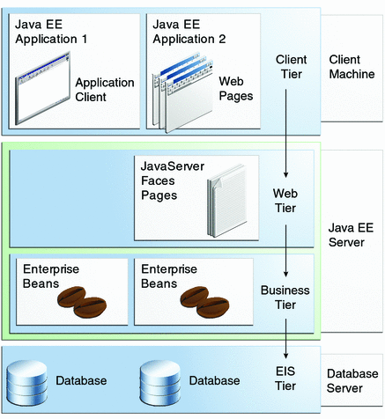
Multitiered Applications

Slide 6
Security
Java EE security environment enables security constraints to be defined at deployment time
Java EE platform makes applications portable to a wide variety of security implementations by shielding application developers from the complexity of implementing security features
provides standard declarative access control rules that are defined by the developer and interpreted when the application is deployed on the server
same application works in a variety of security environments without changing the source code

Slide 7
Java EE Components
A Java EE component is a self-contained functional software unit
A Component is assembled into a Java EE application with its related classes and files and it communicates with other components
Application clients and applets are components that run on the client.
Web components that run on the server:
Java Servlet
JavaServer Faces
JavaServer Pages (JSP)
Enterprise JavaBeans (EJB) components (enterprise beans) are business components that run on the server

Slide 8
Java EE versus Java SE
difference between Java EE components and “standard” Java classes is that EE components are
assembled into a Java EE application
verified to be well formed and in compliance with the Java EE specification
deployed to production (IT dept can focus on production)
run and managed by the Java EE Application Server
Application Server containers manage the lifecycle of JEE components

Slide 9
Java EE Clients
Web Clients (two parts):
Dynamic web pages containing various types of markup language (HTML, XML, etc), which are generated by web components running in the web tier
A web browser, which renders the pages received from the server
A web client is sometimes called a thin client
With thin clients, heavyweight operations are usually handled by enterprise beans executing on the Java EE server, ie
query databases
execute complex business rules
connect to legacy applications
On the server side (Java EE), these can leverage
Security
Speed
Services
Reliability

Slide 10
Java EE Clients
Application Clients
These run on a client machine and provide a way for users to handle tasks that require a richer user interface than can be provided by a markup language
typically have a GUI based on JavaFX, Swing or the Abstract Window Toolkit (AWT) API (Or on the other extreme, Command line interface)
directly access enterprise beans running in the business tier
can open an HTTP connection to establish communication with a servlet running in the web tier
This way, over HTTP, clients on other platforms (Android) or written in languages other than Java can interact with Java EE servers (loose coupling)

Slide 11
Applets
an applet is a small client application that executes in the Java virtual machine installed in the web browser
Big disadvantages of applets
Client systems need the Java Plug-in
Security policy file
Web components are the preferred API for web clients
No applet disadvantages
Clean separation (partitioning) of web page design from application programming (Java) -- two different groups of creators: design vs programmer

Slide 12
JavaBeans Components
A JavaBean is a Plain Old Java Object (POJO), but with certain characteristics
JavaBeans conform to naming and design conventions:
all attributes are private
there are get and set methods (adhering to naming conventions) for accessing all attributes
an attribute with such getter and setter methods is called a property
so now we may use "property" two ways: 1. generally as a synonym for "attribute", or 2. as an attribute together with getter and setter methods adhering to JavaBeans naming conventions
Enterprise JavaBeans are a specific kind of JavaBean, a component of JEE applications:
Message-driven Beans
Session Beans
stateless
stateful

Slide 13
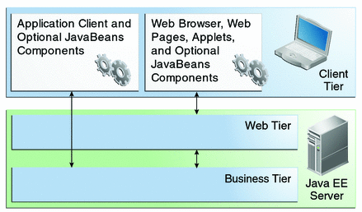
Java EE Server Communications
Client communicates directly with business tier, or if running in a browser,
then through web pages or servlets in web tier

Slide 14
Java EE Web Components
These are either servlets or web pages created using JavaServer Faces technology and/or JSP technology (JSP pages)
Servlets: java classes that dynamically process requests and construct responses
JSP pages are text-based documents that execute as servlets but allow a more natural approach to creating static content
JavaServer Faces technology builds on servlets and JSP and provides a user interface component framework for web apps
Static HTML pages, applets, and server-side utility classes are not considered web components

Slide 15
Business Components
Business code is logic that meets the needs of a business domain:
Banking
Retail
Finance
Factory production
etc
Business code runs in enterprise beans running in either the business or web tier

Slide 16
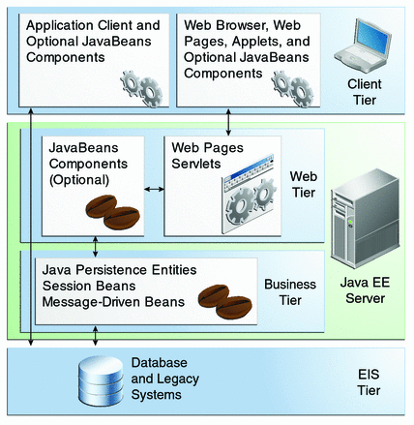
Business and EIS Tiers
An enterprise bean receives data from client programs, processes it, and sends it to the enterprise information tier for storage

Slide 17
Enterprise Information System Tier
Enterprise infrastructure systems:
Enterprise resource planning (ERP)
Mainframe transaction processing
Database systems
Legacy information systems

Slide 18
Implementations of JEE Application Server Specification
Glassfish opensource
Oracle Glassfish
IBM WebSphere
Apache Geronimo
Fujitsu Interstage Application Server
Redhat JBoss
Apache Tomcat (web container)
Implement the same spec, but differ in extra features (like connectors, clustering, fault tolerance, high availability, security, etc), installed size, memory footprint, startup time, etc.

Slide 19
Java EE Containers
thin-client multitiered applications are hard to write:
Transaction and state management
Multithreading
Resource pooling
Complex low-level details…
the Java EE server provides underlying services in the form of a container for every component type
Containers form the interface between the component and the low-level platform specific functionality
Each web, enterprise bean, or application client component must be assembled into a Java EE module and deployed in its container

Slide 20
Java EE Containers
Container settings customize the underlying support by the JavaEE server:
Security: Java EE security model lets you configure a web component or enterprise bean so that system resources are accessed only by authorized users.
Transaction Management: lets you specify relationships among methods that make up a single transaction so that all methods in one transaction are treated as a single unit.
Java Naming and Directory Interface (JNDI) lookup services: provide a unified interface to multiple naming and directory services in the enterprise so that application components can access these services.
Remote connectivity model manages low-level communications between clients and enterprise beans. After an enterprise bean is created, a client invokes methods on it as if it were in the same virtual machine.

Slide 21
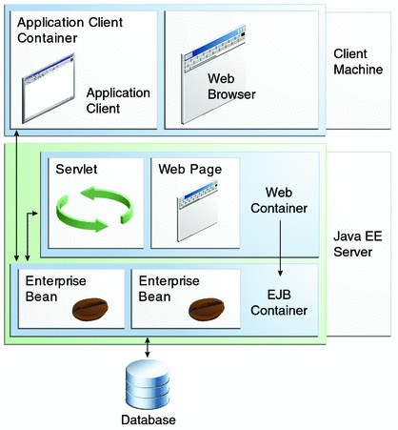
Container Types
Java EE server: The runtime portion of a Java EE product, provides EJB and web containers.
Enterprise JavaBeans (EJB) container: Manages the execution of enterprise beans, which, with their container, run on the Java EE server.
Web container: Manages the execution of web pages, servlets, and some EJB components for Java EE applications. Web components and their container run on the Java EE server.
Application client container: Manages the execution of application client components, which, with their container run, on the client.
Applet container: Manages the execution of applets, and consists of a web browser and Java Plug-in running on the client together.

Slide 22
Packaging Java EE Applications
A Java EE application is delivered in a
Java Archive (JAR) file
Web Archive (WAR) file (jar file with .war extension)
Enterprise Archive (EAR) file (jar file with .ear extension)
Deployment Descriptor (optional): a declarative (XML) document, describes the deployment settings of an app, module or component
Java EE Server reads the deployment descriptor at runtime
Two types:
Java EE deployment descriptor: configure deployment settings
Runtime deployment descriptor: configure Java EE implementation-specific parameters
Example, GlassFish deployment descriptor contains
Context root of a web application
GlassFish Server implementation-specific parameters e.g. caching directives

Slide 23
Enterprise JavaBeans
Enterprise Bean is a body of code having fields and methods to implement modules of business logic
Two types
Session Bean: usually represents a transient conversation with a client. When the client finishes executing, the session bean and its data are gone.
Message-driven Bean: combines features of a session bean and a message listener, allowing a business component to receive messages asynchronously. Commonly, these are Java Message Service (JMS) messages.

Slide 24
Java Servlet Technology
Usually not needed explicitly in JEE programming. Like RMI, Servlets are behind the scenes to implement JSF, JSP)
Lets you define HTTP-specific classes
Extends the capabilities of servers that host applications
Accessed by way of request-response programming model (loose coupling)
Can respond to any type of request, but commonly used to extend the applications hosted by web servers

Slide 25
JavaServer Faces Technology
A user interface framework for building web applications
Deitel and Deitel, Chapters 29/30
Main Components:
A GUI component framework
A flexible model for rendering components in different kinds of HTML or different markup languages and technologies. A Renderer object generates the markup to render the component, and converts the data stored in a model object to types that can be represented in a view
Features supporting GUI components:
Input validation
Event Handling
Data conversion between model objects and GUI components
Managed model object creation
Page navigation configuration
Expression Language (EL)

Slide 26
JavaServer Pages Technology
JSP has been replaced by JSF, which is based on JSP, which is based on Servlets
JavaServer Pages (JSP) technology lets you put snippets of servlet code directly into a text-based document. A JSP page is a text-based document that contains two types of text:
Static data, which can be expressed in any text-based format such as HTML or XML
JSP elements, which determine how the page constructs dynamic content

Slide 27
Java Persistence API (JPA)
The Java Persistence API is a Java standards-based solution for persistence.
Hibernate implements the JPA (the default implementation when you install JEE is called EclipseLink)
Persistence uses an object/relational mapping approach to bridge the gap between an object-oriented model and a relational database.
The Java Persistence API can also be used in Java SE applications, outside of the Java EE environment (as we've seen in the RMI/Hibernate Assignment)
Java Persistence consists of the following areas:
The Java Persistence API
The query language
Object/relational mapping metadata

Slide 28
Java Transaction API
JTA provides a standard interface for demarcating transactions
The Java EE architecture provides a default auto commit to handle transaction commits and rollbacks
An auto commit means that any other applications that are viewing data will see the updated data after each database read or write operation.
When an application performs two separate database access operations that depend on each other, developers use the JTA API to demarcate where the entire transaction, including both operations, begins, rolls back, and commits

Slide 29
Java API for RESTful Web Services
Representational State Transfer (REST) architectural style
The JAX-RS API was introduced in Java EE 6 (now at JEE 8)

Slide 30
Named Beans
lightweight container-managed objects (POJOs)
The @Named (javax.inject.Named) annotation in a class, along with a scope annotation, automatically registers that class as a resource with the JavaServer Faces implementation
Example ShoppingCart class:
@Named("cart")
@SessionScoped
public class ShoppingCart ... { ... }

Slide 31
Named bean scopes
Application (javax.enterprise.context.ApplicationScoped): Application scope persists across all users' interactions with a web application.
Session (javax.enterprise.context.SessionScoped): Session scope persists across multiple HTTP requests in a web application.
Request (javax.enterprise.context.RequestScoped): Request scope persists during a single HTTP request in a web application.

Slide 32
GlassFish (http://glassfish.java.net/docs/index.html)
The GlassFish Server is a compliant implementation of the Java EE 7 platform
(supports all the aforementioned APIs, and more that weren’t mentioned)
Glassfish includes:
Administration Console: stop, manage users, resources, applications
asadmin: command-line admin utility equivalent of Console
appclient: launches the application client container and invokes an app in an application client jar file
capture-schema: command-line tool to extract schema information from a database
package-appclient : command-line tool to package application client container
Java DB database (Derby)
..more

Slide 33
Glassfish Application Server
Application Server (as-)
as-install: e.g. C:\glassfish4\glassfish
e.g. C:\Program Files\glassfish4\glassfish
in config files: ${com.sun.aas.installRoot}
Whenever you see "as-install" in commands on these slides, replace it with your own as-install (e.g. C:\glassfish4\glassfish)
as-install-parent in that example would be C:\glassfish4
Starting/Stopping, Commandline
start: as-install/bin/asadmin start-domain [domain1]
stop: as-install/bin/asadmin stop-domain [domain1]
list: as-install/bin/asadmin list-domains

Slide 34
JEE and Databases
We can set up a MySQL database as a datasource for Glassfish:
http://computingat40s.wordpress.com/how-to-setup-a-jdbc-connection-in-glassfish/
Glassfish also comes with a built-in database engine called Derby

Slide 35
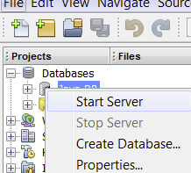
Derby
Starting/Stopping the database:
as-install/bin/asadmin start-database --dbhome as-install-parent/javadb
example: asadmin start-database –dbhome C:\glasfish4\javadb
as-install/bin/asadmin stop-database
Where is the database?
Properties of Netbeans->Services->Databases->Java DB

Slide 36
Glassfish
Admin Console of running server:
http://localhost:4848
Deploying war files:
as-install/bin/asadmin deploy war-name (war-name=path of hello.war)
as-install/bin/asadmin list-applications
as-install/bin/asadmin undeploy appname (e.g. appname = hello)
To Deploy automatically to a domain (e.g. domain1):
as-install/domains/domain1/autodeploy
any applications placed in the autodeploy directory will be deployed
Launching the graphical update tool:
as-install-parent/bin/updatetool

Slide 37
Java EE Annotations
What are Annotations?
Java EE 5 and later support annotations in your source code, so that you can embed
resources, dependencies, services, and life-cycle notifications
in your source code, without having to maintain these artifacts elsewhere in an xml file.
An annotation is a modifier or Metadata tag that provides additional data to Java
classes, interfaces, constructors, methods, fields, parameters, and local variables.
Annotations
Replace XML descriptors for most purposes
Remove the need for marker interfaces (like java.rmi.Remote)
Allow application settings to be visible in the component they affect

Slide 38
Finding out about Annotations
The JEE Tutorial examples use and explain the annotations we'll need.
For more depth -- JSRs: Java Specification Requests
JSR 342: JavaTM Platform, Enterprise Edition 7 (Java EE 7) Specification at http://jcp.org/en/jsr/detail?id=342
JSR 250: Common annotations
JSR-220: EJB 3.0 annotations
JSR-181: Web Services annotations
JSR-220: Java Persistence API annotations
JSR-222: JaxB annotations (Java arch for XML binding)
JSR-224: WS2 annotations (XML-based web services)

Slide 39
Servlets
Servlets are server-side programming technology for dynamic content
A Servlet extends the capability of the server in the request-response programming model
javax.servlet and javax.servlet.http packages provide interfaces and classes for writing servlets
All servlets must implement the Servlet interface, which defines lifecycle methods

Slide 40
Servlet Lifecycle
Servlet Lifecycle is controlled by the container in which the servlet has been deployed
When a request is mapped to a servlet, the container performs the following:
If an instance of the servlet does not exist, the web container
Loads the servlet class.
Creates an instance of the servlet class.
Initializes the servlet instance by calling the init method.
Invokes the service method, passing request and response objects.
If it needs to remove the servlet, the container finalizes the servlet by calling the servlet’s destroy method

Slide 41
Creating and Initializing a Servlet
Use the @WebServlet annotation to define a servlet component in a web application
The annotated servlet must specify at least one URL pattern
This is done by using the urlPatterns or value attribute on the annotation
Classes annotated with @WebServlet must extend the javax.servlet.http.HttpServlet class
Example (mood):
import javax.servlet.annotation.WebServlet;
import javax.servlet.http.HttpServlet;
@WebServlet("/report")
public class MoodServlet extends HttpServlet {
…

Slide 42
Creating and Initializing (cont’d)
The web container initializes a servlet after loading and instantiating the servlet class and before delivering requests from clients
To customize this process, you can either override the init method of the Servlet interface or specify the initParams attribute of the @WebServlet annotation (see Mood filter, Programming Filters Slide below) to
read persistent configuration data
Initialize resources
Any other one-time activities
The initParams attribute contains a @WebInitParam annotation
If it cannot complete its initialization process, a servlet throws an UnavailableException

Slide 43
Maintaining Client State
Many applications require that a series of requests from a client be associated with one another (e.g. state of shopping cart)
Java Servlet technology provides an API for managing sessions and allows several mechanisms for implementing sessions
Sessions are represented by an HttpSession object
You access a session by calling the getSession method of a request object

Slide 44
The Mood Example
The example shows how to develop a simple application by using the @WebServlet, @WebFilter, and @WebListener annotations to create a servlet, a listener, and a filter.
The mood example application is comprised of three components:
mood.web.MoodServlet
mood.web.TimeOfDayFilter
mood.web.SimpleServletListener
Operation:
Request comes in
TimeOfDayFilter sets a mood attribute in the request
MoodServlet then processes the request
All the while, SimpleServletListener is responding to events by logging to the server’s log

Slide 45
MoodServlet
MoodServlet, the presentation layer of the application, displays Duke’s mood in a graphic, based on the time of day.
The @WebServlet annotation specifies the URL pattern:
@WebServlet("/report")
public class MoodServlet extends HttpServlet { ...

Slide 46
TimeOfDayFilter
TimeOfDayFilter sets an initialization parameter indicating that Duke is awake:
@WebFilter(filterName = "TimeOfDayFilter",
urlPatterns = {"/*"},
initParams = {
@WebInitParam(name = "mood", value = "awake")})
public class TimeOfDayFilter implements Filter { ...
The filter calls the doFilter method, which contains a switch statement that sets Duke’s mood based on the current time.
SimpleServletListener logs changes in the servlet’s lifecycle. The log entries appear in the server log.

Slide 47
Hello1 example
Example of JavaServer Faces technology
index.html is the default landing page for a Facelets application
For this application, the page uses simple tag markup to display a form with a graphic image, a header, a text field, and two command buttons
Notice the Submit commandButton element specifies the action as response, meaning that when the button is clicked, the response.xhtml page is displayed
Hello object is a named bean
The web.xml file contains several elements that are required for a Facelets application. All these are created automatically when you use NetBeans

Slide 48
Hello2 example
The hello2 application behaves almost identically to the hello1 application, but it is implemented using Java Servlet technology instead of JavaServer Faces technology
This servlet overrides the doGet method, implementing the GET method of HTTP

Slide 49
Simple Persistence Example
We will study the addressbook JSF example, and implement something similar in our JEE Sprite Application
To create this kind of application from scratch:
http://netbeans.org/kb/docs/javaee/javaee-gettingstarted.html
Simple Java EE 7 web application that contains an EJB 3.1 stateless session bean façade for an entity class (just like address-book)
use the IDE to generate the entity class and session bean
The code generated uses queries defined in the Criteria API part of Java Persistence API 2.0
create a named managed bean that accesses the session façade and
create a presentation layer that uses the Facelets view framework as specified in JSF 2.0

Slide 50
Addressbook application
Glassfish
Managed Bean
EJB
(ContactFacade)
Contact.class
Browser
Web Pages
Database

Slide 51
AddressBook mechanisms
Entity Class: Contact.java
contains annotations for ORM
Contact table created in Derby database engine
Stateless Session Bean: ContactFacade.java
database session, not user's session
interacts with and queries the database
Named Managed Bean: ContactController.java
session scoped (the user's session)
connects the presentation layer (JSF) with the EJB
Obtains an instance of ContactFacade through dependency injection
@EJB private ContactFacade ejbFacade;
Example: prepareEdit and edit methods
when the user clicks the "Edit" button, it calls the prepareEdit function, which gets the data through the ContactFacade and forwards to the Edit view, a JSF page
user enters data and clicks Submit, EL calls the update method, saving updated data through the ContactFacade

Slide 52
AddressBook Cont'd
JSF presentation layer: xhtml pages that contain Expression Language expressions used to communicate with the Named bean
Expression Language
#{bean.method}
EL example:
#{customer.name}
When reading, this would be the result of the getName method of the named bean called "customer"
When writing, this would call setName method of the bean called "customer"
https://docs.oracle.com/javaee/7/tutorial/jsf-el.htm#GJDDD
Uses JSF tag libraries:
xmlns:h="http://xmlns.jcp.org/jsf/html"
xmlns:f="http://xmlns.jcp.org/jsf/core">

Slide 53
Derby
creating a database
rightclick on JavaDB in Netbeans
or
;create=true; in connect statement in commandline ij

Slide 54
Derby (command line)
ij is Derby’s command line SQL client
run from windows command line:
cd c:\program files\glassfish-3.1.1\javadb\bin\ij
ij> connect ‘jdbc:derby://localhost:1527/sun-appserv-samples;user=app;password=app’;
ij> select * from app.contact;
ij> insert into app.contact (id,Birthcity,birthday,email,firstname,homephone,lastname,mobilephone) values (7,'Ottawa','10/10/2000','sample@algonquincollege.com','Bubbie','123-123-1234','Lu','123-123-1234');

Slide 55
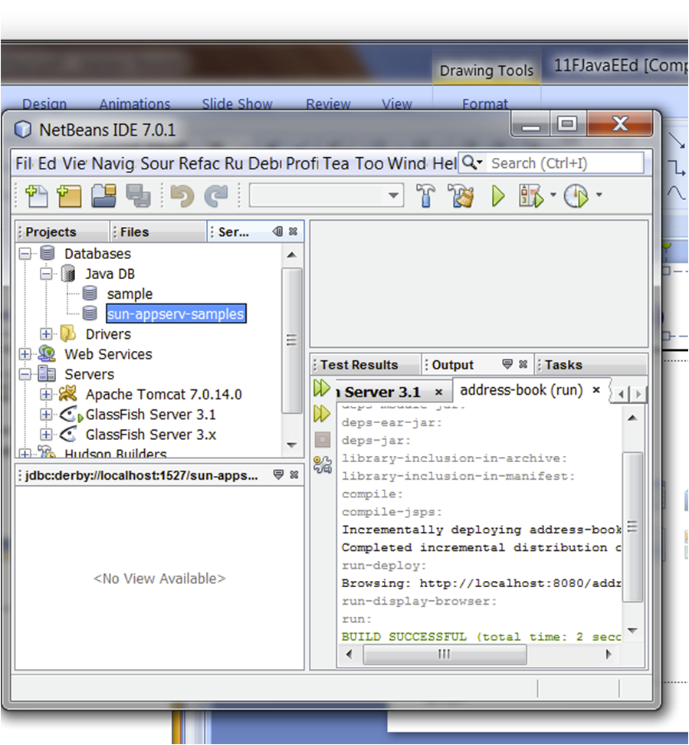
Derby (Netbeans)

Slide 56
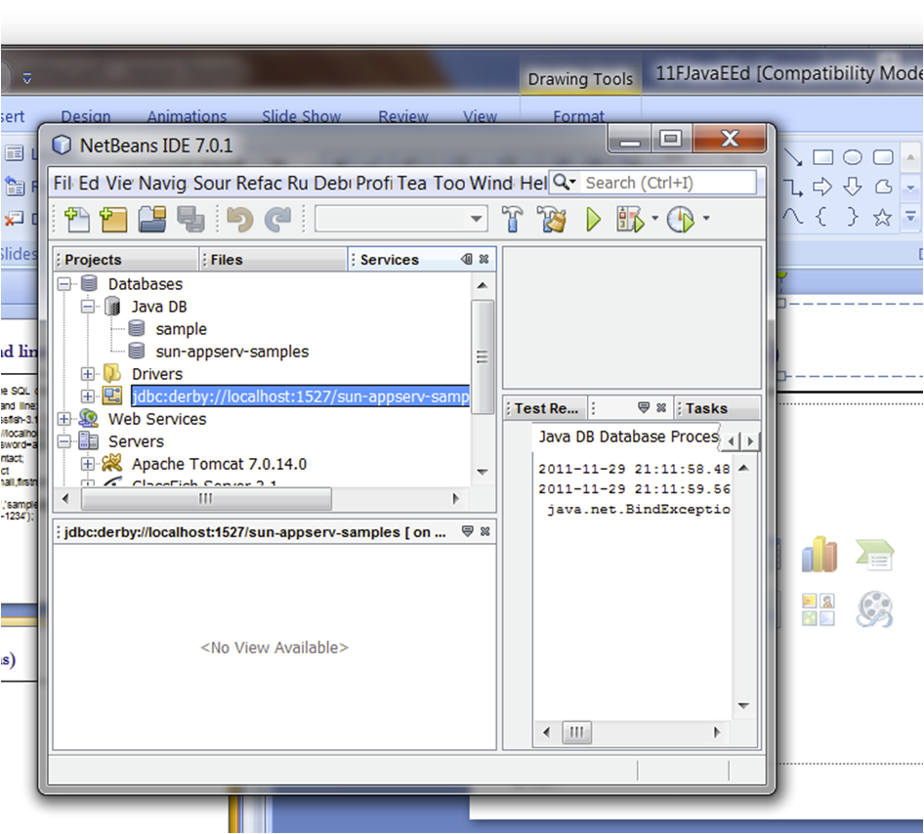
Derby (Netbeans)

Slide 57
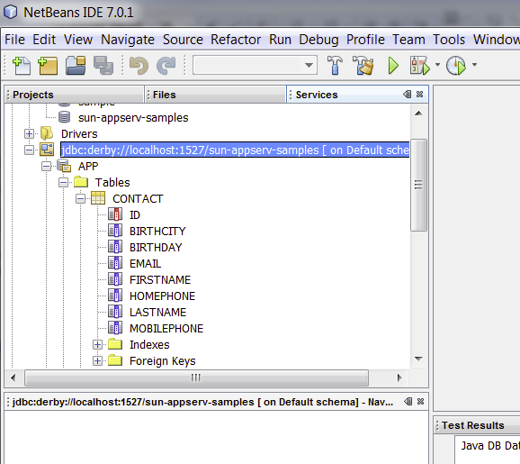
Derby (Netbeans)

Slide 58
JPA (Java Persistence API)
Both Hibernate and EclipseLink implement the JPA -- annotations supported can be different, with different options
Persistence with JEE versus without JEE: The overall creation and management of persistent objects is basically the same (annotate the Entity class(es), carry out transactions)
In both we annotate the entity class (examples: Employee, Contact)

Slide 59
without JEE versus with JEE
Hibernate without JEE:
load configuration (hibernate.cfg.xml), create session factory (once)
(as needed) getCurrentSession, beginTransaction, do work, commit
with JEE:
persistence.xml specifies a persistence-unit which specifies a jta-data-source
Netbeans creates the EntityFacade for us where Entity is the name of the entity class (example, ContactFacade)
@PersistenceContext annotation on the EntityManager in the EntityFacade ties the EntityManager to the persistence-unit
The bean that deals with persistent objects (example ContactController) obtains a reference to the ContactFacade through Dependency Injection: @EJB private ContactFacade ejbFacade;

Slide 60
What's this EntityFacade?
The ContactFacade is the DAO (Data Access Object) for the Contact Entity (a Contact is a persistent object)
A DAO is the go-to object for doing CRUD operations on an Entity
Create
Read
Update
Delete
Sessions and Transactions of the EntityManager in the ContactFacade are handled for us by the JTA (see persistence.xml):
<persistence-unit name="address-bookPU" transaction-type="JTA">
<jta-data-source>MySQLDB</jta-data-source>

Slide 61
User to Database (address-book app)
User's Browser submits the form to Glassfish when the user clicks save
JSF pages are implemented with JSP and Servlets behind the scenes
EL (Expression Language) expressions use the getters and setters on the properties of the Named Bean
example from Create.xhtml
<td><h:inputText id="firstName"
value="#{contactController.selected.firstName}"
title="#{bundle.CreateContactTitle_firstName}" />
</td>
to display the value, on the ContactController object, call getSelected(), then on that, call getFirstName()
to update the value upon submission, call getSelected(), then on that, call setFirstName()
the bundle.CreateContactTitle_firstName is the string that should label the field on the User's webpage (this is Internationalization support – the string can be English, French, Chinese, etc)

Slide 62
User to Database (cont'd)
EL expression on save button:
<h:commandLink action="#{contactController.create}"
value="#{bundle.CreateContactSaveLink}" />
contactController object create() method gets called
create() calls getFacade().create(current);
The Facade's create method calls getEntityManager().persist(entity);
analogous to session.save(entity) with Hibernate
JTA carries out the transaction to update the database
For you TODO:
look at the AddressBook application and trace through this process yourself (follow the method calls)

Slide 63
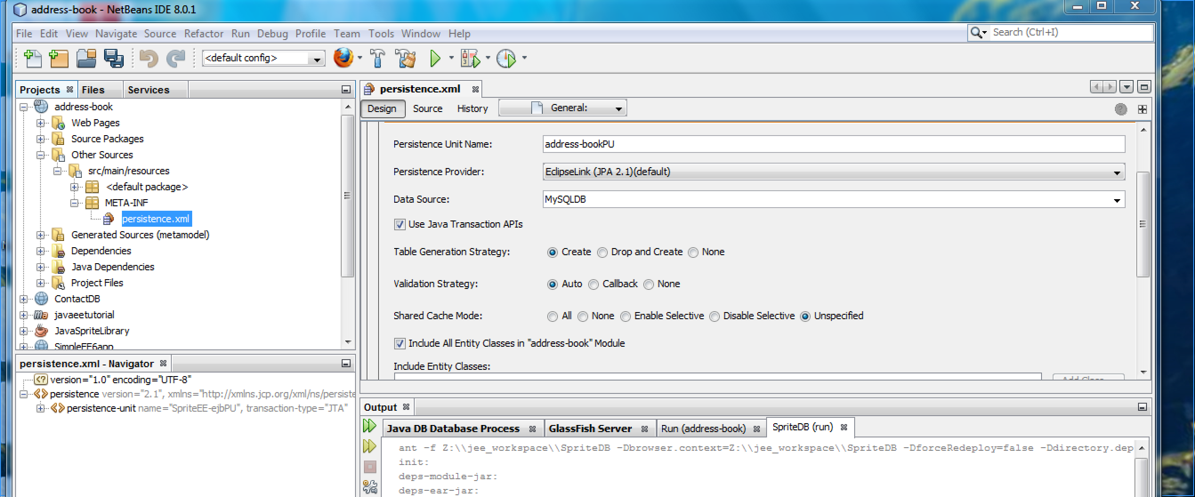
Adding a MySQL datasource
Using Netbeans, in the Design tab of persistence.xml file

Slide 64
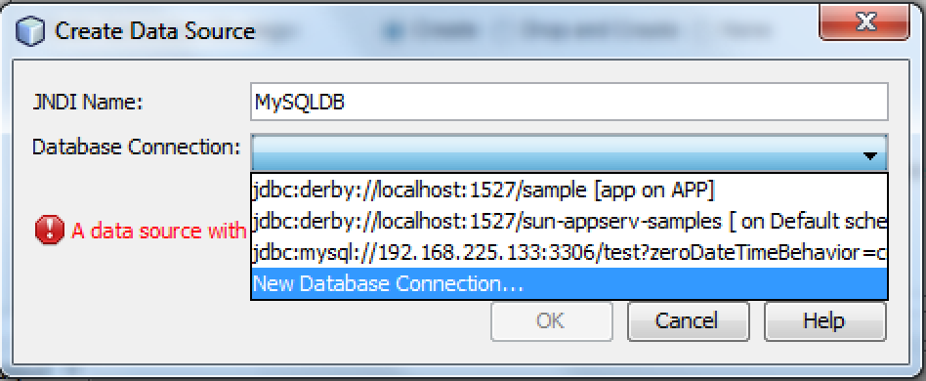
Adding a datasource (MySQL)
Select "New Data Source..." to get this window:

Slide 65
