Slide 1
Java EE Topics 1
Expression Language (Hybrid Activity 3)
Validators. (Burns & Schalk, Chapter 8)
Converters (Burns & Schalk, Chapter 8)
Fun with Javascript

Slide 2
Faces Validation System
Validation applies to data coming from the user to our program
Our Address Book example has the following examples of data validation:
Birthdays of the form DD/MM/YYYY and the date must be in the past
Email addresses match a regular expression representing all email addresses
Phone numbers must be 10 digits

Slide 3
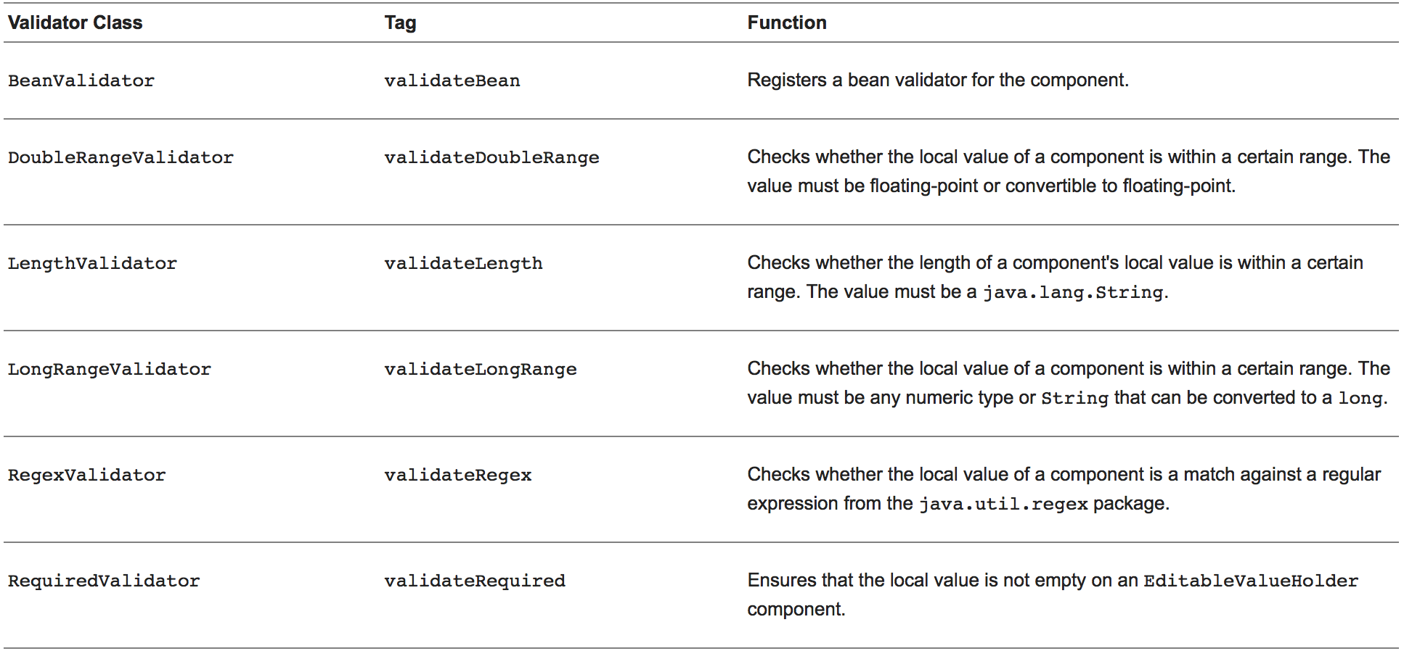
JSF Standard Validators

Slide 4
Validator Example
<h:inputText id="quantity" size="4" value="#{item.quantity}"> <f:validateLongRange minimum="1"/>
</h:inputText>
<h:message for="quantity"/>

Slide 5
Custom Validator
Here, MyOwnJavaConv.java is a class that implements the Validator interface (see https://docs.oracle.com/javaee/6/tutorial/doc/bnauw.html)
<td><h:inputText id="homePhone"
value="#{contactController.selected.homePhone}"
title="#{bundle.CreateContactTitle_homePhone}" >
<f:validator validatorId=”MyOwnJavaConv” />
</h:inputText></td>
<td><h:message for="homePhone" /></td>

Slide 6
JSF Converter System
Converters are two-way:
the text coming from the user is converted into Java Objects
the Java Objects coming from the program are converted into text
Consider the Birthday field in the Address Book application (Create.xhtml):
<td><h:outputLabel value="#{bundle.CreateContactLabel_birthday}"
for="birthday" /></td>
<td><h:inputText id="birthday"
value="#{contactController.selected.birthday}"
title="#{bundle.CreateContactTitle_birthday}" >
<f:convertDateTime pattern="MM/dd/yyyy" />
</h:inputText></td>
<td><h:message for="birthday" /></td>
SEE: https://docs.oracle.com/javaee/7/tutorial/jsf-page-core001.htm#BNASV

Slide 7
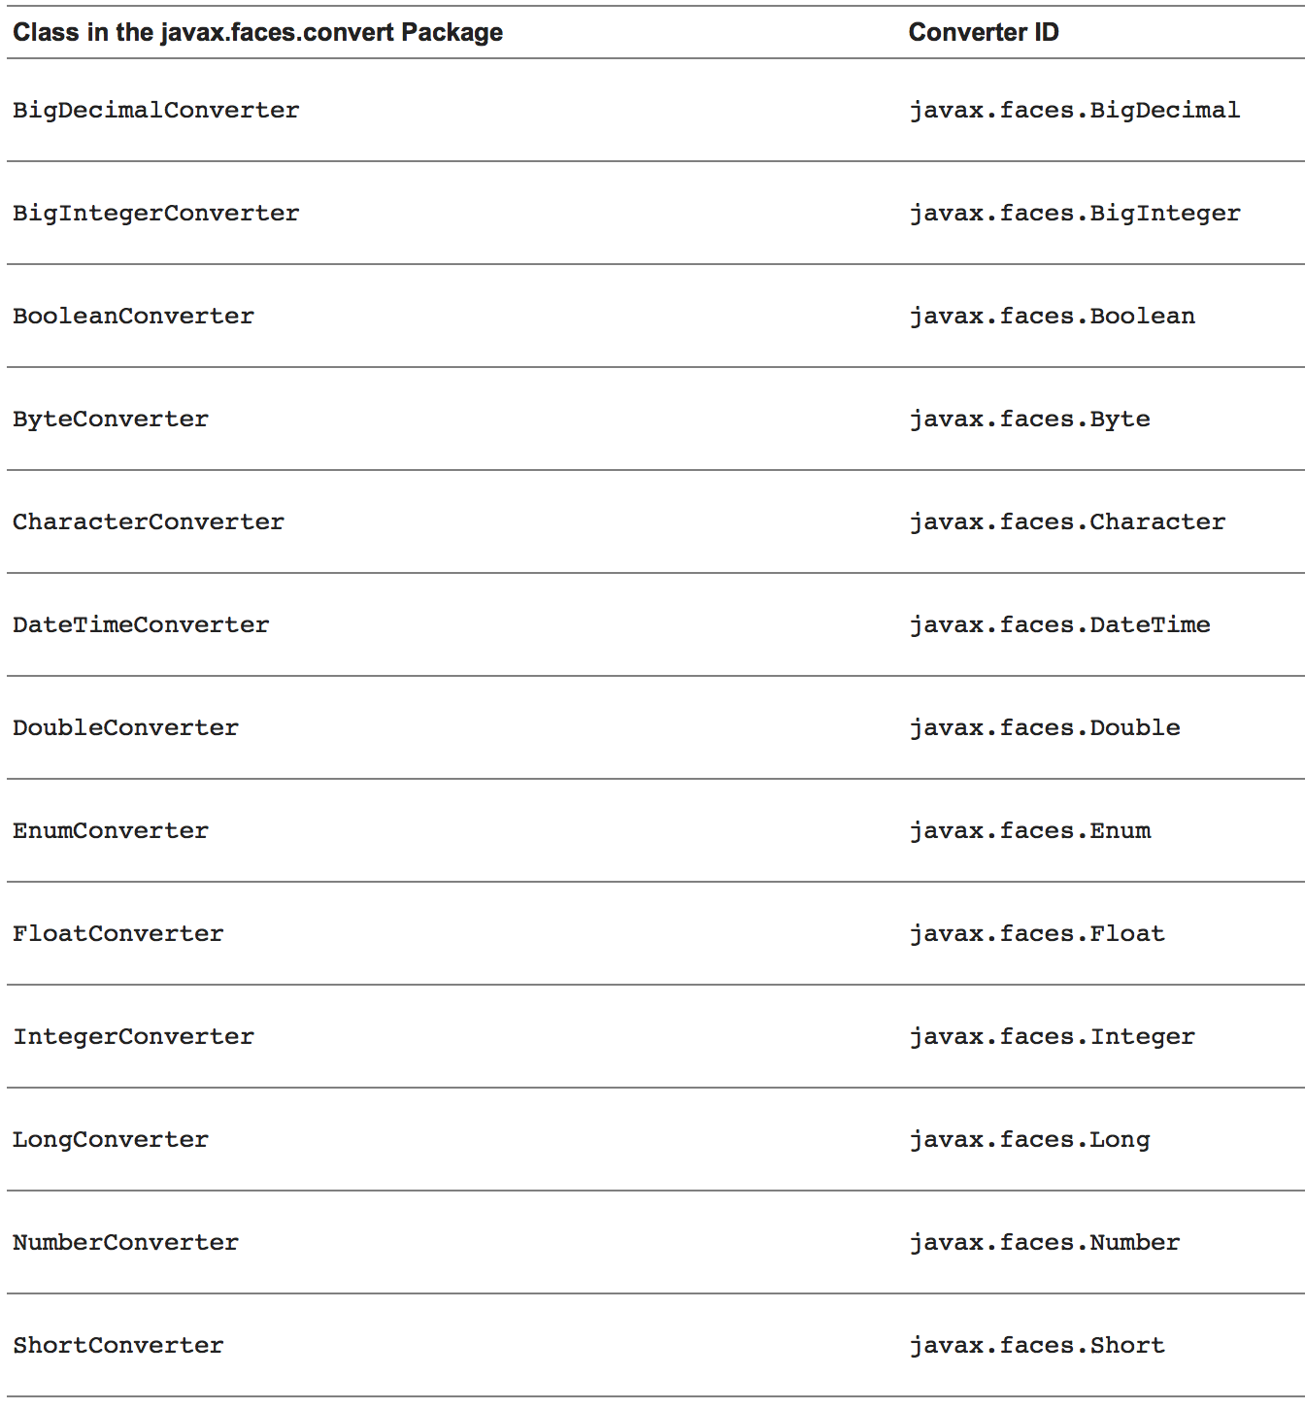
Built-in Converters

Slide 8
Built-in Converters (cont’d)
Built-in Converters are applied implicitly when an Expression Language expression is used (and therefor the datatype is known)
DateTimeConverter has its own <f:convertDateTime> tag
As used in the Address Book example
NumberConverter has its own <f:convertNumber> tag

Slide 9
Custom Converters
Custom Converters implement the javax.faces.convert.Converter interface:
public Object getAsObject(FacesContext context,
UIComponent component, String value)
public String getAsString(FacesContext context,
UIComponent component, Object value)

Slide 10
Explicit Converter Example
Consider the color of our Sprites

