Slide 1
Difficulty is measured, never claimed: toward an evidentiary standard for frontier evaluation benchmarks.
Trinity, Ethara AI. 2026. https://github.com/Ethara-Ai/trinity

Slide 2
The problem
Benchmark difficulty is asserted at authoring time and treated as a fixed property of the artifact. Benchmarks then saturate within months through contamination, shortcuts, and weak scoring, which proves the asserted difficulty was never a property of the artifact at all.
Trace: restates the introduction of paper/main.md, section 1.

Slide 3
The position
Difficulty is a relation between a task, a named population of solvers, and a moment in time. It can only be established by measurement against identified solvers, and every such measurement decays as the solver frontier advances.
Trace: restates the abstract of paper/main.md.

Slide 4
The four principles
Difficulty claims must be relational. They must rest on externally attested measurement against a named solver cohort, with reproducible evidence distinguished from attested-only evidence. The evidence must carry an explicit expiry. And the roles of author, auditor, and record keeper must be separated under public acceptance criteria with sequestered probe instances.
Trace: restates the four principles enumerated in the abstract of paper/main.md.

Slide 5
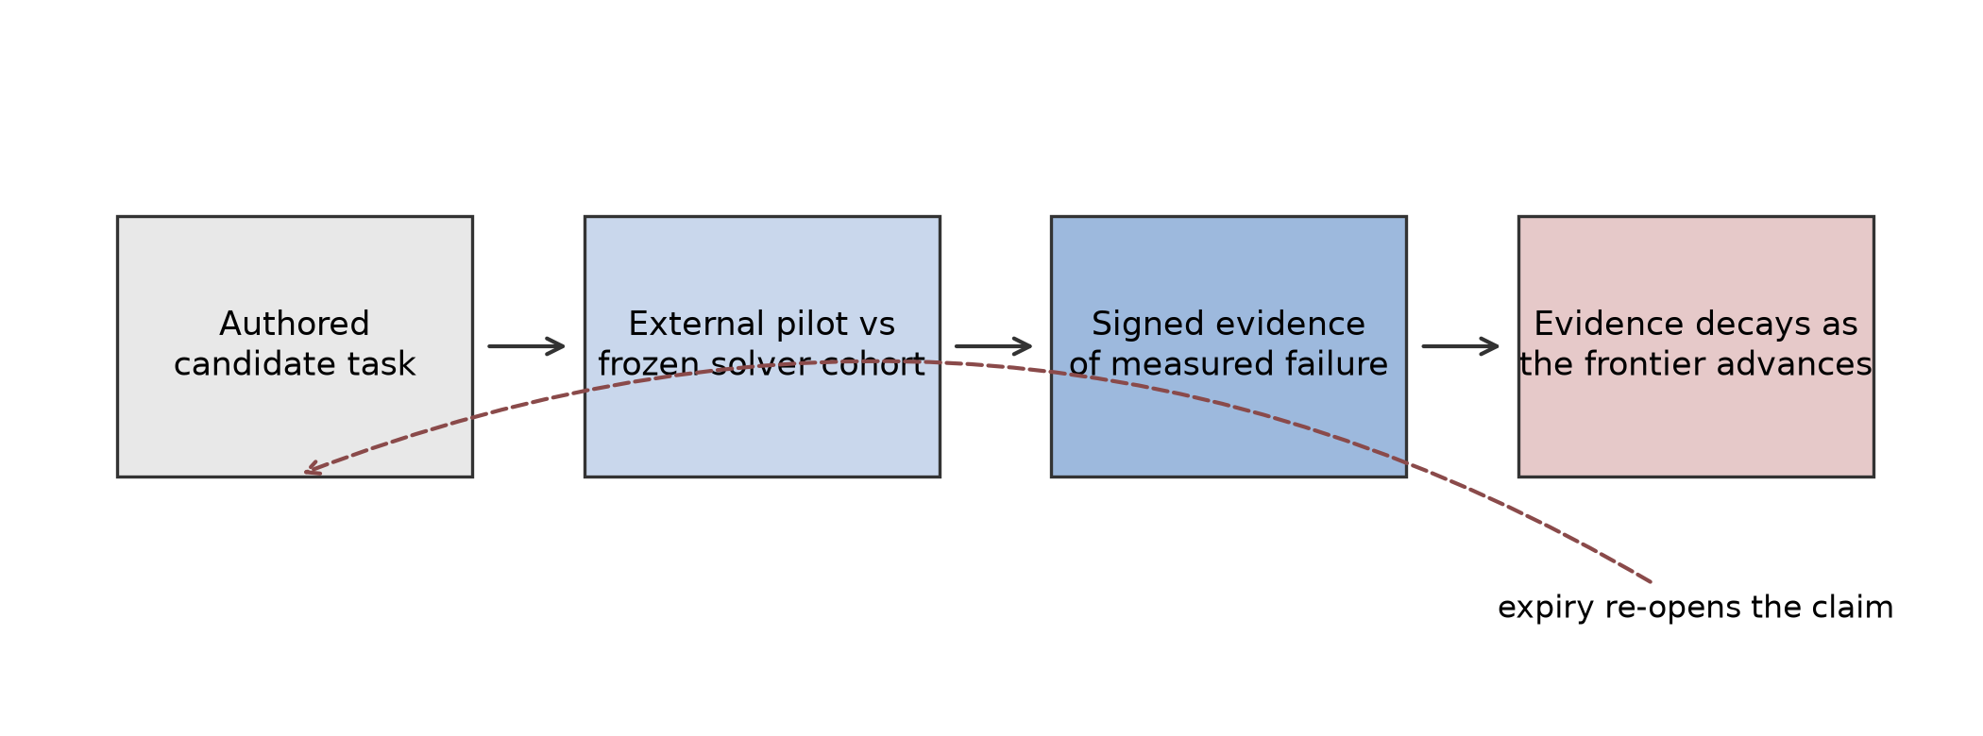
The evidence lifecycle
Measured difficulty is born from an attested run, carries an explicit expiry, and decays to stale as the frontier advances. Hardness is re-earned, never inherited.
Trace: figure reused from paper/figures/evidence_lifecycle.png; claim restates the expiry principle in paper/main.md.

Slide 6
The field already agrees in pieces
Dynamic adversarial collection, rolling contamination-resistant benchmarks, sequestered test sets, and third-party evaluation organizations each concede part of this position in deployed practice. What is missing is the connective standard.
Trace: restates the deployed prior art positioning in paper/main.md, section 5.1.

Slide 7
The motivating corpus
A curated reading list of 21 anchor papers motivates the principles, reported as counts and labeled a selection, not a survey.
Trace: total_anchors = 21 in paper/data/corpus.json, verified by the paper/data/corpus.py self-check.

Slide 8
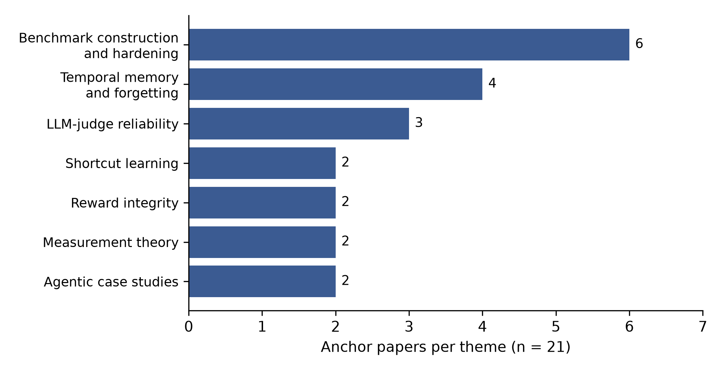
Where the anchors cluster
The 21 anchors span 7 themes, and the largest is benchmark construction and hardening at 6 of 21.
Trace: total_anchors = 21, theme_count = 7, and benchmark_construction_and_hardening = 6/21 in paper/data/corpus.json; figure reused from paper/figures/theme_distribution.png.

Slide 9
The pressure is current
Of the 21 anchors, 18 were published in 2026, 2 in 2025, and 1 in 2024. The evidence motivating the standard comes from the live frontier, not a settled literature.
Trace: year counts 2026 = 18/21, 2025 = 2/21, 2024 = 1/21 in paper/data/corpus.json.

Slide 10
Trinity, the executable architecture
Trinity enforces the standard during benchmark production, not at publication, through information-flow separation of author, auditor, and record keeper, with each of its five patterns standing on decades of prior art from access control, mutation testing, and software supply chain attestation.
Trace: restates the architecture description in the abstract and section 4 of paper/main.md.

Slide 11
Three instruments, one bridge
ENGRAM remembers, expires, and directs. FORGE authors and proves tasks. CRUCIBLE audits the finished project. FORGE and CRUCIBLE never speak: each reads standing direction only through a computed projection, and ENGRAM alone bridges them, because an author who learns what the auditor accepts writes for the auditor.
Trace: ENGRAM.md non-negotiable rules 1 through 4, which pin disjoint ownership of .memory/, .seed/, and .audit/ and make FORGE_VIEW and CRUCIBLE_VIEW the only surfaces a peer may read.

Slide 12
FORGE ships batches, not singletons
Every FORGE invocation opens one batch of thirty ordinary task slots plus at most one anchor, worked as parallel lanes, with Frontier-defeat as the default design target unless a human grant exempts a slot. The batch spreads coverage across eligible archetypes AR1 to AR10, no archetype claims more than one fifth of the slots, and an underfilled or overanchored batch is a named gap, never a quiet shortfall.
Trace: FORGE.md non-negotiable rules 10 and 11 and Phase 0 step 7 bind thirty ordinary slots plus at most one anchor, parallel lanes, the Frontier-defeat mandate and grant exception, and the archetype spread.

Slide 13
CRUCIBLE audits blind
CRUCIBLE grades bytes, not intent. It never reads the raw ledger, the proof store, the hardness contract, or any FORGE surface, and its gate is critical recall over what the author claimed rather than a proof of correctness or difficulty. Every audit instrument must fire on a planted defect and stay silent on a clean fixture before it may move a disposition.
Trace: CRUCIBLE.md non-negotiable rules 1, 2, and 6, plus ENGRAM.md rule 4, which strips authored difficulty claims from CRUCIBLE_VIEW by name.

Slide 14
Difficulty is dated and perishable
Hardness enters the record only as a signed CFER pinning task hash, checker hash, environment hash, frozen solver registry, model cohort, measurement date, and a validity interval. When the interval lapses or the pinned cohort goes stale, the lever expires. A stale certificate never keeps a claim alive.
Trace: ENGRAM.md non-negotiable rules 7 and 8 and Phase 1 step 4, which fix the engram.cfer/v1 pinned field set and the expiry rule.

Slide 15
Fail closed, all the way down
No authored probability, no self-solve, and no local pass reaches SHIP. Local verification caps at HOLD:PILOT_REQUIRED by construction, and only an external signed pilot over frozen bytes releases anything. A missing instrument, an unverified root, or an uncomputable check lowers the disposition; it never yields silence.
Trace: FORGE.md non-negotiable rules 6 and 7 and Phase 4.5, which bind the closed disposition set and the external signed pilot as the sole path to SHIP.

Slide 16
Contamination screening from an immutable baseline
Every task is screened against pinned, immutable roots, and the exclusion list must name SWE-bench, SWE-bench Verified, Terminal-Bench, LiveCodeBench, and the Stack lineage. A client list adds to that baseline and can never erase a row from it. Bundle identity is a canary-normalized hash over the runtime bytes, so a planted token cannot move the identity it is planted under.
Trace: ENGRAM.md Phase 1 steps 8b, 8g, and 8h and FORGE.md Phase 0 steps 9h through 9j pin the four screening roots, the named baseline rows, the union authority mode, and the canary normalization domain.

Slide 17
The record defends itself
Every human prompt a run receives is captured verbatim and attested by an append-only hash chain that only the machine writes. The chain head is folded into a signed Merkle checkpoint and published in the root report, so a silent rewrite is detectable rather than merely forbidden. A chain that fails its walk hard blocks the run.
Trace: the Feedback capture sections of ENGRAM.md, FORGE.md, and CRUCIBLE.md, steps 4 and 5, plus ENGRAM.md Phase 1 step 8a on signed Merkle checkpoints.

Slide 18
Latest main or hard stop
Before any phase work, every instrument resolves its vendored trinity/ checkout against the upstream main tip. Behind, diverged, locally modified, or unverifiable is stale, and stale is a hard block. A gatekeeper reasoning from superseded contract bytes approves against a rulebook nobody is held to.
Trace: the Trinity freshness gate section, stated identically in ENGRAM.md, FORGE.md, and CRUCIBLE.md, and bound by GAUNTLET.md rule 11.

Slide 19
Target and composition headroom are distinct
Hardness targets require at least sixty percent headroom: every target sits at or above 1.6 times the strongest anchored frontier result it cites. Author-side composition separately requires at least fifty percent headroom, or 1.5 times every governing floor, rounding up: twelve instrument-bound levers across nine categories compose to at least eighteen levers across fourteen. Both are design obligations, never evidence of difficulty.
Trace: ENGRAM.md Phase H step 6 binds the 1.6 target multiple; FORGE.md Hardness rules 2 and 2e bind the 1.5 composition multiple and rounded floors; paper/main.md, section 4, Pattern 1 restates both.

Slide 20
GAUNTLET, the adversary at the gate
Human sign-off gates can be discharged out of band only by an approver that first tries to break the artifact and approves solely what survives. Verdicts are cast by a unanimous council of three or more mutually distinct model lineages, every approval carries a DSSE envelope binding the failed attack transcript, and the first grant of that authority is irreducibly human-signed.
Trace: GAUNTLET.md rules 2, 6, and 10, the approval envelope section, and the bootstrap section; ENGRAM.md Phase 0 step 8a binds the autonomous_gates capability that recognizes it.

Slide 21
Every number traces to data
The paper, the deck, the press kit, and the patent draft all read from one data artifact with a self-check that exits non-zero on disagreement. Figures are generated, never redrawn. The deck you are reading is regenerated from its Markdown sources by a deterministic script and is never edited by hand.
Trace: ENGRAM.md required outputs, which bind paper/<work>/data/ as the single source of truth for every quantitative claim on the pitch/, media/, and patent/ surfaces.

Slide 22
We hold ourselves to the standard
Trinity separates its three roles inside a single party, so its own evidence stays inadmissible under the standard until the auditor and record keeper roles are held externally. We state that plainly rather than exempting ourselves, because a standard whose authors exempt themselves is a press release.
Trace: restates the self-application and disclosure passage in paper/main.md, sections 4 and 6.

Slide 23
The ask
Adopt the standard. Demand relational difficulty claims backed by attested measurement with an explicit expiry, and move the auditor and record keeper roles to external parties, so that no benchmark grades its own homework.
Trace: restates the closing position of paper/main.md; contact and repository as on Slide 1.

Slide 24
Erratum: the superseded corpus round
Erratum. Reconciliation against the checked-in reading list found an omitted paper, OpenAnt (Korda and Evron, 2026). Superseded round: anchors = 20; papers in 2026 = 17; agentic case studies = 1. Current round: anchors = 21; papers in 2026 = 18; agentic case studies = 2. The 7 themes and largest theme count of 6 are unchanged. These superseded counts are history, not current headlines.
Trace: paper/main.md, section 5.3, Erratum records these prior and current counts; paper/data/corpus.json supplies the current headlines; ENGRAM.md Phase S step 17 requires this history on the pitch surface.

