Slide 1

Customer Shopping Behavior Analysis
Uncovering insights from 3,900 purchases to guide strategic business decisions

Slide 2
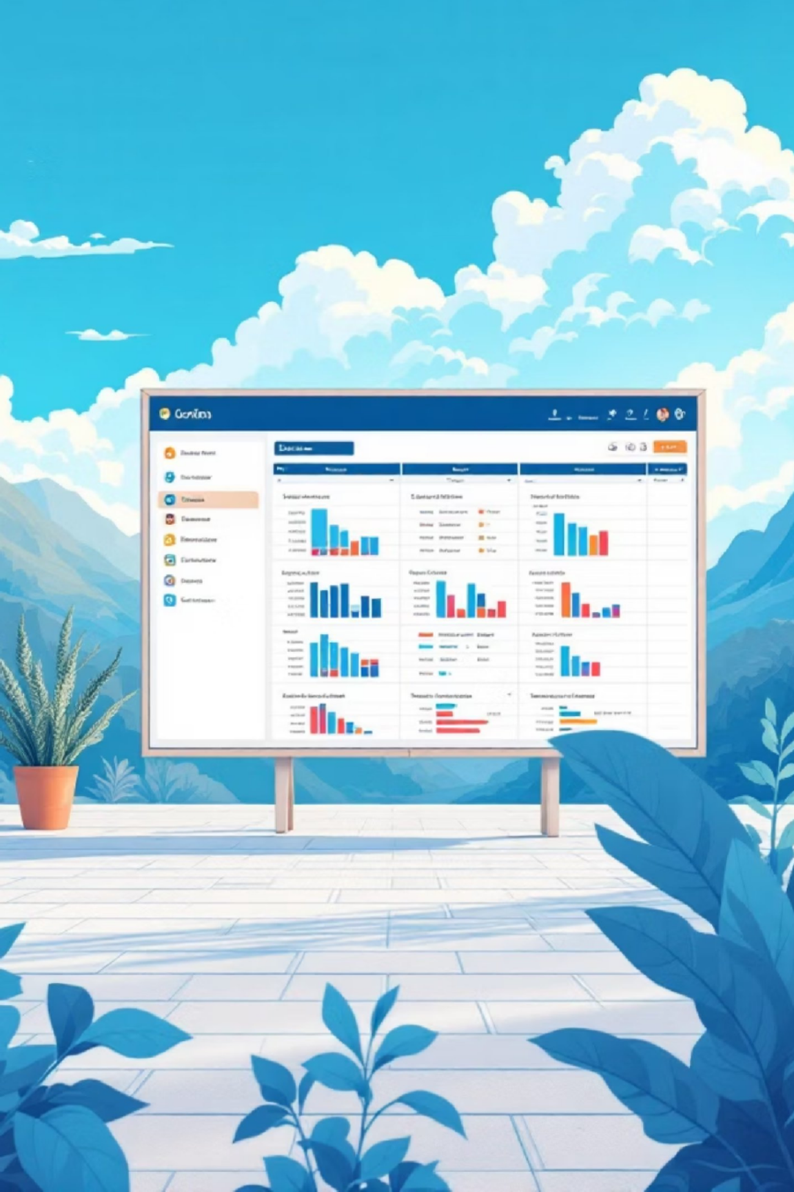
Dataset Overview
3,900
Purchase Records
18
Data Fields
Customer demographics, purchase details, behavior metrics
37
Missing Values
Review ratings imputed
Transactional data analyzed

Slide 3

Python Data Preparation
Data Loading & Exploration
Data Cleaning Steps
Handled missing review ratings
Standardized column names to snake case
Created age groups and purchase frequency metrics
Imported with
pandas
Checked structure with
df.info()
Summary statistics via .describe()

Slide 4

SQL Analysis: Revenue Insights
Gender Revenue Split
Male: $157,890
Age Group Performance
Female: $75,191
Young Adult: $62,143
Middle-aged: $59,197
Shipping Comparison
Standard: $58.46 avg
Express: $60.48 avg

Slide 5

Product Performance
1
Top-Rated Products
Gloves (3.86), Sandals (3.84), Boots (3.82)
2
Discount-Heavy Items
Hat (50%), Sneakers (49.66%), Coat (49.07%)
3
Best-Selling by Category
Clothing: Blouse & Pants (171 each)

Slide 6
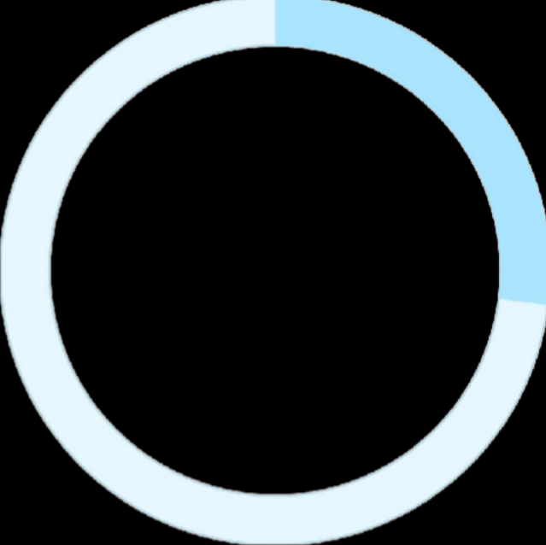

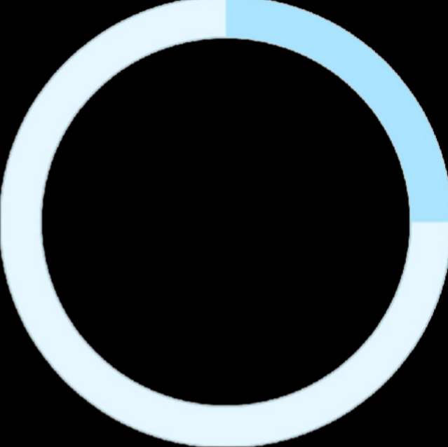

Subscription & Customer Behavior
27%
80%
25%
Subscribers
1,053 customers subscribed
Loyal Customers
3,116 in loyal segment
Returning Buyers
701 customers returning
Subscription Revenue
Repeat Purchase Pattern
Subscribers: $62,645 total
958 customers with >5 purchases
Non-subscribers: $170,436 total
2,518 customers with ≤5 purchases

Slide 7
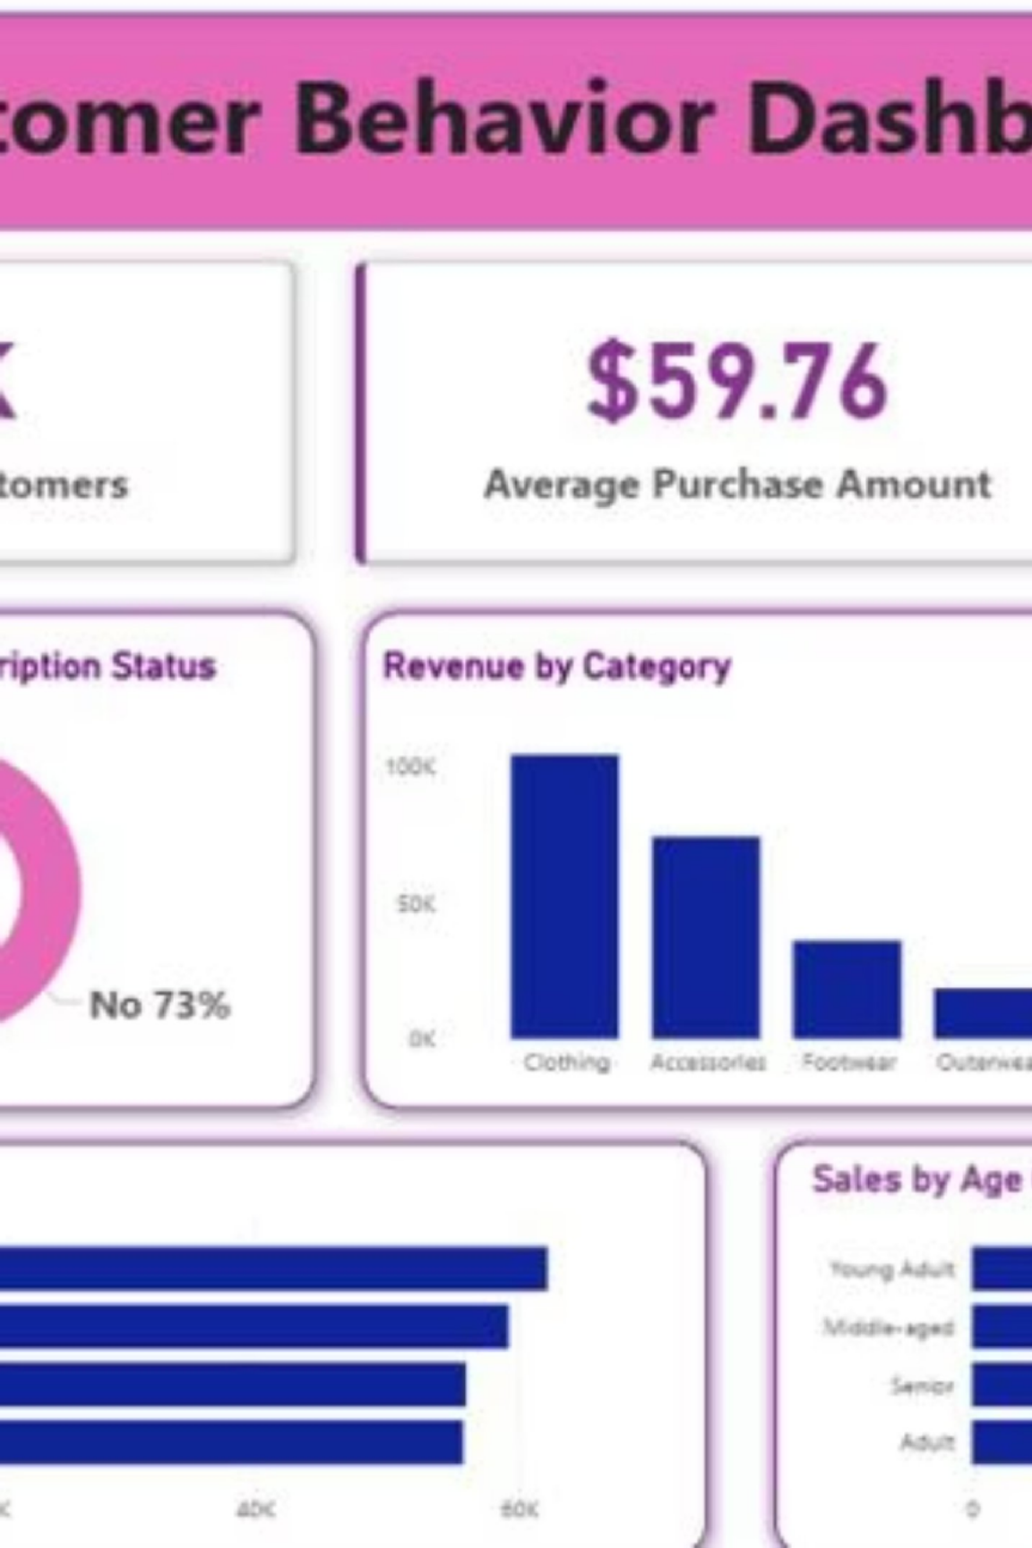
Power BI Dashboard
01
02
Interactive KPIs
3.9K customers, $59.76 avg purchase, 3.75 avg rating
Dynamic Filters
Subscription, gender, category, shipping type selection
03
Visual Analytics
Donut charts, bar charts, horizontal bars for revenue and sales

Slide 8


Key Findings
Revenue Gap
Male customers generate 2.1x more revenue than female customers
Discount Strategy
High-discount products drive sales but may impact margins
Loyalty Base
80% of customers are loyal with consistent purchase patterns

Slide 9





Strategic Recommendations
Boost Subscriptions
Promote exclusive benefits and incentives for subscribers
Loyalty Programs
Reward repeat buyers to accelerate movement to loyal segment
Review Discount Policy
Balance sales boosts with margin control across product categories
Product Positioning
Highlight top-rated and best-selling products in marketing campaigns
Targeted Marketing
Focus on high-revenue age groups and express-shipping users

Slide 10
Data-Driven Growth
Transform insights into action: optimize subscriptions, reward loyalty, and target high-value customer segments

