Slide 1

Random Recipe Generator
Exploring Creativity in the Kitchen
Amanpreet Singh

Slide 2
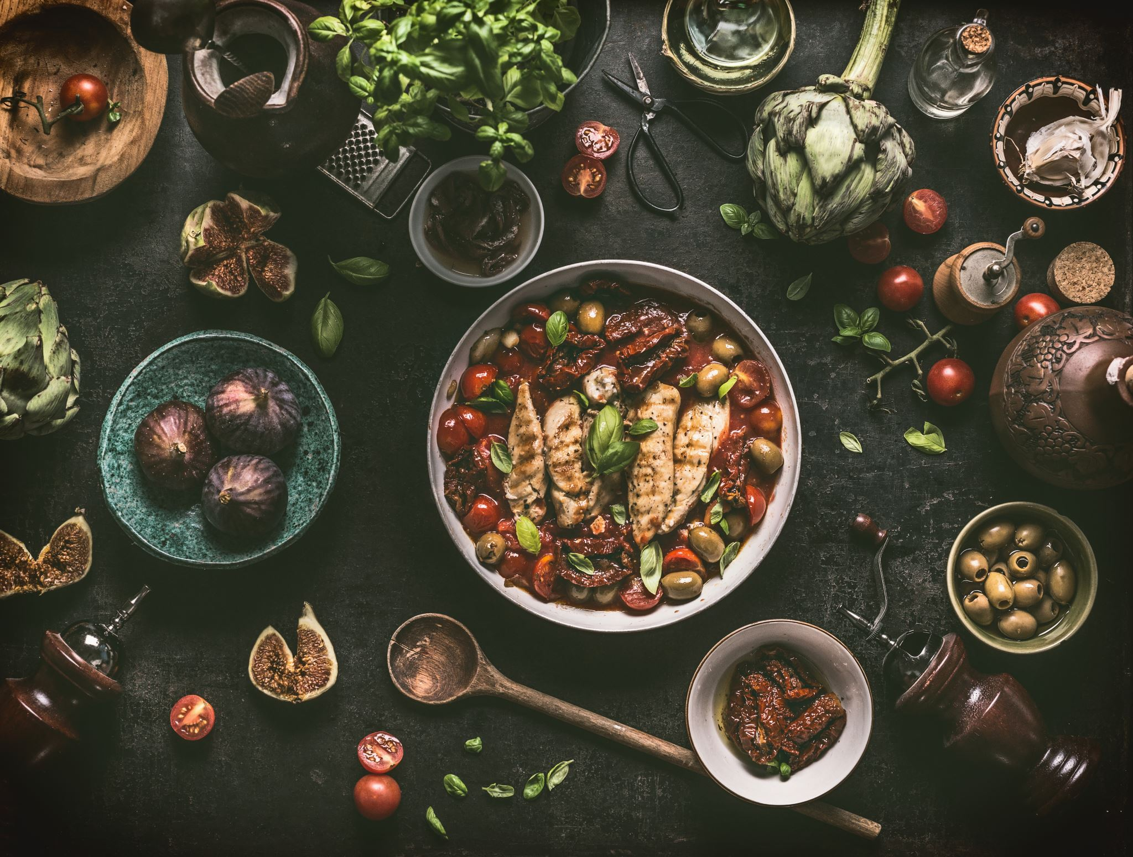
Introduction to the Topic
What is the Random Recipe Generator?
A Python-based application designed to inspire culinary creativity by generating random recipes.
Why this project?
Combines love for food and technology.
Solves the common problem of 'What should I cook today?'

Slide 3
Summary of Findings
History:
Recipe sharing dates back centuries; modern tools include cookbooks and online recipe databases.
Current Software Solutions:
Recipe websites like AllRecipes, API platforms like Spoonacular.
Future Potential:
AI-driven personalized recipe recommendations.
Voice and AR integration for cooking guides.

Slide 4

Real-World Applications
Individual Use:
Encourage healthy eating habits by exploring new recipes.
Food Industry:
Use as a promotional tool for ingredient sales or cooking appliances.
Educational Tools:
Teach cooking skills through interactive software.

Slide 5
Design Approach
Planning Process:
Identified key features: recipe generation, filtering, and saving favorites.
Researched APIs and datasets for diverse recipes.
Prioritized user-friendly and efficient design.
Tools and Technologies:
Python with libraries like `requests` and `json`
Optional GUI with Tkinter or Flask.

Slide 6

Solution Design Proposal
Functional Features:
Generate recipes based on user preferences.
Save and manage favorite recipes.
Search functionality for saved recipes.
Non-Functional Features:
Scalability for API integrations.
High performance and low latency.
User Interface Design:
Console-based UI with intuitive input prompts.
Future enhancements include a web-based GUI.

Slide 7

Open Questions
Unanswered Questions:
How can machine learning enhance recipe personalization?
What are the best practices for ensuring global recipe diversity?
Surprises:
Complexity of handling dietary restrictions in filtering logic.

Slide 8
Citations
Spoonacular API Documentation https://spoonacular.com/food-api
TheMealDB API Documentation https://www.themealdb.com/api.php
Python Official Documentation https://docs.python.org/3/
Edamam Recipe Search API https://developer.edamam.com/edamam-docs-recipe-api
Real Python - JSON Data in Python https://realpython.com/python-json/
Kaggle - Recipe Datasets for Research and Projects https://www.kaggle.com/datasets
Stack Overflow - Python Recipes Discussions https://stackoverflow.com/questions/tagged/recipes

Slide 9
Closing Slide
Thank You!
Questions and discussions are welcome.

