Slide 1
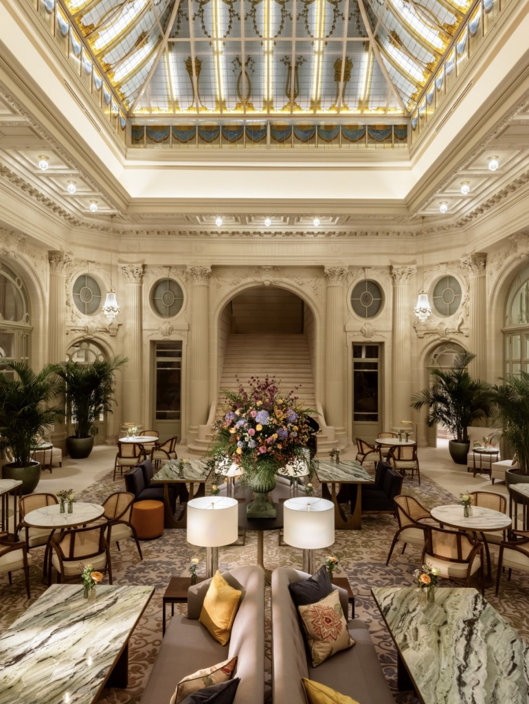
S O C I I S G R O U P
The independent behavioural institution
One evening. One room.
No second chance.
The 64
Founding Gathering
2 2 J u l y 2 0 2 6 · C o r i n t h i a B r u s s e l s
€2,500 excl. VAT per seat · €20,000 excl. VAT per Founding Table

Slide 2
T H E 6 4
What this room is.
SociisGroup is the independent behavioural institution.
We serve humanity by changing how the world behaves.
The 64 is the Founding Gathering.
Built once. For sixty-four people who do not need to perform.
Behaviour is upstream of strategy, of disclosure, of reporting. If individuals and communities change how they behave, the system changes with them.
Once the room is full, it is full.
There is no waitlist. There is no second evening.
0 2 / 0 6

Slide 3
T H E 6 4
The evening.
A R R I V A L
A V O I C E F R O M W B C S D
Champagne and canapés from the first minute. The room forms itself.
Dr. Ilham Kadri, Chair, World Business Council for Sustainable Development.
T H E K E Y N O T E
D E F I N I N G M O M E N T S
Hein Wagner. A blind man with a vision. One voice, one hour.
Sarah McArthur on Frances Hesselbein. The film, then Sarah speaks.
A C U L T U R A L O P E N I N G
T H E I N S T I T U T I O N
A live moment that sets the tone for the evening.
SociisGroup introduces SBS and BEE. A door opening.
T H E D I N N E R
T H E C L O S E
Full seated service. Tables curated by SociisGroup.
A moment held back. The evening ends when the room is ready.
The evening closes with a moment we do not announce in advance.
0 3 / 0 6

Slide 4
T H E 6 4
Voices in the room.
Jeremie Landweer
Dominique Debecker
Hein Wagner
Founder, SociisGroup
Chief Behavioural Officer, SociisGroup
A blind man with a vision
Dr. Ilham Kadri
Sarah McArthur
Iris van der Veken
Chair, WBCSD
Editor-in-Chief, Leader to Leader
Ambassador, SociisGroup
Tim Sanders
Zanele Morrison
Prof. Jan De Visch
Founder & CEO, Silent Donor
Host, Global Engagement
Connect & Transform
All participants attend in a personal capacity. Further voices forming.
0 4 / 0 6

Slide 5
T H E 6 4
What your seat includes.
A private evening at Corinthia Brussels, food and drinks included
Sixty-four curated international leaders in direct proximity
The Keynote, one voice held for this room
A live cultural opening
Dr. Ilham Kadri, Chair, WBCSD, as a voice in the room
Defining Moments, Sarah McArthur on Frances Hesselbein
The Institution, introduction to SBS and BEE
Access to Sociis House, the continuous environment of the institution
F O U N D I N G T A B L E
A table of eight.
Cap of four tables. Closes 31 May 2026.
One table of eight at Corinthia Brussels
Name on the Sociis Wall
A private founder moment during the evening
Permanent recognition in the institutional record
€20,000
e x c l u d i n g V A T
0 5 / 0 6

Slide 6
Begin the Conversation.
One confidential alignment conversation.
N o p r e s s u r e . O n l y c l a r i t y .
hello@sociisgroup.com
All prices exclusive of 21% Belgian VAT. Curation applies. SociisGroup reserves the right to decline participation.

