Slide 1
PRODUCT STRATEGY & IMPLEMENTATION
Autonomous IT Incident Response
An agentic workflow for triage, diagnosis, and remediation — and a trajectory-based
framework for deciding whether open-source models can safely run it.
AI Research Engineer — Take-Home Submission | Part 3 of 3
Notes:
Introduce the deck: this connects the Part 1 research methodology and Part 2 proof-of-concept to a concrete product recommendation for engineering and business leadership.

Slide 2
THE PROBLEM
Incident triage doesn't scale with headcount
On-call engineers spend the first, most time-critical minutes of an incident on repetitive triage: reading logs, checking metrics, ruling out known causes.
A large share of incidents fall into a small number of recurring patterns — resource exhaustion, dependency degradation, transient errors — yet each still needs a human to walk the same diagnostic steps.
Response time is gated by whoever is paged being awake, available, and fast — not by the difficulty of the underlying fix.
A typical page, today
1
Alert fires, engineer paged
2
Engineer opens laptop, orients
3
Manually checks logs, metrics, deps
4
Forms a hypothesis
5
Chooses & runs a remediation
6
Manually re-checks the metric
2
Notes:
Set up the pain point in human terms before introducing the agentic solution. Emphasize that the steps are repetitive and pattern-based, which is exactly what makes them automatable.

Slide 3
BUSINESS IMPACT
Minutes of triage cost more than minutes of downtime
Time-to-resolution is dominated by triage time, not fix time, for the recurring incident classes this system targets — shortening triage compresses the whole incident.
On-call burden from repetitive pages is a retention and morale cost for engineering teams, separate from the direct cost of the outages themselves.
Consistent, policy-constrained automated first response reduces variance between a fast responder and a slow one — the system behaves the same at 3pm and 3am.
Triage
24 / 7
Where time goes
Response consistency
Framing note
This deck avoids fabricated ROI figures. Section 12 (Cost Analysis) labels every dollar figure as an illustrative assumption pending real telemetry — the qualitative case above is what's evidence-backed today.
3
Notes:
Be explicit and credible: we are not claiming a specific dollar savings without real data. The business case here is triage-time compression and consistency, which is defensible without invented numbers.

Slide 4
CURRENT STATE
Today's workflow is entirely manual and serial
Alert fires
→
Human paged
→
Manual diagnosis
→
Manual fix
→
Manual verify
No step begins until a human is actively engaged — total time-to-mitigation includes human paging latency, not just diagnostic time.
Each engineer re-derives the same diagnosis from scratch; institutional knowledge lives in people's heads and runbook wikis, not in the response path itself.
There is no structured record of the reasoning behind a remediation choice — postmortems are reconstructed from memory and chat logs after the fact.
4
Notes:
Walk through the current linear, human-gated process. The key point for the next slide's contrast is: no step happens without a human actively present.

Slide 5
THE SOLUTION
An agent handles triage, escalates what it shouldn't own
Five specialized agents — Monitor, Diagnosis, Decision, Execution, Verification — replace the first pass of manual triage for well-understood incident patterns.
A conservative, explicit policy governs every action: automated remediation only proceeds for higher-confidence, non-critical diagnoses; everything else pages a human.
Every decision and tool call is logged as a structured trajectory — the same data that powers evaluation (Section 7) also becomes the postmortem record automatically.
What changes
Trigger
Alert → agent starts immediately
Diagnosis
Tool-based evidence gathering, seconds
Ambiguous cases
Escalated, not guessed
Record
Structured trajectory, not memory
5
Notes:
Introduce the agentic solution as an augmentation of, not a wholesale replacement for, human on-call — the policy explicitly keeps humans in the loop for anything risky.

Slide 6
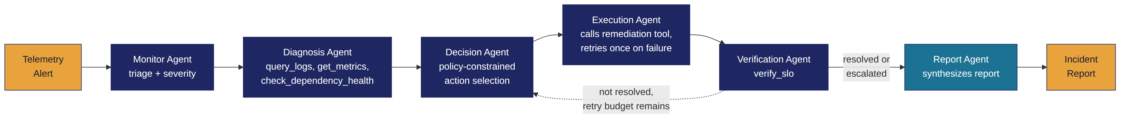
ARCHITECTURE
Six-node LangGraph state machine
State (IncidentState) is typed and shared across all nodes — tool calls and decisions accumulate automatically rather than being re-summarized at each handoff.
The Execution Agent retries a failed tool call once before escalating to a human, rather than looping indefinitely or failing silently.
Tools are mocked in the POC (query_logs, get_metrics, restart_service, etc.) with matching signatures to real systems (Prometheus, Kubernetes, PagerDuty) for a drop-in production swap.
6
Notes:
Walk through the graph topology. Emphasize the conditional retry edge — that's what makes this a real agentic loop rather than a linear pipeline, and it's what Part 2's code implements.

Slide 7
RESEARCH METHODOLOGY
Evaluate the trajectory, not just the final answer
Final-answer evaluation can't distinguish a correct diagnosis from a lucky guess, or a safe retry from a policy-violating shortcut that happened to work.
We score the full sequence: tool calls, arguments, success/failure, reasoning at each decision point, and state transitions — not just whether the incident ended 'resolved'.
Task success itself is checked independently, via the Verification Agent's own SLO check — never taken on the agent's word.
Final-answer vs. trajectory
Final-answer eval
“was the incident resolved?” — misses unsafe paths, silent failures, lucky outcomes.
Trajectory eval
“was each step justified, safe, and recoverable?” — surfaces exactly where and why a run went wrong.
7
Notes:
This is the core methodological argument from the research report. Keep it conceptual here — the next slide shows the actual implemented pipeline.

Slide 8
EVALUATION PIPELINE
A rule-based, auditable scoring pipeline — implemented, not conceptual
1
→
2
→
3
→
4
Run agent
Capture trajectory
Score
Aggregate
Sample alerts through the LangGraph workflow
Structured IncidentState: tool_calls + decisions
trajectory_eval.py: 8 rule-based metrics
Per-run scorecard → cross-model comparison
Metrics: planning quality, tool-selection accuracy, recovery-from-failure, hallucinated-tool rate, state consistency, task success, latency, step efficiency.
Rule-based by design where the answer is objectively checkable (did a call reference an unregistered tool?) — reserving costlier LLM-judge scoring for genuinely subjective dimensions like reasoning quality, run on a sample only.
Unit-tested against synthetic trajectories with known-good/known-bad properties (evaluation/test_core.py), so the scorer itself is verified independent of any model's behavior.
Industry parallel: LangSmith offers this kind of trace capture + evaluation as a hosted product; this pipeline was hand-rolled here to stay dependency-light and fully inspectable, but LangSmith is the natural next step past POC scale.
8
Notes:
This is real, runnable code in the submitted repo — evaluation/trajectory_eval.py — not just a diagram. Mention the unit tests as evidence the scorer itself is trustworthy.

Slide 9
RESULTS — POC DEMONSTRATION
Four scenarios, four distinct trajectories
From actual runs of this repo's mock-mode agent (see app.py --json). No GPT-4.1 / Qwen3 comparison numbers are included here — see slide 10 for why.
Scenario | Root cause found | Action taken | Outcome
checkout-api | Dependency degradation | Escalate (policy: don't auto-fix deps) | Resolved
payments-worker | OOM / resource exhaustion | Scale service | Resolved
notification-service | Generic app error | Restart (1 failure → retry → success) | Resolved
reporting-service | No strong evidence | Escalate (confidence below policy floor) | Resolved
All four cases resolved autonomously; two via direct remediation, two via correct escalation rather than a forced automated fix — the policy engaged exactly as designed.
9
Notes:
These are real outputs from running the mock-mode agent in this repo, not fabricated numbers. Point out that 'resolved' includes cases where the correct behavior was to escalate, not to force an automated fix.

Slide 10
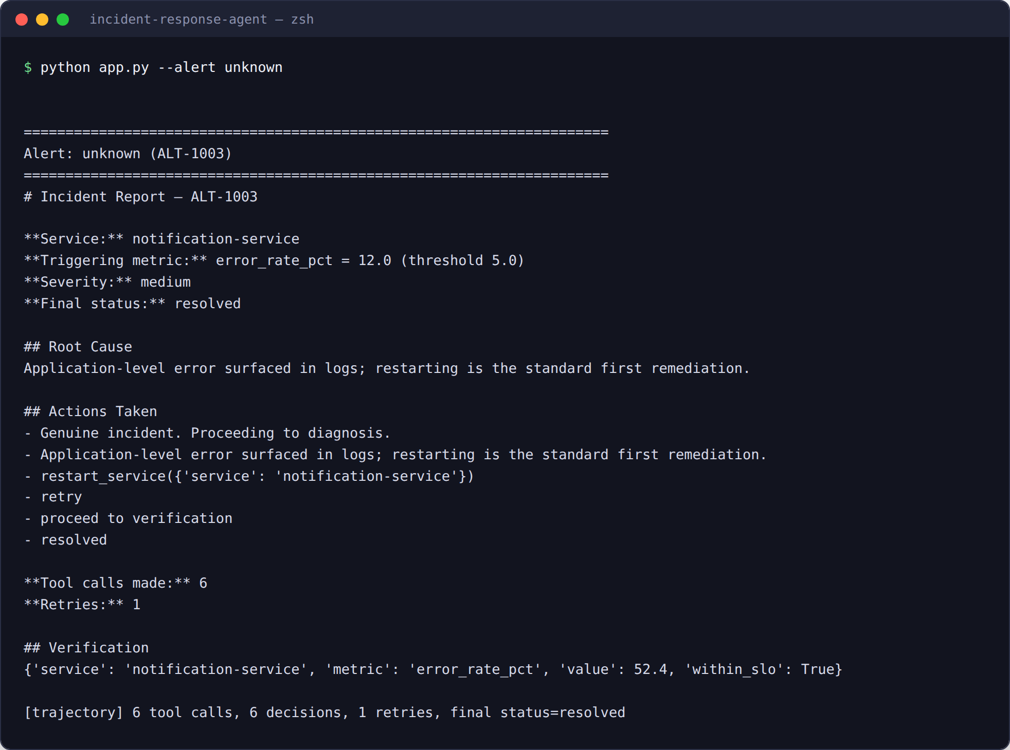
PROOF IT RUNS
Not a mockup — real output from a real run
Chosen deliberately: this scenario is the one that hits the injected tool failure and
exercises the retry-then-succeed recovery path required by the assignment.
Captured against a local shim of the LangGraph/LangChain-core API (this sandbox has no network to install the real packages — see decision_log.md). Control flow and output shown are real.
python app.py --alert unknown
10
Notes:
Address the 'does this actually run' question head-on with real captured output, while being upfront about the shim used in place of a live LangGraph install in this sandboxed environment.

Slide 11
TRADE-OFFS
Every architectural choice traded something away
Choice | Gained | Gave up
Graph-based orchestration (LangGraph) | Explicit retry/escalation loops, typed state | Framework learning curve, more moving parts than a linear chain
Multi-agent decomposition | Narrow, independently-evaluable prompts | More LLM calls than a single mega-agent
Rule-based evaluator (not LLM-judge) | Deterministic, auditable, cheap to run | Can't score subjective reasoning quality on its own
Mock-mode LLM default | Zero-cost, zero-key runnable demo | Doesn't showcase real model reasoning out of the box
11
Notes:
Frame this as intellectual honesty: every design decision in the POC and methodology had a real cost, not just a benefit. This builds credibility with a technical audience.

Slide 12
OPEN VS. CLOSED
GPT-4.1 vs. Qwen3-32B-Instruct for this workflow
Dimension | GPT-4.1 | Qwen3-32B-Instruct
Tool-calling maturity | Mature, first-class function calling | Capable, less battle-tested at complex schemas
Reasoning depth | Frontier-scale | Strong open-weight tier, not frontier-scale
Cost model | Per-token API, no infra ownership | Infra-amortized; cheaper at steady high volume
Data control | Data leaves to third-party API | Full control — relevant for sensitive telemetry
Customization | Prompting only | Fine-tunable on your own incident history
No head-to-head benchmark was run in this environment (no dual API access) — this is architectural reasoning, not a measured result. See research_report.md §3 for full detail.
12
Notes:
Be explicit again here that this table is reasoned, not measured — consistent with the assessment's explicit instruction not to fabricate benchmark numbers.

Slide 13
PRODUCTION RISKS
What could go wrong, and the mitigation already in place
Hallucinated tool call
Unknown action → automatically routed to page_oncall instead of executing (agents.py)
Runaway retry loop
Hard cap: one retry, then escalate — enforced in Execution Agent, not left to the model
Policy violation (e.g. unjustified rollback)
Evaluator flags any rollback without deploy-linked evidence in the diagnosis
Silent false 'resolved' claim
Verification Agent independently re-checks the SLO metric — never trusts the agent's own claim
Open-model capability gap in production
Staged rollout: shadow mode → scored comparison → lowest-severity classes first
13
Notes:
For each risk, point to the specific code or process mitigation already implemented — this should read as 'we thought about this,' not a generic risk-register slide.

Slide 14
COST ANALYSIS
Illustrative cost shape — assumptions stated, not measured
Stated assumptions
Numbers above are illustrative placeholders to show the SHAPE of a volume/cost crossover, not fitted estimates — no real pricing or usage data was available in this environment.
Directional claim only: API cost scales ~linearly with token volume; self-hosted cost is front-loaded (GPU capacity) and better amortized at high, steady volume.
Real analysis needs: actual token counts per incident, GPU pricing for the target instance type, and true traffic seasonality — flagged as immediate next step, not filled in here.
14
Notes:
Be very explicit verbally that every number on this chart is a labeled illustrative assumption, per the assessment's explicit instruction not to fabricate quantitative results.

Slide 15
SCALABILITY
The graph scales horizontally; the policy is what should scale carefully
Each incident is an independent graph execution with its own thread/state — concurrent incidents don't share mutable state, so horizontal scaling is a standard stateless-service problem.
The real scaling constraint is trust, not throughput: expanding which alert classes are eligible for full automation should be gated by evaluation scores (Slide 8), not by traffic volume.
Tool layer (mocked here) will need real rate limits and idempotency guarantees once wired to production systems — a retried restart_service call must be safe to issue twice.
Cross-incident memory (Section 4.4 of the research report) is the main feature currently out of scope that would need its own scaling plan — a vector store keyed by service, not per-run state.
15
Notes:
Distinguish technical scalability (straightforward, stateless graph executions) from the harder question of scaling trust/scope, which is evaluation-gated per the earlier rollout plan.

Slide 16
FUTURE IMPROVEMENTS
Four concrete next steps, in priority order
1
Real dual-model benchmark
2
Cross-incident memory
Run GPT-4.1 and Qwen3-32B through the existing evaluation pipeline on an adversarial alert set to replace reasoned comparison with measured scorecards.
Back IncidentState.memory with a vector store keyed by service, so Diagnosis can retrieve similar past incidents.
3
Reflection before high-risk actions
4
RAG over runbooks
Add a critic pass before rollback_deployment specifically, given its blast radius.
Ground diagnosis in the organization's actual runbook corpus, not generic pattern rules.
16
Notes:
These map directly to the Future Work section of the README, in the order they'd meaningfully unblock the next stage of the rollout plan.

Slide 17
FINAL RECOMMENDATION
Ship the automation for known patterns.
Earn open-model trust with evidence, not assumption.
Now
Next
Later
Deploy the agentic workflow (GPT-4.1-class model) for the recurring, well-understood incident classes it already handles correctly in the POC — with escalation as the safe default.
Run Qwen3-32B in shadow mode alongside it, scored by the same trajectory pipeline, before it touches any real execution.
Promote the open-source model only for alert classes where its measured production-suitability score matches the closed model within an agreed tolerance.
17
Notes:
Close with the concrete, staged recommendation. The emphasis is 'evidence-gated' rollout, not a one-time model choice — tie back to the evaluation pipeline as the mechanism that makes each stage decision.

