Slide 1


Spring 5
www.sunilos.com
www.raystec.com
Notes:
Helpline -9827360504
www.sunilos.com
Copyright (c) sunRays Technologies 2009

Slide 2
Agenda
Spring Container
Spring Core
Spring JDBC
Spring ORM
Spring AOP
Spring MVC
Spring Security
Spring Boot
Cell : 98273-60504
www.raystec.com
Notes:
www.sunrays.co.in
Cell- 98273 60504
Copyright (c) sunRays Technologies

Slide 3
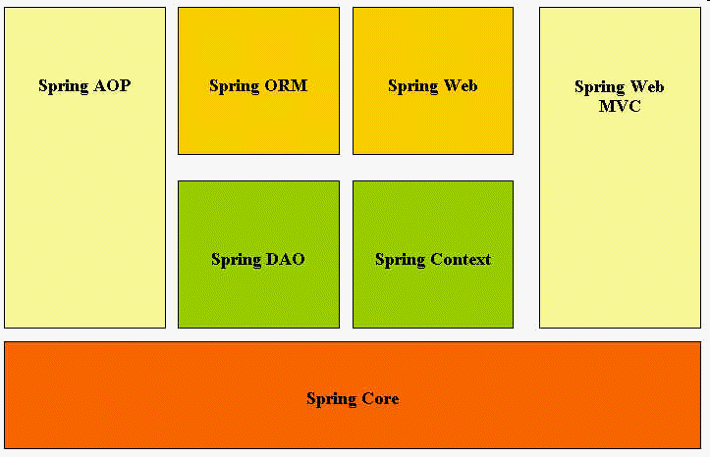
Architecture
Cell : 98273-60504
www.sunrays.co.in
Notes:
www.sunrays.co.in
Cell- 98273 60504
Copyright (c) sunRays Technologies

Slide 4
Application Architecture
Struts
Spring MVC
JSF
Android
IOS
Presentation Layer
Integration Layer
Spring Batch
Spring Mail
Mail
Server
JSP/Servlet
Tiles
JSTL
Spring MVC
Web Services
RMI
Service Classes
Spring
Security
Business Layer
LDAP
Server
Service Beans
Spring AOP
Hibernate
JPA
IBatis
Toplink
Data Access Layer
MySQL
Spring ORM/DAO
JDBC
Layered Architecture
Cell : 98273-60504
www.sunrays.co.in
Notes:
www.sunrays.co.in
Cell- 98273 60504
Copyright (c) sunRays Technologies

Slide 5

More Application Layering Combinations
Presentation/Business/Persistence
Struts+Spring+Hibernate
Struts + Spring + EJB
Tapestry + Spring + EJB
JavaServer Faces + Spring + iBATIS
Spring + Spring + JDO
Flex + Spring + Hibernate
Struts + Spring + JDBC
Spring MVC + Spring + Spring DAO
You decide…
Cell : 98273-60504
www.sunrays.co.in
Notes:
www.sunrays.co.in
Cell- 98273 60504
Copyright (c) sunRays Technologies

Slide 6
Introduction
Light Weight Container
Maintain the lifecycle of a bean
Factory of all kinds of beans
Inject dependencies
Cell : 98273-60504
www.sunrays.co.in
Notes:
www.sunrays.co.in
Cell- 98273 60504
Copyright (c) sunRays Technologies

Slide 7
Inversion of Control (IOC)
Dependency injection
  Beans define their dependencies through constructor arguments or properties
  The container provides the injection at runtime
Decouples object creators and locators from application logic
Easy to maintain and reuse
Testing is easier
Cell : 98273-60504
www.sunrays.co.in
Notes:
www.sunrays.co.in
Cell- 98273 60504
Copyright (c) sunRays Technologies
Inversion of Control has already been referred to as Dependency Injection. The basic principle is that beans define their dependencies (i.e. the other objects they work with) only through constructor arguments or properties. Then, it is the job of the container to actually inject those dependencies when it creates the bean. This is fundamentally the inverse (hence the name Inversion of Control) of the bean instantiating or locating its dependencies on its own using direct construction of classes, or something like the Service Locator pattern. While we will not elaborate too much on the advantages of Dependency Injection, it becomes evident upon usage that code gets much cleaner and reaching a higher grade of decoupling is much easier when beans do not look up their dependencies, but are provided them, and additionally do not even know where the dependencies are located and of what actual type they are.
As touched on in the previous paragraph, Inversion of Control/Dependency Injection exists in two major variants:
setter-based dependency injection is realized by calling setters on your beans after invoking a no-argument constructor to instantiate your bean. Beans defined in the BeanFactory that use setter-based dependency injection are true JavaBeans. Spring generally advocates usage of setter-based dependency injection, since a large number of constructor arguments can get unwieldy, especially when some properties are optional.
constructor-based dependency injection is realized by invoking a constructor with a number of arguments, each representing a collaborator or property. Although Spring generally advocates usage of setter-based dependency injection as much as possible, it does fully support the constructor-based approach as well, since you may wish to use it with pre-existing beans which provide only multi-argument constructors, and no setters. Additionally, for simpler beans, some people prefer the constructor approach as a means of ensuring beans can not be constructed in an invalid state.

Slide 8
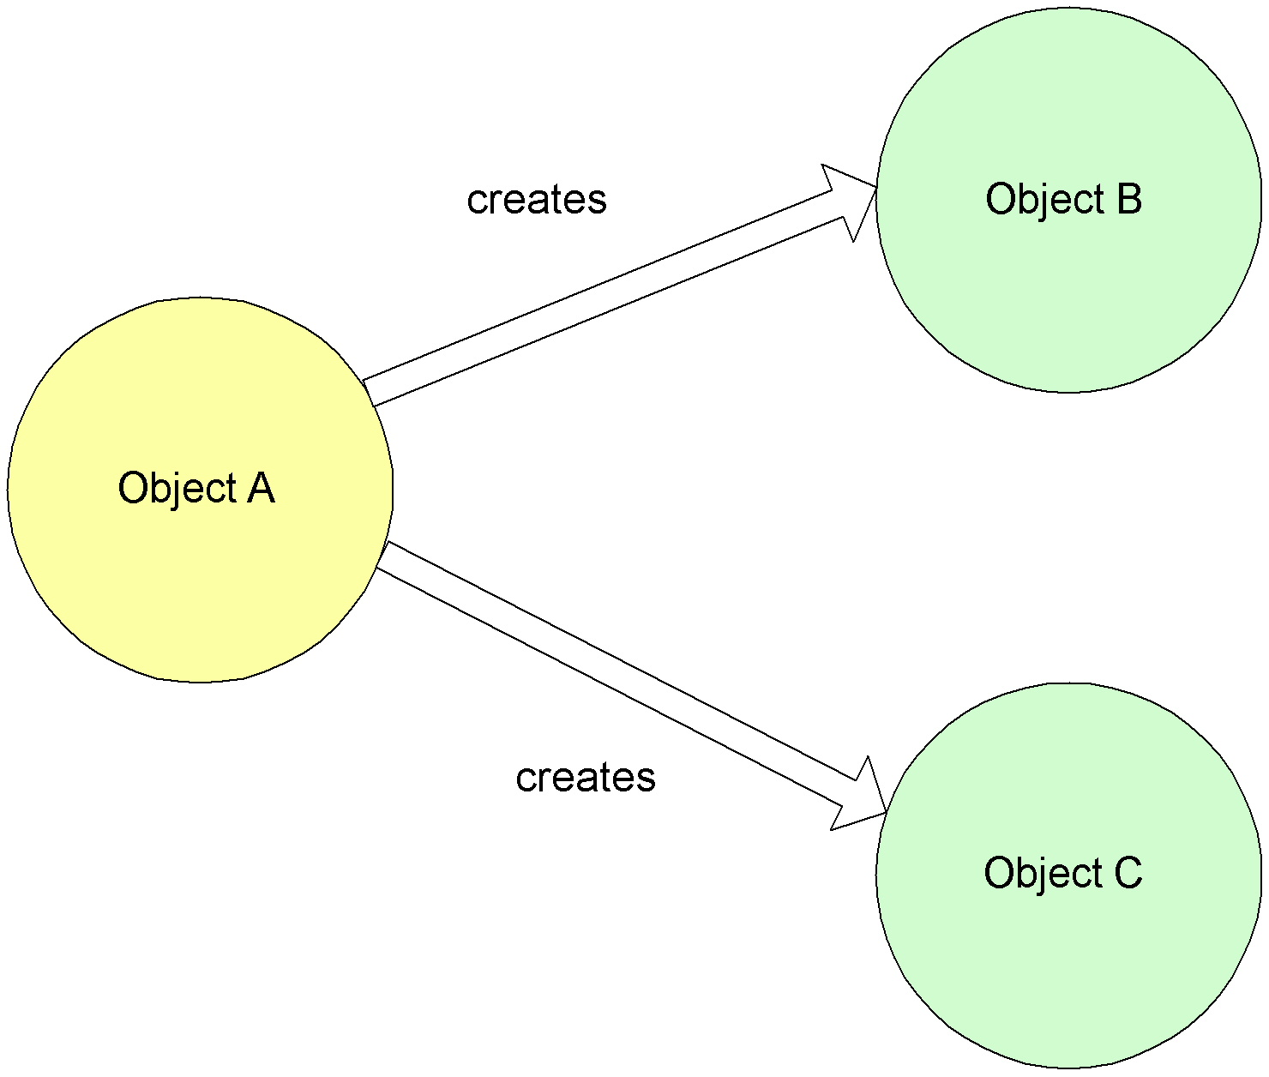
Non-IoC / Dependency Injection
Cell : 98273-60504
www.sunrays.co.in
Notes:
www.sunrays.co.in
Cell- 98273 60504
Copyright (c) sunRays Technologies

Slide 9
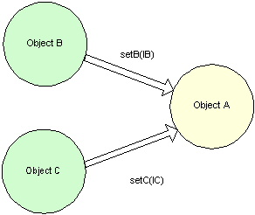
IoC / Dependency Injection
Cell : 98273-60504
www.sunrays.co.in
Notes:
www.sunrays.co.in
Cell- 98273 60504
Copyright (c) sunRays Technologies

Slide 10

RMI
Email
Hibernate
DCP
POJO
Struts
Cell : 98273-60504
www.raystec.com
Notes:
www.sunrays.co.in
Cell- 98273 60504
Copyright (c) sunRays Technologies

Slide 11
Spring is a container
Light Weight Container
Maintain the lifecycle of a bean
Factory of all kinds of beans
Shanta Claus of all beans
Cell : 98273-60504
www.raystec.com
Notes:
www.sunrays.co.in
Cell- 98273 60504
Copyright (c) sunRays Technologies

Slide 12
Create the simplest Bean
public class User {
private String name = null;
private String login = null;
private String password = null;
public String getLogin() {
return login;
}
public void setLogin(String login) {
this.login = login;
}
//Other accessor methods
}
Cell : 98273-60504
www.raystec.com
Notes:
www.sunrays.co.in
Cell- 98273 60504
Copyright (c) sunRays Technologies

Slide 13
Configure Bean
<bean name="user" scope="prototype" class="com.sunilos.User">
<property name="login" value=“sunilos" />
<property name="password" value=“pass" />
</bean>
It is configured in applicationContext.xml file.
Here we configured bean and set its properties values.
@Component (“user”)
@scope(“singleton”)
public class User {
Cell : 98273-60504
www.raystec.com
Notes:
www.sunrays.co.in
Cell- 98273 60504
Copyright (c) sunRays Technologies

Slide 14
<!--Scan @Component, @Repository, @Service,and @Controller spring beans -->
<context:component-scan
base-package="com.sunilos.ors" />
Cell : 98273-60504
www.raystec.com
Notes:
www.sunrays.co.in
Cell- 98273 60504
Copyright (c) sunRays Technologies

Slide 15
Get Bean instance
// Create bean factory from appliationContext.xml
BeanFactory factory = new XmlBeanFactory(new ClassPathResource("applicationContext.xml"));
// get User bean
User dto = (User) factory.getBean("user");
//User dto = factory.getBean("user“,User.class);
//Print attributes
System.out.println(dto.getLogin());
System.out.println(dto.getPassword());
Cell : 98273-60504
www.raystec.com
Notes:
www.sunrays.co.in
Cell- 98273 60504
Copyright (c) sunRays Technologies

Slide 16
Bean Container Types
There are two types of containers
BeanFactory Container
  It is light weight container.
ApplicationContext Container
  It adds more enterprise-specific functionality such as the ability to resolve textual messages from a properties file and the ability to publish application events to interested event listeners.
  Web application uses this container.
Avoids the use of singletons and factories
Cell : 98273-60504
www.raystec.com
Notes:
www.sunrays.co.in
Cell- 98273 60504
Copyright (c) sunRays Technologies

Slide 17
BeanFactory Container
This is light weight and basic container providing basic support for Dependency Injection (DI).
It is implementation of interface org.springframework.beans.factory.BeanFactory.
It is instantiated by
  BeanFactory factory = new XmlBeanFactory (
  new ClassPathResource("applicationContext.xml"));
  User dto = (User) factory.getBean("user");
  //User dto = factory.getBean("user“,User.class);
Cell : 98273-60504
www.raystec.com
Notes:
www.sunrays.co.in
Cell- 98273 60504
Copyright (c) sunRays Technologies

Slide 18
ApplicationContext Container
It is child interface of BeanFactory. It is found in package org.springframework.context.ApplicationContext.
The ApplicationContext container includes all functionality of the BeanFactory container, so it is generally recommended over the BeanFactory.
It has easier integration with Spring AOP.
It resolves textual messages from properties file.
It has ability to publish application events to listed event listeners.
It provides WebApplicationContext for web applications.
Cell : 98273-60504
www.raystec.com
Notes:
www.sunrays.co.in
Cell- 98273 60504
Copyright (c) sunRays Technologies

Slide 19
ApplicationContext Container
Key implementation classes are
  ClassPathXmlApplicationContext
  FileSystemXmlApplicationContext
  XmlWebApplicationContext
ApplicationContext context = new ClassPathXmlApplicationContext("applicationContext.xml");
User dto = (User) context.getBean("user");
Cell : 98273-60504
www.raystec.com
Notes:
www.sunrays.co.in
Cell- 98273 60504
Copyright (c) sunRays Technologies

Slide 20
Context Hierarchy
BeanFactory
ApplicationContext
ClassPathXmlApplicationContext
FileSystemXmlApplicationContext
XmlWebApplicationContext
Cell : 98273-60504
www.raystec.com
Notes:
www.sunrays.co.in
Cell- 98273 60504
Copyright (c) sunRays Technologies

Slide 21
Load Multiple Files
ApplicationContext context =
new ClassPathXmlApplicationContext
(
new String[] {“user-module.xml",“account-module.xml",“hr- module.xml"}
);
Or
<beans>
  <import resource=“user-module.xml"/>
  <import resource=“account-module.xml"/>
  <import resource=“hr-module.xml"/>
</beans>
Cell : 98273-60504
www.raystec.com
Notes:
www.sunrays.co.in
Cell- 98273 60504
Copyright (c) sunRays Technologies

Slide 22
Inversion of Control (IOC)
An Application consists of multiple objects. Multiple objects collaborate to perform a business operation in an application thus one object is depend on other objects to perform a business operation, that is called dependency.
IOC provides dependency injection (DI)
Dependency Injection can be done by two ways:
  Constructor, called constructor injection.
  Setter method, called setter injection.
The container provides the injection at runtime
It decouples object creators and locators from application logic
Cell : 98273-60504
www.raystec.com
Notes:
www.sunrays.co.in
Cell- 98273 60504
Copyright (c) sunRays Technologies
Inversion of Control has already been referred to as Dependency Injection. The basic principle is that beans define their dependencies (i.e. the other objects they work with) only through constructor arguments or properties. Then, it is the job of the container to actually inject those dependencies when it creates the bean. This is fundamentally the inverse (hence the name Inversion of Control) of the bean instantiating or locating its dependencies on its own using direct construction of classes, or something like the Service Locator pattern. While we will not elaborate too much on the advantages of Dependency Injection, it becomes evident upon usage that code gets much cleaner and reaching a higher grade of decoupling is much easier when beans do not look up their dependencies, but are provided them, and additionally do not even know where the dependencies are located and of what actual type they are.
As touched on in the previous paragraph, Inversion of Control/Dependency Injection exists in two major variants:
setter-based dependency injection is realized by calling setters on your beans after invoking a no-argument constructor to instantiate your bean. Beans defined in the BeanFactory that use setter-based dependency injection are true JavaBeans. Spring generally advocates usage of setter-based dependency injection, since a large number of constructor arguments can get unwieldy, especially when some properties are optional.
constructor-based dependency injection is realized by invoking a constructor with a number of arguments, each representing a collaborator or property. Although Spring generally advocates usage of setter-based dependency injection as much as possible, it does fully support the constructor-based approach as well, since you may wish to use it with pre-existing beans which provide only multi-argument constructors, and no setters. Additionally, for simpler beans, some people prefer the constructor approach as a means of ensuring beans can not be constructed in an invalid state.

Slide 23
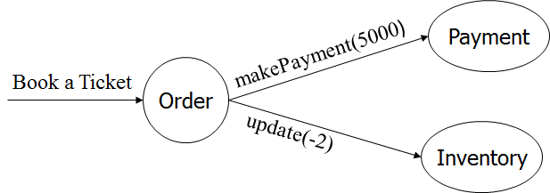
Online Payment
Cell : 98273-60504
www.raystec.com
Notes:
www.sunrays.co.in
Cell- 98273 60504
Copyright (c) sunRays Technologies

Slide 24
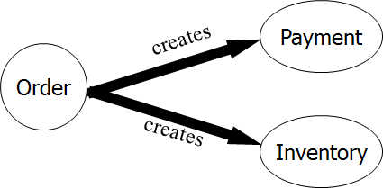
Non-IoC / Dependency Injection
Cell : 98273-60504
www.raystec.com
Notes:
www.sunrays.co.in
Cell- 98273 60504
Copyright (c) sunRays Technologies

Slide 25
Non-IoC : Book A Ticket
public class Order {
public void bookATicket(int item) {
int price = 1000;
//create dependent objects
Payment p = new Payment();
Inventory i = new Inventory();
p.makePayment(items * price);
i.update(item);
System.out.println("Tickets are Booked");
}
}
Cell : 98273-60504
www.raystec.com
Notes:
www.sunrays.co.in
Cell- 98273 60504
Copyright (c) sunRays Technologies

Slide 26

Non-IOC
Object
Dependency
Cell : 98273-60504
www.raystec.com
Notes:
www.sunrays.co.in
Cell- 98273 60504
Copyright (c) sunRays Technologies

Slide 27

IOC
Dependency
Injection
Dependency
Dependency
Spring
Object
Spring
Spring
Injection
Injection
Cell : 98273-60504
www.raystec.com
Notes:
www.sunrays.co.in
Cell- 98273 60504
Copyright (c) sunRays Technologies

Slide 28
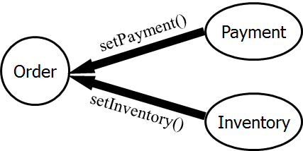
IoC / Dependency Injection
Cell : 98273-60504
www.raystec.com
Notes:
www.sunrays.co.in
Cell- 98273 60504
Copyright (c) sunRays Technologies

Slide 29
IoC : Book A Tickets
public class Order {
private Payment payment = null;
private Inventory inventory = null;
//Setter Injection
public void setPayment(Payment p) { payment = p; }
public void setInventory(Inventory i) { inventory = i; }
public void bookATicket(int items) {
int price = 1000;
payment.makePayment(items * price);
inventory.update(items);
System.out.println("Tickets are Booked");
}
}
Cell : 98273-60504
www.raystec.com
Notes:
www.sunrays.co.in
Cell- 98273 60504
Copyright (c) sunRays Technologies

Slide 30
IoC : Book A Tickets (Cont.)
<bean name="payment" scope="prototype" class="Payment" />
<bean name="inventory" scope="prototype" class="Inventory" />
<bean name="order" scope="prototype" class="Order">
<property name="payment" ref="payment" />
<property name="inventory" ref="inventory" />
</bean>
@Component (“order”)
public class Order {
@Autowired (required=false)
@Qulifier(“payment”)
private Payment payment = null;
ApplicationContext context = …;
Order o = (Order) context.getBean("order");
o.bookATicket(2);
Cell : 98273-60504
www.raystec.com
Notes:
www.sunrays.co.in
Cell- 98273 60504
Copyright (c) sunRays Technologies

Slide 31
Constructor Injection
public class Order {
private Payment payment = null; private Inventory inventory = null;
public Order (Payment p, Inventory i){
payment = p;
inventory = i;
}
//..
}
<bean name="payment" scope="prototype" class="Payment" />
<bean name="inventory" scope="prototype" class="Inventory" />
<bean name="order" scope="prototype" class="Order">
<constructor-arg ref=" payment " />
<constructor-arg ref=" inventory" />
</bean>
Cell : 98273-60504
www.raystec.com
Notes:
www.sunrays.co.in
Cell- 98273 60504
Copyright (c) sunRays Technologies

Slide 32

Bean Life Cycle
Cell : 98273-60504
www.raystec.com
Notes:
www.sunrays.co.in
Cell- 98273 60504
Copyright (c) sunRays Technologies

Slide 33
Lifecycle methods
<bean id=“order” class=“com.sunilos.Order"
init-method="init" destroy-method="cleanup"/>
public class Order{
public void init() {
// do some initialization work
}
public void cleanup() {
// do some destruction work (like closing connection)
}
}
If you are using annotation @Component instead of <bean> tag then lifecycle methods can be defined by @PostConstruct and @PreDestroy annotations.
Cell : 98273-60504
www.raystec.com
Notes:
www.sunrays.co.in
Cell- 98273 60504
Copyright (c) sunRays Technologies

Slide 34
Static Method for instantiation
public class ServiceLocator{ ...
private ServiceLocator(...) { ... }
public static ServiceLocator getInstance() {
  ..
<bean id=“locator" class=“com.sunilos.ServiceLocator"
factory-method=“getInstance“ />
Cell : 98273-60504
www.raystec.com
Notes:
www.sunrays.co.in
Cell- 98273 60504
Copyright (c) sunRays Technologies

Slide 35
Set Collection data
<property name="someList">
<list>
<value>One</value>
<value>Two</value>
</list>
</property>
<property name="someMap">
<map>
<entry>
<key><value>yup an entry</value></key>
<value>just some string</value>
</entry>
<entry>
<key><value>yup a ref</value></key>
<ref bean="myDataSource"/>
</entry>
</map>
</property>
@value
Cell : 98273-60504
www.raystec.com
Notes:
www.sunrays.co.in
Cell- 98273 60504
Copyright (c) sunRays Technologies

Slide 36
Dependent beans
<bean id="beanOne" class="ExampleBean" depends-on="manager">
<property name="manager"><ref local="manager"/></property>
</bean>
<bean id="manager" class="ManagerBean"/>
Cell : 98273-60504
www.raystec.com
Notes:
www.sunrays.co.in
Cell- 98273 60504
Copyright (c) sunRays Technologies

Slide 37
Abstract and child bean definitions
<bean id="inheritedTestBean" abstract="true"
class="org.springframework.beans.TestBean">
<property name="name" value="parent"/>
<property name="age" value="1"/>
</bean>
<bean id="chieldClass" class="org.springframework.beans.DerivedTestBean"
parent="inheritedTestBean" init-method="initialize">
<property name="name" value="override"/>
</bean>
Cell : 98273-60504
www.raystec.com
Notes:
www.sunrays.co.in
Cell- 98273 60504
Copyright (c) sunRays Technologies

Slide 38
Scope of Beans
There are five scope for a bean. Default is singleton
singleton | single object instance will be created for a Spring IoC container.
prototype | When you call getBean() a new bean instance is created.
request | Bean instance is created and kept in HttpRequest object of web container. This scope is valid when Spring is integrated with Web Application.
session | Bean instance is created and kept in HttpSession object of web container. This scope is valid when Spring is integrated with Web Application.
global session | Scopes a single bean definition to the lifecycle of a global HTTP Session. Typically only valid when used in a portlet context. Only valid in the context of a web-aware Spring ApplicationContext.
Cell : 98273-60504
www.raystec.com
Notes:
www.sunrays.co.in
Cell- 98273 60504
Copyright (c) sunRays Technologies

Slide 39
Singlton Vs Prototype
Bean 1
getBean()
new
Order
Prototype
getBean()
new
Order
Prototype
Bean 2
getBean()
new
Order
Prototype
getBean()
Bean 3
getBean()
DCP
singleton
getBean()
Cell : 98273-60504
www.raystec.com
Notes:
www.sunrays.co.in
Cell- 98273 60504
Copyright (c) sunRays Technologies

Slide 40
Bean Auto wiring
It enables implicit bean dependency injection.
Bean reference injections will not be defined explicitly in XML file.
Spring Auto Wiring can be done by two ways:
  XML Configuration
    <bean id=“order" class=".." autowire="default" >
  Annotations
    @Autowired (required = false)
    public UserListCtl (UserService service) {}
  For byName you can use @Qualifier (“payment”) annotaton.
Cell : 98273-60504
www.raystec.com
Notes:
www.sunrays.co.in
Cell- 98273 60504
Copyright (c) sunRays Technologies

Slide 41
Auto wiring Modes
There are 4 modes of auto wiring:
autowire=”no”
  auto-writing is disabled
autowire=”byName”
  Auto-wiring is resolved by property name. Setter method is used for DI.
autowire=”byType”
  Auto-wiring is resolved by property type.
autowire=”constructor”
  byType auto wiring is applied on constructor.
Cell : 98273-60504
www.raystec.com
Notes:
www.sunrays.co.in
Cell- 98273 60504
Copyright (c) sunRays Technologies

Slide 42
Excluding a bean from Auto wiring
You can exclude a bean from being autowired.
It can be done by setting autowire-candidate attribute of <bean> tag to false.
<bean id="userService" scope="prototype" class="in.co.sunrays.service.UserService" autowire-candidate=“false" />
Cell : 98273-60504
www.raystec.com
Notes:
www.sunrays.co.in
Cell- 98273 60504
Copyright (c) sunRays Technologies

Slide 43
Primary bean
When we define two or more beans of the same type, and these beans are get auto wired by byType in some other bean then you can define primary bean.
Primary bean will be candidate of auto wiring.
We can create a primary bean by setting the primary attribute of <bean> tag to true.
<bean id=“.." class=“.." primary="true" />
Cell : 98273-60504
www.raystec.com
Notes:
www.sunrays.co.in
Cell- 98273 60504
Copyright (c) sunRays Technologies

Slide 44
Auto wiring by Annotation
You can use annotation @Autowired to auto wire a bean.
Annotation can be applied on
  attributes,
  Setter/other methods
  and constructors.
  By default it resolves dependency by Type.
@Autowired(required = false)
@Qualifier(“userService”)
private UserService service = null;
Cell : 98273-60504
www.raystec.com
Notes:
www.sunrays.co.in
Cell- 98273 60504
Copyright (c) sunRays Technologies

Slide 45
Auto wiring annotations
Spring 3.x provides three annotations for autowiring:
  Spring’s own @Autowired annotation.
  The @Inject annotation (JSR-330).
  The @Resource annotation (JSR-250).
Annotation based configuration is enabled by <context:annotation-config /> tag in applicationContext.xml file.
Cell : 98273-60504
www.raystec.com
Notes:
www.sunrays.co.in
Cell- 98273 60504
Copyright (c) sunRays Technologies

Slide 46

Spring DAO
Cell : 98273-60504
www.raystec.com

Slide 47
Spring DAO (Data Access Object)
It provides a consistent way to use data access frameworks like JDBC, Hibernate, JPA, JDO etc.
It provides consistent exception hierarchy. This makes your application independent from underlying data access framework.
DAOs are defined with help of @Repository annotation.
A DAO requires access to a Persistent Resource (Data Connection Pool) to get connection to the Database
Cell : 98273-60504
www.raystec.com
Notes:
www.sunrays.co.in
Cell- 98273 60504
Copyright (c) sunRays Technologies

Slide 48
Consistent Exception Hierarchy
JDBC raises SQLException, Hibernate raises HibernateException, and JDO raises JDOException.
Spring-DAO translates ORM specific exceptions into DataAccessException or into its subclasses
Spring enables transparent exception translation using @Repository annotation.
It makes you free from handling different exceptions when you are working on different persistent frameworks
Cell : 98273-60504
www.raystec.com
Notes:
www.sunrays.co.in
Cell- 98273 60504
Copyright (c) sunRays Technologies

Slide 49
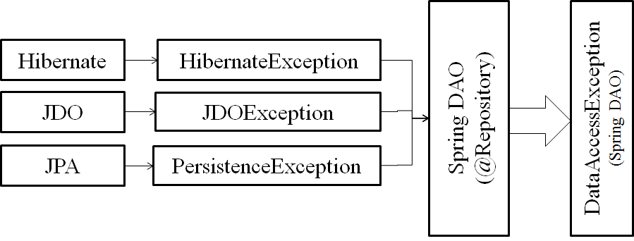
ORM Exception translation
DataAccessException is unchecked exception class.
Cell : 98273-60504
www.raystec.com
Notes:
www.sunrays.co.in
Cell- 98273 60504
Copyright (c) sunRays Technologies

Slide 50
@Repository Annotation
Any POJO can be configured to Spring DAO using @Repository annotation.
@Repository
public class CollegeDAOJDBCImpl implements CollegeDAOInt {
private JdbcTemplate jt;
..
@Autowired
public void setDataSource(DataSource ds) {
this.jdbcTemplate = new JdbcTemplate(ds);
}
Annotated classes are scanned by following tag:
<context:component-scan base-package=“com.sunilos.dao" />
Cell : 98273-60504
www.raystec.com
Notes:
www.sunrays.co.in
Cell- 98273 60504
Copyright (c) sunRays Technologies

Slide 51
Data Connection Pool
A DAO requires DCP to get connection from Database. Different ORMs need different Persistent Resources like JDBC need DataSource, JPA need EntityManager, and Hibernate need SessionFactory.
@Repository
public class CollegeDAOHibImpl implements CollegeDAOInt {
@Autowired
private SessionFactory sf;
@Repository
public class JPACollegeDAOImpl implements CollegeDAOInt {
@PersistenceContext
private EntityManager entityManager;
}
Cell : 98273-60504
www.raystec.com
Notes:
www.sunrays.co.in
Cell- 98273 60504
Copyright (c) sunRays Technologies

Slide 52
Data Source
<bean id="dataSource“ class="org.springframework.jdbc.datasource.DriverManagerDataSource">
<property name="driverClassName" value="com.mysql.jdbc.Driver" />
<property name="url" value="jdbc:mysql://localhost:3306/TEST" />
<property name="username" value="root" />
<property name="password" value="" />
</bean>
Cell : 98273-60504
www.raystec.com
Notes:
www.sunrays.co.in
Cell- 98273 60504
Copyright (c) sunRays Technologies

Slide 53
Session Factory
<bean id="sessionFactory“ class="org.springframework.orm.hibernate3.LocalSessionFactoryBean">
<property name="dataSource" ref="dataSource" />
<property name="hibernateProperties">
<props>
<prop key="hibernate.dialect">
org.hibernate.dialect.MySQLDialect
</prop>
</props>
</property>
<property name="mappingResources">
<list>
<value>com/sunilos/dto/Account.hbm.xml</value>
</list>
</property>
</bean>
Cell : 98273-60504
www.raystec.com
Notes:
www.sunrays.co.in
Cell- 98273 60504
Copyright (c) sunRays Technologies

Slide 54
Spring JDBC
Spring JDBC provides an abstract way to communicate with database using plan old JDBC objects.
It takes care of all the low-level details to open the connection, prepare and execute the SQL statements, process exceptions, handle transactions and finally close the connection.
It provides several approaches and correspondingly classes to communicate with database.
The most popular approach is to use JdbcTemplate class to communicate with database.
JdbcTemplate is the central framework class that manages all the database communication and exception handling.
Cell : 98273-60504
www.raystec.com
Notes:
www.sunrays.co.in
Cell- 98273 60504
Copyright (c) sunRays Technologies

Slide 55
College DAO
CollegeDAOInt
+add (dto)
+update (dto)
+delete (id)
+findByPk():CollegeDTO
+findByName():CollegeDTO
+search (dto)
implements
CollegeDAOHibImpl
CollegeDAOJdbcImpl
+add (dto)
+update (dto)
+delete (id)
+findByPk():CollegeDTO
+findByName():CollegeDTO
+search (dto)
+add (dto)
+update (dto)
+delete (id)
+findByPk():CollegeDTO
+findByName():CollegeDTO
+search (dto)
Cell : 98273-60504
www.raystec.com
Notes:
www.sunrays.co.in
Cell- 98273 60504
Copyright (c) sunRays Technologies

Slide 56
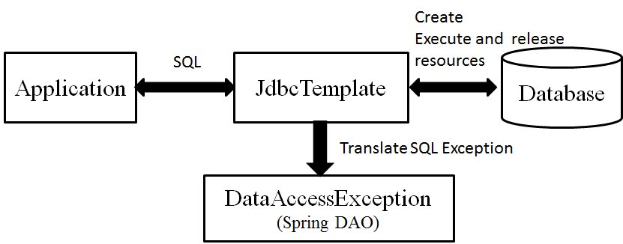
JDBC Template
It is thread-safe.
It handles the creation and release of resources.
It executes SQL statements
It translates SQLException into DataAccessException
Cell : 98273-60504
www.raystec.com
Notes:
www.sunrays.co.in
Cell- 98273 60504
Copyright (c) sunRays Technologies

Slide 57
CollegeDAOJdbcImpl
@Repository
public class CollegeDAOJDBCImpl implements CollegeDAOInt {
private JdbcTemplate jdbcTemplate;
@Autowired
public void setDataSource(DataSource dataSource) {
this.jdbcTemplate = new JdbcTemplate(dataSource);
}
Cell : 98273-60504
www.raystec.com
Notes:
www.sunrays.co.in
Cell- 98273 60504
Copyright (c) sunRays Technologies

Slide 58
Insert/Update/Delete
String sql = "INSERT INTO ST_COLLEGE VALUES(?,?,?)";
jdbcTemplate.update(sql, 1, "IPS", "Rau");
String sql = "UPDATE ST_COLLEGE SET NAME=?,ADDRESS=? WHERE ID=?";
jdbcTemplate.update(sql, "Medicaps", "Rau",1);
String sql = "delete from ST_COLLEGE where id = ?";
int i = jdbcTemplate.update(sql, 1);
//Stored Procedure
jdbcTemplate.update("call USER_COUNT(?)", 25L);
Cell : 98273-60504
www.raystec.com
Notes:
www.sunrays.co.in
Cell- 98273 60504
Copyright (c) sunRays Technologies

Slide 59
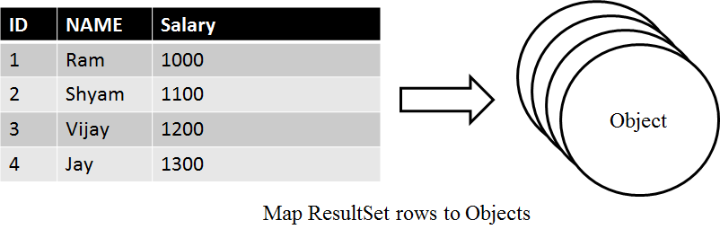
Row Mapper class
It is an interface.
JdbcTemplate uses this to map a row of ResultSet to an Object.
It is stateless thus reusable.
It can be used with OUT parameters of Stored Procedure and Function.
Cell : 98273-60504
www.raystec.com
Notes:
www.sunrays.co.in
Cell- 98273 60504
Copyright (c) sunRays Technologies

Slide 60
CollegeMapper class
public class CollegeMapper implements RowMapper<College> {
public College mapRow(ResultSet rs, int args) throws SQLException {
College dto = new College();
dto.setId(rs.getLong("id"));
dto.setName(rs.getString("name"));
return dto;
}
}
public College findByPK(long pk) {
String sql = "SELECT * FROM ST_COLLEGE WHERE ID=?";
College dto = jdbcTemplate.queryForObject ( sql,
new Object[] { pk }, new CollegeMapper());
return dto;
}
Cell : 98273-60504
www.raystec.com
Notes:
www.sunrays.co.in
Cell- 98273 60504
Copyright (c) sunRays Technologies

Slide 61
Execute count queries
int rowCount = jdbcTemplate.queryForObject(
"SELECT MAX(ID) FROM ST_COLLEGE", Integer.class);
int rowCount = jdbcTemplate.queryForObject(
"select count(*) from PART where UNIT_ID = ?", Integer.class, 2);
Cell : 98273-60504
www.raystec.com
Notes:
www.sunrays.co.in
Cell- 98273 60504
Copyright (c) sunRays Technologies

Slide 62
Spring ORM
It integrates ORM frameworks Hibernate, JPA, and JDO for data access object, transaction and resource management implementation.
It converts ORM exceptions to DataAccessException.
It provides declarative transactions with help of Spring AOP.
Cell : 98273-60504
www.raystec.com
Notes:
www.sunrays.co.in
Cell- 98273 60504
Copyright (c) sunRays Technologies

Slide 63
Hibernate Integration
Hibernate objects can be defined in Spring container as a bean and injected in DAO objects.
@Repository
public class CollegeDAOHibImpl implements CollegeDAOInt {
@Autowired
private SessionFactory sessionFactory;
public long add(College dto) {
Session session = sessionFactory.getCurrentSession();
session.save(dto);
return dto.getId();
}
Cell : 98273-60504
www.raystec.com
Notes:
www.sunrays.co.in
Cell- 98273 60504
Copyright (c) sunRays Technologies

Slide 64
Hibernate 3 API
Hibernate 3 has a feature called contextual sessions.
Hibernate itself manages one current Session per transaction in contextual sessions.
Contextual Session is used by DAO for database manipulation.
This approach is recommended to develop DAO classes in Hibernate.
Cell : 98273-60504
www.raystec.com
Notes:
www.sunrays.co.in
Cell- 98273 60504
Copyright (c) sunRays Technologies

Slide 65
Hibernate 3 API approch
@Repository
public class CollegeDAOHibImpl implements CollegeDAOInt {
@Autowired
private SessionFactory sessionFactory;
public long add(College dto) {
Session session = sessionFactory.getCurrentSession();
session.save(dto);
return dto.getId();
}
Always get current session to manipulate database.
Cell : 98273-60504
www.raystec.com
Notes:
www.sunrays.co.in
Cell- 98273 60504
Copyright (c) sunRays Technologies

Slide 66
Service class
It contains business logic.
Defined by @Service annotation.
It does transaction handling.
Transactions are handled by Spring AOP.
Transaction handling is called declarative transaction handling.
Two ways to apply transactions in Service classes:
  XML Configuration
  @Transactional annotation
Cell : 98273-60504
www.raystec.com
Notes:
www.sunrays.co.in
Cell- 98273 60504
Copyright (c) sunRays Technologies

Slide 67
Define Service class
@Service(value = "collegeService")
public class CollegeServiceImpl implements CollegeServiceInt {
@Autowired
private CollegeDAOInt dao = null;
@Transactional(readOnly = true)
public College get(long id) {
return dao.findByPK(id);
}
@Transactional(propagation = Propagation.REQUIRED)
public long add(College dto) {
return dao.add(dto);
}
Cell : 98273-60504
www.raystec.com
Notes:
www.sunrays.co.in
Cell- 98273 60504
Copyright (c) sunRays Technologies

Slide 68
Book a Ticket Transaction
Cell : 98273-60504
www.raystec.com
Notes:
www.sunrays.co.in
Cell- 98273 60504
Copyright (c) sunRays Technologies

Slide 69
Transaction Attribute
Attribute | @Transactional OrderService .bookATicket() | @Transactional (P=Required ) PaymentService .makePayment()
Required | OrderTx | OrderTx
 | NULL | PaymentTx
2. Required New | OrderTx | PaymentTx
 | NULL | PaymentTx
3. Supported | OrderTx | OrderTx
 | NULL | NULL
4. Not Supported | OrderTx | NULL
 | NULL | NULL
5. Mandatory | OrderTx | OrderTx
 | NULL | Exception
6. Never | NULL | NULL
 | OrderTx | Exception
Cell : 98273-60504
www.raystec.com
Notes:
www.sunrays.co.in
Cell- 98273 60504
Copyright (c) sunRays Technologies

Slide 70
Book a ticket
@Service
public class OrderServiceImpl implements CollegeServiceInt {
@Autowired
private OrderDAOInt dao = null;
@Autowired
private PaymentServiceInt payService = null;
@Autowired
private InventoryServiceInt invService = null;
@Transactional(propagation = Propagation.REQUIRED)
public Order bookATicket(int tickets, float amount, String cardNo) {
payService.makePayment(amount,cardNo);
invService.sell(tickets);
Order o = new Ordere(); ……
dao.save(o);
return o;
}
Cell : 98273-60504
www.raystec.com
Notes:
www.sunrays.co.in
Cell- 98273 60504
Copyright (c) sunRays Technologies

Slide 71
Service
DAO
Manager
DCP
DB
Cell : 98273-60504
www.raystec.com

Slide 72
Spring AOP
Aspects enable modularization such as transaction management that works across multiple types and objects
Cell : 98273-60504
www.raystec.com
Notes:
www.sunrays.co.in
Cell- 98273 60504
Copyright (c) sunRays Technologies

Slide 73
AOP key elements
Aspect:
A modularization operation that cuts across multiple objects.
Transaction management is a good example of a crosscutting concern in J2EE applications.
In Spring AOP, aspects are implemented using regular classes (the schema-based approach) or regular classes annotated with the @Aspect annotation (@AspectJ style).
Cell : 98273-60504
www.raystec.com
Notes:
www.sunrays.co.in
Cell- 98273 60504
Copyright (c) sunRays Technologies

Slide 74
AOP key elements ( Contd. )
Join point
  A point during the execution of a program, such as the execution of a method or the handling of an exception. In Spring AOP, a join point always represents a method execution.
Advice
  It is the action taken by an aspect at a particular join point.
  different types of advices include "around," "before" and "after" advice.
  An advice as an interceptor, maintaining a chain of interceptors "around" the join point.
Pointcut
  An expression that identifies join points.
  Advice is associated with a pointcut expression, that runs on matching joining points.
Cell : 98273-60504
www.raystec.com
Notes:
www.sunrays.co.in
Cell- 98273 60504
Copyright (c) sunRays Technologies

Slide 75


AOP
Join Points
Advice
Point cut
Cell : 98273-60504
www.raystec.com
Notes:
www.sunrays.co.in
Cell- 98273 60504
Copyright (c) sunRays Technologies

Slide 76
AOP Xml Configuration
<bean id=“transactionManager"
class="org.springframework.orm.hibernate3.HibernateTransactionManager">
<property name="sessionFactory" ref="sessionFactory" />
</bean>
<tx:advice id=“txAdvice" transaction-manager=“transactionManager">
<tx:attributes>
<tx:method name="find*" read-only="true" />
<tx:method name="search*" read-only="true" />
<tx:method name="*" propagation="REQUIRED" />
</tx:attributes>
</tx:advice>
Cell : 98273-60504
www.raystec.com
Notes:
www.sunrays.co.in
Cell- 98273 60504
Copyright (c) sunRays Technologies

Slide 77
AOP Xml Configuration (Cont. )
<aop:config>
<aop:pointcut id="serviceOperations"
expression="execution(* com.sunilos.service.*ServiceImpl.*(..))" />
<aop:advisor advice-ref=“txAdvice"
pointcut-ref="serviceOperations" />
</aop:config>
Enable Annotation
<tx:annotation-driven transaction-manager=“transactionManager" />
Cell : 98273-60504
www.raystec.com
Notes:
www.sunrays.co.in
Cell- 98273 60504
Copyright (c) sunRays Technologies

Slide 78
Email Bean
<bean id="mailSender" class="org.springframework.mail.javamail.JavaMailSenderImpl">
<property name="host" value="smtp.gmail.com" />
<property name="port" value="587" />
<property name="protocol" value="smtp" />
<property name="username" value="yourmail@gmail.com" />
<property name="password" value="pass1234" />
<property name="javaMailProperties">
<props>
<prop key="mail.smtp.auth">true</prop>
<prop key="mail.smtp.starttls.enable">true</prop>
<prop key="mail.smtp.debug">false</prop>
</props>
</property>
</bean>
Cell : 98273-60504
www.raystec.com
Notes:
www.raystec.com
Copyright (c) SunilOS Technologies

Slide 79
Inject Email bean
@Service(value = "userService")
public class UserServiceImpl implements UserServiceInt {
@Autowired
private JavaMailSenderImpl mailSender;
//..
Cell : 98273-60504
www.raystec.com
Notes:
www.raystec.com
Copyright (c) SunilOS Technologies

Slide 80
Send Email
MimeMessage msg = mailSender.createMimeMessage();
// use the true flag to indicate you need a multipart message
MimeMessageHelper helper;
try {
helper = new MimeMessageHelper(msg, true);
helper.setTo(“sender@gmail.com”));
helper.setSubject(“Test Subject");
// use the true flag to indicate the text included is HTML
helper.setText(“Test Msg”, true);
} catch (MessagingException e) {
e.printStackTrace();
}
mailSender.send(msg);
Cell : 98273-60504
www.raystec.com
Notes:
www.raystec.com
Copyright (c) SunilOS Technologies

Slide 81
More Application Layering Combinations
Presentation/Business/Persistence
  Struts+Spring+Hibernate
  Struts + Spring + EJB
  Tapestry + Spring + EJB
  JavaServer Faces + Spring + iBATIS
  Spring + Spring + JDO
  Flex + Spring + Hibernate
  Struts + Spring + JDBC
  Spring + Spring + Hibernate
  You decide…
Cell : 98273-60504
www.raystec.com
Notes:
www.sunrays.co.in
Cell- 98273 60504
Copyright (c) sunRays Technologies

Slide 82
Low Level Sequence Diagram
Spring MVC
Spring Service/ AOP
Spring DAO/ORM
JSP
<<view>>
@Controller
@RestController
Controller
@Service
Service
@Repository
DAO
JDBCTemplate
Native API
Submit()
ADD
add()
add()
execute()
Cell : 98273-60504
www.raystec.com
Notes:
www.sunrays.co.in
Cell- 98273 60504
Copyright (c) sunRays Technologies

Slide 83
Other View Framework Integration
Velocity and FreeMarker
  Template Framework
JSTL -JavaServer Pages Standard Tag Library
Tiles
XSLT - is a transformation language for XML
iText - Generate PDF
POI – Generate Excel
Jasper reports - iReport Editor/ Can convert report in HTML/PDF/Excel/DOc
Cell : 98273-60504
www.raystec.com
Notes:
www.sunrays.co.in
Cell- 98273 60504
Copyright (c) sunRays Technologies

Slide 84
Scheduling and Thread Pooling
Timer part of the JDK since 1.3, and the Quartz Scheduler
Quartz uses Trigger, Job and JobDetail
  Trigger contains time
  Job contains operations
  JobDetails contains parameters
Cell : 98273-60504
www.raystec.com
Notes:
www.sunrays.co.in
Cell- 98273 60504
Copyright (c) sunRays Technologies

