Slide 1
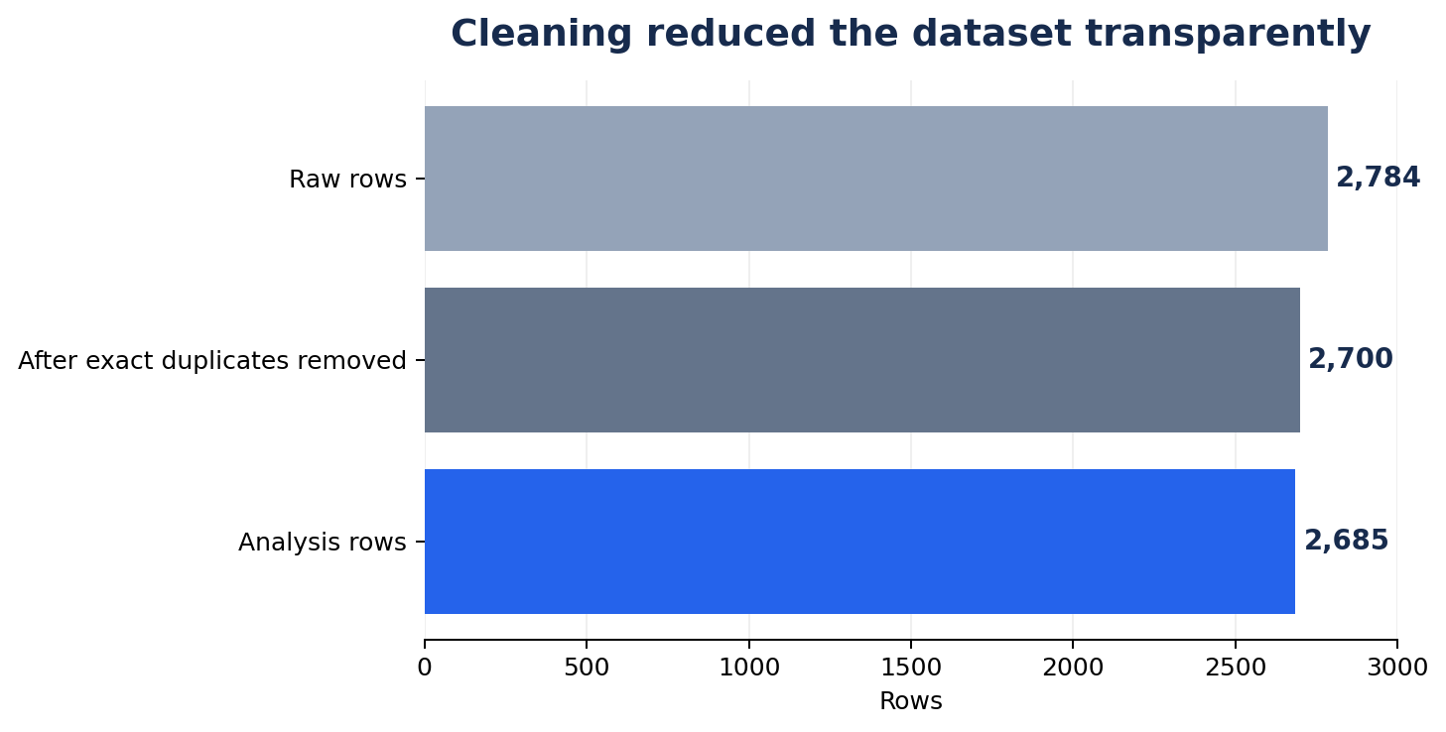
Midnight Cart: The 2 AM Problem
Decision brief for Rohan Mehta · City Operations Head
The business problem
• Orders are growing, but profit is flat and late-night complaints are rising.
• We need to identify when cancellations spike, test checkout-time risk prediction, and recommend changes worth measuring.
RAW ORDERS
2,784
Source dataset
ANALYSIS ROWS
2,685
After cleaning
CANCELLATIONS
394
14.7% of analysis rows
DECISION FOCUS
Test first
Avoid unverified large changes
Cleaning: removed 84 exact duplicate rows; excluded 15 zero-value baskets from contribution analysis.
DSAI Challenge | IIT Roorkee × Masai | 1/5
Notes:
Say: Midnight Cart's issue is not just order volume; it is completed, profitable orders during late hours. We started with 2,784 rows. We removed 84 exact duplicate rows and excluded 15 zero-value baskets from the main analysis, leaving 2,685 rows. There were 394 cancellations, or 14.7%. Our aim is to identify evidence-backed changes, not assume a cause.

Slide 2
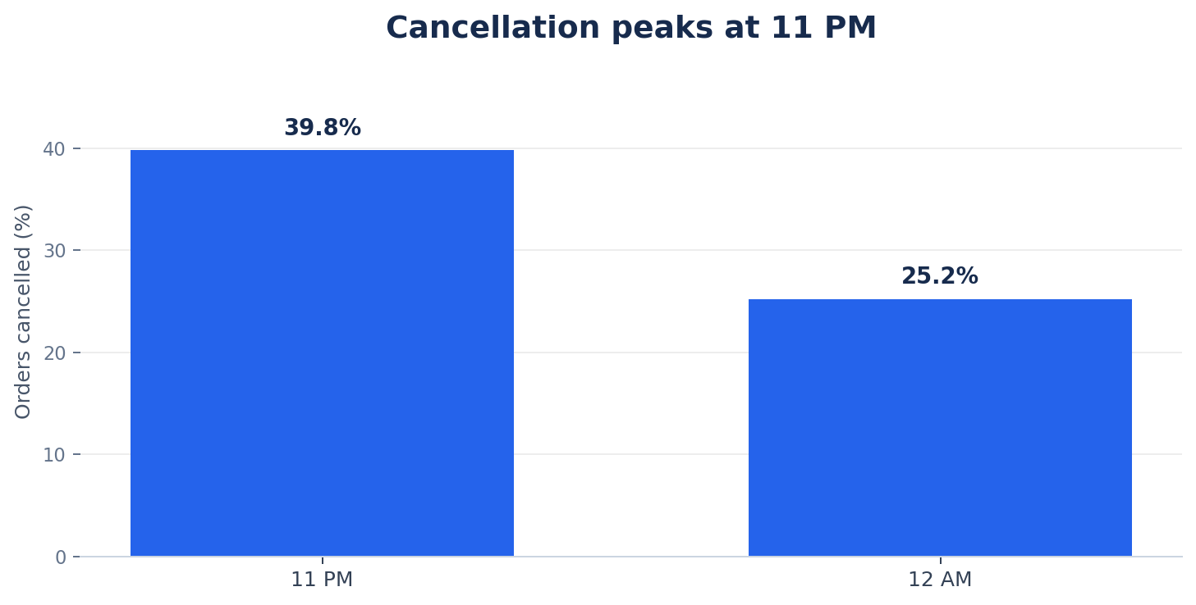
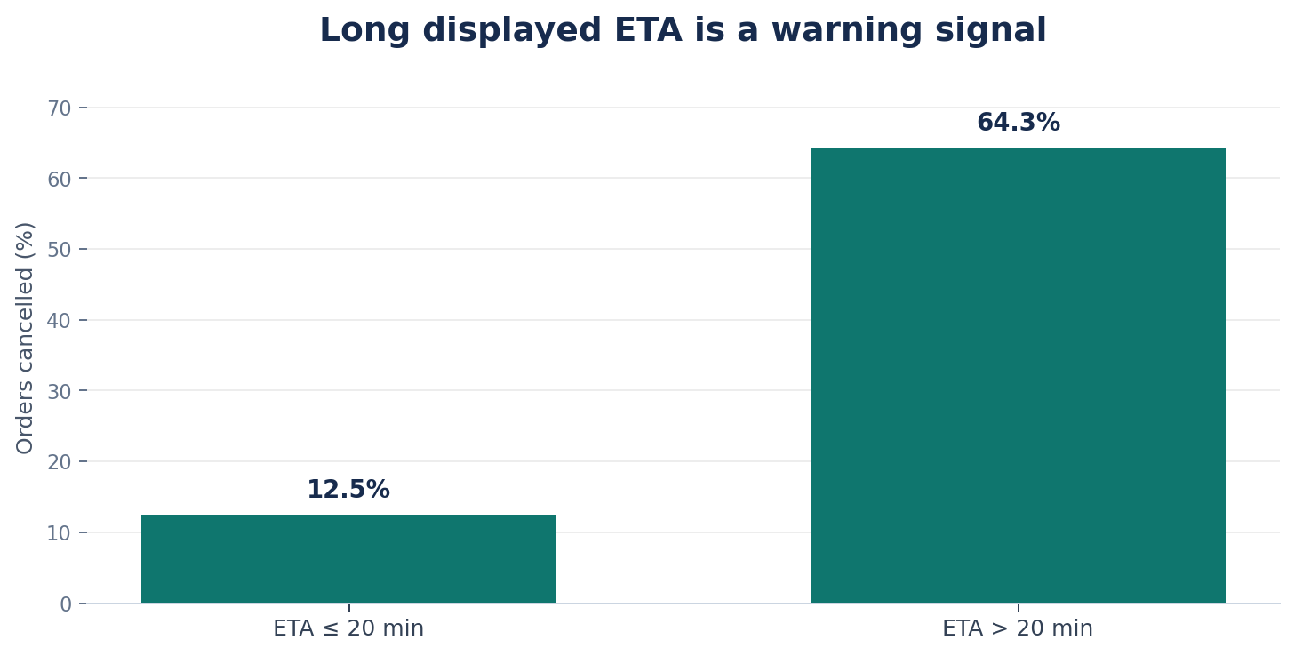
1. Cancellation risk peaks late at night
Operational signal: use the risk window to focus investigation
11 PM CANCELLATION
39.8%
96 cancellations / 241 orders
ETA > 20 MIN
64.3%
74 cancellations / 115 orders
SO WHAT?
Pilot + measure
Review riders, picking delays and ETA accuracy
DSAI Challenge | IIT Roorkee × Masai | 2/5
Notes:
Explain the charts in order. At 11 PM, 96 of 241 orders were cancelled, which is 39.8%. At midnight, 35 of 139 were cancelled, or 25.2%. When the app showed an ETA above 20 minutes, 74 of 115 orders were cancelled, or 64.3%; below or equal to 20 minutes, the rate was about 12.5%. These patterns are associations, not proof that rider shortage or ETA alone caused cancellation. We recommend a targeted operational pilot and root-cause review.

Slide 3
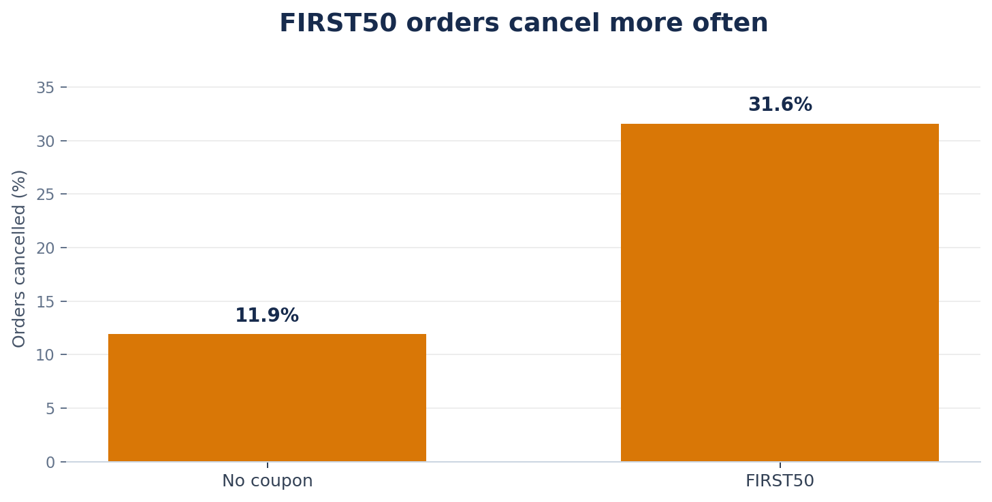
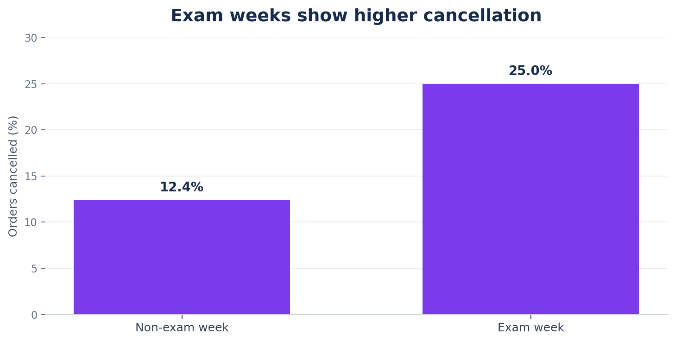
2. Coupon and exam-week pressure
The strongest commercial test is FIRST50; exam weeks need a separate operating plan
FIRST50 CONTRIBUTION PROXY
−₹18.95/order
242 delivered orders; total −₹4,586.75
FIRST50 CANCELLATIONS
31.6%
112 / 354 orders
EXAM-WEEK CANCELLATIONS
25.0%
120 / 480 orders
Contribution proxy is not audited net profit; it excludes several operating costs.
DSAI Challenge | IIT Roorkee × Masai | 3/5
Notes:
FIRST50 orders cancelled at 31.6%, versus 11.9% for orders without a coupon. Delivered FIRST50 orders show a contribution proxy of negative ₹18.95 per order, and negative ₹4,586.75 total across 242 delivered orders. This is not net profit: labour, picking, spoilage and other costs are missing. Exam-week cancellation rate was 25.0%, compared with 12.4% outside exam weeks. The recommendation is a controlled coupon test and an exam-week operating plan. Do not claim the coupon alone causes cancellation.

Slide 4
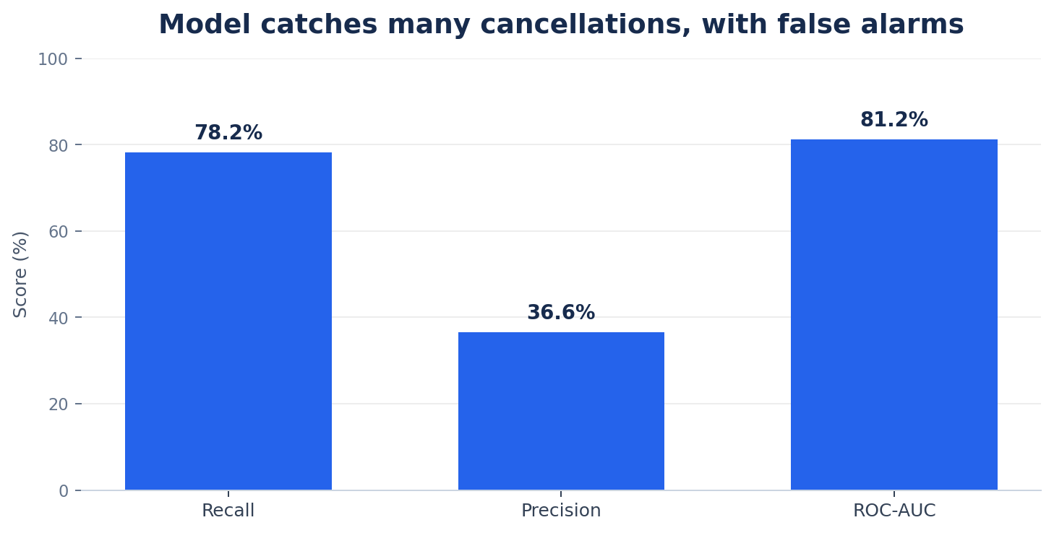
3. Can we predict cancellation at checkout?
Logistic Regression · chronological holdout · 672 later orders
RECALL
78.2%
Finds about 78/100 cancellations
PRECISION
36.6%
About 37/100 alerts are cancellations
• ROC-AUC: 0.812 | F1: 49.9%
• Use the score to prioritise operational checks—not to reject customers automatically.
• Only checkout-time features used; rating and refund excluded.
Limitation: test-set performance may change with staffing, demand and promotions; precision/recall depend on the chosen threshold.
DSAI Challenge | IIT Roorkee × Masai | 4/5
Notes:
Explain recall first: the model found about 78 out of every 100 cancellations in the held-out test set. Precision is lower: only about 37 out of every 100 flagged orders actually cancelled, so there are false alarms. ROC-AUC is 0.812, which suggests useful ranking ability, but it is not a guarantee. The test set is chronological to simulate future orders. The model should help staff prioritise checks, not block customers.

Slide 5
What should Rohan change next month?
Three decisions · one controlled first move · measure net impact before scaling
DECISION
1
DECISION
2
DECISION
3
TEST FIRST50
PILOT NIGHT COVERAGE
PRIORITISE NIGHT STOCK
• A/B test minimum basket or smaller discount.
• Pilot targeted coverage around 11 PM–1 AM.
• Use hour × category × hostel-zone demand to select essentials.
₹ scenario: ₹10 improvement × 300 eligible delivered orders/month = ₹3,000/month.
₹ formula: incremental completed orders × contribution/order − added rider cost.
₹ formula: recovered orders × contribution/order − inventory and spoilage cost.
Evidence: 31.6% cancellation; −₹18.95 contribution proxy per delivered order.
Evidence: 39.8% cancellation at 11 PM; ETA >20 min group at 64.3%.
Evidence: late-night and exam-week risk; validate with a stock pilot.
Recommendation: start with the controlled FIRST50 test. Scale only after measured outcomes and full operating costs.
DSAI Challenge | IIT Roorkee × Masai | 5/5
Notes:
Finish with a clear decision. Start with the FIRST50 test because this dataset directly shows the cancellation difference and negative contribution proxy, but use a control group. The ₹3,000 is only an illustrative scenario: ₹10 improvement times 300 eligible delivered orders, not a promise. For riders and inventory, the source file lacks wages, stock-out and holding-cost data, so use the formulas and collect the missing costs during pilots. Our goal is not only fewer cancellations; it is more completed orders with measured positive contribution.

