Slide 1
Vector Calculus

Slide 2
Vector Calculus
COORDINATE SYSTEMS
RECTANGULAR or Cartesian
CYLINDRICAL
Choice is based on symmetry of problem
SPHERICAL
Examples:
Sheets - RECTANGULAR
Wires/Cables - CYLINDRICAL
Spheres - SPHERICAL

Slide 3
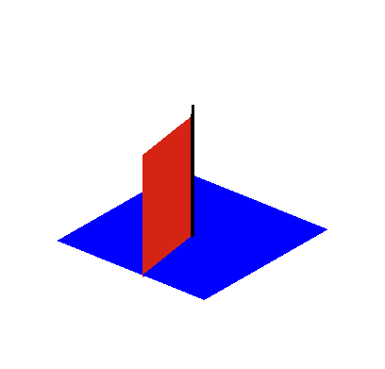
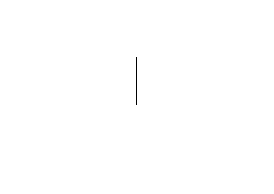
Cylindrical Symmetry
Spherical Symmetry

Slide 4
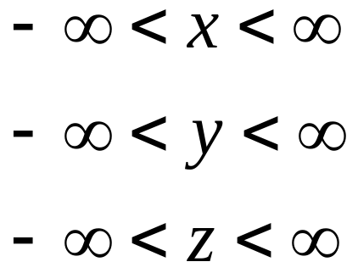
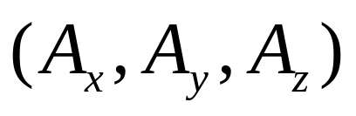
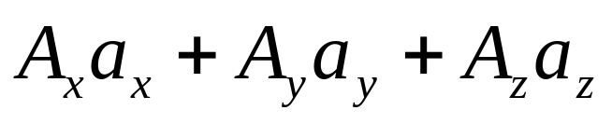
Cartesian Coordinates
Rectangular Coordinates
Or
P (x, y, z)
z
P(x,y,z)
y
x
A vector A in Cartesian coordinates can be written as
or
where a_{x},a_{y} and a_{z} are unit vectors along x, y and z-directions.

Slide 5
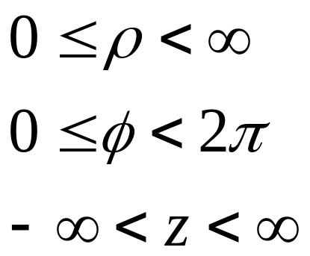
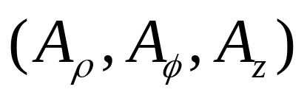
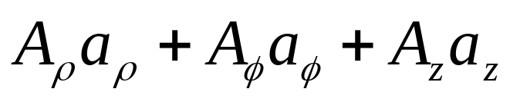
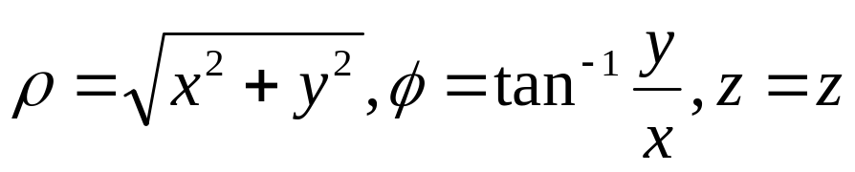
Cylindrical Coordinates
z
P (ρ, Φ, z)
z
P(ρ, Φ, z)
ρ
y
x
Φ
A vector A in Cylindrical coordinates can be written as
or
where a_{ρ},a_{Φ} and a_{z} are unit vectors along ρ, Φ and z-directions.
x= ρ cos Φ, y=ρ sin Φ, z=z

Slide 6
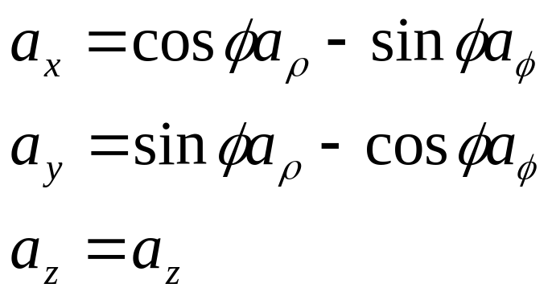
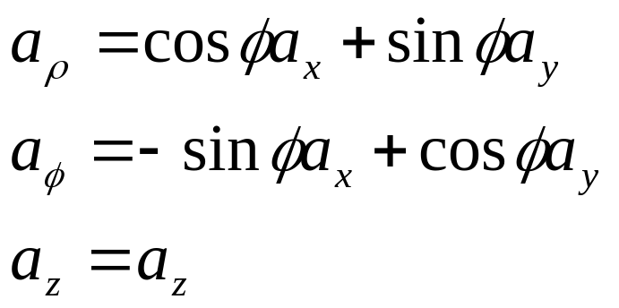
The relationships between (a_{x},a_{y}, a_{z}) and (a_{ρ},a_{Φ}, a_{z})are
or
Then the relationships between (A_{x},A_{y}, A_{z}) and (A_{ρ}, A_{Φ}, A_{z})are

Slide 7
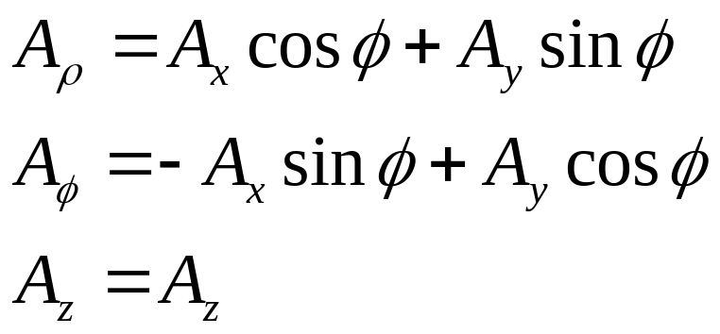
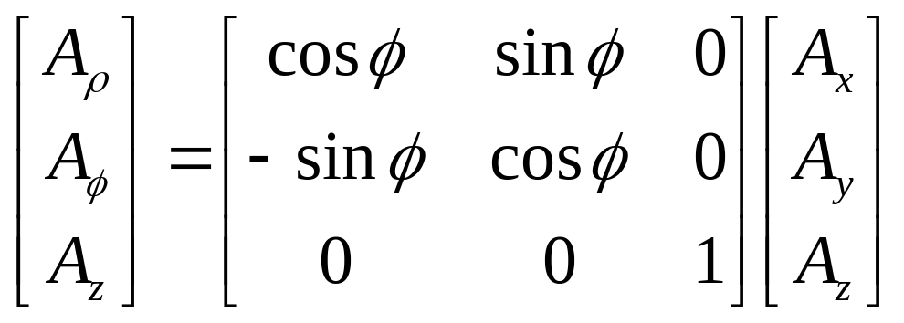
In matrix form we can write

Slide 8
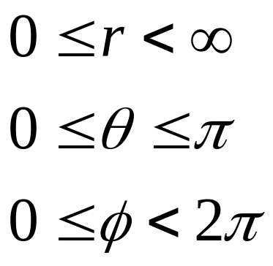
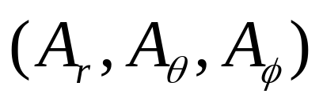
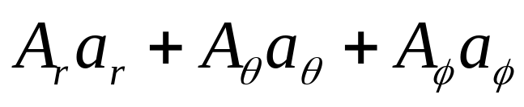
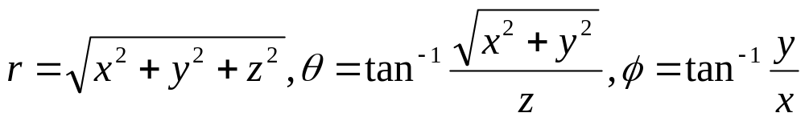
Spherical Coordinates
z
P (r, θ, Φ)
P(r, θ, Φ)
θ
r
y
x
Φ
A vector A in Spherical coordinates can be written as
or
where a_{r}, a_{θ}, and a_{Φ} are unit vectors along r, θ, and Φ-directions.
x=r sin θ cos Φ, y=r sin θ sin Φ, Z=r cos θ

Slide 9
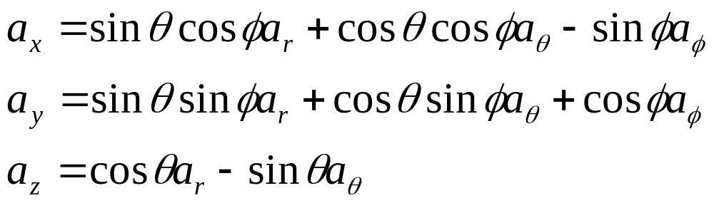
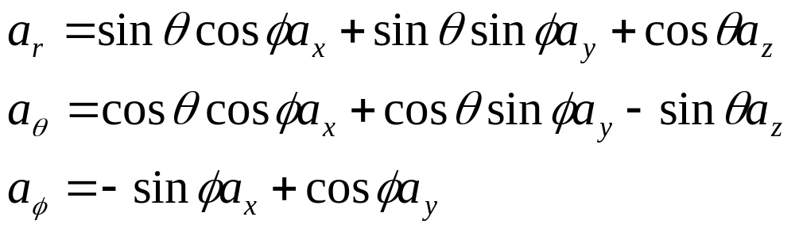
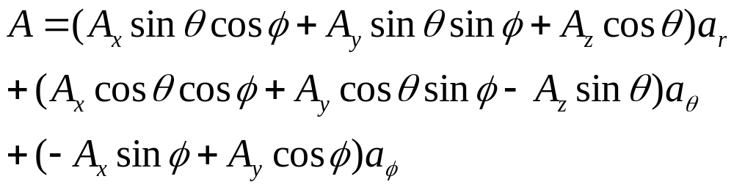
The relationships between (a_{x},a_{y}, a_{z}) and (a_{r},a_{θ},a_{Φ})are
or
Then the relationships between (A_{x},A_{y}, A_{z}) and (A_{r}, A_{θ},and A_{Φ})are

Slide 10
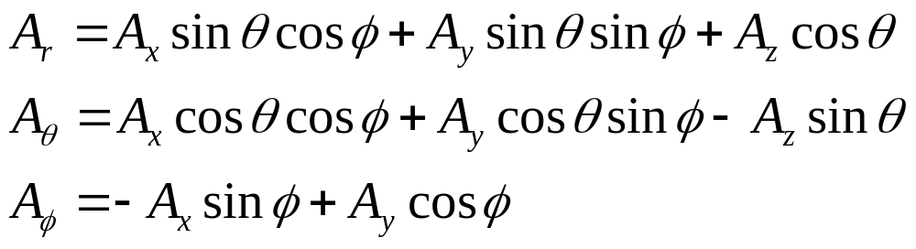
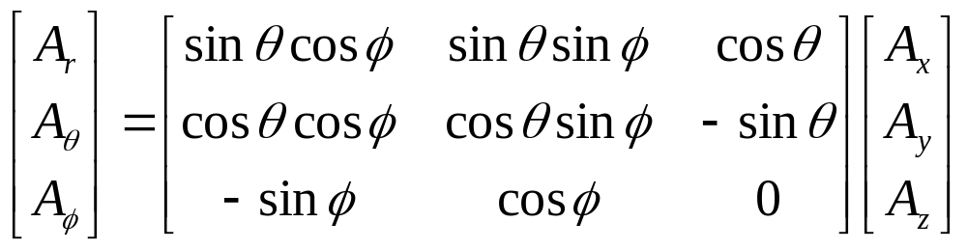
In matrix form we can write

Slide 11
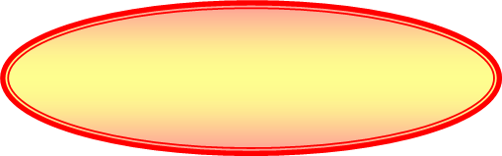
z
z
Cartesian Coordinates
P(x, y, z)
P(x,y,z)
θ
P(r, θ, Φ)
r
y
y
x
x
Φ
Spherical Coordinates
P(r, θ, Φ)
Cylindrical Coordinates
P(ρ, Φ, z)
z
z
P(ρ, Φ, z)
x
r
y
Φ

Slide 12
Scalar and Vector Fields
A scalar field is a function that gives us a single value of some variable for every point in space.
voltage, current, energy, temperature
A vector is a quantity which has both a magnitude and a direction in space.
velocity, momentum, acceleration and force

Slide 13
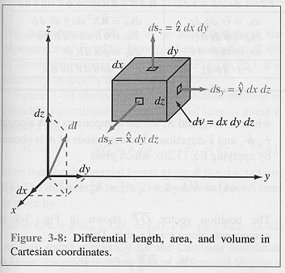
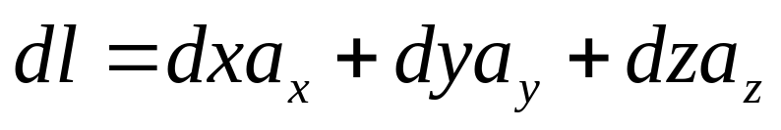
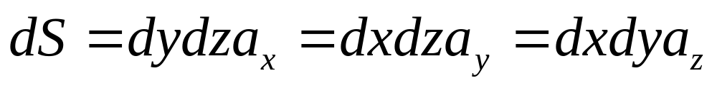
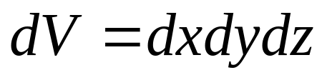
Differential Length, Area and Volume
Cartesian Coordinates
Differential displacement
Differential area
Differential Volume

Slide 14
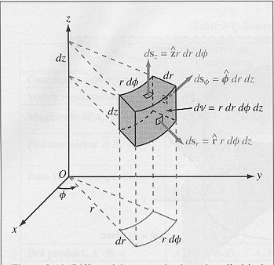
Cylindrical Coordinates
ρ
ρ
ρ
ρ
ρ
ρ
ρ
ρ
ρ
ρ
ρ

Slide 15
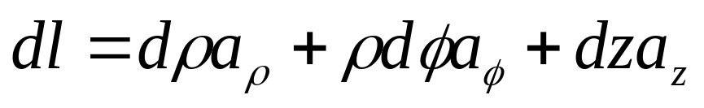
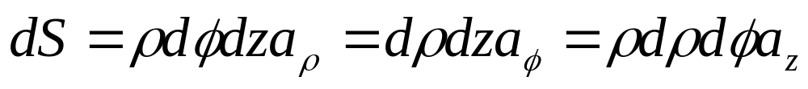
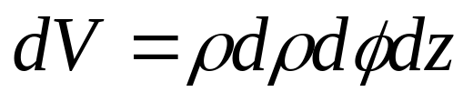
Differential Length, Area and Volume
Cylindrical Coordinates
Differential displacement
Differential area
Differential Volume

Slide 16
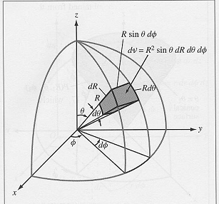
Spherical Coordinates

Slide 17
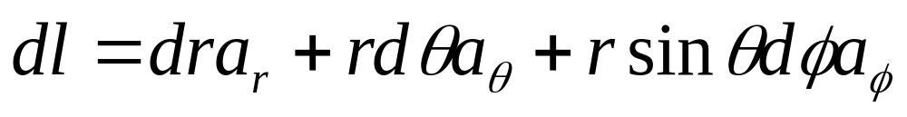
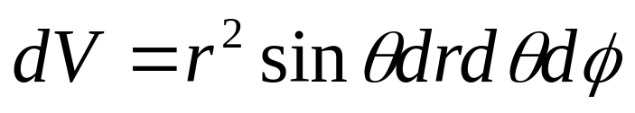
Differential Length, Area and Volume
Spherical Coordinates
Differential displacement
Differential area
Differential Volume

Slide 18
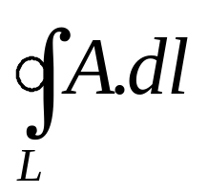
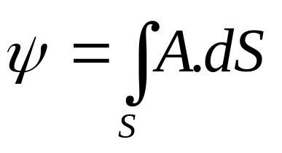
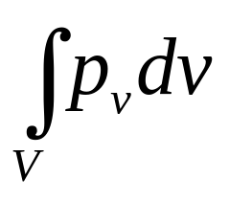
Line, Surface and Volume Integrals
Line Integral
Surface Integral
Volume Integral

Slide 19

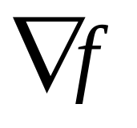
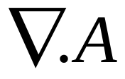
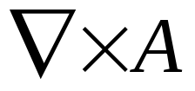
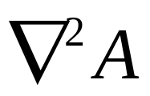
Gradient, Divergence and Curl
The Del Operator
Gradient of a scalar function is a vector quantity.
Divergence of a vector is a scalar quantity.
Curl of a vector is a vector quantity.
The Laplacian of a scalar A
Vector

Slide 20
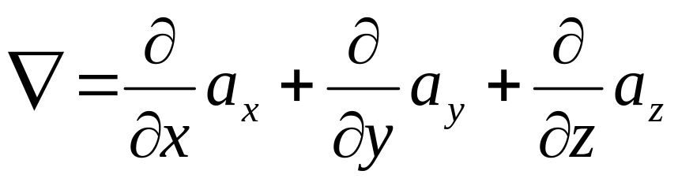
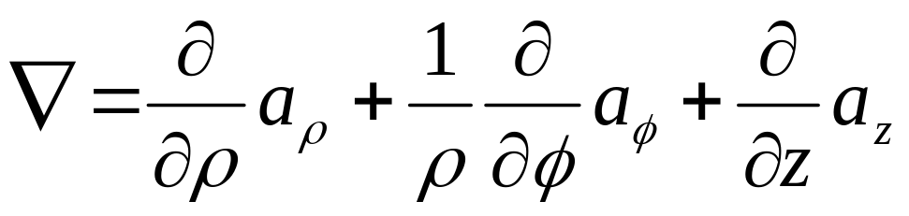
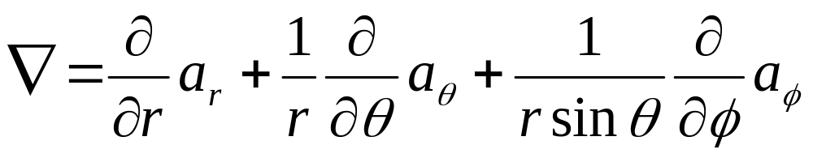
Del Operator
Cartesian Coordinates
Cylindrical Coordinates
Spherical Coordinates

Slide 21
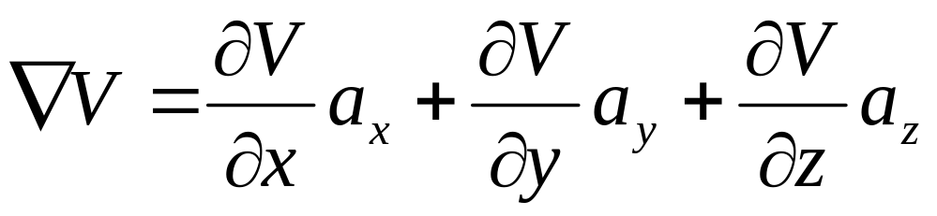
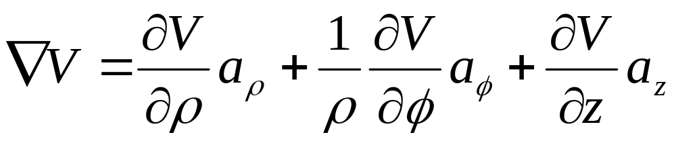
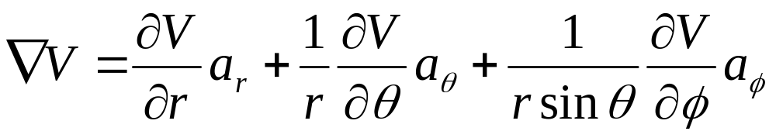
Gradient of a Scalar
The gradient of a scalar field V is a vector that represents both the magnitude and the direction of the maximum space rate of increase of V.

Slide 22
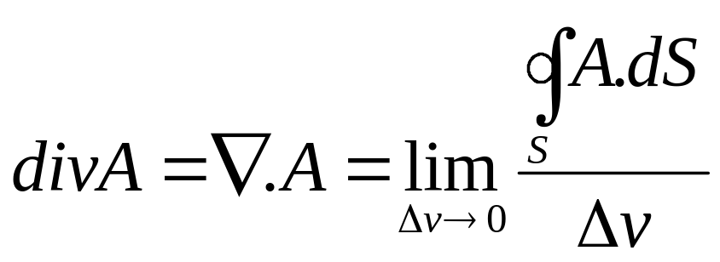
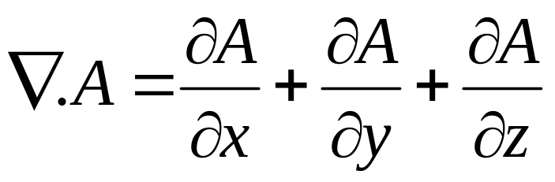
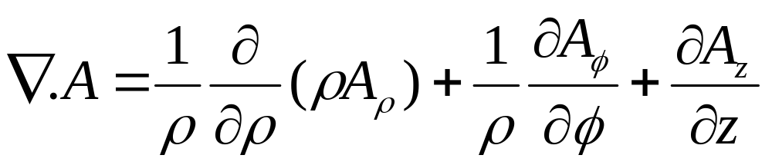
Divergence of a Vector
The divergence of A at a given point P is the outward flux per unit volume as the volume shrinks about P.

Slide 23

Curl of a Vector
The curl of A is an axial vector whose magnitude is the maximum circulation of A per unit area tends to zero and whose direction is the normal direction of the area when the area is oriented to make the circulation maximum.
Where ΔS is the area bounded by the curve L and a_{n} is the unit vector normal to the surface ΔS

Slide 24



Cartesian Coordinates
Cylindrical Coordinates
Spherical Coordinates

Slide 25

Divergence or Gauss’ Theorem
The divergence theorem states that the total outward flux of a vector field A through the closed surface S is the same as the volume integral of the divergence of A.

Slide 26


Stokes’ Theorem
Stokes’s theorem states that the circulation of a vector field A around a closed path L is equal to the surface integral of the curl of A over the open surface S bounded by L, provided A and are continuous on S

