Slide 1
Quantum Mechanics

Slide 2
Introduction
There are a few phenomenon which the classical mechanics
failed to explain.
Stability of an atom
Spectral series of Hydrogen atom
Black body radiation
Max Planck in 1900 at a meeting of German Physical Society read his paper “On the theory of the Energy distribution law of the Normal Spectrum”. This was the start of the revolution of Physics i.e. the start of Quantum Mechanics.

Slide 3
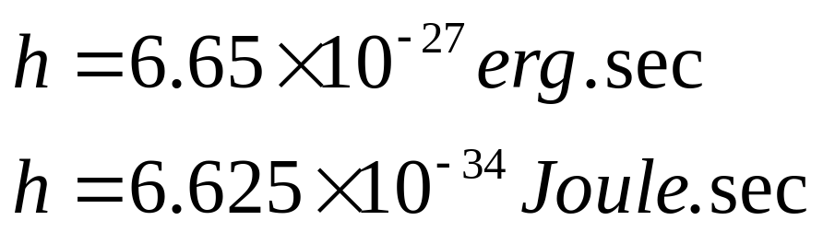
Quantum Mechanics
It is a generalization of Classical Physics that includes classical laws as special cases.
Quantum Physics extends that range to the region of small dimensions.
Just as ‘c’ the velocity of light signifies universal constant, the
Planck's constant characterizes Quantum Physics.

Slide 4
Quantum Mechanics
It is able to explain
Photo electric effect
Black body radiation
Compton effect
Emission of line spectra
The most outstanding development in modern science was the conception of Quantum Mechanics in 1925. This new approach was highly successful in explaining about the behavior of atoms, molecules and nuclei.

Slide 5
Photo Electric Effect
The emission of electrons from a metal plate when illuminated by light or any other radiation of any wavelength or frequency (suitable) is called photoelectric effect. The emitted electrons are called ‘photo electrons’.
Light
Evacuated Quartz tube
Metal plate
Collecting plate
_
+
V
^^^^^^^^
A

Slide 6
Photo Electric Effect
Experimental findings of the photoelectric effect
There is no time lag between the arrival of light at the metal surface and the emission of photoelectrons.
When the voltage is increased to a certain value say V_{o}, the photocurrent reduces to zero.
Increase in intensity increase the number of the photoelectrons but the electron energy remains the same.
3I
Photo Current
2I
I
V_{o}
Voltage

Slide 7
Photo Electric Effect
4. Increase in frequency of light increases the energy of the electrons. At frequencies below a certain critical frequency (characteristics of each particular metal), no electron is emitted.
Photo Current
v₃
v₁
v₂
Voltage

Slide 8
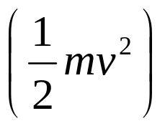
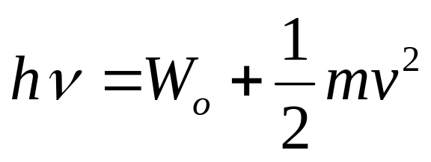
Einstein’s Photo Electric Explanation
The energy of a incident photon is utilized in two ways
A part of energy is used to free the electron from the atom known as photoelectric workfunction (W_{o}).
Other part is used in providing kinetic energy to the emitted electron .
This is called Einstein’s photoelectric equation.

Slide 9
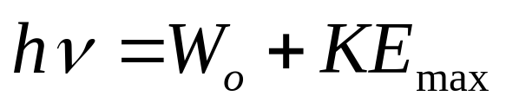
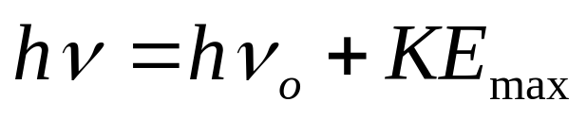
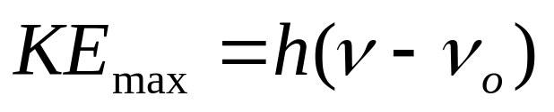
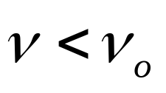
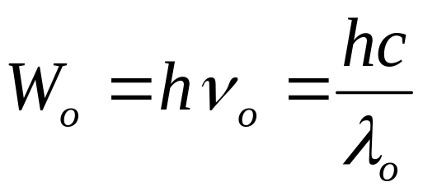
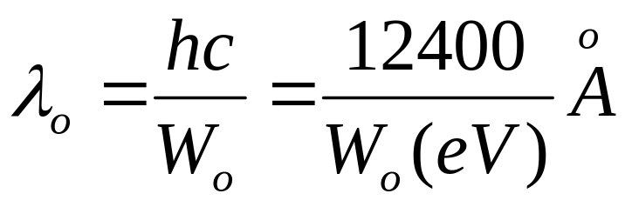
If , no photoelectric effect

Slide 10

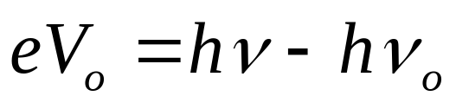
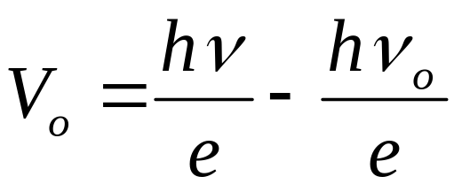


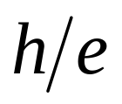
If is the stopping potential, then
It is in form of . The graph with on y-axis and on x-axis will be a straight line with slope

Slide 11
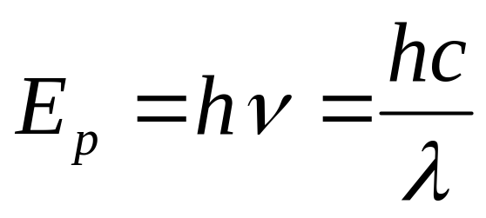
Photons
Einstein postulated the existence of a particle called a photon, to explain detailed results of photoelectric experiment.
Photon has zero rest mass, travels at speed of light
Explains “instantaneous” emission of electrons in photoelectric effect, frequency dependence.

Slide 12

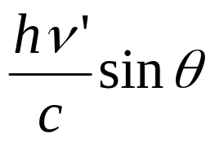
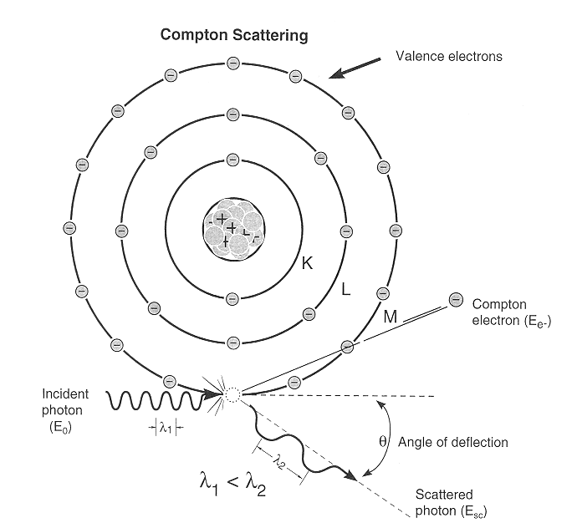




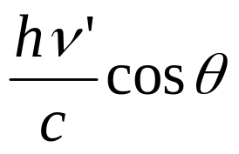
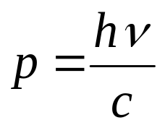


Compton Effect
When a monochromatic beam of X-rays is scattered from a material then both the wavelength of primary radiation (unmodified radiation) and the radiation of higher wavelength (modified radiation) are found to be present in the scattered radiation. Presence of modified radiation in scattered X-rays is called Compton effect.
scattered photon
incident photon
electron
recoiled electron

Slide 13
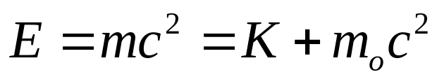
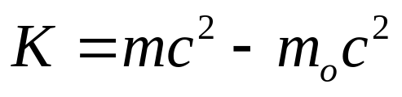
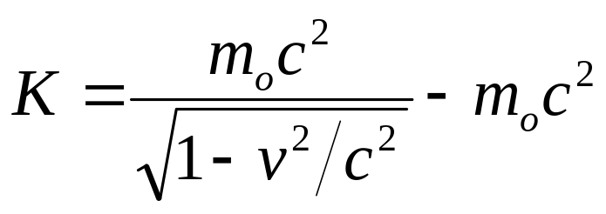
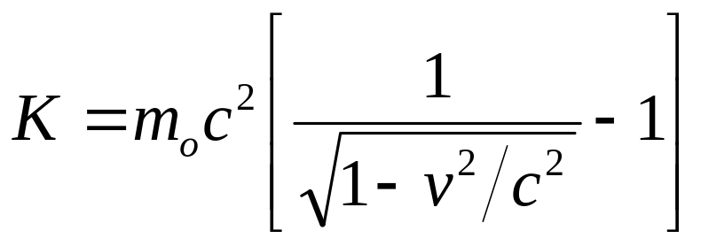
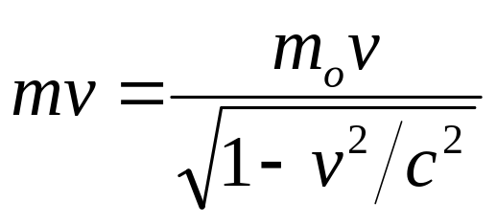
From Theory of Relativity, total energy of the recoiled electron with v ~ c is
Similarly, momentum of recoiled electron is

Slide 14
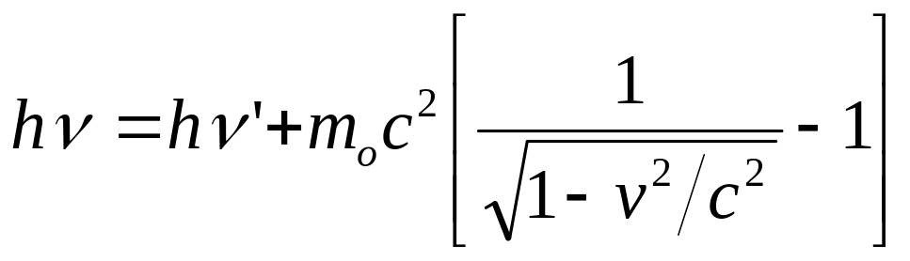
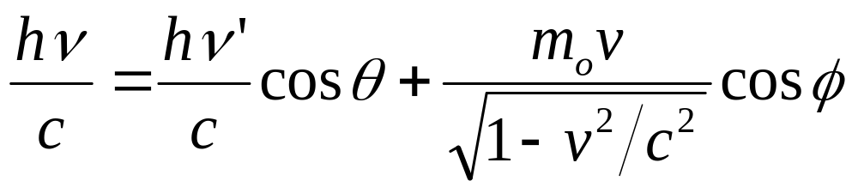
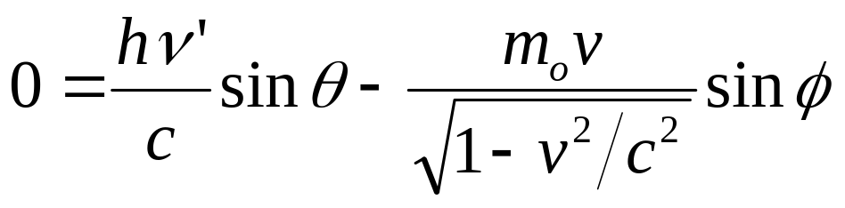
Now from Energy Conversation
(i)
From Momentum Conversation
(ii)
along x-axis
and
(iii)
along y-axis

Slide 15
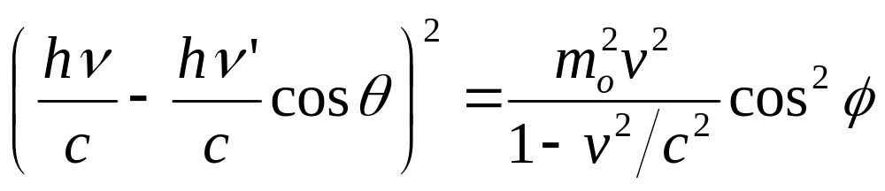
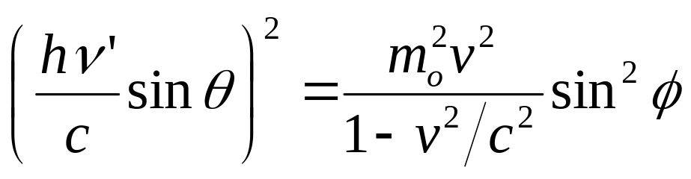
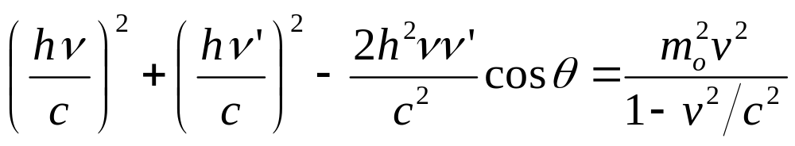
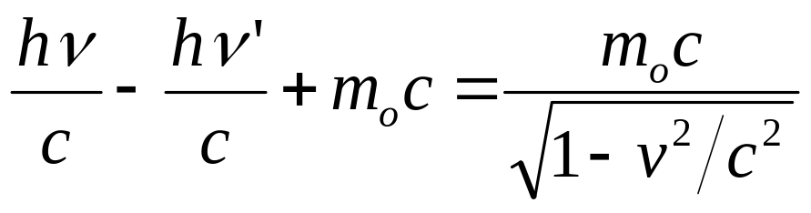
Rearranging (ii) and squaring both sides
(iv)
Rearranging (iii) and squaring both sides
(v)
Adding (iv) and (v)
(vi)
From equation (i)

Slide 16
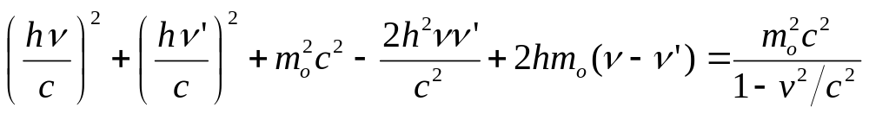
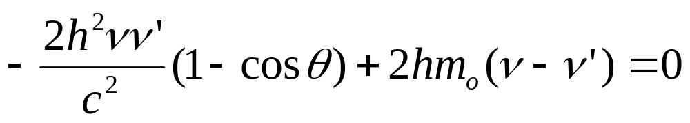
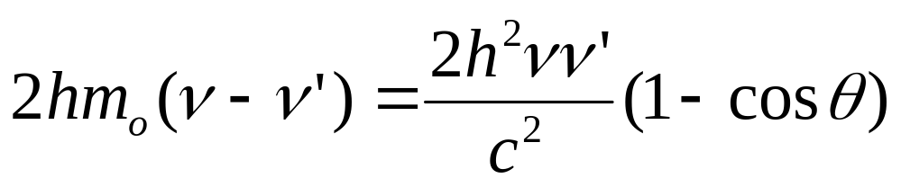
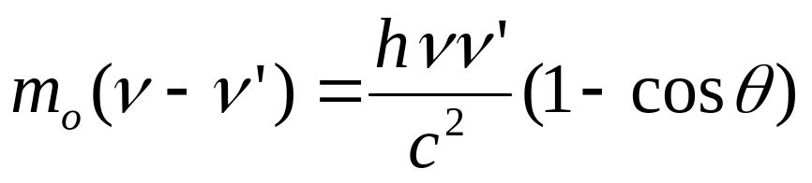
On squaring, we get
(vii)
Subtracting (vi) from (vii)

Slide 17
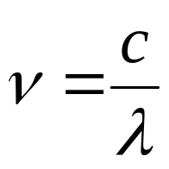
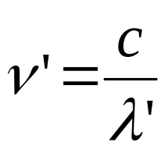
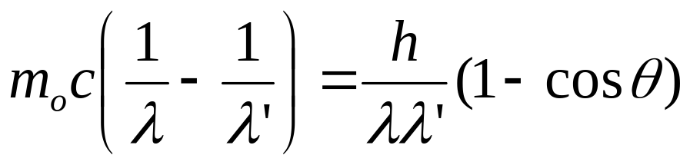
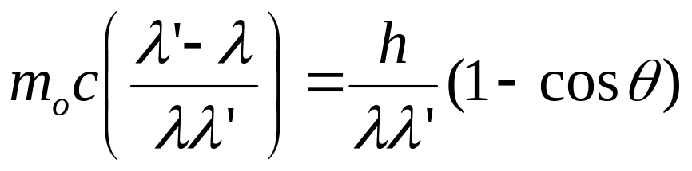
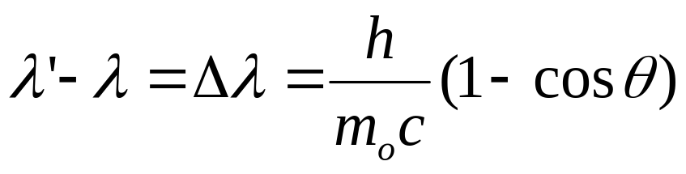


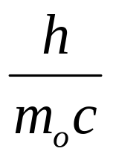
and
So,
But
is the Compton Shift.
It neither depends on the incident wavelength nor on the scattering material. It only on the scattering angle i.e.
is called the Compton wavelength of the electron
and its value is 0.0243 Å.

Slide 18
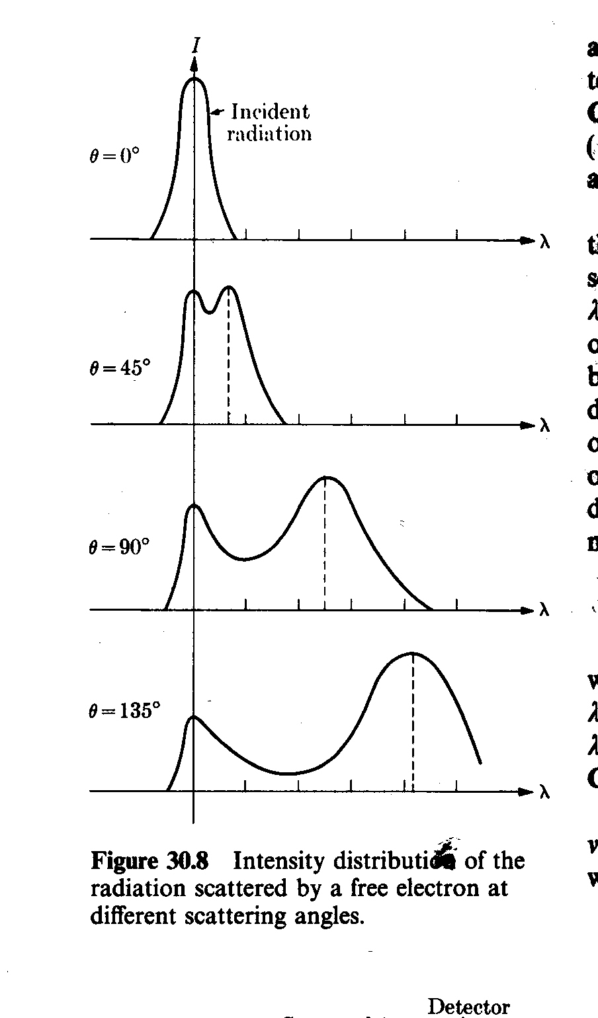
Experimental Verification
photon
Bragg’s X-ray
Spectrometer
Monochromatic
X-ray Source
θ
Graphite
target
1. One peak is found at same position. This is unmodified radiation
2. Other peak is found at higher wavelength. This is modified signal of low energy.
3. increases with increase in .

Slide 19
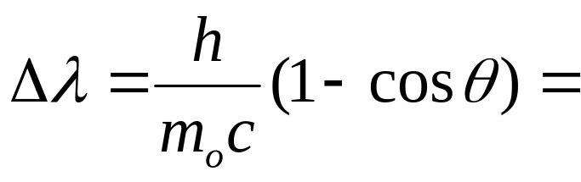
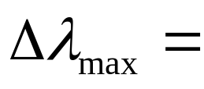

Compton effect can’t observed in Visible Light
0.0243 (1- cosθ) Å
is maximum when (1- cosθ) is maximum i.e. 2.
0.05 Å
So Compton effect can be observed only for radiation having wavelength of few Å.
For 1Å ~ 1%
For 5000Å ~ 0.001% (undetectable)

Slide 20


Pair Production
When a photon (electromagnetic energy) of sufficient energy passes near the field of nucleus, it materializes into an electron and positron. This phenomenon is known as pair production.
Photon
Nucleus (+ve)
In this process charge, energy and momentum remains conserved prior and after the production of pair.

Slide 21
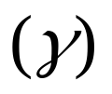
The rest mass energy of an electron or positron is 0.51 MeV (according to E = mc²).
The minimum energy required for pair production is 1.02 MeV.
Any additional photon energy becomes the kinetic energy of the electron and positron.
The corresponding maximum photon wavelength is 1.2 pm. Electromagnetic waves with such wavelengths are called gamma rays .

Slide 22

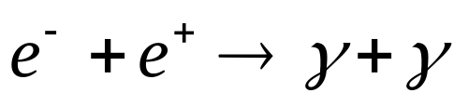
Pair Annihilation
When an electron and positron interact with each other due to their opposite charge, both the particle can annihilate converting their mass into electromagnetic energy in the form of two - rays photon.
Charge, energy and momentum are again conversed. Two - photons are produced (each of energy 0.51 MeV plus half the K.E. of the particles) to conserve the momentum.

Slide 23
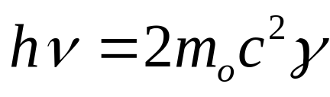
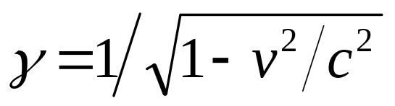


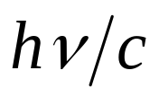
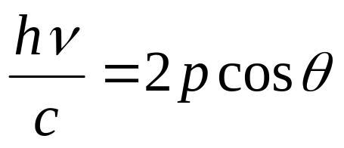
Pair production cannot occur in empty space
From conservation of energy
here m_{o} is the rest mass and
In the direction of motion of the photon, the momentum is conserved if

Slide 24
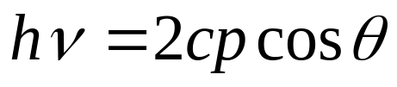
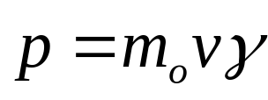





(i)
Momentum of electron and positron is
Equation (i) now becomes
But
and

Slide 25

But conservation of energy requires that
Hence it is impossible for pair production to conserve both the energy and momentum unless some other object is involved in the process to carry away part of the initial photon momentum. Therefore pair production cannot occur in empty space.

Slide 26
Wave Particle Duality
Light can exhibit both kind of nature of waves and particles so the light shows wave-particle dual nature.
In some cases like interference, diffraction and polarization it behaves as wave while in other cases like photoelectric and compton effect it behaves as particles (photon).

Slide 27


De Broglie Waves
Not only the light but every materialistic particle such as electron, proton or even the heavier object exhibits wave-particle dual nature.
De-Broglie proposed that a moving particle, whatever its nature, has waves associated with it. These waves are called “matter waves”.
Energy of a photon is
For a particle, say photon of mass, m

Slide 28






Suppose a particle of mass, m is moving with velocity, v then the wavelength associated with it can be given by
or
(i) If means that waves are associated with moving material particles only.
(ii) De-Broglie wave does not depend on whether the moving particle is charged or uncharged. It means matter waves are not electromagnetic in nature.

Slide 29



Wave Velocity or Phase Velocity
When a monochromatic wave travels through a medium, its velocity of advancement in the medium is called the wave velocity or phase velocity (V_{p}).
where is the angular frequency
and is the wave number.

Slide 30

Group Velocity
In practice, we came across pulses rather than monochromatic waves. A pulse consists of a number of waves differing slightly from one another in frequency.
The observed velocity is, however, the velocity with which the maximum amplitude of the group advances in a medium.
So, the group velocity is the velocity with which the energy in the group is transmitted (V_{g}).
The individual waves travel “inside” the group with their phase velocities.

Slide 31




Relation between Phase and Group Velocity

Slide 32





In a Dispersive medium V_{p} depends on frequency
i.e. constant
So, is positive generally (not always).
generally

Slide 33




In a non-dispersive medium ( such as empty space)
constant

Slide 34




Phase Velocity of De-Broglie’s waves
According to De-Broglie’s hypothesis of matter waves
wave number
(i)
If a particle has energy E, then corresponding wave will have frequency
then angular frequency will be

Slide 35





(ii)
Dividing (ii) by (i)
But v is always < c (velocity of light)
(i) Velocity of De-Broglie’s waves (not acceptable)
(ii) De-Broglie’s waves will move faster than the particle velocity (v) and hence the waves would left the particle behind.

Slide 36


Group Velocity of De-Broglie’s waves
The discrepancy is resolved by postulating that a moving particle is associated with a “wave packet” or “wave group”, rather than a single wave-train.
A wave group having wavelength λ is composed of a number of component waves with slightly different wavelengths in the neighborhood of λ.
Suppose a particle of rest mass m_{o} moving with velocity v then associated matter wave will have
and
where

Slide 37




and
On differentiating w.r.t. velocity, v
(i)
(ii)

Slide 38



Dividing (i) by (ii)
Wave group associated with a moving particle also moves with the velocity of the particle.
Moving particle wave packet or wave group

Slide 39
Davisson & Germer experiment of electron diffraction
If particles have a wave nature, then under appropriate conditions, they should exhibit diffraction
Davisson & Germer measured the wavelength of electrons
This provided experimental confirmation of the matter waves proposed by de Broglie

Slide 40

Davisson and Germer Experiment

Slide 41



Incident Beam
  Current vs accelerating voltage has a maximum (a bump or kink noticed in the graph), i.e. the highest number of electrons is scattered in a specific direction.
The bump becomes most prominent for 54 V at φ ~ 50°

Slide 42


According to de Broglie, the wavelength associated with an electron accelerated through V volts is
Hence the wavelength for 54 V electron
From X-ray analysis we know that the nickel crystal acts as a plane diffraction grating with grating space d = 0.91 Å

Slide 43


Here the diffraction angle, φ ~ 50°
The angle of incidence relative to the family of Bragg’s plane

Slide 44


From the Bragg’s equation
which is equivalent to the λ calculated by de-Broglie’s hypothesis.
It confirms the wavelike nature of electrons

Slide 45


Electron Microscope: Instrumental Application of Matter Waves

Slide 46
Resolving power of any optical instrument is proportional to the wavelength of whatever (radiation or particle) is used to illuminate the sample.
An optical microscope uses visible light and gives 500x magnification/200 nm resolution.
Fast electron in electron microscope, however, have much shorter wavelength than those of visible light and hence a resolution of ~0.1 nm/magnification 1,000,000x can be achieved in an Electron Microscope.

Slide 47







Heisenberg Uncertainty Principle
It states that only one of the “position” or “momentum” can be measured accurately at a single moment within the instrumental limit.
or
It is impossible to measure both the position and momentum simultaneously with unlimited accuracy.
uncertainty in position
uncertainty in momentum
then
The product of & of an object is greater than or equal to

Slide 48




If is measured accurately i.e.
The principle applies to all canonically conjugate pairs of quantities in which measurement of one quantity affects the capacity to measure the other.
Like, energy E and time t.
and angular momentum L and angular position θ

Slide 49


Determination of the position of a particle by a microscope
Suppose we want to determine accurately the position and momentum of an electron along x-axis using an ideal microscope free from all mechanical and optical defects.
The limit of resolution of the microscope is
here i is semi-vertex angle of the cone of rays entering the objective lens of the microscope.
Scattered
Photon
is the order of uncertainty in the x-component of the position of the electron.
Incident
Photon
Recoiled electron

Slide 50



We can’t measure the momentum of the electron prior to illumination. So there is uncertainty in the measurement of momentum of the electron.
The scattered photon can enter the microscope anywhere between the angular range +i to –i.
The momentum of the scattered photon is (according to de-Broglie)
Its x-component can be given as
The x-component of the momentum of the recoiling electron has the same uncertainty, (conservation of momentum)

Slide 51


The product of the uncertainties in the x-components of position and momentum for the electron is
This is in agreement with the uncertainty relation.

Slide 52





Applications of Heisenberg Uncertainty Principle
(i) Non-existence of electron in nucleus
Order of radius of an atom ~ 5 x10⁻¹⁵ m
If electron exist in the nucleus then
then
relativistic

Slide 53
Thus the kinetic energy of an electron must be greater than 20 MeV to be a part of nucleus
Experiments show that the electrons emitted by certain unstable nuclei don’t have energy greater than 3-4 MeV.
Thus we can conclude that the electrons cannot be present within nuclei.

Slide 54







Concept of Bohr Orbit violates Uncertainty Principle
But

Slide 55

According to the concept of Bohr orbit, energy of an electron in a orbit is constant i.e. ΔE = 0.
All energy states of the atom must have an infinite life-time.
But the excited states of the atom have life–time ~ 10⁻⁸ sec.
The finite life-time Δt gives a finite width (uncertainty) to the energy levels.

Slide 56

Two-slit Interference Experiment
Slit
1 meter
Laser
Source
Slit
Detector
Rate of photon arrival = 2 x 10⁶/sec
Time lag = 0.5 x 10⁻⁶ sec
Spatial separation between photons = 0.5 x 10⁻⁶ c = 150 m

Slide 57
  Taylor’s experiment (1908): double slit experiment with very dim light: interference pattern emerged after waiting for few weeks
  interference cannot be due to interaction between photons, i.e. cannot be outcome of destructive or constructive combination of photons
  ⇒ interference pattern is due to some inherent property of each photon - it “interferes with itself” while passing from source to screen
  photons don’t “split” – light detectors always show signals of same intensity
  slits open alternatingly: get two overlapping single-slit diffraction patterns – no two-slit interference
  add detector to determine through which slit photon goes: ⇒ no interference
  interference pattern only appears when experiment provides no means of determining through which slit photon passes

Slide 58
Double slit experiment – QM interpretation
  patterns on screen are result of distribution of photons
  no way of anticipating where particular photon will strike
  impossible to tell which path photon took – cannot assign specific trajectory to photon
  cannot suppose that half went through one slit and half through other
  can only predict how photons will be distributed on screen (or over detector(s))
  interference and diffraction are statistical phenomena associated with probability that, in a given experimental setup, a photon will strike a certain point
  high probability ⇒ bright fringes
  low probability ⇒ dark fringes

Slide 59
Double slit expt. -- wave vs quantum
wave theory
quantum theory
pattern of fringes:
  Intensity bands due to variations in square of amplitude, A², of resultant wave on each point on screen
role of the slits:
  to provide two coherent sources of the secondary waves that interfere on the screen
pattern of fringes:
  Intensity bands due to variations in probability, P, of a photon striking points on screen
role of the slits:
  to present two potential routes by which photon can pass from source to screen

Slide 60




Wave function
The quantity with which Quantum Mechanics is concerned is the wave function of a body.
Wave function, ψ is a quantity associated with a moving particle. It is a complex quantity.
|Ψ|² is proportional to the probability of finding a particle at a particular point at a particular time. It is the probability density.
ψ is the probability amplitude.
Thus if
then

Slide 61




Normalization
|Ψ|² is the probability density.
The probability of finding the particle within an element of volume
Since the particle is definitely be somewhere, so
Normalization
A wave function that obeys this equation is said to be normalized.

Slide 62

Properties of wave function
It must be finite everywhere.
If ψ is infinite for a particular point, it mean an infinite large probability of finding the particles at that point. This would violates the uncertainty principle.
2. It must be single valued.
If ψ has more than one value at any point, it mean more than one value of probability of finding the particle at that point which is obviously ridiculous.
3. It must be continuous and have a continuous first derivative everywhere.
must be continuous
4. It must be normalizable.

Slide 63


Schrodinger’s time independent wave equation
One dimensional wave equation for the waves associated with a moving particle is
where
ψ is the wave amplitude for a given x.
A is the maximum amplitude.
λ is the wavelength
From (i)
(ii)

Slide 64





where K is the K.E. for the non-relativistic case
Suppose E is the total energy of the particle
and V is the potential energy of the particle
(iii)

Slide 65



Equation (ii) now becomes
This is the time independent (steady state) Schrodinger’s wave equation for a particle of mass m_{o}, total energy E, potential energy V, moving along the x-axis.
If the particle is moving in 3-dimensional space then

Slide 66


This is the time independent (steady state) Schrodinger’s wave equation for a particle in 3-dimensional space.
For a free particle V = 0, so the Schrodinger equation for a free particle

Slide 67





Schrodinger’s time dependent wave equation
Wave equation for a free particle moving in +x direction is
(i)
where E is the total energy and p is the momentum of the particle
Differentiating (i) twice w.r.t. x
(ii)
Differentiating (i) w.r.t. t
(iii)

Slide 68



For non-relativistic case
E = K.E. + Potential Energy
(iv)
Using (ii) and (iii) in (iv)
This is the time dependent Schrodinger’s wave equation for a particle in one dimension.

Slide 69


Linearity and Superposition
If ψ₁ and ψ₂ are two solutions of any Schrodinger equation of a system, then linear combination of ψ₁ and ψ₂ will also be a solution of the equation..
is also a solution
Here are constants
Above equation suggests:
(i) The linear property of Schrodinger equation
(ii) ψ₁ and ψ₂ follow the superposition principle

Slide 70







If P₁ is the probability density corresponding to ψ₁ and P₂ is the probability density corresponding to ψ₂
Then
due to superposition principle
Total probability will be
Probability density can’t be added linearly

Slide 71




Expectation values
Expectation value of any quantity which is a function of ‘x’ ,say f(x) is given by
for normalized ψ
Thus expectation value for position ‘x’ is
Expectation value is the value of ‘x’ we would obtain if we measured the positions of a large number of particles described by the same function at some instant ‘t’ and then averaged the results.

Slide 72




Q. Find the expectation value of position of a particle having wave function ψ = ax between x = 0 & 1, ψ = 0 elsewhere.
Solution

Slide 73


Operators
(Another way of finding the expectation value)
An operator is a rule by means of which, from a given function we can find another function.
For a free particle
Then
Here
(i)
is called the momentum operator

Slide 74


Similarly
Here
(ii)
is called the Total Energy operator
Equation (i) and (ii) are general results and their validity is the same as that of the Schrodinger equation.

Slide 75






If a particle is not free then
This is the time dependent Schrodinger equation

Slide 76


If Operator is Hamiltonian
Then time dependent Schrodinger equation can be written as
This is time dependent Schrodinger equation in Hamiltonian form.

Slide 77


Eigen values and Eigen function
Schrodinger equation can be solved for some specific values of energy i.e. Energy Quantization.
The energy values for which Schrodinger equation can be solved are called ‘Eigen values’ and the corresponding wave function are called ‘Eigen function’.
Suppose a wave function (ψ) is operated by an operator ‘α’ such that the result is the product of a constant say ‘a’ and the wave function itself i.e.
then
ψ is the eigen function of
a is the eigen value of

Slide 78







Q. Suppose is eigen function of operator then find the eigen value.
Solution.
The eigen value is 4.

Slide 79





Particle in a Box
Consider a particle of rest mass m_{o} enclosed in a one-dimensional box (infinite potential well).
Boundary conditions for Potential
{
0 for 0 < x < L
V(x)=
particle
for 0 > x > L
Boundary conditions for ψ
{
0 for x = 0
x = 0
x = L
Ψ =
0 for x = L
Thus for a particle inside the box Schrodinger equation is
(i)
inside

Slide 80







(k is the propagation constant)
(ii)
Equation (i) becomes
(iii)
General solution of equation (iii) is
(iv)

Slide 81









Boundary condition says ψ = 0 when x = 0
Equation (iv) reduces to
(v)
Boundary condition says ψ = 0 when x = L

Slide 82





(vi)
Put this in Equation (v)
When n # 0 i.e. n = 1, 2, 3…., this gives ψ = 0 everywhere.
Put value of k from (vi) in (ii)

Slide 83








(vii)
Where n = 1, 2, 3….
Equation (vii) concludes
1. Energy of the particle inside the box can’t be equal to zero.
The minimum energy of the particle is obtained for n = 1
(Zero Point Energy)
If momentum i.e.
But since the particle is confined in the box of dimension L.

Slide 84



Thus zero value of zero point energy violates the Heisenberg’s uncertainty principle and hence zero value is not acceptable.
2. All the energy values are not possible for a particle in
potential well.
Energy is Quantized
3. E_{n} are the eigen values and ‘n’ is the quantum number.
4. Energy levels (E_{n}) are not equally spaced.
n = 3
n = 2
n = 1

Slide 85






Using Normalization condition
The normalized eigen function of the particle are

Slide 86
Probability density figure suggest that:
1. There are some positions (nodes) in the box that will never be occupied by the particle.
2. For different energy levels the points of maximum probability are found at different positions in the box.
|ψ₁|² is maximum at L/2 (middle of the box)
|ψ₂|² is zero L/2.

Slide 87





Particle in a Three Dimensional Box
Eigen energy
Eigen function

