Slide 1
Organic Reactions and Their Mechanisms

Slide 2
What happens in a reaction
  The substrate and the reagent interact to yield the products of the reaction
  Substrate + Reagent Products
  Breaking and making of new bonds of carbon atom in substrate giving to final products through intermediates is called mechanism
  Substrate_______Intermediates______Products

Slide 3
Factors which influence a reaction
Inductive effect
Mesomeric effect
Electromeric effects
Hyperconjugation

Slide 4
INDUCTIVE EFFECT
H-H H₂
H-Cl HCl
The inductive effect (I effect)refers to the polarity produced in a molecule as a result of higher electronegativity of one atom compared to another.
+I effect and –I effect

Slide 5
-I Effect Groups (Electron-attracting):
NO₂, F, Cl, Br, I, OH, C₆H₅-
+I Effect Groups (Electronic-releasing):
(CH₃)₃C-, (CH₃)₂CH-, CH₃CH₂-, CH₃-

Slide 6
Important feature of inductive effect
It is a permanent effect
It is operative in saturated compounds
It brings changes in physical properties such as dipole moment, solubility etc. It effect the rate of reaction.
It is transmitted along a chain of carbon atoms through σ bonds. However, the effect is insignificant beyond second carbon in chain.

Slide 7
MESOMERIC EFFECT
Polarity produced in a molecule as a result of interaction between two ∏ bond or a ∏ bond and lone pair of electrons. For e.g. ˃C=O
The effect is transmitted in the chain in a similar manner as the inductive effect.
+M and –M effect

Slide 8
+M Effect Groups (Electronic-releasing):
-Cl,-Br, -I, -NH₂, -NR₂, -OH, -OCH₃
-M Effect Groups ((Electronic-attracting):
-NO₂, -C≡N, C=O

Slide 9
Difference in Inductive effect and Mesomeric effect
Inductive effect | Mesomeric effect
1. It is operative in saturated compounds | 1. Operative in unsaturated compounds
2. Involves electrons of sigma bonds | 2. It involves electrons of pi bonds or lone pair of electron.
3. Transmitted over a quite short distance | 3. Transmitted to one end to other end

Slide 10
ELECTROMERIC EFFECT
It refers to the polarity produced in a multiple bonded compounds as it is approached by a reagent.
It is a temporary effect.
E⁺
A B A⁺ -:⁻B
Reagent

Slide 11
RESONANCE
The phenomenon in which two or more structures can be written for a compound, but none of them represents it accurately, is referred to as RESONANCE.
It involves delocalisation of π electrons.
The energy content of all the canonical form must be nearly same.
Resonance is responsible for greater stability of the molecule.

Slide 12


Different resonating structure

Slide 13
HYPERCONJUGATION
The relative stability of various carbonium ions may be explained by no bond resonance structures.
Here shifting of bonding electrons from an adjacent C-H bond to electron deficient carbon.
So, the +charge on carbon is dispersed to hydrogen.

Slide 14
How bonds are break and form
Two ways
Homolytic fission or Homolysis
Heterolytic fission or Heterolysis

Slide 15
Homolytic fission
A-B or A : B A. + B.
Formation of free radicals
Usually occurs in non-polar bonds.
Most common mode of fission in the vapour phase
Usually inititated by heat, light or organic peroxide

Slide 16
HETEROCYCLIC FISSION
A:B A⁺ + :B⁻
A:⁻ + B⁺
The products of heterocyclic fission are ions.
These reaction take place at measurable rates
It occurs most readily with polar solvents.

Slide 17
REACTION INTERMEDIATES
Carbonium Ions ( ≡C⁺ )
Carbanions (≡C⁻ )
Carbon free radicals (≡C˙ )

Slide 18
CARBONIUM ION
The positively charged carbon atom in carbonium ion uses sp² hybrid orbitals to form three σ bonds.
+I groups stabilizes carbonium ions by partial neutralization of the positive charge on carbon
t > s > p

Slide 19
Carbanion
Carbanion uses sp³ hybrid orbitals to form the three σ bonds.
-I groups like –NO₂, -Br will stabilizes carbanion by partial removal of the negative chrage on the carbon.
t < s < p

Slide 20
CARBON FREE RADICAL
The carbon atom in a carbon free radical uses sp2 hybrid orbitals to form three σ bonds.
They are extremely reactive species because of the tendency of this electron to become paired at the earliest opportunity.

Slide 21
Reagents
Electrophiles (electron loving)
A reagent which can accept an electron pair in a reaction.
For examples: H⁺, NO₂⁺, R₃C⁺, AlCl₃, BF₃ etc.
Nucleophiles (nucleus loving)
A reagent which can donate an electron pair in a reaction.
For examples: OH⁻, CN⁻, RCH₂⁻, NH₃, RNH₂ etc.

Slide 22
TYPES OF ORGANIC REACTIONS
Substitution
Addition
Elimination
Rearrangement

Slide 23
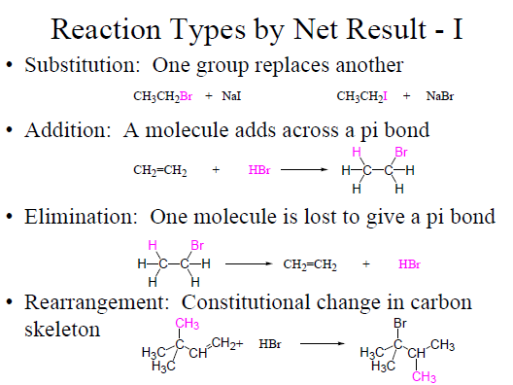

Slide 24
NUCLEOPHILIC SUBSTITUTION REACTIONS OF ALKYL HALIDES

Slide 25
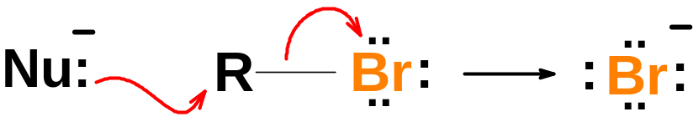
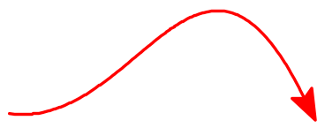
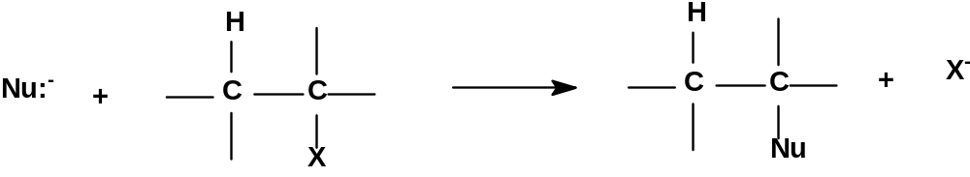

Reactions of Alkyl Halides (R-X):
When a nucleophile (electron donor, e.g., OH⁻) reacts with an alkyl halide, the halogen leaves as a halide
There are two kinds of substitution reactions:
S_{N}1 and S_{N}2
The Nu:⁻ replaces the halogen on the α-carbon.

Slide 26
S_{N}2 reactions, i.e. 2nd Order Nucleophilic Substitution Reactions
S_{N}2 stands for Substitution, Nucleophilic, bimolecular. Another word for bimolecular is ‘2nd order’.
Bimolecular (or 2nd order) means Rate = k [RX] [Nu:⁻] (This is a rate equation and k is a constant).
The mechanism of an S_{N}2 reaction is
Note that the nucleophile must approach to α-carbon from opposite side to the leaving group.

Slide 27
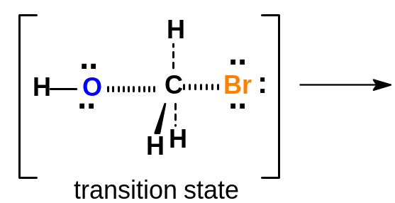
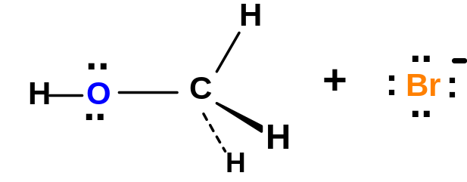
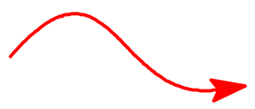

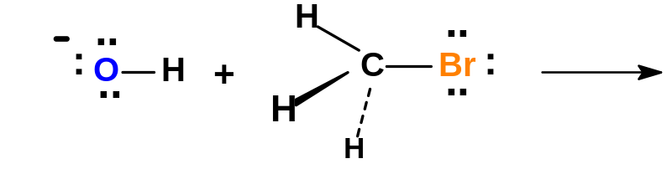
2nd Order Nucleophilic Substitution Reactions, i.e., S_{N}2 reactions
By Ingold and coworkers 1937
The rate of an S_{N}2 reaction depends upon 4 factors:
The effects of substituents on alkyl halide
The power of the nucleophile
The ability of the leaving group to leave
The nature of the solvent

Slide 28
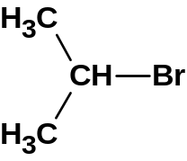
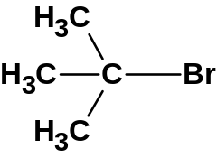


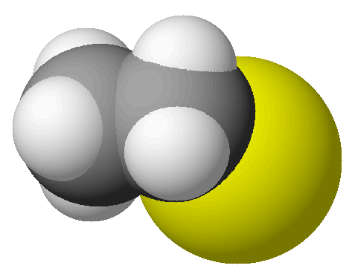
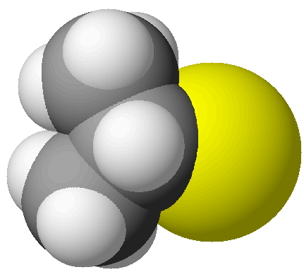
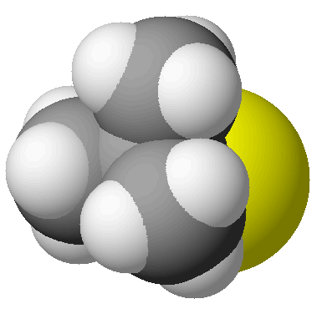
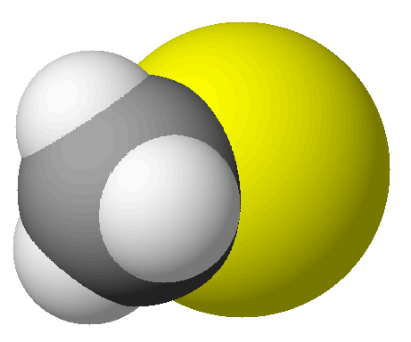
Effect of substituents on RX in rate of S_{N}2 reactions:
methyl bromide
ethyl bromide
isopropyl bromide
t-butyl bromide
SPACE FILLING MODELS SHOW ACTUAL SHAPES AND RELATIVE SIZES
Back side of α-C of a methyl halide is unhindered.
Back side of α-C of a
1° alkyl halide is slightly hindered.
Back side of α-C of a
2° alkyl halide is mostly hindered.
Back side of α-C of a
3° alkyl halide is completely blocked.
Me° >> 1° >> 2° >> 3°
decreasing rate of S_{N}2 reactions

Slide 29
Effect of the nucleophile on rate of S_{N}2 reactions:
  The better the nucleophile, the faster the rate of S_{N}2 reactions.
  The best nucleophiles are the best electron donors.
  Having same attacking atom
  RO⁻ > OH⁻ > RCOO⁻ > ROH > H₂O
  Good Bronsted base is a good nucleophile if it contains no steric hindrance
  CH₃⁻ and (CH₃)₃C⁻
  Nucleophilicity
  I⁻ > Br⁻ > Cl⁻ >> F⁻

Slide 30
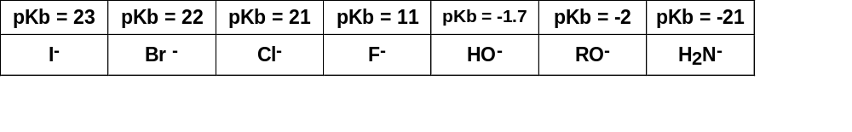
Effect of nature of the leaving group on rate of S_{N}2 reactions:
The leaving group usually has a negative charge
Groups which stabilize a negative charge are the best leaving groups
The weakest bases are stable as anions and are the best leaving groups.
⁻CH₃ < ⁻NH₂ < ⁻OH < ⁻F
Weak bases are readily identified. They have high p^{Kb} values.
Increasing leaving ability

Slide 31
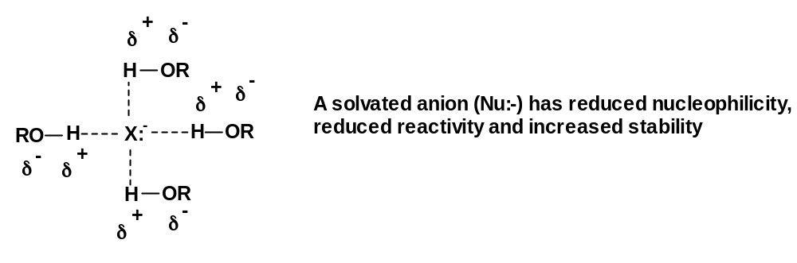
Effect of the solvent on rate of S_{N}2 reactions:
There are 2 classes of organic solvents:
Polar solvent
Non polar solvent
Polar solvents can be further categorised as
Polar Protic solvents (e.g., H₂O, MeOH, EtOH, CH₃COOH, etc.) cluster around the Nu:- (solvate it) and lower its energy (stabilize it) and reduce its reactivity via H-bonding. Protic solvents slow down S_{N}2 reactions.
A solvated nucleophile has difficulty hitting the α-carbon.

Slide 32
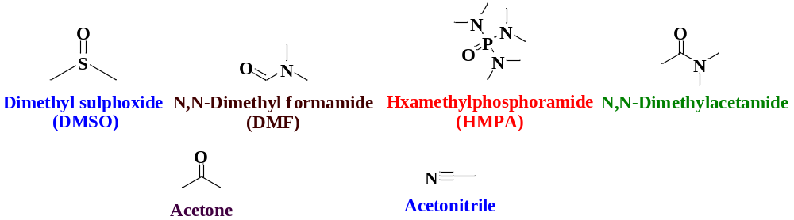
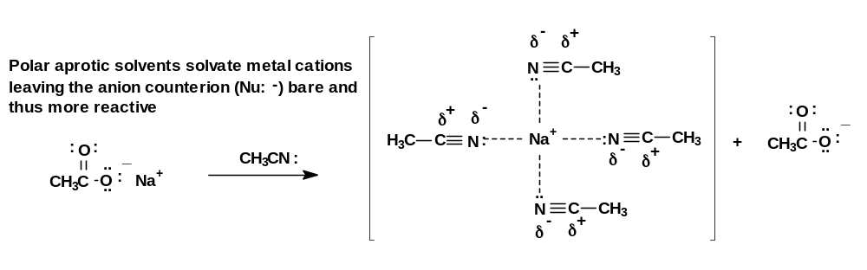
Effect of the solvent on rate of S_{N}2 reactions:
Polar Aprotic Solvents solvate the cation, i.e. counter ion of the nucleophile but not the nucleophile:- Polar aprotic solvents speed up S_{N}2 reactions.

Slide 33
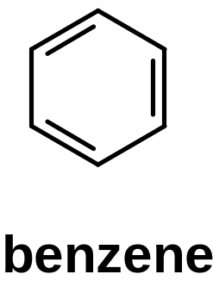
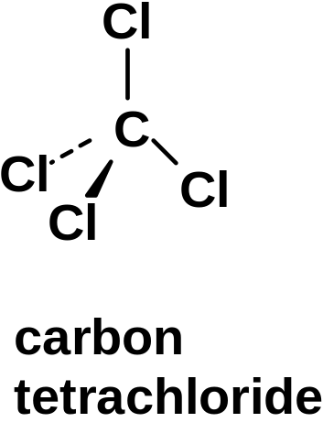
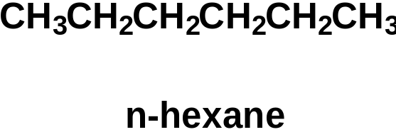
Effect of the solvent on rate of S_{N}2 reactions:
Non polar solvents (benzene, carbon tetrachloride, hexane, etc.) do not solvate or stabilize nucleophiles.
  S_{N}2 reactions are relatively slow in non polar solvents similar to that in protic solvents.

Slide 34
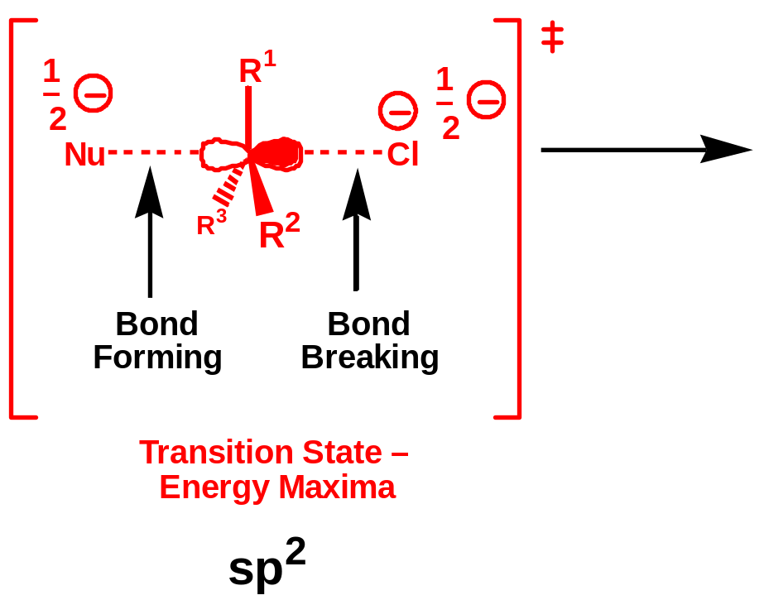
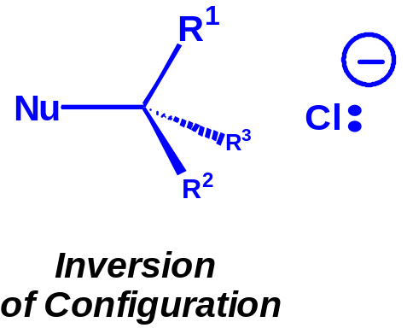
Stereochemistry of S_{N}2 Reaction
1
Bimolecular
Nucleophile attacks from behind the C-Cl σ-bond.
This is where the σ*-antibonding orbital of the C-Cl bond is situated.
Hence inversion of configuration takes place.
This inversion is called “Walden Inversion”
R
Process
Nu
C
l
R
3
Rate =
k
[R-Hal][Nu]
R
2
sp
3
Rate
Determinig
Step

Slide 35
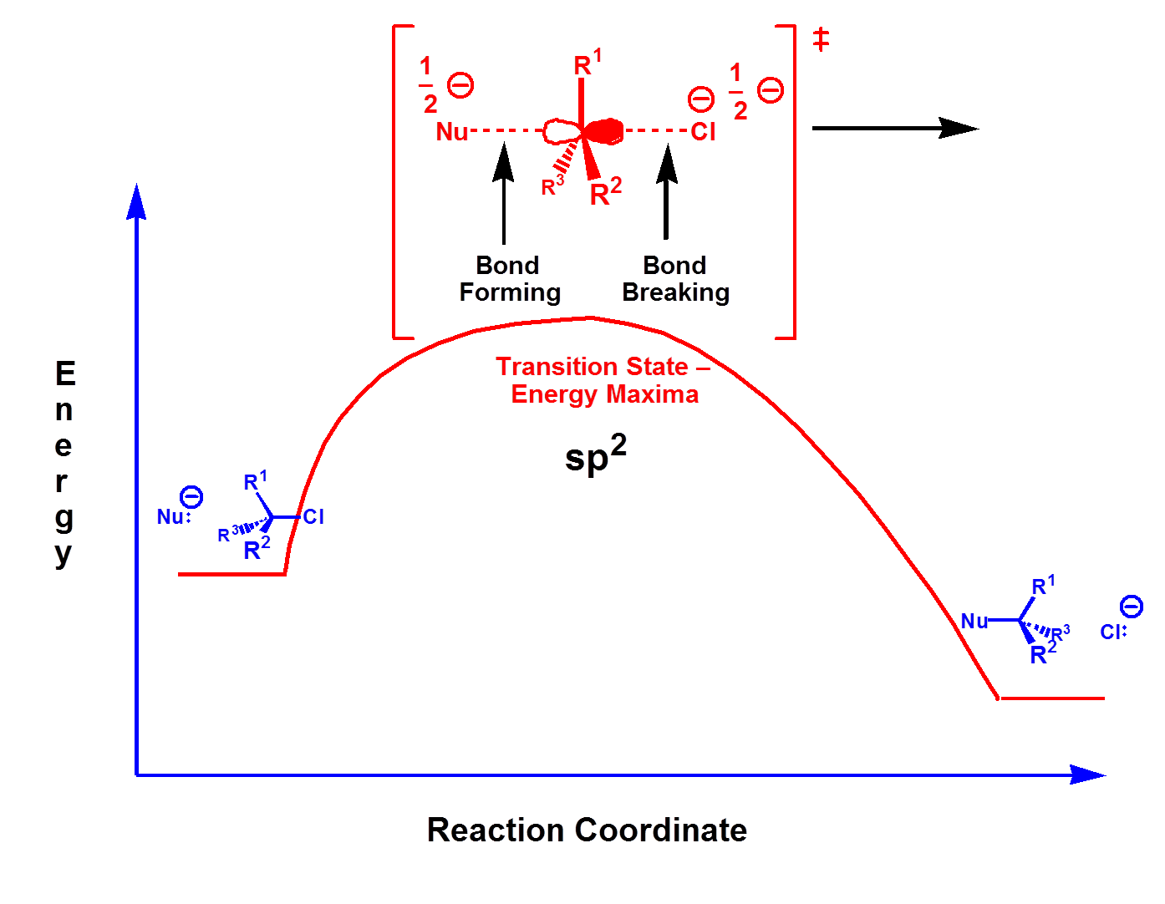

Slide 36
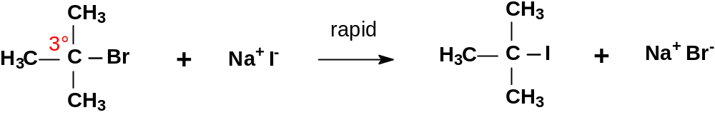
1st Order Nucleophilic Substitution Reactions, i.e., S_{N}1 reactions
3° alkyl halides are essentially inert to substitution by the S_{N}2 mechanism because of steric hindrance at the back side of the α-carbon.
Despite this, 3° alkyl halides do undergo nucleophilic substitution reactions quite rapidly , but by a different mechanism, i.e., the S_{N}1 mechanism.
S_{N}1 = Substitution, Nucleophilic, 1st order (unimolecular).
S_{N}1 reactions obey 1st order kinetics, i.e., Rate = k⋅[RX].
The rate depends upon the concentration of only 1 reactant, the
alkyl halide-not the nucleophile
The order of reactivity of substrates for S_{N}1 reactions is the reverse of S_{N}2
3° > 2° > 1° > vinyl > phenyl > Me°
R₃C-Br R₂HC-Br RH₂C-Br CH₂=CH-Br φ-Br H₃C-Br
increasing rate of S_{N}1 reactions

Slide 37
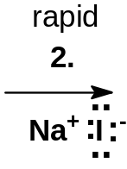
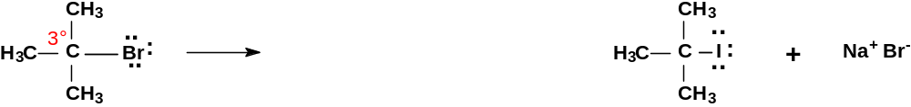



Mechanism of S_{N}1 reactions
The mechanism of an S_{N}1 reaction occurs in 2 steps:
Reaction Steps …
the slower, rate-limiting dissociation of the alkyl halide forming a C+ intermediate
a rapid Nucleophilic attack on the C+
Note that the nucleophile is not involved in the slower, rate-limiting step.

Slide 38
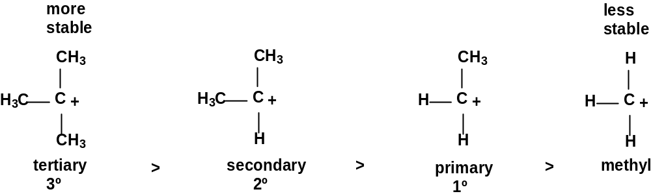
The Rate of S_{N}1 reactions
The rate of an S_{N}1 reaction depends upon 3 factors:
The nature of the substrate (the alkyl halide)
The ability of the leaving group to leave
The nature of the solvent
The rate is independent of the power of the nucleophile.
1. Consider the nature of the substrate:
  Highly substituted alkyl halides (substrates) form a more stable C+.
increasing rate of S_{N}1 reactions

Slide 39
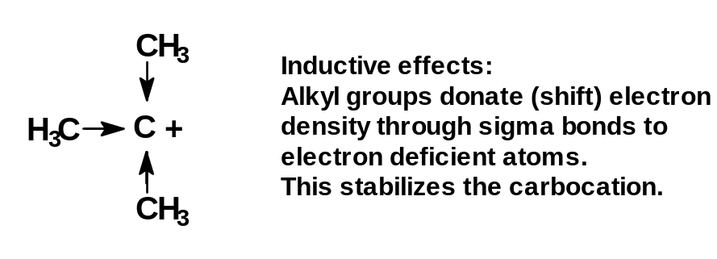
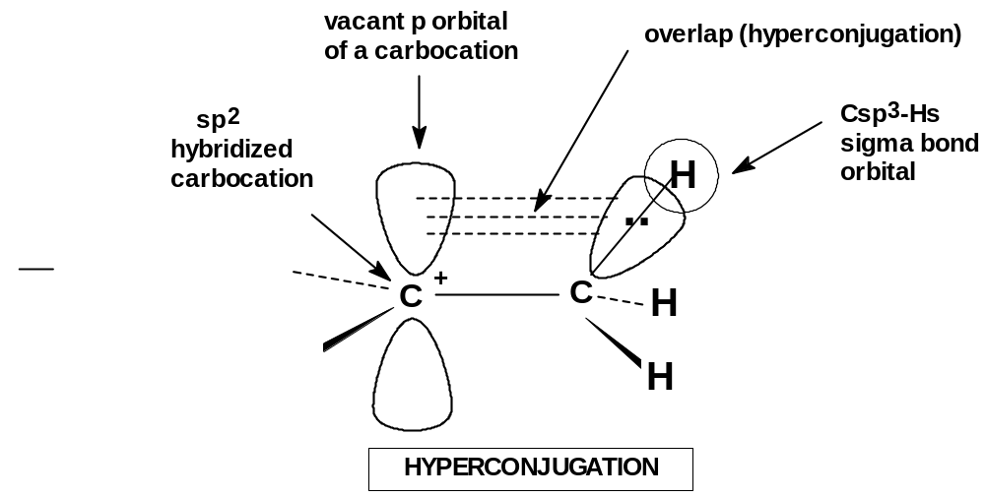
Stability of Carbocations
Alkyl groups are weak electron donors.
They stabilize carbocations by donating electron density by induction (through σ bonds)
They stabilize carbocations by hyperconjugation (by partial overlap of the alkyl C-to-H bonds with the empty p-orbital of the carbocation).

Slide 40
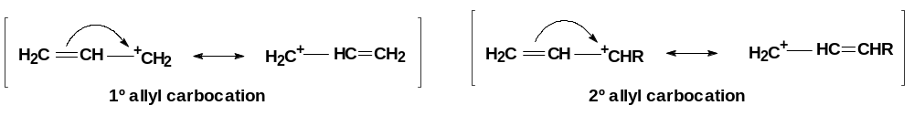
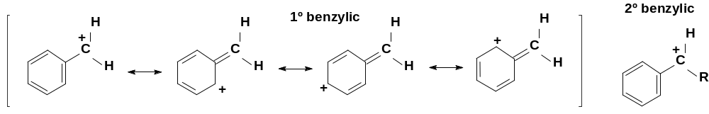



Stability of Carbocations
Allyl and benzyl halides also react quickly by S_{N}1 reactions because their carbocations are unusually stable due to their resonance forms which delocalize charge over an extended π system

Slide 41
Effect of nature of the leaving group on rate of S_{N}1 reactions:
2. Consider the nature of the leaving group:
The nature of the leaving group has the same effect on both S_{N}1 and S_{N}2 reactions.
The better the leaving group, the faster a C+ can form and hence the faster will be the S_{N}1 reaction.
The leaving group usually has a negative charge
Groups which best stabilize a negative charge are the best leaving groups, i.e., the weakest bases are stable as anions and are the best leaving groups.
Weak bases are readily identified. They have high pKb values.
Increasing leaving ability
Iodine (-I) is a good leaving group because iodide (I⁻) is non basic.
The hydroxyl group (-OH) is a poor leaving group because hydroxide (OH⁻) is a strong base.

Slide 42
Effect of the solvent on rate of S_{N}1 reactions
Polar solvents, both protic and aprotic, will solvate and stabilize the charged transition state (C+ intermediate), lowering the activation energy and accelerating S_{N}1 reactions.
Nonpolar solvents do not lower the activation energy and thus make S_{N}1 reactions relatively slower
The relative rates of an S_{N}1 reaction due to solvent effects are given
(CH₃)₃C-Cl + ROH → (CH₃)₃C-OR + HCl
H₂O 20% EtOH (aq) 40% EtOH (aq) EtOH
100,000 14,000 100 1
reaction rate increases with polarity of solvent

Slide 43
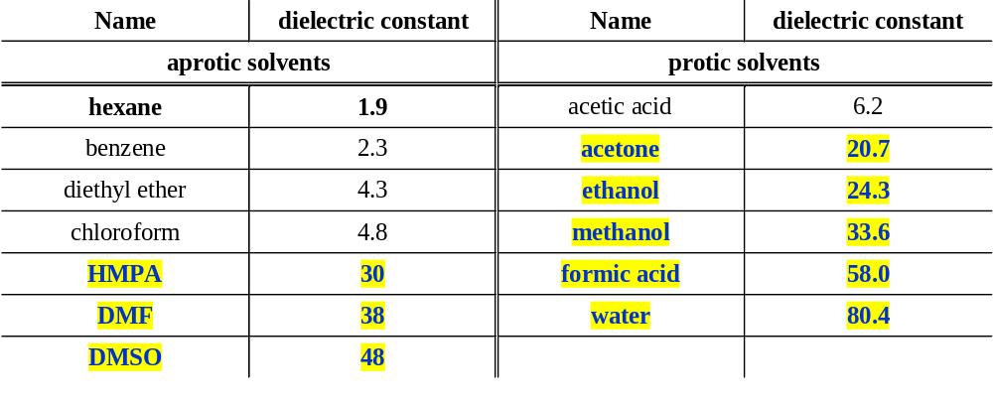
Effect of the solvent on rate of S_{N}1 reactions:
Solvent polarity is usually expressed by the “dielectric constant”, ε, which is a measure of the ability of a solvent to act as an electric insulator.
Polar solvents are good electric insulators because their dipoles surround and associate with charged species.
Dielectric constants of some common solvents are given in the following table

Slide 44
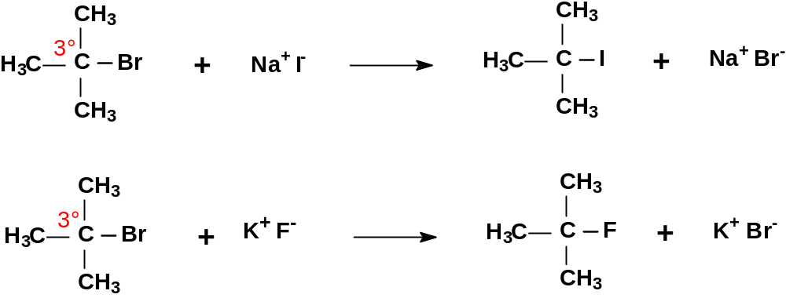
Effect of the nucleophile on rate of S_{N}1 reactions:
Consider the nature of the Nucleophile:
The nature of the nucleophile has no effect on the rate of S_{N}1 reactions because the slowest (rate-determining) step of an S_{N}1 reaction is the dissociation of the leaving group and formation of the carbocation.
All carbocations are very good electrophiles (electron acceptors) and even weak nucleophiles, like H₂O and methanol, will react quickly with them.
The two S_{N}1 reactions will proceed at essentially the same rate since the only difference is the nucleophile.

Slide 45
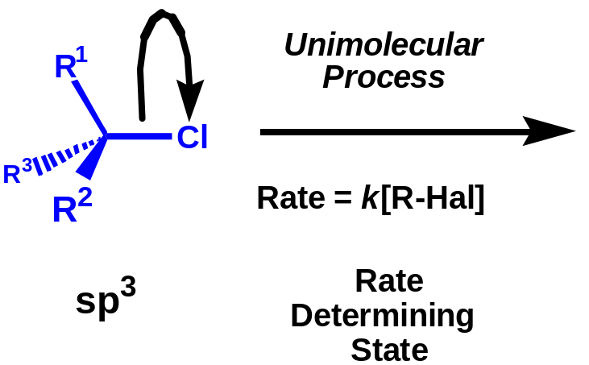
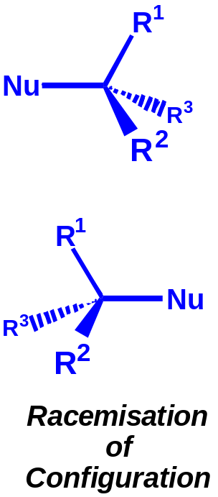
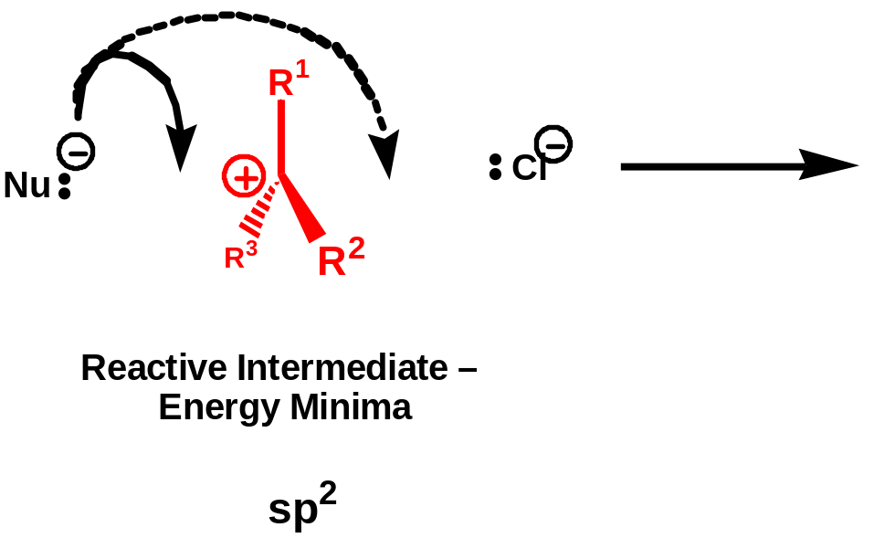
Stereochemistry of S_{N}1 Reaction
Nucleophile attacks from either side of the carbocationic intermediate.

Slide 46
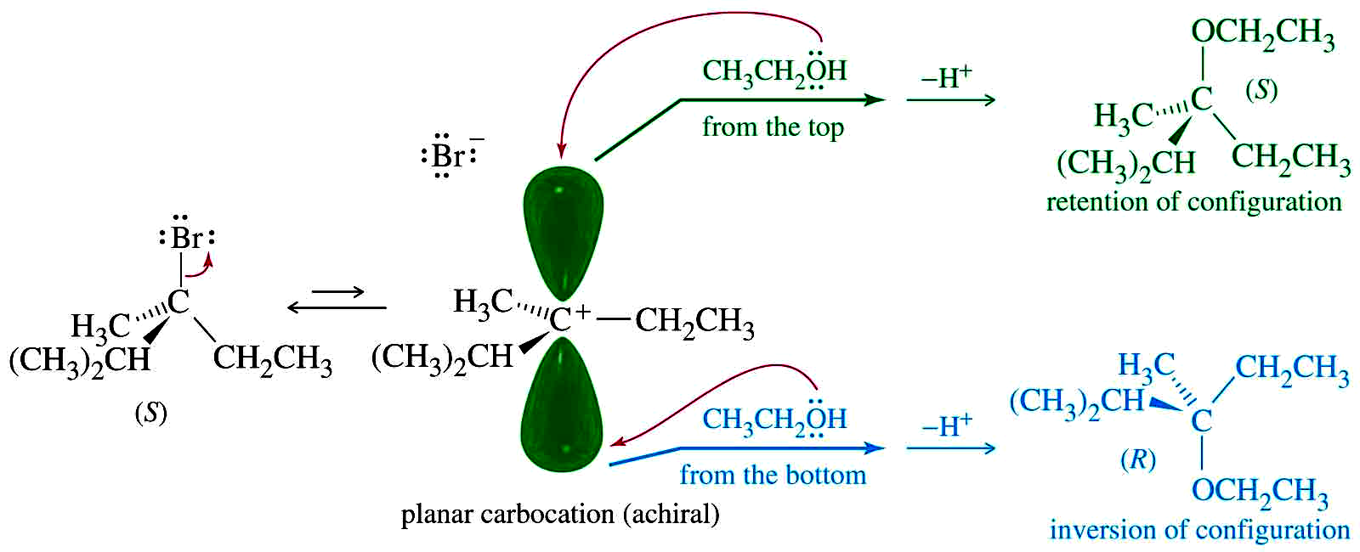
Stereochemistry of S_{N}1 Reaction

Slide 47
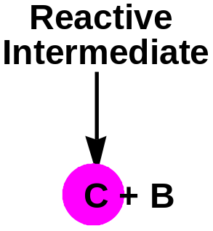
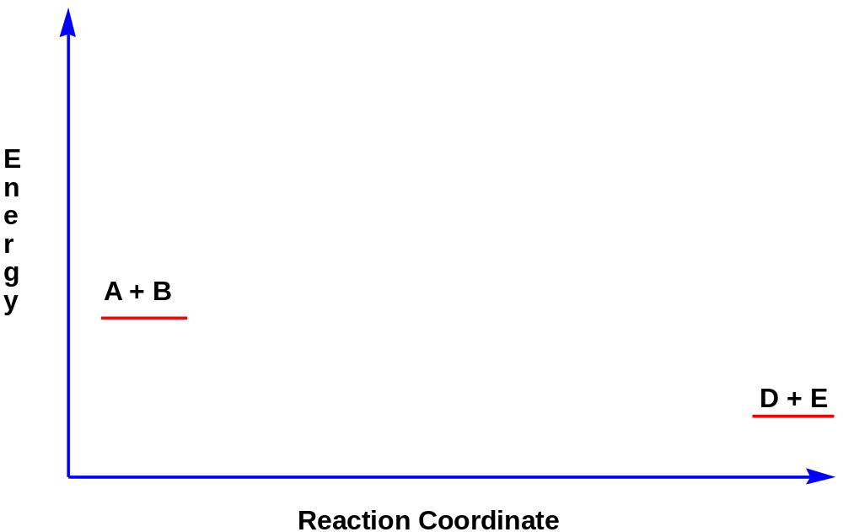
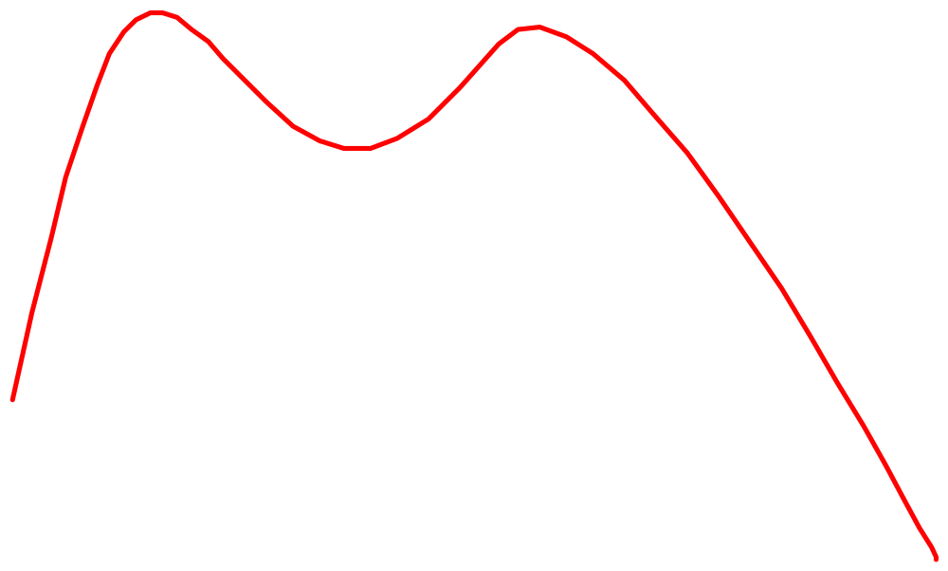
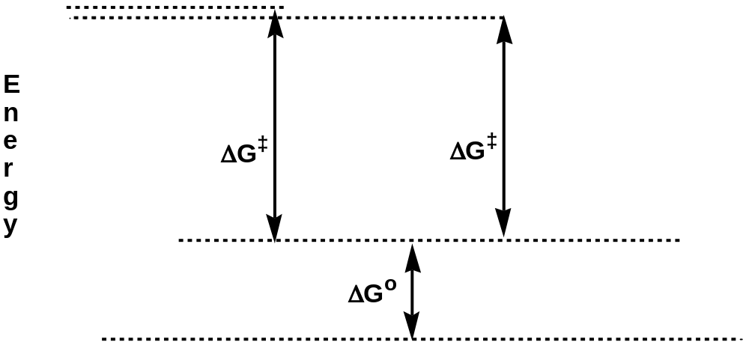

Reactive Intermediates
Rate = k[A]

Slide 48
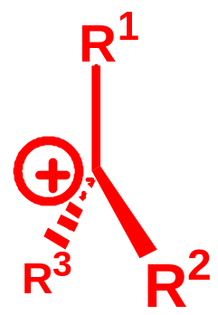
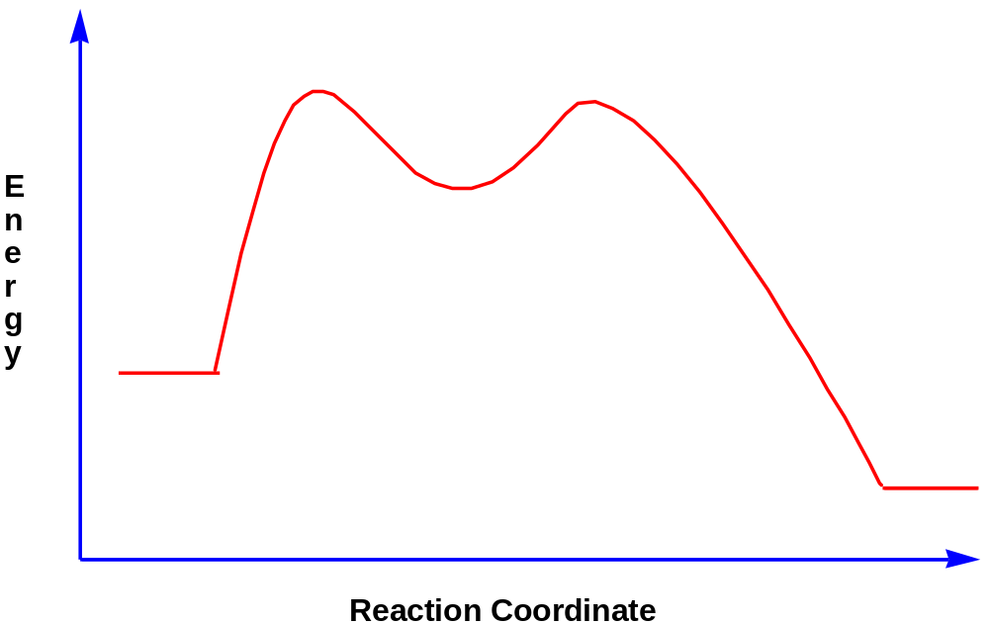
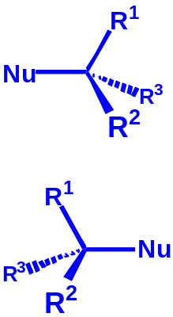
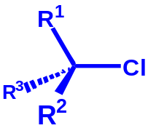
Racemisation takes place after intermediate formation

Slide 49
Electrophilic Substitution Reactions

Slide 50
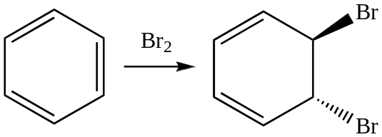
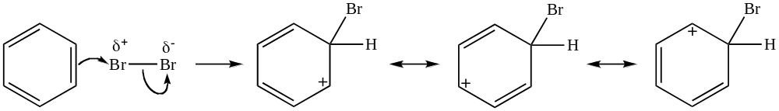
Addition to Benzene Pi Bonds
Benzene has pi bonds...also adds Br₂?

Slide 51
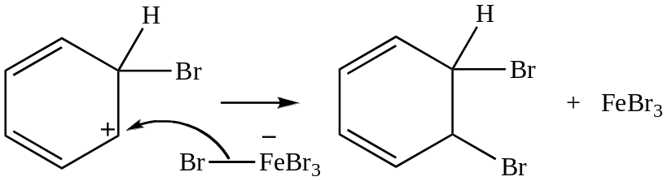
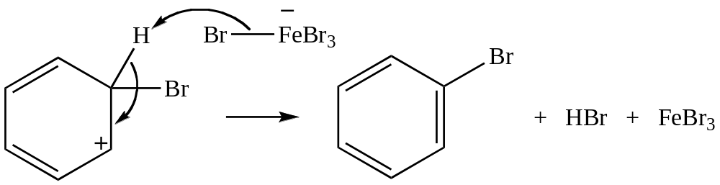
Arenium Ion Fate?
Arenium ion = a carbocation, so carbocation fates apply
Capture a nucleophile:
Aromaticity not restored
Be deprotonated; form pi bond:
Weak base adequate
Aromaticity restored

Slide 52
Substitution Reactions of Benzene and Its Derivatives
Benzene does not undergo electrophilic addition
It undergoes electrophilic aromatic substitution maintaining the aromatic core
Electrophilic aromatic substitution replaces a proton on benzene with another electrophile

Slide 53
Various substitution reaction
Nitration of benzene
The mechanism for the formation of nitrobenzene from benzene.
Halogenation of benzene
The mechanism for the substitution of atoms like chlorine and bromine into benzene rings.
Sulphonation of benzene
The mechanism for reaction between benzene and concentrated sulphuric acid to produce benzenesulphonic acid
Friedel-Crafts alkylation of benzene
The mechanism for the substitution of an alkyl group such as CH₃ into benzene.
Friedel-Crafts acylation of benzene
The mechanism for the substitution of an acyl group such as CH₃CO into benzene.

Slide 54

Electrophilic Aromatic Substitution

Slide 55
Halogenation of Benzene
Benzene’s π electrons participate as a Lewis base in reactions with Lewis acids
  Lewis acid: electron pair acceptor
  Lewis base: electron pair donor
The product is formed by loss of a proton, which is replaced by a halogen

Slide 56



Slide 57
Electrophilic Aromatic Substitution
Activating and Directing effects of substituents already on the ring

Slide 58

Products of Nitration
1 hr
48 hr
0.0003 hr

Slide 59




Mechanism of Electrophilic Aromatic Substitution
With a substituent group G
Depending on the nature of the substituent, the substituent G may stabilize the carbocation intermediate and therefore speed the reaction, or it may raise the energy of the carbocation and slow the reaction. Substituents that make the ring react faster (than benzene) with electrophiles are called activators; those that make the ring react slower (than benzene) are called deactivators.

Slide 60
Substituent effects
All activators also direct incoming electrophiles to the ortho- and the para-positions.
Most deactivators direct incoming electrophiles to the meta position. The exceptions are the halogens, which are weakly deactivating yet ortho-para directing.

Slide 61

Classification of Substituents

Slide 62
Free Radical Substitution Reactions
Mechanism involves free radical chain reaction
3 steps: initiation, propagation and termination
Example- chlorination of alkanes

Slide 63
ADDITION REACTION
Which have at least one pi bond.
Loss of one pi bond and gain of two σ bond.
Hence product is more stable.
Spontaneous reaction.

Slide 64
ELETROPHILIC ADDITION REACTION
Given by alkene and alkyne.
Two step reaction.
Given with those reagent which on dissociation gives electrophile and nucleophile.
If reagent is a weak acid then electrophilic addition is catalysed by strong acid.
Addition is a/c to markovnikov’s rule.

Slide 65
Reactivity of C=C
Electrons in pi bond are loosely held.
Electrophiles are attracted to the pi electrons.
Reaction can be :
  Ionic- Polar medium
  Free radical- non polar medium
Ionic:
Carbocation intermediate forms.s
Nucleophile adds to the carbocation.
Net result is addition to the double bond.
=>
Chapter 8

Slide 66


Electrophilic Addition
Step 1: Pi electrons attack the electrophile.
Step 2: Nucleophile attacks the carbocation.
Bond Broken -1 π & ! Sigma
Formed 2 sigma
=>
Chapter 8

Slide 67

MECHANISMS IN ALKENE

Slide 68
Unsymmetrical alkene where substituents present on doubly bonded carbon are +I groups, the addition will be a/c to Markovnikov’s rule
CH₂=CH-CH₃
Unsymmetrical where substituents present on doubly bonded carbon are -I groups, the addition will be a/c to anti-Markovnikov’s rule
CH₂=CH-G
Where G is a strong –I group such as
-NO₂, -CN, -CHO, -COOH, -COR, -CX₃ etc.

Slide 69
ADDITION IN ALKYNE
Here reaction intermediates is vinyl carbocation.
Alkene are more reactive than alkynes for E.A.R.
R-CH=CH₂ + H⁺ R-C⁺H-CH₃
R-C C-H + H⁺ R-C⁺=CH₂
Alkynes are more reactive than alkene for nucleophilic addition.

Slide 70

Types of Additions
=>
Chapter 8

Slide 71

Hydrogenation
Alkene + H₂ → Alkane
Catalyst required, usually Pt, Pd, or Ni.
Finely divided metal, heterogeneous
Syn addition
=>
Chapter 8

Slide 72

Addition of Halogens
Cl₂, Br₂, and sometimes I₂ add to a double bond to form a vicinal dibromide.
Anti addition, so reaction is stereospecific.
=>
Chapter 8

Slide 73

Mechanism for Halogenation
Pi electrons attack the bromine molecule.
A bromide ion splits off.
Intermediate is a cyclic bromonium ion.
=>
Chapter 8

Slide 74

Mechanism (2)
Halide ion approaches from side opposite the three-membered ring.
=>
Chapter 8

Slide 75


Examples of Stereospecificity
=>
Chapter 8

Slide 76
Test for Unsaturation
Add Br₂ in CCl₄ (dark, red-brown color) to an alkene in the presence of light.
The color quickly disappears as the bromine adds to the double bond.
“Decolorizing bromine” is the chemical test for the presence of a double bond.
=>
Chapter 8

Slide 77


Formation of Halohydrin
If a halogen is added in the presence of water, a halohydrin is formed.
Water is the nucleophile, instead of halide.
Product is Markovnikov and anti.
=>
Chapter 8

Slide 78

Regiospecificity
The most highly substituted carbon has the most positive charge, so nucleophile attacks there.
=>
Chapter 8

Slide 79

Addition of HX (1)
Protonation of double bond yields the most stable carbocation. Positive charge goes to the carbon that was not protonated.
X
=>
Chapter 8

Slide 80


Addition of HX (2)
=>
Chapter 8

Slide 81
Regiospecificity
Markovnikov’s Rule: The proton of an acid adds to the carbon in the double bond that already has the most H’s. “Rich get richer.”
More general Markovnikov’s Rule: In an electrophilic addition to an alkene, the electrophile adds in such a way as to form the most stable intermediate.
HCl, HBr, and HI add to alkenes to form Markovnikov products. =>
Chapter 8

Slide 82

Hydration of Alkenes
Reverse of dehydration of alcohol
Use very dilute solutions of H₂SO₄ or H₃PO₄ to drive equilibrium toward hydration.
=>
Chapter 8

Slide 83



Mechanism for Hydration
=>
Chapter 8

Slide 84


Orientation for Hydration
Markovnikov product is formed.
=>
Chapter 8

Slide 85
Nucleophilic addition reaction
Here addition of nucleophile in the first step and electrophile in the second step.
This reaction is given by alkene in which –I group is present on one of the double bonded carbon and the compounds containing polar functional group.
Ex- carbonyls

Slide 86
Addition to C=O
Highly polar carbonyl bond >C^{δ+}=O^{δ-}
Attack on +ve charge carbon-=carbanion
Attack on -ve charge carbon-=carbanium ion
Structure & Reactivity of Carbonyl Compounds:
+I effect groups - decreases reactivity
- I effect groups -Increases reactivity

Slide 87

addition of hydrogen cyanide to the carbonyl group of an aldehyde or ketone

Slide 88

Reduction of aldehydes and ketones with sodium tetrahydridoborate(III) or lithium tetrahydridoaluminate(III)

Slide 89

Grignard reaction

Slide 90
Elimination Reactions

Slide 91
There are two types of elimination reactions:
α-elimination: Elimination from same C-atom
2. β-elimination: Elimination from adjacent
C-atoms
a. E1
b. E2

Slide 92




E2 Reaction Mechanism
There are 2 kinds of elimination reactions, E1 and E2.
E2 = Elimination, Bimolecular (2nd order)
Rate = k [RX] [Nu:⁻]
E2 reactions occur when a 2° or 3° alkyl halide is treated with a strong base such as OH⁻, OR⁻, NH₂⁻ etc.
The Nu:⁻ removes an H⁺ from a β-carbon & the halogen leaves forming an alkene.
All strong bases, like OH⁻, are good nucleophiles. In 2° and 3° alkyl halides the α-carbon in the alkyl halide is hindered. In such cases, a strong base will ‘abstract’ (remove) a hydrogen ion (H+) from a β-carbon, before it hits the α-carbon. Thus strong bases cause elimination (E2) in 2° and 3° alkyl halides and cause substitution (S_{N}2) in unhindered methyl and 1° alkyl halides.

Slide 93


E2 Reaction Mechanism
In E2 reactions, the Base to H σ bond formation, the C to H σ bond breaking, the C to C π bond formation, and the C to Br σ bond breaking all occur simultaneously. No carbocation intermediate forms.
Reactions in which several steps occur simultaneously are called ‘concerted’ reactions’.
Satyzeff’s Rule:
In elimination of HX from alkyl halides, the more highly substituted (more stable) alkene product predominates.

Slide 94
E2 Reactions are ‘antiperiplanar’
E2 reactions, do not always follow Zaitsev’s rule.
E2 eliminations occur with anti-periplanar geometry, i.e., periplanar means that all 4 reacting atoms - H, C, C, & X - all lie in the same plane. Anti means that H and X (the eliminated atoms) are on opposite sides of the molecules.

Slide 95

E2 Stereochemistry

Slide 96









Antiperiplanar E2 Reactions in Cyclic Alkyl Halides
When E2 reactions occur in open chain alkyl halides, the Zaitsev product is usually the major product. Single bonds can rotate to the proper alignment to allow the antiperiplanar elimination.
In cyclic structures, however, single bonds cannot rotate. So it is necessary to look the stereochemistry of cyclic alkyl halides undergoing E2 reactions.
Trans –1-chloro-2-methylcyclopentane undergoes E2 elimination with NaOH.

Slide 97

E1 Reactions
Just as S_{N}2 reactions are analogous to E₂ reactions, so S_{N}1 reactions have an analog, E1 reaction.
E1 = Elimination, unimolecular (1st order); Rate = k × [RX]
E1 eliminations, like S_{N}1 substitutions, begin with unimolecular dissociation, but the dissociation is followed by loss of a proton from the β-carbon (attached to the C⁺) rather than by substitution.
E1 & S_{N}1 normally occur in competition, whenever an alkyl halide is treated in a protic solvent with a nonbasic, poor nucleophile.
Note: The best E1 substrates are also the best S_{N}1 substrates, and mixtures of products are usually obtained.

Slide 98

E1 Reactions
As with E2 reactions, E1 reactions also produce the more highly substituted alkene (Zaitsev’s rule). However, unlike E2 reactions where no C⁺ is produced, C⁺ rearrangements can occur in E1 reactions.
e.g., t-butyl chloride + H₂O (in EtOH) at 65 °C → t-butanol + 2-methylpropene
In most unimolecular reactions, S_{N}1 is favored over E1, especially at low temperature. Such reactions with mixed products are not often used in synthetic chemistry.
If the E1 product is desired, it is better to use a strong base and force the E2 reaction.

Slide 99


E1 Reaction
=>

Slide 100

Energy profile diagram for E1 reaction

Slide 101
Substitution vs Elimination
Primary alkyl halides can undergo only substitution at room temperature.
Secondary alkyl halides will undergo mainly SN2 but with a hindered base it will undergo E2.
In tertiary alkyl halides, E2 predominates with a hindered base.
High temperature always favours elimination.
Decrease in polarity increases the rate of elimination reaction. Therefore alcoholic solvent will give elimination whereas aqueous solvent will give Substitution.

