Slide 1
POLYMERS

Slide 2
Topics
Introduction
Classification
Physical Properties
Types of Polymerization
Copolymers
Vulcanization
PVC
Polyurethane
PAN
PET
Poly amides
Polyethylene
Polypropylene
Resins(Phenol-Formaldehyde)
Polymethylmethacrylate

Slide 3
POLYMERS
Contents:
Types of polymers
Physical properties
Types of polymerisation
Some important polymers

Slide 4
Terminology
Polymer:
A long molecule made
up from lots of small
molecules called
monomers.
A + A + A + A → -A-A-A-A-
Eg. Ethene →polyethene
styrene → polystyrene
Vinyl chloride→Polyvinyl chloride

Slide 5
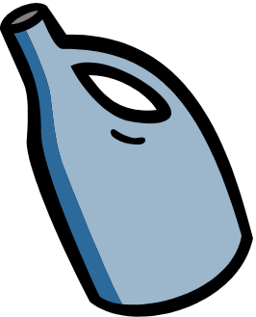

Eg. PE ( Polyethene )

Slide 6
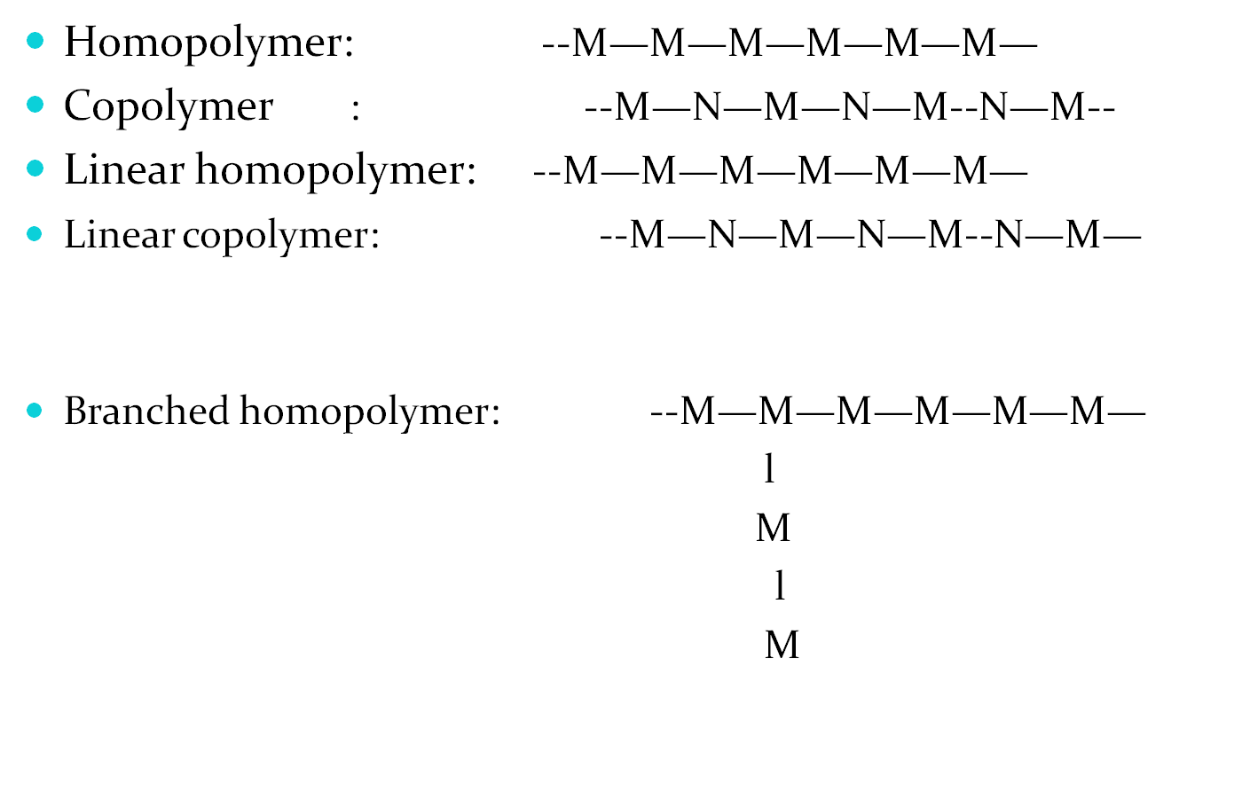
Terminology…

Slide 7

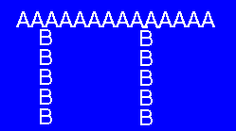
Homopolymer AAAAAAAAAAA
Random CCACBBACABAA
Alternating ABCABCABCABC
Block AAAABBBBCCCC
Graft
Cross link polymer

Slide 8
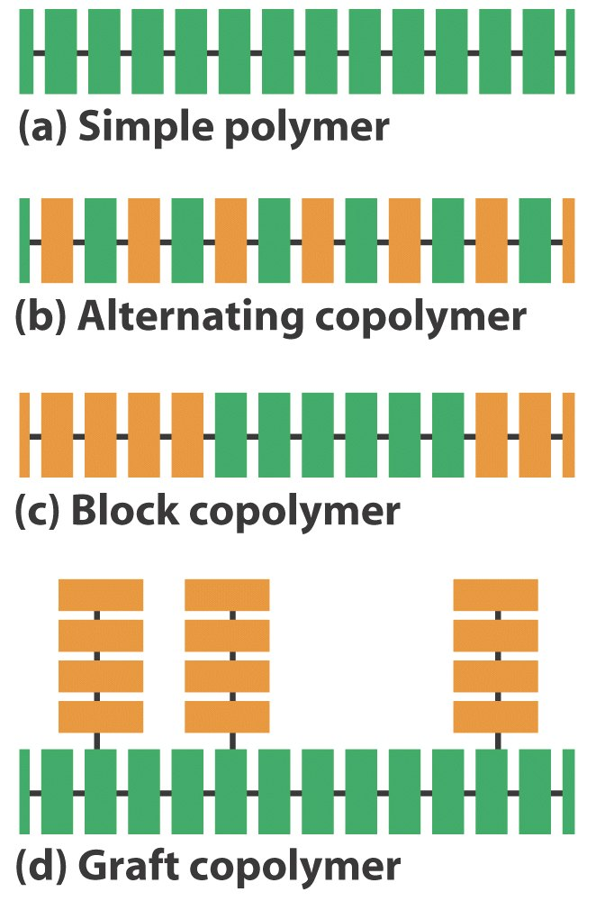
a)Homopolymer
b)Copolymer
c) Block copolymer
d) Graft copolymer

Slide 9
The number of repeating units in chain formed in a polymer is known as the "degree of polymerization(DP)

Slide 10

Degree of polymerisation: The number of repeating units in a polymer molecule.
5,000 – 2,00,000 malecular mass range.

Slide 11

The configuration of monomeric units in a polymer molecule

Slide 12
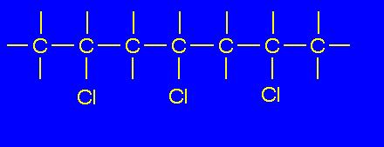
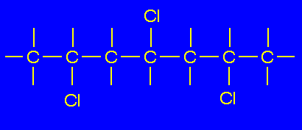
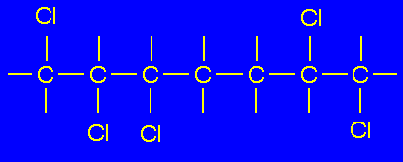
Isomerism/Polymer Tacticity
Isotactic
Sindiotactic
Random

Slide 13
Functionality
The number of bonding sites/active sites

Slide 14
Types of Polymerisation
Addition or Chain Polymerisation
Condensation or step- Polymerisation
Copolymerisation

Slide 15
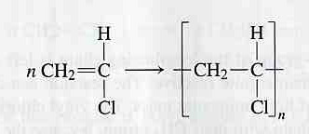
Addition or chain polymerisation

Slide 16
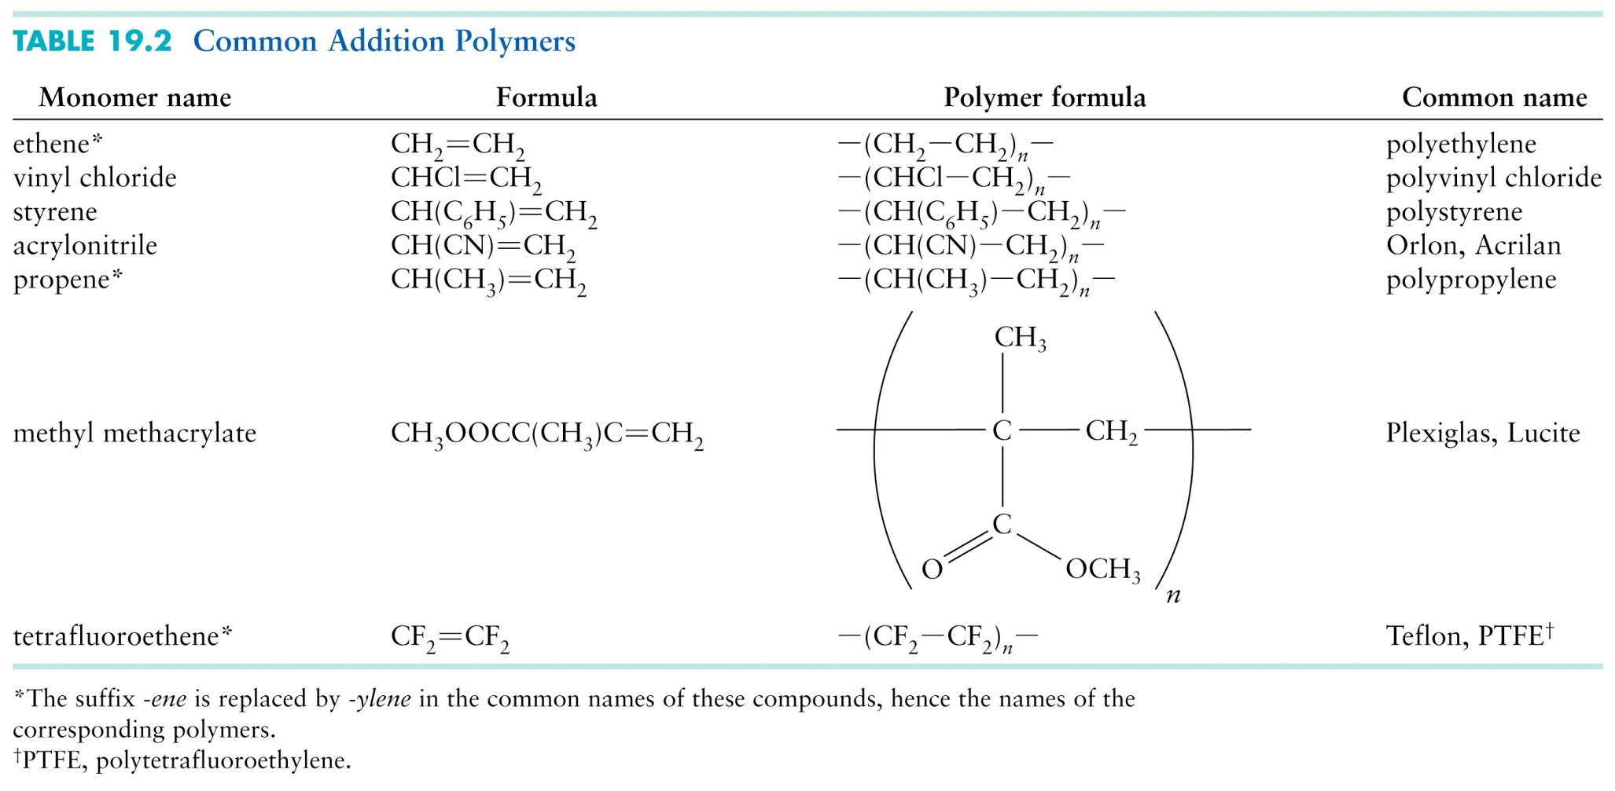
Example of addition polymers

Slide 17
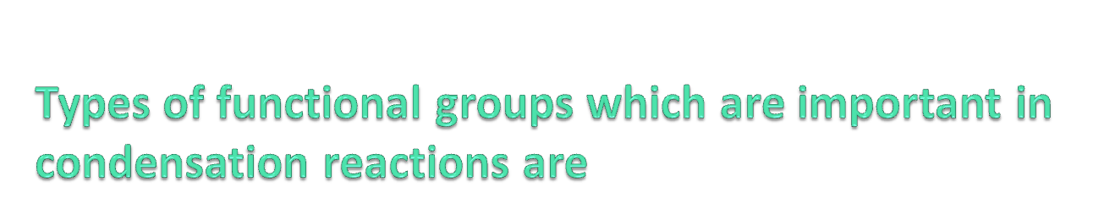
1st group | 2nd group | Product | Example
Hydroxyl -OH | Carboxyl -COOH | Polyester -OOC- | Polyethylenetere-phthalate(terylene)
Amino _NH2 | Carboxyl -COOH | Polyamide _NH-CO- | Nylon-6:6
Hydroxyl -OH | Isocyanate OCN- | Polyurethane -OC-NH- | Spandex fibre

Slide 18
Types of polymers
On the basis of source:
a) Natural ----- which are found in nature in animals and plants starch(polymer of α-D-glucose, cellulose(polymer of β-D-glucose), proteins(polypeptides,polyamides),nucleic acids,
natural rubber(a polymer of cis-iso prene)
Gutta percha (polymer of trans isoprene)
b) Synthetic……PE, PP, PS, PVC,nylon,terylene,bakelite

Slide 19
On the basis of structure
Linear polymers:posess high m.p,density,and tensile strength due to close packing of polymer chain
High density polythene(HDPE)
Nylons, polyester
Branched chain polymers: posess low m.p density,and tensile strength due to poor packing of polymer chain in the presence of branches.
low density polyethene(IDPE),glycogen,amylopectin
Three dimensional network polymers: Hard,rigid,brittle,donot melt but burn on strong heating due to the presence of cross links
bakelite,urea-formaldehyde ,melamine-formaldehyde

Slide 20
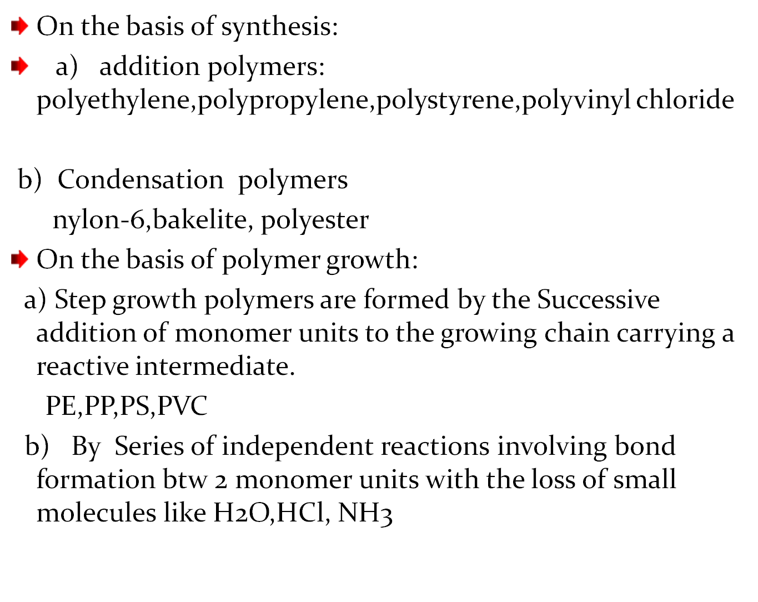

Slide 21
On the basis of molecular forces:
a) Thermoplastic polymers:
Linear long chain polymers which can be softened on heating and hardened on cooling
Hardness is temporary property
Can be prosessed again and again
PE, PP, PVC, PS, Teflon, Nylon
b) Thermosetting polymers:
Permanent setting polymers
Three dimensional cross linked structure with strong covalent bonds
Cannot be reprocessed

Slide 22
Polyester,bakelite,epoxy resins,urea formaldehyde resin
Elastomers: (or synthetic rubber)
Any rubber like structure which can be stretched at least thrice its length
Fibres: whose chains are held together by strong intermolecular forces like hydrogen bonding.
Cryatalline,High tensile strength

Slide 23
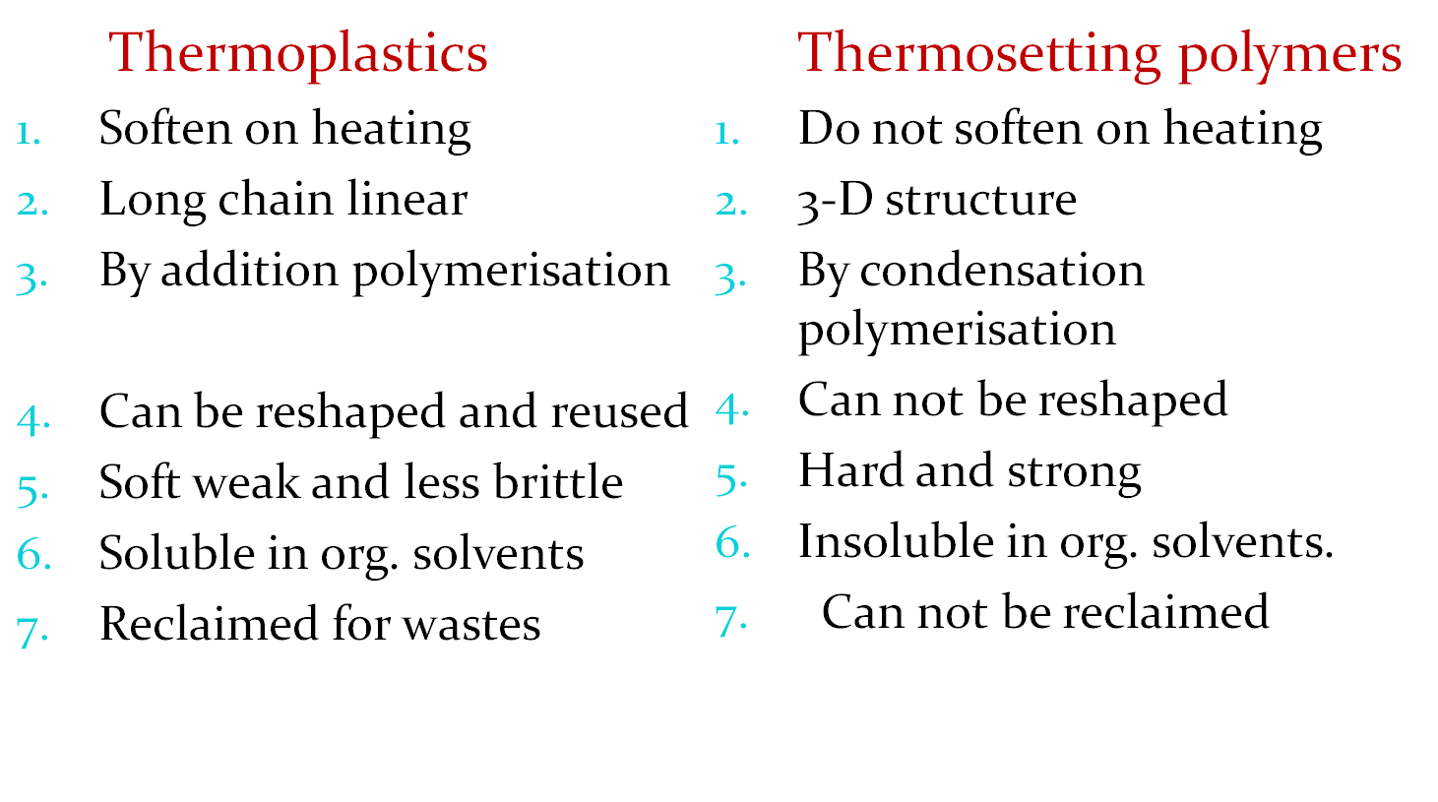
Thermoplastics vs. Thermosetting plastics

Slide 24
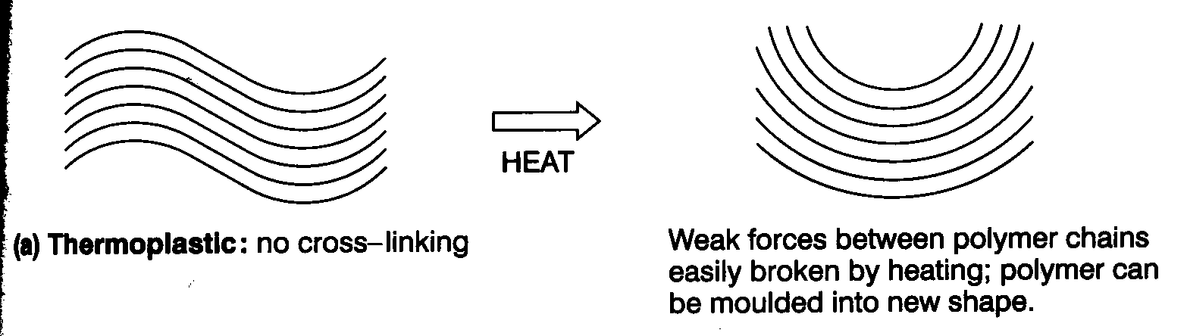
Thermoplastics (80%)
No cross links between chains.
Weak attractive forces between chains broken by warming.
Change shape - can be remoulded.
Weak forces reform in new shape when cold.

Slide 25
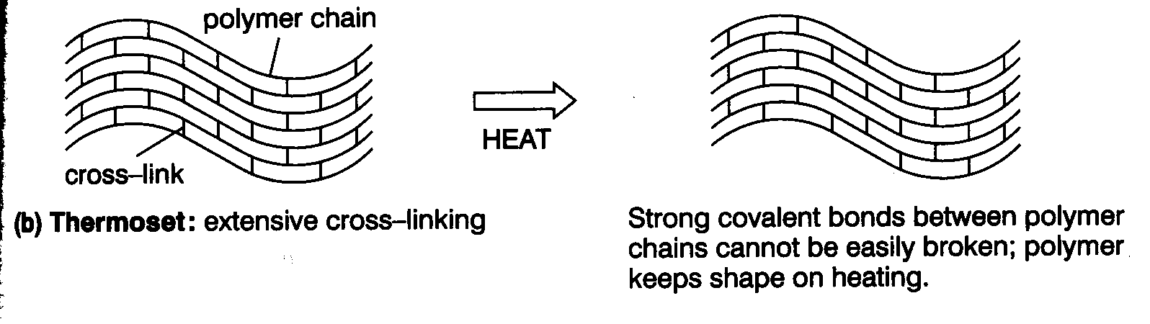
Thermosets
Extensive cross-linking formed by covalent bonds.
Bonds prevent chains moving relative to each other.
What will the properties of this type of plastic be like?

Slide 26
Addition polymerisation
Monomers contain C=C bonds
Double bond opens to (link) bond to next monomer molecule
Chain forms when same basic unit is repeated over and over.
Modern polymers also developed based on alkynes R-C C - R’

Slide 27
Copolymerisation
when more than one monomer is used.
An irregular chain structure will result eg propene/ethene/propene/propene/ethene
Why many polymers designers want to design a polymer in this way?
(Hint) Intermolecular bonds!

Slide 28
Mechanism
..
RO:
H₂C
CHCH₃
•
Notes:
9

Slide 29
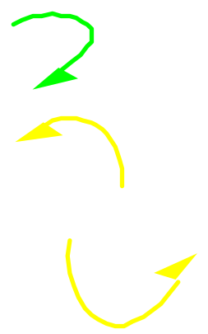
Mechanism
..
RO:
H₂C
CHCH₃
•
H₂C
CHCH₃
Notes:
10

Slide 30
Mechanism
..
RO:
H₂C
CHCH₃
H₂C
CHCH₃
•
Notes:
10

Slide 31
Mechanism
..
RO:
H₂C
CHCH₃
H₂C
CHCH₃
•
H₂C
CHCH₃
Notes:
10

Slide 32
Mechanism
..
RO:
H₂C
CHCH₃
H₂C
CHCH₃
H₂C
CHCH₃
•
Notes:
10

Slide 33
Mechanism
..
RO:
H₂C
CHCH₃
H₂C
CHCH₃
H₂C
CHCH₃
•
H₂C
CHCH₃
Notes:
10

Slide 34
Free-Radical AdditionPolymerization of Ethylene
H₂C
CH₂
200 °C
2000 atm
O₂
peroxides
CH₂
CH₂
CH₂
CH₂
CH₂
CH₂
CH₂
polyethylene
Notes:
6

Slide 35
Free-Radical Polymerization of Propene
H₂C
CHCH₃
CH
CH
CH
CH
CH
CH
CH
CH₃
CH₃
CH₃
CH₃
CH₃
CH₃
CH₃
polypropylene
Notes:
6

Slide 36
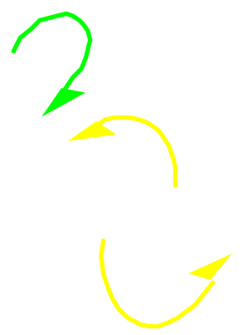
Mechanism
..
RO
•
..
H₂C
CHCH₃
Notes:
7

Slide 37
Mechanism
..
RO:
H₂C
CHCH₃
H₂C
CHCH₃
H₂C
CHCH₃
•
Notes:
10

Slide 38
Likewise...
H₂C=CHCl polyvinyl chloride
H₂C=CHC₆H₅ polystyrene
F₂C=CF₂ Teflon
Notes:
19

Slide 39
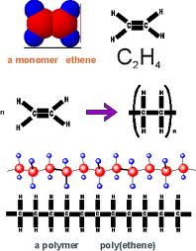
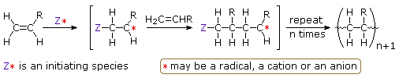
Chain growth polymerization
Addition polymerization
All the atoms in monomer is used to produce a polymer.
Steps in chain reaction:
initiation
propagation
termination

Slide 40
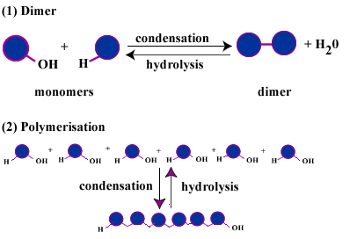
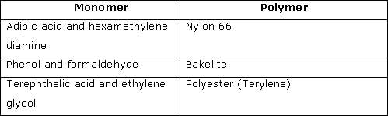
Step growth polymerization
Polymerization mechanism in which bi-functional or multifunctional monomers react to form first dimers, then trimers, longer oligomers and eventually long chain polymers.
Eg: polyesters, polyamides, polyurethanes. Etc
Polymer+molecule with low molecular weight.

Slide 41
Differences between step-growth polymerization and chain-growth polymerization
Step growth
Chain growth
Growth throughout matrix
Rapid loss of monomer early in the reaction
Similar steps repeated throughout reaction process
Average molecular weight increases slowly at low conversion and high extents of reaction are required to obtain high chain length.
Ends remain active (no termination)
No initiator necessary
Growth by addition of monomer only at one end of chain
Some monomer remains even at long reaction times
Different steps operate at different stages of mechanism.
Molar mass of backbone chain increases rapidly at early stage and remains approximately the same throughout the polymerization
Chains not active after termination
Initiator required

Slide 42
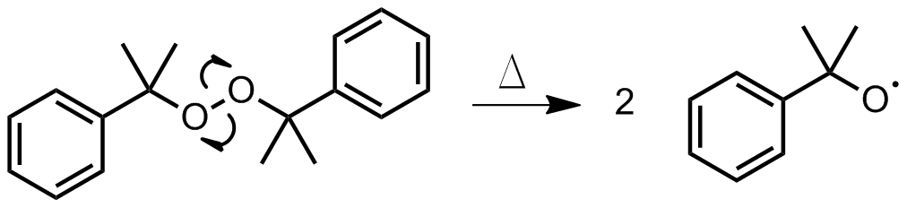
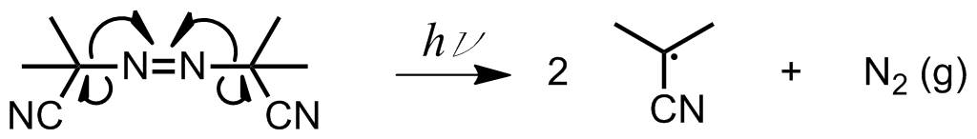
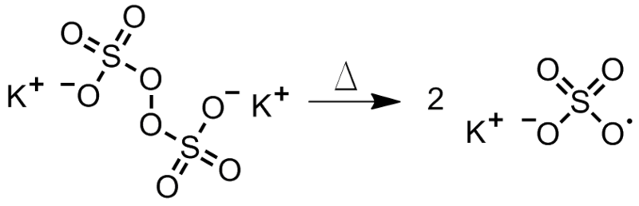
Free radical polymerization
Initiation: active center created.
2 steps
Radicals from initiators
Transfer to monomer
Types of initiation:
Thermal decomposition
Photolysis
Redox reactions
Persulfate

Slide 43
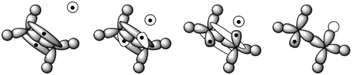



Propagation:
Termination :
Combination of two active chain ends
Combination of an active chain end with an initiator radical

Slide 44
Cationic polymerization
Cationic initiator binds & transfers charge to monomer.
Reactive monomer reacts with other monomer to form a polymer.
Active site: carboniumion , oxonium, sulfonium or phosphonium ion
Monomers: alkoxy. phenyl, vinyl, 1,1-dialkyl-substituted alkene monomers.
Initiator: provide electrophile
eg: bronsted acids(acetic acid,HCL), Lewis acids+electron donor.
Application :polyisobutylene.

Slide 45
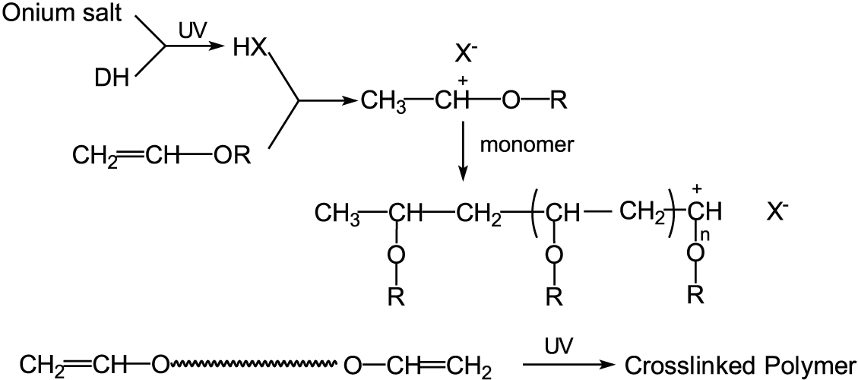
Cationic polymerization

Slide 46
Anionic polymerization
Carried out through carbanion active species.
Monomer: vinyl monomers with substituents on double bond able to stabilise a –ve charge.
  Eg: styrene, dienes, methacrylate, vinyl pyridine, aldehydes, epoxide, episulfide cyclic siloxane, and lactones
Polar monomers:
  eg: acrylonitrile, cyanoacrylate, propylene oxide, vinyl ketone, acrolein, vinyl sulfone, vinyl sulfoxide, vinylsilane andisocyanate.
.

Slide 47
Solvents- polar solvents decrease stability.
initiation : electron transfer, strong acids.
Propagation: very fast,low temp, heat is released.
Termination: quenching, water, alcohol, chain transfer.
Application :polydiene synthetic rubbers, solution styrene/butadiene rubbers (SBR), and styrenic thermoplastic elastomers

Slide 48
Polymerization techniques
Bulk polymerization
Solution polymerization
Suspension polymerization
Emulsion polymerization

Slide 49
Bulk polymerization
Mass or bulk polymerization: Polymerization of the undiluted monomer.
carried out by adding a soluble initiator to pure monomer into liquid state.
Viscosity increases dramatically during conversion
2 types
  Quiescent bulk polymerization
  Eg: phenol- formaldehyde condensation
  Stirred bulk polymerization
  Eg: nylon 66.

Slide 50
Advantages
Disadvantages
The system is simple and requires thermal insulation.
The polymer is obtained pure.
Large castings may be prepared directly molecular weight distribution can be easily changed with the use of a chain transfer agent.
Heat transfer and mixing become difficult as the viscosity of reaction mass increases.
Highly exothermic.
The polymerization is obtained with a broad molecular weight distribution due to the high viscosity and lack of good heat transfer.
Very low molecular weights are obtained.

Slide 51
Solution polymerization
Monomer dissolved in solvent, formed polymer stays dissolved. Depending on concentration of monomer the solution does not increase in viscosity.
Advantages Disadvantages
* Product sometimes * Contamination with solvent
directly usable
* Controlled heat release * Chain transfer to solvent
* Recycling solvent
Applications
Acrylic coating, fibrespinning, film casting

Slide 52
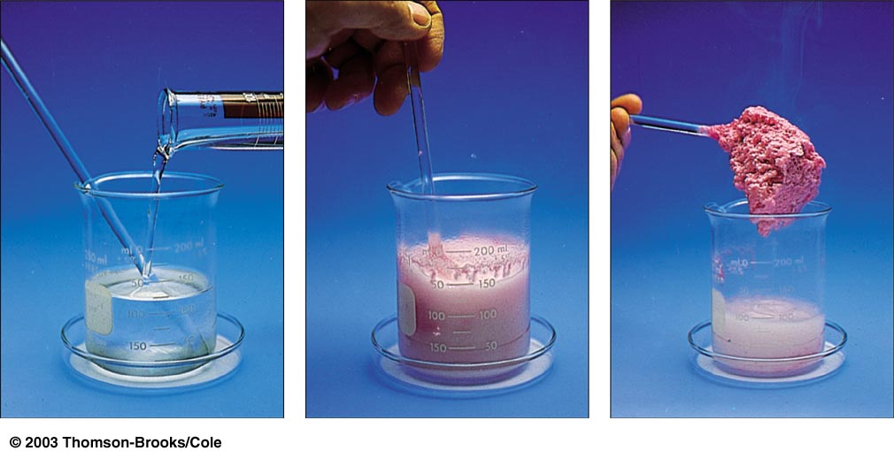

Slide 53
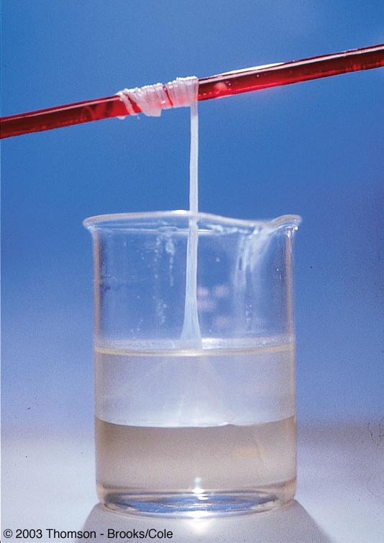

Slide 54
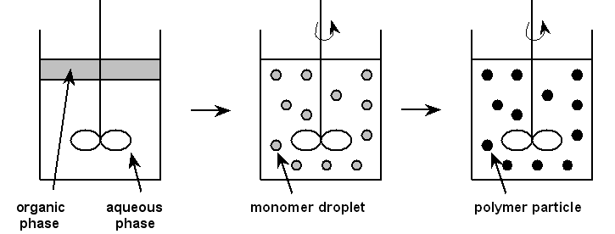
Suspension polymerization
Liquid or dissolved monomer suspended in liquid phase.
Suspending agent- PVA, methyl cellulose.
Initiator
Particle size 10-500µm.

Slide 55
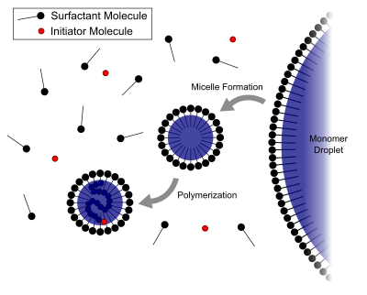
Emulsion polymerization
Water
Monomer
Surfactant
Examples:
Synthetic rubber-styrene-butadiene (SBR), Polybutadiene, Polychloroprene.
Plastics-PVC, polystyrene, Acrylonitrile-butadiene-styrene terpolymer (ABS).
Dispersions-polyvinyl acetate, polyvinyl acetate copolymers, latexacrylic paint, Styrene-butadiene, VAE

Slide 56
Advantages
Disadvantages
Surfactants and polymerization adjuvants -difficult to remove
For dry (isolated) polymers, water removal is an energy-intensive process
Designed to operate at high conversion of monomer to polymer. This can result in significant chain transfer to polymer.
Can not be used for condensation, ionic or Ziegler-Natta polymerization.
High molecular weight polymers
fast polymerization rates.
allows removal of heat from the system.
viscosity remains close to that of water and is not dependent on molecular weight.
The final product can be used as such ,does not need to be altered or processed

Slide 57
Polyethylene
The liquid gases under high pressure is pumped into a heated pressure vessel maintained 150 to 250c .
By the catalytic effect of traces of oxygen present ethylene is polymerized in to poly ethylene.
Properties:
A rigid waxy solid
white, transulent non polar meterial
Chemically resistant to strong acids, alkalies and salt solutions
Good insulator of electricirty

Slide 58
Swollen and permeable to most oils and organic solvents particularly to kerosene
Due to its high symmetrical structure polyethylene crystallizes very easily
Polyethylene produced by high pressure process has a branched structure and therefore flexible and tough
Low pressure process results in a completely linear PE having high density and better chemical resistance
Commercial PE is divided in to 3 types
Type I or low density PE (0.91-0.925g/cm³)
Type II or medium density PE(0.925 -0.940 g/cm³)
Type III or high density PE (0.941- 0.965 g /cm³)

Slide 59
USES
For making high frequency insulator parts
Bottle caps
Flexible bottles
Kitchen and domestic appliances
Toys
Sheets for packing materials
Tubes pipes
Coated wires and cables
Bags for packing

Slide 60
Poly propylene
Isomer of propylene by Zeigler natta reaction
Properties
Stereo regular ( iso tactic)
Highly crystalline polymer (M.P 160-170 c)
Better hardness
Strength
Stiff than PE
More resistant than PE

Slide 61
USES
In producing moulded parts and fibers
Its fibers are used in making ropes(extremely strong by weight)
Carpets
Furniture upholstery,Blankets,Hand bags, etc
Water pipes
Washing machine parts
Sterilizable hospital equipment

Slide 62
Poly Vinyl Chloride
Is obtained by heating a water emulsion of Vinyl chloride in presence of small amounts of benzyl peroxide or hydrogen peroxide in an auto clave under pressure
Vinyl chlodire so needed is prepared by treating acetylene at 1 to 1.5 atm with hydrogen chloride at 60-80 °C in the presence of metal chloride as catalyst

Slide 63
Properties
PVC is acolourless ,Odourless ,inflammable chemically inert ,resistant to light,atmospheric oxygen,inorganic acids,alkalies but soluble in hot chlorinated hydrocarbons such as ethyl chloride
Greater stiffness and rigidity compared to PE but is brittle
Most widely used synthetic plastic

Slide 64
USES
Rigid PVC has superior chemical resistance and high rigidity but is brittle
Used for making sheets which are employed for tank lining
Light fittings, safety helmets
Refrigerator components
Tyres
Cycle and motor cycle mudguards

Slide 65
Poly vinyl Acetate
Properties
It is colorless, transparent material
Resistant to water, atmospheric oxygen and chemicals
It is fairly soluble in organic solvents
Good heat resistance but slight yellowing takes place after prolonged storage above 120 C
It is harmless if taken orally

Slide 66
USES
Under the influence of compressive or tensile forces articles made from polyvinyl acetate are distorted, even at room temperature, so it is not used for moulding purposes
However used for making records,
chewing gums
surgical dressings,
paints,
lacquors,

Slide 67
plastic emulsions,
coatings,
card-boards,
wrap-ping papers,
finishing textiles and other fabric and
bonding paper,
leather,
textiles

Slide 68
Poly Styrene
It is transparent
Light
Excellent moisture-resistant
It can be nitrated by fuming nitric acid and sulphonated by Conc.sulphuric acid, at 100 C it yields water soluble emulsions
It is highly electric insulating
Highly resistant to acids and good chemical resistant
Brittle
It has a unique property of transmitting light through curved sections

Slide 69
Uses
In moulding articles like toys, combs,
Buttons, buckles, radio and television patrs
Refrigerator parts, battery cases
High frequency electrical insulators,
Lenses,
Indoor lightening panels

Slide 70
Poly methyl methacrylate or Lucite or plexiglass
Is obtained by the polymerisation of methyl methacryalate (ester of methyl acrylic acid) in presence of acetyl peroxide or hydrogen peroxide.
It is an acrylic polymer

Slide 71
Properties
PMMA is hard fairly rigid material with high softening point of about 130-140 C but it becomes rubbber like at 65 C
This relatively wide span of temperature from its rigid state to viscous consistency accounts for outstanding shape forming properties of PMMA.
It has high optical transperancy
High resistance to sun light and ability of transmitting light accurately even in curved sections

Slide 72
Uses
For making lenses
Air craft light fixtures
Bomber noses
Gun turrets
Cockpit canopies
Transparent models of complicated mechanisms
Bone splints
Artificial eyes
Dentures
Emulsions
Paints
Adhesives
Automotive appliances
Jewellery
Wind screens
T.V screens
guards

Slide 73
Poly acrylonitrile
I t is obtained by the polymerisation of acrylonitrile in the presence of a peroxide
It is an acrylic polymer
Properties:
It is a high melting , hard and horny solid.

Slide 74
Uses
As a substituent for wool for making fibres like acrilan. Thus it is used for making warm clothes, carpets , blankets etc

Slide 75
Phenolic resins or Phenoplasts
They are the condensation polymerisation products of phenolic derivatives(like phenol, resorcinol) with aldehydes (like formaldehyde).
Most important member of this class is Bakelite
It is prepared by condensing phenol with formaldehyde in presence of acidic/alkaline catalyst
The initial reaction results in the formation of o- and P-hydroxy methyl phenol, which reacts to form liner polymer navolac

Slide 76
During moulding hexamethylene tetra amine is added , this provides formaldehyde, which converts the soluble , fusible navolac in to a hard infusible and insoluble solid of cross linked structure
Properties:
Rigid
Hard
Scratch resistant
Infusible
Water resistant
Insoluble solid

Slide 77
Resistant to non oxidising acids, salts and many organic solvents but are attached by alkaliesbecause of the presence of free hydroxy group in their structure
They posses excellent insulating character

Slide 78
Uses
For making electrical insulating partslike switches, plugs, switch boars, heater handles etc
For making moulded articles like telephone parts, cabinets of radio and television
As adhesives for grinding wheels used in propeller shafts for paper industry for rolling mills

Slide 79
Properties
Polycarbonates are charecteriseed by impact and tensile strength over a wide a range of tempetature.
They are soluble in organic solvents and alkalies
Uses:
For preparing moulded domestic ware
Electric insulators in electronics and electrical industries.

