Slide 1
CORROSION

Slide 2
CONTENTS
Introduction
Cause
Theories of corrosion
Types of corrosion
Factors affecting corrosion
Corrosion control

Slide 3
Corrosion:
It is the process of gradual deterioration of a metal from its surface due to unwanted chemical or electrochemical interaction with its environment.
Examples:
Rusting of iron.
Formation of green layer on copper surface.

Slide 4

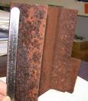
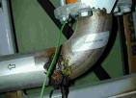
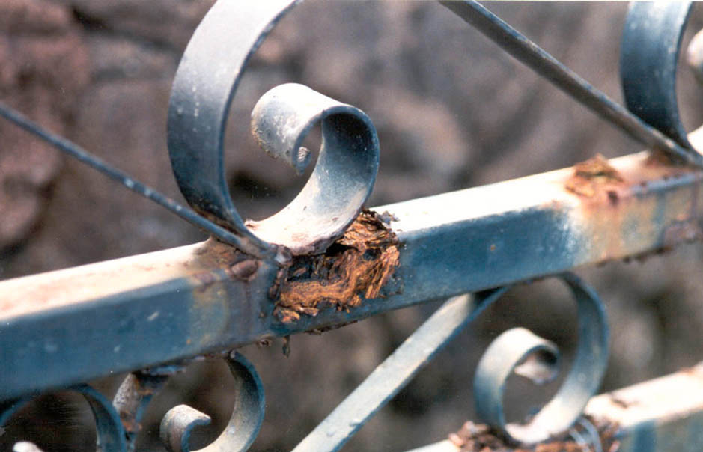
Few corrosion cases in daily life

Slide 5
Corrosion Engineering:
The branch of Engineering dealing with the study of corrosion mechanisms and to prevent or control it economically and safely.

Slide 6
FACTS ABOUT CORROSION
Corrosion is a natural and electrochemical process.
Corrosion leads to tremendous loss. It can’t be eliminated completely. However, its extent can be minimized.
Corrosion is exactly the reverse of extraction of metals and also known as weeping of metals.

Slide 7
CAUSE OF CORROSION
Ore of Metal Pure Metal Corroded metal
(Low energy (High energy (Low energy
state) state) state)
Metallurgical operation
Environment

Slide 8
EFFECTS OF CORROSION
Loss of useful properties of metal and thus loss of efficiency.
Decrease in production rate.
Increase in maintenance and production cost.
Contamination of product.
Leakage of toxic liquids or gases.

Slide 9
Theories of corrosion:
A. Chemical or Dry Theory
B. Wet or Electrochemical Theory
C. The acid theory

Slide 10
CHEMICAL OR DRY THEORY
By direct attack of oxidizing agent (O₂, S, halogens, H₂S) in absence of a liquid or electrolyte

Slide 11
Types of Chemical Corrosion
Oxidation corrosion
Corrosion by other gases
Liquid metal corrosion.

Slide 12
1. Oxidation Corrosion
2M 2M^{n+} + 2ne⁻ (oxidation)
nO₂ + 2ne⁻ 2nO²⁻ (reduction)
2M + nO₂ 2M^{n+} + 2nO²⁻
^{Metal oxide}
MO layer: FILM – thickness ≤ 300Å
SCALE - thickness > 300Å

Slide 13
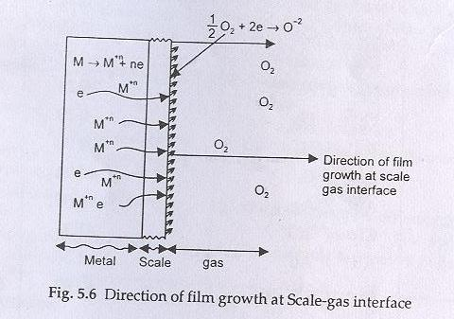
Case I: When metal ion diffuses faster outward:
In this case oxide layer is formed at the metal oxide – gas or scale – gas interface. e.g. In FeO, CoO, NiO, Cu₂O

Slide 14
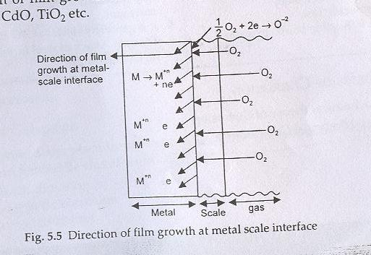
Case II: When oxygen diffuses inward:
In this case oxide layer is formed at the metal- scale interface or metal – metal oxide interface. e.g in ZnO, CdO, TiO₂ etc

Slide 15


Nature of metal oxide layer
^{a) Stable film –}An impervious layer is formed, which checks further oxidation corrosion.
^{e.g.} oxide films on Al, Sn, Pb, Cu etc.
b) Unstable film-
Metal oxide Metal + O₂
O₂ Metal oxide
decomposes
e.g. in Au and Ag

Slide 16

c) Volatile film- oxide layer volatilizes leaving the underlying metal surface for further attack. E.g. molybdenum oxide (MoO₃) is volatile.
O₂ metal oxide
volatilizes
d) Porous film- atmospheric O₂ have access to the
underlying surface of metal.

Slide 17
Pilling-Bedworth rule
Specific volume ratio = volume of metal oxide
Volume of metal
Smaller Specific volume ratio, Greater corrosion
If Volume of metal oxide ≥ volume of metal
Oxide layer is protective or non-porous
e.g. Al
If Volume of metal oxide < volume of metal
Oxide layer is porous
e.g. Alkali and alkaline earth metals

Slide 18
2. Corrosion by other gases-
CO₂, SO₂,Cl_{2,}H₂S, etc
Nature of chemical Interaction
Film formed

Slide 19
Protective or non-porous.
AgCl layer formed by the attack of
Cl₂ on Ag
Film
Non-protective or porous.
i) Formation of volatile SnCl₄ by the
attack of dry Cl₂ on Sn.
ii) In petroleum industry, H₂S at high T
attacks steel forming porous FeS scale

Slide 20
3. Liquid metal corrosion- Occurs due to the
chemical action of flowing liquid metal at high T on
solid metal or alloy.
Possible processes are:
Dissolution of a solid metal by a liquid metal
Internal penetration of the liquid metal into the solid
metal
Eg. Coolant (sodium metal) leads to corrosion of cadmium in nuclear reactor

Slide 21
WET OR ELECTROCHEMICAL THEORY
Also called ‘immersed corrosion’.
Two essential requirements are:
i) Formation of anodic and cathodic areas
ii) Electrical contact between the cathodic and anodic parts to enable the conduction of e⁻
Mechanism
i) Anodic reactions
M_{(s)} M^{n+}_{(aq)} + ne⁻ (oxidation)
Fe_{(s)} Fe²⁺_{(aq)} + 2e⁻ (oxidation)

Slide 22
ii) Cathodic reactions
a) Electroplating
Cu²⁺_{(aq)} + 2e⁻ Cu_{(s)}
b) In acidic solution in the absence of O₂
2H⁺ + 2e⁻ H₂
c) In acidic solution in the presence of O₂
O₂ + 4H⁺ + 4e⁻ 2H₂O
d) In neutral or alkaline medium in the absence of O₂
2H₂O + 2e⁻ H₂ + 2OH⁻
(e) In neutral or alkaline medium in the presence of O₂
O₂ + 2H₂O + 4e- 4OH-

Slide 23
Example: Rusting of iron occurs by O₂ in the presence
of aqueous solution
At anode Fe Fe²+ 2e⁻
At cathode 1/2O₂ + H₂O + 2e⁻ 2OH⁻
Overall reaction Fe + 1/2O₂ + H₂O Fe²⁺ + 2OH⁻ or Fe(OH)₂

Slide 24
(i)In excess supply of oxygen: In excess supply of oxygen, ferrous hydroxide is easily oxidized to ferric hydroxide.
2Fe(OH)₂ + H₂O + 1/2O₂ 2Fe(OH)₃
Fe₂O₃.xH₂O
Yellow rust
(ii) In limited supply of oxygen: In limited supply of oxygen, black magnetite Fe₃O₄ or ferroferric oxide is formed.
Fe(OH)₂ Fe₂O₃.FeO.6H₂O
Black

Slide 25
Wet corrosion Dry corrosion
It takes place in presence of water It takes place in absence of liquid or
or an electrolyte. electrolyte. Gases and vapours are
the corrodants.
It is an electrochemical attack. It is a chemical attack.
It generally takes place at low It takes place at high temperature.
temperature.
It is also known as low It is also known as high
temperature corrosion. temperature corrosion.
It is generally fast. It is generally slow.
Eg. Rusting of iron in water. Eg. Attack of steel furnace by gases at
high temperature.

Slide 26
The Acid Theory
Applicable particularly to rusting of iron
2Fe + O₂ + 4CO₂ + 2H₂O 2Fe(HCO₃)₂
2Fe(HCO₃)₂ + H₂O + [O] 2Fe(OH)CO₃+2CO₂+ 2H₂O
2Fe(OH)CO₃ + 2H₂O 2Fe(OH)₃ + 2CO₂

Slide 27
TYPES OF CORROSION
[I] Galvanic Corrosion (Bimetallic corrosion):
E.g. Zinc and copper couple
More reactive Zn Zn²⁺ + 2e⁻ At anode
(Corrodes)
Less reactive Cu²⁺ + 2e⁻ Cu At Cathode
(protected)

Slide 28
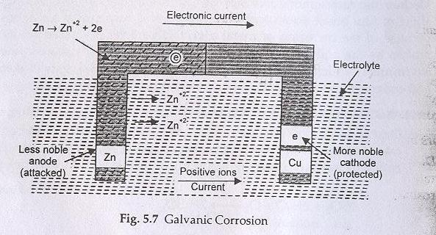

Slide 29
Factors affecting galvanic corrosion:
Potential difference between the two metals coupled
Relative area of cathode and anode
e.g. a) Steel pipe connected to copper plumbing.
b) Steel screw in brass marine hardware

Slide 30
Electrochemical series Galvanic series
The arrangement of metals and The arrangement of metals and alloys in non-metals in increasing order decreasing order of their corroding their standard reduction potential tendency in an unpolluted sea water
It contains metals and non-metals It contains metals and alloys.
It is an ideal series It is a practical series
It gives information about the It gives information about the
displacement tendencies relative corrosion tendencies

Slide 31
[II] Erosion Corrosion:
Due to abrading action of flow of gases or mechanical rubbing action of solids over the metal surface.
[III] Crevice Corrosion:
Due to cracks in paint coating or crevice between metallic objects like bolts, nuts etc.
[IV] Pitting Corrosion:
Most dangerous form of corrosion as it leads to sudden failure of material due to formation of holes.

Slide 32
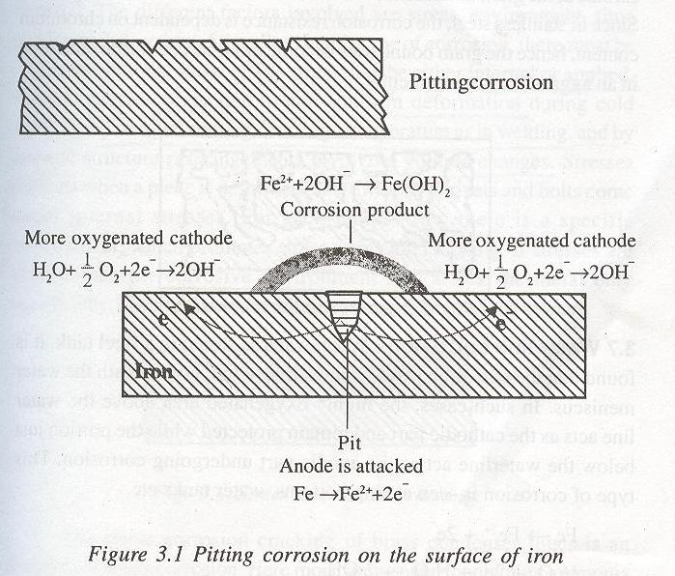

Slide 33
Facts about pitting corrosion
Pitting corrosion is autocatalytic, self stimulating and self propagating.
It takes place exclusively in chloride and chloride containing environment.

Slide 34
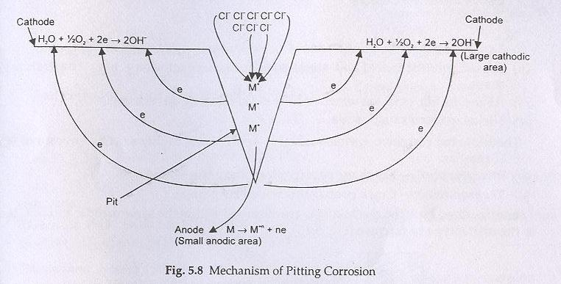

Slide 35
[IV] Differential aeration Corrosion (Oxygen Concentration Cell Corrosion)
One part of the metal is exposed to a different air/O₂ concentration from the rest of the part.
Portion with lesser O₂ = Anode
Portion with more O₂ = Cathode
e.g. A iron nail inside the wood undergoes corrosion easily

Slide 36
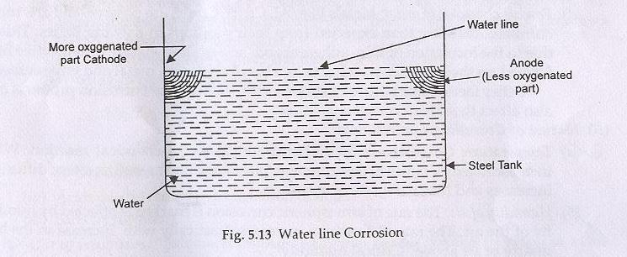
[V] Waterline Corrosion

Slide 37
[VI] Micro-Biological Corrosion :
Due to metabolic activity of various micro-organisms
[VII] Stress-Corrosion Cracking
Metal under stress becomes more anodic and tend to increase the rate of corrosion.
The stress can be due to non-uniform deformation by unequal cooling from high temperature as in welding

Slide 38
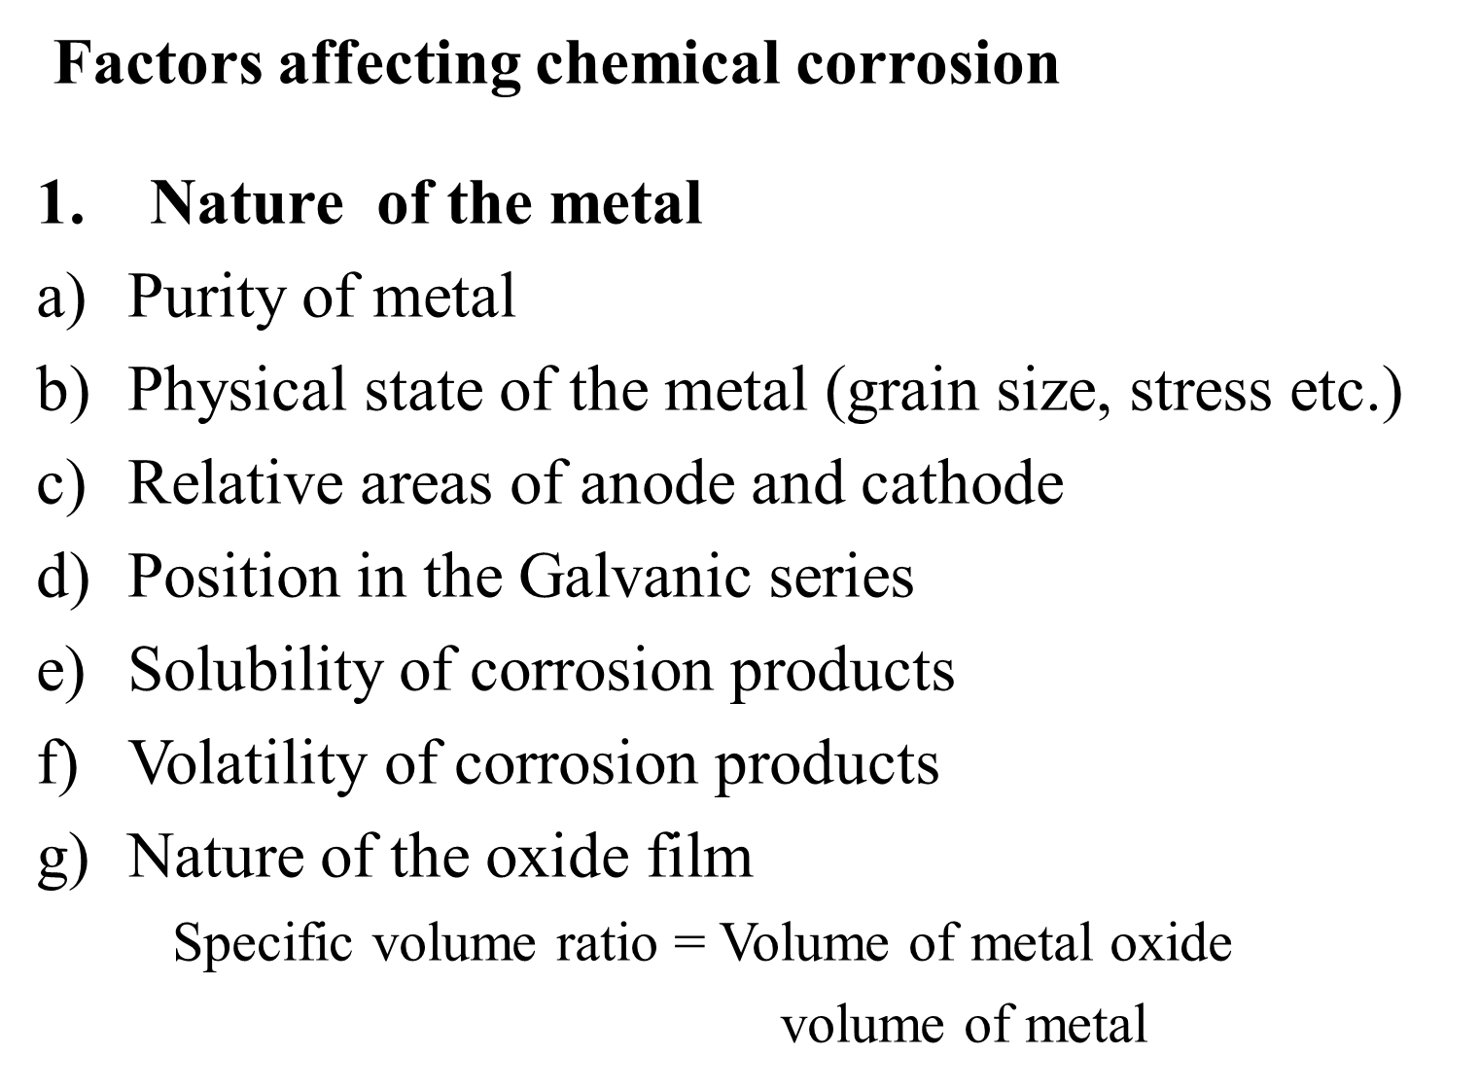

Slide 39
Nature of environment
Temperature
Humidity
Effect of pH
Presence of impurities in atmosphere: Corrosive gases (CO₂, H₂S, SO₂ etc.) in the vicinity of industrial area
Nature of ions present in electrolyte: Chloride ions present in the medium destroy the protective film, while silicate in the medium leads to the formation of insoluble film over the metal surface.
Formation of O₂concentration cell

Slide 40
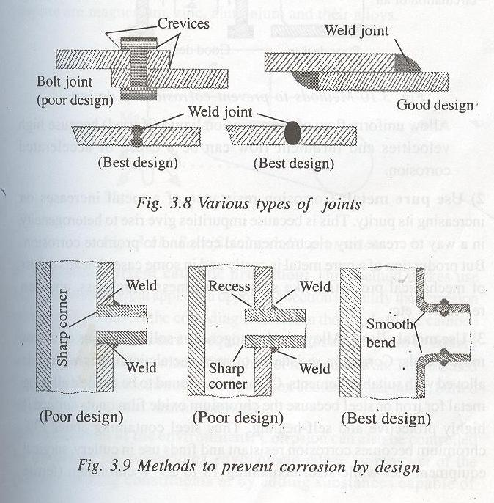
PROTECTION FROM CORROSION
[I] Material Selection and Design

Slide 41
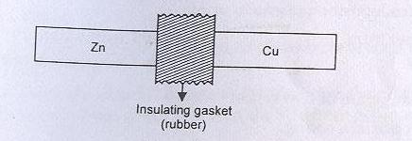
When contact of dissimilar metals is unavoidable, suitable insulator should be inserted between them to reduce current flow and attack on the anode.

Slide 42
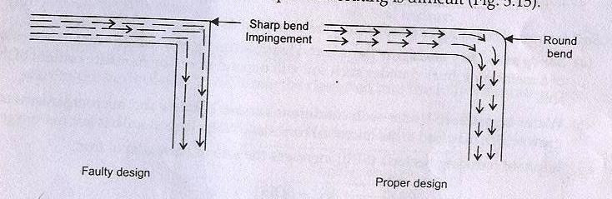

Slide 43
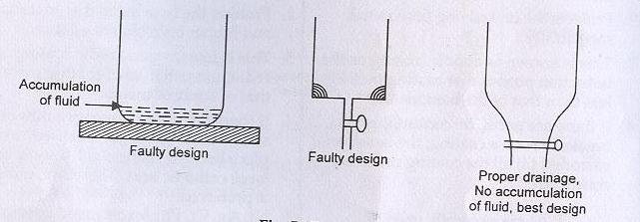

Slide 44
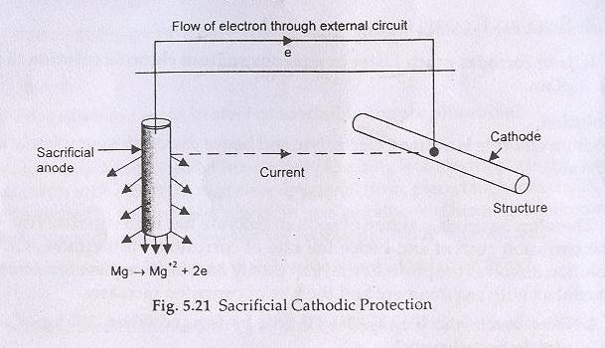
[II] Cathodic Protection (Electrochemical protection)
(i) Sacrificial Anodic Protection:

Slide 45
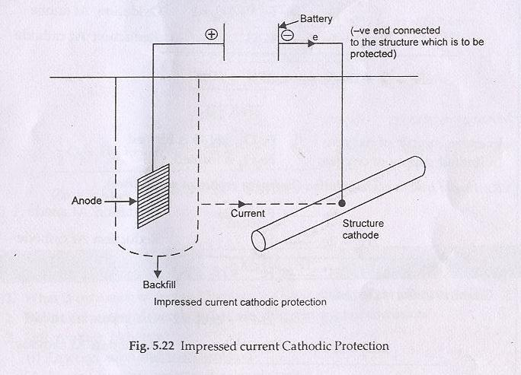
(ii) By impressed current cathodic protection

Slide 46
Advantages of impressed current cathodic protection over sacrificial anodic protection
It is controlled from outside.
No anode has to be replaced.

Slide 47
[III] Modifying the Environment
Deaeration: Removal of oxygen
Deactivation : Addition of chemicals, capable of combining rapidly with O₂ in aqueous solution
Dehumidification: by using silica gel
Acid neutralization: by lime
Salt removal: Using ion-exchange resins
Use of inhibitors: By forming a layer in between which acts as a barrier between the material and environment or by retarding the anodic or cathodic or both processes

Slide 48
4. Use of protective coatings
Metallic coatings: By electroplating, hot dipping, vaporising, metal spraying or cementation. Zn, Sn, Ni, Al, Cr, Cu etc. are used for coating the metal.
Inorganic coatings: Chemical dip coating (phosphate or chromate), anodised oxide coating (oxide film) and porcelain enamel coating.
Organic coating: Protecting metals by using paints, varnishes, enamels and lacquers.

Slide 49
Metallic coating are of two types:
Sacrificial coating Noble coating
Base metal is coated with a metal which is Base metal is coated with a
more reactive than the base metal. metal which is more noble than the base metal.
Protects the underlying base metal sacrificially. Protects the underlying base metal due to its noble character and higher corrosion resistance.
This is known as anodic coating as the reduction This is known as cathodic coating as
potential of coating metal is less than that the reduction potential of coating the base metal. Metal is more than that of the base metal
Zn, Cd, Al are generally used as sacrificial coating Ni, Ag, Cr, Pb, Au etc. are generally
used as noble coating
E.g. Galvanised iron i.e. coating of Zn on Fe E.g. coating of Sn on Fe

Slide 50
Passivation
Passivation is the phenomenon by which a metal or alloy shows high corrosion resistant due to the formation of a highly protective, very thin (about 0.0004 mm thick) surface film.
Example- Ti, Cr and Al containing stainless steel alloys exhibit outstanding corrosion resistant in the presence of oxygen.

