Slide 1
THE PHOTOELECTRIC EFFECT
THIS IS THE EMISSION OF ELECTRONS FROM MATTER WHEN MATTER IS ILLUMINATED BY CERTAIN TYPES OF ELECTROMAGNETIC RADIATION.
IT WAS FIRST OBSERVED BY HEINRICH HERTZ IN 1887
THE EFFECT OCCURS WHEN METALS ARE ILLUMINATED BY UV LIGHT AND CAN OCCUR WITH THE ALKALI METALS FOR VISIBLE LIGHT.

Slide 2
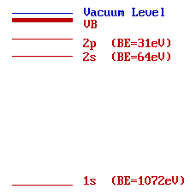
Quantum Implications
Electrons must exist only at specific energy levels within an atom →→
Notes:
Because the quanta of energy carried by photons can only be wholly absorbed by atoms, the theory demanded that

Slide 3
The electromagnetic radiation releases electrons from the metal cathode. These electrons are attracted to the anode and complete a circuit allowing a current to flow
Radiation
Anode +ve
vacuum
Cathode -ve
electrons
mA

Slide 4
If the polarity is reversed, the pd across the tube can be increased until even the most energetic electrons fail to cross the tube to A. The milliammeter then reads zero.
Radiation
A
C
electrons
electrons
V
mA
The p.d. across the tube measures the maximum kinetic energy of the ejected electrons in electron volts.

Slide 5
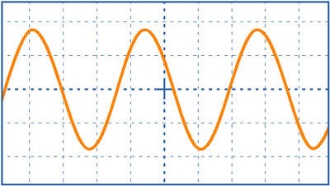
At the end of the nineteenth century, Classical Electromagnetic Wave Theory thought of light waves as being like water waves.
A
The wave’s Intensity or energy was directly proportional to the square of the Amplitude, A.

Slide 6
Photoelectric Effect
Metal Foil

Slide 7
Photoelectric Effect
Metal Foil

Slide 8
Photoelectric Effect
As blue light strikes the metal foil, the foil emits electrons.

Slide 9
Photoelectric Effect

Slide 10
Photoelectric Effect
When red light hits the metal foil, the foil does not emit electrons.
Blue light has more energy than red light.
How could we get more energy into the red light?
Try increasing the brightness.

Slide 11
Photoelectric Effect

Slide 12
Photoelectric Effect
Well, that didn’t work!
Maybe its still not bright enough.

Slide 13
Photoelectric Effect

Slide 14
Photoelectric Effect
Still not working.
What happens with brighter blue light?

Slide 15
Photoelectric Effect

Slide 16
Photoelectric Effect
More blue light means more electrons emitted, but that doesn’t work with red.

Slide 17
Photoelectric Effect

Slide 18
Photoelectric Effect
Wave theory cannot explain these phenomena, as the energy depends on the intensity (brightness)
According to wave theory bright red light should work!
BUT IT DOESN’T!

Slide 19
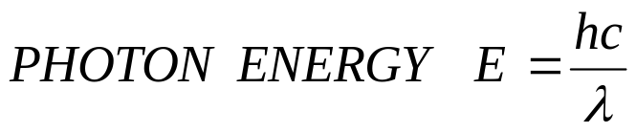
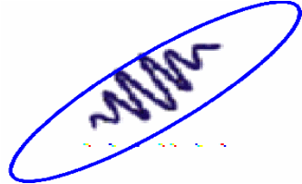

frequency
uv light < 400 nm
the visible spectrum
violet light light 400 nm
red light
light 700 nm
λ
Blue photon
Red photon
Which photon has the most energy ?????
BLUE !!!

Slide 20
An analogy with a ball and a pit
show photon view
Light like a Kicker…
Puts in energy. All concentrated
on one ball/electron.
Blue kicker always kicks the same,
and harder than red kicker
always kicks.
Ball emerges with:
KE = kick energy - mgh
mgh = energy needed to
make it up hill and out.
mgh for highest electron
analogous to work function.
h
Kick energy. Top ones
get out, bottom don’t.
Harder kick (shorter
wavelength light),
more get out.
electrons
metal

Slide 21
An analogy with a ball and a pit
show photon view
Light like a Kicker…
Puts in energy. All concentrated
on one ball/electron.
Blue kicker always kicks the same,
and harder than red kicker
always kicks.
Ball emerges with:
KE = kick energy - mgh
energy needed to get most
energetic electron out of pit
(“work function”)
h
h
sodium- easy to kick out
small work function ⇔ shallow pit
platinum, hard to kick out
large work function ⇔ deep pit

Slide 22
If photon has enough energy, electron emerges with:
KE = photon energy – work function
Photon…
Puts in kick of energy
energy needed to kick
highest electron out of metal.
“WORK FUNCTION” (φ)
Each photon has: Energy = Planks constant * Frequency
(Energy in Joules) (Energy in eV)
E=hf=(6.626*10⁻³⁴ J-s)*(f s⁻¹) E=hf= (4.14*10⁻¹⁵ eV-s)*(f s⁻¹)
E=hc/λ = (1.99*10⁻²⁵ J-m)/(λ m) E= hc/λ = (1240 eV-nm)/(λ nm)
Initial KE of electron = E_{photon} - energy needed to kick
as it comes out of metal electron out of metal
Depends on type of metal.

Slide 23
Photoelectric effect experiment: Apply Conservation of Energy
Energy in = Energy out
Energy of photon = energy needed to kick + Initial KE of electron electron out of metal as exits metal
Loosely stuck electron, takes least energy to kick out
work function (Φ) = energy needed to kick
highest electron out of metal
Electron Potential
Energy
Outside
metal
Inside
metal
Tightly stuck, needs more energy to escape

Slide 24
Apply Conservation of Energy.
Energy in = Energy out
Energy of photon = energy needed to kick + Initial KE of electron electron out of metal as exits metal
What happens if send in bunch of blue photons?
E_{photon}
work function (Φ)
Electron Potential
Energy
Outside
metal
Photon gives electron
“kick of energy”.
Inside
metal
Electrons have equal chance of absorbing photon:
→ Max KE of electrons = photon energy - Φ
→ Min KE = 0
→ Some electrons, not enough energy to pop-out, energy into heat.

Slide 25
Electrons over large range of energy have equal chance of absorbing photons.
E_{phot}
You initially have blue light shining on metal. If you change the frequency to violet light (at same # of photons per second), what happens to the number of electrons coming out?
a. fewer electrons kicked out
b. same # of electrons
c. more electrons kicked out
d. not enough information
E_{phot}
Electron potential
energy
work function Φ
Inside
metal

Slide 26
Electrons over large range of energy have equal chance of absorbing photons.
E_{phot}
work function Φ
elect. potential
energy
metal
c. more electrons come out with violet
absorb blue light and have enough energy to leave
absorb blue light, but don’t come out
so the more energy the light has, the more electrons that come
out, until so much energy that every electron comes out.
(violet and ultraviolet would not be very different in this case)

Slide 27
Typical energies
Photon Energies:
Each photon has: Energy = Planks constant * Frequency
(Energy in Joules) (Energy in eV)
E=hv=(6.626*10⁻³⁴ J-s)*(v s⁻¹) E=hv= (4.14*10⁻¹⁵ eV-s)*(v s⁻¹)
E=hc/λ = (1.99*10⁻²⁵ J-m)/(λ m) E= hc/λ = (1240 eV-nm)/(λ nm)
Red Photon: 650 nm
E_{photon} = 1240 eV-nm = 1.91 eV
650 nm
Work functions of metals (in eV):
Aluminum | 4.08 eV | Cesium | 2.1 | Lead | 4.14 | Potassium | 2.3
Beryllium | 5.0 eV | Cobalt | 5.0 | Magnesium | 3.68 | Platinum | 6.35
Cadmium | 4.07 eV | Copper | 4.7 | Mercury | 4.5 | Selenium | 5.11
Calcium | 2.9 | Gold | 5.1 | Nickel | 5.01 | Silver | 4.73
Carbon | 4.81 | Iron | 4.5 | Niobium | 4.3 | Sodium | 2.28
Uranium | 3.6
Zinc | 4.3

Slide 28
For electron emission, the photon's energy has to be greater than the work function .
The maximum kinetic energy the released electron can have is given by:
E_{K} = photon energy – the work function.
E_{K} = hv - Φ
For every metal there is a threshold frequency, v₀, where hv₀ = Φ ,
that gives the photon enough energy to produce photoemission.
The number of photoelectrons emerging from the metal surface per unit time is proportional to the number of photons striking the surface that in turn depends on the intensity of the incident radiation
It follows that the photo electric current is proportional to the intensity of the radiation provided the frequency of radiation is above threshold frequency.

Slide 29
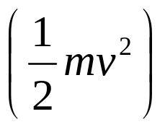
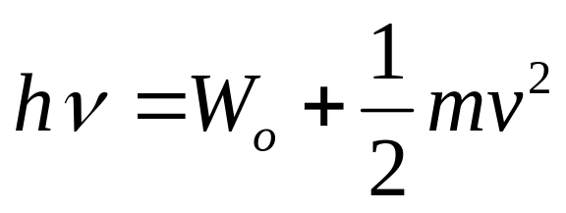
Einstein’s Photo Electric Explanation
The energy of a incident photon is utilized in two ways
A part of energy is used to free the electron from the atom known as photoelectric workfunction (W_{o}).
Other part is used in providing kinetic energy to the emitted electron .
This is called Einstein’s photoelectric equation.

Slide 30
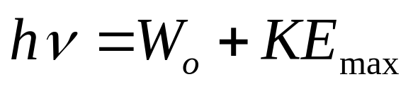
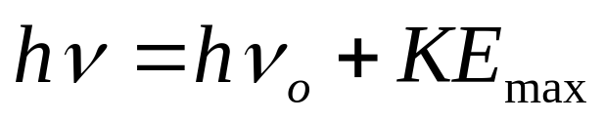
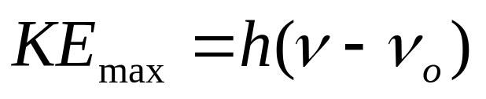
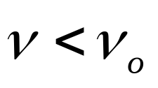
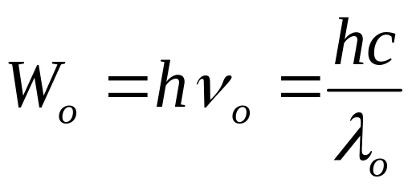
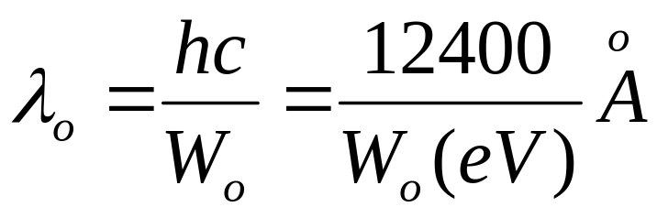
If , no photoelectric effect

Slide 31

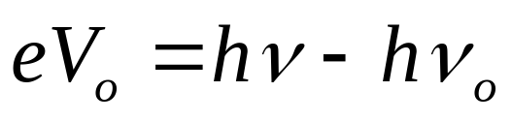
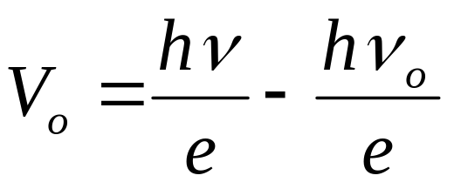


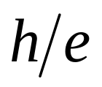
If is the stopping potential, then
It is in form of . The graph with on y-axis and on x-axis will be a straight line with slope

Slide 32
metal A
Maximum E_{K} emitted electrons / J
metal B
Threshold frequency v₀
Frequency v/ Hz
E_{K} = hv - Φ
Work function, Φ
Gradient of each graph = Planck’s constant, h.

Slide 33
Max E_{k} / eV
Potassium
Magnesium
Aluminium
2
1
0 5 10 15
f / Hz 10¹⁴

Slide 34
Summary of Photoelectric experiment results.
1. Current linearly proportional to intensity.
2. Current appears with no delay.
3. Electrons only emitted if frequency of light exceeds
a threshold. (same as “if wavelength short enough”).
4. Maximum energy that electrons come off with
increases linearly with frequency (=1/wavelength).
(Max. energy = -stopping potential)
5. Threshold frequency depends on type of metal.
how do these compare with classical wave predictions?

Slide 35
Classical wave predictions vs. experimental observations
Increase intensity, increase current.
experiment matches
Color light does not matter, only intensity.
experiment shows strong dependence on color
Takes time to heat up ⇒ current low and increases with
time.
experiment: electrons come out immediately, no time delay to heat up

Slide 36
Summary of what we know so far:
If light can kick out electron, then even smallest intensities of that light will continue to kick out electrons. KE of electrons does not depend on intensity.
(Light energy must be getting concentrated/focused somehow)
2. At lower frequencies, initial KE decreases & KE changes linearly with frequency.
(This concentrated energy is linearly related to frequency)
3. Is minimum frequency below which light won’t kick out electrons.
(Need a certain amount of energy to free electron from metal)
(Einstein) Need “photon” picture of light to explain observations:
- Light comes in chunks (“particle-like”) of energy (“photon”)
- a photon interacts only with single electron
- Photon energy depends on frequency of light, …
for lower frequencies, photon energy not enough to free an electron

Slide 37
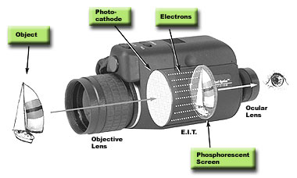
Emergent Applications…
Response is linear with light intensity
Extremely short response time
For example, night vision devices:
Notes:
Devices employing the photoelectric effect take advantage of… Electrons are carried away from the photocathode through a disk with millions of channels in it, amplified, then strike a phosphorescent screen on the other side, reproducing a real image.

