Slide 1
Dictionaries stores elements so that they can be located quickly using keys.
For eg
A Dictionary may hold bank accounts.
In which key will be account number.
And each account may stores many additional information.
Dictionaries

Slide 2
How to Implement a Dictionary?
Different data structure to realize a key
Array , Linked list
Binary tree
Hash table
Red/Black tree
AVL Tree
B-Tree

Slide 3
Why Hashing??
The sequential search algorithm takes time proportional to the data size, i.e, O(n).
Binary search improves on liner search reducing the search time to O(log n).
With a BST, an O(log n) search efficiency can be obtained; but the worst-case complexity is O(n).
To guarantee the O(log n) search time, BST height balancing is required ( i.e., AVL trees).

Slide 4
Why Hashing?? (Cntd.)
Suppose that we want to store 10,000 students records (each with a 5-digit ID) in a given container.
· A linked list implementation would take O(n) time.
· A height balanced tree would give O(log n) access time.
· Using an array of size 100,000 would give O(1) access time but will lead to a lot of space wastage.

Slide 5
Why Hashing?? (Cntd.)
Is there some way that we could get O(1) access without wasting a lot of space?
The answer is hashing.

Slide 6
Hashing
Another important and widely useful technique for implementing dictionaries
Constant time per operation (on the average)
Like an array, come up with a function to map the large range into one which we can manage.

Slide 7
Basic Idea
Use hash function to map keys into positions in a hash table
Ideally
If Student A has ID(Key) k and h is hash function, then A’s Details is stored in position h(k) of table
To search for A, compute h(k) to locate position. If no element, dictionary does not contain A.

Slide 8
Example
Let keys be ID of 100 students
And ID in form of like 345610.
Now, we decided to take A[100]
And, Hash function is , say , LAST TWO DIGIT
So, 103062 will go to location 62
And same if some one have 113062
Then again goes to the location 62
THIS EVENT IS CALLED COLLISION

Slide 9
Collision Resolution
Chaining
Linear Probe
Double hashing

Slide 10
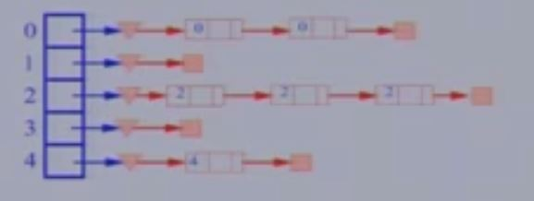
Chaining

Slide 11
Hash Functions
  A Good Hash function is one which distribute keys evenly among the slots.
  And It is said that Hash Function is more art than a science. Becoz it need to analyze the data.
Hash Function
Key
Slot

Slide 12
Hash Function(cntd.)
  Need of choose a good Hash function
  Quick Compute.
  Distributes keys in uniform manner throughout the table.
How to deal with Hashing non integer Key???
1.Find some way of turning keys into integer.
eg if key is in character then convert it into integer using ASCII
2.Then use standard Hash Function on the integer.

Slide 13
Hash Function (contd.)
The Mapping of keys to indices of a hash table is called a hash function.
The Hash Function is ussually the composition of two maps:
Hash code map
Keys Integer
Compression map
Integer A[0….m-1]

Slide 14
Collision Resolution (contd.)
Now, there is two more techniques to deal with collision
Linear Probing
Double Hashing

Slide 15
Linear probe
Linearprobeinsert(k)
If(table is full)
{error}
probe =h(k)
while(table[probe] is occupied)
{probe = (probe + 1) % m //m is no. of slots
}
Table[probe]=k

Slide 16
Linear Probe(contd.)
If the current location is used, Try the next table Location.
Used less memory than chaining as one does not have to store all those link(i.e. address of others).
Slower than chaining as one might have to walk along the table for a long time.

Slide 17
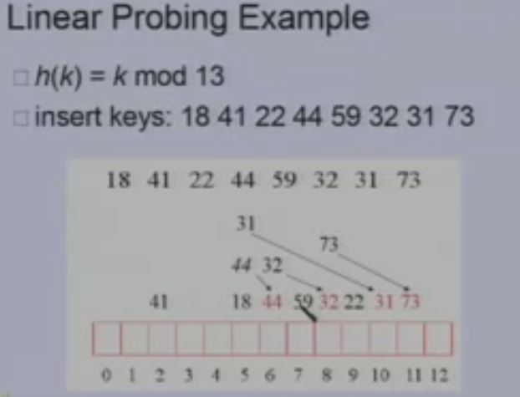
Linear Probe (contd.)

Slide 18
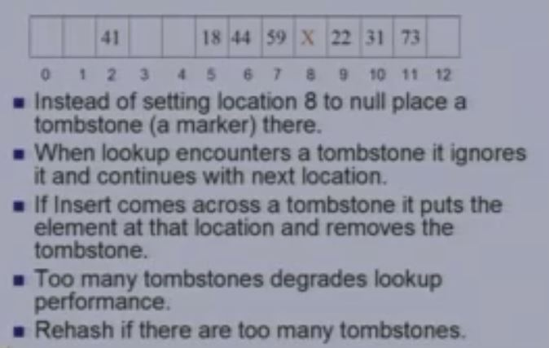
Linear probe (contd.)
Deletion in Linear probe

Slide 19
Double Hashing
h1(k) - Position in the table where we first check for the key
h2(k) – Determine offset when h1(k) is already occupied
In Linear probing offset is always 1.

Slide 20
Double Hashing (contd.)
Doublehashing insert(k)
If (table is full)
{error
}
Probe=h1(k); offset=h2(k);
While (table[probe] is occupied)
{probe=(probe + offset)%m
}
table[probe]=k;

Slide 21
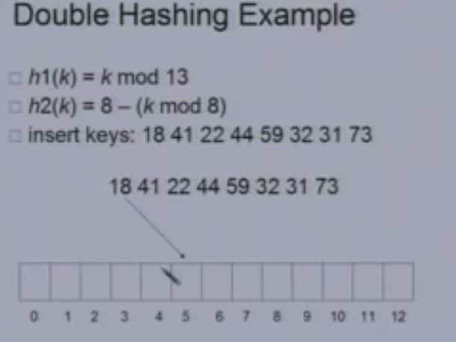
Double Hashing(contd.)

Slide 22
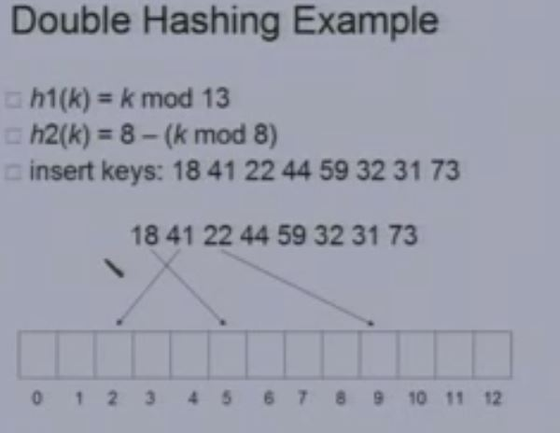
Double Hashing(contd.)

Slide 23
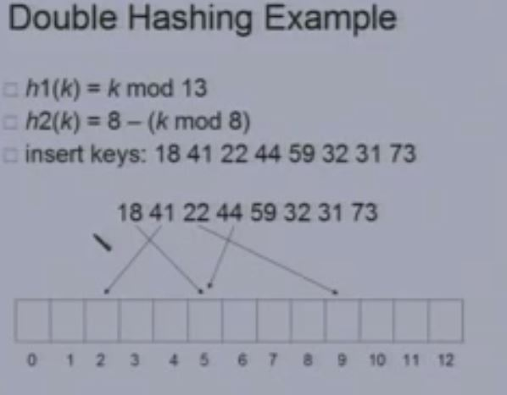
Double Hashing(contd.)

Slide 24
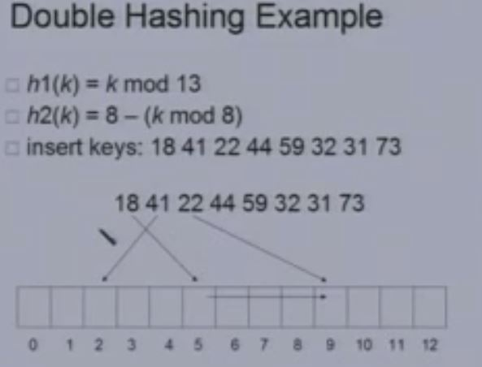
Double Hashing(contd.)

Slide 25
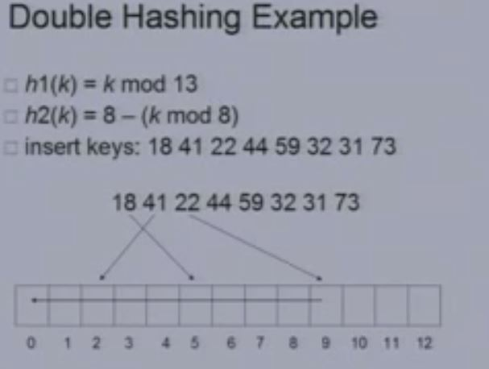
Double Hashing(contd.)

Slide 26
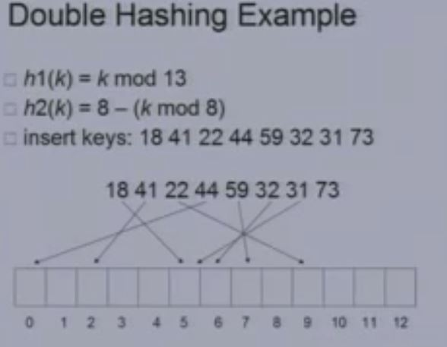
Double Hashing(contd.)

Slide 27
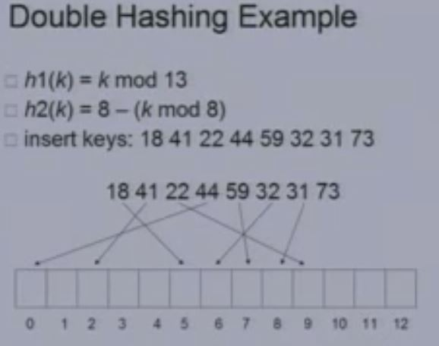
Double Hashing(contd.)

Slide 28
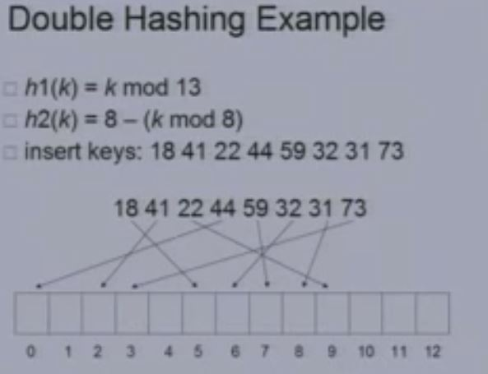
Double Hashing(contd.)

Slide 29
Thank
U ☺

