Slide 1
Electromagnetic Theory

Slide 2
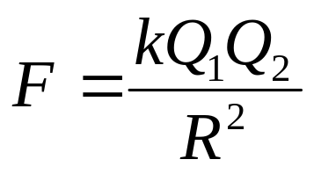
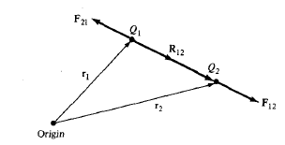



Coulomb’s Law
It states that the force F between two point charges Q₁ and Q₂ is
In Vector form
Or
If we have more than two point charges

Slide 3
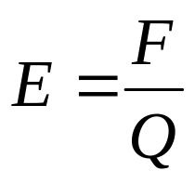


Electric Field Intensity
Electric Field Intensity is the force per unit charge when placed in the electric field
In Vector form
E
If we have more than two point charges

Slide 4
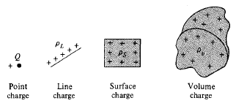


Electric Field due to Continuous Charge Distribution
If there is a continuous charge distribution say along a line, on a surface, or in a volume
The charge element dQ and the total charge Q due to these charge distributions can be obtained by

Slide 5




The electric field intensity due to each charge distribution ρ_{L}, ρ_{S} and ρ_{V} may be given by the summation of the field contributed by the numerous point charges making up the charge distribution.

Slide 6
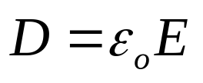

Electric Flux Density
The electric field intensity depends on the medium in which the charges are placed.
Suppose a vector field D independent of the medium is defined by
The electric flux ψ in terms of D can be defined as
The vector field D is called the electric flux density and is measured in coulombs per square meter.

Slide 7


Electric Flux Density
For an infinite sheet the electric flux density D is given by
For a volume charge distribution the electric flux density D is given by
In both the above equations D is a function of charge and position only (independent of medium)

Slide 8
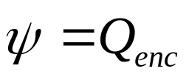



Gauss Law
It states that the total electric flux ψ through any closed surface is equal to the total charge enclosed by that surface.
(i)

Slide 9

Using Divergence Theorem
(ii)
Comparing the two volume integrals in (i) and (ii)
This is the first Maxwell’s equation.
It states that the volume charge density is the same as the divergence of the electric flux density.

Slide 10
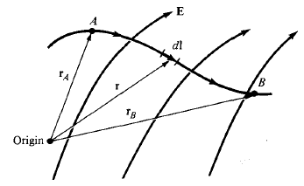
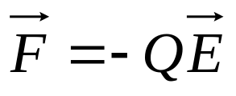
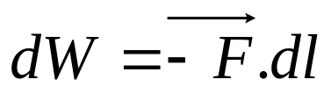
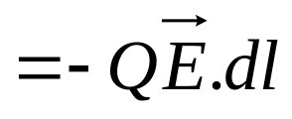
Electric Potential
Electric Field intensity, E due to a charge distribution can be obtained from Coulomb’s Law.
or using Gauss Law when the charge distribution is symmetric.
We can obtain E without involving vectors by using the electric scalar potential V.
From Coulomb’s Law the force on point
charge Q is
The work done in displacing the charge
by length dl is
The negative sign indicates that the work is being done by an external agent.

Slide 11
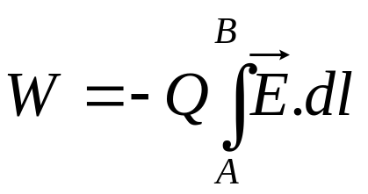
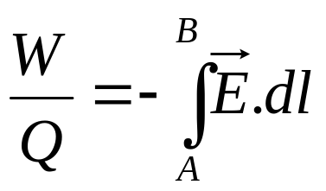
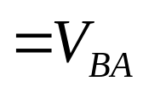
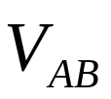
The total work done or the potential energy required in moving the point charge Q from A to B is
Dividing the above equation by Q gives the potential energy per unit charge.
is known as the potential difference between points A and B.
1. If is negative, there is loss in potential energy in moving Q from A to B (work is being done by the field), if is positive, there is a gain in potential energy in the movement (an external agent does the work).
2. It is independent of the path taken. It is measured in Joules per Coulomb referred as Volt.

Slide 12
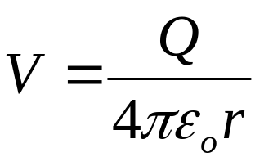
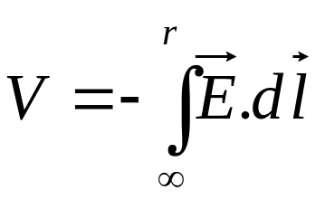

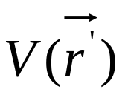
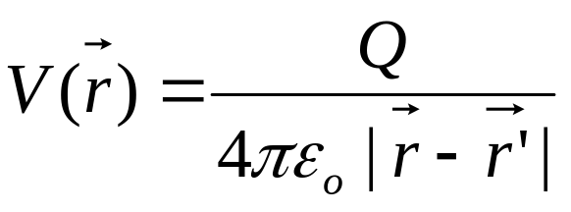
The potential at any point due to a point charge Q located at the origin is
The potential at any point is the potential difference between that point and a chosen point at which the potential is zero.
Assuming zero potential at infinity, the potential at a distance r from the point charge is the work done per unit charge by an external agent in transferring a test charge from infinity to that point.
If the point charge Q is not at origin but at a point whose position vector is , the potential at becomes

Slide 13
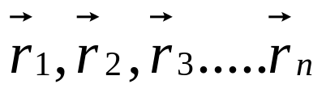

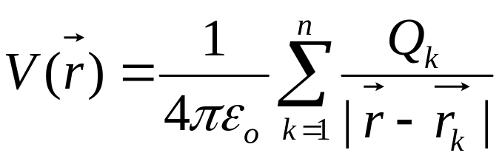



For n point charges Q₁, Q₂, Q₃…..Q_{n} located at points with position vectors the potential at is
If there is continuous charge distribution instead of point charges then the potential at becomes

Slide 14
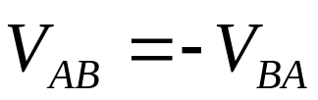
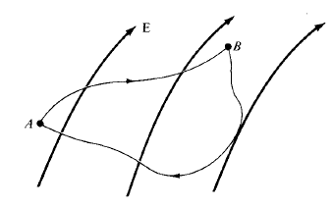
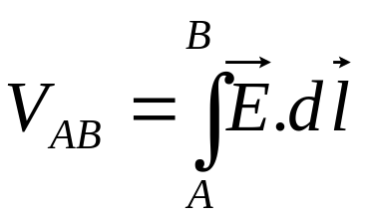
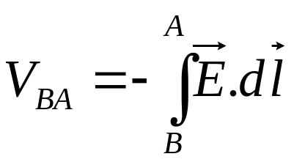
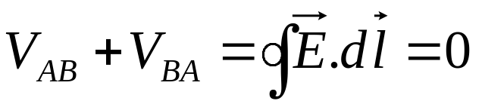
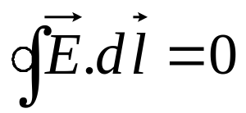
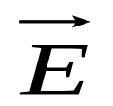
Relationship between E and V
The potential difference between points A and B is independent of the path taken
and
(i)
It means that the line integral of along a closed path must be zero.

Slide 15
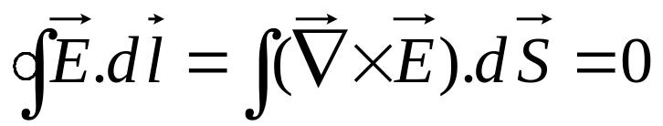
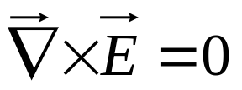
Physically it means that no net work is done in moving a charge along a closed path in an electrostatic field.
Applying Stokes’s theorem to equation (i)
(ii)
Equation (i) and (ii) are known as Maxwell’s equation for static electric fields.
Equation (i) is in integral form while equation (ii) is in differential form, both depicting conservative nature of an electrostatic field.

Slide 16
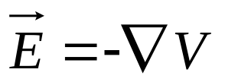

Also
It means Electric Field Intensity is the gradient of V.
The negative sign shows that the direction of is opposite to the direction in which V increases.

Slide 17
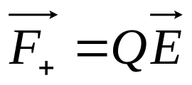

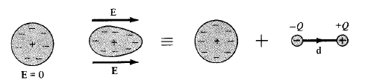
Polarization in Dielectrics
Consider an atom of the dielectric consisting of an electron cloud (-Q) and a positive nucleus (+Q).
When an electric field is applied, the positive charge is displaced from its equilibrium position in the direction of by while the negative charge is displaced by in the opposite direction.
A dipole results from the displacement of charges and the dielectric is polarized. In polarized the electron cloud is distorted by the applied electric field.

Slide 18
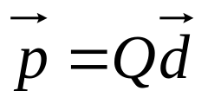




This distorted charge distribution is equivalent to the original distribution plus the dipole whose moment is
where is the distance vector between -Q to +Q.
If there are N dipoles in a volume Δv of the dielectric, the total dipole moment due to the electric field
For the measurement of intensity of polarization, we define polarization (coulomb per square meter) as dipole moment per unit volume

Slide 19
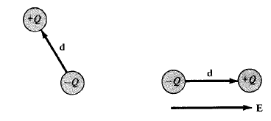
The major effect of the electric field on the dielectric is the creation of dipole moments that align themselves in the direction of electric field.
This type of dielectrics are said to be non-polar. eg: H₂, N₂, O₂
Other types of molecules that have in-built permanent dipole moments are called polar. eg: H₂O, HCl
When electric field is applied to a polar material then its permanent dipole experiences a torque that tends to align its dipole moment in the direction of the electric field.

Slide 20


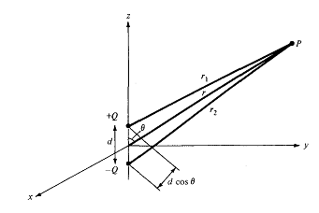

Electric Dipole

Slide 21
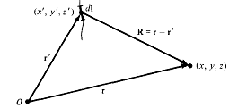



Slide 22
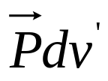

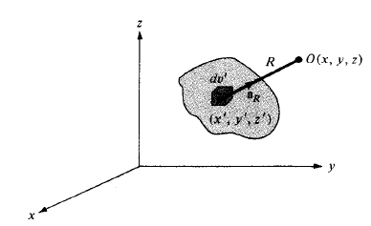


Field due to a Polarized Dielectric
Consider a dielectric material consisting of dipoles with Dipole moment per unit volume.
The potential dV at an external point O due to
(i)
where R² = (x-x’)²+(y-y’)²+(z-z’)² and R is the distance between volume element dv’ and the point O.
But
Applying the vector identity
= -

Slide 23




Put this in (i) and integrate over the entire volume v’ of the dielectric
Applying Divergence Theorem to the first term
(ii)
where a_{n}’ is the outward unit normal to the surface dS’ of the dielectric
The two terms in (ii) denote the potential due to surface and volume charge distributions with densities

Slide 24


where ρ_{ps} and ρ_{pv} are the bound surface and volume charge densities.
Bound charges are those which are not free to move in the dielectric material.
Equation (ii) says that where polarization occurs, an equivalent volume charge density, ρ_{pv} is formed throughout the dielectric while an equivalent surface charge density, ρ_{ps} is formed over the surface of dielectric.
The total positive bound charge on surface S bounding the dielectric is
while the charge that remains inside S is

Slide 25


Total charge on dielectric remains zero.
Total charge =
When dielectric contains free charge
If ρ_{v} is the free volume charge density then the total volume charge density ρ_{t}
Hence
Where

Slide 26


The effect of the dielectric on the electric field is to increase inside it by an amount .
The polarization would vary directly as the applied electric field.
Where is known as the electric susceptibility of the material
It is a measure of how susceptible a given dielectric is to electric fields.

Slide 27
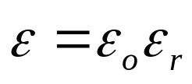

Dielectric Constant and Strength
We know that
and
Thus
or
where
and
where є is the permittivity of the dielectric, є_{o} is the permittivity of the free space and є_{r} is the dielectric constant or relative permittivity.

Slide 28
No dielectric is ideal. When the electric field in a dielectric is sufficiently high then it begins to pull electrons completely out of the molecules, and the dielectric becomes conducting.
When a dielectric becomes conducting then it is called dielectric breakdown. It depends on the type of material, humidity, temperature and the amount of time for which the field is applied.
The minimum value of the electric field at which the dielectric breakdown occurs is called the dielectric strength of the dielectric material.
or
The dielectric strength is the maximum value of the electric field that a dielectric can tolerate or withstand without breakdown.

Slide 29



Continuity Equation and Relaxation Time
According to principle of charge conservation, the time rate of decrease of charge within a given volume must be equal to the net outward current flow through the closed surface of the volume.
The current I_{out} coming out of the closed surface
(i)
where Q_{in} is the total charge enclosed by the closed surface.
Using divergence theorem
But

Slide 30



Equation (i) now becomes
or
(ii)
This is called the continuity of current equation.
Effect of introducing charge at some interior point of a conductor/dielectric
According to Ohm’s law
According to Gauss’s law

Slide 31




Equation (ii) now becomes
or
This is homogeneous liner ordinary differential equation. By separating variables we get
Integrating both sides

Slide 32

(iii)
where
Equation (iii) shows that as a result of introducing charge at some interior point of the material there is a decay of the volume charge density ρ_{v}.
The time constant T_{r} is known as the relaxation time or the relaxation time.
Relaxation time is the time in which a charge placed in the interior of a material to drop to e⁻¹ = 36.8 % of its initial value.
For Copper T_{r} = 1.53 x 10⁻¹⁹ sec (short for good conductors)
For fused Quartz T_{r} = 51.2 days (large for good dielectrics)

Slide 33


Boundary Conditions
If the field exists in a region consisting of two different media, the conditions that the field must satisfy at the interface separating the media are called boundary conditions
These conditions are helpful in determining the field on one side of the boundary when the field on other side is known.
We will consider the boundary conditions at an interface separating
Dielectric (є_{r1}) and Dielectric (є_{r2})
Conductor and Dielectric
Conductor and free space
For determining boundary conditions we will use Maxwell’s equations
and

Slide 34
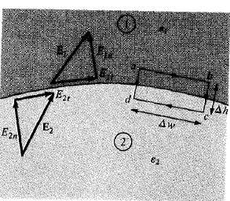
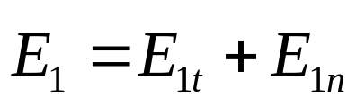
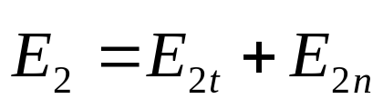

Boundary Conditions (Between two different dielectrics)
Consider the E field existing in a region consisting of two different dielectrics characterized by є₁ = є₀ є_{r1} and є₂ = є₀ є_{r2}
E₁ and E₂ in the media 1 and 2 can be written as
and
But
Assuming that the path abcda is very small with respect to the variation in E

Slide 35


As Δh 0
………..(1)
Thus the tangential components of E are the same on the two sides of the boundary. E is continuous across the boundary.
But
Thus
or
………..(2)
Here D_{t} undergoes some change across the surface and is said to be discontinuous across the surface.

Slide 36
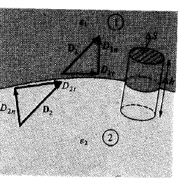

Applying
Putting Δh 0 gives
Where ρ_{s} is the free charge density placed deliberately at the boundary
If there is no charge on the boundary i.e. ρ_{s} = 0 then
………..(3)
Thus the normal components of D is continuous across the surface.

Slide 37

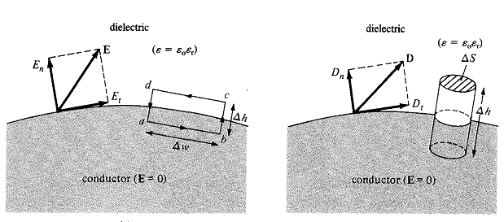
………..(4)
Thus the normal components of E is discontinuous across the boundary.
The Eqns. (1) to (4) are the boundary conditions.
Conductor and Dielectric Boundary Conditions:
For a perfect conductor, and for eg., copper and silver.

Slide 38





Again for determining boundary conditions we will use Maxwell’s equations
and
But E=0 inside the conductor. Considering closed path abcda,
Similarly,
As inside the conductor,

Slide 39
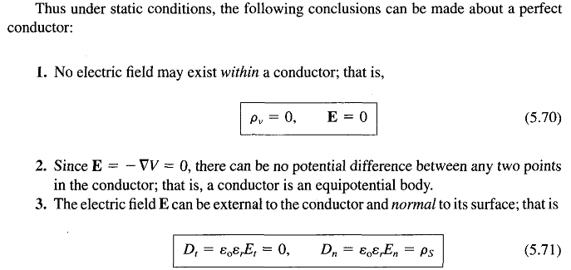
Conductor-Free Space Boundary Conditions:
It is a special case of conductor-dielectric conditions

Slide 40
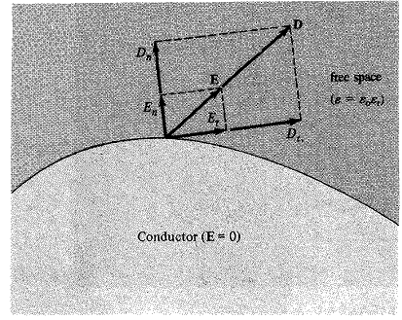
Conductor-Free Space Boundary Conditions:
It is a special case of conductor-dielectric conditions
Because free space may be regarded as a special dielectric for which

