Slide 1
Overview
Binary logic and Gates
Boolean Algebra
  Basic Properties
  Algebraic Manipulation
Standard and Canonical Forms
  Minterms and Maxterms (Canonical forms)
  SOP and POS (Standard forms)
Karnaugh Maps (K-Maps)
  2, 3, 4, and 5 variable maps
  Simplification using K-Maps
K-Map Manipulation
  Implicants: Prime, Essential
  Don’t Cares
More Logic Gates
Boolean Algebra
PJF - <number>
Notes:
Boolean Algebra

Slide 2
Binary Logic
Deals with binary variables that take 2 discrete values (0 and 1), and with logic operations
Three basic logic operations:
  AND, OR, NOT
Binary/logic variables are typically represented as letters: A,B,C,…,X,Y,Z
Boolean Algebra
PJF - <number>
Notes:
Boolean Algebra

Slide 3
Binary Logic Function
F(vars) = expression
Example: F(a,b) = a’•b + b’
G(x,y,z) = x•(y+z’)
Operators ( +, •, ‘ )
Variables
Constants ( 0, 1 )
Groupings (parenthesis)
set of binary
variables
Boolean Algebra
PJF - <number>
Notes:
Boolean Algebra

Slide 4
Basic Logic Operators
AND
OR
NOT
F(a,b) = a•b, F is 1 if and only if a=b=1
G(a,b) = a+b, G is 1 if either a=1 or b=1
H(a) = a’, H is 1 if a=0
Binary
Unary
Boolean Algebra
PJF - <number>
Notes:
Boolean Algebra

Slide 5
Basic Logic Operators (cont.)
1-bit logic AND resembles binary multiplication:
  0 • 0 = 0, 0 • 1 = 0,
  1 • 0 = 0, 1 • 1 = 1
1-bit logic OR resembles binary addition, except for one operation:
  0 + 0 = 0, 0 + 1 = 1,
  1 + 0 = 1, 1 + 1 = 1 (≠ 10₂)
Boolean Algebra
PJF - <number>
Notes:
Boolean Algebra

Slide 6
Truth Tables for logic operators
Truth table: tabular form that uniguely represents the relationship between the input variables of a function and its output
2-Input AND
2-Input OR
A | B | F=A•B
0 | 0 | 0
0 | 1 | 0
1 | 0 | 0
1 | 1 | 1
A | B | F=A+B
0 | 0 | 0
0 | 1 | 1
1 | 0 | 1
1 | 1 | 1
NOT
A | F=A’
0 | 1
1 | 0
Boolean Algebra
PJF - <number>
Notes:
Boolean Algebra

Slide 7
Truth Tables (cont.)
Q: Let a function F() depend on n variables. How many rows are there in the truth table of F() ?
A: 2^{n} rows, since there are 2^{n} possible binary patterns/combinations for the n variables
Boolean Algebra
PJF - <number>
Notes:
Boolean Algebra

Slide 8
Logic Gates
Logic gates are abstractions of electronic circuit components that operate on one or more input signals to produce an output signal.
2-Input AND
2-Input OR
NOT (Inverter)
A
A
F
G
A
H
B
B
H = A’
F = A•B
G = A+B
Boolean Algebra
PJF - <number>
Notes:
Boolean Algebra

Slide 9
Timing Diagram
t₀
t₁
t₂
t₃
t₄
t₅
t₆
A
1
Input
signals
0
1
Transitions
B
0
F=A•B
1
0
Basic
Assumption:
Zero time for
signals to
propagate
Through gates
Gate
Output
Signals
G=A+B
1
0
H=A’
1
0
Boolean Algebra
PJF - <number>
Notes:
Boolean Algebra

Slide 10
Combinational Logic Circuit from Logic Function
Consider function F = A’ + B•C’ + A’•B’
A combinational logic circuit can be constructed to implement F, by appropriately connecting input signals and logic gates:
  Circuit input signals → from function variables (A, B, C)
  Circuit output signal → function output (F)
  Logic gates → from logic operations
C
A
F
B
Boolean Algebra
PJF - <number>
Notes:
Boolean Algebra

Slide 11
Combinational Logic Circuit from Logic Function (cont.)
In order to design a cost-effective and efficient circuit, we must minimize the circuit’s size (area) and propagation delay (time required for an input signal change to be observed at the output line)
Observe the truth table of F=A’ + B•C’ + A’•B’ and G=A’ + B•C’
Truth tables for F and G are identical → same function
Use G to implement the logic circuit (less components)
A | B | C | F | G
0 | 0 | 0 | 1 | 1
0 | 0 | 1 | 1 | 1
0 | 1 | 0 | 1 | 1
0 | 1 | 1 | 1 | 1
1 | 0 | 0 | 0 | 0
1 | 0 | 1 | 0 | 0
1 | 1 | 0 | 1 | 1
1 | 1 | 1 | 0 | 0
Boolean Algebra
PJF - <number>
Notes:
Boolean Algebra

Slide 12
Combinational Logic Circuit from Logic Function (cont.)
C
A
F
B
C
B
A
G
Boolean Algebra
PJF - <number>
Notes:
Boolean Algebra

Slide 13
Boolean Algebra
VERY nice machinery used to manipulate (simplify) Boolean functions
George Boole (1815-1864): “An investigation of the laws of thought”
Terminology:
  Literal: A variable or its complement
  Product term: literals connected by •
  Sum term: literals connected by +
Boolean Algebra
PJF - <number>
Notes:
Boolean Algebra

Slide 14
Boolean Algebra Properties
Let X: boolean variable, 0,1: constants
X + 0 = X -- Zero Axiom
X • 1 = X -- Unit Axiom
X + 1 = 1 -- Unit Property
X • 0 = 0 -- Zero Property
Boolean Algebra
PJF - <number>
Notes:
Boolean Algebra

Slide 15
Boolean Algebra Properties (cont.)
Let X: boolean variable, 0,1: constants
X + X = X -- Idepotence
X • X = X -- Idepotence
X + X’ = 1 -- Complement
X • X’ = 0 -- Complement
(X’)’ = X -- Involution
Boolean Algebra
PJF - <number>
Notes:
Boolean Algebra

Slide 16
Duality
The dual of an expression is obtained by exchanging (• and +), and (1 and 0) in it, provided that the precedence of operations is not changed.
Cannot exchange x with x’
Example:
  Find H(x,y,z), the dual of F(x,y,z) = x’yz’ + x’y’z
  H = (x’+y+z’) (x’+y’+ z)
Boolean Algebra
PJF - <number>
Notes:
Boolean Algebra

Slide 17
Duality (cont’d)
With respect to duality, Identities 1 – 8 have the following relationship:
1. X + 0 = X 2. X • 1 = X (dual of 1)
3. X + 1 = 1 4. X • 0 = 0 (dual of 3)
5. X + X = X 6. X • X = X (dual of 5)
7. X + X’ = 1 8. X • X’ = 0 (dual of 8)
Boolean Algebra
PJF - <number>
Notes:
Boolean Algebra

Slide 18
More Boolean Algebra Properties
Let X,Y, and Z: boolean variables
10. X + Y = Y + X 11. X • Y = Y • X -- Commutative
12. X + (Y+Z) = (X+Y) + Z 13. X•(Y•Z) = (X•Y)•Z -- Associative
14. X•(Y+Z) = X•Y + X•Z 15. X+(Y•Z) = (X+Y) • (X+Z)
-- Distributive
16. (X + Y)’ = X’ • Y’ 17. (X • Y)’ = X’ + Y’ -- DeMorgan’s
In general,
( X₁ + X₂ + … + X_{n} )’ = X₁’•X₂’ • … •X_{n}’, and
( X₁•X₂•… •X_{n} )’ = X₁’ + X₂’ + … + X_{n}’
Boolean Algebra
PJF - <number>
Notes:
Boolean Algebra

Slide 19
Absorption Property
x + x•y = x
x•(x+y) = x (dual)
Proof:
x + x•y = x•1 + x•y
= x•(1+y)
= x•1
= x
QED (2 true by duality, why?)
Boolean Algebra
PJF - <number>
Notes:
Boolean Algebra

Slide 20
Power of Duality
x + x•y = x is true, so (x + x•y)’=x’
(x + x•y)’=x’•(x’+y’)
x’•(x’+y’) =x’
Let X=x’, Y=y’
X•(X+Y) =X, which is the dual of x + x•y = x.
The above process can be applied to any formula. So if a formula is valid, then its dual must also be valid.
Proving one formula also proves its dual.
Boolean Algebra
PJF - <number>
Notes:
Boolean Algebra

Slide 21
Consensus Theorem
xy + x’z + yz = xy + x’z
(x+y)•(x’+z)•(y+z) = (x+y)•(x’+z) -- (dual)
Proof:
xy + x’z + yz = xy + x’z + (x+x’)yz
= xy + x’z + xyz + x’yz
= (xy + xyz) + (x’z + x’zy)
= xy + x’z
QED (2 true by duality).
Boolean Algebra
PJF - <number>
Notes:
Boolean Algebra

Slide 22
Truth Tables (revisited)
Enumerates all possible combinations of variable values and the corresponding function value
Truth tables for some arbitrary functions
F₁(x,y,z), F₂(x,y,z), and F₃(x,y,z) are shown to the right.
x | y | z |  | F₁ | F₂ | F₃
0 | 0 | 0 |  | 0 | 1 | 1
0 | 0 | 1 |  | 0 | 0 | 1
0 | 1 | 0 |  | 0 | 0 | 1
0 | 1 | 1 |  | 0 | 1 | 1
1 | 0 | 0 |  | 0 | 1 | 0
1 | 0 | 1 |  | 0 | 1 | 0
1 | 1 | 0 |  | 0 | 0 | 0
1 | 1 | 1 |  | 1 | 0 | 1
Boolean Algebra
PJF - <number>
Notes:
Boolean Algebra

Slide 23
Truth Tables (cont.)
Truth table: a unique representation of a Boolean function
If two functions have identical truth tables, the functions are equivalent (and vice-versa).
Truth tables can be used to prove equality theorems.
However, the size of a truth table grows exponentially with the number of variables involved, hence unwieldy. This motivates the use of Boolean Algebra.
Boolean Algebra
PJF - <number>
Notes:
Boolean Algebra

Slide 24
Boolean expressions-NOT unique
x | y | z |  | F | G
0 | 0 | 0 |  | 1 | 1
0 | 0 | 1 |  | 0 | 0
0 | 1 | 0 |  | 1 | 1
0 | 1 | 1 |  | 0 | 0
1 | 0 | 0 |  | 0 | 0
1 | 0 | 1 |  | 0 | 0
1 | 1 | 0 |  | 1 | 1
1 | 1 | 1 |  | 0 | 0
Unlike truth tables, expressions representing a Boolean function are NOT unique.
Example:
  F(x,y,z) = x’•y’•z’ + x’•y•z’ + x•y•z’
  G(x,y,z) = x’•y’•z’ + y•z’
The corresponding truth tables for F() and G() are to the right. They are identical.
Thus, F() = G()
Boolean Algebra
PJF - <number>
Notes:
Boolean Algebra

Slide 25
Algebraic Manipulation
Boolean algebra is a useful tool for simplifying digital circuits.
Why do it? Simpler can mean cheaper, smaller, faster.
Example: Simplify F = x’yz + x’yz’ + xz.
F = x’yz + x’yz’ + xz
= x’y(z+z’) + xz
= x’y•1 + xz
= x’y + xz
Boolean Algebra
PJF - <number>
Notes:
Boolean Algebra

Slide 26
Algebraic Manipulation (cont.)
Example: Prove
x’y’z’ + x’yz’ + xyz’ = x’z’ + yz’
Proof:
x’y’z’+ x’yz’+ xyz’
= x’y’z’ + x’yz’ + x’yz’ + xyz’
= x’z’(y’+y) + yz’(x’+x)
= x’z’•1 + yz’•1
= x’z’ + yz’
QED.
Boolean Algebra
PJF - <number>
Notes:
Boolean Algebra

Slide 27
Complement of a Function
The complement of a function is derived by interchanging (• and +), and (1 and 0), and complementing each variable.
Otherwise, interchange 1s to 0s in the truth table column showing F.
The complement of a function IS NOT THE SAME as the dual of a function.
Boolean Algebra
PJF - <number>
Notes:
Boolean Algebra

Slide 28
Complementation: Example
Find G(x,y,z), the complement of
F(x,y,z) = xy’z’ + x’yz
G = F’ = (xy’z’ + x’yz)’
= (xy’z’)’ • (x’yz)’ DeMorgan
= (x’+y+z) • (x+y’+z’) DeMorgan again
Note: The complement of a function can also be derived by finding the function’s dual, and then complementing all of the literals
Boolean Algebra
PJF - <number>
Notes:
Boolean Algebra

Slide 29
Canonical and Standard Forms
We need to consider formal techniques for the simplification of Boolean functions.
  Identical functions will have exactly the same canonical form.
  Minterms and Maxterms
  Sum-of-Minterms and Product-of- Maxterms
  Product and Sum terms
  Sum-of-Products (SOP) and Product-of-Sums (POS)
Boolean Algebra
PJF - <number>
Notes:
Boolean Algebra

Slide 30
Definitions
Literal: A variable or its complement
Product term: literals connected by •
Sum term: literals connected by +
Minterm: a product term in which all the variables appear exactly once, either complemented or uncomplemented
Maxterm: a sum term in which all the variables appear exactly once, either complemented or uncomplemented
Boolean Algebra
PJF - <number>
Notes:
Boolean Algebra

Slide 31
Minterm
Represents exactly one combination in the truth table.
Denoted by m_{j}, where j is the decimal equivalent of the minterm’s corresponding binary combination (b_{j}).
A variable in m_{j} is complemented if its value in b_{j} is 0, otherwise is uncomplemented.
Example: Assume 3 variables (A,B,C), and j=3. Then, b_{j} = 011 and its corresponding minterm is denoted by m_{j} = A’BC
Boolean Algebra
PJF - <number>
Notes:
Boolean Algebra

Slide 32
Maxterm
Represents exactly one combination in the truth table.
Denoted by M_{j}, where j is the decimal equivalent of the maxterm’s corresponding binary combination (b_{j}).
A variable in M_{j} is complemented if its value in b_{j} is 1, otherwise is uncomplemented.
Example: Assume 3 variables (A,B,C), and j=3. Then, b_{j} = 011 and its corresponding maxterm is denoted by M_{j} = A+B’+C’
Boolean Algebra
PJF - <number>
Notes:
Boolean Algebra

Slide 33
Truth Table notation for Minterms and Maxterms
Minterms and Maxterms are easy to denote using a truth table.
Example:
Assume 3 variables x,y,z
(order is fixed)
x | y | z |  | Minterm | Maxterm
0 | 0 | 0 |  | x’y’z’ = m₀ | x+y+z = M₀
0 | 0 | 1 |  | x’y’z = m₁ | x+y+z’ = M₁
0 | 1 | 0 |  | x’yz’ = m₂ | x+y’+z = M₂
0 | 1 | 1 |  | x’yz = m₃ | x+y’+z’= M₃
1 | 0 | 0 |  | xy’z’ = m₄ | x’+y+z = M₄
1 | 0 | 1 |  | xy’z = m₅ | x’+y+z’ = M₅
1 | 1 | 0 |  | xyz’ = m₆ | x’+y’+z = M₆
1 | 1 | 1 |  | xyz = m₇ | x’+y’+z’ = M₇
Boolean Algebra
PJF - <number>
Notes:
Boolean Algebra

Slide 34
Canonical Forms (Unique)
Any Boolean function F( ) can be expressed as a unique sum of minterms and a unique product of maxterms (under a fixed variable ordering).
In other words, every function F() has two canonical forms:
  Canonical Sum-Of-Products (sum of minterms)
  Canonical Product-Of-Sums (product of maxterms)
Boolean Algebra
PJF - <number>
Notes:
Boolean Algebra

Slide 35
Canonical Forms (cont.)
Canonical Sum-Of-Products:
The minterms included are those m_{j} such that F( ) = 1 in row j of the truth table for F( ).
Canonical Product-Of-Sums:
The maxterms included are those M_{j} such that F( ) = 0 in row j of the truth table for F( ).
Boolean Algebra
PJF - <number>
Notes:
Boolean Algebra

Slide 36
Example
Truth table for f₁(a,b,c) at right
The canonical sum-of-products form for f₁ is
f₁(a,b,c) = m₁ + m₂ + m₄ + m₆
= a’b’c + a’bc’ + ab’c’ + abc’
The canonical product-of-sums form for f₁ is
f₁(a,b,c) = M₀ • M₃ • M₅ • M₇
= (a+b+c)•(a+b’+c’)• (a’+b+c’)•(a’+b’+c’).
Observe that: m_{j} = M_{j}’
a | b | c |  | f₁
0 | 0 | 0 |  | 0
0 | 0 | 1 |  | 1
0 | 1 | 0 |  | 1
0 | 1 | 1 |  | 0
1 | 0 | 0 |  | 1
1 | 0 | 1 |  | 0
1 | 1 | 0 |  | 1
1 | 1 | 1 |  | 0
Boolean Algebra
PJF - <number>
Notes:
Boolean Algebra

Slide 37
Shorthand: ∑ and ∏
f₁(a,b,c) = ∑ m(1,2,4,6), where ∑ indicates that this is a sum-of-products form, and m(1,2,4,6) indicates that the minterms to be included are m₁, m₂, m₄, and m₆.
f₁(a,b,c) = ∏ M(0,3,5,7), where ∏ indicates that this is a product-of-sums form, and M(0,3,5,7) indicates that the maxterms to be included are M₀, M₃, M₅, and M₇.
Since m_{j} = M_{j}’ for any j,
∑ m(1,2,4,6) = ∏ M(0,3,5,7) = f₁(a,b,c)
Boolean Algebra
PJF - <number>
Notes:
Boolean Algebra

Slide 38
Conversion Between Canonical Forms
Replace ∑ with ∏ (or vice versa) and replace those j’s that appeared in the original form with those that do not.
Example:
f₁(a,b,c) = a’b’c + a’bc’ + ab’c’ + abc’
= m₁ + m₂ + m₄ + m₆
= ∑(1,2,4,6)
= ∏(0,3,5,7)
= (a+b+c)•(a+b’+c’)•(a’+b+c’)•(a’+b’+c’)
Boolean Algebra
PJF - <number>
Notes:
Boolean Algebra

Slide 39
Standard Forms (NOT Unique)
Standard forms are “like” canonical forms, except that not all variables need appear in the individual product (SOP) or sum (POS) terms.
Example:
f₁(a,b,c) = a’b’c + bc’ + ac’
is a standard sum-of-products form
f₁(a,b,c) = (a+b+c)•(b’+c’)•(a’+c’)
is a standard product-of-sums form.
Boolean Algebra
PJF - <number>
Notes:
Boolean Algebra

Slide 40
Conversion of SOP from standard to canonical form
Expand non-canonical terms by inserting equivalent of 1 in each missing variable x:
(x + x’) = 1
Remove duplicate minterms
f₁(a,b,c) = a’b’c + bc’ + ac’
= a’b’c + (a+a’)bc’ + a(b+b’)c’
= a’b’c + abc’ + a’bc’ + abc’ + ab’c’
= a’b’c + abc’ + a’bc + ab’c’
Boolean Algebra
PJF - <number>
Notes:
Boolean Algebra

Slide 41
Conversion of POS from standard to canonical form
Expand noncanonical terms by adding 0 in terms of missing variables (e.g., xx’ = 0) and using the distributive law
Remove duplicate maxterms
f₁(a,b,c) = (a+b+c)•(b’+c’)•(a’+c’)
= (a+b+c)•(aa’+b’+c’)•(a’+bb’+c’)
= (a+b+c)•(a+b’+c’)•(a’+b’+c’)•
(a’+b+c’)•(a’+b’+c’)
= (a+b+c)•(a+b’+c’)•(a’+b’+c’)•(a’+b+c’)
Boolean Algebra
PJF - <number>
Notes:
Boolean Algebra

Slide 42
Karnaugh Maps
Karnaugh maps (K-maps) are graphical representations of boolean functions.
One map cell corresponds to a row in the truth table.
Also, one map cell corresponds to a minterm or a maxterm in the boolean expression
Multiple-cell areas of the map correspond to standard terms.
Boolean Algebra
PJF - <number>
Notes:
Boolean Algebra

Slide 43
Two-Variable Map
x₁
0
1
x₂
0
1
x₂
x₁
0
m₀
m₁
0
m₀
m₂
0
1
0
2
OR
1
m₂
m₃
2
3
1
m₁
m₃
1
3
NOTE: ordering of variables is IMPORTANT for f(x₁,x₂), x₁ is the row, x₂ is the column.
Cell 0 represents x₁’x₂’; Cell 1 represents x₁’x₂; etc. If a minterm is present in the function, then a 1 is placed in the corresponding cell.
Boolean Algebra
PJF - <number>
Notes:
Boolean Algebra

Slide 44
Two-Variable Map (cont.)
Any two adjacent cells in the map differ by ONLY one variable, which appears complemented in one cell and uncomplemented in the other.
Example:
m₀ (=x₁’x₂’) is adjacent to m₁ (=x₁’x₂) and m₂ (=x₁x₂’) but NOT m₃ (=x₁x₂)
Boolean Algebra
PJF - <number>
Notes:
Boolean Algebra

Slide 45
2-Variable Map -- Example
f(x₁,x₂) = x₁’x₂’+ x₁’x₂ + x₁x₂’
= m₀ + m₁ + m₂
= x₁’ + x₂’
1s placed in K-map for specified minterms m₀, m₁, m₂
Grouping (ORing) of 1s allows simplification
What (simpler) function is represented by each dashed rectangle?
  x₁’ = m₀ + m₁
  x₂’ = m₀ + m₂
Note m₀ covered twice
x₁ | 0 | 1
0 | 1 | 1
1 | 1 | 0
x₂
0
1
2
3
Boolean Algebra
PJF - <number>
Notes:
Boolean Algebra

Slide 46
Minimization as SOP using K-map
Enter 1s in the K-map for each product term in the function
Group adjacent K-map cells containing 1s to obtain a product with fewer variables. Group size must be in power of 2 (2, 4, 8, …)
Handle “boundary wrap” for K-maps of 3 or more variables.
Realize that answer may not be unique
Boolean Algebra
PJF - <number>
Notes:
Boolean Algebra

Slide 47
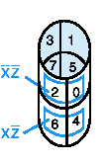
Three-Variable Map
yz
00
01
11
10
x
0
m₀
m₁
m₃
m₂
0
1
3
2
1
m₄
m₅
m₇
m₆
4
5
7
6
-Note: variable ordering is (x,y,z); yz specifies column, x specifies row.
-Each cell is adjacent to three other cells (left or right or top or bottom or edge wrap)
Boolean Algebra
PJF - <number>
Notes:
Boolean Algebra

Slide 48
Three-Variable Map (cont.)
minterm
The types of structures that are either minterms or are generated by repeated application of the minimization theorem on a three variable map are shown at right.
Groups of 1, 2, 4, 8 are possible.
group of 2 terms
group of 4 terms
Boolean Algebra
PJF - <number>
Notes:
Boolean Algebra

Slide 49
Simplification
Enter minterms of the Boolean function into the map, then group terms
Example: f(a,b,c) = a’c + abc + bc’
Result: f(a,b,c) = a’c+ b
bc
a
 | 1 | 1 | 1
 |  | 1 | 1
 | 1 | 1 | 1
 |  | 1 | 1
Boolean Algebra
PJF - <number>
Notes:
Boolean Algebra

Slide 50
More Examples
yz X | 00 | 01 | 11 | 10
0 |  |  | 1 | 1
1 |  | 1 | 1
f₁(x, y, z) = ∑ m(2,3,5,7)
f₂(x, y, z) = ∑ m (0,1,2,3,6)
f₁(x, y, z) = x’y + xz
1 | 1 | 1 | 1
 |  |  | 1
f₂(x, y, z) = x’+yz’
Boolean Algebra
PJF - <number>
Notes:
Boolean Algebra

Slide 51
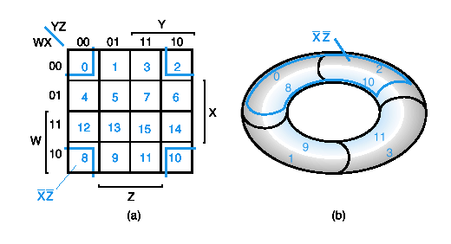
Four-Variable Maps
YZ
00
01
11
10
_{WX}
00
m₀
m₁
m₃
m₂
01
m₄
m₅
m₇
m₆
11
m₁₂
m₁₃
m₁₅
m₁₄
10
m₈
m₉
m₁₁
m₁₀
Top cells are adjacent to bottom cells. Left-edge cells are adjacent to right-edge cells.
Note variable ordering (WXYZ).
Boolean Algebra
PJF - <number>
Notes:
Boolean Algebra

Slide 52
Four-variable Map Simplification
One square represents a minterm of 4 literals.
A rectangle of 2 adjacent squares represents a product term of 3 literals.
A rectangle of 4 squares represents a product term of 2 literals.
A rectangle of 8 squares represents a product term of 1 literal.
A rectangle of 16 squares produces a function that is equal to logic 1.
Boolean Algebra
PJF - <number>
Notes:
Boolean Algebra

Slide 53
Example
Simplify the following Boolean function (A,B,C,D) = ∑m(0,1,2,4,5,7,8,9,10,12,13).
First put the function g( ) into the map, and then group as many 1s as possible.
ab
_{cd}
1
1
1
1
1
1
1
1
1
1
1
1
1
1
1
1
1
1
1
1
1
1
g(A,B,C,D) = c’+b’d’+a’bd
Boolean Algebra
PJF - <number>
Notes:
Boolean Algebra

Slide 54
Don't Care Conditions
There may be a combination of input values which
  will never occur
  if they do occur, the output is of no concern.
The function value for such combinations is called a don't care.
They are denoted with x or –. Each x may be arbitrarily assigned the value 0 or 1 in an implementation.
Don’t cares can be used to further simplify a function
Boolean Algebra
PJF - <number>
Notes:
Boolean Algebra

Slide 55
Minimization using Don’t Cares
Treat don't cares as if they are 1s to generate PIs.
Delete PI's that cover only don't care minterms.
Treat the covering of remaining don't care minterms as optional in the selection process (i.e. they may be, but need not be, covered).
Boolean Algebra
PJF - <number>
Notes:
Boolean Algebra

Slide 56
Example
cd
ab
00
01
11
10
00
0 | 1 | 0 | 1
1 | 1 | 0 | 1
0 | 0 | x | x
1 | 1 | x | x
01
Simplify the function f(a,b,c,d)
whose K-map is shown at the right.
f = a’c’d+ab’+cd’+a’bc’
or
f = a’c’d+ab’+cd’+a’bd’
11
10
0
1
0
1
1
1
0
1
0
0
x
x
1
1
x
x
0
1
0
1
1
1
0
1
0
0
x
x
1
1
x
x
Boolean Algebra
PJF - <number>
Notes:
Boolean Algebra

Slide 57
Another Example
cd
ab
x | 1 | 0 | 0
1 | x | 0 | x
1 | x | x | 1
0 | x | x | 0
Simplify the function g(a,b,c,d) whose K-map is shown at right.
g = a’c’+ ab
or
g = a’c’+b’d
x | 1 | 0 | 0
1 | x | 0 | x
1 | x | x | 1
0 | x | x | 0
x | 1 | 0 | 0
1 | x | 0 | x
1 | x | x | 1
0 | x | x | 0
Boolean Algebra
PJF - <number>
Notes:
Boolean Algebra

Slide 58
Algorithmic minimization
What do we do for functions with more variables?
You can “code up” a minimizer (Computer-Aided Design, CAD)
  Quine-McCluskey algorithm
  Iterated consensus
We won’t discuss these techniques here
Boolean Algebra
PJF - <number>
Notes:
Boolean Algebra

Slide 59
More Logic Gates
NAND and NOR Gates
  NAND and NOR circuits
  Two-level Implementations
  Multilevel Implementations
Exclusive-OR (XOR) Gates
  Odd Function
  Parity Generation and Checking
Boolean Algebra
PJF - <number>
Notes:
Boolean Algebra

Slide 60
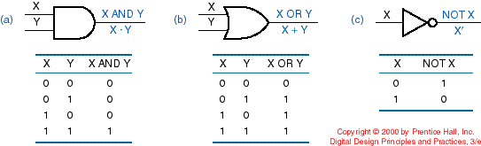
More Logic Gates
We can construct any combinational circuit with AND, OR, and NOT gates
Additional logic gates are used for practical reasons
Boolean Algebra
PJF - <number>
Notes:
Boolean Algebra

Slide 61
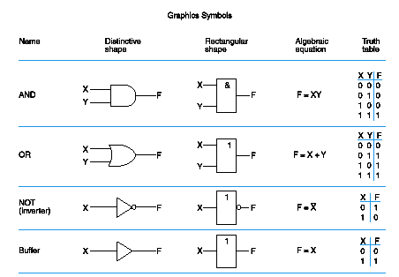
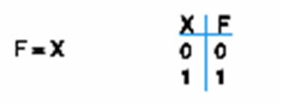
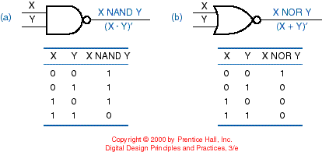
BUFFER, NAND and NOR
Boolean Algebra
PJF - <number>
Notes:
Boolean Algebra

Slide 62
NAND Gate
Known as a “universal” gate because ANY digital circuit can be implemented with NAND gates alone.
To prove the above, it suffices to show that AND, OR, and NOT can be implemented using NAND gates only.
Boolean Algebra
PJF - <number>
Notes:
Boolean Algebra

Slide 63
NAND Gate Emulation
F = (X•X)’
= X’+X’
= X’
X
F = X’
X
X
X
F X•Y
F = ((X•Y)’)’
= (X’+Y’)’
= X’’•Y’’
= X•Y
Y
Y
X
X
F = (X’•Y’)’
= X’’+Y’’
= X+Y
F = X+Y
Y
Y
Boolean Algebra
PJF - <number>
Notes:
Boolean Algebra

Slide 64
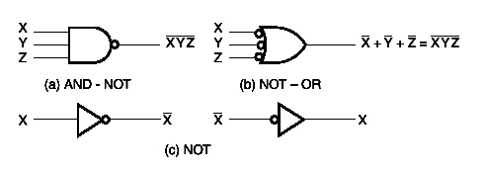
NAND Circuits
To easily derive a NAND implementation of a boolean function:
  Find a simplified SOP
  SOP is an AND-OR circuit
  Change AND-OR circuit to a NAND circuit
  Use the alternative symbols below
Boolean Algebra
PJF - <number>
Notes:
Boolean Algebra

Slide 65
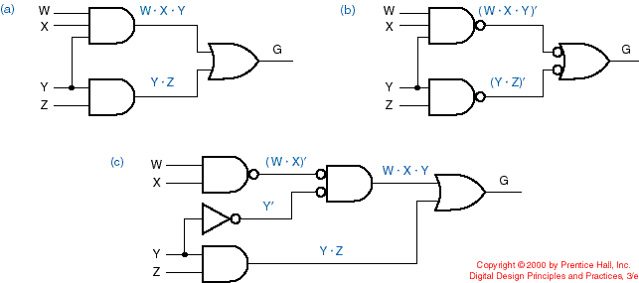
AND-OR (SOP) Emulation
Using NANDs
Two-level implementations
Original SOP
Implementation with NANDs
Boolean Algebra
PJF - <number>
Notes:
Boolean Algebra

Slide 66
AND-OR (SOP) Emulation
Using NANDs (cont.)
Verify:
G = WXY + YZ
G = ( (WXY)’ • (YZ)’ )’
= (WXY)’’ + (YZ)’’ = WXY + YZ
Boolean Algebra
PJF - <number>
Notes:
Boolean Algebra

Slide 67
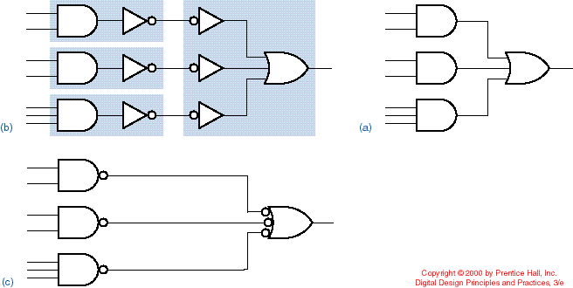
SOP with NAND
Original SOP
Double inversion and grouping
Replacement with NANDs
AND-NOT
NOT-OR
Boolean Algebra
PJF - <number>
Notes:
Boolean Algebra

Slide 68
Two-Level NAND Gate Implementation - Example
F (X,Y,Z) = Σm(0,6)
Express F in SOP form:
F = X’Y’Z’ + XYZ’
Obtain the AND-OR implementation for F.
Add bubbles and inverters to transform AND-OR to NAND-NAND gates.
Boolean Algebra
PJF - <number>
Notes:
Boolean Algebra

Slide 69
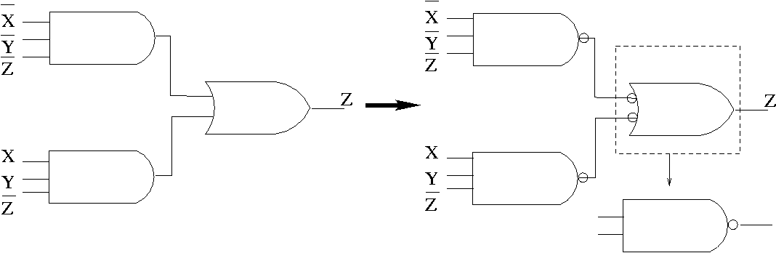
Example (cont.)
Two-level implementation with NANDs
F = X’Y’Z’ + XYZ’
Boolean Algebra
PJF - <number>
Notes:
Boolean Algebra

Slide 70
Multilevel NAND Circuits
Starting from a multilevel circuit:
Convert all AND gates to NAND gates with AND-NOT graphic symbols.
Convert all OR gates to NAND gates with NOT-OR graphic symbols.
Check all the bubbles in the diagram. For every bubble that is not counteracted by another bubble along the same line, insert a NOT gate or complement the input literal from its original appearance.
Boolean Algebra
PJF - <number>
Notes:
Boolean Algebra

Slide 71
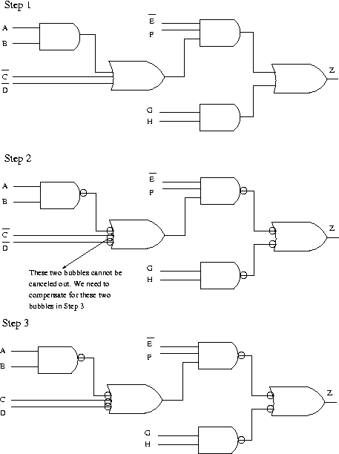
Example
Use NAND gates
and NOT gates to implement
Z=E’F(AB+C’+D’)+GH
AB
AB+C’+D’
E’F(AB+C’+D’)
E’F(AB+C’+D’)+GH
Boolean Algebra
PJF - <number>
Notes:
Boolean Algebra

Slide 72
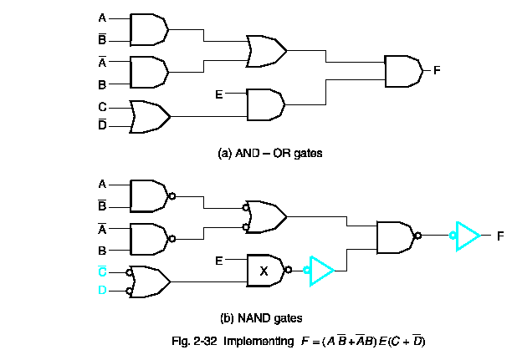
Yet Another Example!
Boolean Algebra
PJF - <number>
Notes:
Boolean Algebra

Slide 73
NOR Gate
Also a “universal” gate because ANY digital circuit can be implemented with NOR gates alone.
This can be similarly proven as with the NAND gate.
Boolean Algebra
PJF - <number>
Notes:
Boolean Algebra

Slide 74
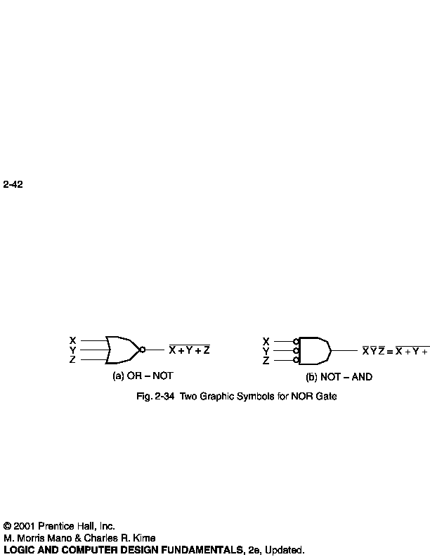
NOR Circuits
To easily derive a NOR implementation of a boolean function:
  Find a simplified POS
  POS is an OR-AND circuit
  Change OR-AND circuit to a NOR circuit
  Use the alternative symbols below
Boolean Algebra
PJF - <number>
Notes:
Boolean Algebra

Slide 75
Two-Level NOR Gate Implementation - Example
F(X,Y,Z) = Σm(0,6)
Express F’ in SOP form:
  F’ = Σm(1,2,3,4,5,7)
  = X’Y’Z + X’YZ’ + X’YZ + XY’Z’ + XY’Z + XYZ
  F’ = XY’ + X’Y + Z
Take the complement of F’ to get F in the POS form: F = (F’)' = (X'+Y)(X+Y')Z'
Obtain the OR-AND implementation for F.
Add bubbles and inverters to transform OR-AND implementation to NOR-NOR implementation.
Boolean Algebra
PJF - <number>
Notes:
Boolean Algebra

Slide 76
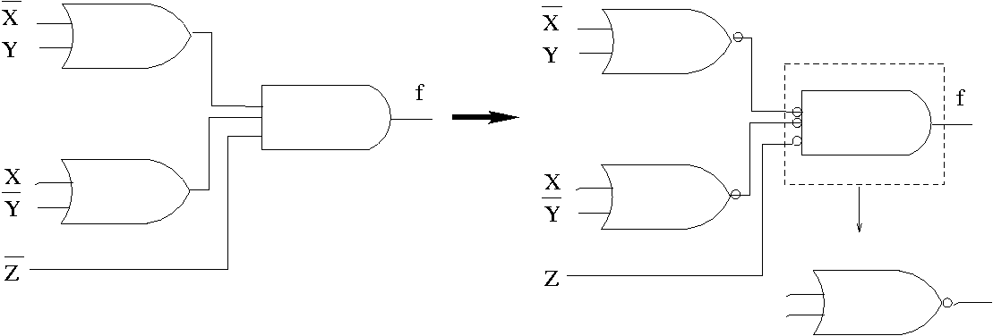
Example (cont.)
Two-level implementation with NORs
F = (F’)' = (X'+Y)(X+Y')Z'
Boolean Algebra
PJF - <number>
Notes:
Boolean Algebra

Slide 77
XOR and XNOR
X | Y | F = X⊕Y
0 | 0 | 0
0 | 1 | 1
1 | 0 | 1
1 | 1 | 0
XOR: “not-equal” gate
X
F
Y
X | Y | F = X⊕Y
0 | 0 | 1
0 | 1 | 0
1 | 0 | 0
1 | 1 | 1
XNOR: “equal” gate
X
F
Y
Boolean Algebra
PJF - <number>
Notes:
Boolean Algebra

Slide 78
Exclusive-OR (XOR) Function
XOR (also ⊕) : the “not-equal” function
XOR(X,Y) = X ⊕ Y = X’Y + XY’
Identities:
  X ⊕ 0 = X
  X ⊕ 1 = X’
  X ⊕ X = 0
  X ⊕ X’ = 1
Properties:
  X ⊕ Y = Y ⊕ X
  (X ⊕ Y) ⊕ W = X ⊕ ( Y ⊕ W)
Boolean Algebra
PJF - <number>
Notes:
Boolean Algebra

Slide 79
XOR function implementation
XOR(a,b) = ab’ + a’b
Straightforward: 5 gates
  2 inverters, two 2-input ANDs, one 2-input OR
  2 inverters & 3 2-input NANDs
Nonstraightforward:
  4 NAND gates
Boolean Algebra
PJF - <number>
Notes:
Boolean Algebra

Slide 80
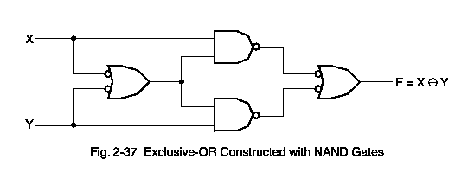
XOR circuit with 4 NANDs
Boolean Algebra
PJF - <number>
Notes:
Boolean Algebra

