Slide 1
Interrupts
INTERRUPT
I/O
Processor
When I/O Device is ready, it sends the INTERRUPT signal to processor via a dedicated controller line
Using interrupt we are ideally eliminating WAIT period
In response to the interrupt, the processor executes the Interrupt Service Routine (ISR)
All the registers, flags, program counter values are saved by the processor before running ISR
The time required to save status & restore contribute to execution overhead → “Interrupt Latency”

Slide 2
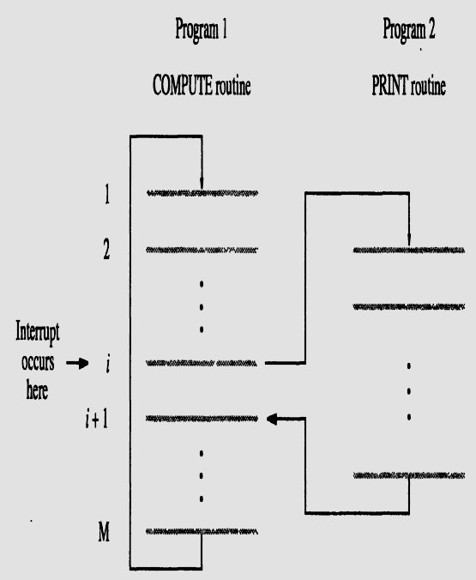

Slide 3
interrupt-acknowledge signal - I/O device interface
accomplishes this by execution of an instruction in the interrupt-service routine (ISR) that accesses a status or data register in the device interface; implicitly informs the device that its interrupt request has been recognized. IRQ signal is then removed by device.
ISR is a sub-routine – may belong to a different user than the one being executed and then halted.
The condition code flags and the contents of any registers used by both the interrupted program and the interrupt-service routine are saved and restored.
The concept of interrupts is used in operating systems and in many control applications, where processing of certain routines must be accurately timed relative to external events (e.g. real-time processing).

Slide 4

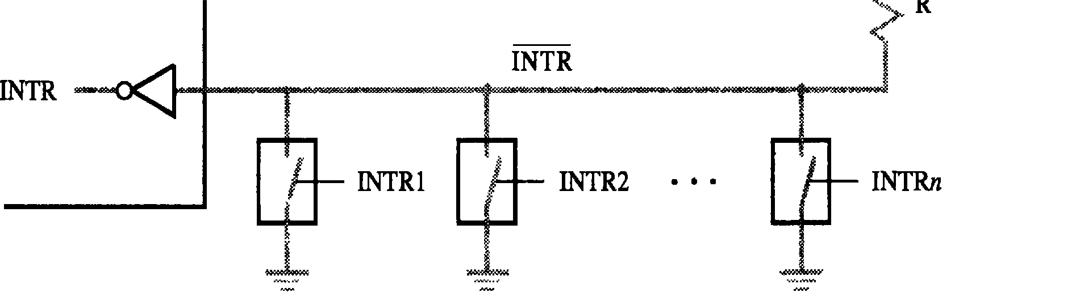
Interrupt Hardware
Pull-up resister
INTR = INTR1 +…..+INTR n
An equivalent circuit for an open-drain bus used to implement a common interrupt-request line

Slide 5
Interrupt Hardware
Supply
Processor
R
INTR
Pull-up resister
INTR 1
INTR 2
INTR 3
INTR = INTR1 +…..+INTR n
GND
INTR

Slide 6
Enabling and Disabling Interrupts
Device activates interrupt signal line and waits with this signal activated until processors attends
The interrupt signal line is active during execution of ISR and till the device caused interrupt is serviced
Necessary to ensure that the active signal does not lead to successive interruptions (level-triggered input) causing the system to fall in infinite loop.
What if the same device interrupts again, within an ISR ?
Three methods of Controlling Interrupts (single device)
Ignoring interrupt
Disabling interrupts
Special Interrupt request line

Slide 7
Ignoring Interrupts
Processor hardware ignores the interrupt request line until the execution of the first instruction of the ISR completed
Using an interrupt disable instruction after the first instruction of the ISR – no further interrupts
A return from interrupt instruction is completed before further interruptions can occur
Disabling Interrupts
Processor automatically disables interrupts before starting the execution of the ISR
The processor saves the contents of PC and PS (status register) before performing interrupt disabling.
The interrupt-enable is set to 0 – no further interrupts allowed
When return from interrupt instruction is executed the contents of the PS are restored from the stack, and the interrupt enable is set to 1

Slide 8
Special Interrupt line
– Special interrupt request line for which the interrupt handling circuit responds only to the leading edge of
the signal
Edge –triggered
Processor receives
only one request regardless of
how long the line is activated
– No separate interrupt disabling instructions

Slide 9
The sequence of events involved in handling an interrupt request from a single device.
Assuming that interrupts are enabled, the following is a typical scenario:
The device raises an interrupt request.
The processor interrupts the program currently being executed.
Interrupts are disabled by changing the control bits in the PS (except in the case of edge-triggered interrupts).
The device is informed that its request has been recognized, and in response, it deactivates the interrupt- request signal.
The action requested by the interrupt is performed by the interrupt-service routine.
Interrupts are enabled and execution of the interrupted program is resumed.

Slide 10
Handling Multiple Devices
Multiple devices
can initiate interrupts
They uses the common interrupt request line
Techniques are
Polling
Vectored Interrupts
Interrupt Nesting
Daisy Chaining

Slide 11
Polling Scheme
The IRQ (interrupt request) bit in the status register is set when a device is requesting an interrupt.
The Interrupt service connected to the bus.
routine
polls
the I/O devices
The first device encountered with the serviced and the subroutine is invoked.
IRQ bit set is
Easy to implement, but too much checking the IRQ bits of all devices,
time
spent on
though
some
devices may not be requesting service.

Slide 12
Vectored Interrupts
Device requesting an interrupt identifies itself directly to the processor
The device sends a special code to the processor over the bus.
The code contains the
identification of the device,
starting address for the ISR,
address of the branch to the ISR
PC finds the ISR address from the code.
To add flexibility for multiple devices - corresponding ISR is executed by the processor using a branch address to the appropriate routine - device specified Interrupt Vector.

Slide 13
An interrupt vector is the memory address of an interrupt handler, or an index into an array called an interrupt vector table or dispatch table - a table of interrupt vectors (pointers to routines that handle interrupts).
Interrupt vector tables contain the memory addresses of interrupt handlers. When an interrupt is generated, the processor saves its execution state via a context switch, and begins execution of the interrupt handler at the interrupt vector.
The Interrupt Descriptor Table (IDT) is specific to the I386 architecture. It tells where the Interrupt Service Routines (ISR) are located.
Each interrupt number is reserved for a specific purpose. For example, 16 of the vectors are reserved for the 16 IRQ lines.
On PCs, the interrupt vector table (IVT or IDT) consists of 256 4-byte pointers - the first 32 (0-31 or 00-1F) of which are reserved for processor exceptions; the rest for hardware interrupts, software interrupts. This resides in the first 1 K of addressable memory.

Slide 14
Interrupt Nesting
Pre-Emption of low priority Interrupt by another high
priority interrupt is known as Interrupt nesting.
Disabling Interrupts during the execution of
the ISR
may not favor devices which need immediate attention.
Need a priority of IRQ devices and accepting IRQ from a high priority device.
The priority level of the processor can be changed dynamically.
The privileged instruction write in the PS (processor status word), that encodes the processors priority.

Slide 15



Interrupt Nesting (contd.)
INTR1
INTRp
Processor
.. .
Device 1
Device 2
Device p
INTA 1
INTA p
Priority arbitration circuit
Organizing I/O devices in a prioritized structure.
Each of the interrupt-request lines is assigned a different priority level.
The processor is interrupted only by a high priority device.

Slide 16



Daisy Chaining
The interrupt request line INTR is common to all the devices
The interrupt acknowledgement line INTA is connected to devices in a DAISY CHAIN way
INTA propagates serially through the devices
Device that is electrically closest to the processor gets high priority
Low priority device may have a danger of STARVATION
INTR
Processor
. .
Device 1
Device 2
Device n
INTA

Slide 17


Daisy Chaining with Priority Group
Combining Daisy chaining and Interrupt nesting to form priority group
Each group has different priority levels and within each group devices are connected in daisy chain way
INTR1
essor
Device 1
Device 1
INTA 1
.
.
.
.
Proc
INTR p
Device 1
Device 1
INTA p
Priority arbitration circuit
Arrangement of priority groups

