Slide 1
INPUT/OUTPUT ORGANIZATION
Accessing I/O Devices
I/O interface
Input/output mechanism Memory-mapped I/O Programmed I/O
Interrupts
Direct Memory Access
Buses
Synchronous Bus Asynchronous Bus

Slide 2
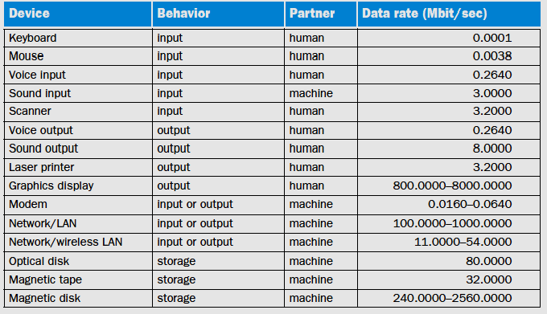
I/O in CO and O/S
Programmed I/O
Interrupts
•
DMA (Direct memory Access)

Slide 3
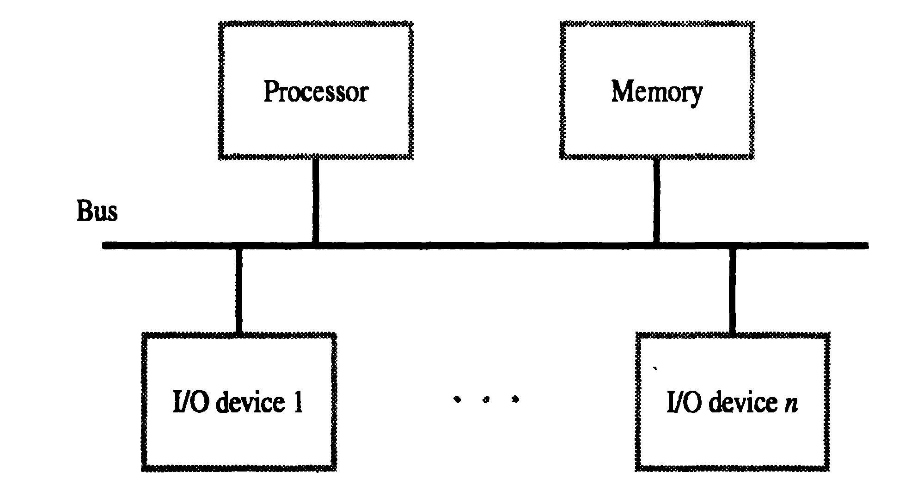
A bus is a shared communication link, which uses one set of wires to connect multiple subsystems.
The two major advantages of the bus organization are versatility and low cost.

Slide 4
Accessing I/O Devices
Most modern computers use single bus arrangement for connecting I/O devices to CPU & Memory
The bus enables all the devices connected to it to exchange information
Bus consists of 3 set of lines : Address, Data, Control
Processor places a particular address (unique for an I/O Dev.) on address lines
Device which recognizes this address responds to the commands issued on the Control lines
Processor requests for either Read / Write
The data will be placed on Data lines

Slide 5
Hardware to connect I/O devices to bus
Interface Circuit
Address Decoder
Control Circuits
Data registers
Status registers
The Registers in I/O Interface – buffer and control
Flags in Status Registers, like SIN, SOUT
Data Registers, like Data-IN, Data-OUT

Slide 6
I/O interface for an input device
Memory
Processor
Address
Data Control
Address
Control
Data and status
I/O
Decoders
circuits
registers
Interface
Input device (s)

