Slide 1
Combinational Logic and Design

Slide 2
Topics
Common Logic Functions
  Decoders
  Encoders
  Multiplexers
A little more Verilog syntax
Verilog for creating test vectors

Slide 3
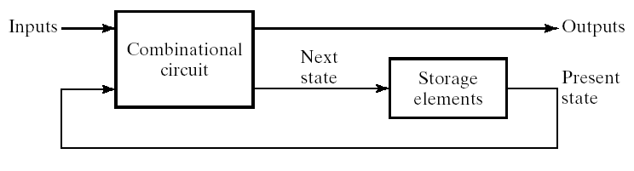
Comb. Logic in Context
Typically part of system with storage
Computer looks like this at high level

Slide 4
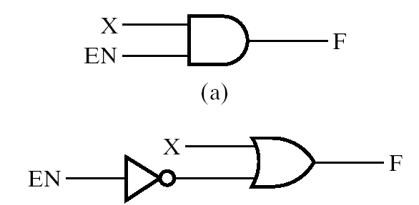
Enable
Enable is a common input to logic functions
See it in memories and today’s logic blocks

Slide 5
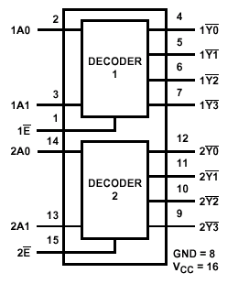
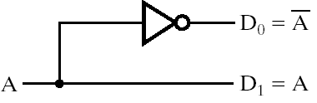
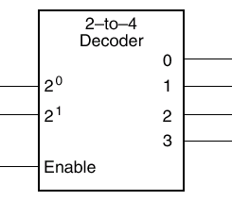
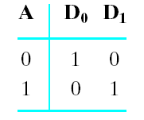
Decoders
Typically n inputs and 2n outputs
Drives high the output corresponding to binary code of input
74139

Slide 6
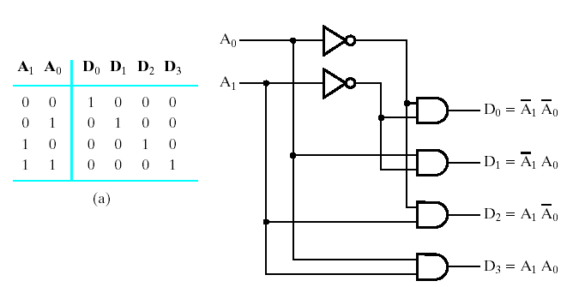
2-to-4 Line Decoder

Slide 7
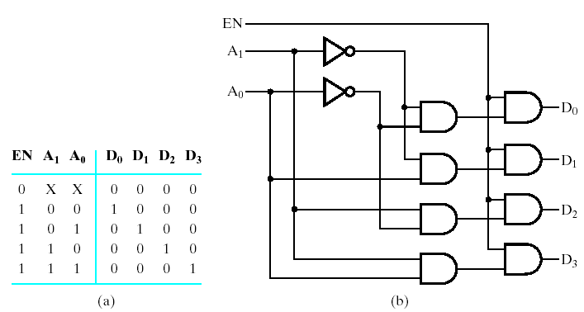
2-to-4 with Enable

Slide 8
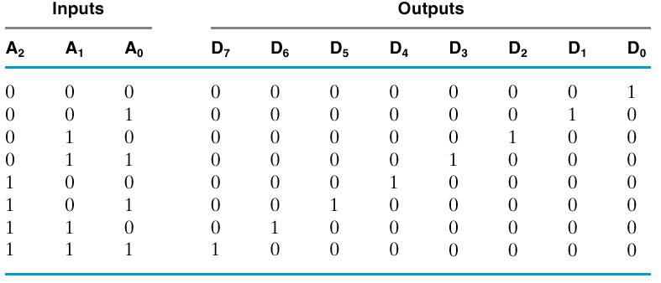
Truth Table, 3-to-8 Decoder
Notice they are minterms

Slide 9
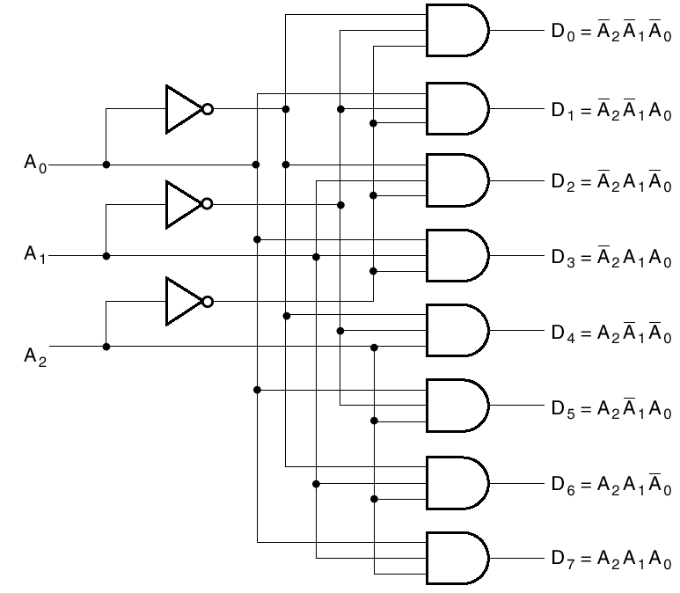
Schematic

Slide 10
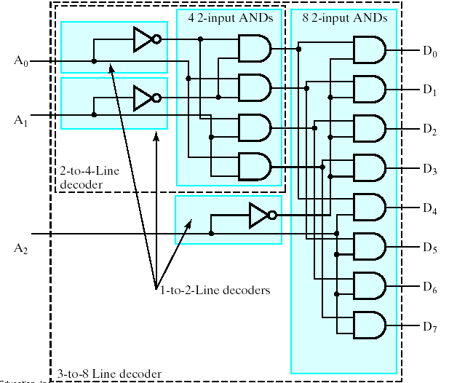
Multi-Level 3-to-8

Slide 11
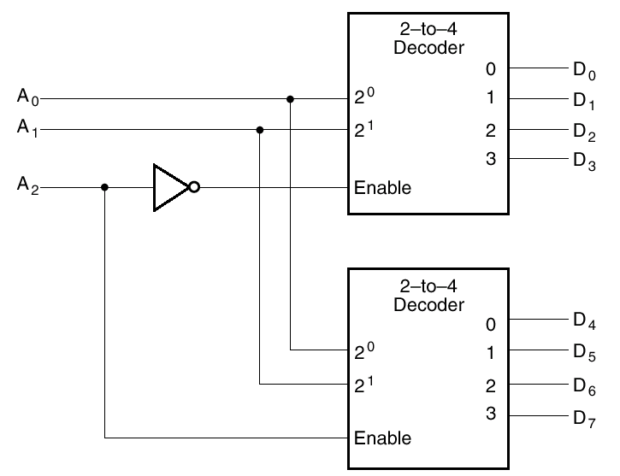
Enable Used for Expansion

Slide 12
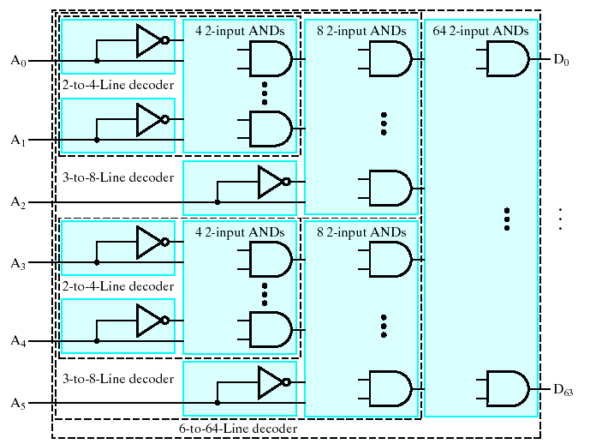
Multi-Level 6-to-64

Slide 13
Uses for Decoders
Binary number might serve to select some operation
Computer op codes are encoded
  Decoder lines might select add, or subtract, or multiply, etc.
Memory address lines

Slide 14
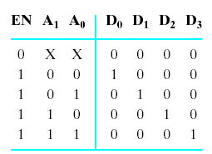
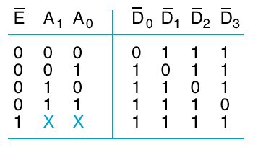
Variations
At right
  Enable not
  Inverted outputs

Slide 15
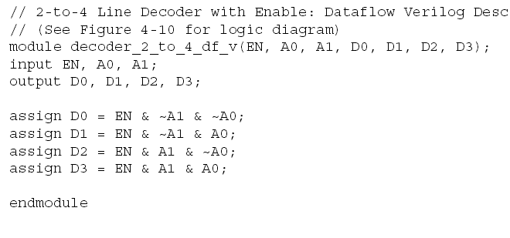
Verilog

Slide 16
Encoder
Encoder is the opposite of decoder
2^{n} inputs (or less – maybe BCD in)
n outputs

Slide 17
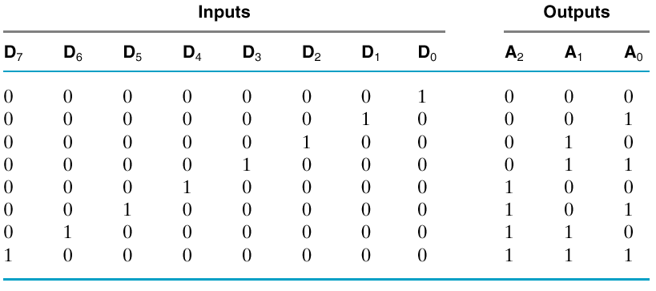
Truth Table

Slide 18
Inputs are Minterms
Can OR them together appropriately
A₀ = D₁ + D₃ + D₅ + D₇

Slide 19
What’s the Problem?
What if D3 and D6 both high?
Simple OR circuit will set A to 7

Slide 20

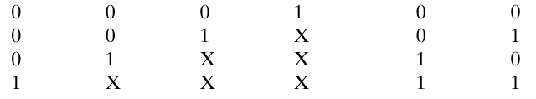
Priority Encoder
Chooses one with highest priority
  Largest number, usually
Note “don’t cares”
What if all inputs are zero?

Slide 21
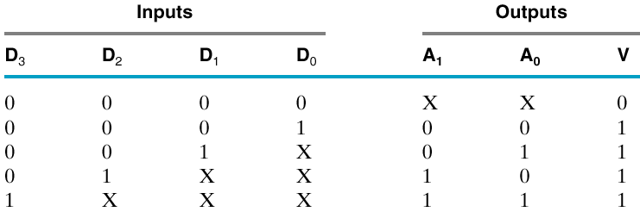
Need Another Output
A “Valid” output

Slide 22
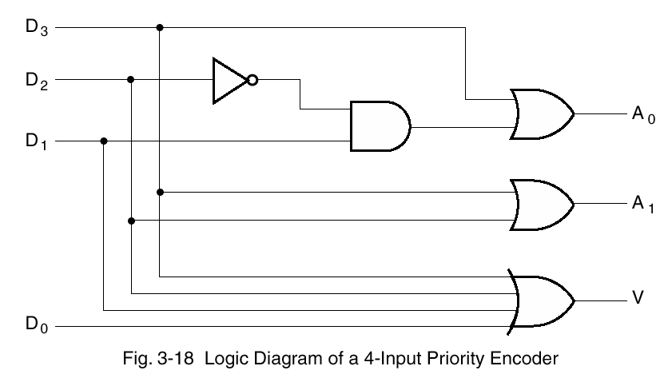
Valid is OR of inputs

Slide 23
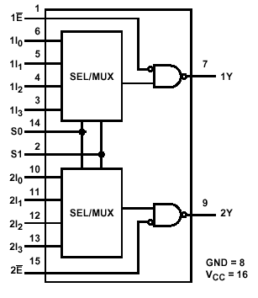
Multiplexer (or Mux)
Selects one of a set of inputs to pass on to output
Binary control code, n lines
  Choose from 2^{n} inputs
Useful for choosing from sets of data
  Memory or register to ALU
Very common
74153

Slide 24
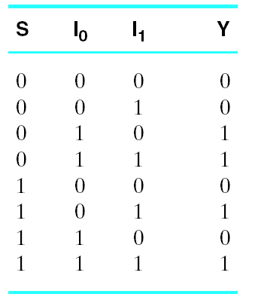
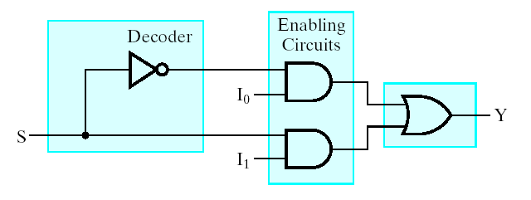
Two Input Mux

Slide 25
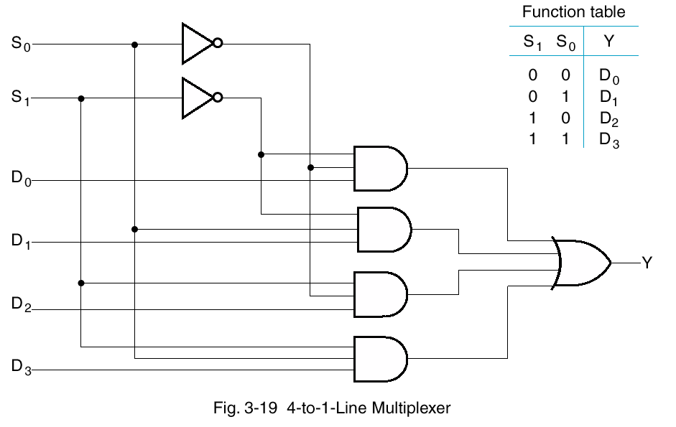
Logic

Slide 26
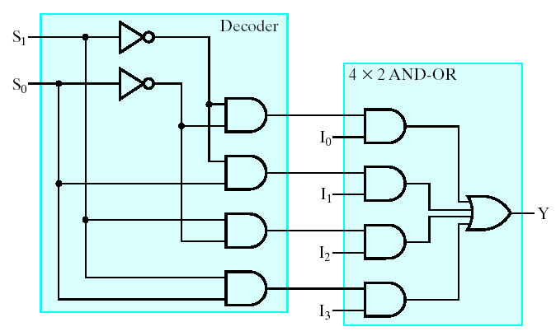
Logic is Decoder Plus

Slide 27
Structural Verilog
module mux_4_to_1_line_structural(S, D, Y);
input [1:0] S;
input [3:0] D;
output Y;
wire [1:0] not_S;
wire [0:3] N;
not(not_S[0], S[0]);
not(not_S[1], S[1]);
and(N[0], not_S[1], not_S[0], D[0]);
and(N[1], not_S[1], S[0], D[1]);
and(N[2], S[1], not_S[0], D[2]);
and(N[3], S[1], S[0], D[3]);
or(Y, N[0], N[1], N[2], N[3]);
endmodule
We can do better
with dataflow
(next)

Slide 28
Dataflow Verilog
module mux_4_to_1_df(S, D, Y);
input [1:0] S;
input [3:0] D;
output Y;
assign Y = (~ S[1] & ~ S[0] & D[0])|
(~ S[1] & S[0] & D[1]) |
( S[1] & ~ S[0] & D[2]) |
( S[1] & S[0] & D[3]);
endmodule
Can do even
better (next)

Slide 29
But First an Aside
Verilog constants
Conditional assignment

Slide 30
Constants in Verilog
Syntax
  [size][‘radix]constant
Radix can be d, b, h, or o (default d)
Examples
  assign Y = 10; // Decimal 10
  assign Y = ‘b10; // Binary 10, decimal 2
  assign Y = ‘h10; // Hex 10, decimal 16
  assign Y = 8‘b0100_0011 // Underline ignored
Binary values can be 0, 1, or x

Slide 31
Conditional Assignment
Equality test
S == 2'b00
Assignment
assign Y = (S == 2'b00)?‘b0:‘b1;
  If true, assign 0 to Y
  If false, assign 1 to Y

Slide 32
4-to-1 Mux Truth Table-ish
module mux_4_to_1_dataflow(S, D, Y);
input [1:0] S;
input [3:0] D;
output Y;
assign Y = (S == 2'b00) ? D[0] :
(S == 2'b01) ? D[1] :
(S == 2'b10) ? D[2] :
(S == 2'b11) ? D[3] : 1'bx ;
endmodule

Slide 33
Verilog for Decision Tree
module mux_4_to_1_binary_decision(S, D, Y);
input [1:0] S;
input [3:0] D;
output Y;
assign Y = S[1] ? (S[0] ? D[3] : D[2]) :
(S[0] ? D[1] : D[0]) ;
endmodule

Slide 34
Binary Decisions
If S[1] == 1, branch one way
assign Y = S[1] ? (S[0] ? D[3] : D[2])
  and decide Y = either D[2] or D[3] based on S[0]
Else
: (S[0] ? D[1] : D[0]) ;
  decide Y is either D[2] or D[3] based on S[0]
Notice that conditional test is for ‘1’ condition like in C

Slide 35
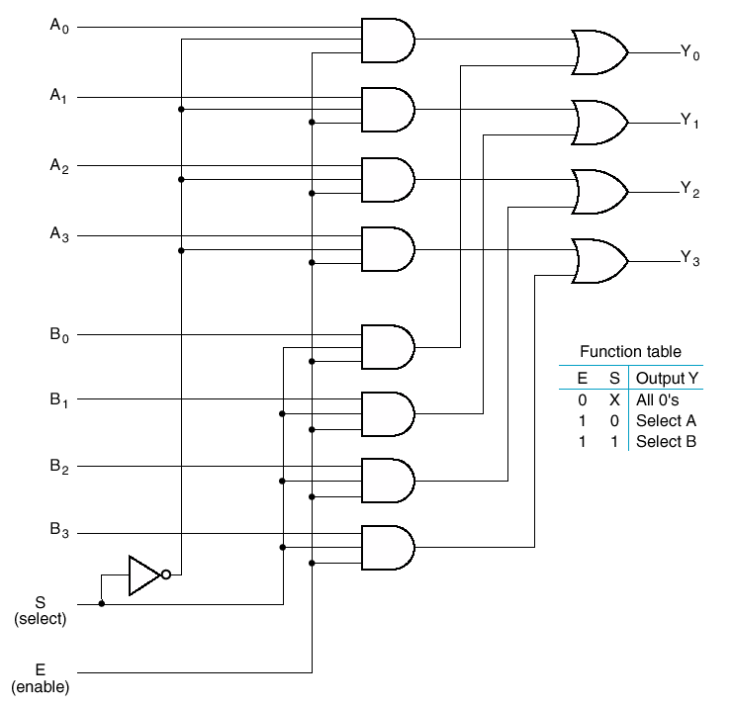
Quad 2-to-4 Line Mux
Select one set of 4 lines
Can gang these
Select a whole 64-bit data bus

Slide 36
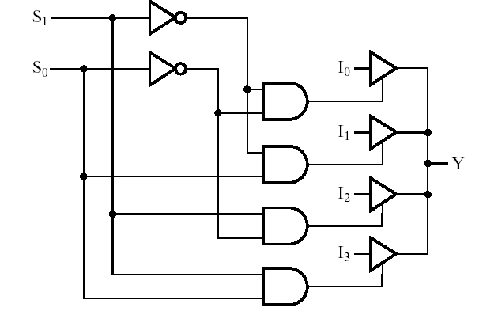
Three-State Implementation

Slide 37
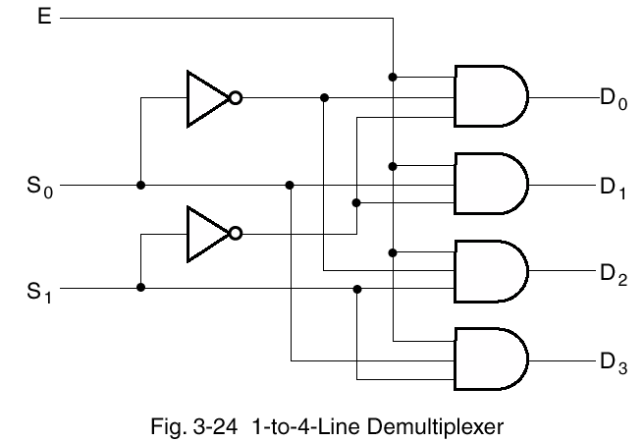
Demultiplexer
Takes one input
Out to one of 2^{n} possible outputs

Slide 38
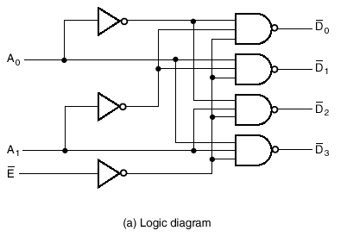

Demux is a Decoder
With an enable

Slide 39
Code Converters
One code to another
Book puts seven-segment decoder in this category
Typically multiple outputs
  Each output has function or truth table

Slide 40


Seven-Segment Decoder
This Friday’s lab: Verilog of hex to LEDs
Extended version of book example
You may want to work out mapping (truth table/function) before lab

Slide 41
Change Topics to
Verilog
  First a couple of syntax styles
  Help you program more efficiently
Verilog test programs

Slide 42
Instance Port Names
Module
module modp(output C, input A);
Ports referenced as
modp i_name(conC, conA)
Also as
modp i_name(.A(conA), .C(conC));

Slide 43
Parameter
Can set constant
  Like #define
parameter SIZE = 16;

Slide 44
Verilog for Simulation
Code more convenient than the GUI testbench
  Also more complex conditions
  Can test for expected result

Slide 45
ISE
Make Verilog Test Fixture
Will create a wrapper (a module)
  Instantiating your circuit
  It’ll be called UUT (unit under test)
You then add your test code
Example on next slides

Slide 46
Module and Instance UUT
module syn_adder_for_example_v_tf();
// DATE: 21:22:20 01/25/2004
// ...Bunch of comments...
...
// Instantiate the UUT
syn_adder uut (
.B(B),
.A(A),
.C0(C0),
.S(S),
.C4(C4)
);
...
endmodule

Slide 47
Reg
It will create storage for the inputs to the UUT
// Inputs
reg [3:0] B;
reg [3:0] A;
reg C0;
We’ll talk more about reg next class

Slide 48
Wires for Outputs
That specify bus sizes
// Outputs
wire [3:0] S;
wire C4;

Slide 49
Begin/End
Verilog uses begin and end for block
instead of curly braces

Slide 50
Initial
Initial statement runs when simulation begins
initial
begin
B = 0;
A = 0;
C0 = 0;
end

Slide 51
Procedural assignment
Why no “assign”?
Because it’s not a continuous assignment
Explain more next class when we look at storage/clocking

Slide 52
Initialize in Default Test File
There’s one in ISE generated file, but don’t think auto_init is defined
// Initialize Inputs
`ifdef auto_init
initial begin
B = 0;
A = 0;
C0 = 0;
end
`endif

Slide 53
What to Add?
Need to make simulation time pass
Use # command for skipping time
Example (note no semicolon after #50)
initial
begin
B = 0;
#50 B = 1;
end

Slide 54
For
Can use for loop in initial statement block
initial
begin
for(i=0; i < 5; i = i + 1)
begin
#50 B = i;
end
end

Slide 55
Integers
Can declare for loop control variables
  Will not synthesize, as far as I know
  integer i;
  integer j;
Can copy to input regs
  There may be problems with negative values

Slide 56
There are also
While
Repeat
Forever

Slide 57
Timescale
Need to tell simulator what time scale to use
Place at top of test fixture
`timescale 1ns/10ps

Slide 58
System Tasks
Tasks for the simulator
$stop – end the simulation
$display – like C printf
$monitor – prints when arguments change (example next)
$time – Provides value of simulated time

Slide 59
Monitor
// set up monitoring
initial
begin
$monitor($time, " A=%b ,B=%b\n", A, B);
end
// These statements conduct the actual test
initial
begin
Code...
end

Slide 60
Today
Common functions – should know these
  Decoder
  Priority encoder
  Multiplexer (mux)
  Demultiplexer
A little more Verilog
Verilog test programs

Slide 61
Next
Sequential Circuits
  Storing state
  Sections 6-1, 6-2, 6-3
We’ll put off the study of arithmetic circuits
  Chapter 5

