Slide 1
UNIT-II
Divide and Conquer Designing Method

Slide 2
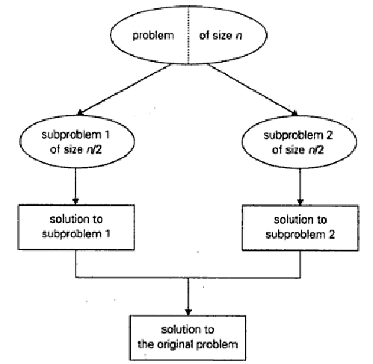
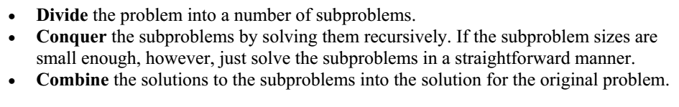
Introduction
Flowchart:
Algorithm:

Slide 3
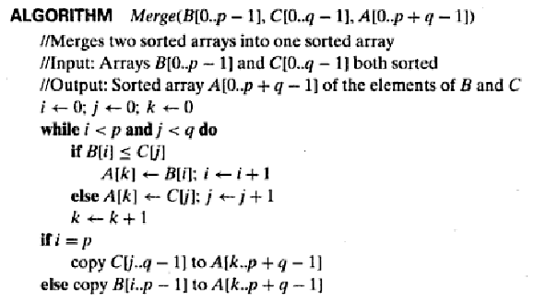
Merge two sorted array:

Slide 4
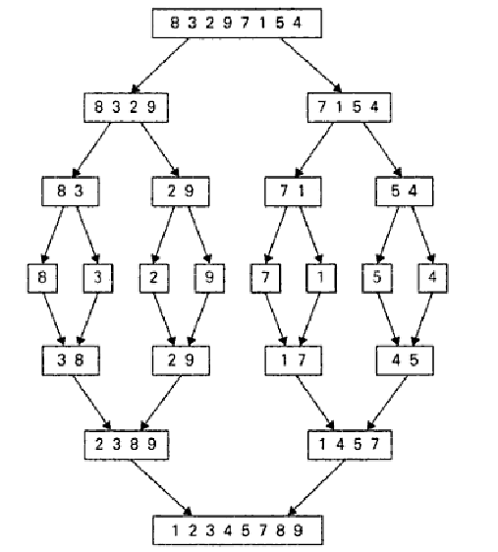
Merge Sort Example:

Slide 5
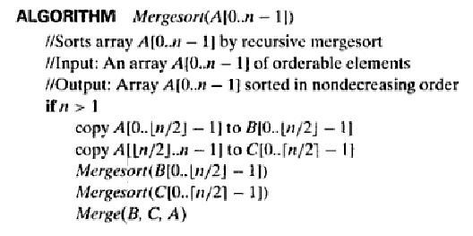
Algorithm:

Slide 6


Time Complexity:

Slide 7
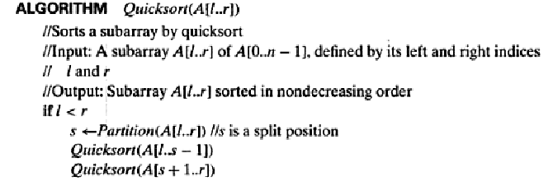
Quick Sort Algorithm:

Slide 8
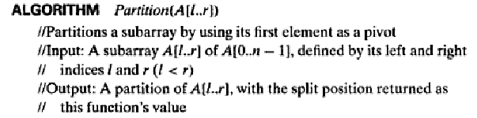
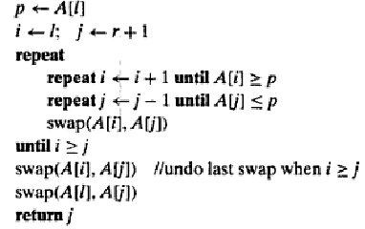
Partition Algorithm:

Slide 9
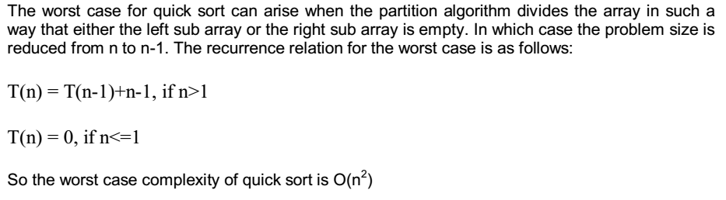
Time Complexity:
Worst case:

Slide 10
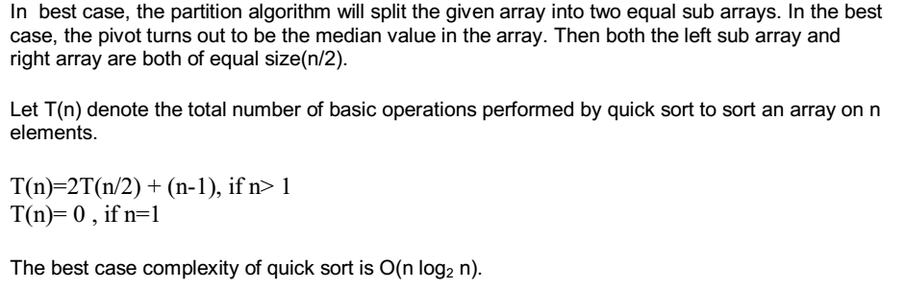
Best case:

Slide 11
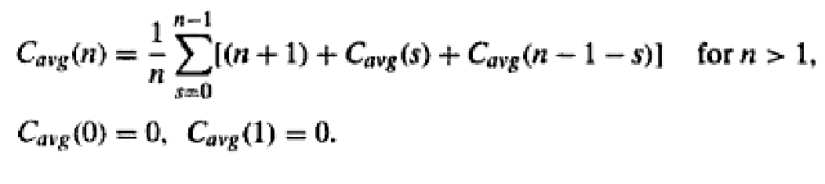

Average case:

Slide 12
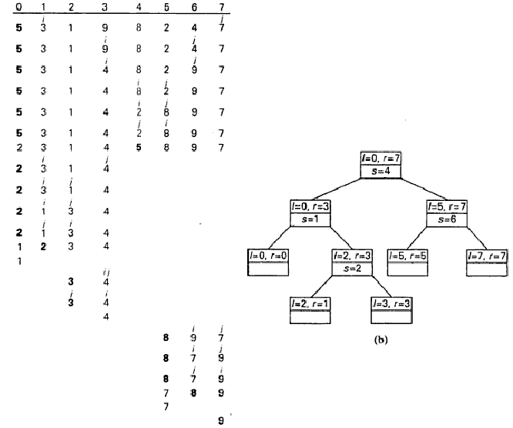
Recursive call tree

Slide 13
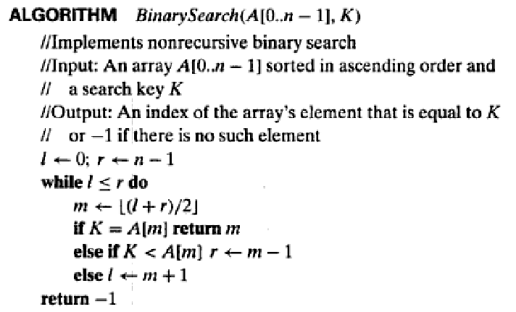
Binary Search Algorithm:

Slide 14

Time Complexity:

Slide 15
Linear Search Algorithm
Algorithm linear_search (list, value)
Input: Array of n elements
Output: Success or failure
for each item in the list
if match item == value
return the item's location
end if
end for
Return -1

Slide 16
Differences between linear and Binary search
 | Linear Search | Binary Search
Type of Input | Unsorted array | Sorted array
No. of comparisons in worst case | N | log₂N
Best case | When element in first location | When element in mid location
Time complexity | O(N) | O(log₂N)
For 2N elements | 2N comparisons | (log₂N+1) comparisons
Efficiency | Not good | Better than linear search

Slide 17
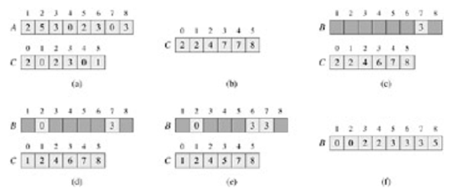
Counting Sort

Slide 18
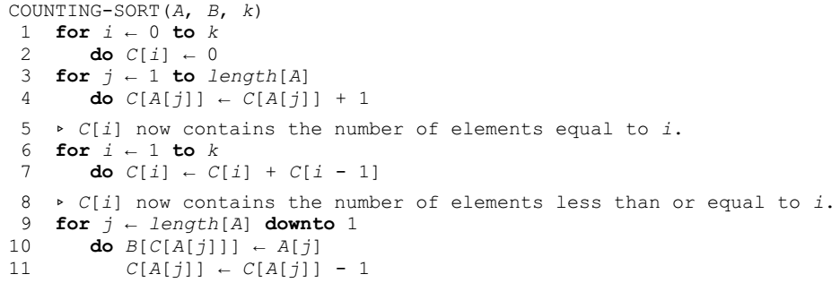

Slide 19
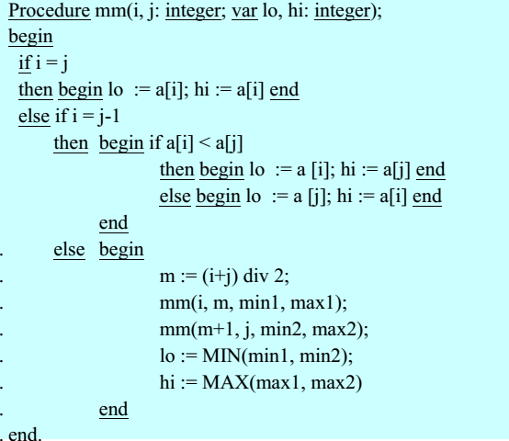
MinMax Algorithm

Slide 20
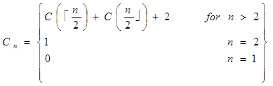
Time complexity

Slide 21
Sum of N numbers

Slide 22
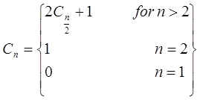
Time complexity

Slide 23

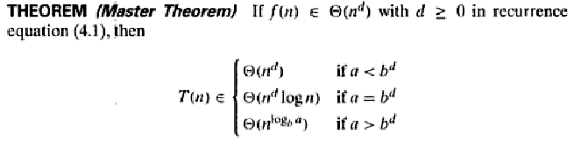
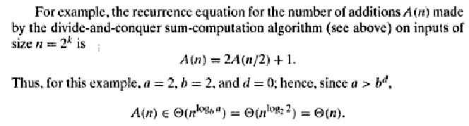
Master Theorem

Slide 24
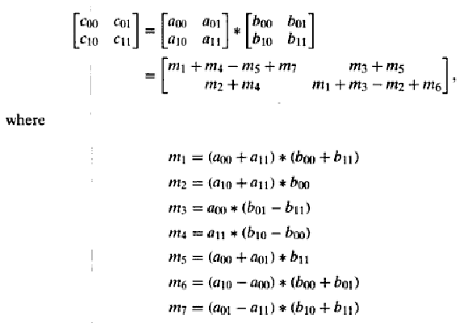

Slide 25
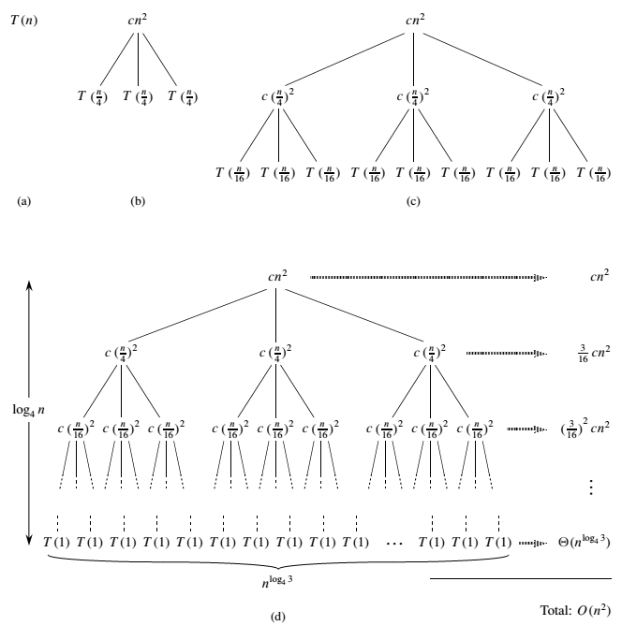
Recursive tree method

Slide 26
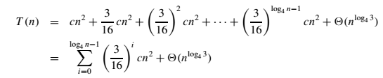
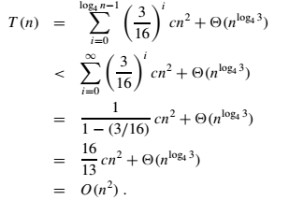

Slide 27
