Slide 1


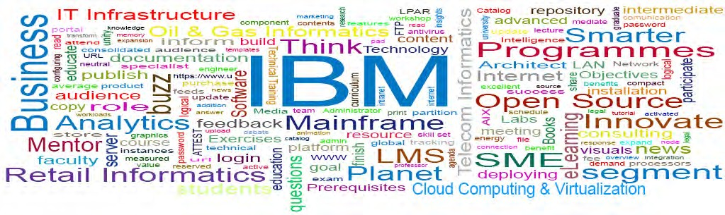
Unit 2
BPM Life Cycle Methodology
1
© 2013 IBM Corporation

Slide 2
Learning Objectives
Understand the BPM lifecycle
Understand Process Modeling and its relation to BPM
2

Slide 3
Introduction
BPM uses a methodical and efficient approach to continuously improve business effectiveness and efficiency while aiming for innovation, flexibility and integration with technology
BPM can have a huge impact on the cost and revenue generation of an organization
BPM considers processes as strategic assets of an organization that have to be understood, managed, and improved to deliver value-added products and services to clients
BPM provides an approach to integrate an organizational "change capability" that is both human and technological
3

Slide 4
Introduction
BPM is often spoken about as
“Management by business processes”
“corporate management through processes”
“company performance management through processes”
4

Slide 5
Business process management activities can be classified into six categories
Business Process Management Activities
✓Vision
design
modeling
execution
✓Monitoring
✓optimization
5

Slide 6
Vision
Functions are designed around the strategic vision and goals of an organization
Each function is connected with a list of processes
Each functional head in an organization is in charge of certain sets of processes made up of tasks which are to be executed and reported as planned
Multiple processes and multiple functions are aggregated to achieve organizational goals
6

Slide 7
Design
Process design takes into consideration of existing processes “as-is” and the design of "to-be" processes
The representation of the process flow, the factors within it, alerts & notifications, escalations, standard operating procedures, service level agreements, and task hand- over mechanisms are the areas of focus.
Good design brings down the number of problems over the lifetime of the process
The aim of this step is to make sure that a correct and efficient theoretical design is prepared
7

Slide 8
Design
cont…
The proposed improvement could be in human-to-human, human-to-system or system-to-system workflows, and may target regulatory, market, or competitive challenges experienced by the businesses
The existing process and the design of new process for various applications will have to coordinate.
8

Slide 9
Modeling
Modeling takes the theoretical design and introduces combinations of variables ( e.g. changes in rent or material cost)
It also involves running "what-if analysis" on the processes: "What if I have 75% of resources to do the same task?" "What if I want to do the same job for 80% of the current cost?"
9

Slide 10
Execution
One of the ways to computerize processes is to develop or purchase an application that performs the required process; but in real time, these applications rarely execute all the steps of the process accurately or completely
Another method is to use a combination of software and human intervention; but this complex approach makes the documentation process difficult
In response to these problems, software has been created that enables the full business process to be defined in a computer language which can be executed by the computer directly
The system will use services in connected applications to perform business operations or ask for human input when a step is too complex to be automated
10

Slide 11
Execution cont…
Compared to the previous approaches, directly executing a process definition can be more simple and direct and therefore easier to improve. However, automating a process definition needs
Flexible and comprehensive infrastructure, which typically rules out implementing these systems in a legacy IT environment.
Systems have used business rules to provide definitions for governing behavior, and a business rule engine can be used to drive process execution and resolution.
11

Slide 12
Monitoring
Monitoring includes the tracking of individual processes, so that information on their state can be easily seen, and statistics on the performance of one or more processes can be given
An example of the tracking is being able to determine the state of a customer order so that problems in its execution can be identified and corrected
Moreover, this information can be used to work with customers and suppliers to make their connected processes better.
Statistics example & Measures:
How many orders were processed? How quickly order was processed?
Three categories: cycle time, defect rate & productivity
12

Slide 13
Monitoring cont…
The degree of monitoring is based on what information the business wants to evaluate and analyze and how business wants it to be monitored, in real-time, near real-time or ad hoc
Business activity monitoring (BAM) extends and expands the monitoring tools generally offered by BPMS
Process mining is a collection of methods & tools associated with process monitoring.
Mining allows process analysts to spot discrepancies between the actual process execution and the priori model as well as to analyze bottlenecks
13

Slide 14
Optimization
Process optimization includes recovering process performance information from modeling or monitoring phase
Identifying the potential or actual bottlenecks and the potential opportunities for cost savings or other improvements and then apply those improvements in the design of the process
14

Slide 15
Re-engineering
When the process becomes too noisy and optimization is not getting the desired output, it is recommended to re-engineer the entire process cycle.
BPR has become an essential part of organisations to achieve efficiency and productivity at work.

Slide 16
Components
of a BPM Suite
Process Engine – strong platform for modeling and executing process-based applications, including business rules
Business Analytics — helps managers to identify business issues, trends, and opportunities with reports and dashboards and take action accordingly
Content Management — offers a system for storing and securing electronic documents, images, and other files
Collaboration Tools — eliminate intra- and interdepartmental communication barriers through discussion forums, dynamic workspaces, and message boards
16

Slide 17
Establishing a common language for business IT alignment
Validation of BPMS is a technical issue that vendors and users should be aware of, if regulatory compliance is compulsory.
An authenticated third party or the users themselves can perform the validation task.
Validation document is generated which can either be
Published officially or
Retained by users

Slide 18
Cloud computing BPM
Cloud computing business process management is the use of (BPM) tools that are delivered as software services (SaaS) over a network
Cloud BPM business logic is deployed on an application server and the business data is stored in cloud storage
The advantages of using cloud BPM services include removing the need and cost of maintaining specialized technical skill sets in-house and reducing distractions from an enterprise's main focus
It provides controlled IT budgeting and permits geographical mobility.
18

Slide 19
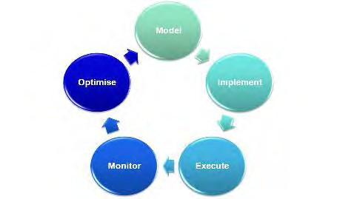
BPM lifecycle – Phases
19

Slide 20
Model
Capture the business processes at a high level
Collect just enough details to understand conceptually how the process works
Concentrate on ensuring the high level detail is correct without being sidelined by the details of how it’s going to be implemented.
Traditionally carried out by business analysts, but simple-to- use technologies such as Sequence are allowing the business manager to take up this task, as this is usually where the in-depth knowledge is needed to model the process lives
20

Slide 21
Implement
Extend the model to collect more detail needed to execute the process
Example-
Recipients
Form controls and layout
Email message content
System integrations
21

Slide 22
Execute
and Monitor
Execute
Instances of the process are floated and end users interact with it
Monitor
Measure key performance indicators and process performance
View these vs. SLAs service level agreement (SLA) is a contract between a service provider (either internal or external) and the end user that defines the level of service expected from the service provider. SLAs are output-based in that their purpose is specifically to define what the customer will receive. via graphical dashboards and textual reports to monitor the process performance ** identify and understand the bottlenecks/inefficiencies in the process
22
Notes:
SLA- Service level agreement

Slide 23
Optimize
Improve the business process and performance against SLAs by minimizing the bottlenecks/inefficiencies spotted during monitoring
Simulate these changes using “ what-if “ simulation
Determine which changes will give the maximum benefit
Fine tune the process
23

Slide 24
Business Model
Business model is a structure for creating economic, social and/or other forms of value.
Business model is the method of doing business by which a company can generate revenue and sustain itself.
Business model clearly points out how a company makes money by specifying where it is positioned in the value chain.

Slide 25
Business Process
Business process is a set of related, structured activities or tasks that produce a specific service or product (serve a particular goal) for a particular customer or customers.
Three major types of business processes:
Management Process: that govern the operation of a system.
Include corporate governance and strategic management
Operational Process: constitute core business and create primary value stream.
Purchasing , manufacturing , marketing and sales.
Supporting Process: that support the core processes.
accounting , recruitment and technical support.

Slide 26
Modeling and simulation functionality allows for pre- execution "what-if" modeling and simulation
Modeling and simulation
Post-execution optimization is available based on the analysis of actual as-performed metrics
Use case Diagram & Activity Diagram
Some business process modeling techniques:
Business Process Model and Notation (BPMN)
Cognition enhanced Natural language Information Analysis Method (CogNIAM)
Extended Business Modeling Language (xBML)
Event-driven process chain (EPC)
ICAM DEFinition (IDEF0)
Unified Modeling Language (UML)
26

Slide 27
BPMN
Modeling and simulation
Programming languages used for BPM
Business Process Execution Language (BPEL)
Web Services Choreography Description Language (WS-CDL) XML Process Definition Language (XPDL)
Vendor-specific languages
Architecture of Integrated Information Systems (ARIS) supports EPC,
Java Process Definition Language (JBPM) or java business process model
27

Slide 28
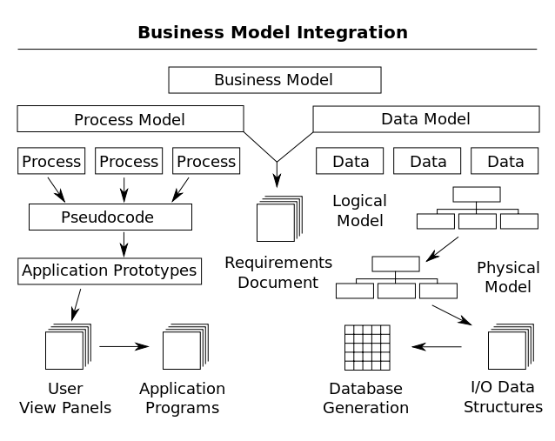
between business process and data
Interaction
28

Slide 29
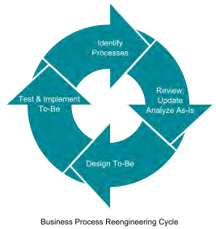
Business Process Reengineering Cycle
29

Slide 30
Business Process Reengineering
Aims to improve the efficiency and effectiveness of
the processes that exist within and across organizations.
It examines business processes from a "clean slate" perspective to determine how best to construct them
Business process reengineering (BPR) began as a private sector technique to help organizations fundamentally rethink how they do their work
A key stimulus for reengineering has been the development and deployment of sophisticated information systems and networks
30

Slide 31
Checkpoint
The various stages in BPM lifecycle and the tasks of each stage
Role of process modeling and its association with BPM
31

