Slide 1
SCHOOL OF ENGINEERING & TECHNOLOGY
DEPARTMENT OF COMPUTER SCIENCE AND ENGINEERING
Introduction to Java
Presented By:
Pushpendra K. Rajput
Assistant Professor,
Department of Computer Science & Engineering

Slide 2
SCHOOL OF ENGINEERING & TECHNOLOGY
DEPARTMENT OF COMPUTER SCIENCE AND ENGINEERING
Outline
Introduction
Process and MultiTasking
Thread
Need for multithreading
Thread Support in Java
Thread Scheduling
Thread synchronization
Summary

Slide 3
Multitasking vs multiprocessing
Multitasking
Multiprocessing

Slide 4
Process
It is executable program in memory
Process Properties:
Address Space
Own program counter, Execution context
Each process may execute a different program
May contain multiple thread

Slide 5
Thread
It is lightweight process, a single sequentially executed stream of instructions
Properties:
Shares address space with other threads
Communicate via shared access to data
Multiple thread in process execute same program

Slide 6
Single thread vs Multiple threads
T0
T1
T2
T3
T4
T0
T1
T2
T3
T4
One thread can pause without stopping other parts of your program.

Slide 7
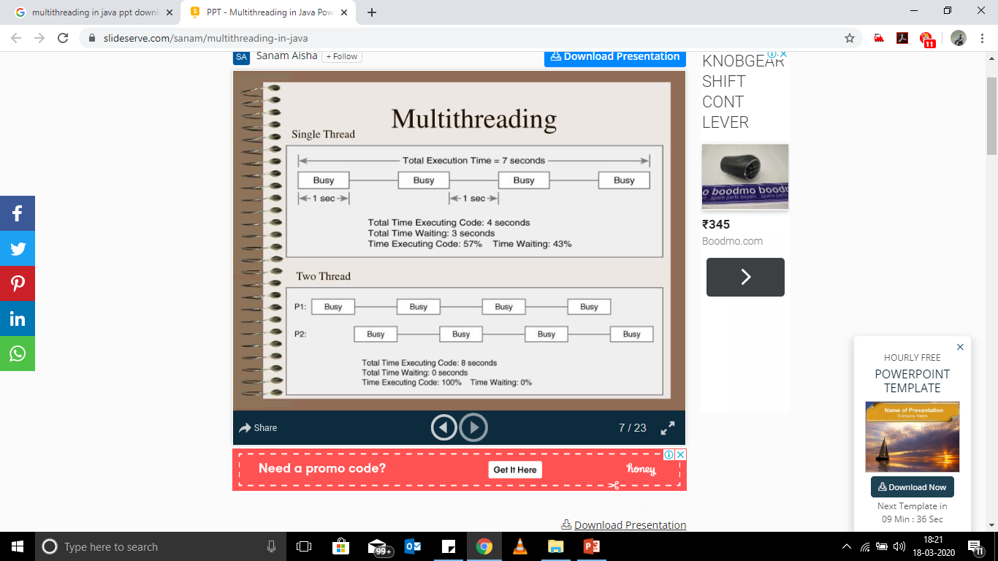

Slide 8
Need of multithreading
Speed up the computation
Two threads each solve half of the problem and then combine their results
Faster response
One thread computes while another handles user interface
One thread loads an image from internet while another performs computation
Performing multiple tasks simultaneously
One thread does garbage collection while other performs computation
Several thread performs animation simultaneously

Slide 9
Multithreaded Programming
Java provides built-in support
A program has two or more parts that can run concurrently
Each part is called thread
Specialized form of multitasking

Slide 10
State of a thread
New – created, waiting for start
Runnable – can begin execution, got CPU time
Running – currently executing
Blocked – waiting for event
Dead – finished execution

Slide 11
Transition between states Thread management
Through methods – start(), yield(), sleep(), wait(), notify()
Through external events – Scheduler, I/O, returning from run()

Slide 12
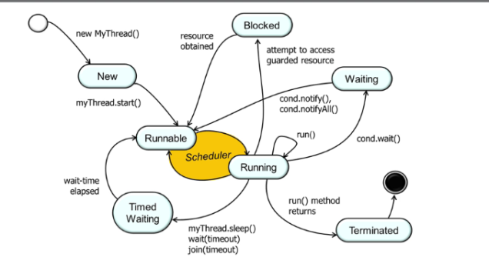
Thread state Diagram

Slide 13
Java Threads
Thread Class
Runnable Interface
Thread
Thread
(class)
Runnable
(Interface)
Override
(run() )
Extends
Implements

Slide 14
Thread Class
Constructors
Thread()
Thread(String name)
Thread(Runnable r)
Thread(Runnable r, String name)

Slide 15
Thread Class
Methods
public void run() | public void start()
public static void sleep(long miliseconds) | public void interrupt()
public void join(long miliseconds) | public void join()
public int setPriority(int priority) | public int getPriority()
public final void setName(String name) | public String getName()
public static Thread currentThread() | public int getId()
public Thread.State getState() | public boolean isAlive()
public void suspend() | public void yield()
public void stop() | public void resume()

Slide 16
The main Thread
As the program starts up it begins
Created automatically
Can be controlled through a Thread object
Call method getCurrentThread() to get reference

Slide 17
Creating a Thread
Override public void run() method
Define the code that constitutes the new thread.
Create object of Thread using constructor
Call start() method through thread object
In essence, start( ) executes a call to run( ).

Slide 18
Scheduling of Threads
Scheduler
Determines which runnable threads to run
Can be based on tread priority
Part of OS or JVM
Scheduling Policy
Preemptive
Non-preemptive

Slide 19
Priority of Threads
Priority determines how the thread should be treated with respect to the others
Used to decide when to switch from one thread to other.
A higher-priority thread can also preempt a lower-priority one
NOEM_PRIORITY – 5
MIN_PRIORITY – 1
MAX_PRIORITY – 10

Slide 20
Context switch
The rules that determine when a context switch takes place are simple:
A thread can voluntarily relinquish control.
explicitly yielding, sleeping, or blocking on pending I/O.
A thread can be preempted by a higher-priority thread.
as soon as a higher-priority thread wants to run, it does

Slide 21
Critical section
Critical section is executed by multiple threads
Sequence of execution makes a difference in result
Multiple threads access the same resource
Memory, systems or files
public class Counter {
protected long count = 0;
public void add(long value){
this.count = this.count + value;
}
}

Slide 22
Race Condition
The situation where two threads compete for the same resource, where the sequence in which the resource is accessed is significant, is called race conditions.
A code section that leads to race conditions is called a critical section.

Slide 23
Preventing Race condition
Critical section must be executed as an atomic instruction
once a single thread is executing it, no other threads can execute it until the first thread has left the critical section.
Use thread synchronization in critical sections

Slide 24
Synchronization
Mutual Exclusion: It means that only one thread or process can execute a block of code (critical section) at a time.
Visibility: It means that changes made by one thread to shared data are visible to other threads.

Slide 25
Synchronization
Java implements interprocess synchronization
The monitor
Monitor a small box that can hold only one thread
Once a thread enters a monitor, all other threads must wait until that thread exits the monitor.
There is no class Monitor
In-built support provided
Notes:
There is no class “Monitor”; instead,
each object has its own implicit monitor that is automatically entered when one of the object’s
synchronized methods is called. Once a thread is inside a synchronized method, no other
thread can call any other synchronized method on the same object. This enables you to write
very clear and concise multithreaded code, because synchronization support is built into the
language.

Slide 26
Synchronization
Do not allow two or more threads to access critical data or section
synchronized(Object) {
------
}
Automatically taken care by thread manager

Slide 27
Synchronized block
public void push(int x){
synchronized(this){…..}
}
Short Form
public synchronized void push(int x){
-----
}

Slide 28
Split synchronized blocks
public class TwoSums {
private int sum1 = 0;
private int sum2 = 0;
private Integer sum1Lock = new Integer(1);
private Integer sum2Lock = new Integer(2);
public void add(int val1, int val2){
synchronized(this.sum1Lock){
this.sum1 += val1;
}
synchronized(this.sum2Lock){
this.sum2 += val2;
}
}
}
public class TwoSums {
private int sum1 = 0;
private int sum2 = 0;
public void add(int val1, int val2){
synchronized(this){
this.sum1 += val1;
this.sum2 += val2;
}
}
}

Slide 29
volatile keyword
Visibility: It means that changes made by one thread to shared data are visible to other threads.
Read/write for volatile variable will be from/to main memory, not only from CPU cache
Notes:
http://tutorials.jenkov.com/java-concurrency/volatile.html

Slide 30
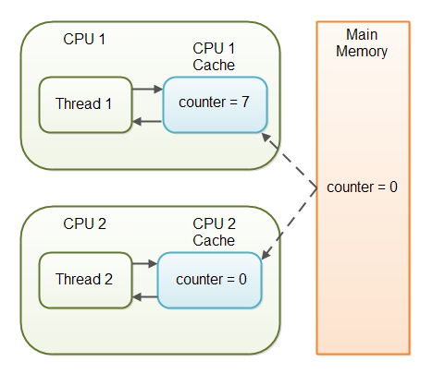
Variable visibility
The Java volatile keyword guarantees visibility of changes to variables across threads

Slide 31
Visibility Guarantee
By declaring the counter variable volatile all writes to the counter variable will be written back to main memory immediately
If T1 modifies, T2 will get updated value
public class SharedObject
{
public static volatile int counter = 0;
}

Slide 32
compiler optimization happens-before guarantee
Write to volatile variable: From after to before is allowed, but from before to after is not allowed.
Read from a volatile variable: From before to after is allowed, but from after to before is not allowed.

Slide 33
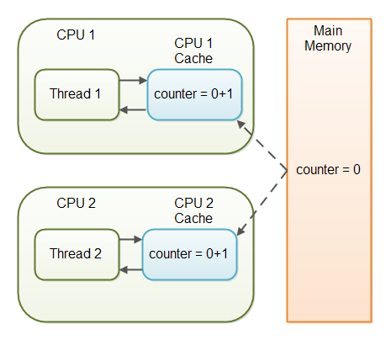
Challenges with volatile
May occur race condition
If multiple threads are updating the value of shared variable

Slide 34
Inter-thread Communication
Synchronized threads can communicate to cooperate
A running thread will be paused and allow other thread to enter in its critical section.
Following methods are used to achieve:
wait()
notify()
notifyAll()

Slide 35
wait(), notify(), and notifyAll()
Belongs to Object class.
Allows threads to communicate about the lock status of a resource.

Slide 36
wait()
wait() – causes current thread to release the lock and wait until either another thread invokes the notify() method or the notifyAll() method for this object, or a specified amount of time has elapsed.
synchronized( lockObject )
{
while( ! condition )
{
lockObject.wait();
}
//take the action here;
}
Method
public final void wait()throws InterruptedException
public final void wait(long timeout)throws InterruptedException

Slide 37
notify()
Wakes up a single thread that is waiting
synchronized(lockObject)
{
//establish_the_condition;
lockObject.notify();
//any additional code if needed
}

Slide 38
notifyAll()
It wakes up all the threads that called wait() on the same object
Generally the highest priority thread will run first.
synchronized(lockObject)
{
establish_the_condition;
lockObject.notifyAll();
}

Slide 39
Managing Threads
Older versions have suspend(), resume(), stop() methods to control execution of a thread.
Now deprecated
Can use wait() and notify() as alternatives

Slide 40
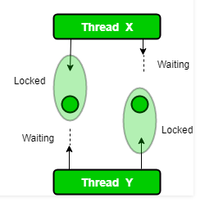
Deadlock in Java Multithreading
Two or more threads are blocked forever
Threads are waiting for each other
Notes:
Deadlock in java is a part of multithreading. Deadlock can occur in a situation when a thread is waiting for an object lock, that is acquired by another thread and second thread is waiting for an object lock that is acquired by first thread.

Slide 41
SCHOOL OF ENGINEERING & TECHNOLOGY
DEPARTMENT OF COMPUTER SCIENCE AND ENGINEERING
Thank You!

