Slide 1


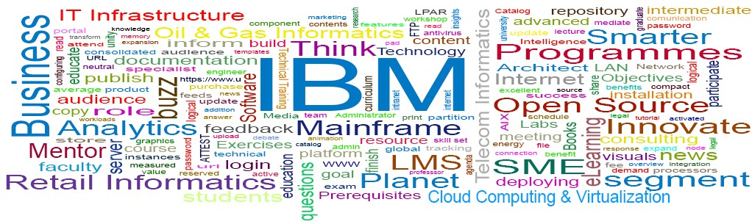
Business Process Management
BPM
© 2013 IBM Corporation

Slide 2
BPM
What is BPM ?
Business Process is defined set of business activities that represent the steps required to achieve a business objective. It includes the flow and use of information and resources.
Business Process Management, BPM is a systematic approach that is used to make an organization’s workflow effective, efficient and responsive to changing environment.

Slide 3
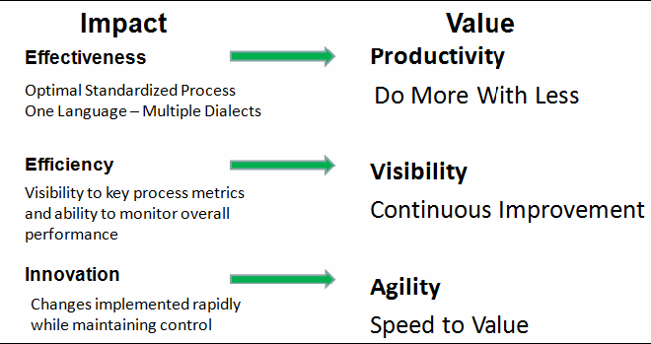
BPM
What is BPM ?

Slide 4
BPM
What is BPM ?
"BPM shifts Project thinking to Process thinking.“
A key part to BPM transformation is to reorganize information resources as substantially independent reusable services.

Slide 5
BPM
Business Process Model
Business Process Model is an Illustrated description of business processes, usually created with flow diagrams.
The model contains the relationship between activities, processes, sub-processes and information, as well as roles, the organization and resources.
It is also termed as "Business Process Mapping".

Slide 6
BPM
Business Process Model
– A Business Process | Model typically | consist of
workflow diagrams, | descriptions, | Input-output
KPI are indicators of descriptive time, cost or quality indicators used to capture the performance of a process.
,Key Performance Indicators(KPI) and data that provide both overview and detailed information about an organization's business processes.

Slide 7
BPM
Business Process Design
– Business Process Design, BPD is the systematic working by which an organization understands, defines and documents the business activities that enable it to function efficiently, effectively and economically.

Slide 8
BPM
Business Process Software
Software that allows users to create BPM diagrams and integrate process content with critical business entities viz., Departments, Resources.
E.g.. BPM for IBM, Process Maker, Oracle Business Process Management Suite.

Slide 9
BPM
Business Process Re-Engineering
The realignment of business process strategies through the use of an analytic tool and an intense consultation process.
BPR involves a great deal of risk due to change management.

Slide 10
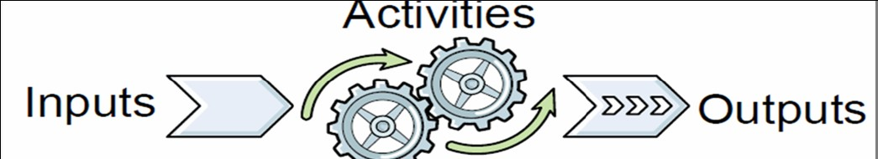
BPM
Process
– Processes
are the central nervous system of
organizations and yet they are not always clearly understood, defined, documented, communicated or optimized.

Slide 11
BPM
Process
– A business process is a repeating set of coordinated tasks or activities and transactions used to achieve organizational objectives.

Slide 12
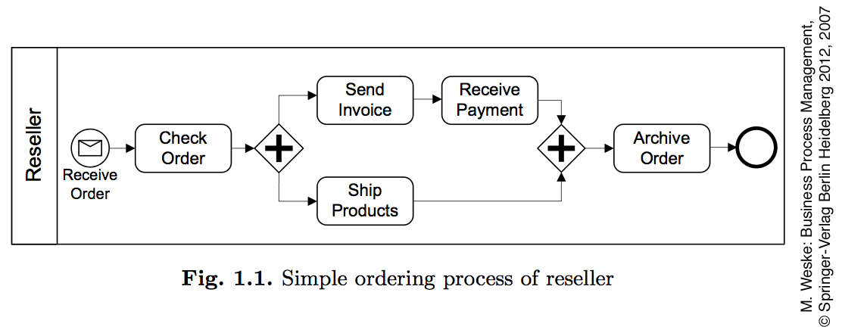

Slide 13
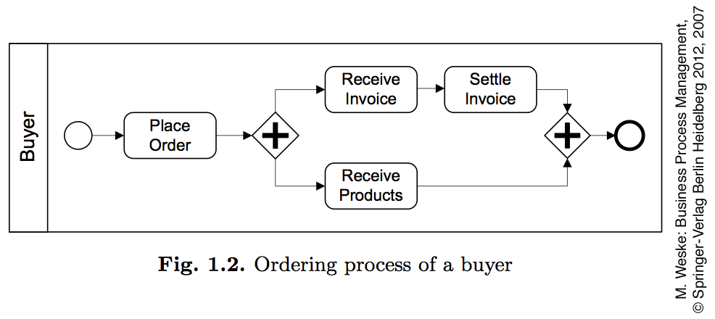

Slide 14
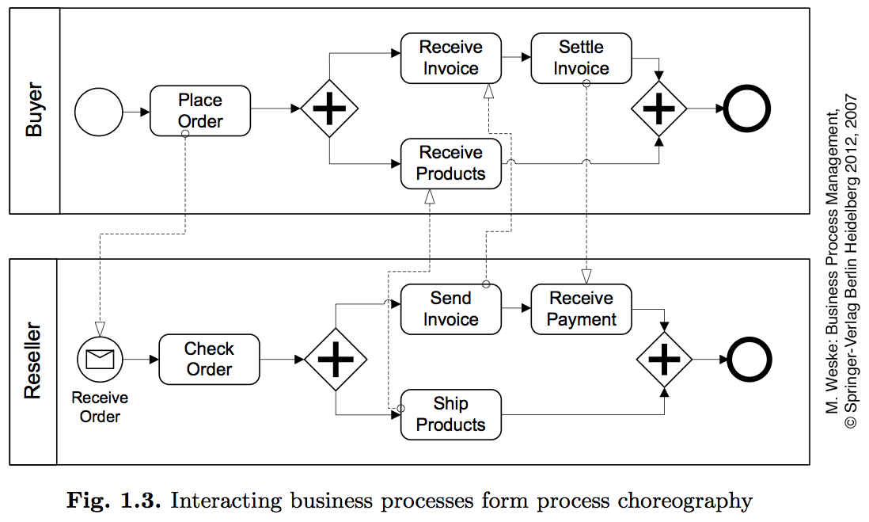

Slide 15
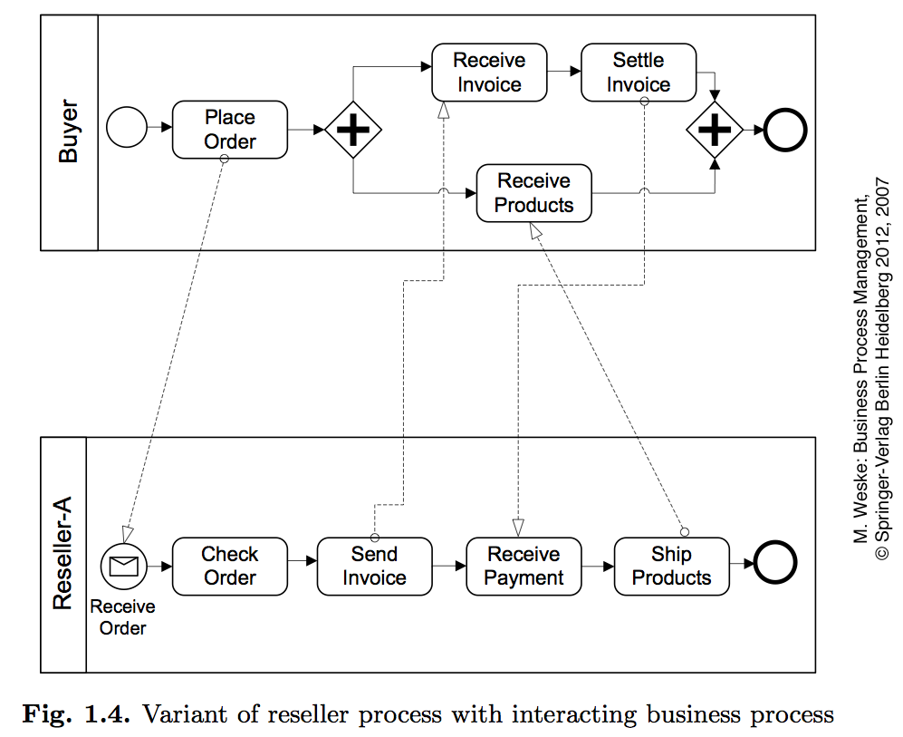

Slide 16
BPM
Benefits of BPM
Improves process quality, reliability and output.
Helps for continuous process improvement foundations for BPR.
that
provides
Maximizes process visibility that helps in reducing costs.
Improves strategic decision-making by providing correct information at correct time. It provides end to-end performance visibility and optimization of resources.
Improves operational efficiency that results in the avoidance of wastage and loss.
Consistent execution reduces process cycle time.

Slide 17
BPM
Benefits of BPM
Improves customer satisfaction by delivering better value.
Promotes organizational flexibility and business agility.
Promotes communication and collaboration between departments.
Helps in standardization of procedures.
Helps in measuring KPIs and thus improves accountability.
Promotes safe working conditions that protects company resources.
Defines roles and responsibilities that enhances employee satisfaction.
Simplifies regulatory compliance.

Slide 18





BPM
BPM Architecture – Three Phase Approach
Descriptive Modeling
Analytical Modeling
Executable Modeling

Slide 19
BPM
Descriptive Modeling
Descriptive Modeling is a High level model describing the process based on business requirements that is easily communicated across the organization.
It is used to specify visions and goals of business and associated Key Performance Indicators (KPI).

Slide 20
BPM
Analytical Modeling
Analytical Modeling is analytical and a more detailed modeling, showing all pertinent activities and flow used to detail process requirements.
This phase focuses on process requirements and functional requirements of the business.

Slide 21
BPM
Executable Modeling
– Executable Modeling is a model that details the functional requirements to implement the executable process application by developing the requirements and build a solution implementation for functional aspects on the business.

Slide 22
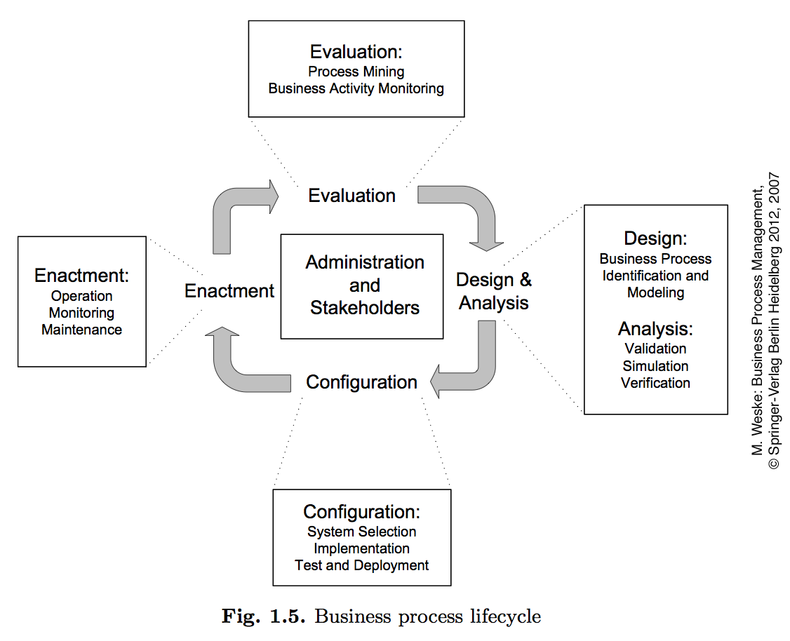

Slide 23
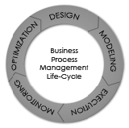
BPM
BPM Lifecycle

Slide 24
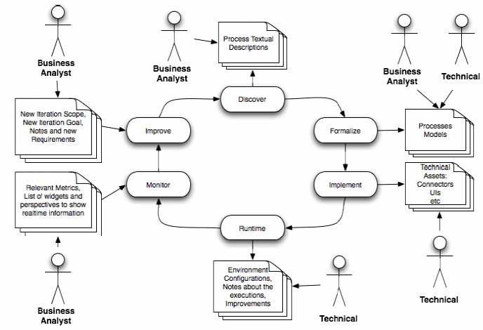
BPM
BPM Lifecycle activities

Slide 25
BPM
Discover Stage – Major activities
Find how the work is being done.
Interview every person involved with the process under analysis.
Gather information about how people and systems are handling each activity to achieve the goals.
Diagnose paper work that it's being done inside the process.
Collect and structure the interviews answers to find out a textual description about how the work is done in the company.

Slide 26
BPM
Formalize Stage – Major activities
– This stage is performed by the business analyst with a aim to create and validate a formal model using a formal language to model the discovered process.

Slide 27
BPM
Implement Stage – Major activities
process as per definition in textual cases.
– This stage creates | and | records all the | technical
details needed to | run | Organization’s | business

Slide 28
BPM
Runtime Stage – Major activities
– This stage aims at environment configuration and observes execution improvements so as to promote business effectiveness and efficiency.

Slide 29
BPM
Monitor Stage – Major activities
This stage aims at applying relevant metrics to evaluate processes and "Process Mining".
This is performed by the business analyst to gather perspectives from real time information.

Slide 30
BPM
Improve Stage – Major activities
– This stage suggests iteration in order to re-engineer the current or new business process with a defined scope, goal or new requirements to meet current business needs.

Slide 31
bpm is characterized by many Administration & Stakeholders with dff knowledge
Chief Process Officer
Accountable for standardizing the business processes.
Development of business processes in the context of changing market requirements.
Acknowledges the significance of BPM at the top level management.
Business Engineer
Business domain experts in charge of defining strategic goals of the company.
Non-technical educational background
Convenient & simple to use notations to communicate with stakeholders.

Slide 32
Administration & Stakeholders
Process Designer
Accountable for modelling the business processes by interacting with domain experts & other stakeholders.
Desired Qualities:
Analytical capabilities
Communication skills
Process Participant
carry out actual operational work during the enactment of business process instances.
Plays vital role during business process modelling.
Have knowledge about activities & their interrelationships

Slide 33
Administration & Stakeholders
Knowledge Worker
Process participants who employ software systems to execute activities in a business process.
Have detailed knowledge of the application domain
Can perform activities or parts of Business process independently.
Process Responsible
BP Model is allocated, and responsible for its correct & efficient execution of all business processes using this model.
Accountable for detecting inefficiencies in the process and for improving it.

Slide 34
Administration & Stakeholders
System Architect
Developing & configuring BPM systems so that business processes works in the context of information systems.
Developers
IT professionals who create software artifacts( digital environment) needed to implement business processes.
Implementations of interfaces to existing software systems.

Slide 35
Classification of Business Processes
Organisational versus operational
At the highest level,
the strategy of company is stated, which describes its long term concepts to develop a sustainable competitive advantage in the market.
e.g. cost leadership for products in a certain domain
At the second level,
business strategy is reduced to operational goals
Each goal is divided into set of sub goals
e.g. reducing the cost for supplied materials

Slide 36
Classification of Business Processes
Organisational versus operational
At the third level,
Organisational business processes are specified in textual forms by their inputs, their outputs, their expected results, and their dependencies on other business organisational process.
Act as supplier or consumer processes
e.g. to handle incoming raw materials provided by set of suppliers.

Slide 37
Classification of Business Processes
Organisational versus operational
At the fourth & fifth level,
Operational Business process are the foundation for developing implemented business processes.
Implemented business processes possess
information on the execution of the process activities
Technical and organisational environment in which they will be executed.
Business process are implemented by
Written procedures and policies of the organisation to use of process enactment platforms.

Slide 38
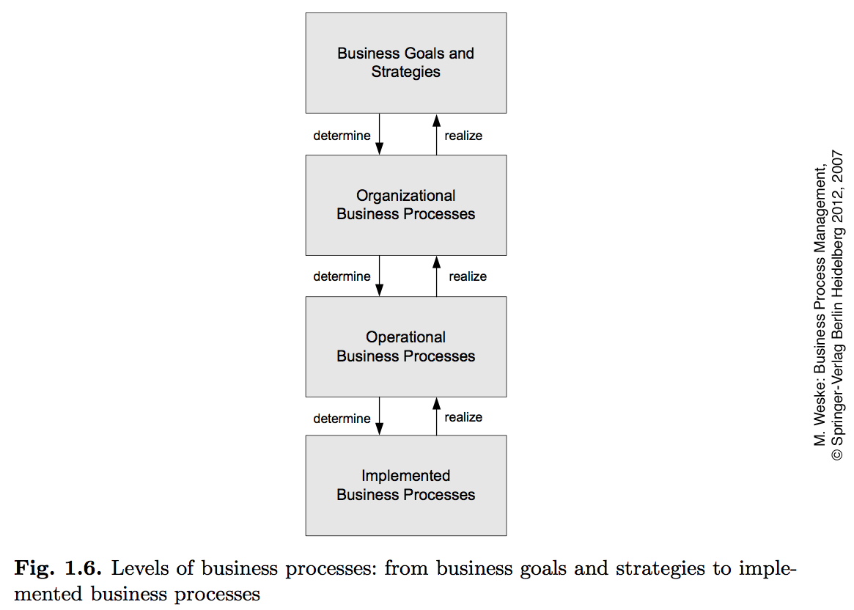

Slide 39
Classification of Business Processes
Intraorganisational versus process choreographies
Intraorganisational
If there is no interaction with business processes done by other parties.
Primary focus is the reorganisation of the internal processes by removing activities that do not offer value.
Process choreographies
Business processes communicate with other business processes in other organisations

Slide 40
BPM
Degree of Automation
Manual vs Automated
There are fully automated processes
purchasing an online ticket using interface
Processes with less manual work
Processing an insurance claim, where documents are submitted manually

Slide 41
BPM
Degree of Repetition
Highly repetitive
With/Without human involvement
Online air ticketing
Less repetitive
Claiming for insurance

Slide 42
BPM
Degree of Structuring
Structured- business process model lays down the activities and their execution constraints in a complete fashion.
e.g. money transfer request with upper limit constraint.
Production Overflow - Leymann & Roller have organised business processes based on dimensions, structure and repetition.
Well structured and highly repetitive.

Slide 43
BPM
Degree of Structuring
If process participants with the experience and competence to decide on their working procedures carry out business process activities, structured processes are more of a hindrance than an advantage.
Skip certain process activities that
knowledge worker does not need
execute steps in a concurrent manner that are ordered sequentially.
Is impossible in structured Business Process.

Slide 44
BPM
Degree of Structuring
Ad hoc processes for Unstructured parts of Business processes to support knowledge worker
Business processes models can define processes in a more flexible manner.
So that activities can be executed in any order or even multiple times until the goals are achieved.
e.g. Requirement Gathering, Case Handling,
Fine-grained data dependencies are used to control the performance of the business process.

Slide 45
BPM
Goals, Structure & Organisation
Goal of BPM
Better Understanding of the operations of the company performs & their relationships.
Recognizing the activities and their relationships and depicting them by Business Process models helps stakeholders
Efficient and effective communication
Flexibility- the ability to change
Organisational environment
Software layer without changing the overall business process.
Enables continuous process improvement
Narrows the gap between business processes that a company performs and the realization of these processes in software.

Slide 46
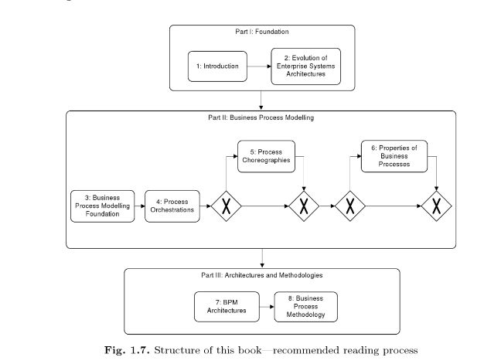
BPM

Slide 47
BPM
Business Process Modelling Foundation
Introduces foundation of business process modelling by analysing abstraction concepts and introducing the main subdomains of business process modelling
Modelling functions
Processes
Data
Organisation
Operation

Slide 48
BPM
Conceptual Model & Terminology
Business processes comprise of activities whose coordinated execution realizes some business goal.
These activities can be
System activities
User interaction activities
Manual activities
e.g. sending a parcel to a business partner

Slide 49
BPM
Conceptual Model & Terminology
System activities
Do not involve human user; performed by information systems.
e.g. recovering stock information from a stock broker application
e.g. checking the balance of a bank account
User interaction activities
Done by knowledge workers using information systems
Requires applications with appropriate user interfaces
e.g. entering data on an insurance claim
Manual activities
Not sustained by information systems
e.g. sending a parcel to a business partner

Slide 50
BPM
Conceptual Model & Terminology
System workflow & human Interaction Workflow
Workflow management system ensure that
activities of business process are performed in the order defined.
Information systems are initiated to realize the business functionality.
Workflow is not in an “is-a” relationship with business process
Is an association with business process
System activities can take part in any kind of workflow
User interaction activities and manual activities can only participate in human interaction workflows.

Slide 51
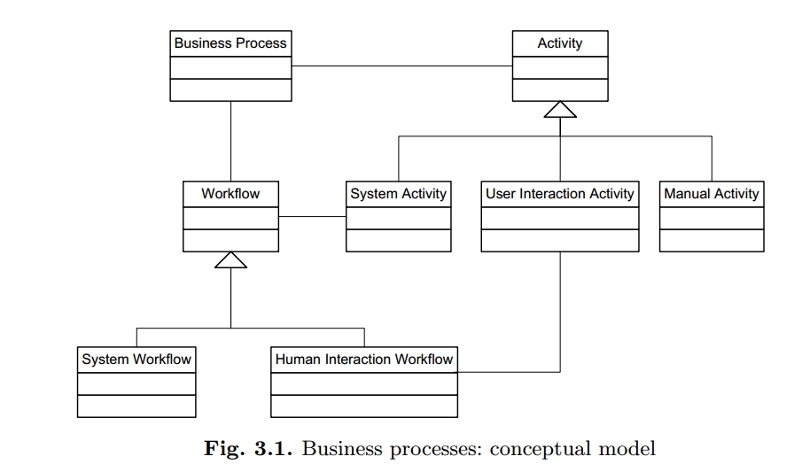
BPM
Conceptual Model & Terminology

Slide 52
Abstraction concepts
To capture the complexity in business process management, different abstraction concepts are introduced.
Horizontal abstraction :A traditional abstraction concept in computer science is the separation of modelling levels, from instance level to model level to meta model level.
Vertical abstraction: Even when using horizontal abstraction, separate subdomains need to be investigated. In order to follow the divide-and-conquer approach, these subdomains need to be represented separately.
Notes:
Metamodeling or meta-modeling is the analysis, construction and development of the frames, rules, constraints, models and theories applicable and useful for modeling a predefined class of problems.

Slide 53
Abstraction concepts
Aggregation abstraction: At a higher level of abstraction, multiple elements of a lower level of abstraction can be grouped and represented by a single artifact.
The coarse-grained business function aggregates activities of smaller granularity.
Aggregation abstraction is different from horizontal abstraction, because all activities (the small-grained and the coarse-grained) are at one horizontal level of abstraction, e.g., the instance level.
Aggregation abstraction is primarily used in the functional subdomain, where functions of smaller granularity are combined to create functions of larger granularity.
e.g. a coarse-grained business function “order management” might aggregate many smaller-grained activities, like receiving an incoming order, checking the inventory, and confirming the order.

Slide 54
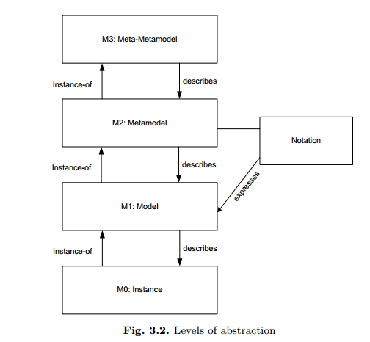
Abstraction concepts

Slide 55
Abstraction concepts
Horizontal Abstraction
Along the lines of the levels of abstraction identified by the Object Management Group, the meta model level, the model level, and the instance level play important roles in the design and analysis of complex systems in general and software systems in particular.
The instance level reflects the concrete entities that are involved in business processes. Executed activities, concrete data values, and resources and persons are represented at the instance level.
To organize the complexity of business process scenarios, a set of similar entities at the instance level are identified and classified at the model level.

Slide 56
Abstraction concepts
Horizontal Abstraction
Models are expressed in metamodels that are associated with notations, often of a graphical nature. e.g. Petrinet metamodel.
The complete set of concepts and associations between concepts is called meta model.

Slide 57
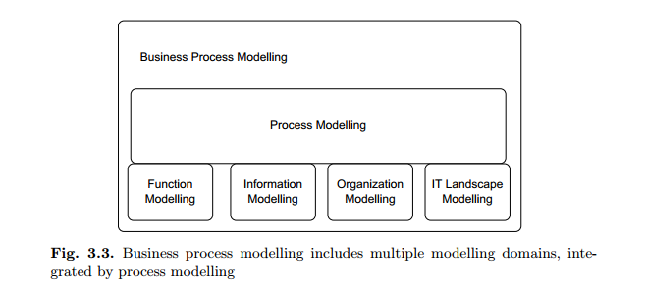
Abstraction concepts
Vertical Abstraction

Slide 58
Abstraction concepts
Vertical Abstraction
Function modelling, data modelling, organization modelling, and modelling of the operational information technology landscape are required
to provide a complete picture of a business process.
The specification of the work can be done at different aggregation levels, from coarse-grained business functions to fine granular functions
at the operational level
realized by knowledge workers and information systems.

Slide 59
Abstraction concepts
Vertical Abstraction
The investigation and proper representation of data in business processes is important, because decisions made during a business process depend on particular data values.
Data dependencies between activities need to be taken into account in process design, to avoid situations in which a function requires certain data not available at that time.
e.g. in a credit approval business process, the type of approval depends on the credit amount requested.

Slide 60
BPM
From Business Functions to Business processes
Top-level business functions are broken down to functions of smaller granularity and, ultimately, to activities of operational business processes.
Functional decomposition is the technique of choice.

Slide 61
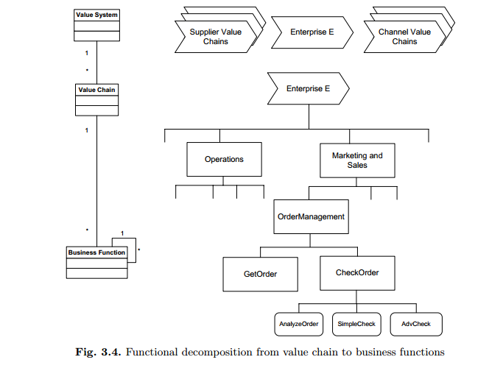

Slide 62
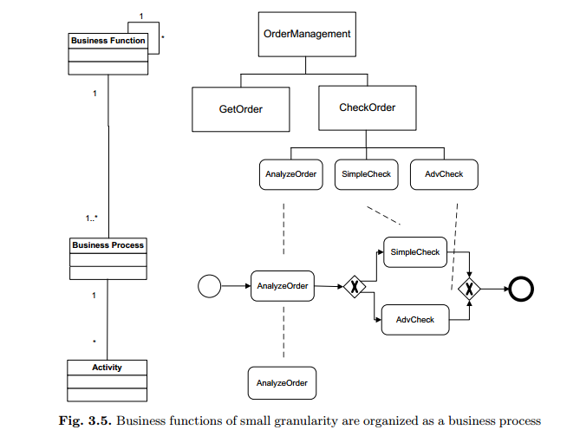

Slide 63
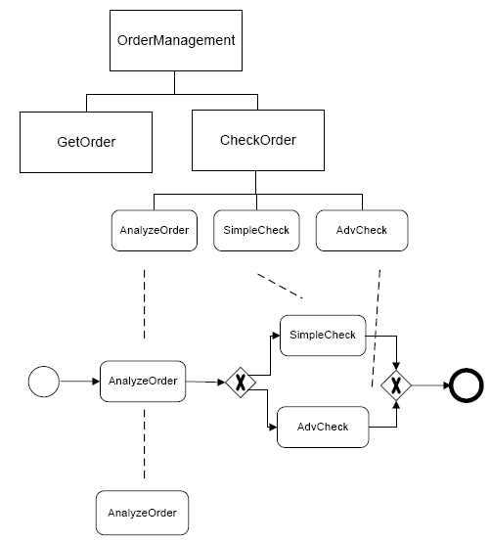
Example
AnalyzeOrder, Simple Check & AdvCheck are linked to each other by execution constraints
Process begins with analyzing the order, and then conducting either a simplecheck or an advcheck based on the decision taken during process execution
This process has a dedicated start event and a dedicated end event

Slide 64
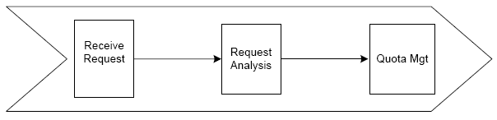
Order of execution
Business functions Receive Request, Request Analysis, and Quota Management are shown in figure.
An execution ordering relation is represented since there is a strict ordering between these business functions.

Slide 65
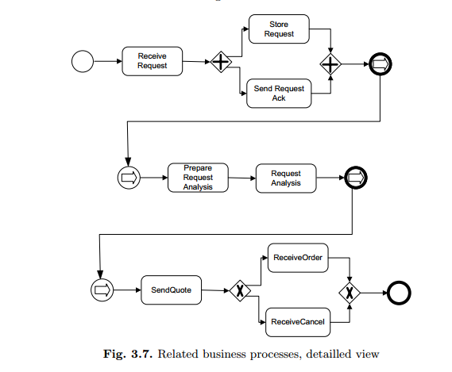

Slide 66
Notations
Business functions are represented by rectangles,
While functions of the finest granularity are represented by rectangles with rounded corners.
Functions at the leaf level of the functional decomposition are also called activities.

Slide 67
BPM
BPMN
Business Process Model and Notation (BPMN) is a standard for business process modeling, and provides a graphical notation for specifying business processes based on a flow chart representational technique.
BPMN is flow-chart based notation for defining Business Processes.

Slide 68
BPM
BPMN
– BPMN is an agreement between multiple Modeling tools vendors, to synchronize their views and standardize to use a single notation for the benefit of end-user understand and training.

Slide 69
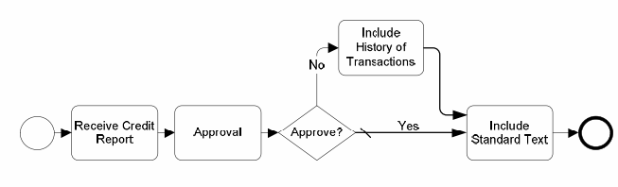
BPM
Sample BPMN depiction for Credit Report Approval

Slide 70
Why use BPMN to design processes?
BPMN 2.0 is the official way to design and share processes between almost all BPMS in the market.
BPMN is an OMG(object management group) standard.
It provides businesses with the capability of understanding their internal business procedures in a graphical notation.

Slide 71
BPM
BPEL(Business Process Execution Language)
is a business process Modeling language for specifying business process behavior based on Web Services.
Is serialized in XML and aims to enable high level state transition interactions of a process (programming).

Slide 72
BPM Notation Symbols
Core elements from BPMN
Activity
Event
Gateway
Flow
Pool
Lane

Slide 73
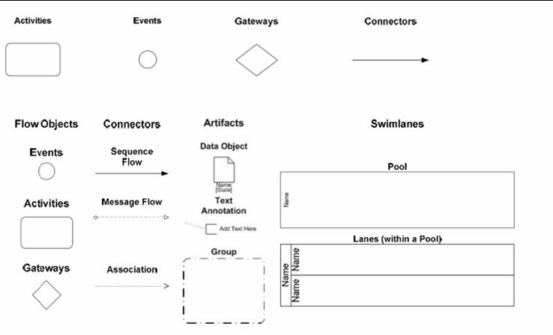
BPM
BPMN – Notation Symbols

Slide 74
BPM Notation Symbols
Activity
Is work that is performed within a business process.
Can be atomic or non-atomic(compound)
Can be performed once or can have internally defined loops.
Notation- Rounded rectangles
Types of activities:
Tasks
Sub-processes
Task
Sub-Process
Looped Task
+

Slide 75
BPM Notation Symbols- Activity
Tasks
Is an atomic activity that is included within a process.
Is used when the work in the process is not broken down to a finer level of Process model detail.
There are specialized type of tasks for sending and receiving or user based tasks.
Send Invoice
Receive appointment
Fill order

Slide 76
BPM Notation Symbols- Activity
Sub-Processes
Enable hierarchical process development
Is a Compound activity (can be broken down into finer level of detail through a set of sub-activities) that is included within a process.
Collapsed Sub -Process
+
Expanded Sub- Process

Slide 77
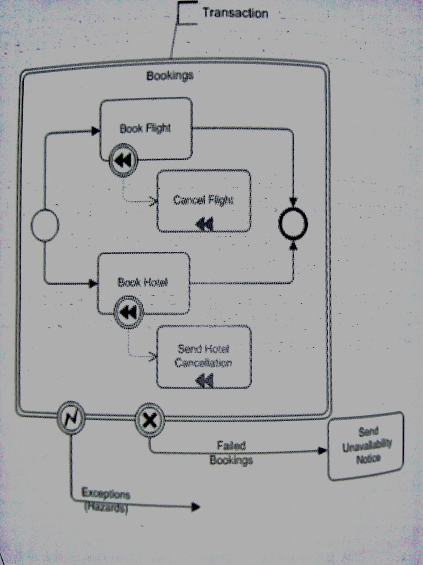

Slide 78
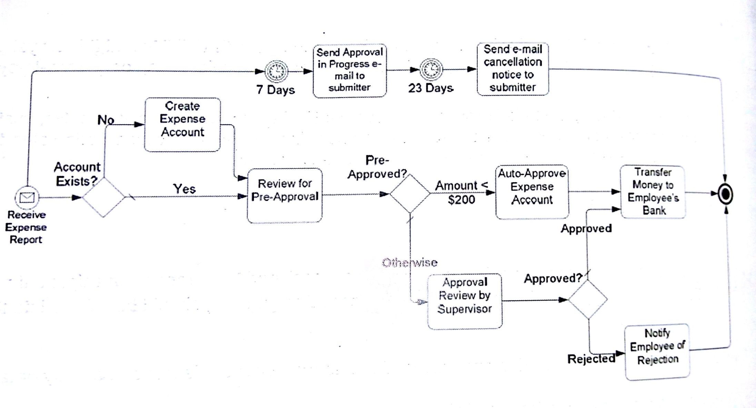
Sample Diagram

Slide 79
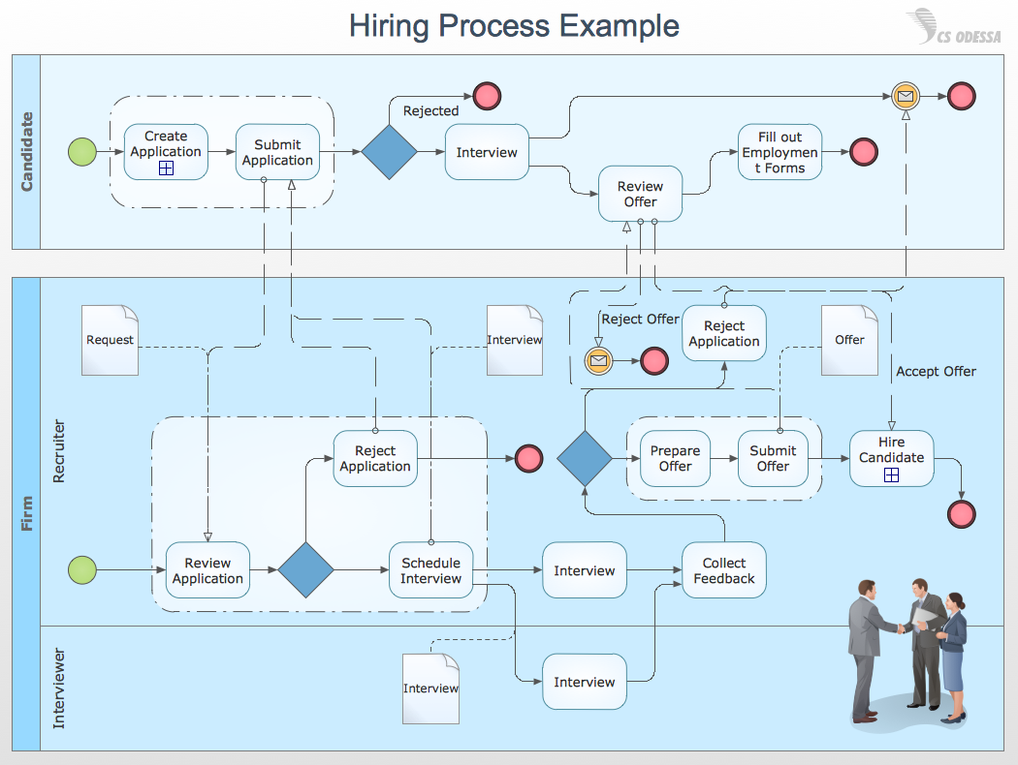

Slide 80
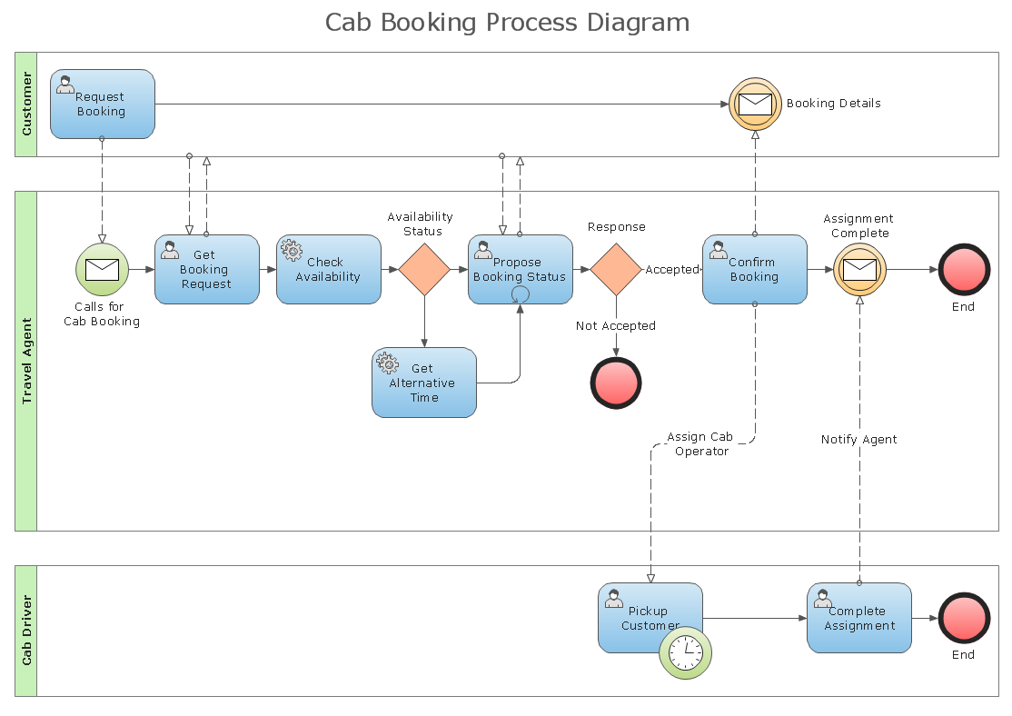

Slide 81
BPM and BPMN
BPM
Helps to increase efficiency by focusing on business process with visibility.
Expected result is “Process Improvement” which brings financial benefits, customer & employee satisfaction.
BPMN
Collection of standardized notations which adds value to the whole process as it adorns the process from a diagrammatic perspective.

Slide 82
BPM
Where does SOA fit in BPM
SOA is a way of executing BPM more efficiently and effectively.
SOA provides the architecture to provision how processes exchange data in a flexible manner across
business processes, | both in | company | and
collaborating companies | following | the value | chain
more closely.
– SOA unifies business processes by structuring large applications as an ad-hoc collection of smaller modules called "services".(service oriented architecture)
Notes:
Service oriented architecture

Slide 83
BPM
Where does SOA fit in BPM
XML has been used extensively in SOA to create data which is wrapped in neat descriptive containers.
The services are described by Web Service Description Language(WSDL) and SOAP a protocol for exchanging XML based messages over the internet using HTTP/HTTPS.
The goal of SOA is to allow programs or applications to be strung together to form new adhoc applications which are built almost entirely from existing software systems.

Slide 84
BPM
Where does SOA fit in BPM
Use of Web Service Business Execution Language (WS-BEL) helps in processes to exclusively import / export functionality by using web interfaces.
Software reuse is one goal without reconfiguring the existing application.

Slide 85
Comparison- BPM
BPM provides the higher level abstraction for defining businesses processes and SOA provides the services for performing them.

Slide 86
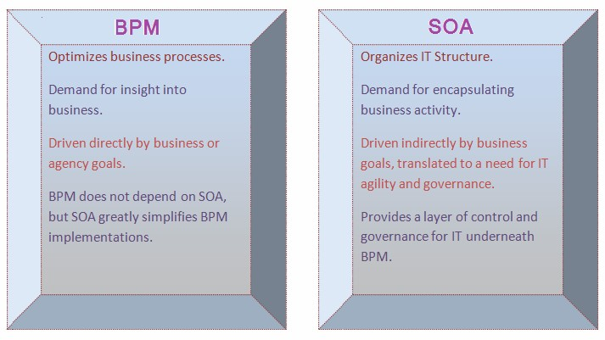
BPM and SOA
BPM and SOA comparison chart

Slide 87
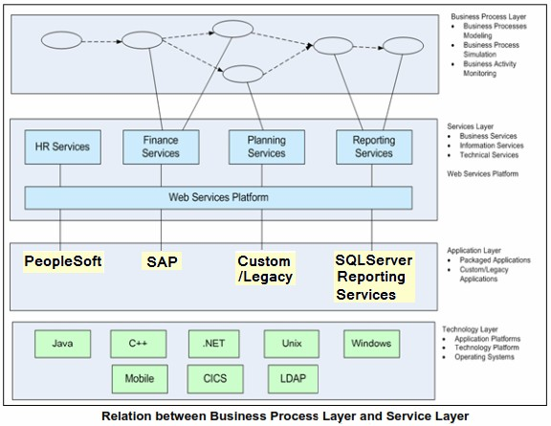
BPM and SOA
Relation between Services Layer & Business Layer

Slide 88
Service Layer and Business Layer
Process and service independence
SOA inherently allows provisioning to provide a loosely coupled integration platform that allows application instance to change and evolve without affecting the core integration technology.

Slide 89
BPM and SOA
Process Implementation
BPM does the modeling, simulation, and redesign of processes. SOA infrastructure orchestrates business processes and mediates service providers.
Services are exposed, to be used in various processes. Service changes should not impact processes. Process changes reuse various services as needed.

Slide 90
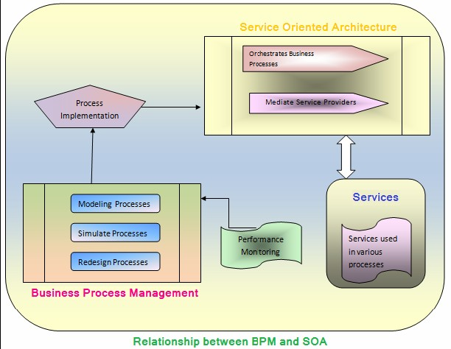
BPM and SOA
Relationship between BPM & SOA

