Slide 1
Direct Memory Access (DMA)
For I/O transfer, Processor determines the status of I/O devices, by
Polling
Waiting for Interrupt signal
Considerable overhead is incurred in above I/O transfer processing
To transfer large blocks of data at high Speed, between EXTERNAL devices & Main Memory, DMA approach is often used
DMA controller allows data transfer directly between I/O device and Memory, with minimal intervention of processor.

Slide 2
Direct Memory Access (DMA)
DMA controller acts as a Processor, but it is controlled by CPU
To initiate transfer of a block of words, the processor sends the following data to controller
The starting address of the memory block
The word count
Control to specify the mode of transfer such as read or write
A control to start the DMA transfer
DMA controller performs the requested I/O operation and sends a interrupt to the processor upon completion

Slide 3
31 30
1
0
IRQ | IE |  | R/W | Done
Status and Control
Starting address Word count
In DMA interface
First register stores the starting address
Second register stores Word count
Third register contains status and control flags
Bits and Flags | 1 | 0
R/W | READ | WRITE
Done | Data transfer finishes
IRQ | Interrupt request
IE | Raise interrupt (enable) after Data Transfer

Slide 4



Processor
Main memory
Disk/DMA controller
DMA
controller
Printer
Keyboard
Network Interface
Disk
Disk
Use of DMA Controller in a computer system

Slide 5
Memory accesses are interwoven
by the processor
and DMA Controller
DMA devices have BUS control
higher
priority
then
processor
over
Cycle Stealing:- DMA from processor,
cycles most
Controller
“steals” memory
though
processor originates
memory access.
Block or Burst mode:- The | DMA controller may | given
exclusive access to the main of data without interruption | memory to transfer a | block
Conflicts in DMA:
Processor and DMA,
Two DMA controllers, try to use the Bus at the same time to access the main memory

Slide 6
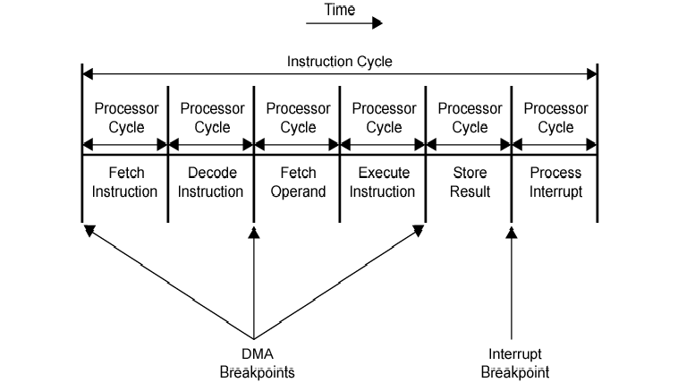
DMA and Interrupt Breakpoints During an Instruction Cycle

