Slide 1
About Linux and Distributions

Slide 2
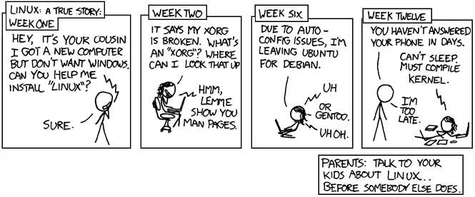
The Birds and the Bees
Source: xkcd.com
Notes:
Ask, what is Linux in preparation for the next slide.

Slide 3
Linux Distributions
In order to be called “Linux”, a distribution must have the Linux kernel
Each usually has some kind of package management system in order to install software
There are 1000’s of distributions out there
You can create your own, if you would like - http://www.linuxfromscratch.org/
Distributions may include, including the kernel:
Open source tools and libraries
Window Manager
Desktop environment
While most Linux distributions are open source, some are paid for due to support and proprietary software

Slide 4
Linux Distributions – How to decide
What Linux distribution is best?
Really, which Linux distro is best for me?
Does the distribution have support?
Is there paid support?
Is there a large user support community?
Does the distribution stay up to date on packages?
Do they stay up to date on security patches?
How difficult is the distribution to use?
Will my coworkers hate me for picking it?
Notes:
Some sample questions to ask… book has some too…
Book says, is this distro going to be around for 5 years?

Slide 5
Linux Distributions – Major
Distrowatch.com has a lot of information about distribution
Major distribution include:
Redhat
Fedora,CentOS,Scientific
Debian
Ubuntu, Knoppix, Mint
openSUSE
Arch
Gentoo
Slackware

Slide 6

distributions Comic

Slide 7
Linux Distributions – Custom Examples
Phones - Android
Routers - ddWRT
Security - Kali
IoT – Nest, Raspberry Pi
Privacy - Tails

Slide 8
Conclusion
Linux distributions have all kinds of different capabilities
Some are large, some are small
Some provide great support
It’s really up to the system administrator to decide what distro is right for which purpose

