Slide 1
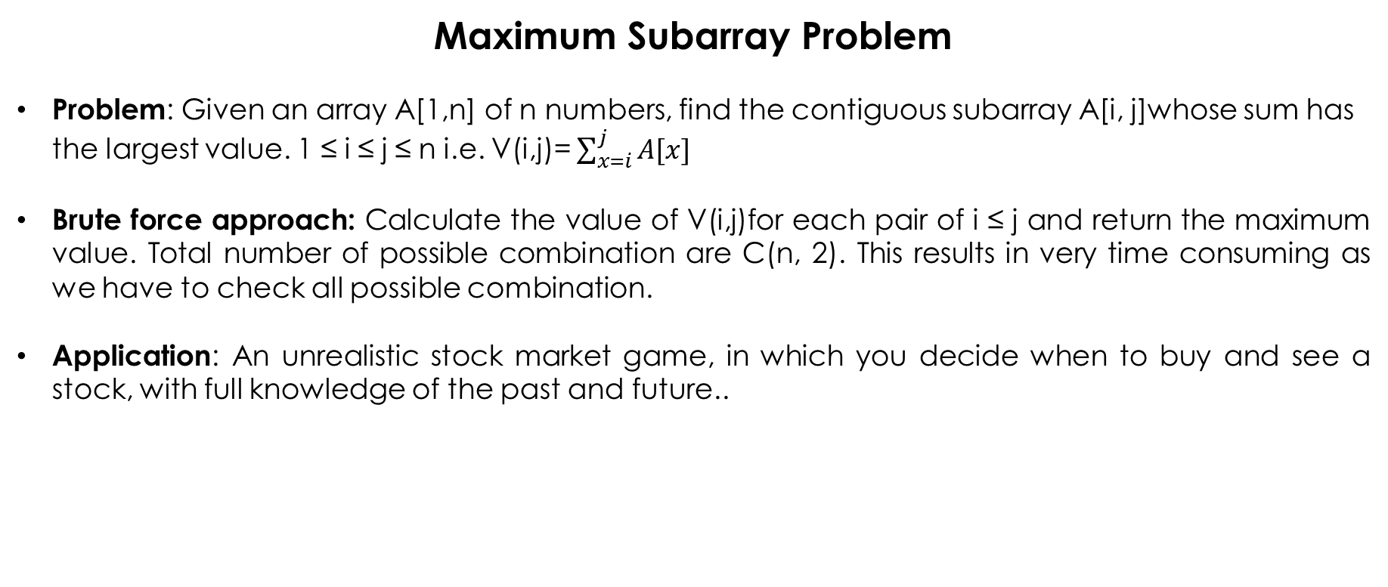
Maximum Subarray Problem
Problem: Given an array A[1,n] of n numbers, find the contiguous subarray A[i, j]whose sum has the largest value. 1 ≤ i ≤ j ≤ n i.e. V(i,j)= $\sum_{x=i}^{j}{A[x]}$
Brute force approach: Calculate the value of V(i,j)for each pair of i ≤ j and return the maximum value. Total number of possible combination are C(n, 2). This results in very time consuming as we have to check all possible combination.
Application: An unrealistic stock market game, in which you decide when to buy and see a stock, with full knowledge of the past and future..

Slide 2
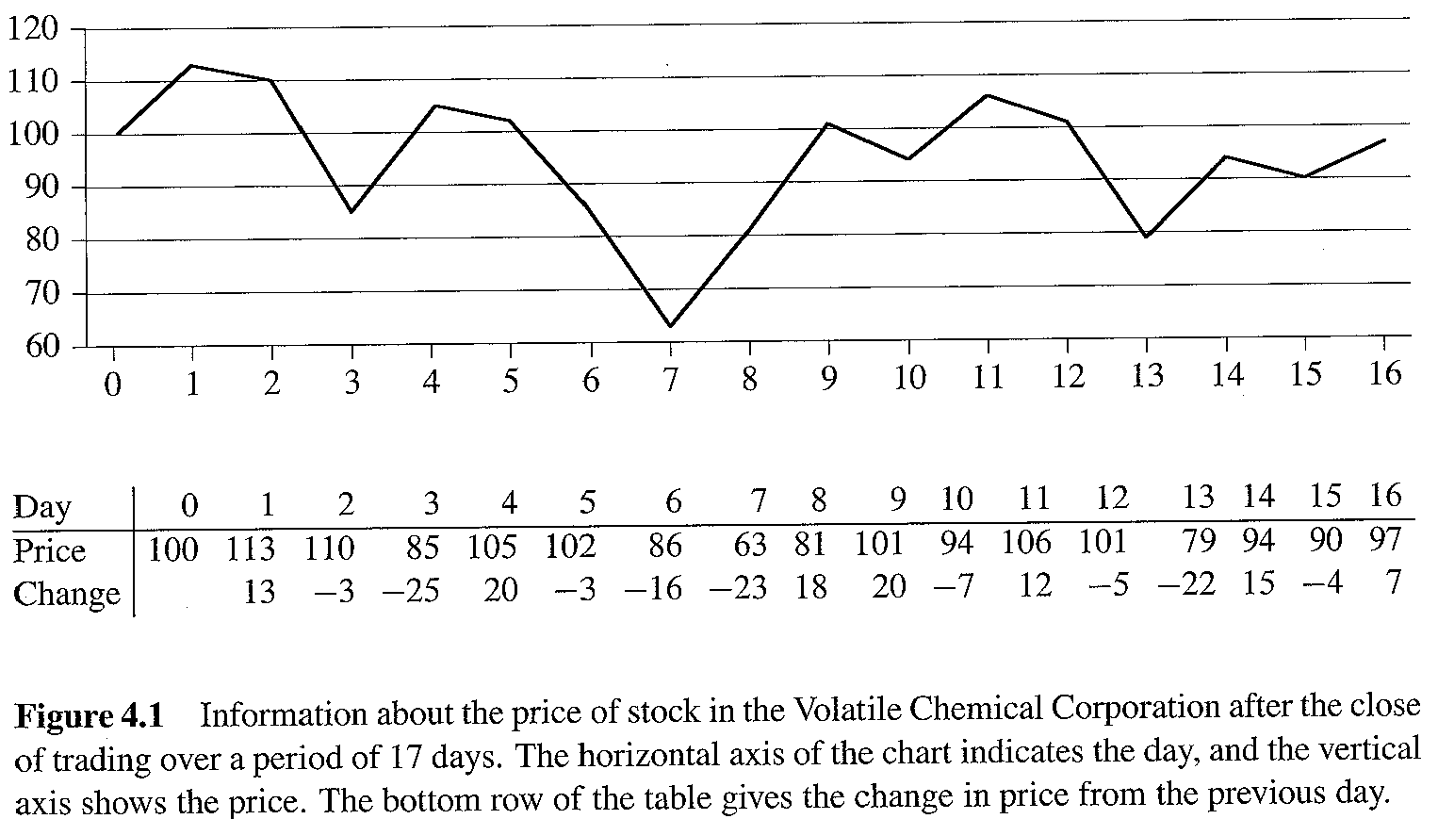
Example 1

Slide 3
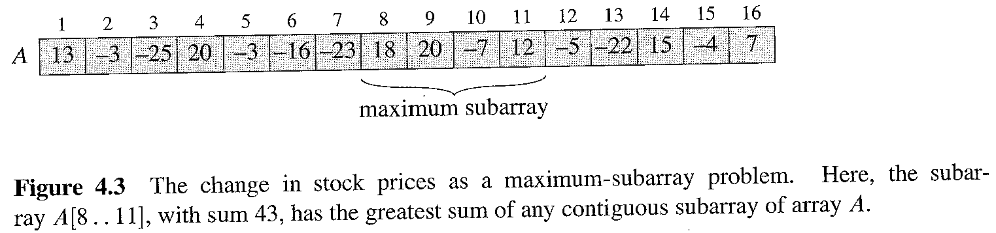
Solution of problem – Divide and Conquer Approach
Instead of the daily price, let us consider the daily change:
A[i] is the difference between the closing value on day i and that on day i-1
The problem becomes that of finding a contiguous subarray the sum of whose values is maximum.

Slide 4
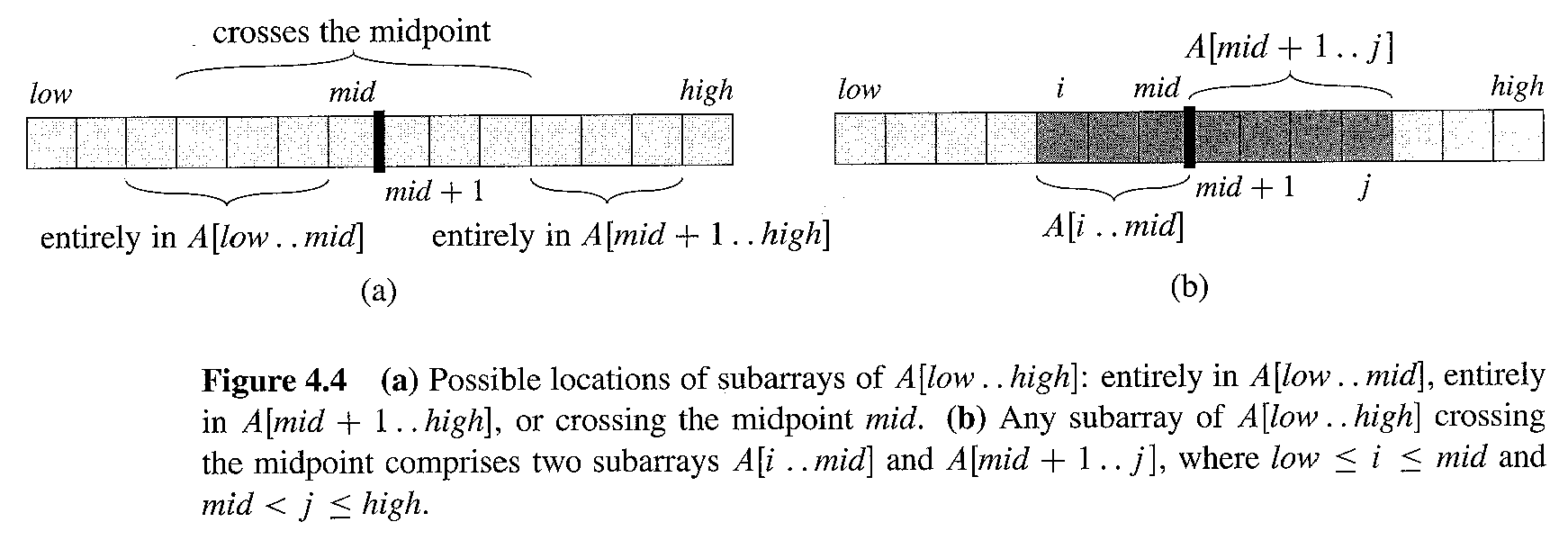
Solution of problem – Divide and Conquer Approach
How do we divide?
We observe that a maximum contiguous subarray A[i…j] must be located as follows:
It lies entirely in the left half of the original array: [low…mid];
It lies entirely in the right half of the original array: [mid+1…high];
It straddles the midpoint of the original array: i ≤ mid < j.

Slide 5
Solution of problem – Divide and Conquer Approach
The “left” and “right” sub-problems are smaller versions of the original problem, so they are part of the standard Divide & Conquer recursion.
The “middle” sub-problem is not, so we will need to count its cost as part of the “combine” (or “divide”) cost.

Slide 6
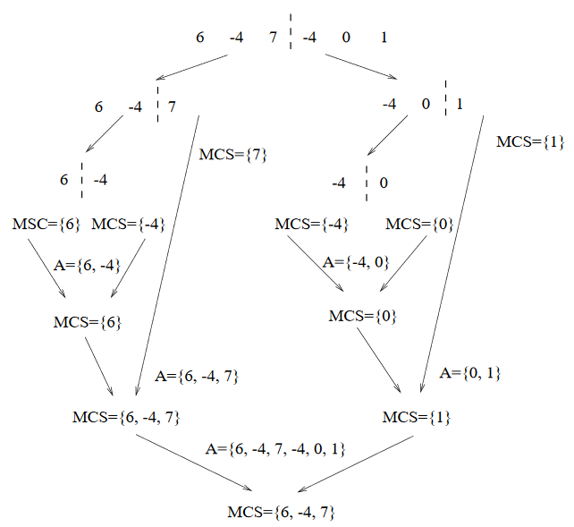
Solution of problem – Divide and Conquer Approach - Example

Slide 7
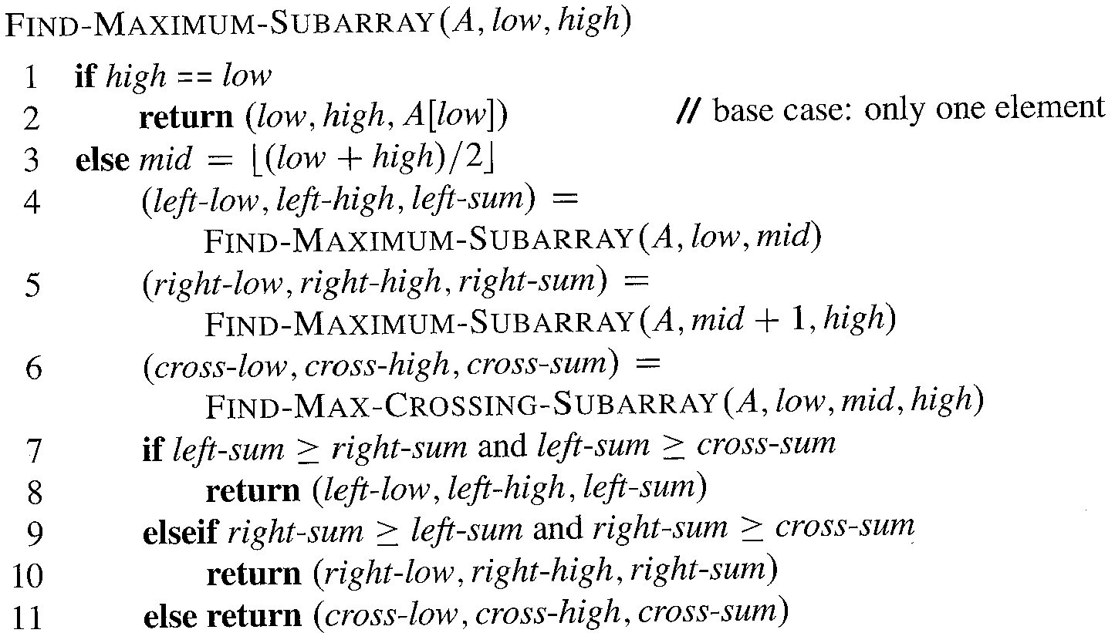
Algorithm

Slide 8
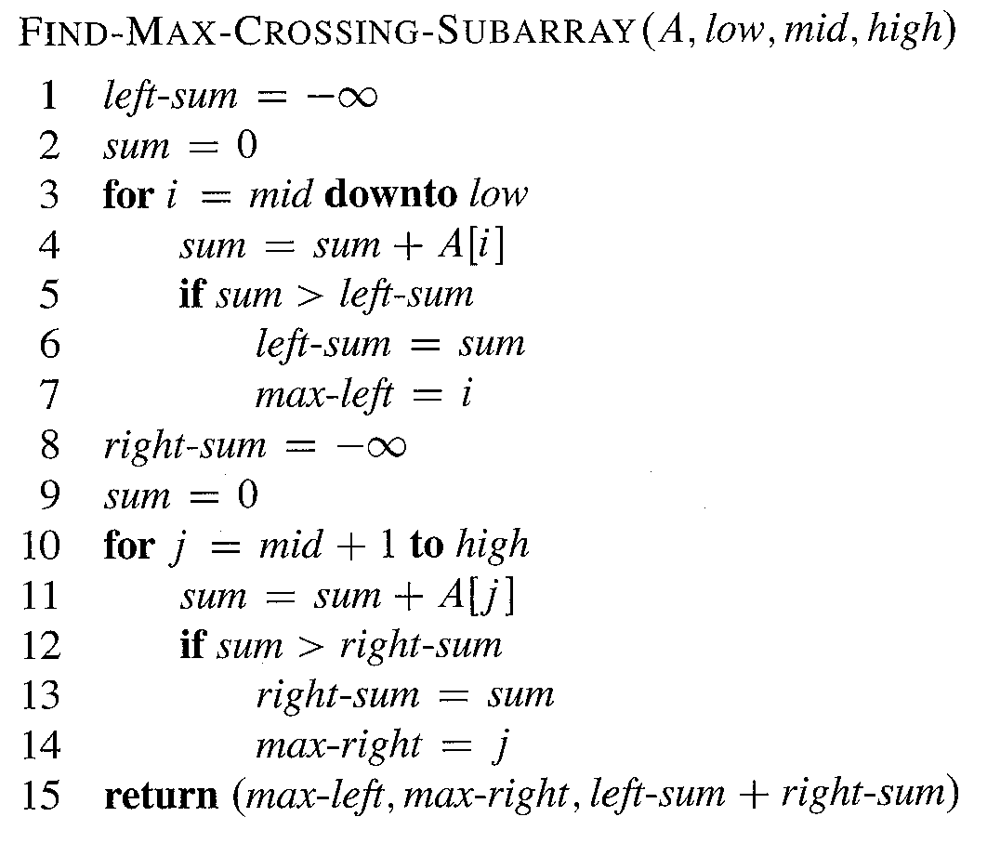
Sub Algorithm

Slide 9
Analysis
The base case n = 1. This is easy: T(1) = Θ(1)
The recursion case n > 1.
T(n) = cost of splitting + 2T(n/2) + cost of finding largest midpoint-straddling subarray + cost of comparing the three subarray values and returning the correct triple .
The cost of splitting is constant = Θ(1);
the cost of finding the largest straddling subarray is Θ (n);
the cost of the final comparison and return is constant Θ(1).
T(n) = Θ (1) + 2T(n/2) + Θ (n) + Θ (1)

Slide 10
Analysis
Finally:
The recurrence has the same form as that for MERGESORT, and thus we should expect it to have the same solution T(n) = Θ(n lg n).

