Slide 1
Vector Space
2-D Linear Transformation

Slide 2
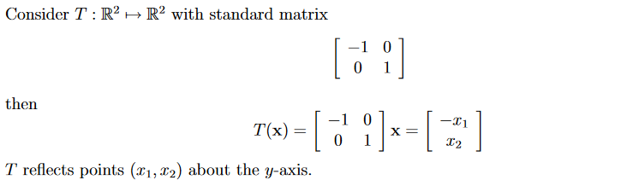
Reflections

Slide 3
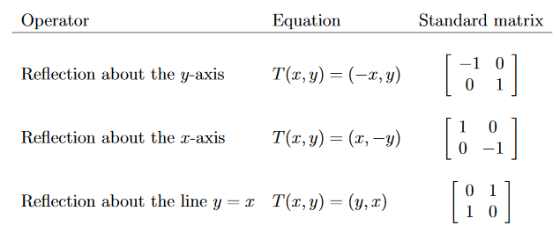

Slide 4
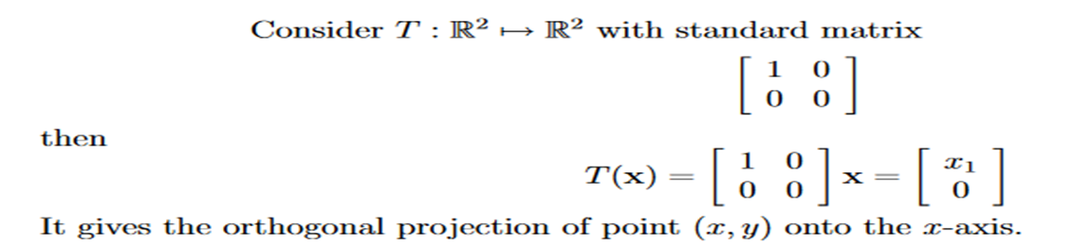
Projections

Slide 5
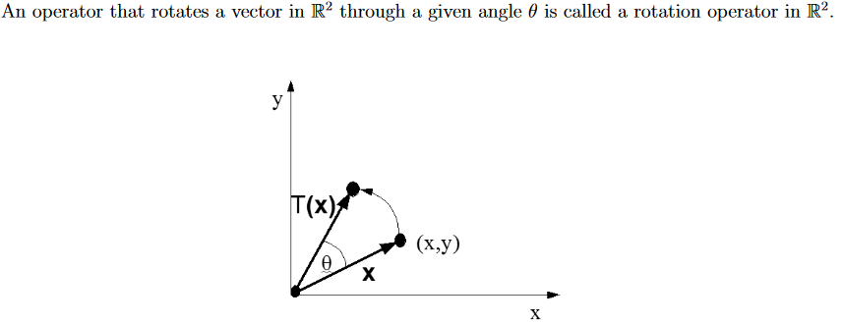
Rotation

Slide 6
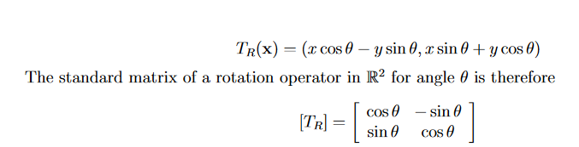

Slide 7
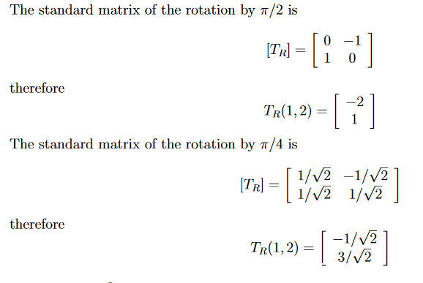
Example

Slide 8
Dilation and Contraction (Scaling)
This is the operator stretching or shrinking a vector by a factor k, but keeping the direction un-changed. We call the operator a dilation if the transformed vector is at least as long as the original vector, and a contraction if the transformed vector is at most as long as the original vector.

Slide 9
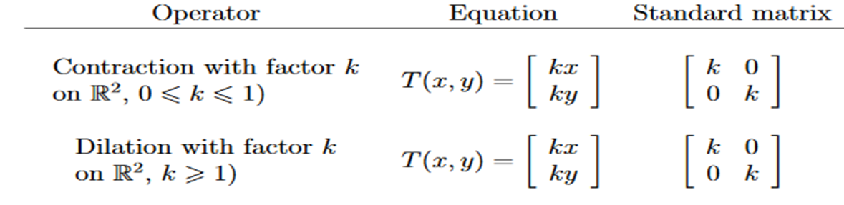

Slide 10
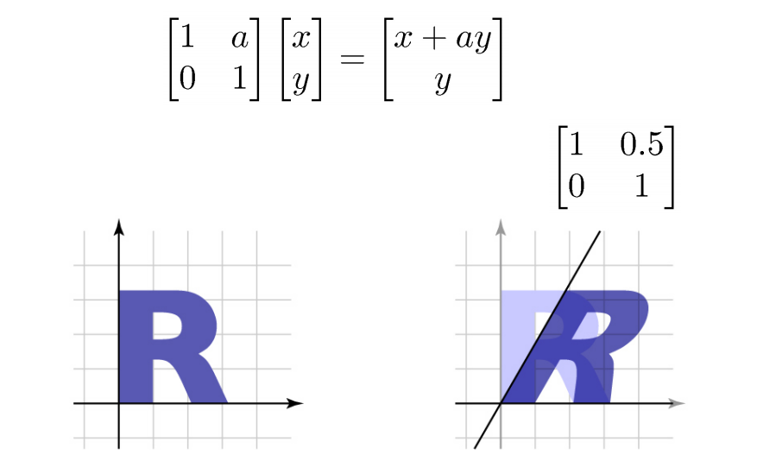
Shearing in x-direction

Slide 11
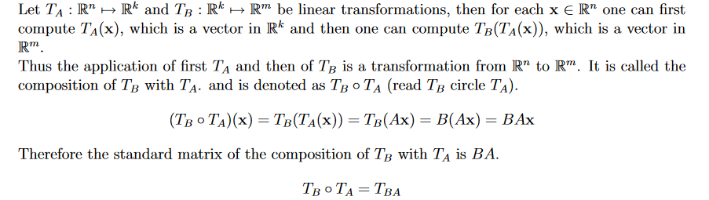
Composition of Linear Transformations

Slide 12
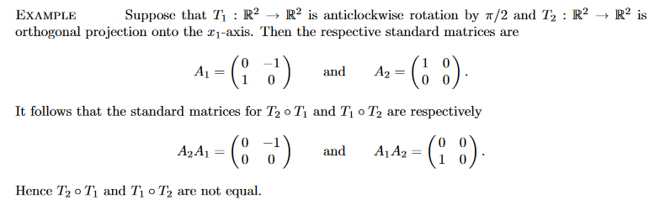

Slide 13
