Slide 1
Linear Transformation

Slide 2
Linear Transformation
A linear transformation, T:U→V, is a function that carries elements of the vector space U (called the domain) to the vector space V (called the codomain), and which has two additional properties
1. T(u1+u2)=T(u1)+T(u2)T for all u1,u2∈U
2. T(αu)=αT(u) for all u∈U

Slide 3
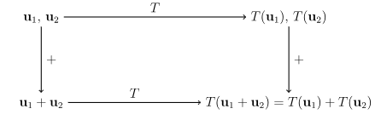
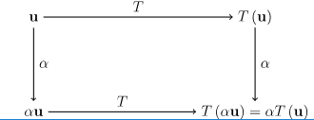

Slide 4

Example: A linear transformation
Define T:R³→R² by describing the output of the function for a input with the formula

Slide 5

Example: Not a linear transformation
Define T:R³→R³ by describing the output of the function for a input with the formula

Slide 6
Linear Transformation Composition
Suppose that T:U→V and S:V→W are linear transformations. Then the composition of S and T is the function (S∘T):U→W whose outputs are defined by
(S∘T)(u)=S(T(u))
Composition of Linear Transformations is a Linear

Slide 7
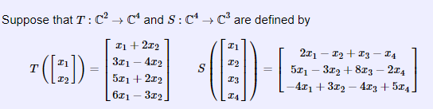
Example: Composition of two linear transformations

Slide 8
