Slide 1
MAIN MEMORY MANAGEMENT
TOTAL SESSION NEEDED (4-5)
Monit Kapoor
AP(SS)
CIT

Slide 2
Memory Management
Background
Swapping
Contiguous Memory Allocation
Paging
Structure of the Page Table
Segmentation
Example: The Intel Pentium

Slide 3
Objectives
To provide a detailed description of various ways of organizing memory hardware
To discuss various memory-management techniques, including paging and segmentation
To provide a detailed description of the Intel Pentium, which supports both pure segmentation and segmentation with paging

Slide 4
Background
Program must be brought (from disk) into memory and placed within a process for it to be run
Main memory and registers are only storage CPU can access directly
Register access in one CPU clock (or lesser even!)
Main memory can take many cycles
Cache sits between main memory and CPU registers
Protection of memory required to ensure correct operation

Slide 5
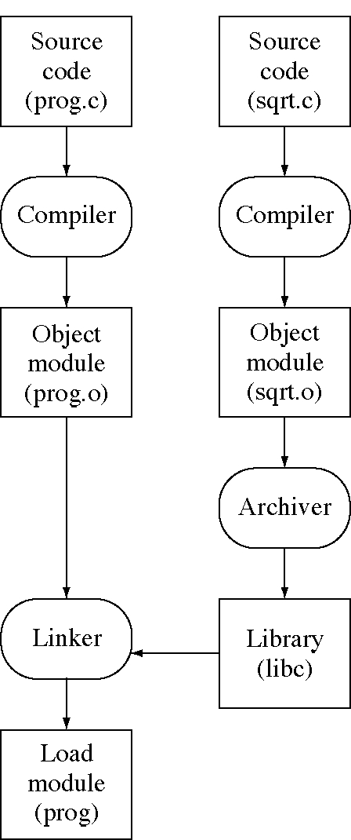
Creating a load module
Crowley OS Chap. 10

Slide 6
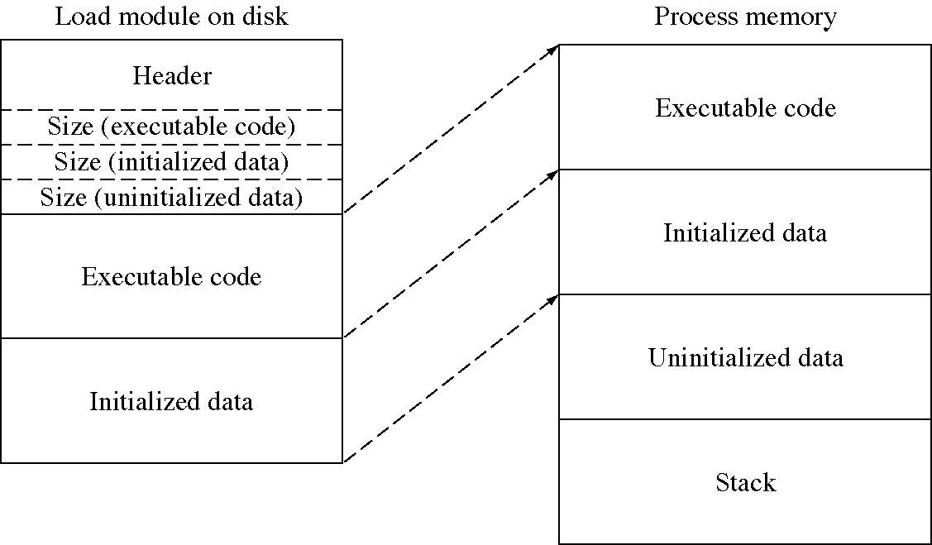
Loading a program into memory
Crowley OS Chap. 10

Slide 7
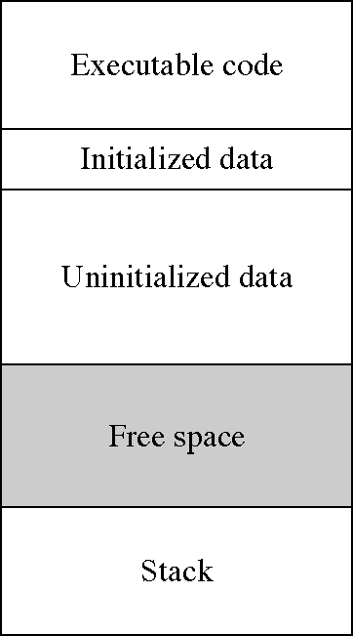
Memory areas in a running process
Crowley OS Chap. 10

Slide 8
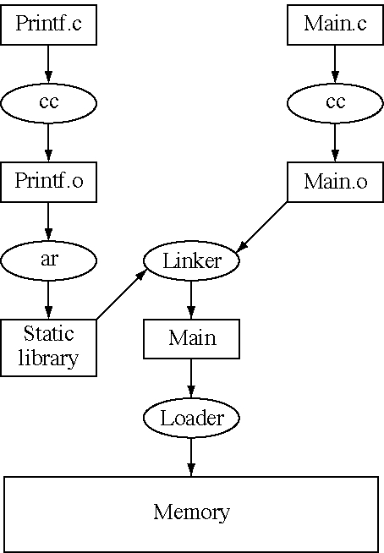
Normal linking and loading
Crowley OS Chap. 10

Slide 9
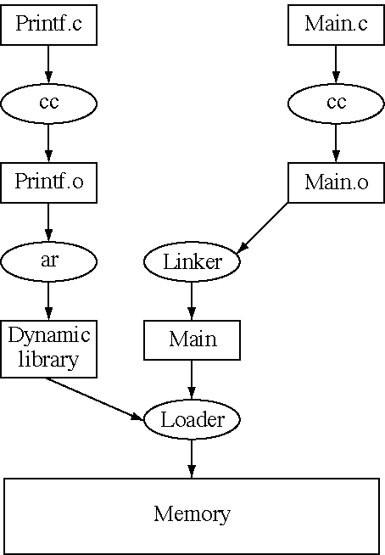
Load-time dynamic linking
Crowley OS Chap. 10
Notes:
http://cs-fundamentals.com/c-programming/static-and-dynamic-linking-in-c.php

Slide 10
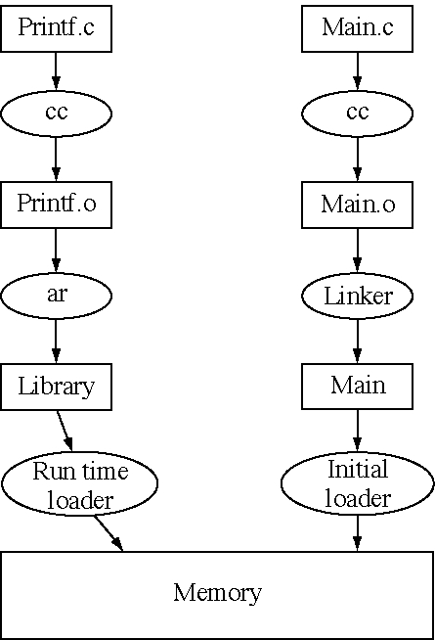
Run-time dynamic linking
Crowley OS Chap. 10

Slide 11
Instruction Cycle(revisited)
Memory consists of array of words/bytes.
CPU fetches instructions from main memory according to values of program counter.
Instruction cycle:
  Fetch an instruction from main memory
  Instruction is then decoded and may cause operands to be fetched from main memory
  After execution of operation on operands , results may be stored back to main memory
Role of memory Management Unit???
  See slide notes.
Notes:
Memory Management Unit sees only a stream of memory addresses and it does not know how they are generated or what they are for- instructions or data.
From O/S perspective we are interested only in the sequence of memory addresses generated by running program and not how memory addresses are being generated.

Slide 12
Address Binding-Binding of Instructions and Data to Memory
Address Binding???
Address binding of instructions and data to memory addresses can happen at three different stages
  Compile time: If memory location known a priori, absolute code can be generated; must recompile code if starting location changes
  Load time: Must generate relocatable code if memory location is not known at compile time . Final binding delayed until load time.
  Execution time: Binding delayed until run time if the process can be moved during its execution from one memory segment to another. Need hardware support for address maps (e.g., base and limit registers)

Slide 13
Logical vs. Physical Address Space
The concept of a logical address space that is bound to a separate physical address space is central to proper memory management
  Logical address – generated by the CPU; also referred to as virtual address
  Physical address – address seen by the memory unit
Logical and physical addresses are the same in compile-time and load-time address-binding schemes;
logical (virtual) and physical addresses differ in execution-time address-binding scheme

Slide 14

Multistep Processing of a User Program

Slide 15
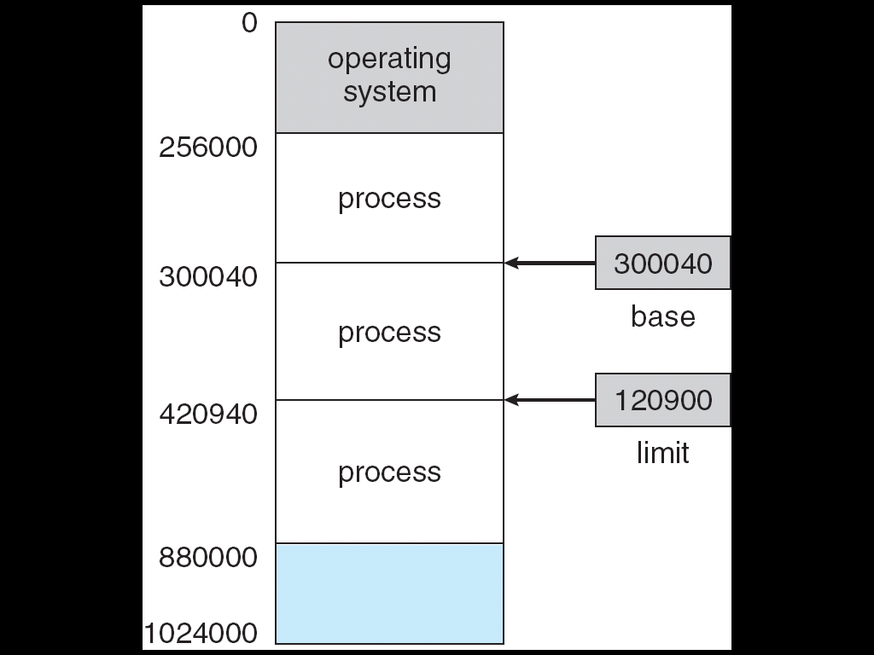
Base and Limit Registers
A pair of base and limit registers define the logical address space

Slide 16
Memory-Management Unit (MMU)
Hardware device that maps virtual/logical address to physical address
In MMU scheme, the value in the relocation register is added to every address generated by a user process at the time it is sent to memory
The user program deals with logical addresses; it never sees the real physical addresses

Slide 17

Dynamic relocation using a relocation register

Slide 18

HW address protection with base and limit registers(numerical in notes)
Notes:
Assume that we have 1M memory. O/S is allotted 256K starting from 0. Memory is partitioned into fixed size memory chunks of 64K
Calculate
No of memory chunks/available holes
Determine the actual starting physical address of first memory partition
No of words in each memory partition
Slot the following processes in memory
P1 : Base register : 448K, Limit Register: 56056
P2 : Base register : 640K, Limit Register: 63000
e. Determine the trap when P1 generates the following addresses
i.458752
ii.524288
iii.452000

Slide 19
Dynamic Loading
The size of the process is limited by the size of physical memory.
A routine is not loaded until it is called.
Routines are stored in disk in relocatable “load format”.
Scenario:Routine 1 calls Routine 2
  Routine 1 to check if routine 2 is loaded
  If not , Relocatable Linking Loader called to load the desired routine.
  Program’s address tables are updated.
Advantages??

Slide 20
Dynamic Loading
Routine is not loaded until it is called
Better memory-space utilization; unused routine is never loaded
Useful when large amounts of code are needed to handle infrequently occurring cases.
Program size might be large but the portion that is used might be small.
No special support from the operating system is required implemented through program design
http://www.linuxjournal.com/article/3687

Slide 21
Dynamic Linking
Static Linking-System Libraries are part of the program image.
Dynamic Linking similar to dynamic loading in some ways , as here linking postponed to execution time.
What happens if this facility is not available?
Each program would have its own copy of libraries leading to wastage of time and memeory

Slide 22
Dynamic Linking
Linking postponed until execution time
Small piece of code, stub, used to locate the appropriate memory-resident library routine
Stub replaces itself with the address of the routine, and executes the routine
Operating system needed to check if routine is in processes’ memory address
Dynamic linking is particularly useful for libraries
System also known as shared libraries

Slide 23
End of Day One!!!
Discussions.
Queries(if any-can be posted on email/Blackboard)

Slide 24
Contiguous Allocation
Main memory usually into two partitions:
  Resident operating system, usually held in low memory with interrupt vector
  User processes then held in high memory
Relocation registers used to protect user processes from each other, and from changing operating-system code and data
  Base register contains value of smallest physical address
  Limit register contains range of logical addresses – each logical address must be less than the limit register
  MMU maps logical address dynamically

Slide 25
Swapping
A process can be swapped temporarily out of memory to a backing store, and then brought back into memory for continued execution
Backing store – fast disk large enough to accommodate copies of all memory images for all users; must provide direct access to these memory images
Roll out, roll in – swapping variant used for priority-based scheduling algorithms; lower-priority process is swapped out so higher-priority process can be loaded and executed
Major part of swap time is transfer time; total transfer time is directly proportional to the amount of memory swapped
Modified versions of swapping are found on many systems (i.e., UNIX, Linux, and Windows)
System maintains a ready queue of ready-to-run processes which have memory images on disk

Slide 26

Schematic View of Swapping

Slide 27
Contiguous Allocation (Cont.)
Multiple-partition allocation
  Hole – block of available memory; holes of various size are scattered throughout memory
  When a process arrives, it is allocated memory from a hole large enough to accommodate it
  Operating system maintains information about:
  a) allocated partitions b) free partitions (hole)
OS
OS
OS
OS
process 5
process 5
process 5
process 5
process 9
process 9
process 8
process 10
process 2
process 2
process 2
process 2

Slide 28
Dynamic Storage-Allocation Problem
How to satisfy a request of size n from a list of free holes
First-fit: Allocate the first hole that is big enough
Best-fit: Allocate the smallest hole that is big enough; must search entire list, unless ordered by size
  Produces the smallest leftover hole
Worst-fit: Allocate the largest hole; must also search entire list
  Produces the largest leftover hole
First-fit and best-fit better than worst-fit in terms of speed and storage utilization
Check notes for one question
Notes:
Consider variable size partitioning technique, where holes available are 20MB, 30MB, 44MB and 12MB of size. A Process of size 19MB is allocated as per First Fit, Best Fit and Worse Fit algorithms. Then write in percentage the space wasted in each case

Slide 29
Fragmentation
External Fragmentation – total memory space exists to satisfy a request, but it is not contiguous
Internal Fragmentation – allocated memory may be slightly larger than requested memory; this size difference is memory internal to a partition, but not being used
Reduce external fragmentation by compaction
  Shuffle memory contents to place all free memory together in one large block
  Compaction is possible only if relocation is dynamic, and is done at execution time
  I/O problem
    Latch job in memory while it is involved in I/O
    Do I/O only into OS buffers

Slide 30
End of session 2
Questions?
Discussions!!!

Slide 31
Paging
Logical address space of a process can be noncontiguous; process is allocated physical memory whenever the latter is available
Divide physical memory into fixed-sized blocks called frames (size is power of 2, between 512 bytes and 8,192 bytes)
Divide logical memory into blocks of same size called pages
Keep track of all free frames
To run a program of size n pages, need to find n free frames and load program
Set up a page table to translate logical to physical addresses
Internal fragmentation

Slide 32
Address Translation Scheme
Address generated by CPU is divided into:
  Page number (p) – used as an index into a page table which contains base address of each page in physical memory
  Page offset (d) – combined with base address to define the physical memory address that is sent to the memory unit
  For given logical address space 2^{m} and page size 2^{n}
page number
page offset
p
d
m - n
n

Slide 33

Paging Hardware

Slide 34

Paging Model of Logical and Physical Memory

Slide 35

Paging Example
32-byte memory and 4-byte pages

Slide 36

Free Frames
Before allocation
After allocation

Slide 37
Implementation of Page Table
Page table is kept in main memory
Page-table base register (PTBR) points to the page table
Page-table length register (PRLR) indicates size of the page table
In this scheme every data/instruction access requires two memory accesses. One for the page table and one for the data/instruction.
The two memory access problem can be solved by the use of a special fast-lookup hardware cache called associative memory or translation look-aside buffers (TLBs)
Some TLBs store address-space identifiers (ASIDs) in each TLB entry – uniquely identifies each process to provide address-space protection for that process

Slide 38
Associative Memory
Associative memory – parallel search
Address translation (p, d)
  If p is in associative register, get frame # out
  Otherwise get frame # from page table in memory
Page #
Frame #

Slide 39

Paging Hardware With TLB

Slide 40
Effective Access Time
Associative Lookup = ε time unit
Assume memory cycle time is 1 microsecond
Hit ratio – percentage of times that a page number is found in the associative registers; ratio related to number of associative registers
Hit ratio = α
Effective Access Time (EAT)
EAT = (1 + ε) α + (2 + ε)(1 – α)
= 2 + ε – α

Slide 41
Memory Protection
Memory protection implemented by associating protection bit with each frame
Valid-invalid bit attached to each entry in the page table:
  “valid” indicates that the associated page is in the process’ logical address space, and is thus a legal page
  “invalid” indicates that the page is not in the process’ logical address space

Slide 42

Valid (v) or Invalid (i) Bit In A Page Table

Slide 43
Shared Pages
Shared code
  One copy of read-only (reentrant) code shared among processes (i.e., text editors, compilers, window systems).
  Shared code must appear in same location in the logical address space of all processes
Private code and data
  Each process keeps a separate copy of the code and data
  The pages for the private code and data can appear anywhere in the logical address space

Slide 44
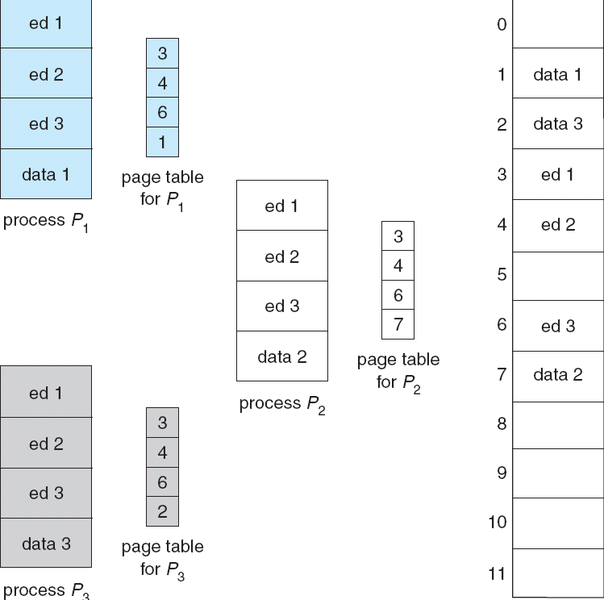
Shared Pages Example

Slide 45
Structure of the Page Table
Hierarchical Paging
Hashed Page Tables
Inverted Page Tables

Slide 46
Hierarchical Page Tables
Break up the logical address space into multiple page tables
A simple technique is a two-level page table

Slide 47

Two-Level Page-Table Scheme

Slide 48
Two-Level Paging Example
A logical address (on 32-bit machine with 1K page size) is divided into:
  a page number consisting of 22 bits
  a page offset consisting of 10 bits
Since the page table is paged, the page number is further divided into:
  a 12-bit page number
  a 10-bit page offset
Thus, a logical address is as follows:
where p_{i} is an index into the outer page table, and p₂ is the displacement within the page of the outer page table
page number
page offset
p_{i}
p₂
d
12
10
10

Slide 49

Address-Translation Scheme

Slide 50


Three-level Paging Scheme

Slide 51
Hashed Page Tables
Common in address spaces > 32 bits
The virtual page number is hashed into a page table. This page table contains a chain of elements hashing to the same location.
Virtual page numbers are compared in this chain searching for a match. If a match is found, the corresponding physical frame is extracted.

Slide 52

Hashed Page Table

Slide 53
Inverted Page Table
One entry for each real page of memory
Entry consists of the virtual address of the page stored in that real memory location, with information about the process that owns that page
Decreases memory needed to store each page table, but increases time needed to search the table when a page reference occurs
Use hash table to limit the search to one — or at most a few — page-table entries

Slide 54

Inverted Page Table Architecture

Slide 55
Segmentation
Memory-management scheme that supports user view of memory
A program is a collection of segments. A segment is a logical unit such as:
main program,
procedure,
function,
method,
object,
local variables, global variables,
common block,
stack,
symbol table, arrays

Slide 56

User’s View of a Program

Slide 57
Logical View of Segmentation
1
1
2
4
3
4
2
3
user space
physical memory space

Slide 58
Segmentation Architecture
Logical address consists of a two tuple:
<segment-number, offset>,
Segment table – maps two-dimensional physical addresses; each table entry has:
  base – contains the starting physical address where the segments reside in memory
  limit – specifies the length of the segment
Segment-table base register (STBR) points to the segment table’s location in memory
Segment-table length register (STLR) indicates number of segments used by a program;
segment number s is legal if s < STLR

Slide 59
Segmentation Architecture (Cont.)
Protection
  With each entry in segment table associate:
    validation bit = 0 ⇒ illegal segment
    read/write/execute privileges
Protection bits associated with segments; code sharing occurs at segment level
Since segments vary in length, memory allocation is a dynamic storage-allocation problem
A segmentation example is shown in the following diagram

Slide 60

Segmentation Hardware

Slide 61

Example of Segmentation

Slide 62
Example: The Intel Pentium
Supports both segmentation and segmentation with paging
CPU generates logical address
  Given to segmentation unit
    Which produces linear addresses
  Linear address given to paging unit
    Which generates physical address in main memory
    Paging units form equivalent of MMU

Slide 63
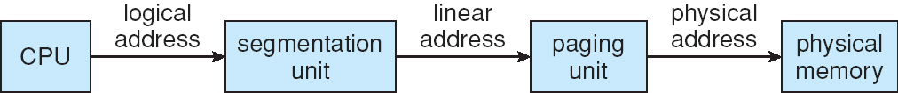

Logical to Physical Address Translation in Pentium

Slide 64

Intel Pentium Segmentation

Slide 65
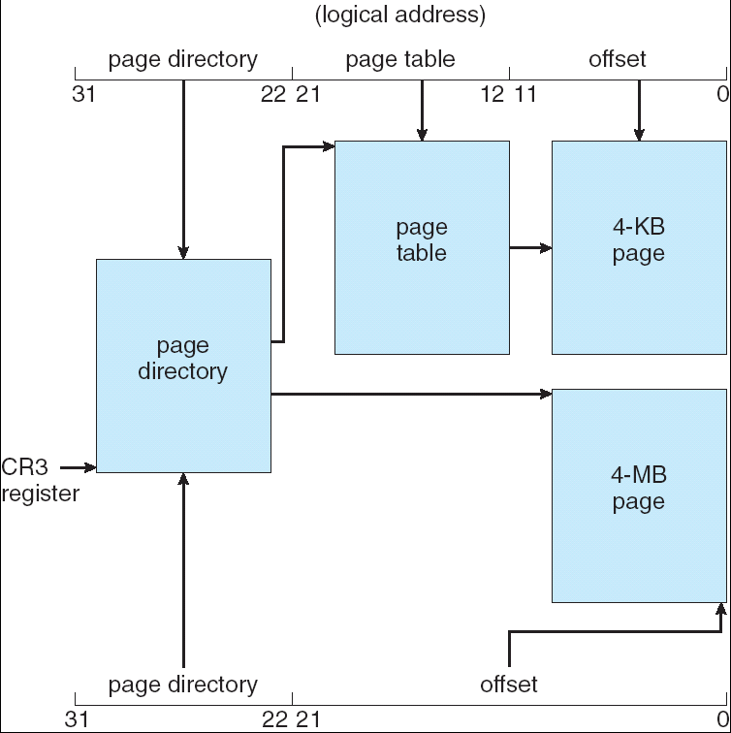
Pentium Paging Architecture

Slide 66
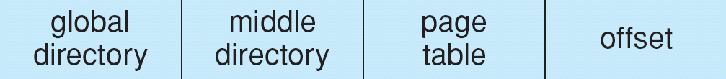
Linear Address in Linux
Broken into four parts:

Slide 67
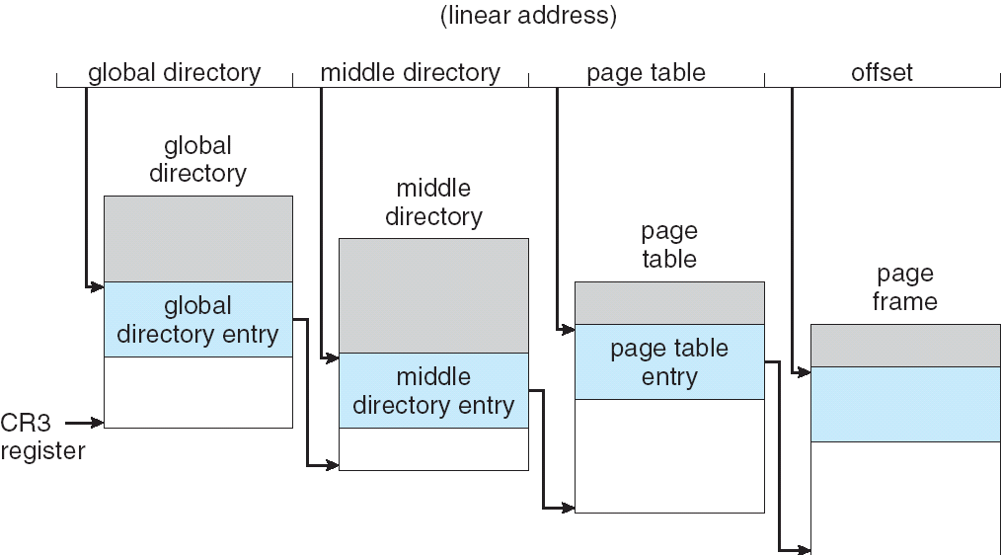
Three-level Paging in Linux

