Slide 1


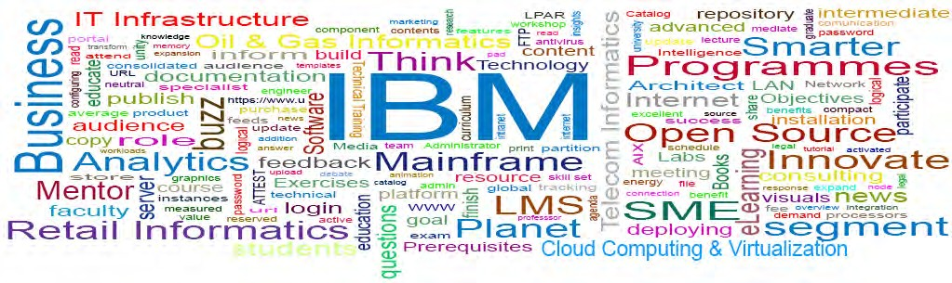
Unit 4
Creating User Interfaces
107
© 2013 IBM Corporation

Slide 2
Learning Objectives
Architecting complex process applications
Advanced routing
External system integration
User interfaces

Slide 3
Creating user interfaces
User interfaces is used by users interact with business processes
Human services indicate what actions these users perform within the process
Coaches are the user interface for these services
A Coach can be built as the user interface that process participants use to interact with a service

Slide 4
Coaches
Coaches are elements of the human service flow
During run time, when the flow enters a Coach, the user can see the user interface that is defined for that Coach
The user interface includes HTML code that is displayed in a web browser
When a boundary event occurs the flow leaves the Coach
A Coach can have multiple exit flows with each one connected to a different boundary event

Slide 5
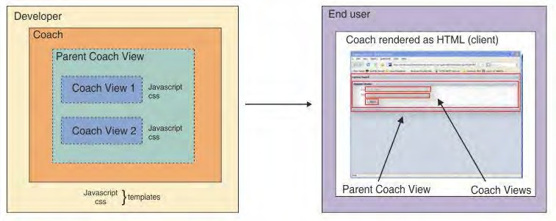
Visual layout

Slide 6
Coaches cont..
Coach Views can be reused so you can create a library of common user interfaces and behaviour
These common user interfaces can be combined to rapidly develop new Coaches
The Coaches toolkit that is part of IBM BPM has a set of common user interfaces, called stock controls
These stock controls can be included when you are creating your own Coach Views.

Slide 7
Difference between Coaches and Heritage
Coaches have one or more Coach Views
Coach Views are reusable collections of user interfaces that are often bound to a data type and can share common pieces of user interface between other Coaches
Eg. Coach View bound to an Address business object having individual text fields bound to parameters of address can be reused by another coach if the same parameters are required
On the contrary, with Heritage Coaches you must re-create the address fields
Coaches support collaboration while Heritage Coaches do not. It is possible for more than one person to work on the same Coach instance at the same time in their own browsers

Slide 8
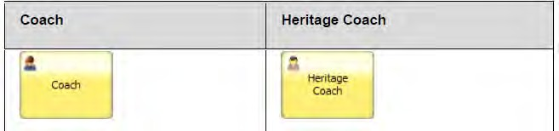
Coaches and Heritage Coaches
Services use Coaches and Heritage Coaches for the user interface
A service flow can mix Coaches and Heritage Coaches to enable one type to flow into the other
Coach cannot contain Heritage Coach elements and Heritage Coaches cannot have Coach Views. Thus a user interface must be a Coach or Heritage Coach and not a mix of the two.

Slide 9
Developing reusable Coach Views
A Coach View can be created in a toolkit or in the process application
To enable the reusability of the Coach View in multiple process applications, create it in a toolkit
The advantage is that the Coach View is available to all process applications that use that toolkit
There is always a risk if someone edits that Coach View, because the changes apply to all instances of that Coach View
These changes may have unintended consequences in other process applications
If you consider the risk to be too high, you may want to create the Coach View in the process application to restrict the changes to that particular process application

Slide 10
Stock controls
Stock controls are Coach Views in the IBM® Business Process Manager. They can be found in the Coaches (SYSC) toolkit
For each stock control, the business object that the stock control uses for its data is listed out in the business object binding table
The definition configuration column holds the corresponding configuration options as they are described in the Variables page of the stock control
It is not possible to edit the definition of a stock control, but instances of a stock control can be edited by setting their configuration options
Stock controls have the mobile ready tag, which indicates that they will work when viewed in the Safari browser on the Apple iPad.

Slide 11
Content box for coaches
A content box is a placeholder for content that a parent
Coach View or Coach describes
A parent Coach or Coach View is one that holds the other smaller Coach Views.
By creating a content box, the parent has an area for specific content while the Coach View can remain generic so that it can be reused for other Coach Views and Coaches.
The content that you place is specific to that instance of the Coach View

Slide 12
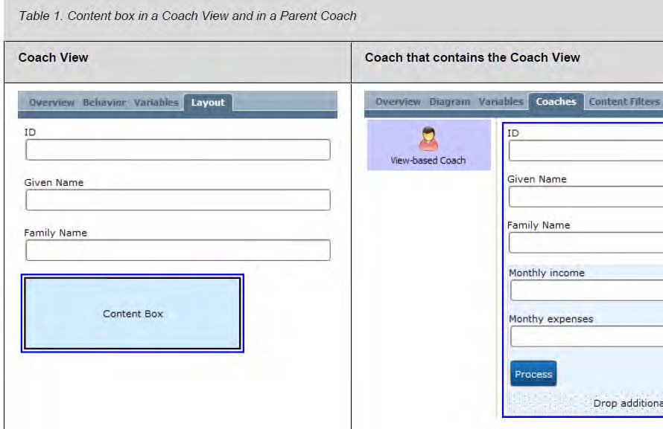
Content box for coaches

Slide 13
Defining Coach View behavior
Define the behavior for the Coach View in the Behavior
page
Add existing script files from the library using Included Scripts and CSS code and JavaScript to the Coach View definition using Inline CSS and Inline JavaScript.
If you are using JavaScript calls inside HREF <a></a> tags, ensure you catch and handle events properly
To insert a code like <meta> tags into the header of the Coach View, make use of Header HTML.
If required, define the functions used by the Coach View in the appropriate event handlers.

Slide 14
Accessing a child Coach view
At design time, each control in a Coach is provided a default control ID, which can be changed
Within the parent view the control ID is unique
At run time, the parent view is rendered as a <div></div> tag, which includes a nested <div></div> tag for each sub view (or control). The control ID can be used to access an instance of the sub view at run time.
The control ID of a view-based Coach differs from the control ID of a Heritage Coach
The control ID of a Heritage Coach is the div node ID. But view-based Coaches are different because Coach Views are reusable and can have multiple views in a Coach.

Slide 15
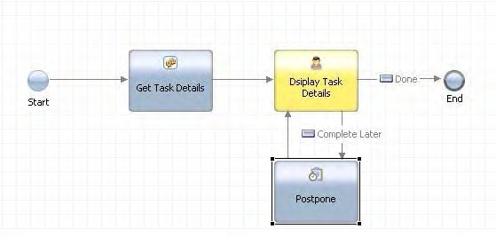
Building Services
Services are made up of steps that define what happens when Service (task) activities are triggered in the process
Each step enables the service to do a different job, from integrating with an external data source to generating forms (Coaches)

Slide 16
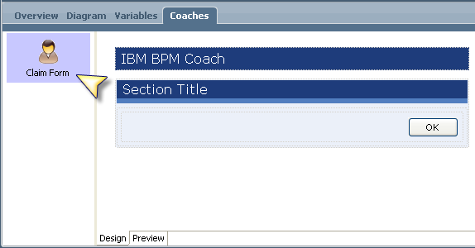
Creating coaches

Slide 17
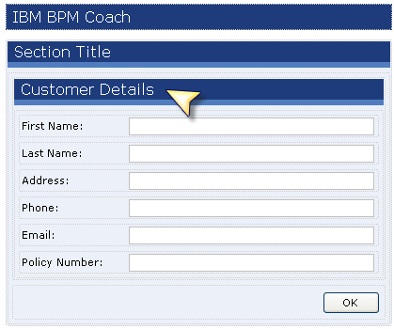
Creating coaches cont…

Slide 18
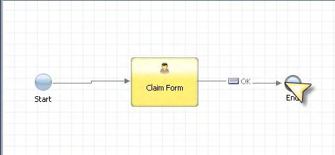
Sequence the flow

Slide 19
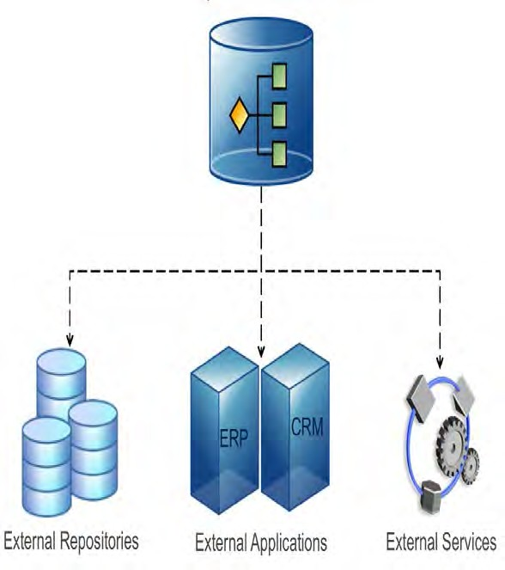
Integrating with Other Systems
IBM BPM provides support for outbound and inbound integration.
When communicating with an outside system to retrieve, update or insert data, it is referred to as outbound integration
128

Slide 20
Most outbound integrations involve calling out to data sources and web services.
Integrating with Other Systems
In considering what kind of integration component to build, think about the available integration methods and protocols.
SOAP(Simple Object Access Protocol) integrations tend to be very easy to build and are very useful, especially if you are not passing volumes of information
Java integrations are robust because they are built in Java, and sometimes you can find existing Java connections to legacy systems
When you call out to other systems, you do so by using an Integration Service and a Java or Web Service Integration Component.
Notes:
SOAP (Simple Object Access Protocol) is a protocol specification for exchanging structured information in the implementation of web services in computer networks. Its purpose is to induce extensibility, neutrality and independence.

Slide 21
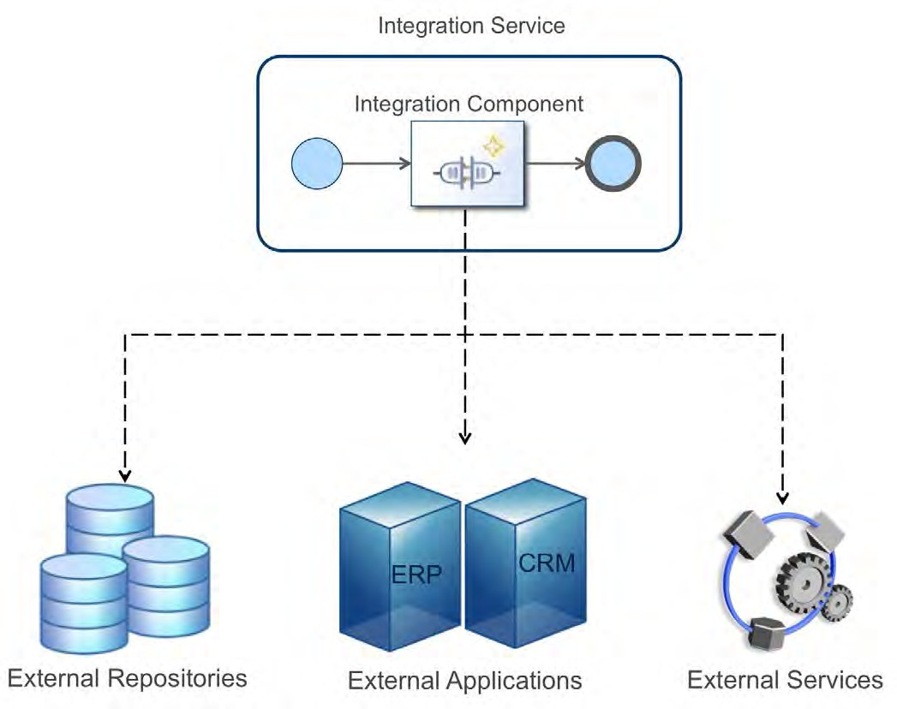
Integrating with Other Systems

Slide 22
Two basic integration architectures
There are two basic integration architectures that can be implemented:
Java Integration Components
Web Service Integration Components

Slide 23
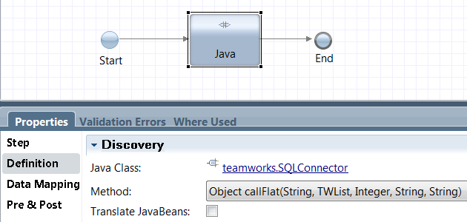
Java Integration Component
Calls methods from a Java class and interfaces with most third-party Java APIs, thus supporting a variety of integration scenarios.

Slide 24
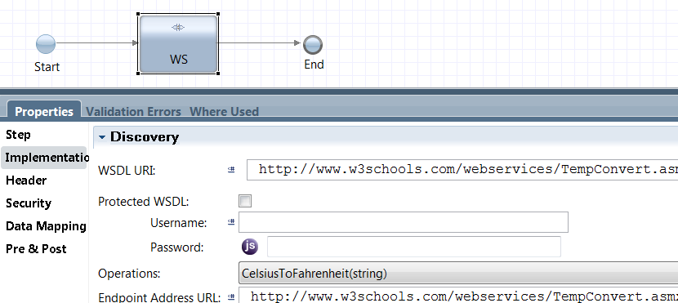
Web Service Integration Component
You should build an Integration service when you want to integrate with an external system to retrieve, update, or insert data in order to complete a task.

Slide 26

Unit 5
Dashboards and Reports
© 2013 IBM Corporation
Innovation Centre for Education
© 2013 IBM Corporation
135

Slide 27
Learning Objectives
This unit is about managing complex task and process applications
It also deals with creation of dashboards and reports for efficient data visibility

Slide 28
Present business environment
Introduction
fast-paced
companies need to make quick decisions to win new business
maintain existing relationships
and build on the trust and goodwill earned over time
Due to the complexity of existing business logic, adjusting or improving applications takes careful planning and time to implement any needed changes effectively

Slide 29
Integrated sense-and-respond solution
An integrated sense-and-respond solution creates awareness through events, direction through decisions, actions through processes, and insight through analysis
This simplified solution shows how you can structure advanced applications around business process management concepts and methodologies to enable decision-making capabilities that are based on real-time data analysis

Slide 30
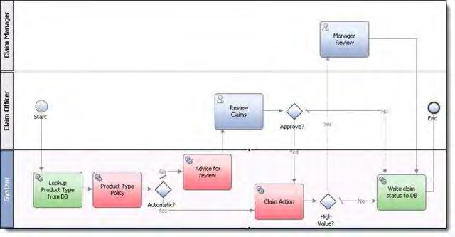
Warranty Reporting Solution

Slide 31
The scenario
A customer enters the serial number of a purchased product and selects the claim type by using the online reporting tool
When the tool logs each claim, if it records multiple claims for the same serial number in quick succession, it activates an event, which specifies that these claims should be examined together
Upon receipt of each claim, the event manager launches a business process to kick start the warranty review
This process invokes the business rules system to assess each event and to activate the appropriate actions as per the documented warranty policies. That is, a claim can be processed automatically, or similar claims require special handling
This process also writes the claim status to an attached database
The information that is collected during the warranty review process is consolidated in reports through the decision support system, which is accessible by web browser or mobile device.

Slide 32
Solution overview
Warranty reporting solution uses
IBM® Business Process Manager
IBM WebSphere® Operational Decision Manager
IBM Cognos® Business Intelligence are combined to create situational awareness, action, and insight
Solution also uses IBM Rational® tooling to handle the complexities that are associated with developing and deploying advanced applications
IBM Solution for Collaborative Lifecycle Management offers integration across products based on IBM JAZZ™ tools to connect the work of analysts with development and test teams, which helps them to validate solution requirements and produce solution artifacts more efficiently.

Slide 33
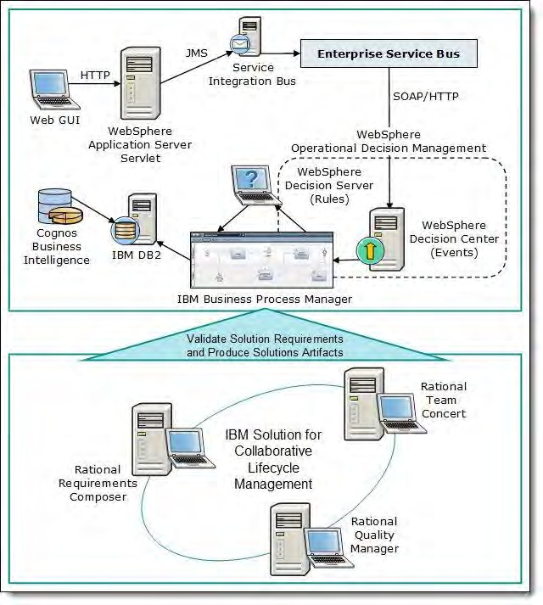
Architecture

Slide 34
IBM products used for WRS
IBM Solution for Collaborative Lifecycle Management | Provides seamless integration that connects the work of the analyst, the developer, and the test team with bundled IBM Rational Team Concert™, IBM Rational Requirements Composer, and IBM Rational Quality Manager. IBM Solution for Collaborative Lifecycle Management is used to handle the build, testing, change, and configuration management of the warranty reporting solution. Creates a collaborative data design environment for discovering, modeling, relating, standardizing, and integrating diverse and distributed data assets.
IBM Infosphere® Data Architect | Infosphere Data Architect is used to organize and manage the logical and physical databases required by the sample solution.

Slide 35
IBM products used for WRS
IBM Business Process Manager | Provides a complete BPM platform. The Process Server, Process Center, Process Designer, and Integration Designer are the main components Business Process Manager is used to execute the business process in the scenario. When business events are passed by WebSphere Operational Decision Manager, business decisions are invoked to satisfy the process.

Slide 36
IBM products used for WRS
IBM WebSphere Operational Decision Management | WebSphere Decision Center govern business rules and business event-based decision logic WebSphere Operational Decision Management is used to define the necessary actions to events that are activated by the warranty reporting process It allows the solution to automate claims decisions that are based on specified business situations defined in the business process

Slide 37
IBM products used for WRS
IBM Cognos Business Intelligence | Provides mechanisms for querying, reporting, and analyzing data Contains dashboards and the software to gather and organize information from multiple sources to help make decisions for better business outcomes now and in the future Cognos Business Intelligence is used to give insight through the creation of reports that are collected from the data and events that are gathered by the warranty reporting system

Slide 38
Roles associated with the solution
The analyst clarifies customer requirements and handles them by using IBM Rational Requirements Composer
The data developer creates the data model and its infrastructure based on solution requirements and then executes both
The business developer creates the business processes, decisions, situations, analysis reports, and dashboards as per approved business requirements. The person in this role also designs the integration between the process and business rules, the database, and other components

Slide 39
Roles associated with the solution
The test engineer describes the test case for the unit test with IBM Rational Quality Manager and IBM Rational Team Concert and for the integration test with IBM Rational Quality Manager. The person in this role also assesses test cases
The project leader organizes and leads the project and interacts with the customer

Slide 40
Infosphere Data Architecture
Product-specific roles
The data architect is in charge of the data architecture, leading the data modeling to create the Data Definition Language (DDL) and the data design for the database.
Cognos Business Intelligence
The Cognos BI administrator administers server environments, creates and maintains metadata, and generates all

Slide 41
Business Process Manager
Product-specific roles
The process analyst analyzes the process from the perspective of a business and leads process improvement when the as-is process is implemented.
The process participant (SME) adds additional depth and detail on process flows, business policies, and user interface interactions as discovered in user stories.
The process developer creates and executes process flows, services, business logic, and user interfaces for human workflow tasks (known as coaches in Business Process Manager).

Slide 42
Business Process Manager
Product-specific roles
The integration developer manages the integration of business processes, business rules, and other back-end systems
This role is also responsible for the implementation of an enterprise service bus.
The software administrator designs and sets parameters, such as custom data storage with the administrative console, and sets up the process application to the run time.

Slide 43
Product-specific roles
The solution architect designs the overall solution architecture of the process application, including the stipulated interaction functions between the process layer, the integration layer, and the rules and events.

Slide 44
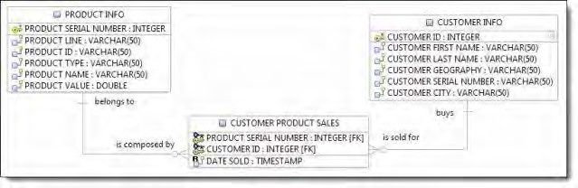
Infosphere Data Architect

Slide 45
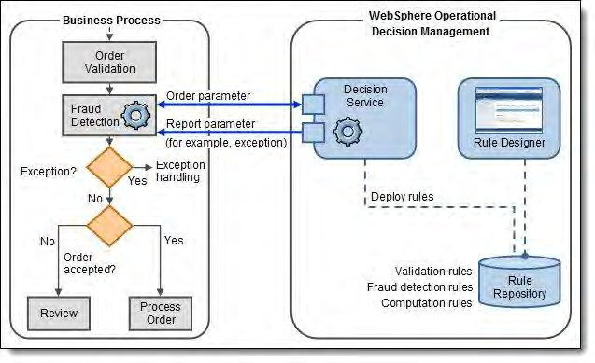
WebSphere Operational Decision Management

Slide 46
Business Process Manager
Business Process Manager models the warranty business process, which handles the core business process flow of the solution and acts as the choreographer of process steps and activities
Business Process Manager also synchronizes with events and decision management in WebSphere Operational Decision Management to handle the integration between process components and events, database, and decision management components

Slide 47
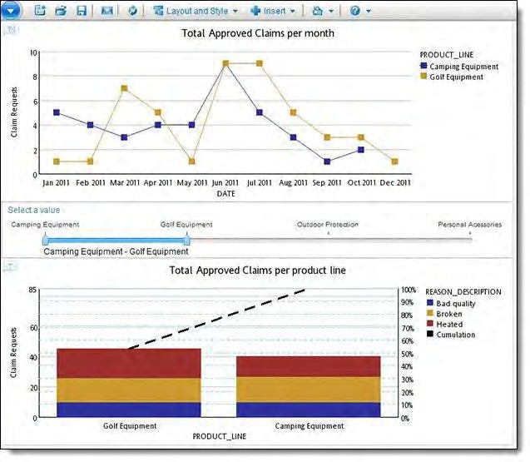
Cognos Business Intelligence

Slide 48
Deployment with IBM Workload Deployer
Integration
Workload Deployer endows the ability to create development, test, and production environments quickly at less cost and fewer resources in a repeatable and consistent manner
Workload Deployer can be used to install a virtual application pattern for the warranty reporting system
Users will be able to create the required virtual images for each IBM product, used in this solution to complete a virtual application pattern for deployment

Slide 49
Configuring a role-based business user interface
Designing process interactions for business users
Before we deploy process application, different elements should be configured in the business process definition to manage the types of actions that different business users
Developing flexible and efficient process applications
After mapping out process to include all of the normal task flows for normal process execution, process can be optimized to make it more flexible and efficient for the business users

Slide 50
Designing process interactions for business users
Setting up collaboration features for business users
Business Process Manager offers several features that permit business users to collaborate with other users while working with processes.
Enabling task management
Many of the business users who interact with your applications in the Process Portal will be allocated tasks that appear in their work list, grouped according to priority and upcoming due dates.
The activities can be configured in your BPD to have a generated due date that will affect, for example, which task appear categorized as "At Risk" or "Overdue" in their list and in the views seen by management. You can also enable management to see reports and charts that show the current progress of running process instances.

Slide 51
Designing process interactions for business users
Generating names for process instances
IBM® BPM creates a default name for the process instance. This name can be seen by business users in the Process Portal, allowing them to differentiate between different instances of a process as they complete their work. In Process Designer, the way the process instance names are generated for a BPD can be changed in the Process Portal.

Slide 52
Tracking IBM Business Process Manager performance data
Enabling processes for tracking and reporting
To create customized and third-party reports in IBM BPM, you need to spot the data to track and send that data to the Performance Data Warehouse.
Sending tracking definitions to Performance Data Warehouse
In order to track performance data, you must send tracking definitions to the Business Performance Data Warehouse. Each time you update your tracking requirements in IBM Process Designer, you should send the updated definitions to Performance Data Warehouse
Defining reports in Process Designer (deprecated)
Reports help you to analyze business data that is specific to your processes. You will be able to specify the variables to track and define the report to query your tracked data. Users could see the resulting report scoreboards from the Dashboards page in Process Portal.

Slide 53
IBM® Business Monitor
IBM® Business Monitor is a business activity monitoring environment that displays key performance indicators and metrics through dashboards.
Combining IBM Business Monitor with other Business Process Management (BPM) software can accelerate processes and facilitate business innovation.
BPM governs an organization's cross-functional, core business processes to attain business goals by directing resources from across the organization into efficient processes that create customer value.
BPM enabled by Service Oriented Architecture (SOA) improves a flexible IT architecture to create and reuse business services.

Slide 54
IBM Business Monitor in your business
Define actions to be taken when specified situations occur.
Capture business-related data from business applications, based on the monitor model that you define and install.
Extract the measurement variables from the data.
Transform the variables into metric and KPI values.
Display the measurement values on your dashboard. For example, you can display instance diagrams in context in any annotated Scalable Vector Graphics (SVG) diagrams. Elements can be defined to set colors, show and hide, associate metric and KPI values, and more.
Offer business intelligence insight through dimensional analysis and reporting.
Identify and alert you of operation failures for inspection and analysis.

Slide 55
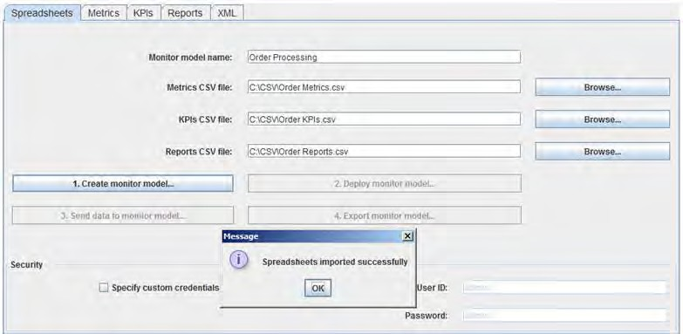
IBM Business Monitor dashboards
Using a simple CSV

Slide 56
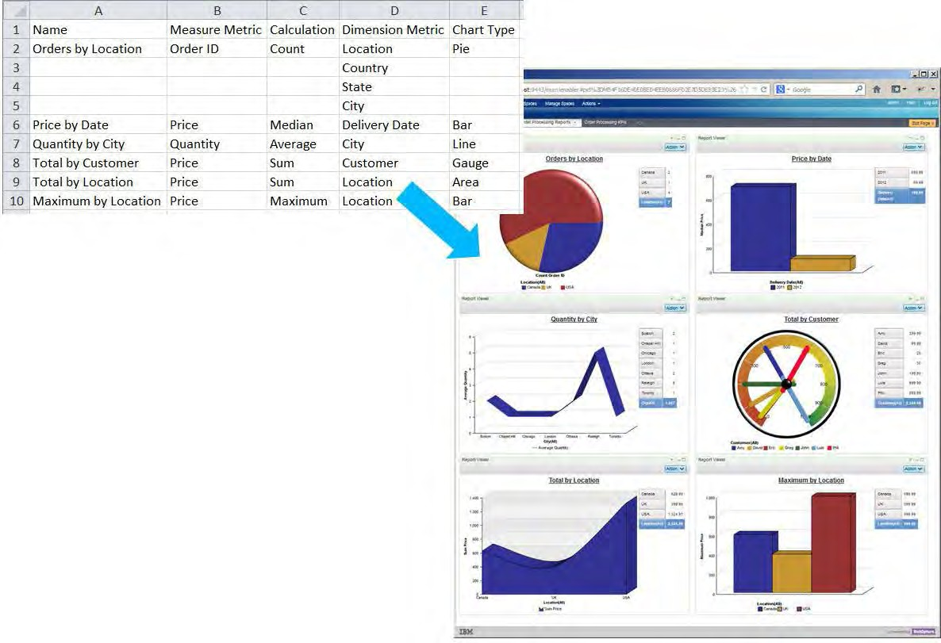
Spreadsheet and resulting dashboard

Slide 57
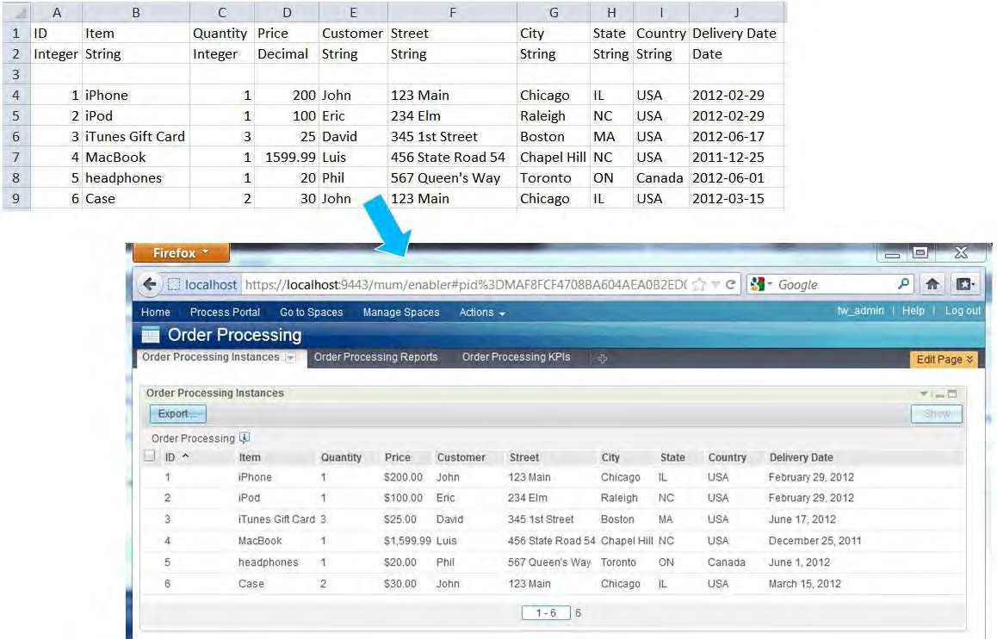
Spreadsheet and resulting dashboard
168

Slide 58
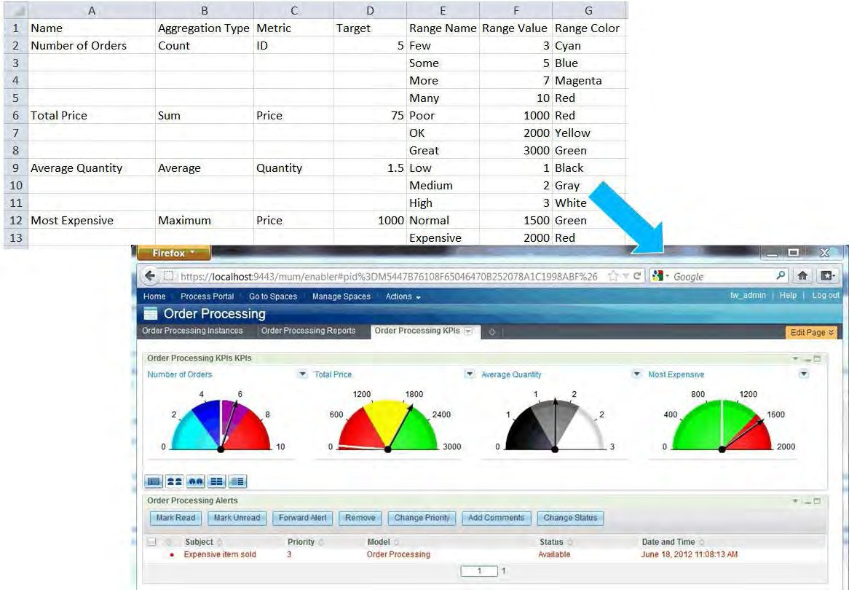
Spreadsheet and resulting dashboard

Slide 59
Spreadsheet and resulting dashboard

Slide 60
Checkpoint
Integrated sense-and-respond solution
Warranty Reporting Solution
Architecture implemented WRS
IBM products used for WRS
Roles associated with the solution
Product-specific roles
Visibility through dashboards and reports

