Slide 1
Virtual Memory Concepts
Monit Kapoor
Assistant Professor(SS)
CIT,UPES.

Slide 2
Implementation of virtual memory
Virtual memory allows
time multiplexing of memory
users to see a larger (virtual) address space than the physical address space
the operating system to split up a process in physical memory
Implementation requires extensive hardware assistance and a lot of OS code and time
but it is worth it

Slide 3
Basics
Virtual memory – separation of user logical memory from physical memory.
Only part of the program needs to be in memory for execution.
Logical address space can therefore be much larger than physical address space.
Need to allow pages to be swapped in and out.
Virtual memory can be implemented via:
Demand paging
Demand segmentation

Slide 4
Demand Paging
Bring a page into memory only when it is needed.
Less I/O needed
Less memory needed
Faster response
More users
Page is needed ⇒ reference to it
invalid reference ⇒ abort
not-in-memory ⇒ bring to memory

Slide 5
Valid-Invalid Bit
With each page table entry a valid–invalid bit is associated (v ⇒ in-memory, i ⇒ not-in-memory)
Initially valid–invalid bit is set to i on all entries
Example of a page table snapshot:
During address translation, if valid–invalid bit in page table entry
is I ⇒ page fault
Frame #
valid-invalid bit
v
v
v
v
i
….
i
i
page table

Slide 6
Valid-Invalid Bit
With each page table entry a valid–invalid bit is associated (1 ⇒ in-memory, 0 ⇒ not-in-memory)
Initially valid–invalid but is set to 0 on all entries.
Example of a page table snapshot.
During address translation, if valid–invalid bit in page table entry is 0 ⇒ page fault.
Frame #
valid-invalid bit
1
1
1
1
0

0
0
page table

Slide 7
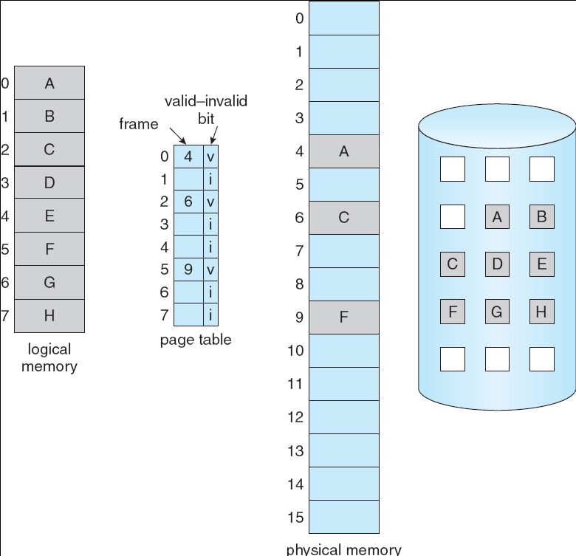
Page Table When Some Pages Are Not in Main Memory

Slide 8
Page Fault
If there is a reference to a page, first reference to that page will trap to operating system:
page fault
Operating system looks at another table to decide:
Invalid reference ⇒ abort
Just not in memory
Get empty frame
Swap page into frame
Reset tables
Set validation bit = v
Restart the instruction that caused the page fault

Slide 9
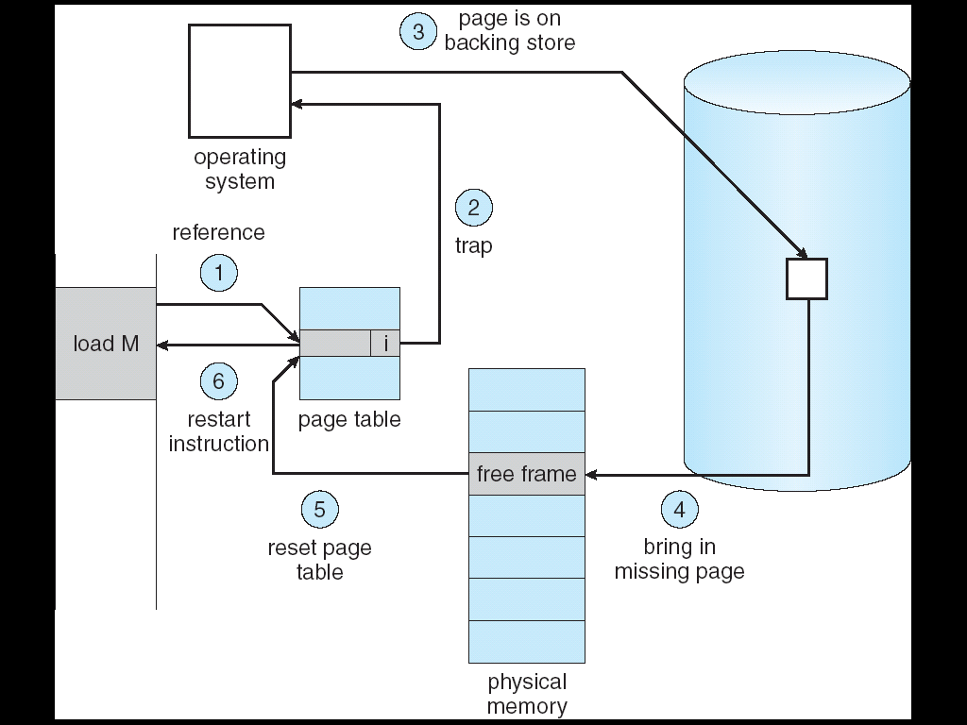
Steps in Handling a Page Fault

Slide 10
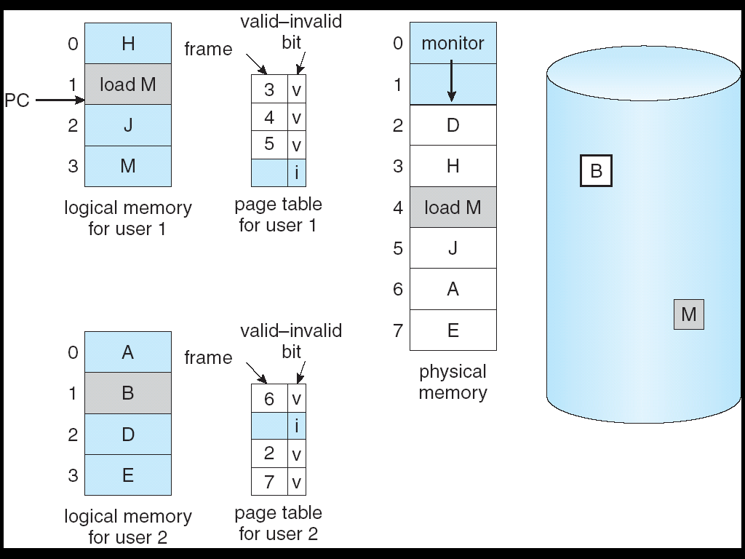
Need For Page Replacement

Slide 11
Basic Page Replacement
Find the location of the desired page on disk
Find a free frame: - If there is a free frame, use it - If there is no free frame, use a page replacement algorithm to select a victim frame
Bring the desired page into the (newly) free frame; update the page and frame tables
Restart the process

Slide 12
What happens if there is no free frame?
Page replacement – find some page in memory, but not really in use, swap it out.
algorithm
performance – want an algorithm which will result in minimum number of page faults.
Same page may be brought into memory several times.

Slide 13
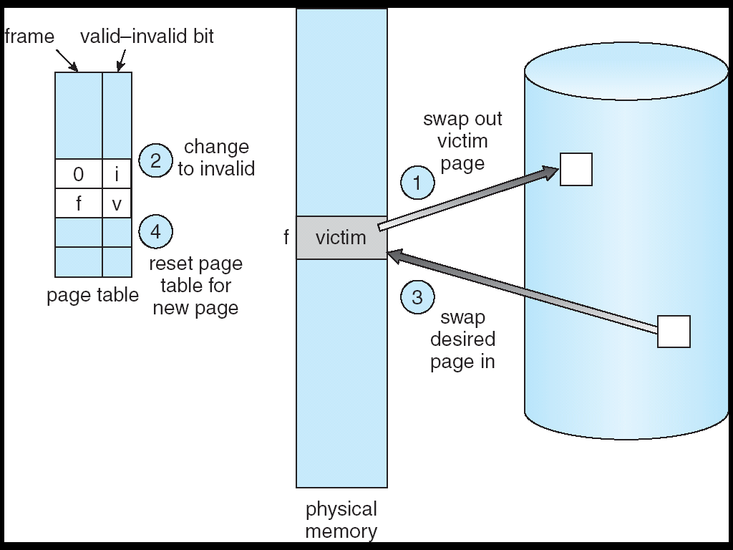
Page Replacement

Slide 14
Page Replacement Algorithms
Want lowest page-fault rate
Evaluate algorithm by running it on a particular string of memory references (reference string) and computing the number of page faults on that string
In all our examples, the reference string is
1, 2, 3, 4, 1, 2, 5, 1, 2, 3, 4, 5

Slide 15
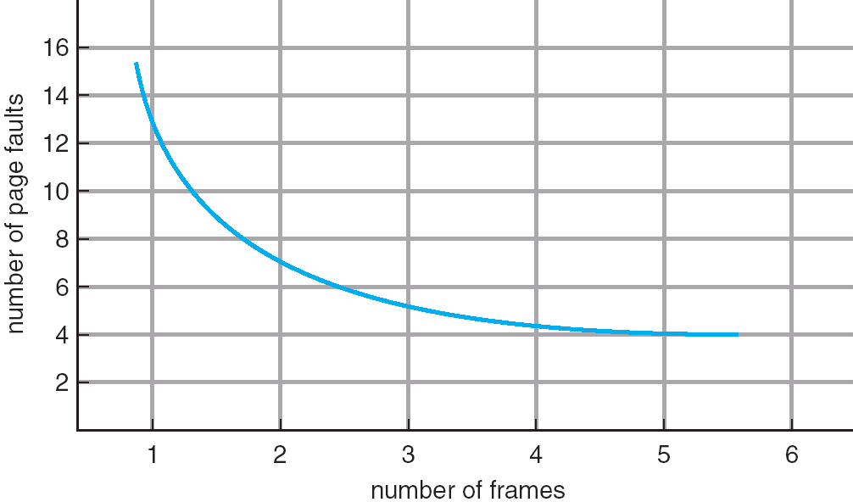
Graph of Page Faults Versus The Number of Frames

Slide 16
First-In-First-Out (FIFO) Algorithm
Reference string: 1, 2, 3, 4, 1, 2, 5, 1, 2, 3, 4, 5
3 frames (3 pages can be in memory at a time per process)
4 frames
Belady’s Anomaly: more frames ⇒ more page faults
1
1
4
5
2
2
1
3
9 page faults
3
3
2
4
1
1
5
4
2
2
1
5
10 page faults
3
3
2
4
4
3

Slide 17
Page Fault
If there is ever a reference to a page, first reference will trap to OS ⇒ page fault
OS looks at another table to decide:
Invalid reference ⇒ abort.
Just not in memory.
Get empty frame.
Swap page into frame.
Reset tables, validation bit = 1.
Restart instruction: Least Recently Used
block move
auto increment/decrement location

Slide 18
Performance of Demand Paging
Page Fault Rate 0 ≤ p ≤ 1.0
if p = 0 no page faults
if p = 1, every reference is a fault
Effective Access Time (EAT)
EAT = (1 – p) x memory access
+ p (page fault overhead
+ [swap page out ]
+ swap page in
+ restart overhead)

