Slide 1
Huffman Encoding
Dr. Bernard Chen Ph.D.
University of Central Arkansas

Slide 2
Text Compression (Zip)
On a computer: changing the representation of a file so that it takes less space to store or/and less time to transmit.
Original file can be reconstructed exactly from the compressed representation

Slide 3

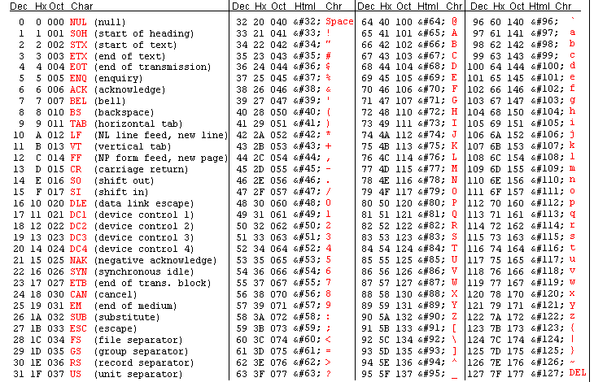
ASCII Codes
Let the word

Slide 4
First Approach
Let the word
How to write this string in a most economical way?
Since it has 5 words, 3 bit to represent it is required!!
Is there a better way?

Slide 5
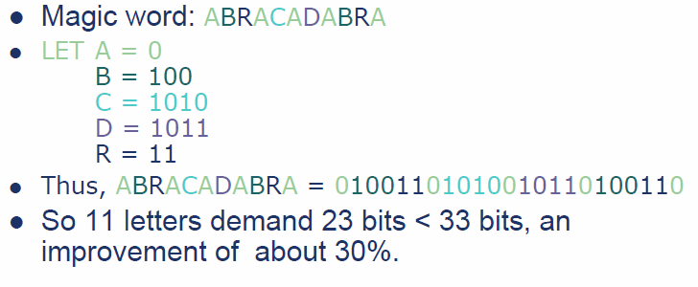
Of Course!!

Slide 6
However…
There are some concerns…
Suppose we have
  A-> 01
  B-> 0101
If we have 010101, is this AB? BA? Or AAA?
Therefore: prefix codes, no codeword is a prefix of another codeword, is necessary

Slide 7
Prefix Codes
Any prefix code can be represented by a full binary tree
Each leaf stores a symbol.
Each node has two children – left branch means 0, right means 1.
codeword = path from the root to the leaf interpreting suitably the left and right branches

Slide 8
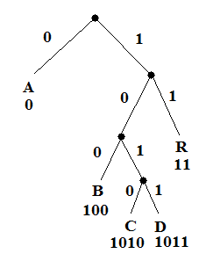
For Example
A = 0
B = 100
C = 1010
D = 1011
R = 11
Decoding is unique and simple!

Slide 9
How do we find the optimal coding tree?
it is clear that the two symbols with the smallest frequencies must be at the bottom of the optimal tree, as children of the lowest internal node
This is a good sign that we have to use a bottom-up manner to build the optimal code!
Huffman’s idea is based on a greedy approach, using the previous notices.

Slide 10
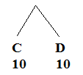
Constructing a Huffman Code
Assume that frequencies of symbols are
A: 50 B: 15 C: 10 D: 10 R: 18
Smallest numbers are 10 and 10 (C and D)

Slide 11
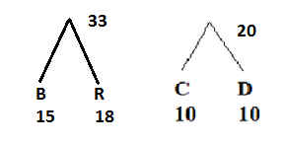
Constructing a Huffman Code
Now Assume that frequencies of symbols are A: 50 B: 15 C+D: 20 R: 18
C and D have already been used, and the new node above them (call it C+D) has value 20
The smallest values are B + R

Slide 12
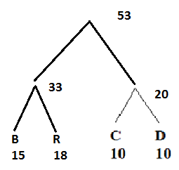
Constructing a Huffman Code
Now Assume that frequencies of symbols are A: 50 B+R: 33 C+D: 20
The smallest values are
(B + R)+(C+D)=53

Slide 13
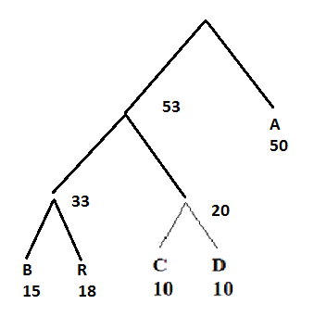
Constructing a Huffman Code
Now Assume that frequencies of symbols are A: 50 (B+R) + (C+D): 53
The smallest values are
A+ ((B + R)+(C+D))=103

Slide 14
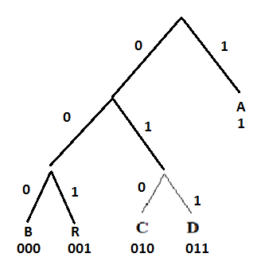
Constructing a Huffman Code

Slide 15
Constructing a Huffman Code
Assume that frequencies of symbols are
A: 50 B: 20 C: 10 D: 10 R: 30
Smallest numbers are 10 and 10 (C and D)

Slide 16
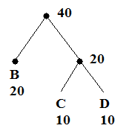
Constructing a Huffman Code
Assume that frequencies of symbols are
A: 50 B: 20 C: 10 D: 10 R: 30
C and D have already beenused, and the new node above them (call it C+D) has value 20
The smallest values are B, C+D

Slide 17
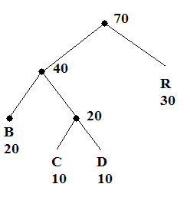
Constructing a Huffman Code
Assume that frequencies of symbols are
A: 50 B: 20 C: 10 D: 10 R: 30
Next, B+C+D (40) and R (30)

Slide 18
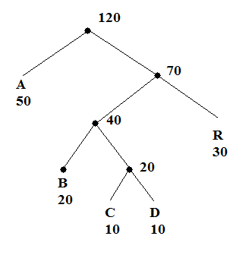
Constructing a Huffman Code
Assume that frequencies of symbols are
A: 50 B: 20 C: 10 D: 10 R: 30
Finally:

Slide 19
Constructing a Huffman Code

Slide 20
Decode the tree
Suppose we have the
Following code:
10001011
What is the decode
result?

Slide 21
In class practice
A: 10
B: 10
C: 25
D: 15
E: 30
F: 21
What is the Huffman Encoding Tree?

