Slide 1
UNIT V: Audit & Monitoring, Intelligence, Compliance, Management and Governance

Slide 2
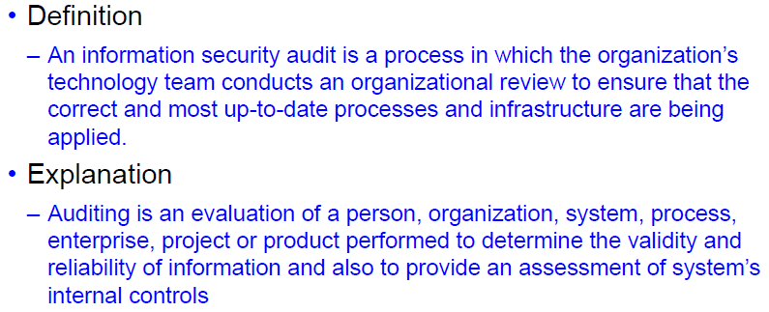
Audit?

Slide 3
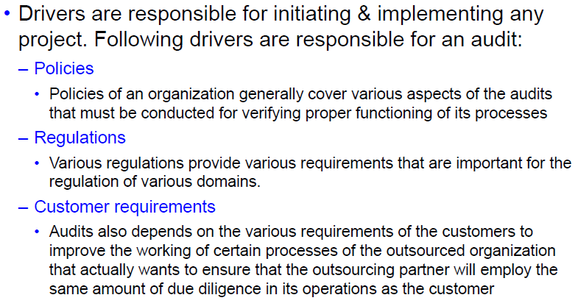
Audit Drivers

Slide 4
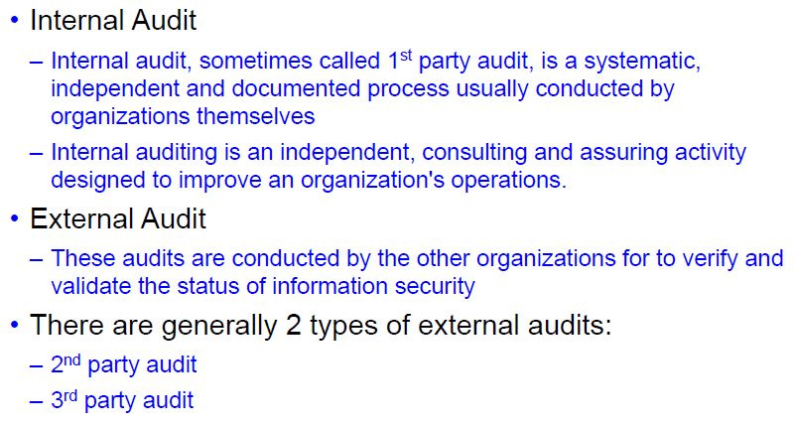
Types of Audit

Slide 5
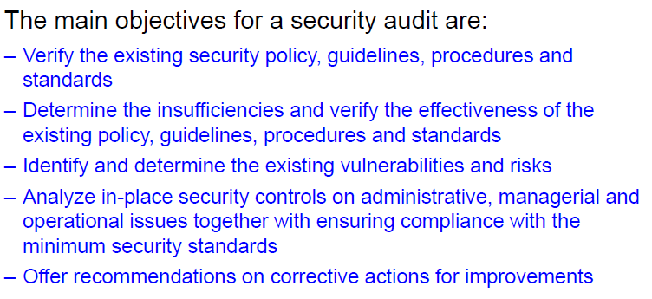
Audit Process

Slide 6
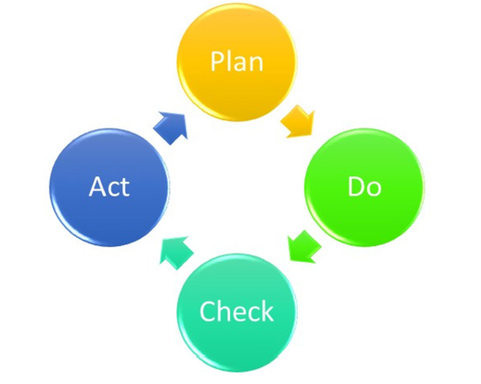
Approach for Information Security Audit

Slide 7
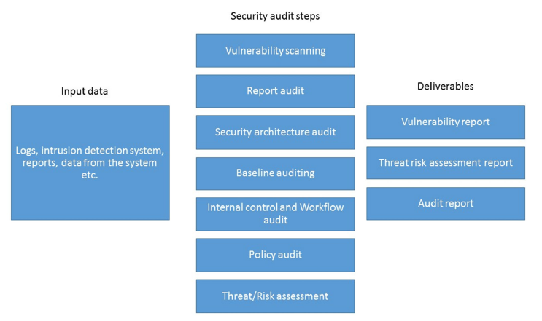
Information Security Audit Process

Slide 8
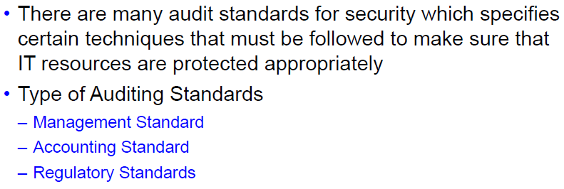
Information Security Auditing Standards

Slide 9
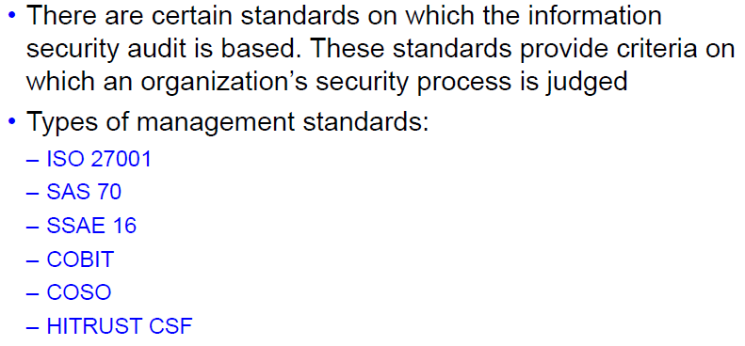
Management Standard

Slide 10
SAS 70: Statement on Auditing Standards No. 70 : Service Organizations
SSAE 16: Statements on Standards for Attestation Engagements No. 16
COBIT: Control Objectives for Information and Related Technologies
COSO: Committee of Sponsoring Organizations of the Treadway Commission
HITRUST CSF: Health Information Trust Alliance Common Security Framework

Slide 11
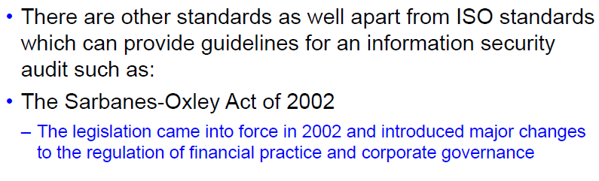
Accounting Standard

Slide 12
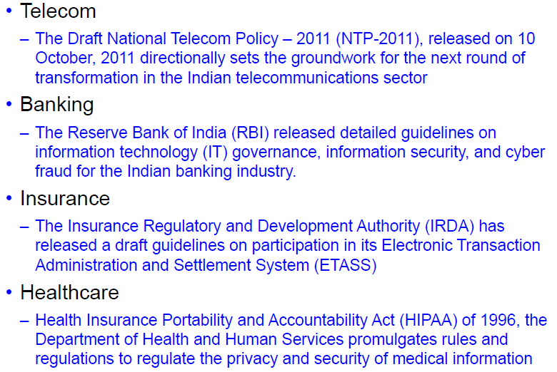
Regulatory Standards

Slide 13
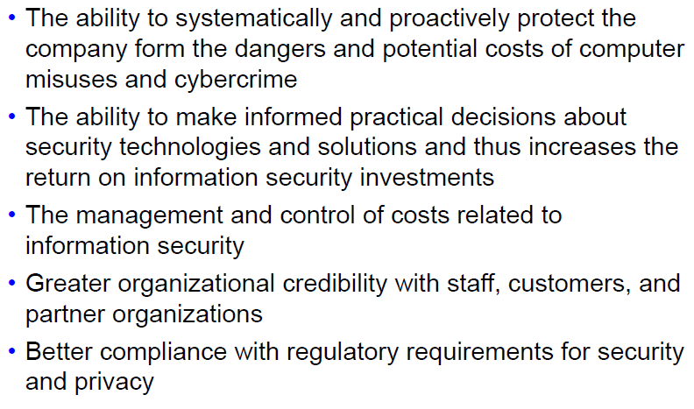
Benefits

Slide 14
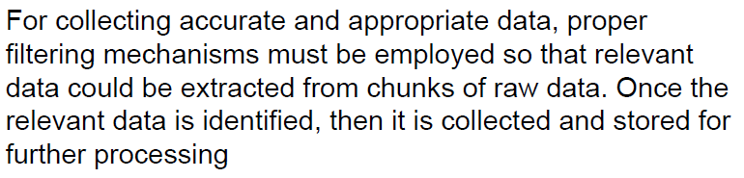
Data Sampling and Collection

Slide 15
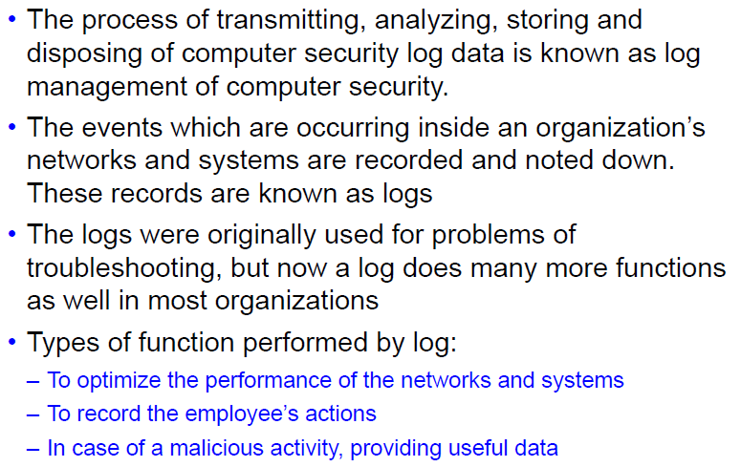
Log Management 1

Slide 16
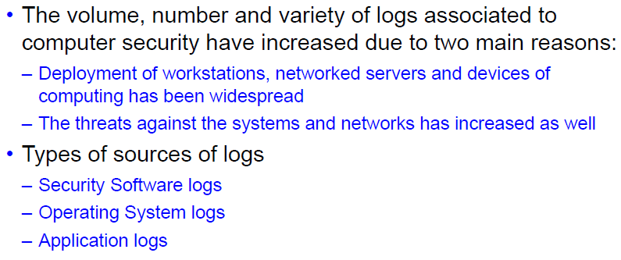
Log Management 2

Slide 17
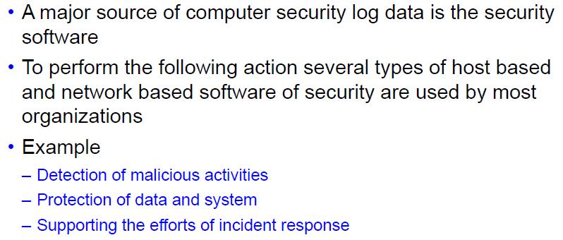
Security Software Logs

Slide 18
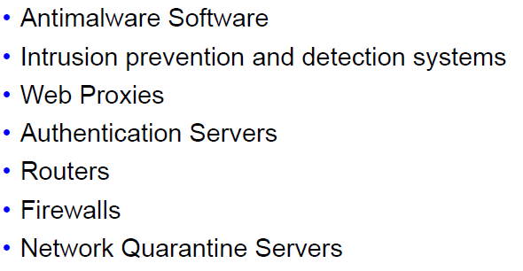
Security Software Generating Logs

Slide 19
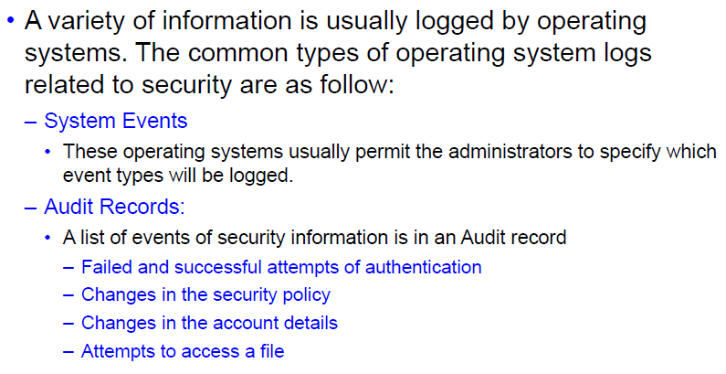
Operating System Logs

Slide 20
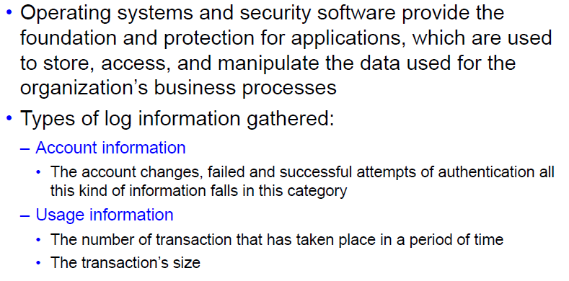
Application Logs

Slide 21
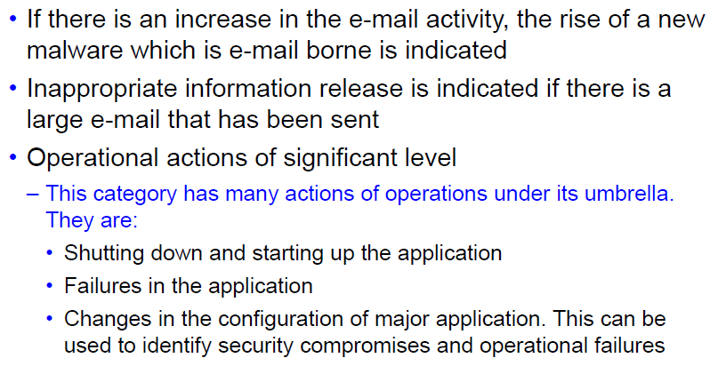
Application Log Indicators

Slide 22
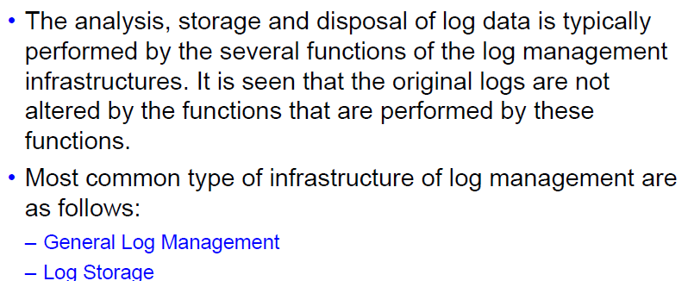
Data Aggregation and Reduction

Slide 23
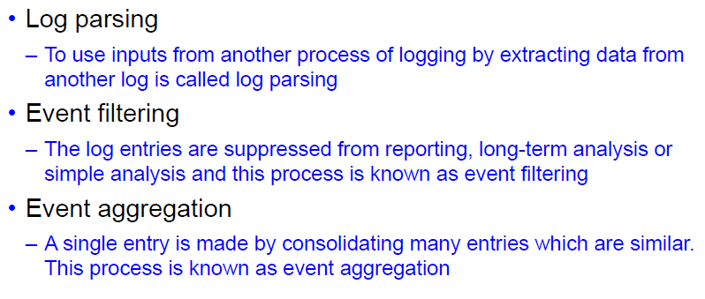
General Log Management

Slide 24
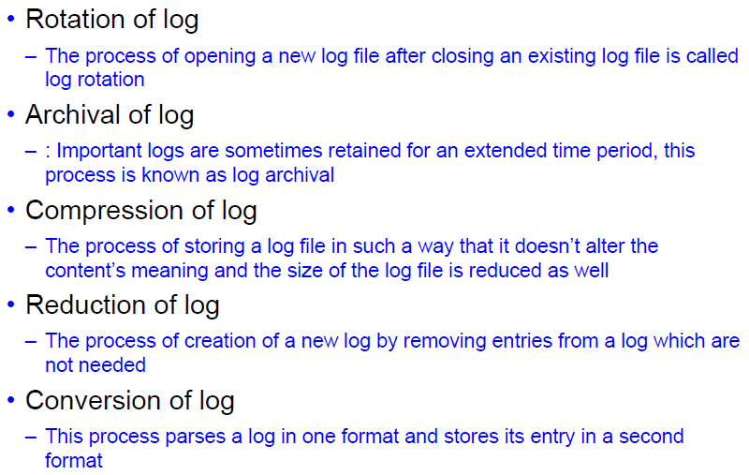
Log Storage

Slide 25
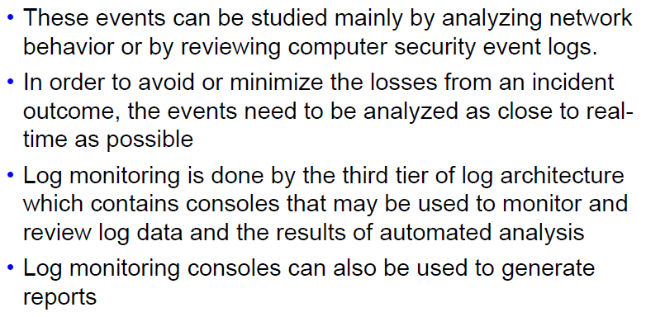
Monitoring and Control

Slide 26
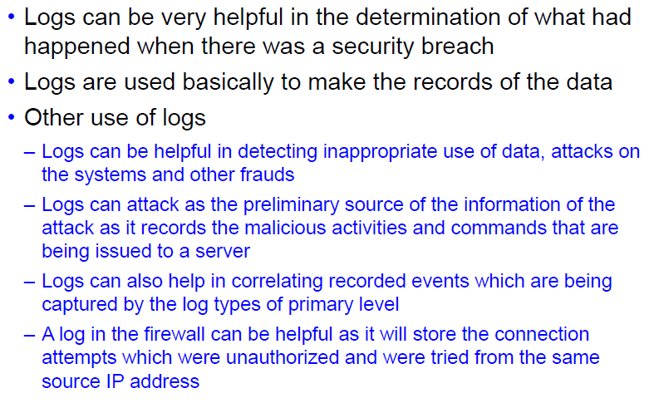
Importance of Logs

Slide 27
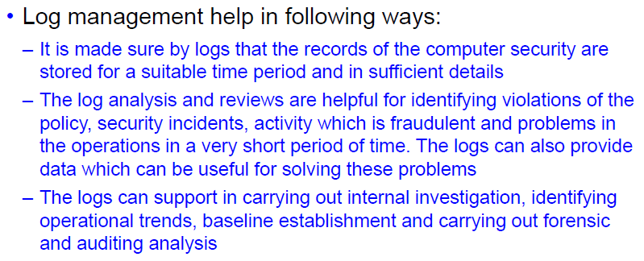
Needs for Management of Logs 1

Slide 28
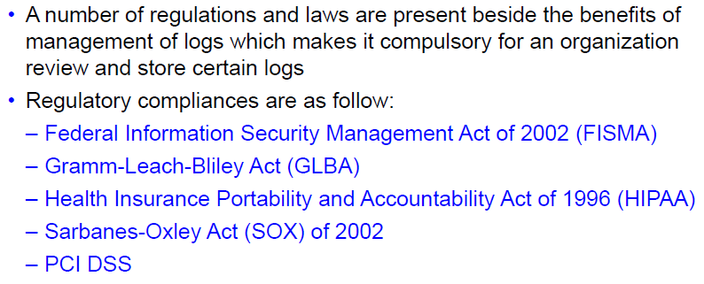
Need for Management of Logs 2

Slide 29
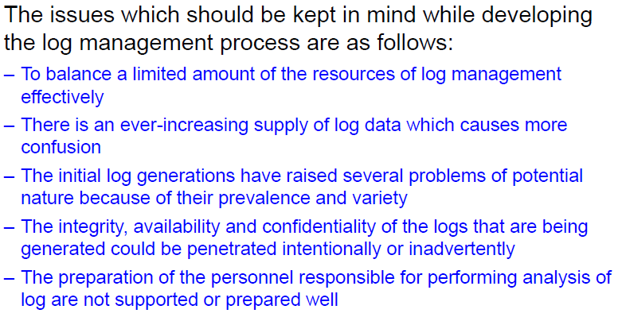
Considerations for effective Log Management

Slide 30
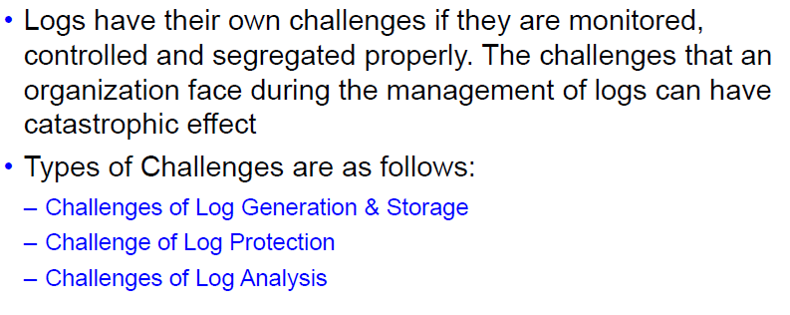
Challenges affecting Log Management

Slide 31
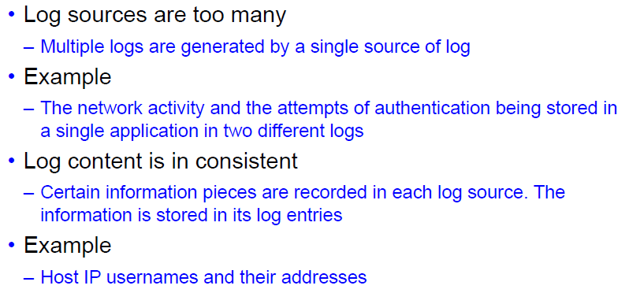
Challenges of log Generation and Storage 1

Slide 32
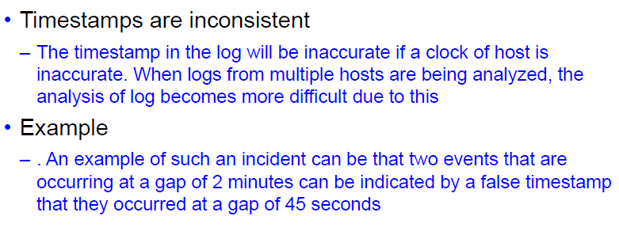
Challenges of log Generation and Storage 1

Slide 33
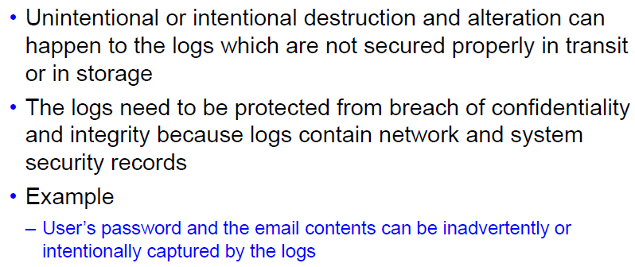
Challenges of Log Protection

Slide 34
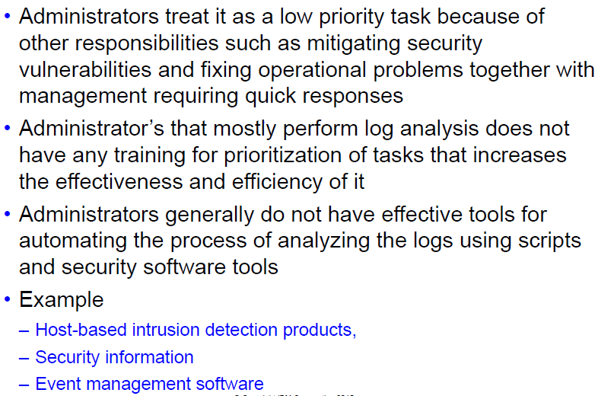
Challenges of Log Analysis 1

Slide 35
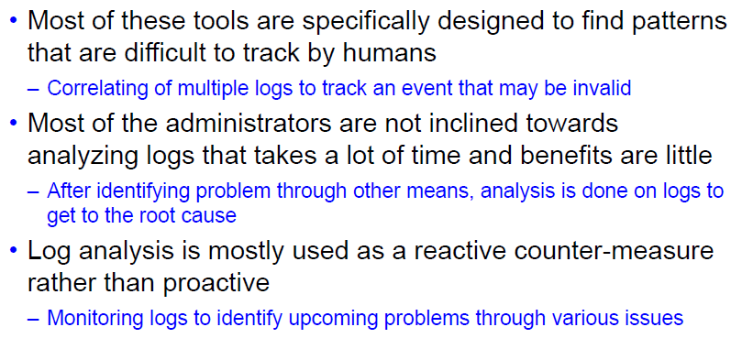
Challenges of Log Analysis 2

Slide 36
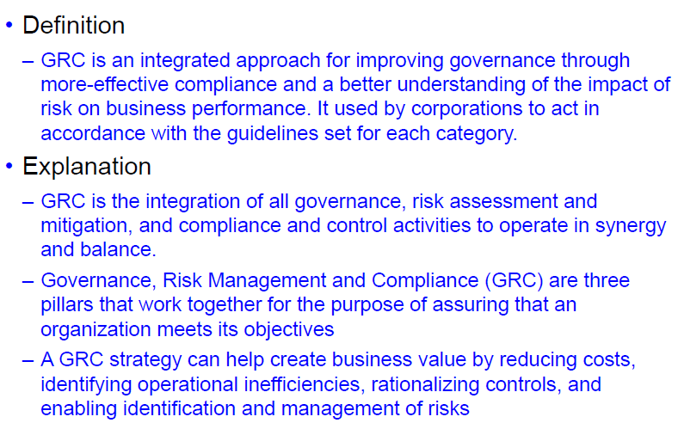
Introduction to Governance, Risk & Compliance

Slide 37
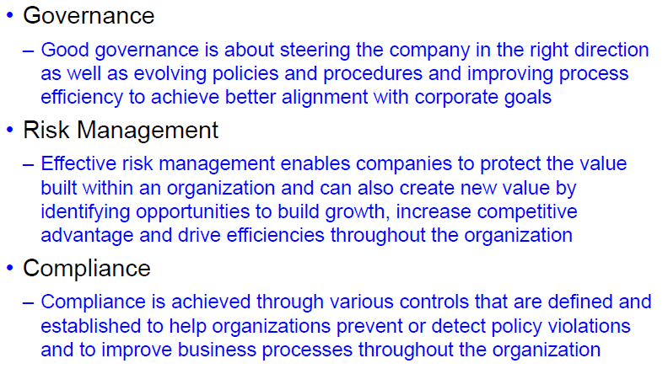
GRC Pillars

Slide 38
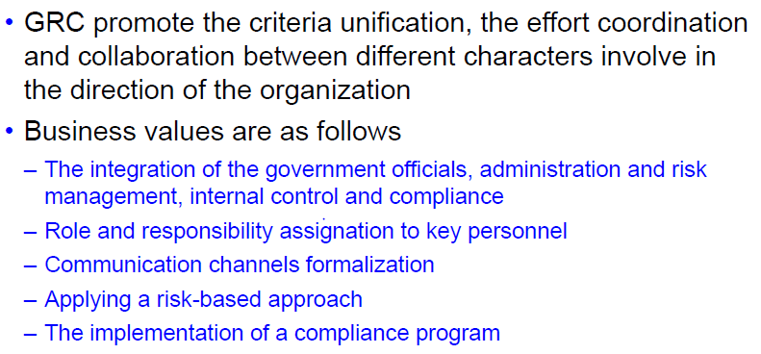
Value of GRC to Business

Slide 39
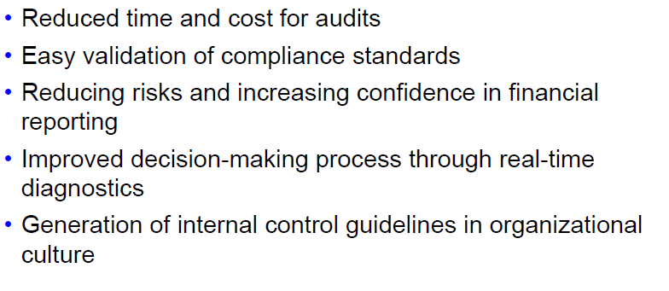
Benefits

Slide 40
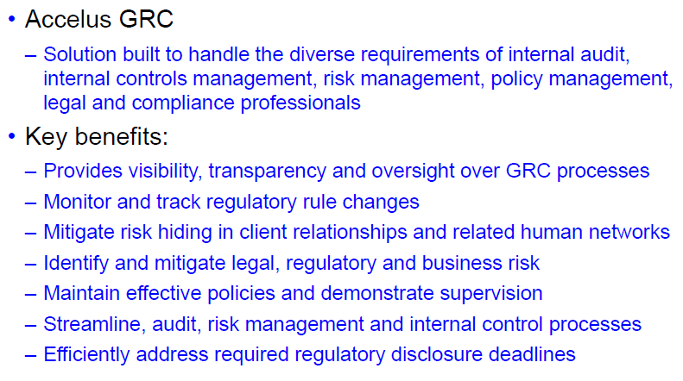
Tools for GRC 1

Slide 41
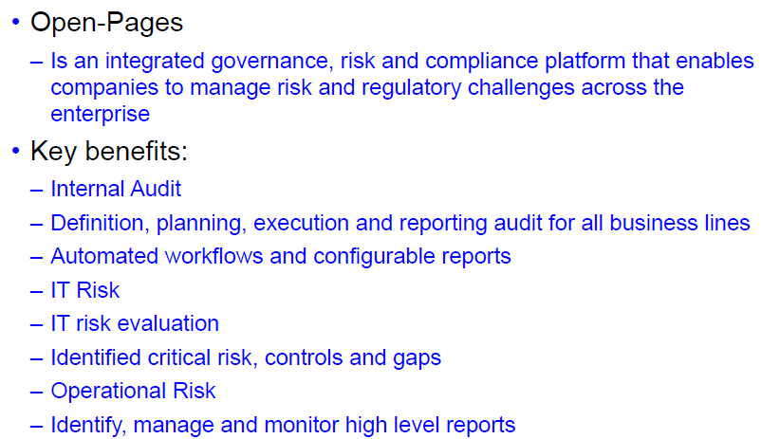
Tools for GRC 2

Slide 42
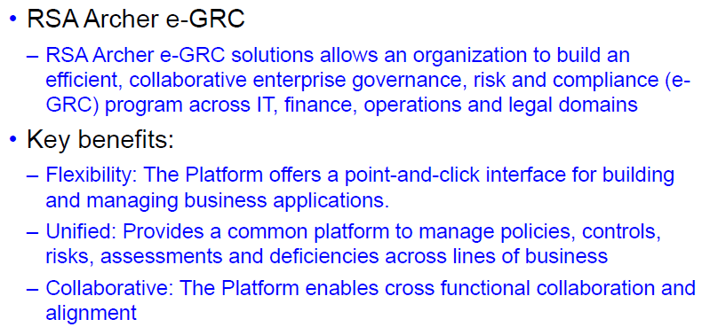
Tools for GRC 3

Slide 43
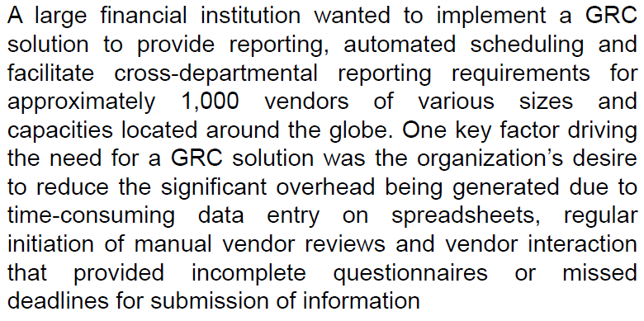
Implementation in Real World 1

Slide 44
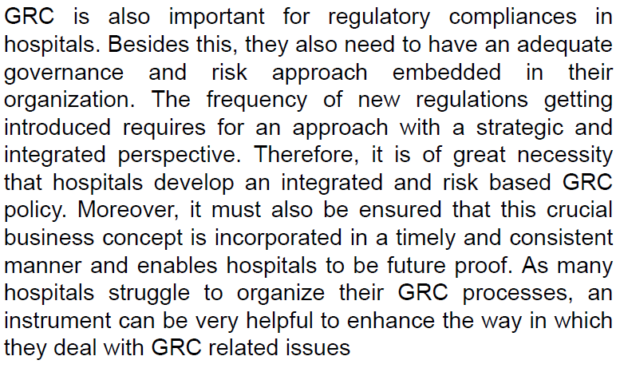
Implementation in Real World 2

Slide 45
Thank You!!!

