Slide 1
CHAPTER 5: CPU SCHEDULING

Slide 2
Chapter 5: CPU Scheduling
Basic Concepts
Scheduling Criteria
Scheduling Algorithms
Multiple-Processor Scheduling
Real-Time Scheduling
Operating Systems Examples

Slide 3
Basic Concepts
Maximum CPU utilization obtained with multiprogramming
CPU–I/O Burst Cycle – Process execution consists of a cycle of CPU execution and I/O wait
CPU burst distribution

Slide 4


CPU Scheduler
Selects from among the processes in memory that are ready to execute, and allocates the CPU to one of them
CPU scheduling decisions may take place when a process:
  1. Switches from running to waiting state
  2. Switches from running to ready state
  3. Switches from waiting to ready
  4. Terminates
Scheduling under 1 and 4 is non preemptive i.e. Process keeps the CPU until it releases the CPU by terminating or by switching to the waiting state.
All other scheduling is preemptive

Slide 5
Dispatcher
Dispatcher module gives control of the CPU to the process selected by the short-term scheduler; this involves:
  switching context
  switching to user mode
  jumping to the proper location in the user program to restart that program
Dispatch latency – time it takes for the dispatcher to stop one process and start another running

Slide 6
Scheduling Criteria
CPU utilization – keep the CPU as busy as possible
Throughput – # of processes that complete their execution per time unit
Turnaround time – amount of time to execute a particular process
Waiting time – amount of time a process has been waiting in the ready queue
Response time – amount of time it takes from when a request was submitted until the first response is produced, not output (for time-sharing environment)

Slide 7
Optimization Criteria
Max CPU utilization
Max throughput
Min turnaround time
Min waiting time
Min response time

Slide 8
First-Come, First-Served (FCFS) Scheduling
Process Burst Time
P₁ 24
P₂ 3
P₃ 3
Suppose that the processes arrive in the order: P₁ , P₂ , P₃
The Gantt Chart for the schedule is:
Waiting time for P₁ = 0; P₂ = 24; P₃ = 27
Average waiting time: (0 + 24 + 27)/3 = 17
P₁
P₂
P₃
0
24
27
30

Slide 9
FCFS Scheduling (Cont.)
Suppose that the processes arrive in the order
P₂ , P₃ , P₁
The Gantt chart for the schedule is:
Waiting time for P₁ = 6; P₂ = 0; P₃ = 3
Average waiting time: (6 + 0 + 3)/3 = 3
Much better than previous case
Convoy effect short process behind long process
P₂
P₃
P₁
0
3
6
30

Slide 10
Shortest-Job-First (SJF) Scheduling
Associate with each process the length of its next CPU burst. Use these lengths to schedule the process with the shortest time
Two schemes:
  nonpreemptive – once CPU given to the process it cannot be preempted until completes its CPU burst
  preemptive – if a new process arrives with CPU burst length less than remaining time of current executing process, preempt. This scheme is know as the
  Shortest-Remaining-Time-First (SRTF)
SJF is optimal – gives minimum average waiting time for a given set of processes

Slide 11
Example of Non-Preemptive SJF
Process Arrival Time Burst Time
P₁ 0.0 7
P₂ 2.0 4
P₃ 4.0 1
P₄ 5.0 4
SJF (non-preemptive)
Average waiting time = (0 + 6 + 3 + 7)/4 = 4
P₁
P₃
P₂
P₄
0
3
7
8
12
16

Slide 12
Example of Preemptive SJF
Process Arrival Time Burst Time
P₁ 0.0 7
P₂ 2.0 4
P₃ 4.0 1
P₄ 5.0 4
SJF (preemptive)
Average waiting time = (9 + 1 + 0 +2)/4 = 3
P₁
P₂
P₃
P₂
P₄
P₁
0
2
4
5
7
11
16

Slide 13
Priority Scheduling
A priority number (integer) is associated with each process
The CPU is allocated to the process with the highest priority (smallest integer ≡ highest priority)
  Preemptive
  nonpreemptive
SJF is a priority scheduling where priority is the predicted next CPU burst time
Problem ≡ Starvation – low priority processes may never execute
Solution ≡ Aging – as time progresses increase the priority of the process

Slide 14
Round Robin (RR)
Each process gets a small unit of CPU time (time quantum), usually 10-100 milliseconds. After this time has elapsed, the process is preempted and added to the end of the ready queue.
If there are n processes in the ready queue and the time quantum is q, then each process gets 1/n of the CPU time in chunks of at most q time units at once. No process waits more than (n-1)q time units.
Performance
  q large ⇒ FIFO
  q small ⇒ q must be large with respect to context switch, otherwise overhead is too high

Slide 15
Example of RR with Time Quantum = 20
Process Burst Time
P₁ 53
P₂ 17
P₃ 68
P₄ 24
The Gantt chart is:
Typically, higher average turnaround than SJF, but better response
P₁
P₂
P₃
P₄
P₁
P₃
P₄
P₁
P₃
P₃
0
20
37
57
77
97
117
121
134
154
162

Slide 16
Multilevel Queue
Ready queue is partitioned into separate queues:
foreground (interactive)
background (batch)
Each queue has its own scheduling algorithm
  foreground – RR
  background – FCFS
Scheduling must be done between the queues
  Fixed priority scheduling; (i.e., serve all from foreground then from background). Possibility of starvation.
  Time slice – each queue gets a certain amount of CPU time which it can schedule amongst its processes; i.e., 80% to foreground in RR
  20% to background in FCFS

Slide 17

Multilevel Queue Scheduling

Slide 18
Multilevel Feedback Queue
A process can move between the various queues; aging can be implemented this way
Multilevel-feedback-queue scheduler defined by the following parameters:
  number of queues
  scheduling algorithms for each queue
  method used to determine when to upgrade a process
  method used to determine when to demote a process
  method used to determine which queue a process will enter when that process needs service

Slide 19
Example of Multilevel Feedback Queue
Three queues:
  Q₀ – RR with time quantum 8 milliseconds
  Q₁ – RR time quantum 16 milliseconds
  Q₂ – FCFS
Scheduling
  A new job enters queue Q₀ which is served FCFS. When it gains CPU, job receives 8 milliseconds. If it does not finish in 8 milliseconds, job is moved to queue Q₁.
  At Q₁ job is again served FCFS and receives 16 additional milliseconds. If it still does not complete, it is preempted and moved to queue Q₂.

Slide 20

Multilevel Feedback Queues

Slide 21
Multiple-Processor Scheduling
CPU scheduling more complex when multiple CPUs are available
Homogeneous processors within a multiprocessor
Load sharing
Asymmetric multiprocessing – only one processor accesses the system data structures, alleviating the need for data sharing

Slide 22
Real-Time Scheduling
Hard real-time systems – required to complete a critical task within a guaranteed amount of time
Soft real-time computing – requires that critical processes receive priority over less fortunate ones

Slide 23
END OF CHAPTER 5

Slide 24
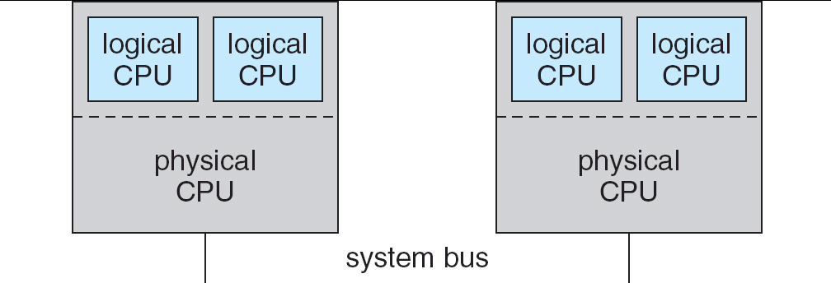
5.08

Slide 25

In-5.7

Slide 26
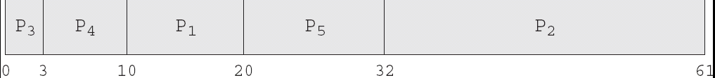
In-5.8

Slide 27

In-5.9

Slide 28

Dispatch Latency

Slide 29
Java Thread Scheduling
JVM Uses a Preemptive, Priority-Based Scheduling Algorithm
FIFO Queue is Used if There Are Multiple Threads With the Same Priority

Slide 30
Java Thread Scheduling (cont)
JVM Schedules a Thread to Run When:
  The Currently Running Thread Exits the Runnable State
  A Higher Priority Thread Enters the Runnable State
* Note – the JVM Does Not Specify Whether Threads are Time-Sliced or Not

Slide 31
Time-Slicing
Since the JVM Doesn’t Ensure Time-Slicing, the yield() Method
May Be Used:
while (true) {
// perform CPU-intensive task
. . .
Thread.yield();
}
This Yields Control to Another Thread of Equal Priority

Slide 32
Thread Priorities
Priority Comment
Thread.MIN_PRIORITY Minimum Thread Priority
Thread.MAX_PRIORITY Maximum Thread Priority
Thread.NORM_PRIORITY Default Thread Priority
Priorities May Be Set Using setPriority() method:
setPriority(Thread.NORM_PRIORITY + 2);

