Slide 1
Digital Logic Design
Basics
Combinational Circuits
Sequential Circuits

Slide 2
Introduction to Digital Logic Basics
Hardware consists of a few simple building blocks
  These are called logic gates
    AND, OR, NOT, …
    NAND, NOR, XOR, …
Logic gates are built using transistors
    NOT gate can be implemented by a single transistor
    AND gate requires 3 transistors
Transistors are the fundamental devices
    Pentium consists of 3 million transistors
    Compaq Alpha consists of 9 million transistors
    Now we can build chips with more than 100 million transistors

Slide 3
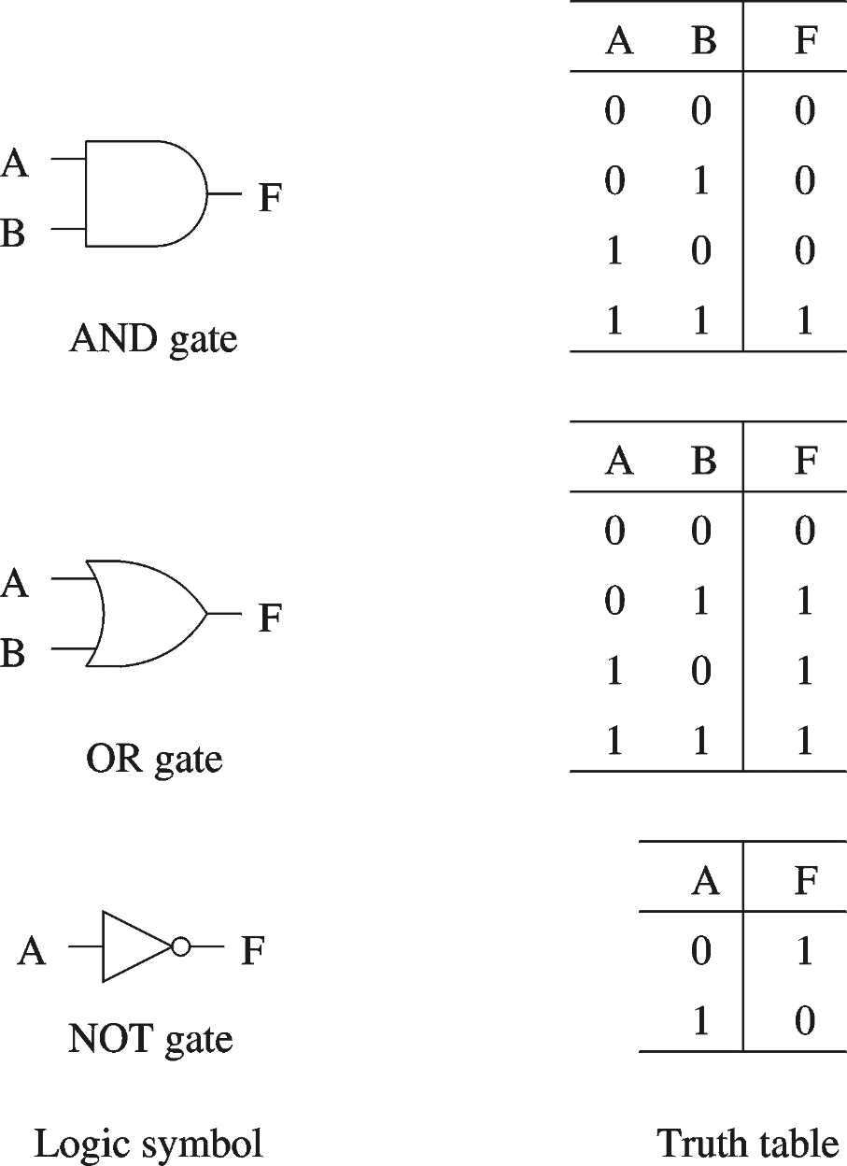
Basic Concepts
Simple gates
  AND
  OR
  NOT
Functionality can be expressed by a truth table
  A truth table lists output for each possible input combination
Precedence
  NOT > AND > OR
  F = A B + A B
  = (A (B)) + ((A) B)

Slide 4
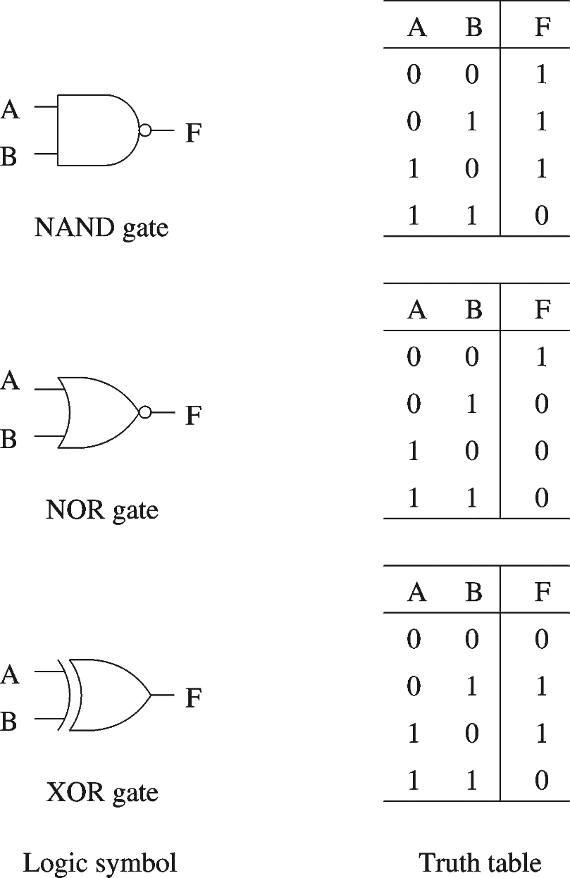
Basic Concepts (cont.)
Additional useful gates
  NAND
  NOR
  XOR
NAND = AND + NOT
NOR = OR + NOT
XOR implements exclusive-OR function
NAND and NOR gates require only 2 transistors
  AND and OR need 3 transistors!

Slide 5
Basic Concepts (cont.)
Number of functions
  With N logical variables, we can define
  2^{2N} functions
  Some of them are useful
    AND, NAND, NOR, XOR, …
  Some are not useful:
    Output is always 1
    Output is always 0
  “Number of functions” definition is useful in proving completeness property

Slide 6
Basic Concepts (cont.)
Complete sets
  A set of gates is complete
    If we can implement any logical function using only the type of gates in the set
      You can uses as many gates as you want
  Some example complete sets
    {AND, OR, NOT} Not a minimal complete set
    {AND, NOT}
    {OR, NOT}
    {NAND}
    {NOR}
  Minimal complete set
      A complete set with no redundant elements.

Slide 7
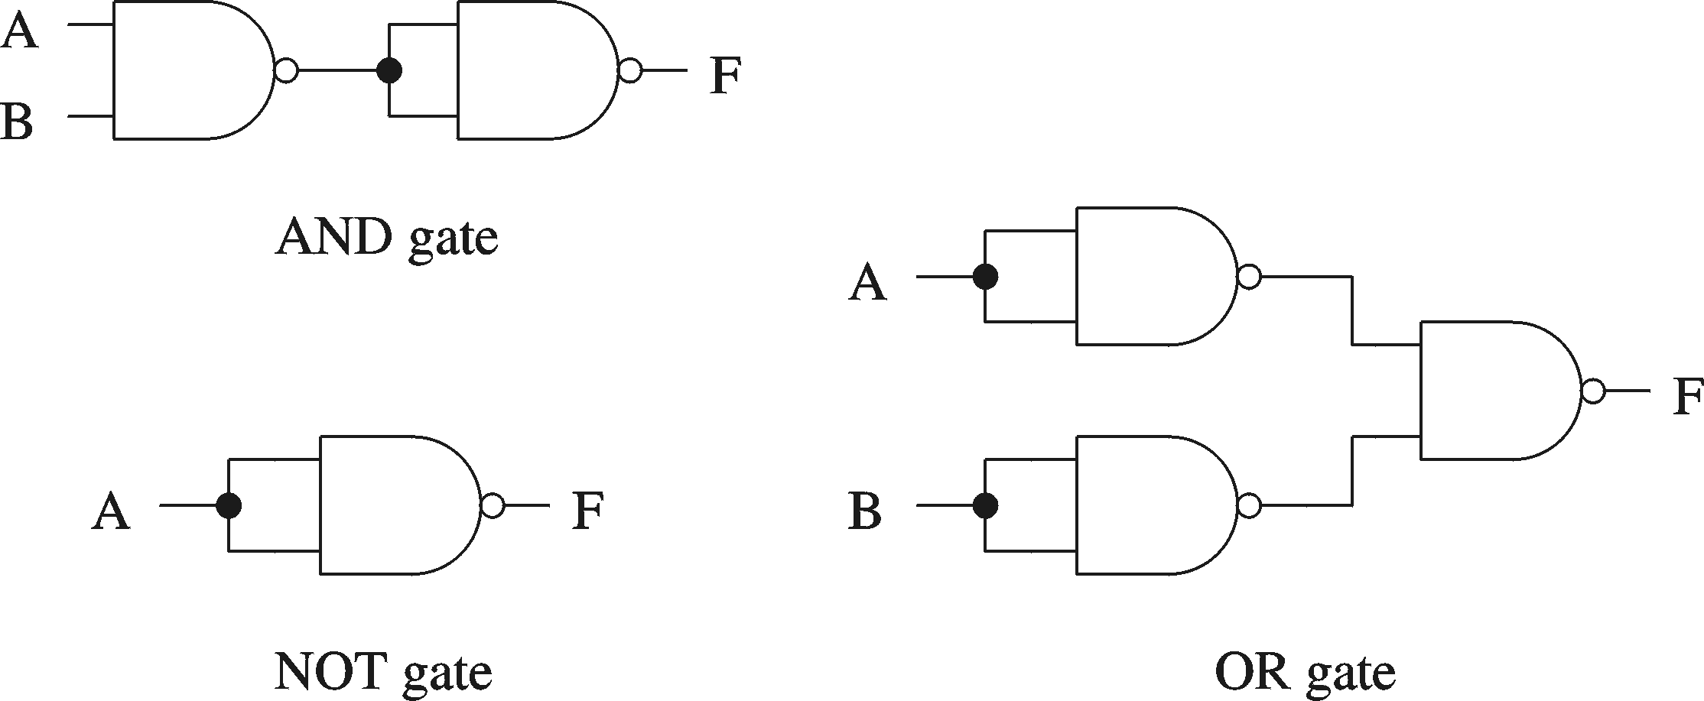
Basic Concepts (cont.)
Proving NAND gate is universal

Slide 8
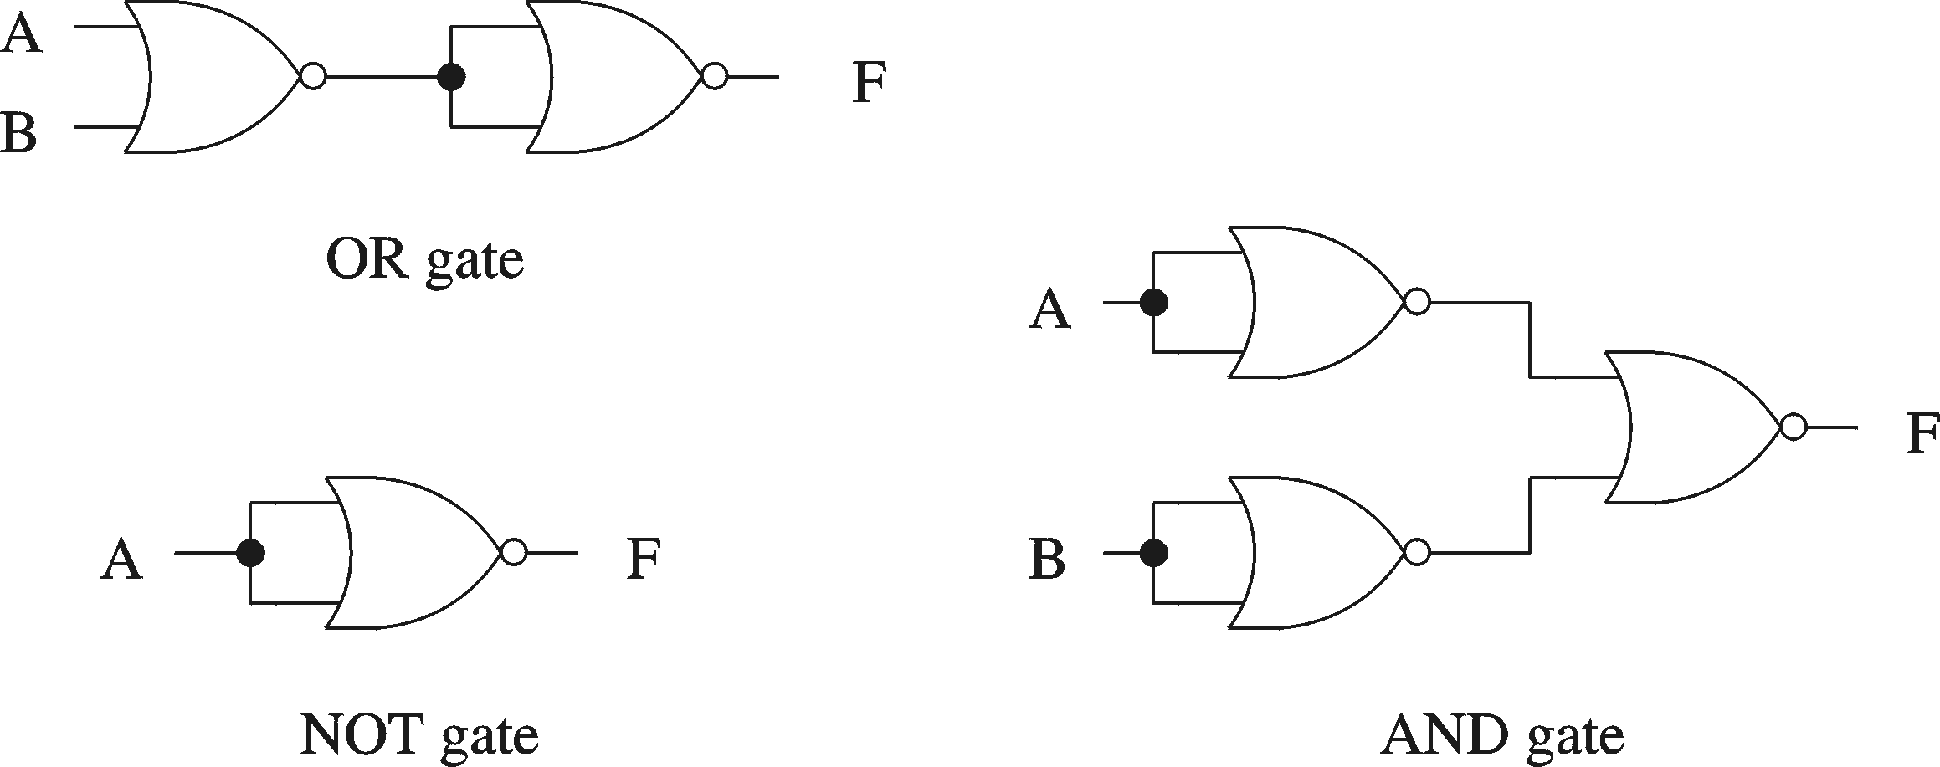
Basic Concepts (cont.)
Proving NOR gate is universal

Slide 9
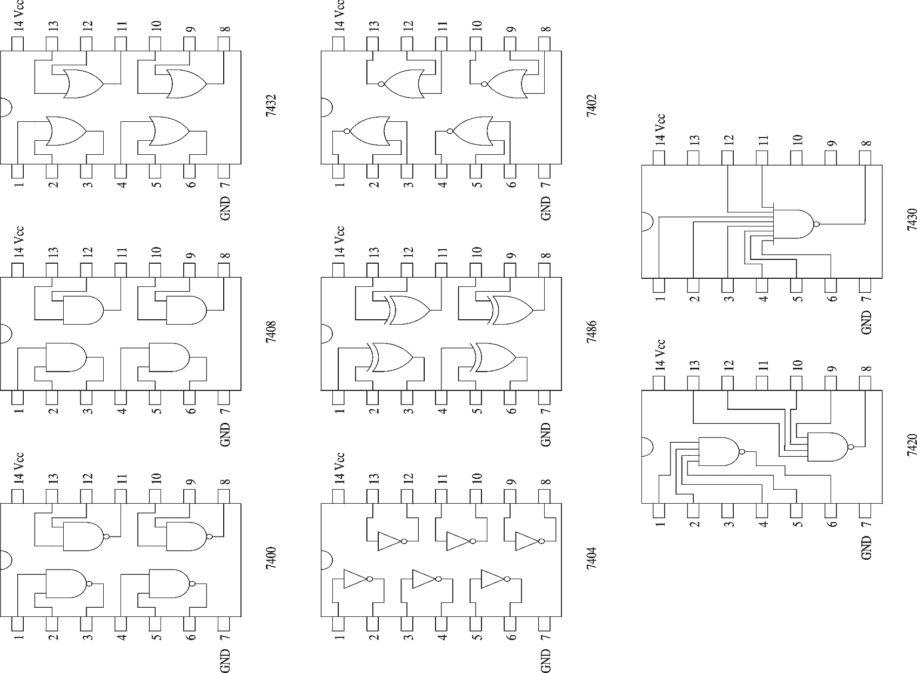
Logic Chips (cont.)

Slide 10
Logic Chips (cont.)
Integration levels
  SSI (small scale integration)
    Introduced in late 1960s
    1-10 gates (previous examples)
  MSI (medium scale integration)
    Introduced in late 1960s
    10-100 gates
  LSI (large scale integration)
    Introduced in early 1970s
    100-10,000 gates
  VLSI (very large scale integration)
    Introduced in late 1970s
    More than 10,000 gates

Slide 11
Logic Functions
Logical functions can be expressed in several ways:
  Truth table
  Logical expressions
  Graphical form
Example:
  Majority function
    Output is one whenever majority of inputs is 1
    We use 3-input majority function

Slide 12
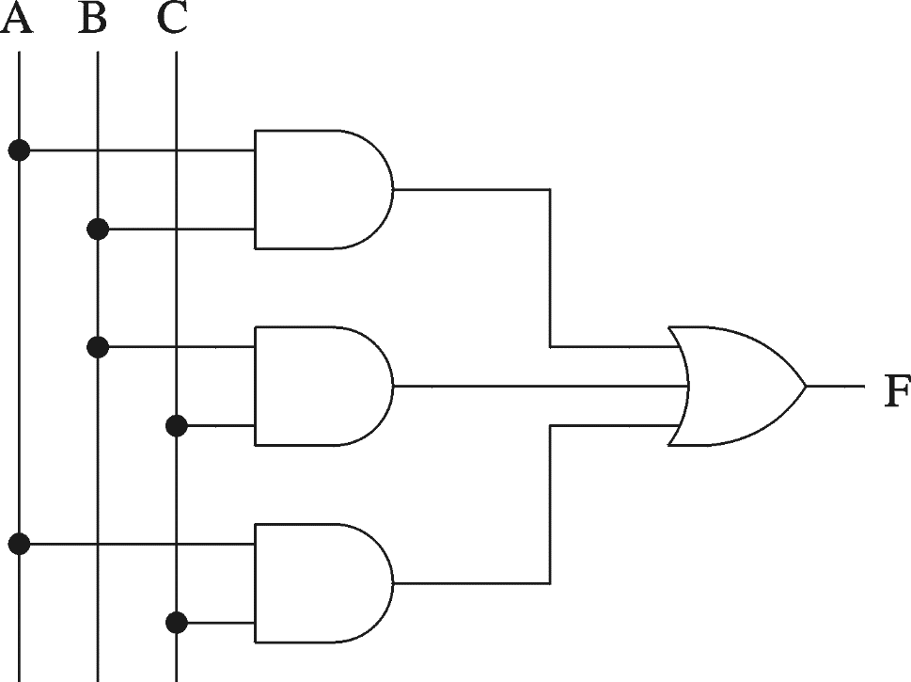
Logic Functions (cont.)
3-input majority function
A B C F
0 0 0 0
0 0 1 0
0 1 0 0
0 1 1 1
1 0 0 0
1 0 1 1
1 1 0 1
1 1 1 1
Logical expression form
F = A B + B C + A C

Slide 13
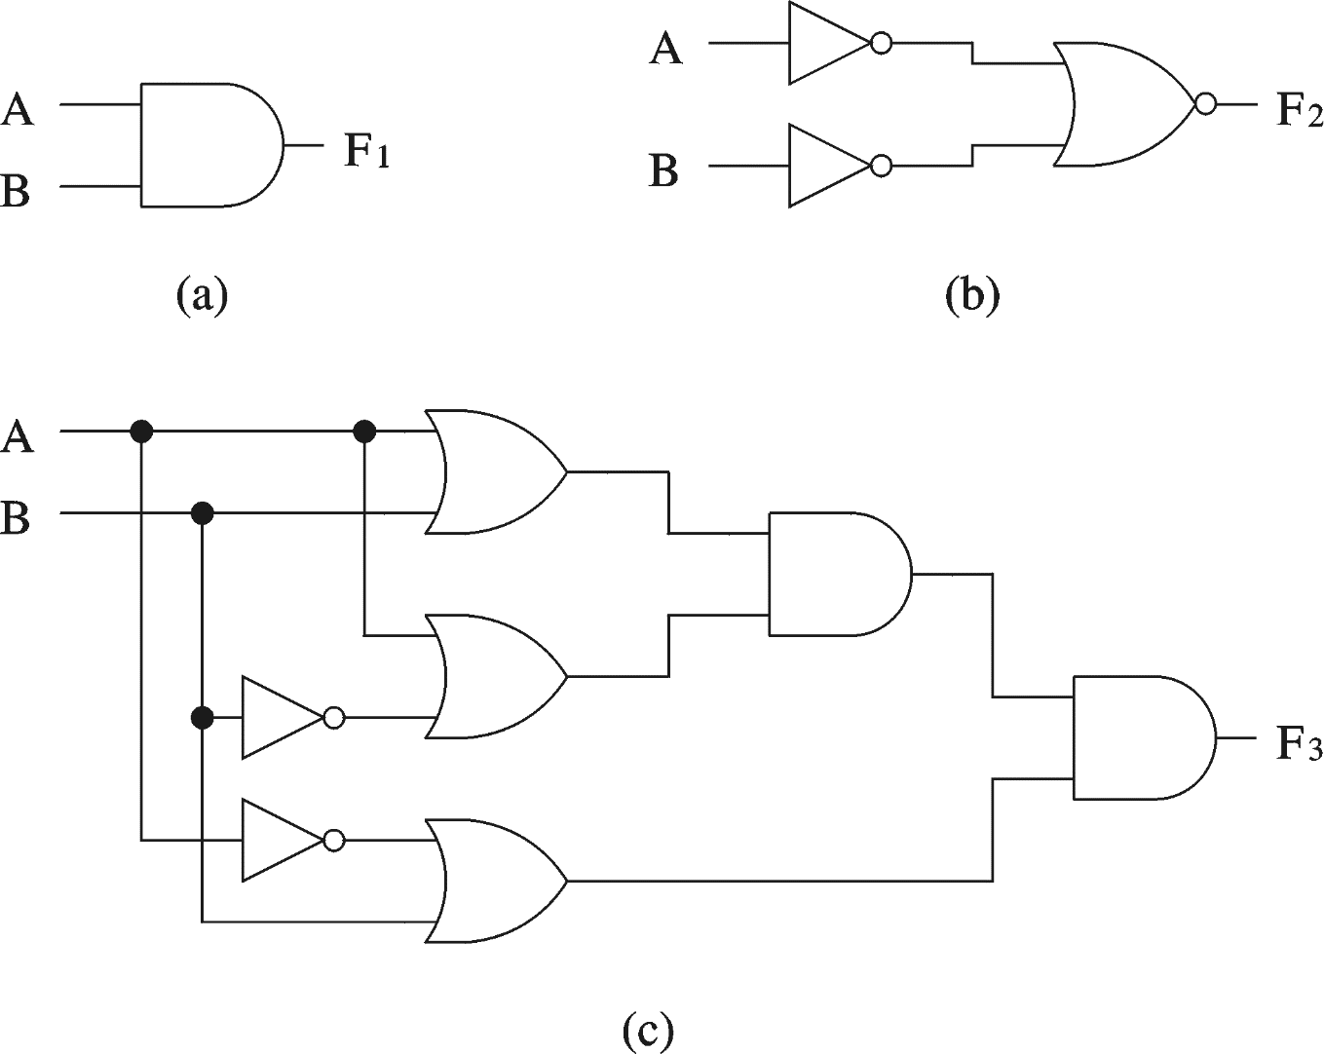
Logical Equivalence
All three circuits implement F = A B function

Slide 14
Logical Equivalence (cont.)
Proving logical equivalence of two circuits
  Derive the logical expression for the output of each circuit
  Show that these two expressions are equivalent
    Two ways:
      You can use the truth table method
        For every combination of inputs, if both expressions yield the same output, they are equivalent
        Good for logical expressions with small number of variables
      You can also use algebraic manipulation
        Need Boolean identities

Slide 15
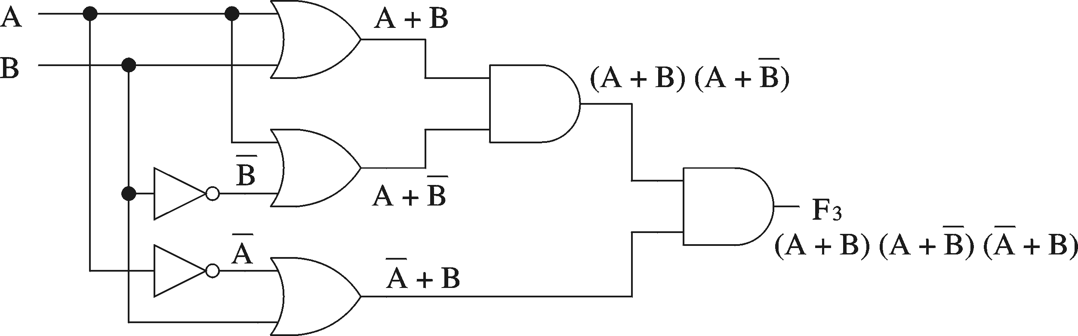
Logical Equivalence (cont.)
Derivation of logical expression from a circuit
  Trace from the input to output
    Write down intermediate logical expressions along the path

Slide 16
Logical Equivalence (cont.)
Proving logical equivalence: Truth table method
  A B F1 = A B F3 = (A + B) (A + B) (A + B)
  0 0 0 0
  0 1 0 0
  1 0 0 0
  1 1 1 1

Slide 17
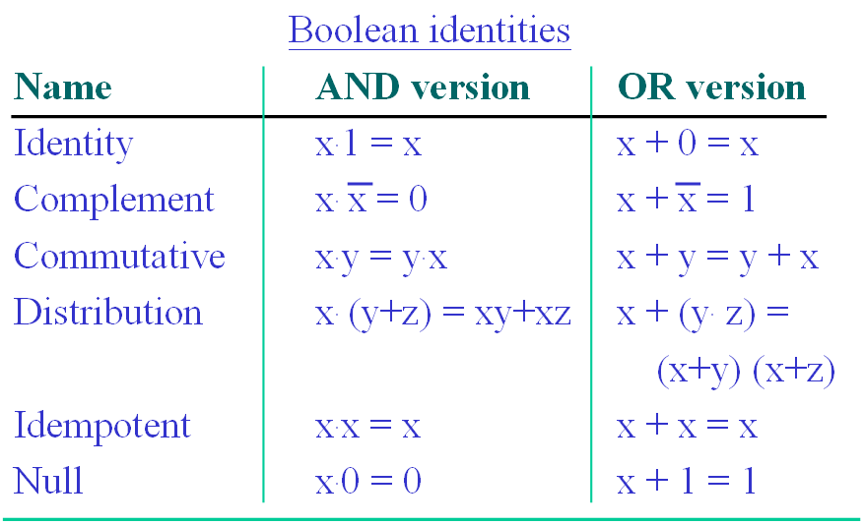
Boolean Algebra

Slide 18
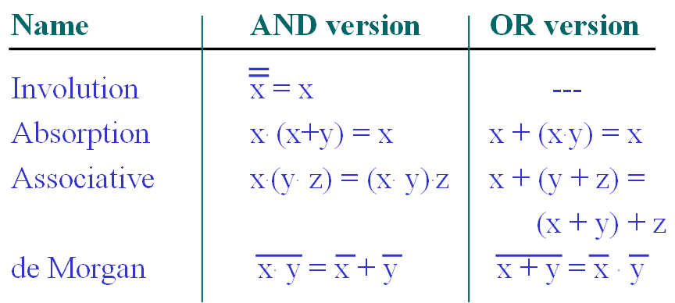
Boolean Algebra (cont.)

Slide 19
Boolean Algebra (cont.)
Proving logical equivalence: Boolean algebra method
  To prove that two logical functions F1 and F2 are equivalent
    Start with one function and apply Boolean laws to derive the other function
    Needs intuition as to which laws should be applied and when
      Practice helps
    Sometimes it may be convenient to reduce both functions to the same expression
  Example: F1= A B and F3 are equivalent

Slide 20
Logic Circuit Design Process
A simple logic design process involves
  Problem specification
  Truth table derivation
  Derivation of logical expression
  Simplification of logical expression
  Implementation

Slide 21
Deriving Logical Expressions
Derivation of logical expressions from truth tables
  sum-of-products (SOP) form
  product-of-sums (POS) form
SOP form
  Write an AND term for each input combination that produces a 1 output
    Write the variable if its value is 1; complement otherwise
  OR the AND terms to get the final expression
POS form
  Dual of the SOP form

Slide 22
Deriving Logical Expressions (cont.)
3-input majority function
A B C F
0 0 0 0
0 0 1 0
0 1 0 0
0 1 1 1
1 0 0 0
1 0 1 1
1 1 0 1
1 1 1 1
SOP logical expression
Four product terms
  Because there are 4 rows with a 1 output
F = A B C + A B C +
A B C + A B C

Slide 23
Deriving Logical Expressions (cont.)
3-input majority function
A B C F
0 0 0 0
0 0 1 0
0 1 0 0
0 1 1 1
1 0 0 0
1 0 1 1
1 1 0 1
1 1 1 1
POS logical expression
Four sum terms
  Because there are 4 rows with a 0 output
F = (A + B + C) (A + B + C)
(A + B + C) (A + B + C)

Slide 24
Logical Expression Simplification
  Algebraic manipulation
    Use Boolean laws to simplify the expression
      Difficult to use
      Don’t know if you have the simplified form

Slide 25
Algebraic Manipulation
Majority function example
  A B C + A B C + A B C + A B C =
  A B C + A B C + A B C + A B C + A B C + A B C
We can now simplify this expression as
  B C + A C + A B
A difficult method to use for complex expressions
Added extra

Slide 26
Implementation Using NAND Gates
Using NAND gates
  Get an equivalent expression
        A B + C D = A B + C D
  Using de Morgan’s law
        A B + C D = A B . C D
  Can be generalized
    Majority function
        A B + B C + AC = A B . BC . AC
Idea: NAND Gates: Sum-of-Products, NOR Gates: Product-of-Sums

Slide 27
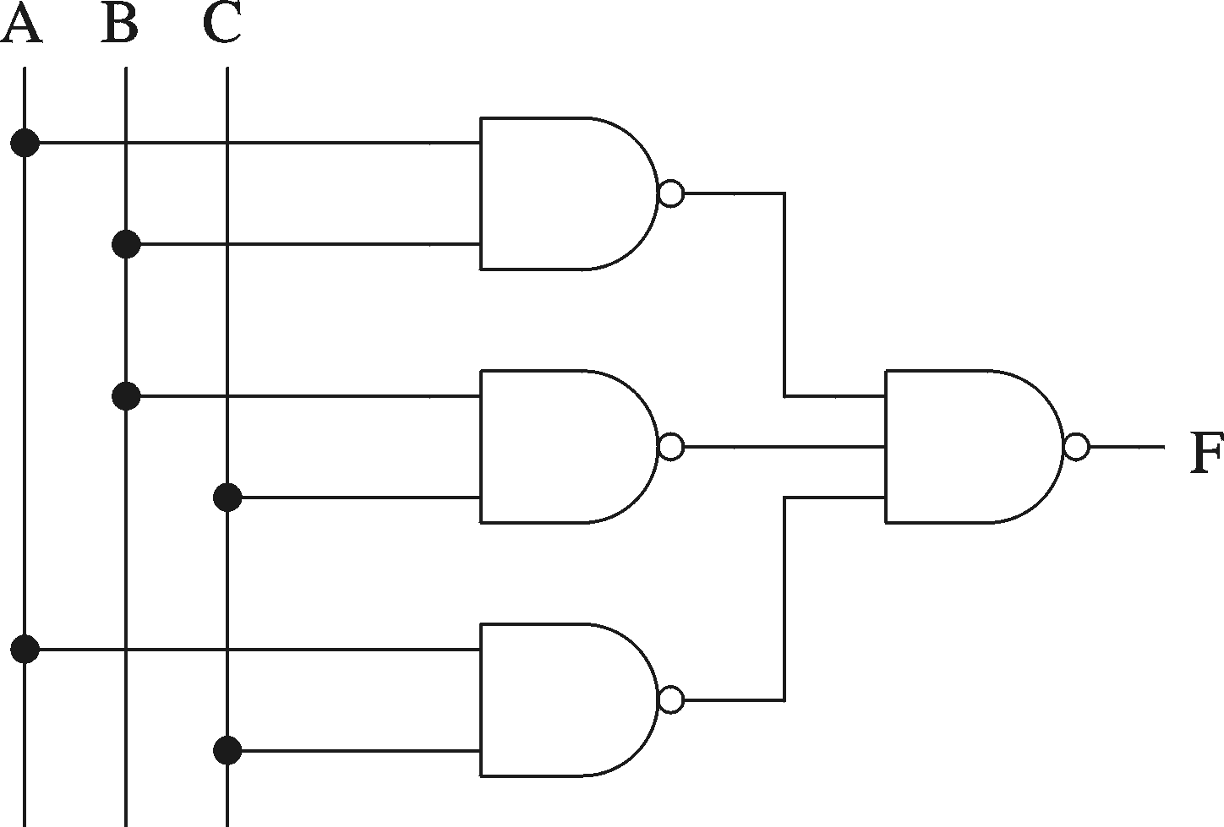
Implementation Using NAND Gates (cont.)
Majority function

Slide 28
Introduction to Combinational Circuits
Combinational circuits
    Output depends only on the current inputs
Combinational circuits provide a higher level of abstraction
  Help in reducing design complexity
  Reduce chip count
We look at some useful combinational circuits

Slide 29
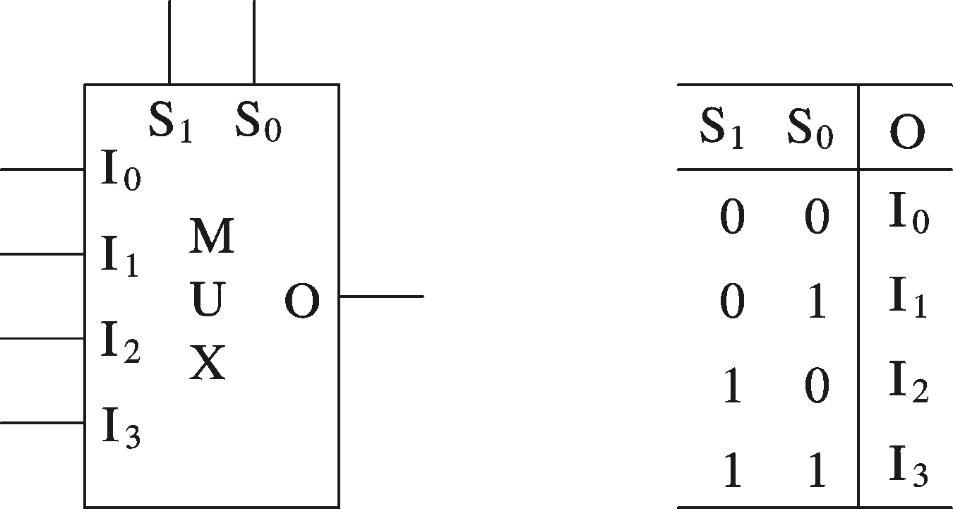
Multiplexers
Multiplexer
  2^{n} data inputs
  n selection inputs
  a single output
Selection input determines the input that should be connected to the output
4-data input MUX

Slide 30
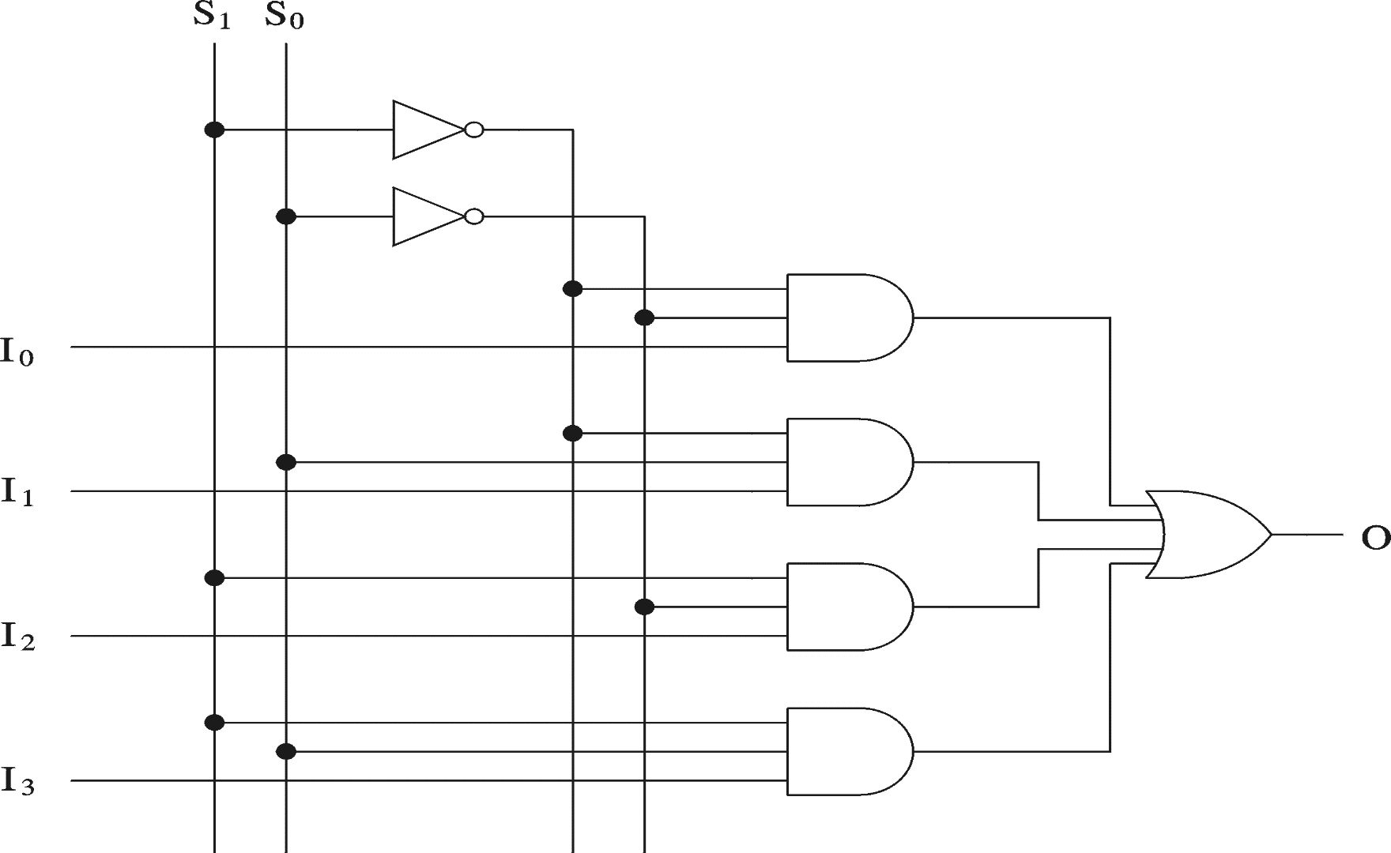
Multiplexers (cont.)
4-data input MUX implementation

Slide 31
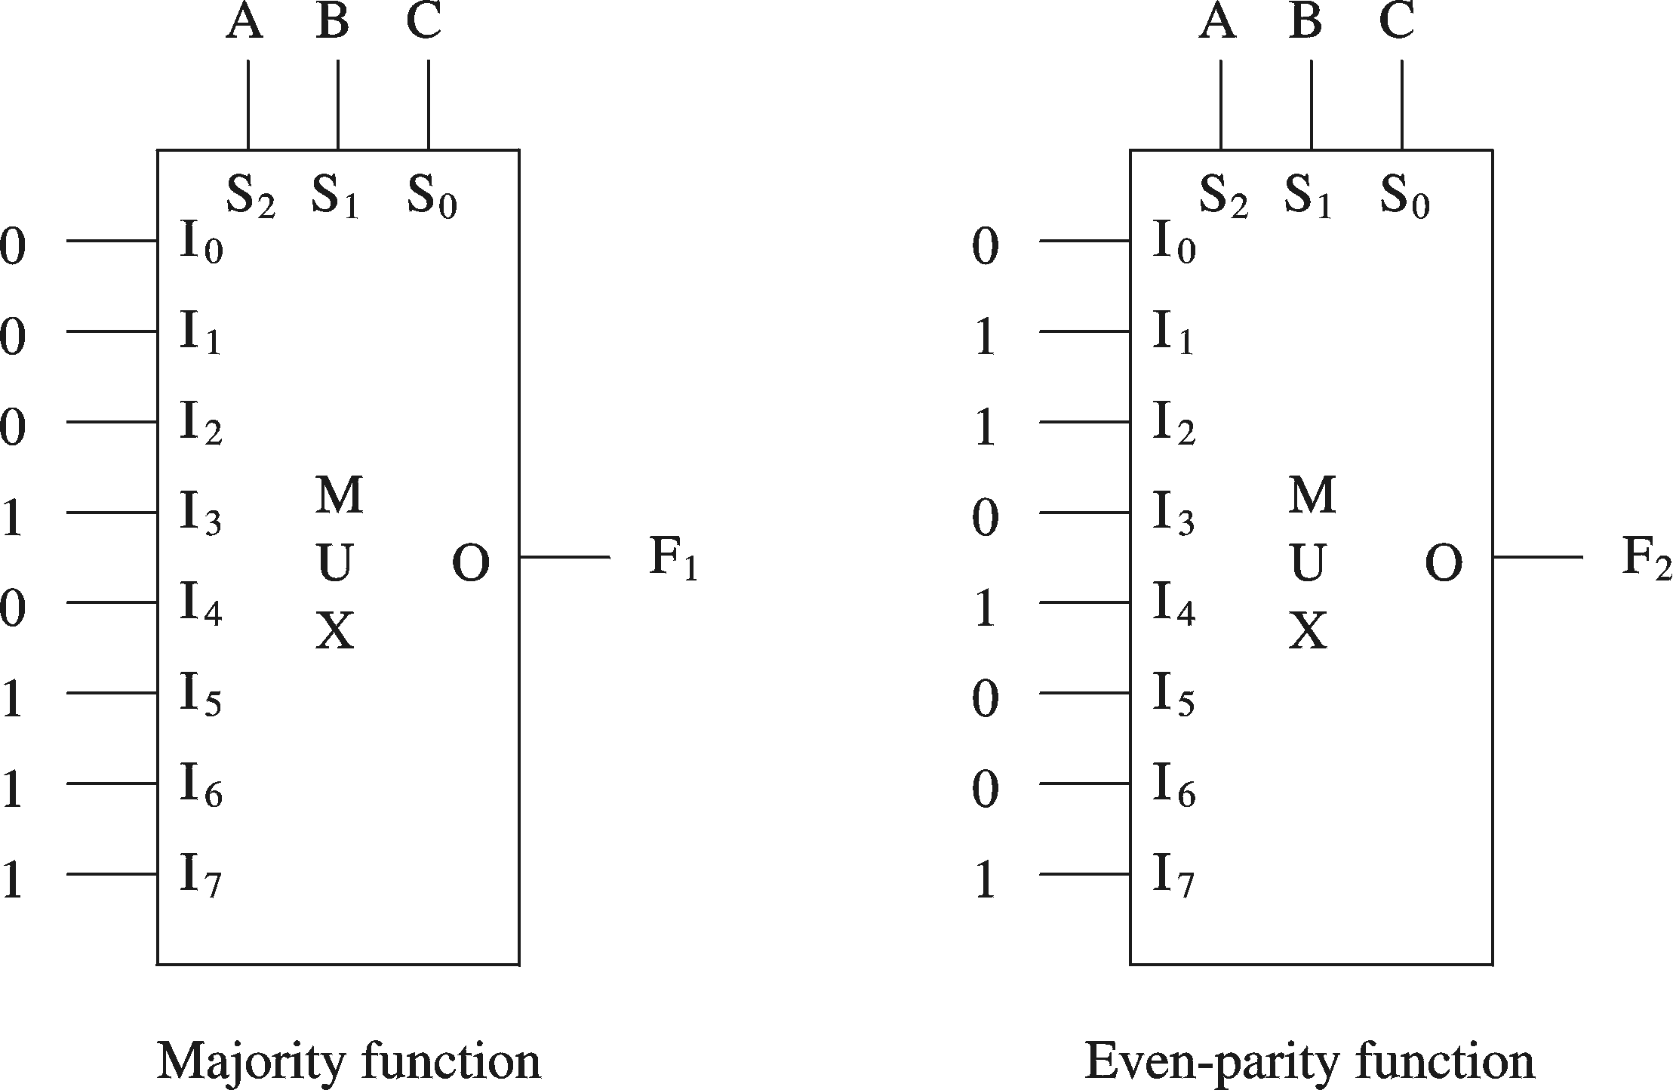
Multiplexers (cont.)
MUX implementations

Slide 32
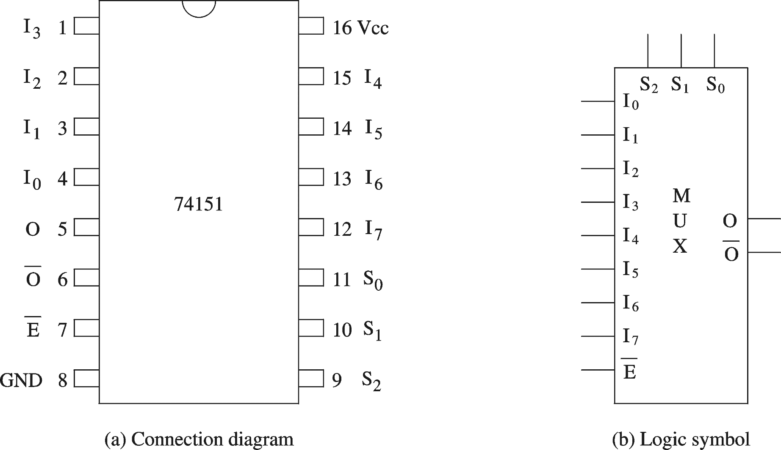
Multiplexers (cont.)
Example chip: 8-to-1 MUX

Slide 33
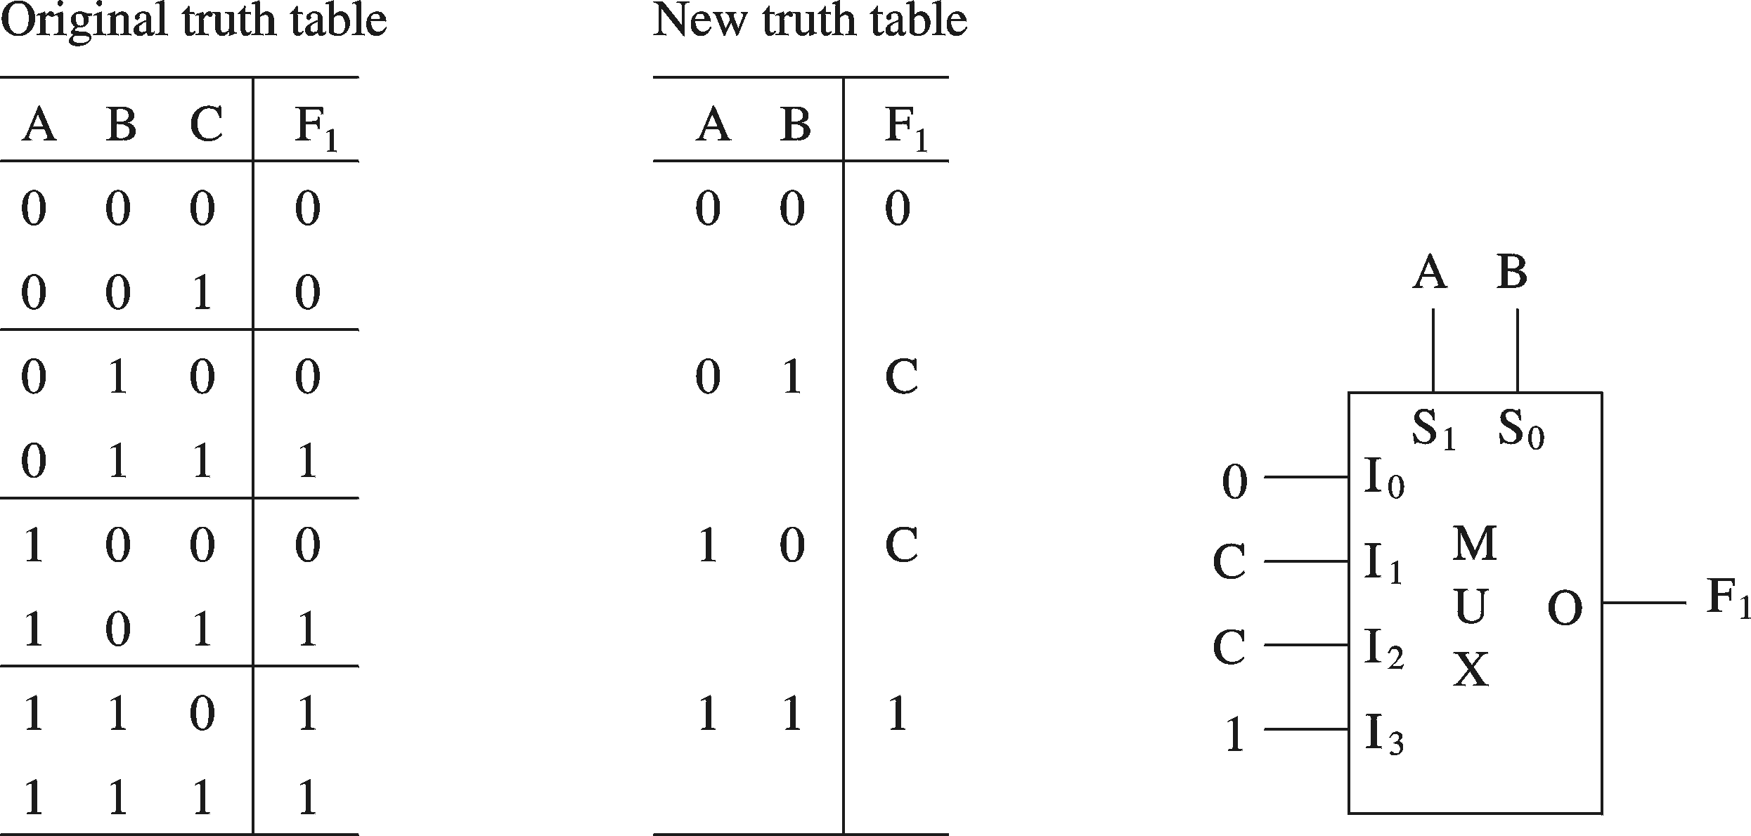
Multiplexers (cont.)
Efficient implementation: Majority function

Slide 34
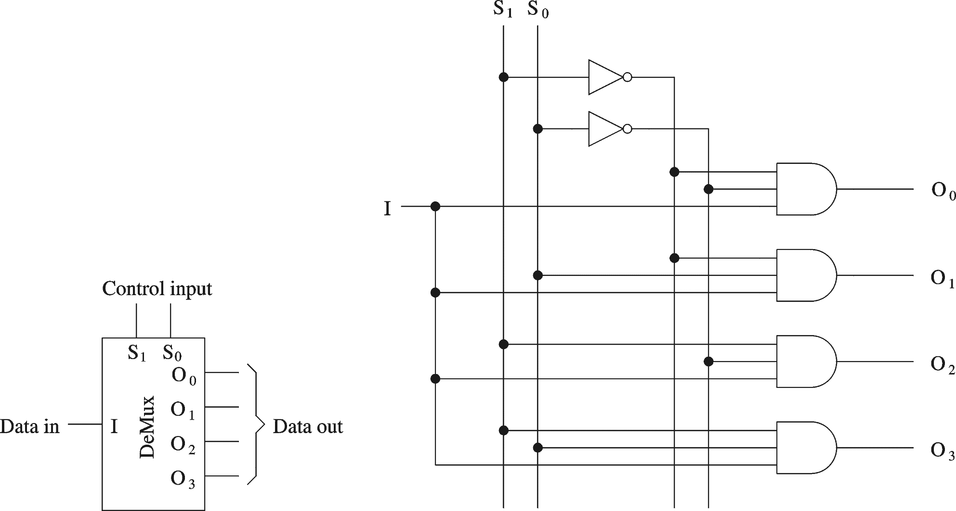
Demultiplexers
Demultiplexer (DeMUX)

Slide 35
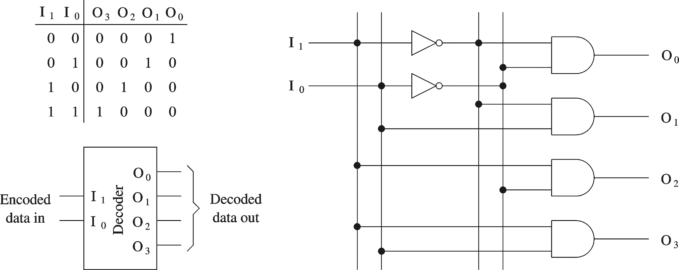
Decoders
Decoder selects one-out-of-N inputs

Slide 36
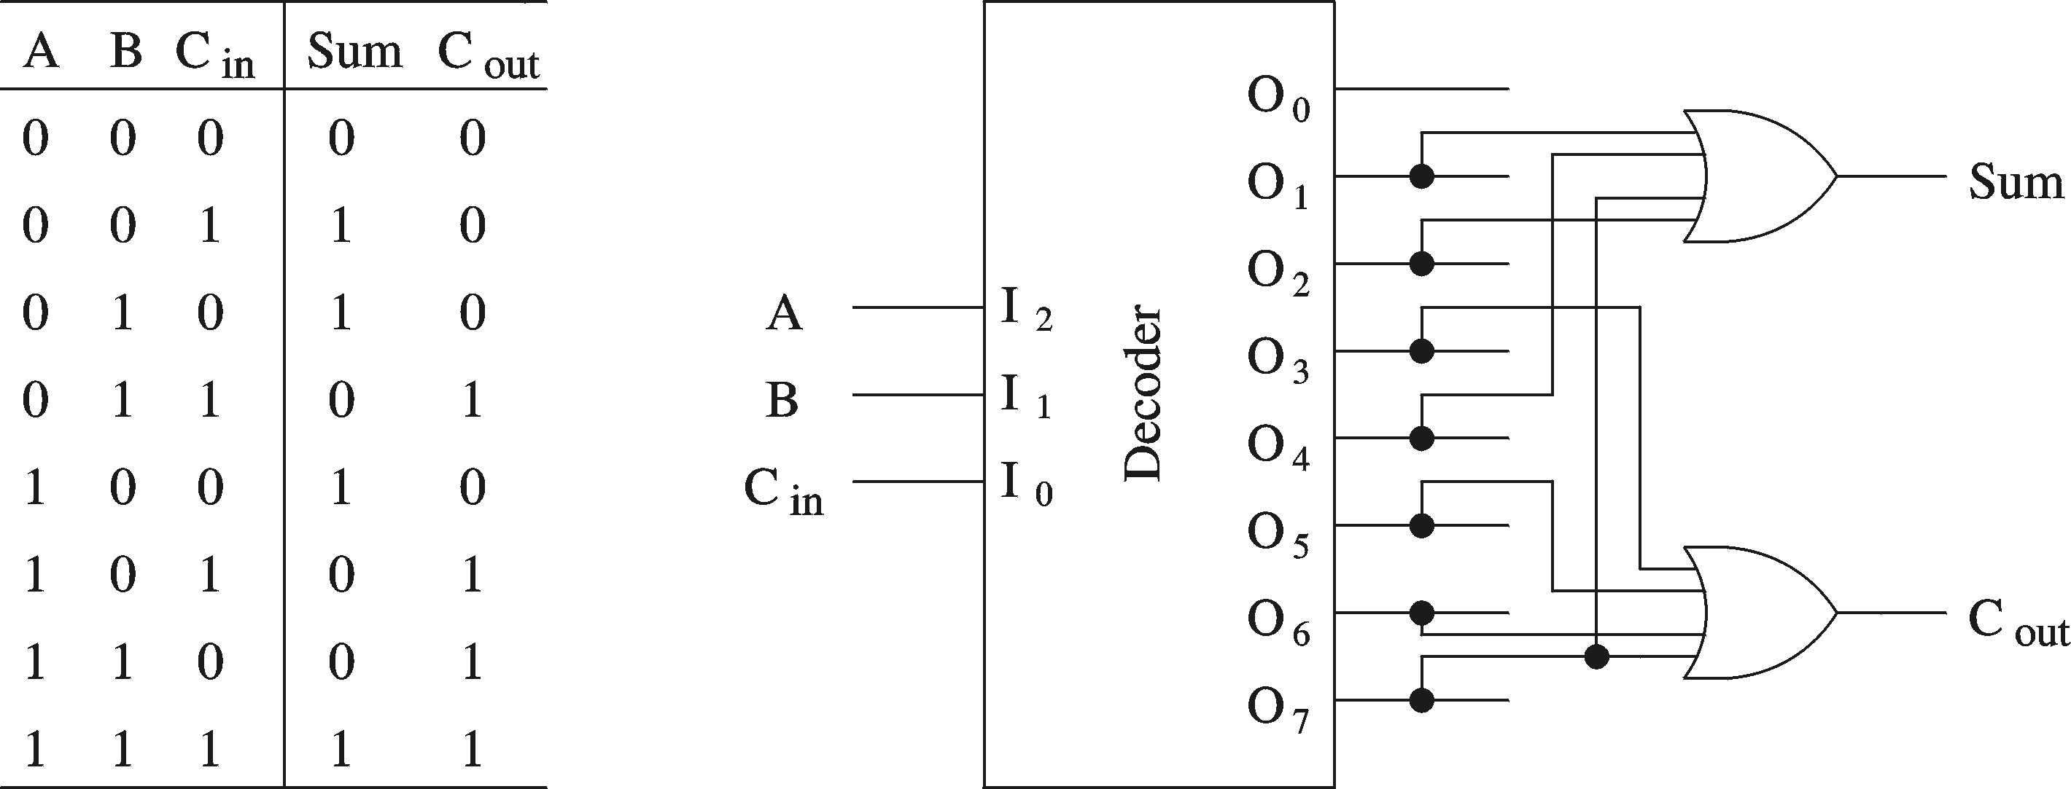
Decoders (cont.)
Logic function implementation
(Full Adder)

Slide 37
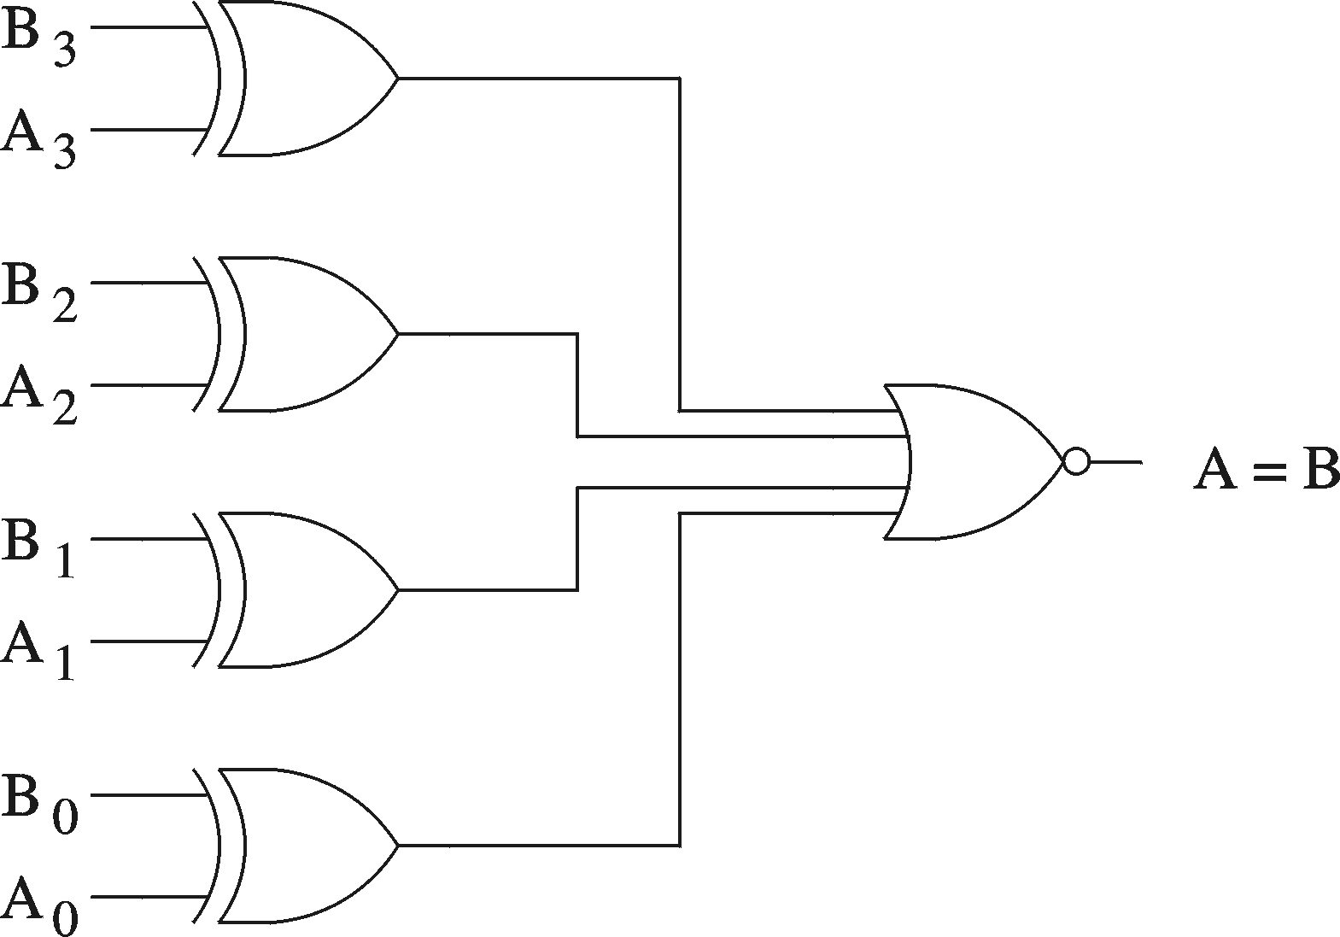
Comparator
Used to implement comparison operators (= , > , < , ≥ , ≤)

Slide 38
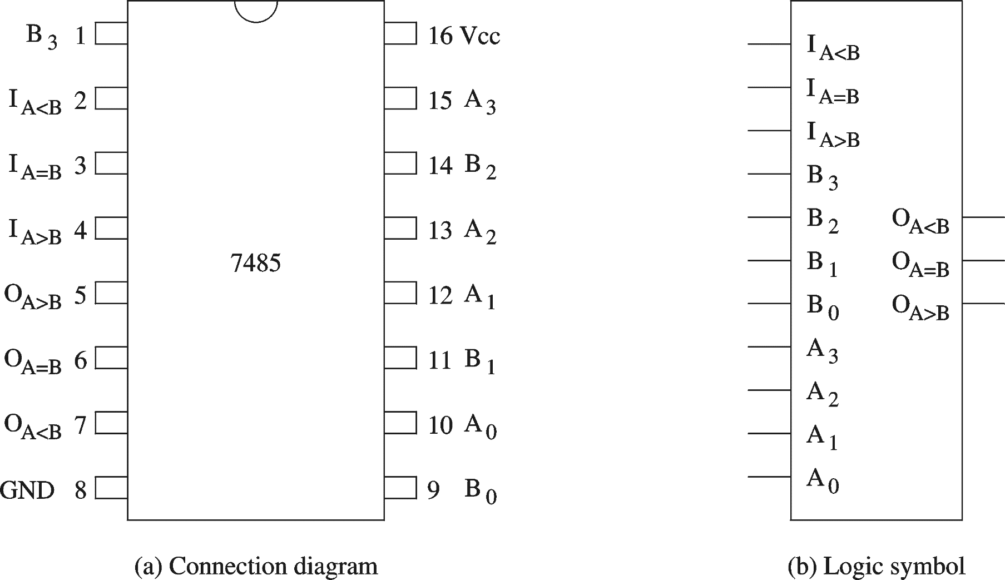
Comparator (cont.)
A=B: O_{x} = I_{x} (x=A<B, A=B, & A>B)
4-bit magnitude comparator chip

Slide 39
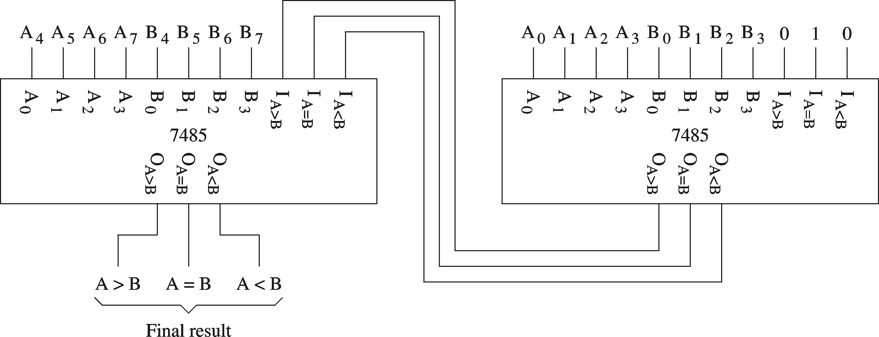
Comparator (cont.)
Serial construction of an 8-bit comparator

Slide 40
1-bit Comparator
CMP
x>y
x=y
x<y
x
y
x
y
x>y
x=y
x<y

Slide 41
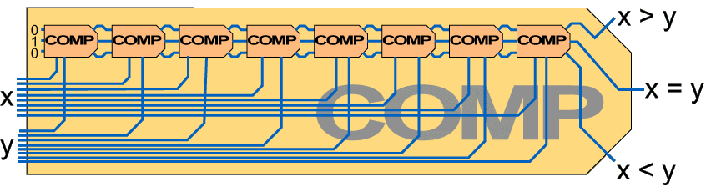
8-bit comparator
x_{n}>yn
CMP
x>y
xn=yn
x=y
xn<yn
x<y
x
y

Slide 42
Adders
Half-adder
  Adds two bits
    Produces a sum and carry
  Problem: Cannot use it to build larger inputs
Full-adder
  Adds three 1-bit values
    Like half-adder, produces a sum and carry
  Allows building N-bit adders
    Simple technique
      Connect C_{out} of one adder to C_{in} of the next
    These are called ripple-carry adders

Slide 43
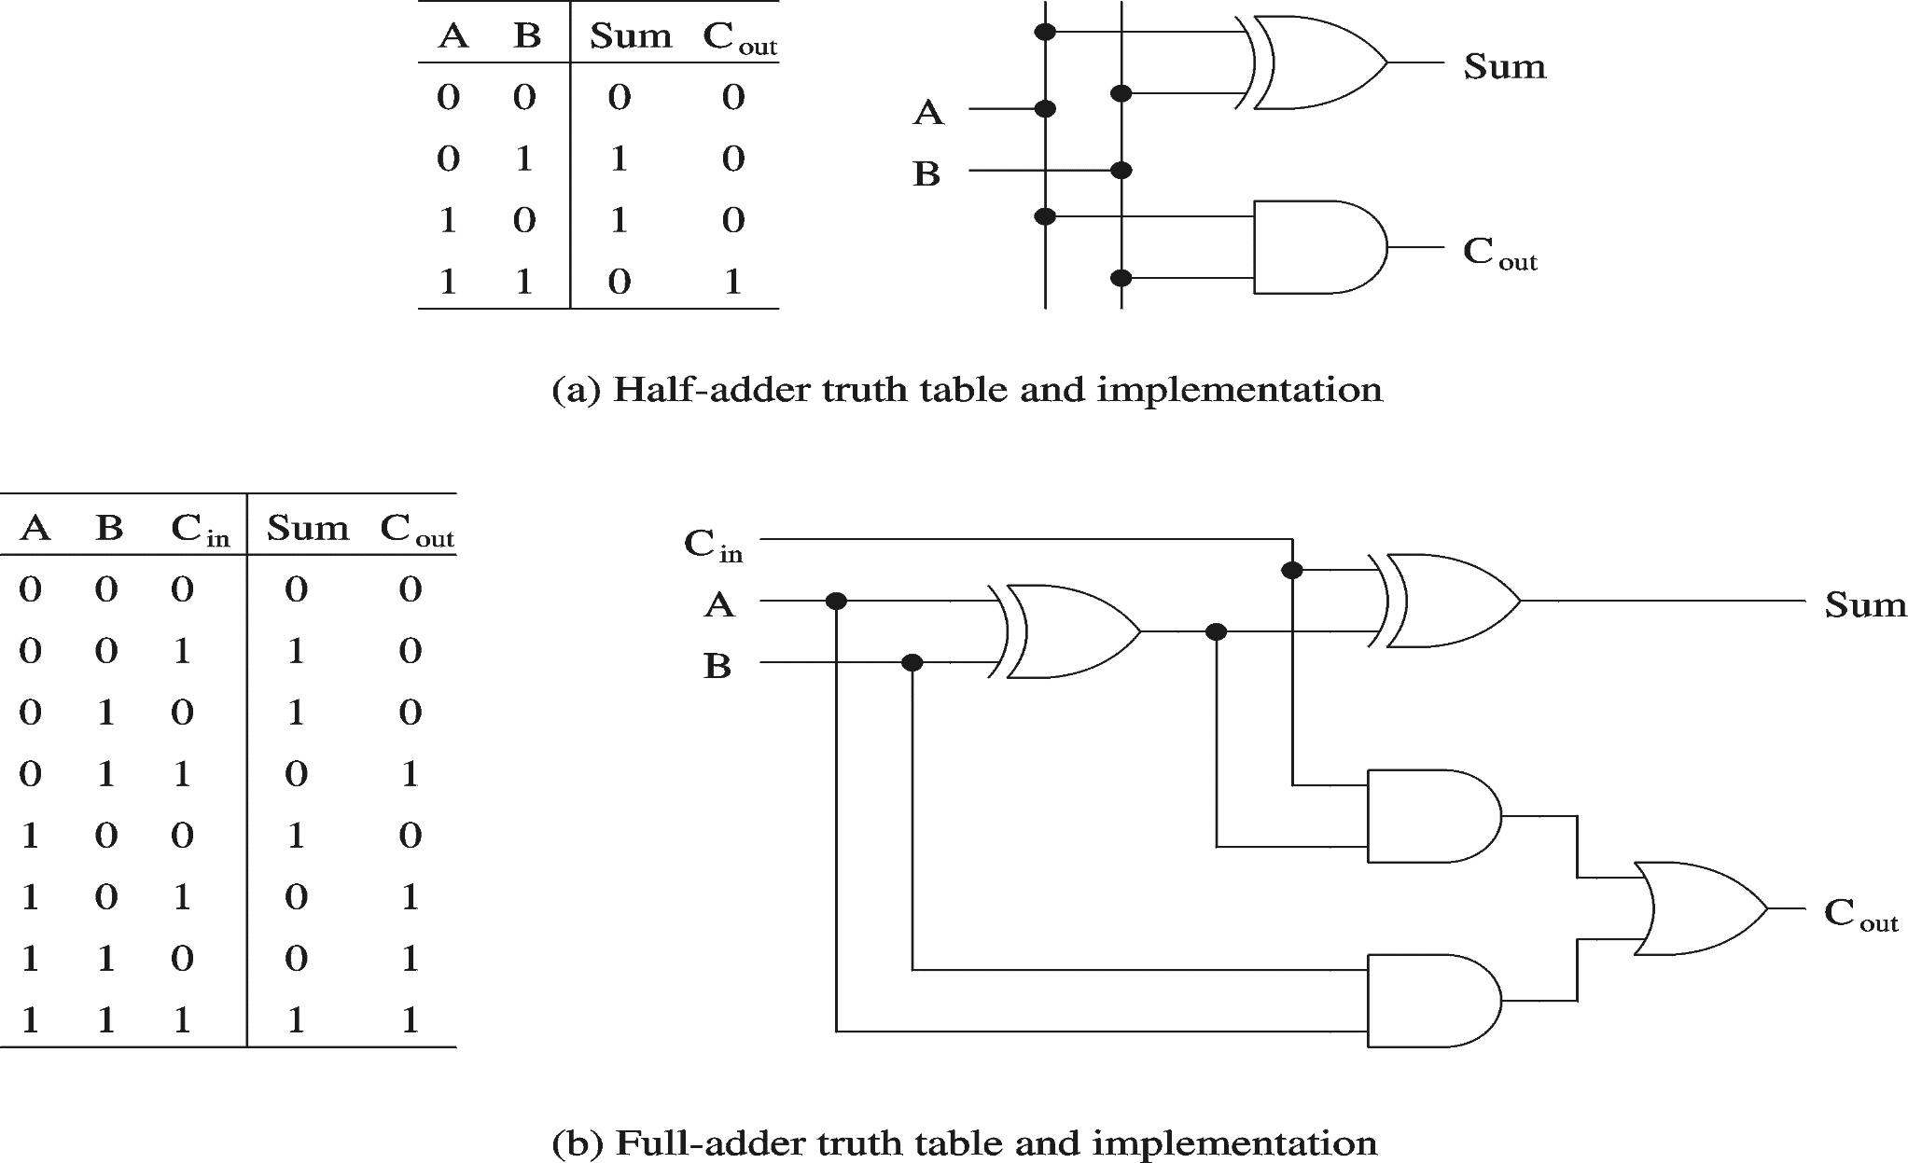
Adders (cont.)

Slide 44
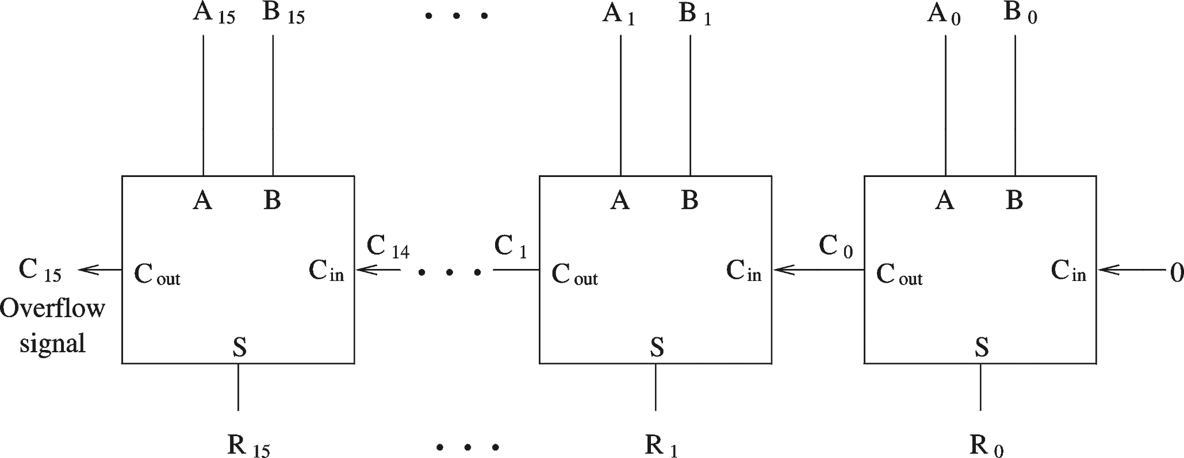
Adders (cont.)
A 16-bit ripple-carry adder

Slide 45
Adders (cont.)
Ripple-carry adders can be slow
  Delay proportional to number of bits
Carry lookahead adders
  Eliminate the delay of ripple-carry adders
  Carry-ins are generated independently
    C₀ = A₀ B₀
    C₁ = A₀ B₀ A₁ + A₀ B₀ B₁ + A₁ B₁
    . . .
  Requires complex circuits
  Usually, a combination carry lookahead and ripple-carry techniques are used

Slide 46
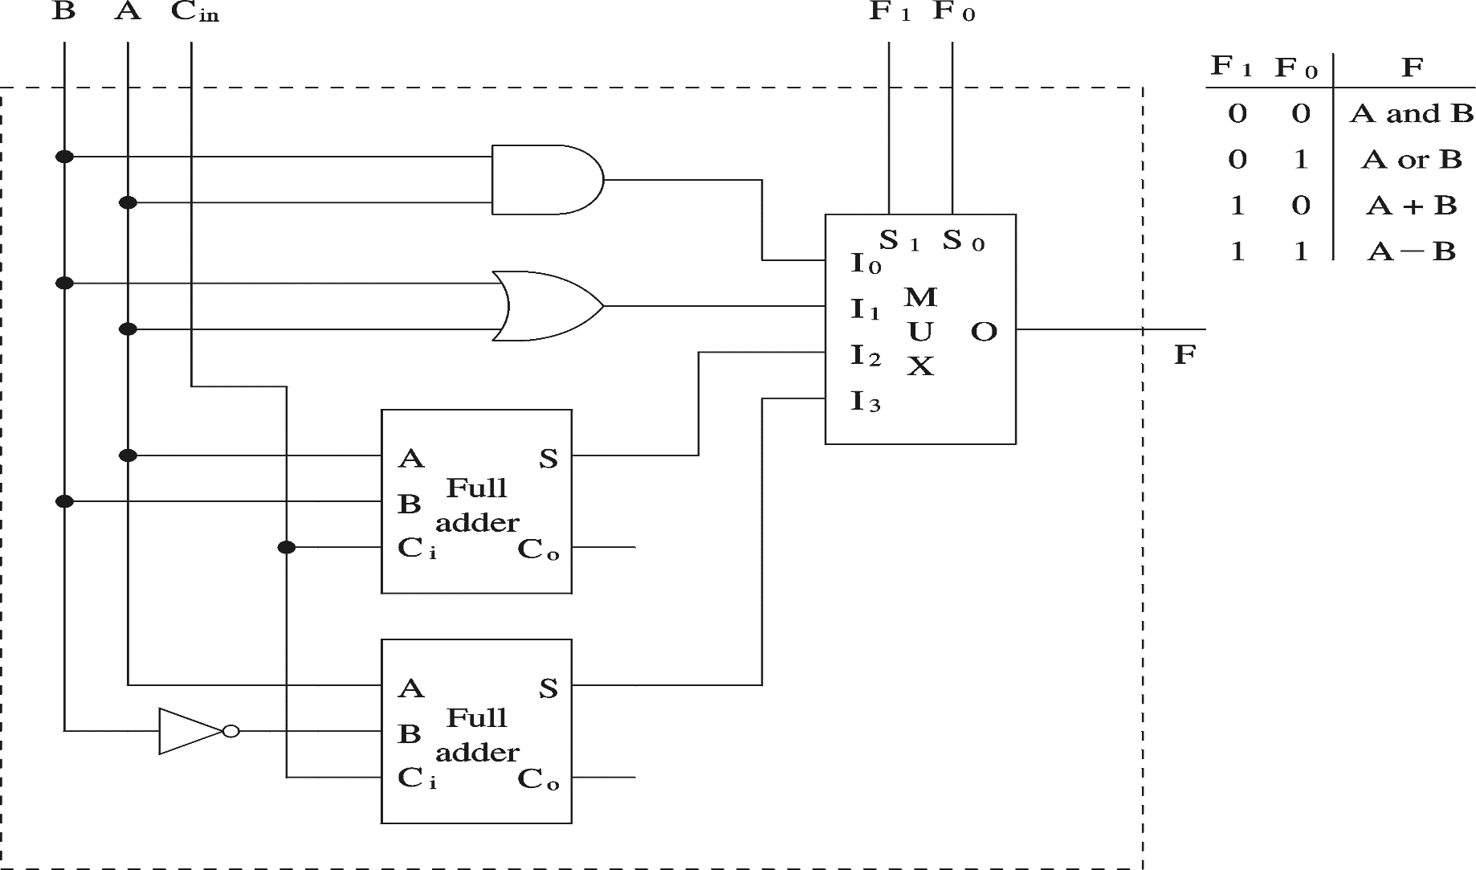
1-bit Arithmetic and Logic Unit
Preliminary ALU design
2’s complement
Required 1 is added via C_{in}

Slide 47
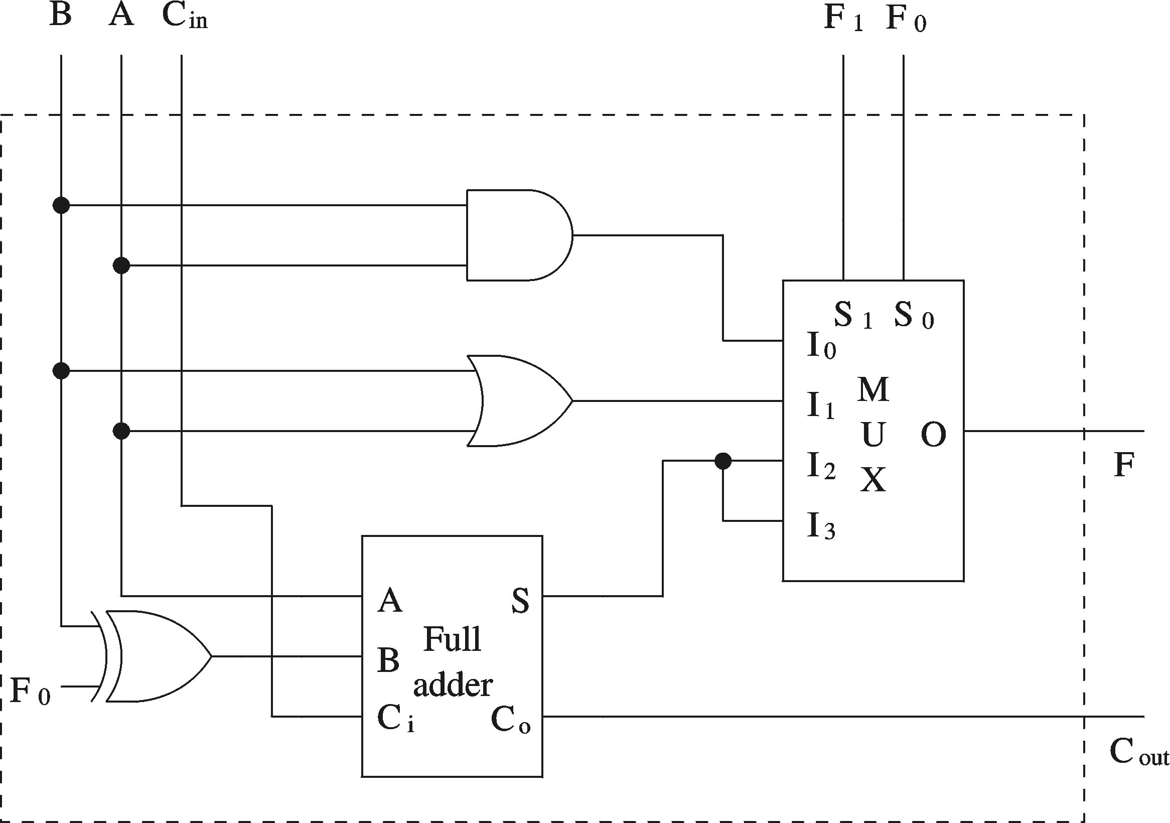
1-bit Arithmetic and Logic Unit (cont.)
Final design

Slide 48
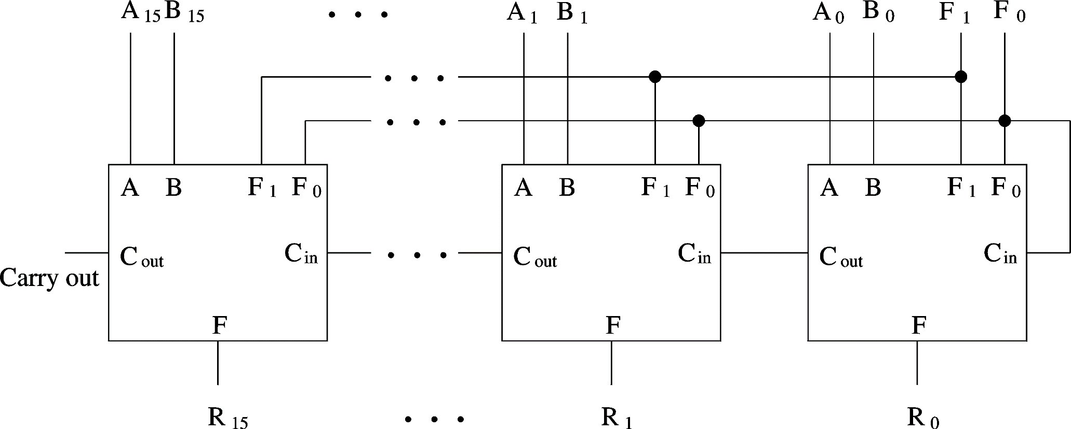
Arithmetic and Logic Unit (cont.)
16-bit ALU

Slide 49
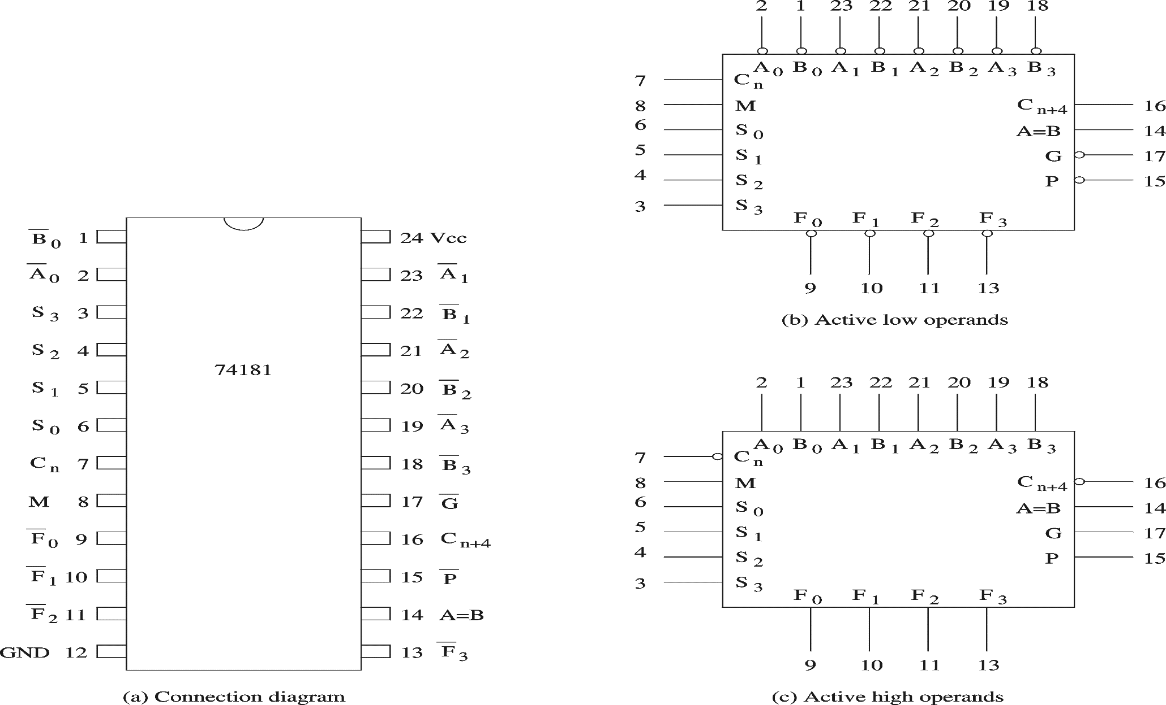
Arithmetic and Logic Unit (cont’d)
4-bit ALU

