Slide 1
UNIT II: CRYPTOGRAPHY AND OPERATIONS SECURITY
Information Security Fundamentals
B.Tech CSF I Sem

Slide 2
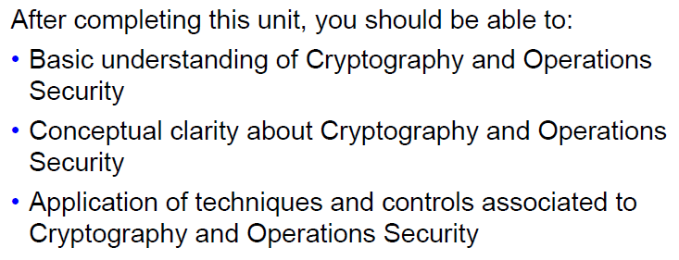
Unit Objectives

Slide 3
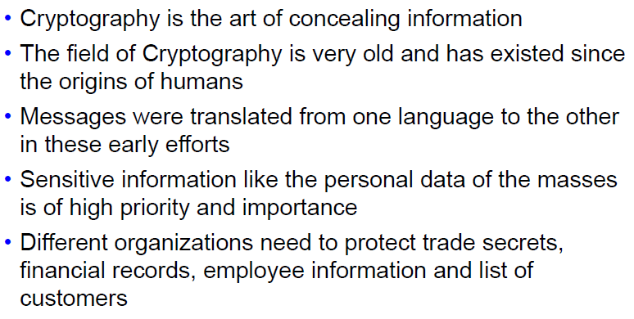
Background of Cryptography

Slide 4
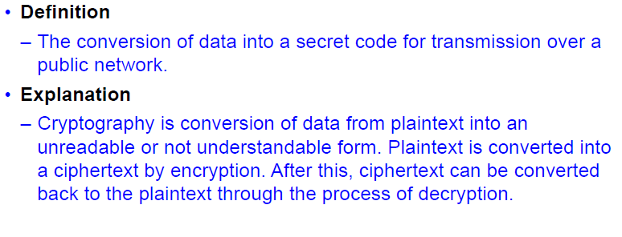
Introduction to Cryptography

Slide 5
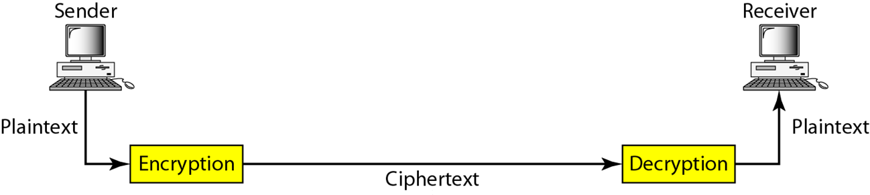
Encryption/Decryption Process

Slide 6
Types of Cryptography
Non-mathematical
Mathematical
Quantum

Slide 7
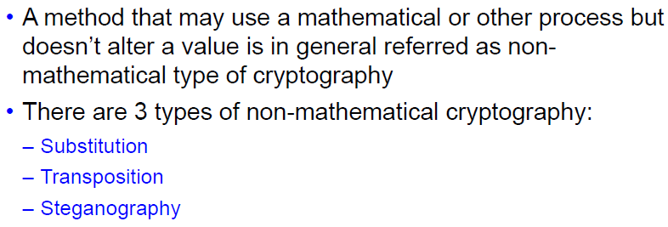
Non-mathematical Cryptography

Slide 8
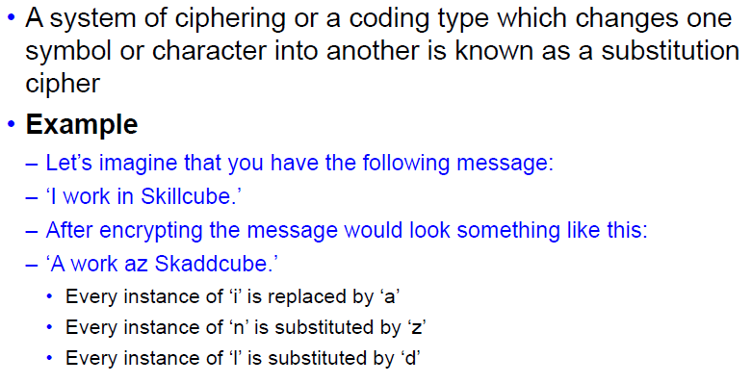
Substitution Ciphers

Slide 9
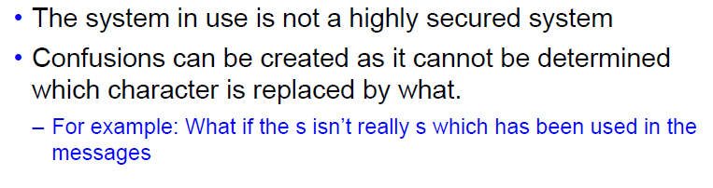
Substitution Cipher: Problems

Slide 10
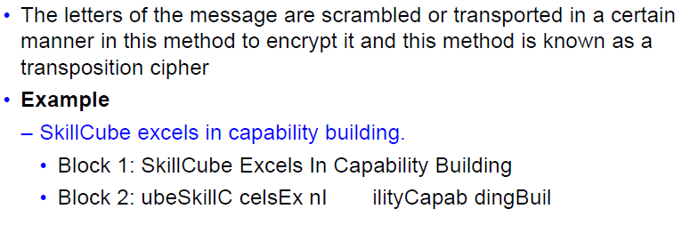
Transposition Ciphers

Slide 11
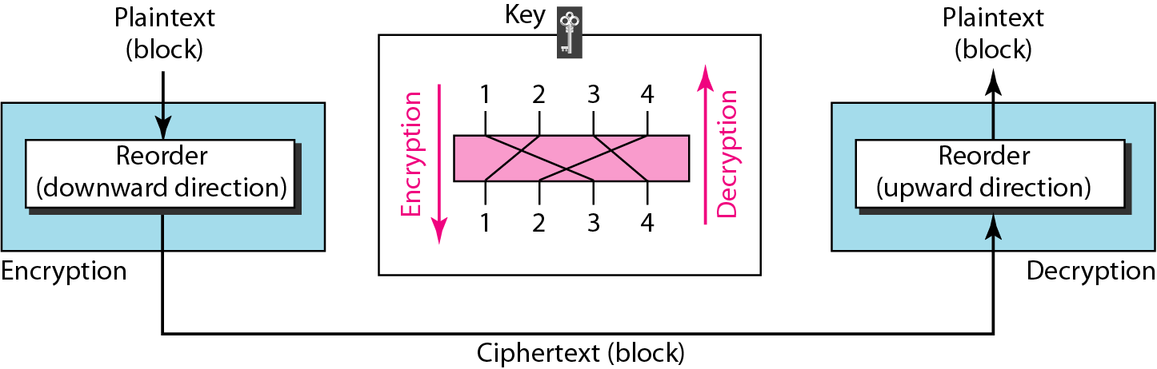
Transposition Cipher
A transposition cipher reorders (permutes) symbols in a block of symbols.

Slide 12
Whereas Substitution ciphers replace each letter with a different letter or symbol to produce the cipher text, in a Transposition cipher, the letters are just moved around.
One example of a transposition cipher, is to reverse the order of the letters in a plaintext. So "a simple example" becomes "ELPMAXE ELPMIS A".
Another, similar, way to encrypt a message would be to reverse the letters of each word, but not the order in which the words are written. In this case "a simple example" becomes "A ELPMIS ELPMAXE".
One important strength of transposition ciphers is that they are not susceptible to frequency analysis, since we have not changed the symbols for each letter. If there are 14 "e" in the plaintext, then there will be 14 "E" in the cipher text, just in different positions. However, there are still methods that cryptanalysts can use to break intercepted messages.

Slide 13
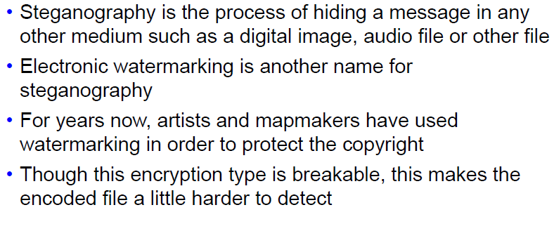
Steganography

Slide 14
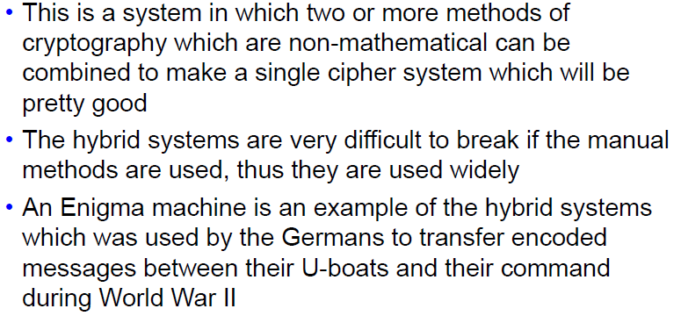
Hybrid Systems

Slide 15
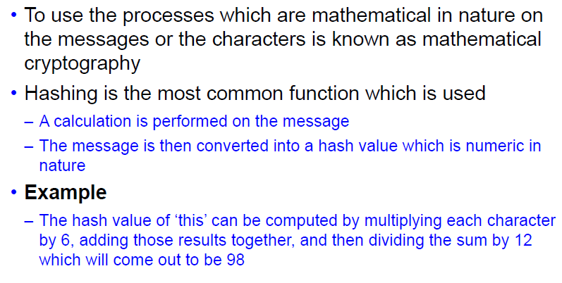
Mathematical Cryptography

Slide 16
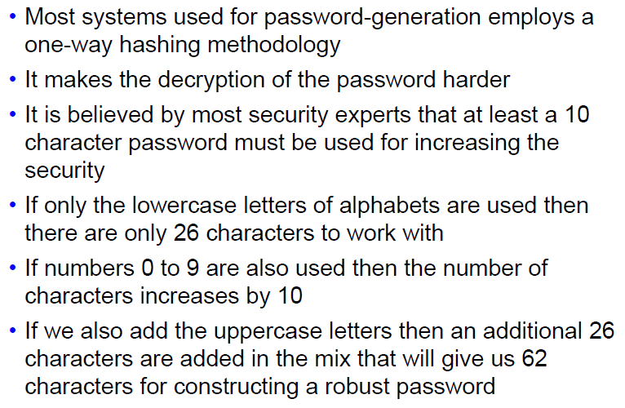
Mathematical Cryptography in Passwords

Slide 17
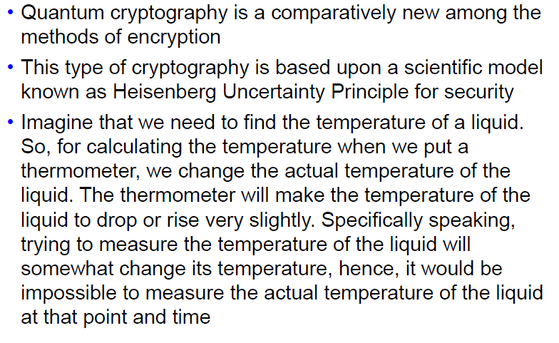
Quantum Cryptography

Slide 18
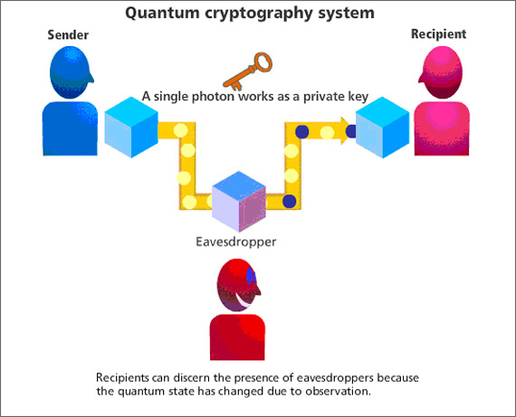
Quantum Cryptography

Slide 19
How does it work?
The sender creates message in the form of series of quantum particles (i.e. photons).
Photons are sent to the recipient, who reads the information according to sequence and polarity of photons.
If a spy or hacker tries to intercept the photons, their state (or polarity) changes.
The sender and recipient will realize that someone is trying to intercept the information.
Transmission of the information will stop.
Sender can again send the message with new set of sequence and polarity.

Slide 20
Objective of Cryptographic Controls
To provide :
Confidentiality
Integrity
Authentication
Non-repudiation
Access Control

Slide 21
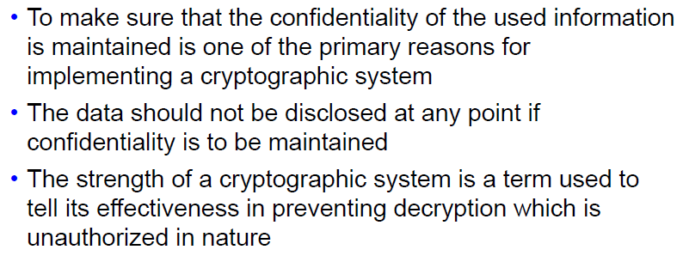
Maintaining Confidentiality

Slide 22
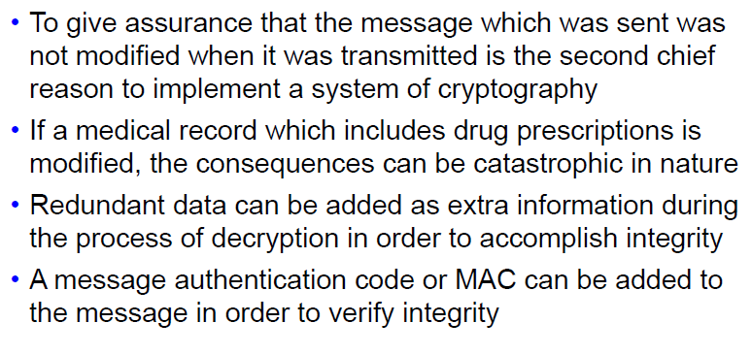
Maintaining Integrity

Slide 23
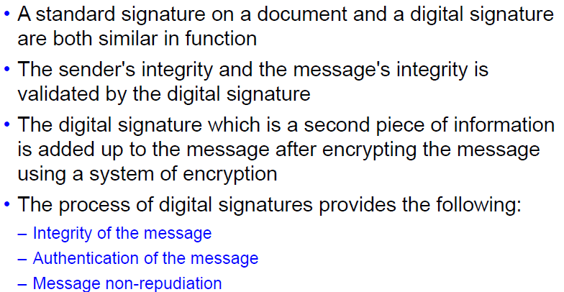
Digital Signatures for Integrity

Slide 24
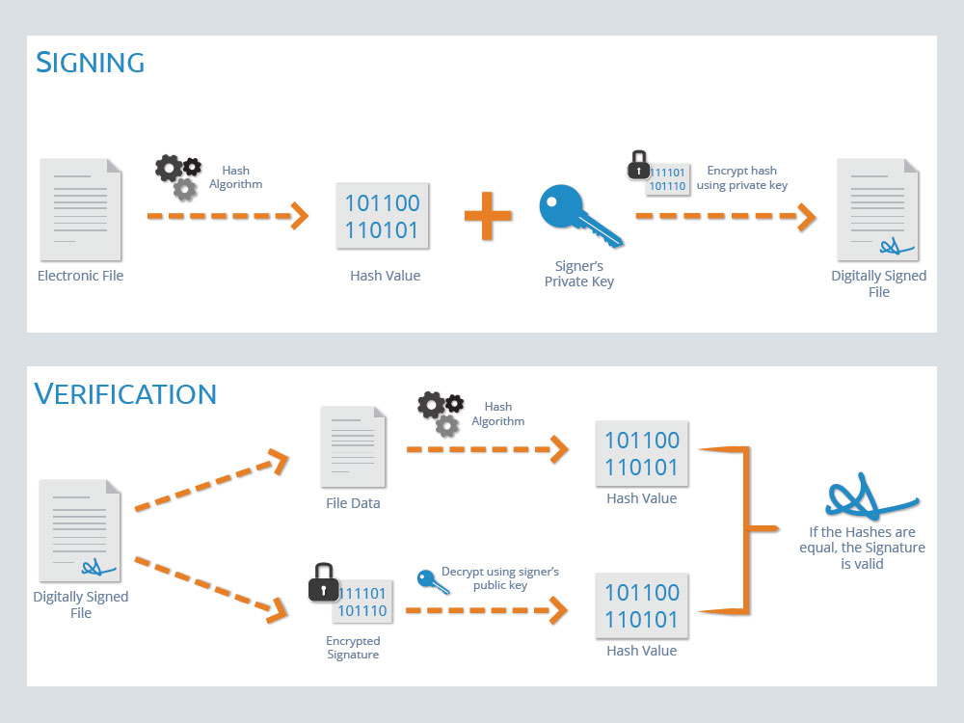
Digital Signature

Slide 25
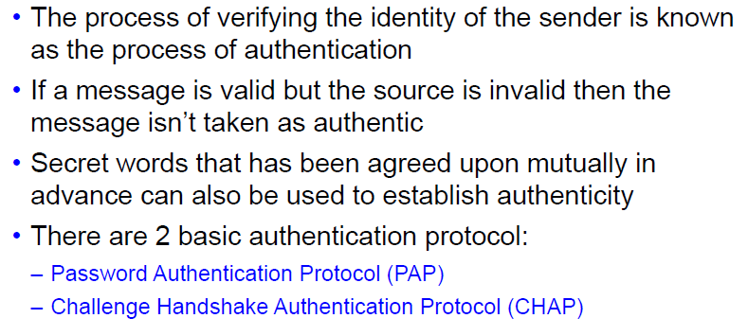
Authentication through Cryptography

Slide 26
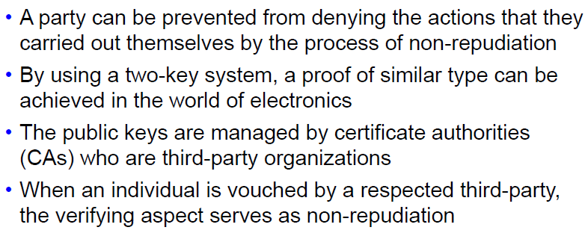
Non-repudiation through Cryptography

Slide 27
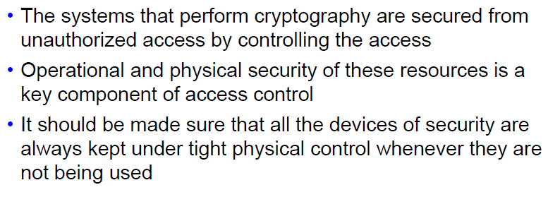
Access Control through Cryptography

Slide 28
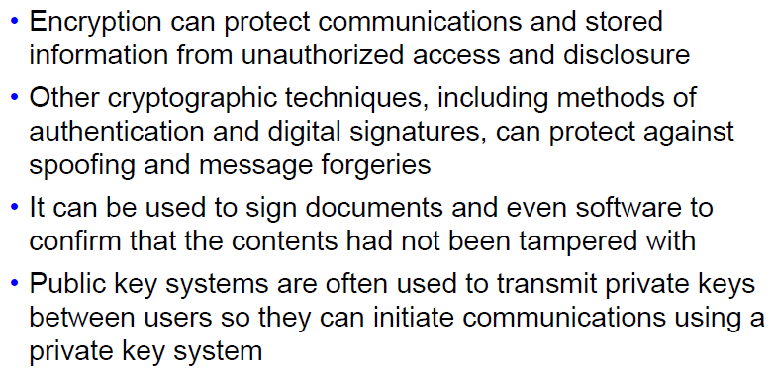
Benefits of Cryptography 1

Slide 29
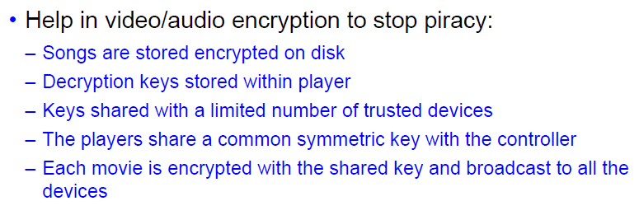
Benefits of Cryptography 2

Slide 30
Types of Cryptographic Algorithms
There are three methods for encoding the message:
1. Hashing
2. Symmetric Algorithms
3. Asymmetric Algorithms

Slide 31
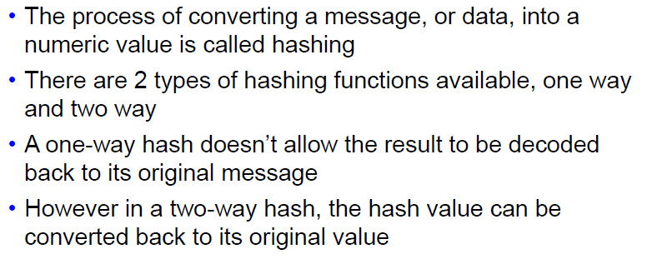
Hashing

Slide 32
Hashing Types
Secure Hash Algorithm (SHA)
Message Digest (MD) Algorithm
RIPEMD
LANMAN
NTLM

Slide 33
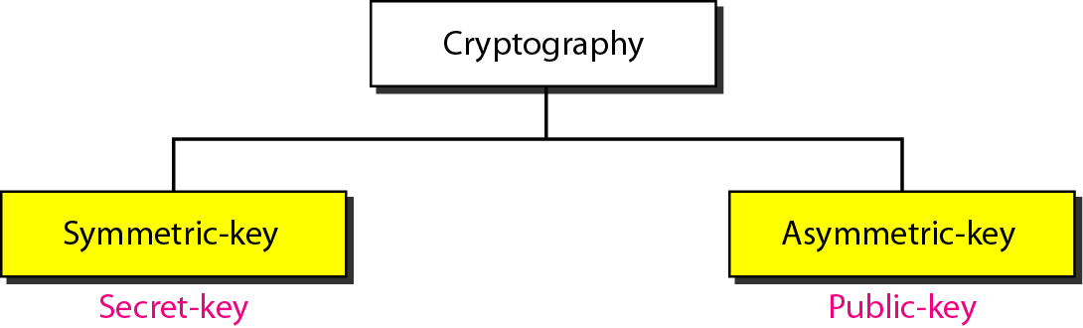
Cryptographic Algorithms

Slide 34
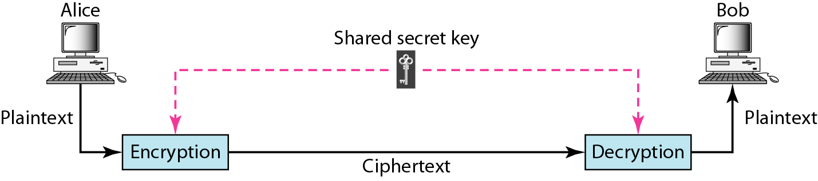
Symmetric Algorithm
In symmetric-key cryptography, the same key is used by the sender
(for encryption) and the receiver (for decryption).
The key is shared.

Slide 35
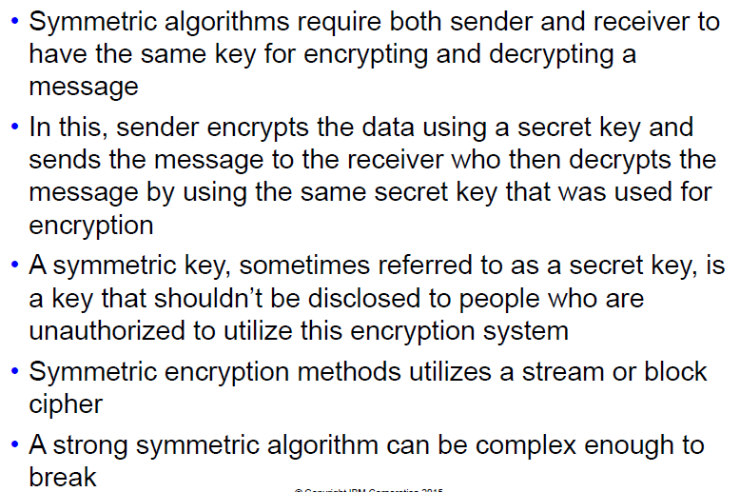
Symmetric Algorithms

Slide 36
Types of Symmetric Algorithms
Data Encryption Standard (DES)
Triple-DES
Advanced Encryption Standard (AES)
AES256
Rivest’s Cipher
Blowfish and Twofish
International Data Encryption Algorithm (IDEA)

Slide 37
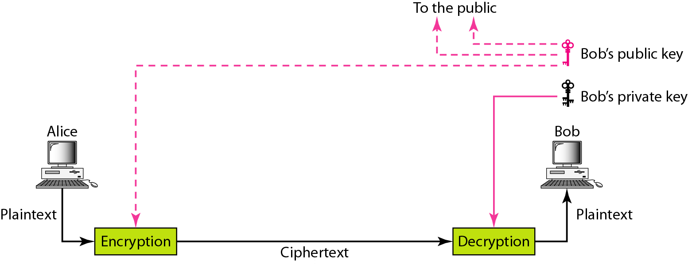
Asymmetric Algorithm

Slide 38
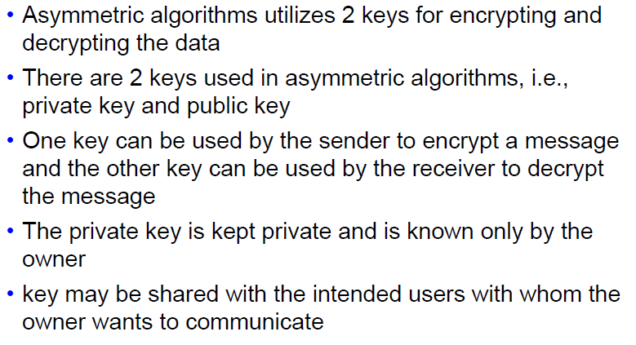
Asymmetric Algorithms

Slide 39
Types of Asymmetric Algorithms
RSA
Diffie-Hellman
Elliptic Curve Cryptography
El Gamal

Slide 40
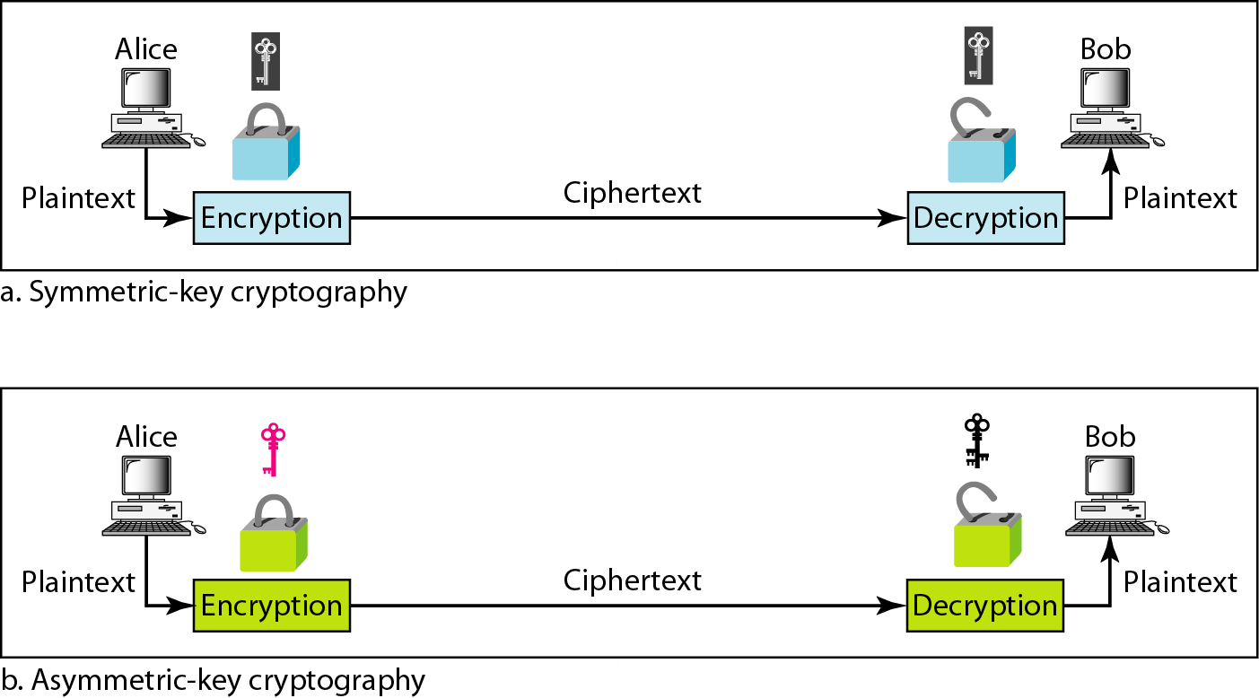
Comparison between both Algorithms

Slide 41
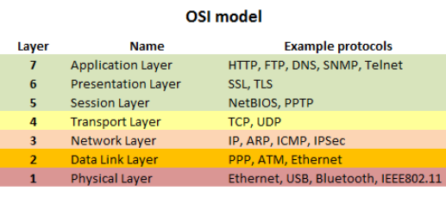

Slide 42
OSI Model :
Physical Layer (Lowest Layer):
It is responsible for the actual physical connection between the devices.
The physical layer contains information in the form of bits.
When receiving data, this layer will get the signal received and convert it into 0s and 1s and send them to the Data Link layer, which will put the frame back together.
Data Link Layer (DLL) (Layer 2) :
The data link layer is responsible for the node to node delivery of the message.
Main function of this layer is to make sure data transfer is error free from one node to another, over the physical layer.
Network Layer (Layer 3) :
Network layer works for the transmission of data from one host to the other located in different networks.
It also takes care of packet routing i.e. selection of shortest path to transmit the packet, from the number of routes available. The sender & receiver’s IP address are placed in the header by network layer.

Slide 43
OSI Model :
Transport Layer (Layer 4) :
Transport layer provides services to application layer and takes services from network layer. The data in the transport layer is referred to as Segments.
It is responsible for the End to End delivery of the complete message. Transport layer also provides the acknowledgement of the successful data transmission and re-transmits the data if error is found
Session Layer (Layer 5) :
This layer is responsible for establishment of connection, maintenance of sessions, authentication and also ensures security.
Presentation Layer (Layer 6) :
Presentation layer is also called the Translation layer.
The data from the application layer is extracted here and manipulated as per the required format to transmit over the network.

Slide 44
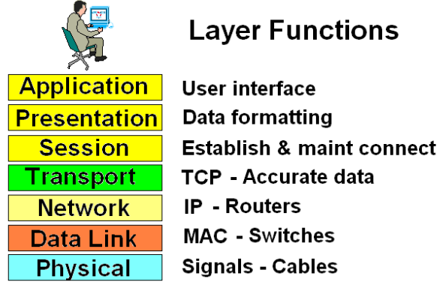
OSI Model :
Application Layer (Layer 7) :
At the very top of the OSI Reference Model stack of layers, we find Application layer which is implemented by the network applications.
These applications produce the data, which has to be transferred over the network. Ex: Application – Browsers, Skype Messenger etc. **Application Layer is also called as Desktop Layer.

Slide 45
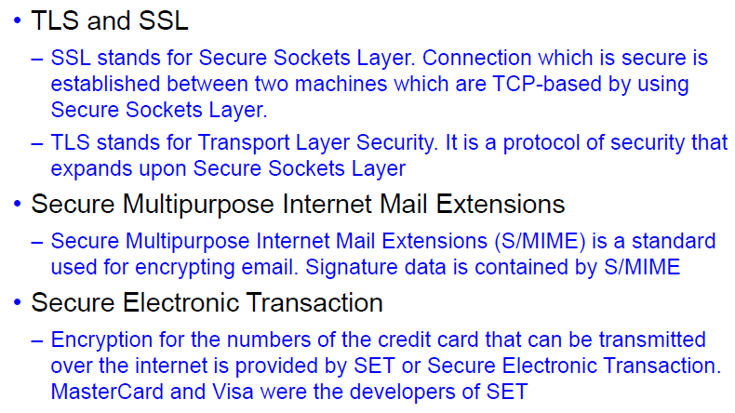
Techniques for Cryptography 1

Slide 46
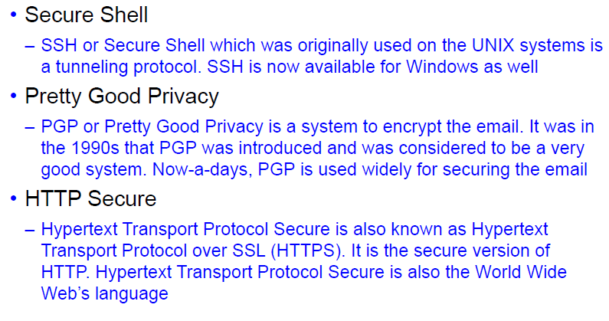
Techniques for Cryptography 2

Slide 47
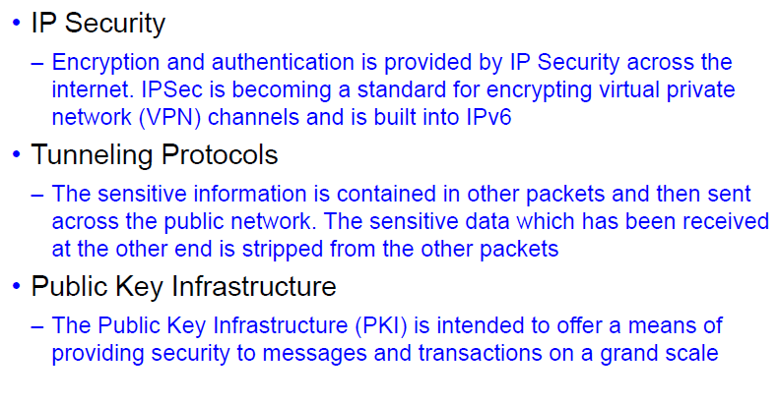
Techniques for Cryptography 3

Slide 48
SSL/TLS
These both provide a secure transport connection between applications (e.g., a web server and a browser)
Both prevents the network communication from being eavesdropped or tampered.
The usage of SSL technology ensures that all data transmitted between the web server and browser remains encrypted.
An SSL certificate is necessary to create SSL connection. You would need to give all details about the identity of your website and your company as and when you choose to activate SSL on your web server.
The SSL protocol is used by millions of online business to protect their customers, ensuring their online transactions remain confidential. A web page should use encryption when it expects users to submit confidential data, including personal information, passwords, or credit card details.
All web browsers have the ability to interact with secured sites so long as the site's certificate is issued by a trusted CA.

Slide 49
SSL/TLS
Secure Sockets Layer (SSL) is a standard security technology for establishing an encrypted link between a server and a client—typically a web server (website) and a browser, or a mail server and a mail client (e.g., Outlook).
SSL allows sensitive information such as credit card numbers, social security numbers, and login credentials to be transmitted securely. Normally, data sent between browsers and web servers is sent in plain text—leaving you vulnerable to eavesdropping. If an attacker is able to intercept all data being sent between a browser and a web server, they can see and use that information.
More specifically, SSL is a security protocol. Protocols describe how algorithms should be used. In this case, the SSL protocol determines variables of the encryption for both the link and the data being transmitted.
All browsers have the capability to interact with secured web servers using the SSL protocol. However, the browser and the server need what is called an SSL Certificate to be able to establish a secure connection.
SSL secures millions of peoples’ data on the Internet every day, especially during online transactions or when transmitting confidential information. Internet users have come to associate their online security with the lock icon that comes with an SSL-secured website or green address bar that comes with an Extended Validation SSL-secured website. SSL-secured websites also begin with https rather than http.

Slide 50
Is My Certificate SSL or TLS?
The SSL protocol has always been used to encrypt and secure transmitted data. Each time a new and more secure version was released, only the version number was altered to reflect the change (e.g., SSLv2.0). However, when the time came to update from SSLv3.0, instead of calling the new version SSLv4.0, it was renamed TLSv1.0. We are currently on TLSv1.2.
Because SSL is still the better known, more commonly used term, DigiCert uses SSL when referring to certificates or describing how transmitted data is secured.

Slide 51
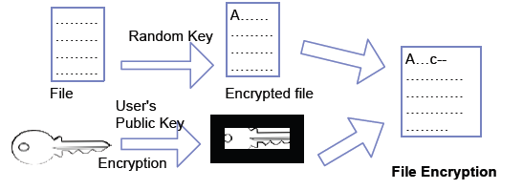
Pretty Good Privacy (PGP)

Slide 52
Pretty Good Privacy (PGP)
PGP encryption uses a serial combination of hashing, data compression, symmetric key cryptography and finally public key cryptography. Each step uses one of several supported algorithms.
Each public key is bound to a user name or an e-mail address.
In this system, each user has an encryption key that is publicly known and a private key that is known only to that user.
You encrypt a message you send to someone else using their public key. When they receive it, they decrypt it using their private key.
Since encrypting an entire message can be time-consuming, PGP uses a faster encryption algorithm to encrypt the message and then uses the public key to encrypt the shorter key that was used to encrypt the entire message. Both the encrypted message and the short key are sent to the receiver who first uses the receiver's private key to decrypt the short key and then uses that key to decrypt the message.
PGP comes in two public key versions – Rivest Shamir Adleman (RSA) and Diffie Hellman.

Slide 53
Public Key Infrastructure
It is a set of hardware, software, people, policies and procedures required to create, manage, distribute, use, store and revoke digital certificates.
The purpose of a PKI is to facilitate the secure electronic transfer of information for a range of network activities such as e-commerce, internet banking and confidential email. It is required for activities where simple passwords are an inadequate authentication method and more rigorous proof is required to confirm the identity of the parties involved in the communication and to validate the information being transferred.
Components of PKI
A certificate authority (CA) that stores, issues and signs the digital certificates
A registration authority which verifies the identity of entities requesting their digital certificates to be stored at the CA
Digital Certificates
Encryption Algorithm that is RSA

Slide 54
S/MIME (Secure/Multipurpose Internet Mail Extensions)
It is an application layer protocol which is used to send digitally signed and encrypted email messages.
It uses the Rivest-Shamir-Adleman encryption (RSA) system for email encryption
Administrators need to enable S/MIME based security for mailboxes in their organizations.

Slide 55
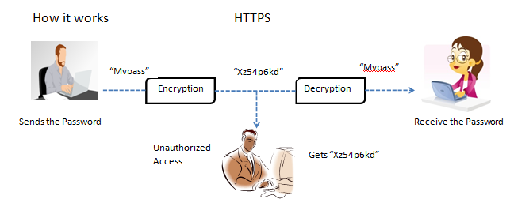
HTTPS=HTTP+’S’
HTTPS ensures secure communication between two computers over HTTP
The connection is encrypted using Transport Layer Protocol Security (TLS) or Secure Sockets Layer (SSL) protocol
It is often used in confidential online transactions
It protects against man in the middle attacks as data is transmitted over encrypted channel.

Slide 56
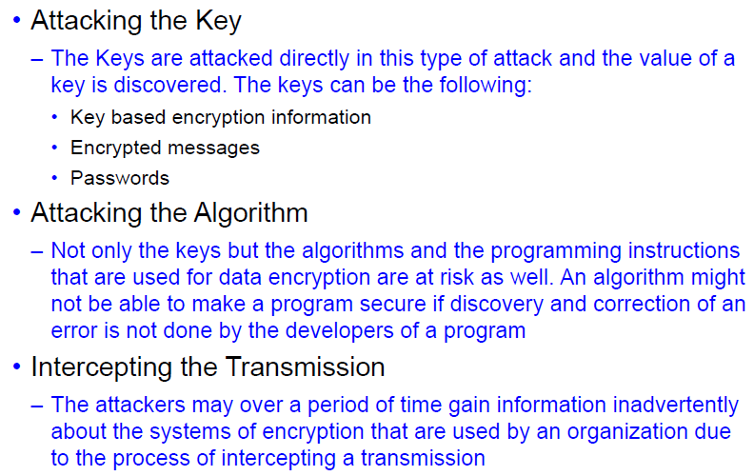
Attacks on Cryptographic Techniques

Slide 57
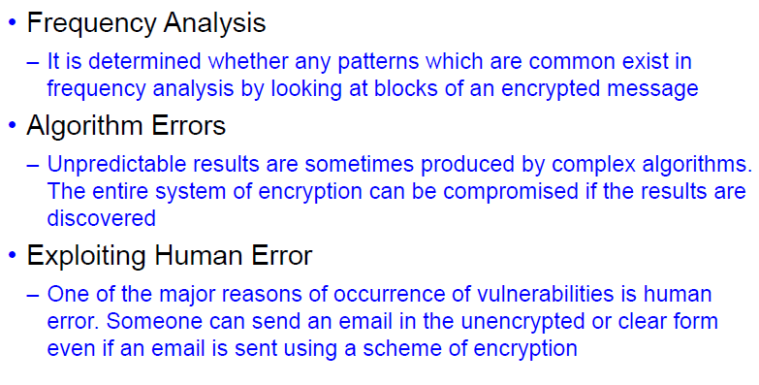
Techniques of Code Breaking

Slide 58
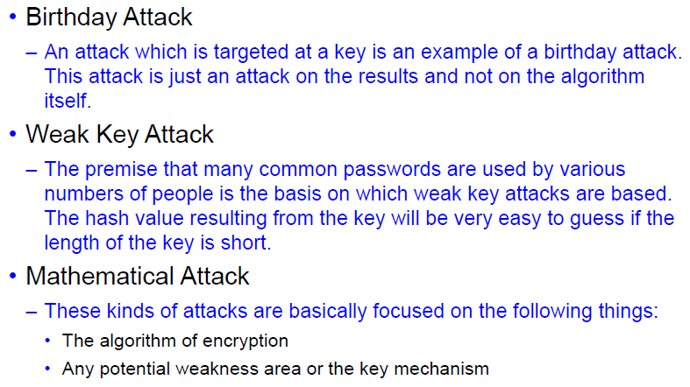
Cryptographic Attacks

Slide 59
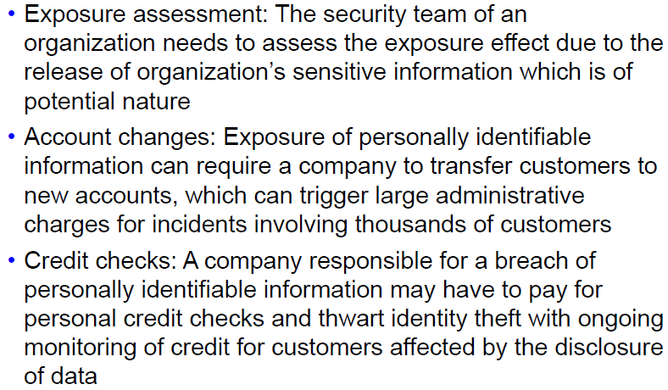
Cryptography: Cost Categories 1

Slide 60
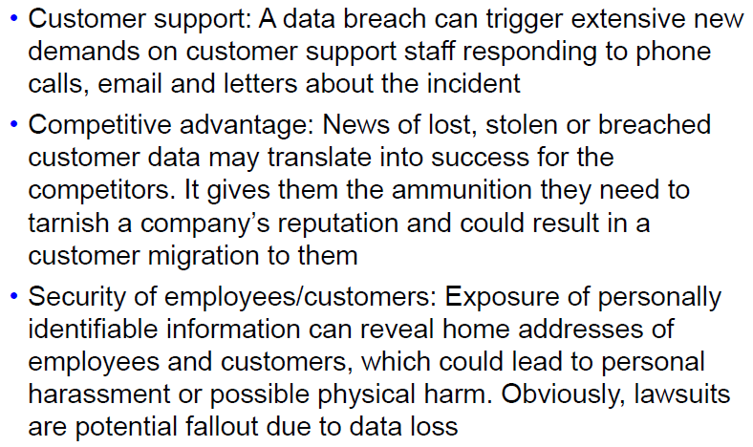
Cryptography: Cost Categories 2

Slide 61
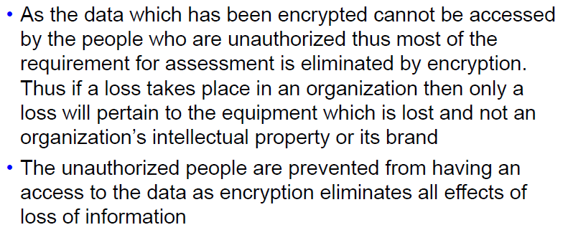
Cryptography Cost Benefits

Slide 62
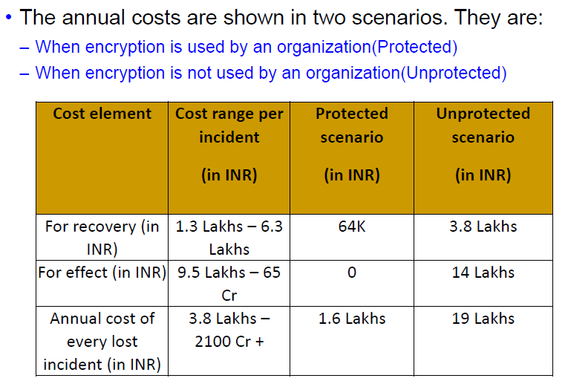
Scenario based Annual Costs

Slide 63
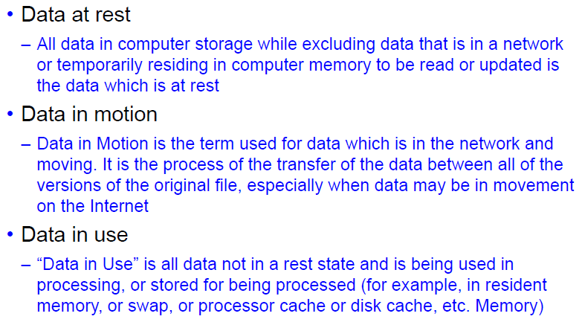
Data Classification

Slide 64
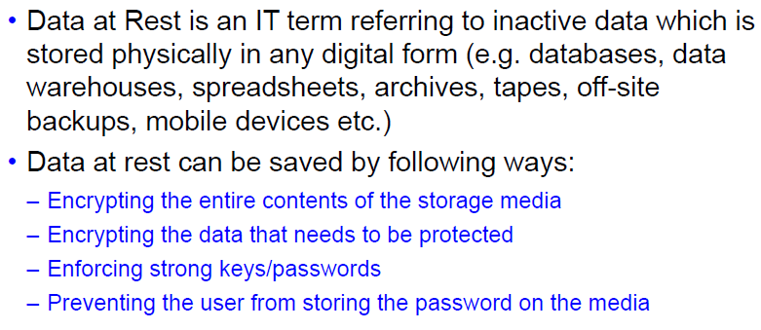
Protecting data at rest

Slide 65
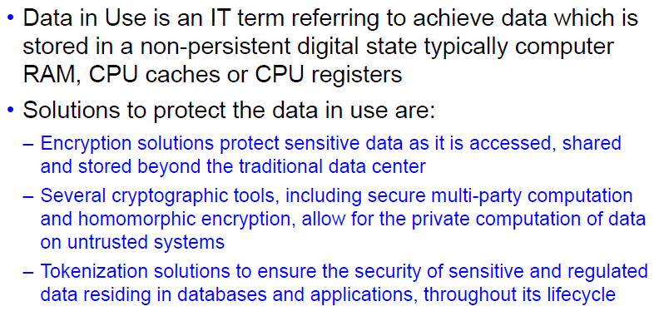
Protecting data in use

Slide 66
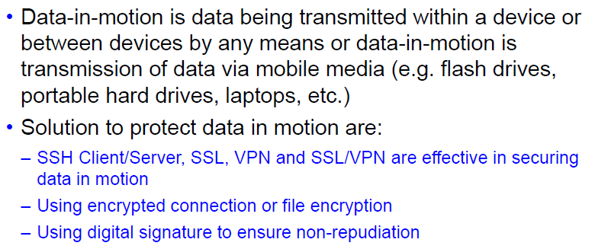
Protecting data in motion

Slide 67
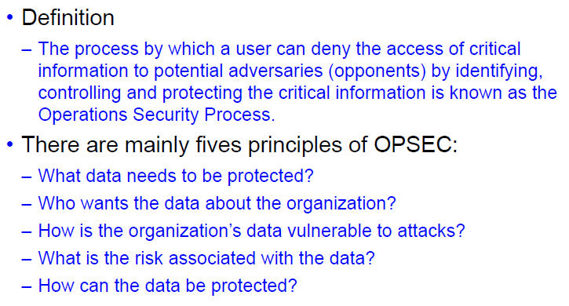
Introduction to Operations Security

Slide 68

Benefits of Operations Security

Slide 69
Process of Operations Security
Identification of critical information
Analysis of threats
Analysis of vulnerabilities
Assessment of risk
Application of appropriate countermeasures to mitigate the risk

Slide 70
Types of Assets
Information Assets
Software Assets
Physical Assets
Services

Slide 71

Threat Analysis

Slide 72

Vulnerability Analysis

Slide 73

Risk Assessment

Slide 74
Application of appropriate countermeasures to mitigate the risk
Avoidance of risk
Transferring risks
Mitigation of risks
Deterring the risks
Accepting the risks

Slide 75

Operations Security Techniques 1

Slide 76

Operations Security Techniques 2

Slide 77

Operations Security in Personal Life 1

Slide 78

Operations Security in Personal Life 2

Slide 79

Operations Security in Personal Life 3

Slide 80

Operations Security Cost vs Benefit

Slide 81
Thank You !!!!!

