Slide 1
Knapsack Problem

Slide 2
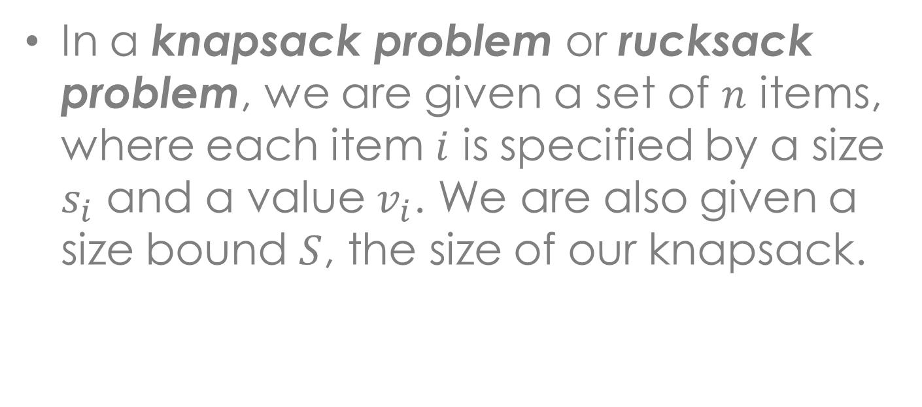
Knapsack Problem
In a knapsack problem or rucksack problem, we are given a set of $n$ items, where each item $i$ is specified by a size $s_{i}$ and a value $v_{i}$. We are also given a size bound $S$, the size of our knapsack.
Item # | Size | Value
1 | 1 | 8
2 | 3 | 6
3 | 5 | 5

Slide 3
Knapsack Problem
There are two versions of the problem:
0-1 Knapsack Problem
Fractional Knapsack Problem
Bounded Knapsack Problem
Unbounded Knapsack Problem
Notes:
1. Items are indivisible: you either take an item or not. Solved with dynamic programming
2. Items are divisible: you can take any fraction of an item. Solved with a greedy algorithm

Slide 4
Knapsack Problem
Sample Problem
 | A | B | C | D | E | F | G
value | 7 | 9 | 5 | 12 | 14 | 6 | 12
time | 3 | 4 | 2 | 6 | 7 | 3 | 5
Notes:
Imagine you have a problem set with different parts labelled A through G. Each part has a “value” (in points) and a “size” (time in hours to complete). Say the value and time for the problem set are as follows… And say you have a total of 15 hours – the knapsack – : which parts should you do?
With the 0-1 Knapsack, you need to know which parts you should do to get the best total value possible. We want maximizing our chance to get more points.
If there was partial credit that was proportional to the amount of work done (e.g., one hour spent on problem C earns you 2.5 points), that is what we call now the Fractional Knapsack the best approach is to work on problems in order of points/hour (a greedy strategy).

Slide 5
Solutions to Knapsack Problems
Brute-Force Approach – solve the problem with a straightforward algorithm

Slide 6
Solutions to Knapsack Problems
{}
{1, 2, 3, 4, 5}
{}
{2, 3, 4, 5}
{1}
{2, 3, 4, 5}
{}
{3, 4, 5}
{2}
{3, 4, 5}
{1}
{3, 4, 5}
{1, 2}
{3, 4, 5}
Notes:
Since there are n items, there are $2^{n}$ possible combinations of items
We need to go through all combinations to find the one with maximum value with total size <= S
NOT OPTIMAL

Slide 7
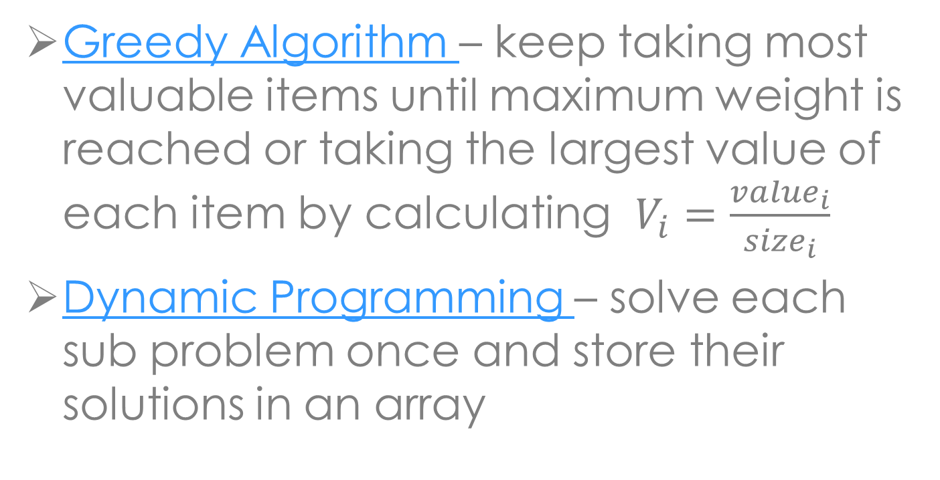
Solutions to Knapsack Problems
Greedy Algorithm – keep taking most valuable items until maximum weight is reached or taking the largest value of each item by calculating $V_{i}=\frac{{value}_{i}}{{size}_{i}}$
Dynamic Programming – solve each sub problem once and store their solutions in an array

Slide 8
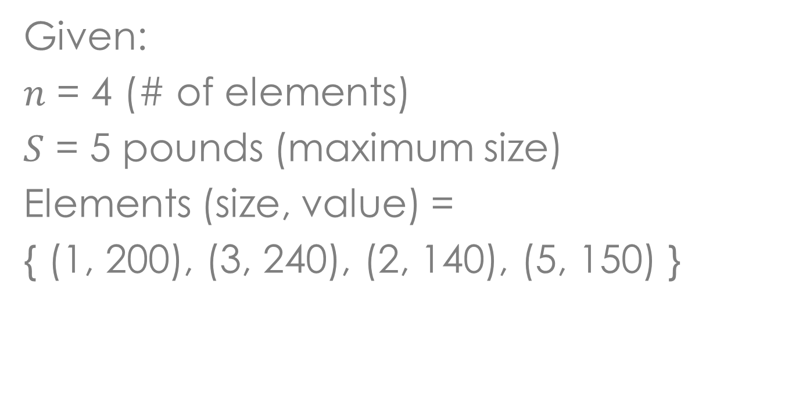
Example
Given:
$n$ = 4 (# of elements)
$S$ = 5 pounds (maximum size)
Elements (size, value) =
{ (1, 200), (3, 240), (2, 140), (5, 150) }

Slide 9
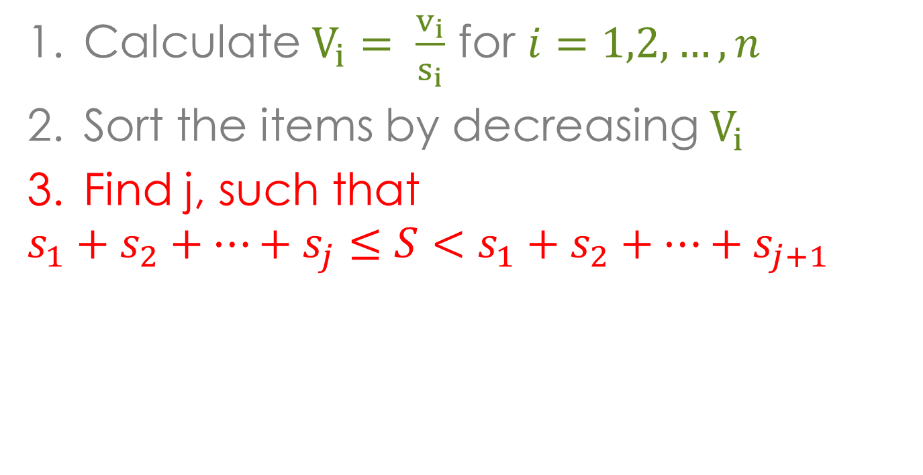
Greedy Algorithm
Calculate $V_{i}= \frac{v_{i}}{s_{i}}$ for $i=1,2,…,n$
Sort the items by decreasing $V_{i}$
Find j, such that
$$s_{1}+s_{2}+…+s_{j}≤S<s_{1}+s_{2}+…+s_{j+1}$$
Notes:
Legend:
Red – wala pud ko kasabot

Slide 10


Greedy Algorithm
Sample Problem
$V_{i}= \frac{{cost}_{i}}{{weight}_{i}}$
$V_{i}= \frac{{value}_{i}}{{size}_{i}}$
$= \frac{{cost}_{i}}{{weight}_{i}}$
 | A | B | C | D
cost | 200 | 240 | 140 | 150
weight | 1 | 3 | 2 | 5
value | 200 | 80 | 70 | 30
Notes:
Solution is
1 pds A
3 pds B
1 pd C

Slide 11
Greedy Algorithm
The optimal solution to the fractional knapsack
Not an optimal solution to the 0-1 knapsack

Slide 12
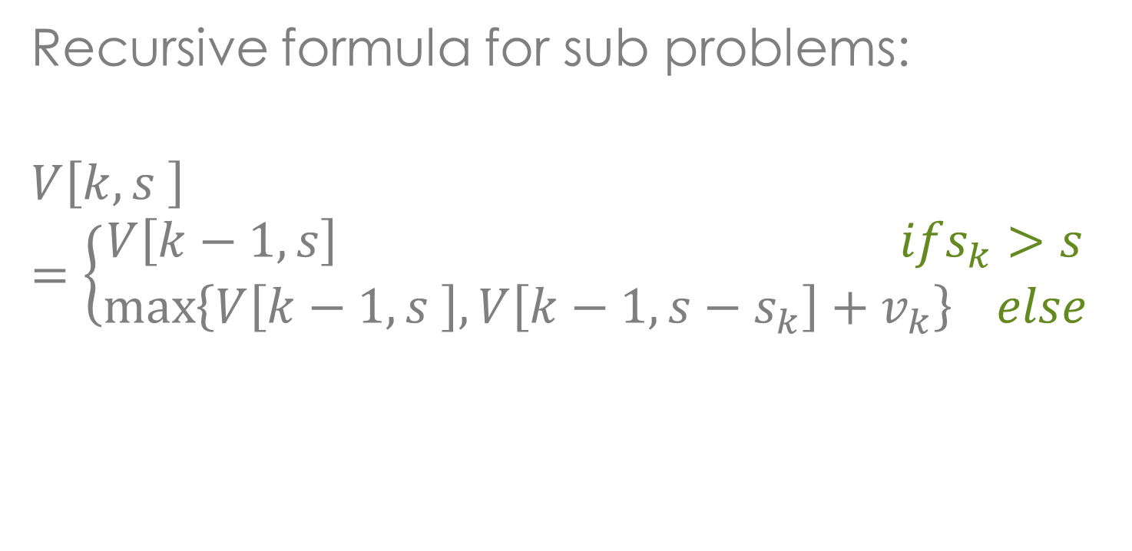
Dynamic Programming
Recursive formula for sub problems:
$$V\left[k,s \right]=\left\{\begin{aligned}V\left[k−1, s\right] ifs_{k}>s \\ \max\left\{V\left[k−1,s \right],V\left[k−1,{s−s}_{k}\right]+v_{k}\right\} else\end{aligned}\right.$$
Notes:
This means that the best subset of $S_{k}$that has the total size $S,$ can either contains item k or not.
First case: $s_{k}>s.$ Item k can’t be part of the solution, since if it was, the total size would be $>$s, which is unacceptable
Second case: $w_{k}≤w$. Then the item k can be in the solution, and we choose the case with greater value.

Slide 13

Dynamic Programming
for $s$= 0 to $S$
V[ 0, $s$ ] = 0
for $i$ = 1 to $n$
V[$i$, 0 ] = 0
Notes:
First for-loop: $s=0 to S$. We go through all the possible sizes of our knapsack until S and if item i is equal to 0, which is “V[0,s]” its corresponding maximum value is of course, 0. Because when i = 0, this means that we are not taking any item.
Second for-loop: $i=1 to n$. We go through all the items from 1 to n and if the knapsack’s size is equal to 0, which is “V[i, 0]” its corresponding values is again 0. Because when s = 0, this means that we can’t put anything in the knapsack.

Slide 14
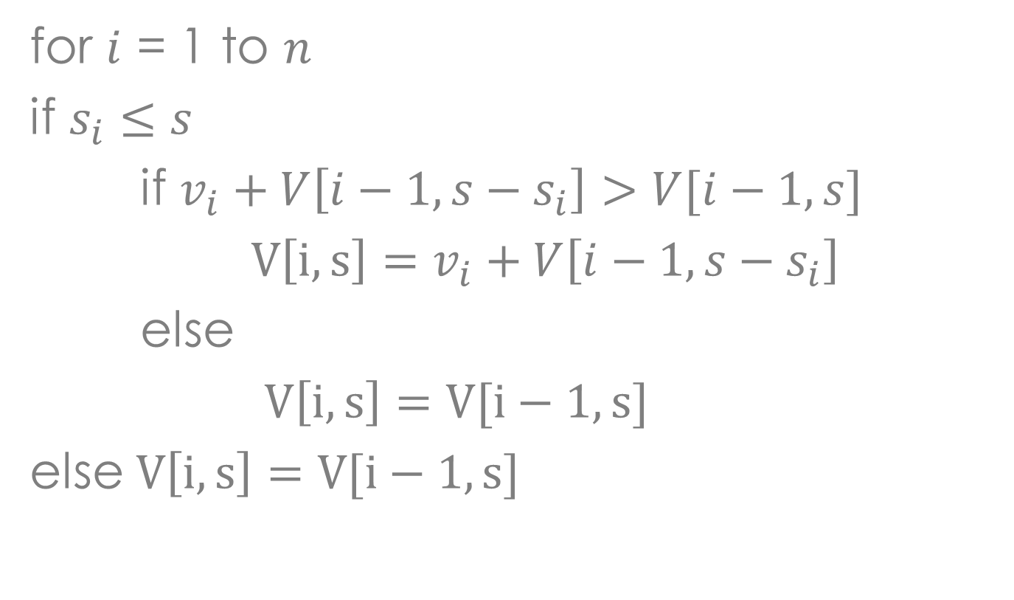
Dynamic Programming
for $i$ = 1 to $n$
if $s_{i}≤s$
if $v_{i}+V\left[i−1, s−s_{i}\right]>V[i−1, s]$
$V\left[i, s\right]=v_{i}+V\left[i−1, s−s_{i}\right]$
else
$V\left[i, s\right]=V[i−1,s]$
else $V\left[i, s\right]=V[i−1,s]$
Notes:
Again, we go through all the items and:
Outer if:${ s}_{i}≤s.$This means that the size of the item can fit in the current size of the knapsack and we should consider its possible maximum value.
Outer else: $s_{i}>s.$ Item i can’t be part of the solution, since its size is bigger than the knapsack’s current limit. Then, we’ll just copy the value above it.
Inner if: $v_{i}+V\left[i−1, s−s_{i}\right]>V[i−1, s]$. This means that if the current item’s value + $V\left[i−1, s−s_{i}\right]$ is greater than the value above it, we must use the current item’s value + $V\left[i−1, s−s_{i}\right].$
Inner else: $v_{i}+V\left[i−1, s−s_{i}\right]≤V[i−1, s]$. This means that if the current item’s value + $V\left[i−1, s−s_{i}\right]$ is less than or equal to the value above it, we must use the value on the previous item (or simple the value above it).
The outer if and else conditions check if the knapsack can hold the current item or not.
The inner if and else conditions check if the current value is bigger than the previous value so as to maximize the values the knapsack can hold.

Slide 15
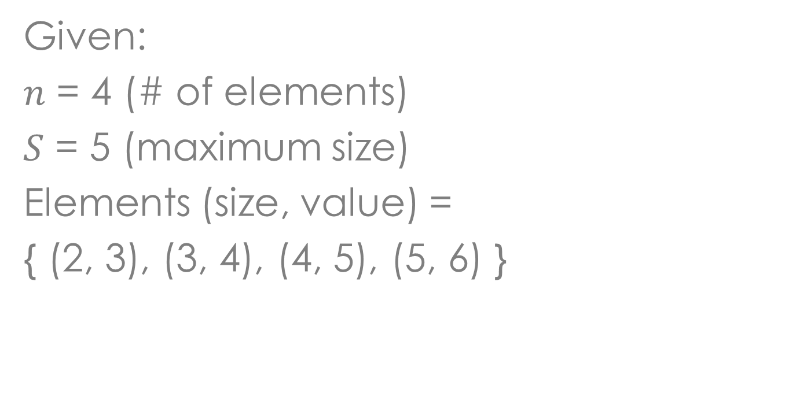
Example
Given:
$n$ = 4 (# of elements)
$S$ = 5 (maximum size)
Elements (size, value) =
{ (2, 3), (3, 4), (4, 5), (5, 6) }

Slide 16
Example
i\s | 0 | 1 | 2 | 3 | 4 | 5
0
1
2
3
4

Slide 17
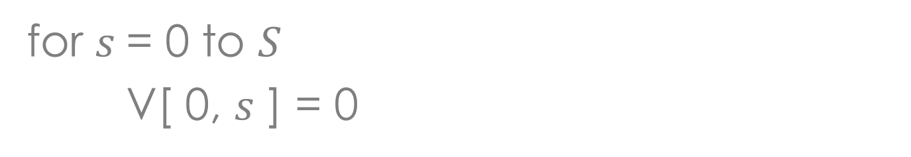
Example
for $s$= 0 to $S$
V[ 0, $s$ ] = 0
i\s | 0 | 1 | 2 | 3 | 4 | 5
0 | 0 | 0 | 0 | 0 | 0 | 0
1
2
3
4

Slide 18
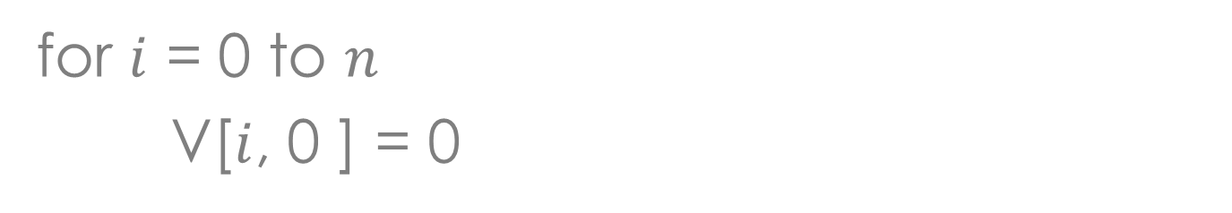
Example
for $i$ = 0 to $n$
V[$i$, 0 ] = 0
i\s | 0 | 1 | 2 | 3 | 4 | 5
0 | 0 | 0 | 0 | 0 | 0 | 0
1 | 0
2 | 0
3 | 0
4 | 0

Slide 19
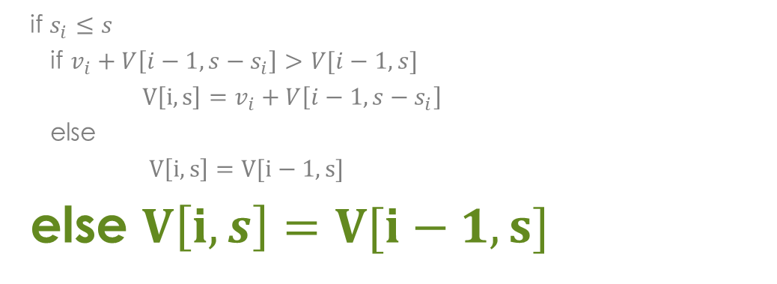
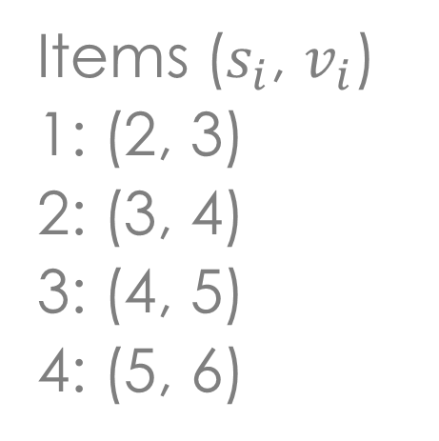
Example
Items ($s_{i}$, $v_{i}$)
1: (2, 3)
2: (3, 4)
3: (4, 5)
4: (5, 6)
if $s_{i}≤s$
if $v_{i}+V\left[i−1, s−s_{i}\right]>V[i−1, s]$
$V\left[i, s\right]=v_{i}+V\left[i−1, s−s_{i}\right]$
else
$V\left[i, s\right]=V[i−1,s]$
else $V\left[i, s\right]=V[i−1,s]$
i\s | 0 | 1 | 2 | 3 | 4 | 5
0 | 0 | 0 | 0 | 0 | 0 | 0
1 | 0 | 0
2 | 0
3 | 0
4 | 0
Notes:
i = 1
v_{i} = 3
s_{i} = 2
s = 1
s - s_{i} = -1

Slide 20
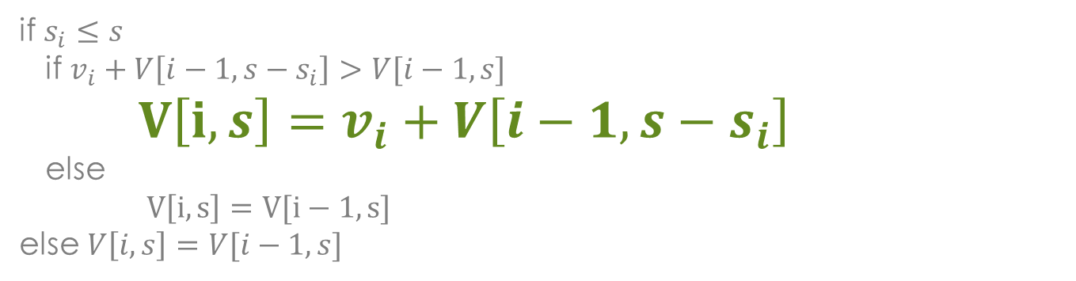
Example
Items ($s_{i}$, $v_{i}$)
1: (2, 3)
2: (3, 4)
3: (4, 5)
4: (5, 6)
if $s_{i}≤s$
if $v_{i}+V\left[i−1, s−s_{i}\right]>V[i−1, s]$
$V\left[i, s\right]=v_{i}+V\left[i−1, s−s_{i}\right]$
else
$V\left[i, s\right]=V[i−1,s]$
else $V\left[i, s\right]=V[i−1,s]$
i\s | 0 | 1 | 2 | 3 | 4 | 5
0 | 0 | 0 | 0 | 0 | 0 | 0
1 | 0 | 0 | 3
2 | 0
3 | 0
4 | 0
Notes:
i = 1
v_{i} = 3
s_{i} = 2
s = 2
s - s_{i} = 0

Slide 21
Example
Items ($s_{i}$, $v_{i}$)
1: (2, 3)
2: (3, 4)
3: (4, 5)
4: (5, 6)
if $s_{i}≤s$
if $v_{i}+V\left[i−1, s−s_{i}\right]>V[i−1, s]$
$V\left[i, s\right]=v_{i}+V\left[i−1, s−s_{i}\right]$
else
$V\left[i, s\right]=V[i−1,s]$
else $V\left[i, s\right]=V[i−1,s]$
i\s | 0 | 1 | 2 | 3 | 4 | 5
0 | 0 | 0 | 0 | 0 | 0 | 0
1 | 0 | 0 | 3 | 3
2 | 0
3 | 0
4 | 0
Notes:
i = 1
v_{i} = 3
s_{i} = 2
s = 3
s - s_{i} = 1

Slide 22
Example
Items ($s_{i}$, $v_{i}$)
1: (2, 3)
2: (3, 4)
3: (4, 5)
4: (5, 6)
if $s_{i}≤s$
if $v_{i}+V\left[i−1, s−s_{i}\right]>V[i−1, s]$
$V\left[i, s\right]=v_{i}+V\left[i−1, s−s_{i}\right]$
else
$V\left[i, s\right]=V[i−1,s]$
else $V\left[i, s\right]=V[i−1,s]$
i\s | 0 | 1 | 2 | 3 | 4 | 5
0 | 0 | 0 | 0 | 0 | 0 | 0
1 | 0 | 0 | 3 | 3 | 3
2 | 0
3 | 0
4 | 0
Notes:
i = 1
v_{i} = 3
s_{i} = 2
s = 4
s - s_{i} = 2

Slide 23
Example
Items ($s_{i}$, $v_{i}$)
1: (2, 3)
2: (3, 4)
3: (4, 5)
4: (5, 6)
if $s_{i}≤s$
if $v_{i}+V\left[i−1, s−s_{i}\right]>V[i−1, s]$
$V\left[i, s\right]=v_{i}+V\left[i−1, s−s_{i}\right]$
else
$V\left[i, s\right]=V[i−1,s]$
else $V\left[i, s\right]=V[i−1,s]$
i\s | 0 | 1 | 2 | 3 | 4 | 5
0 | 0 | 0 | 0 | 0 | 0 | 0
1 | 0 | 0 | 3 | 3 | 3 | 3
2 | 0
3 | 0
4 | 0
Notes:
i = 1
v_{i} = 3
s_{i} = 2
s = 5
s - s_{i} = 3

Slide 24
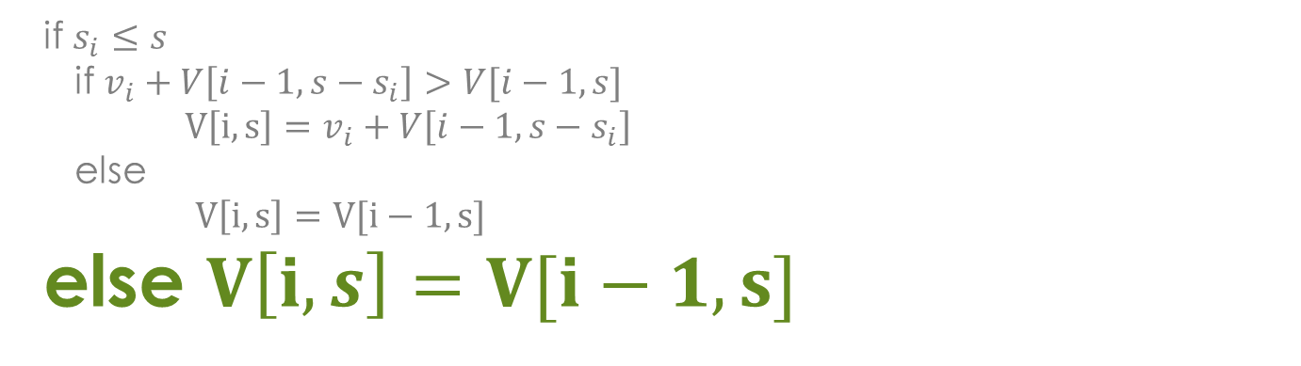
Example
Items ($s_{i}$, $v_{i}$)
1: (2, 3)
2: (3, 4)
3: (4, 5)
4: (5, 6)
if $s_{i}≤s$
if $v_{i}+V\left[i−1, s−s_{i}\right]>V[i−1, s]$
$V\left[i, s\right]=v_{i}+V\left[i−1, s−s_{i}\right]$
else
$V\left[i, s\right]=V[i−1,s]$
else $V\left[i, s\right]=V[i−1,s]$
i\s | 0 | 1 | 2 | 3 | 4 | 5
0 | 0 | 0 | 0 | 0 | 0 | 0
1 | 0 | 0 | 3 | 3 | 3 | 3
2 | 0 | 0
3 | 0
4 | 0
Notes:
i = 2
v_{i} = 4
s_{i} = 3
s = 1
s - s_{i} = -2

Slide 25
Example
Items ($s_{i}$, $v_{i}$)
1: (2, 3)
2: (3, 4)
3: (4, 5)
4: (5, 6)
if $s_{i}≤s$
if $v_{i}+V\left[i−1, s−s_{i}\right]>V[i−1, s]$
$V\left[i, s\right]=v_{i}+V\left[i−1, s−s_{i}\right]$
else
$V\left[i, s\right]=V[i−1,s]$
else $V\left[i, s\right]=V[i−1,s]$
i\s | 0 | 1 | 2 | 3 | 4 | 5
0 | 0 | 0 | 0 | 0 | 0 | 0
1 | 0 | 0 | 3 | 3 | 3 | 3
2 | 0 | 0 | 3
3 | 0
4 | 0
Notes:
i = 2
v_{i} = 4
s_{i} = 3
s = 2
s - s_{i} = -1

Slide 26
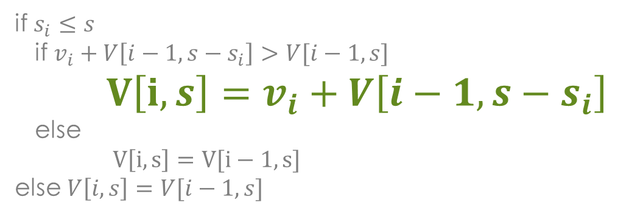
Example
Items ($s_{i}$, $v_{i}$)
1: (2, 3)
2: (3, 4)
3: (4, 5)
4: (5, 6)
if $s_{i}≤s$
if $v_{i}+V\left[i−1, s−s_{i}\right]>V[i−1, s]$
$V\left[i, s\right]=v_{i}+V\left[i−1, s−s_{i}\right]$
else
$V\left[i, s\right]=V[i−1,s]$
else $V\left[i, s\right]=V[i−1,s]$
i\s | 0 | 1 | 2 | 3 | 4 | 5
0 | 0 | 0 | 0 | 0 | 0 | 0
1 | 0 | 0 | 3 | 3 | 3 | 3
2 | 0 | 0 | 3 | 4
3 | 0
4 | 0
Notes:
i = 2
v_{i} = 4
s_{i} = 3
s = 3
s - s_{i} = 0

Slide 27
Example
Items ($s_{i}$, $v_{i}$)
1: (2, 3)
2: (3, 4)
3: (4, 5)
4: (5, 6)
if $s_{i}≤s$
if $v_{i}+V\left[i−1, s−s_{i}\right]>V[i−1, s]$
$V\left[i, s\right]=v_{i}+V\left[i−1, s−s_{i}\right]$
else
$V\left[i, s\right]=V[i−1,s]$
else $V\left[i, s\right]=V[i−1,s]$
i\s | 0 | 1 | 2 | 3 | 4 | 5
0 | 0 | 0 | 0 | 0 | 0 | 0
1 | 0 | 0 | 3 | 3 | 3 | 3
2 | 0 | 0 | 3 | 4 | 4
3 | 0
4 | 0
Notes:
i = 2
v_{i} = 4
s_{i} = 3
s = 4
s - s_{i} = 1

Slide 28
Example
Items ($s_{i}$, $v_{i}$)
1: (2, 3)
2: (3, 4)
3: (4, 5)
4: (5, 6)
if $s_{i}≤s$
if $v_{i}+V\left[i−1, s−s_{i}\right]>V[i−1, s]$
$V\left[i, s\right]=v_{i}+V\left[i−1, s−s_{i}\right]$
else
$V\left[i, s\right]=V[i−1,s]$
else $V\left[i, s\right]=V[i−1,s]$
i\s | 0 | 1 | 2 | 3 | 4 | 5
0 | 0 | 0 | 0 | 0 | 0 | 0
1 | 0 | 0 | 3 | 3 | 3 | 3
2 | 0 | 0 | 3 | 4 | 4 | 7
3 | 0
4 | 0
Notes:
i = 2
v_{i} = 4
s_{i} = 3
s = 5
s - s_{i} = 2

Slide 29
Example
Items ($s_{i}$, $v_{i}$)
1: (2, 3)
2: (3, 4)
3: (4, 5)
4: (5, 6)
if $s_{i}≤s$
if $v_{i}+V\left[i−1, s−s_{i}\right]>V[i−1, s]$
$V\left[i, s\right]=v_{i}+V\left[i−1, s−s_{i}\right]$
else
$V\left[i, s\right]=V[i−1,s]$
else $V\left[i, s\right]=V[i−1,s]$
i\s | 0 | 1 | 2 | 3 | 4 | 5
0 | 0 | 0 | 0 | 0 | 0 | 0
1 | 0 | 0 | 3 | 3 | 3 | 3
2 | 0 | 0 | 3 | 4 | 4 | 7
3 | 0 | 0 | 3 | 4
4 | 0
Notes:
i = 3
v_{i} = 5
s_{i} = 4
s = 1…3

Slide 30
Example
Items ($s_{i}$, $v_{i}$)
1: (2, 3)
2: (3, 4)
3: (4, 5)
4: (5, 6)
if $s_{i}≤s$
if $v_{i}+V\left[i−1, s−s_{i}\right]>V[i−1, s]$
$V\left[i, s\right]=v_{i}+V\left[i−1, s−s_{i}\right]$
else
$V\left[i, s\right]=V[i−1,s]$
else $V\left[i, s\right]=V[i−1,s]$
i\s | 0 | 1 | 2 | 3 | 4 | 5
0 | 0 | 0 | 0 | 0 | 0 | 0
1 | 0 | 0 | 3 | 3 | 3 | 3
2 | 0 | 0 | 3 | 4 | 4 | 7
3 | 0 | 0 | 3 | 4 | 5
4 | 0
Notes:
i = 3
v_{i} = 5
s_{i} = 4
s = 4
s - s_{i} = 0

Slide 31
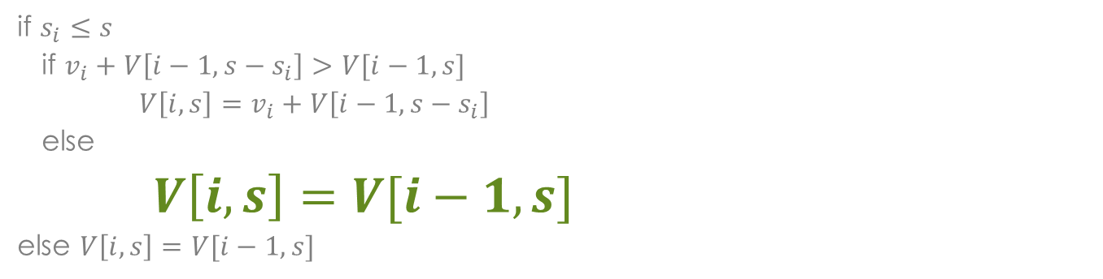
Example
Items ($s_{i}$, $v_{i}$)
1: (2, 3)
2: (3, 4)
3: (4, 5)
4: (5, 6)
if $s_{i}≤s$
if $v_{i}+V\left[i−1, s−s_{i}\right]>V[i−1, s]$
$V\left[i, s\right]=v_{i}+V\left[i−1, s−s_{i}\right]$
else
$V\left[i, s\right]=V[i−1,s]$
else $V\left[i, s\right]=V[i−1,s]$
i\s | 0 | 1 | 2 | 3 | 4 | 5
0 | 0 | 0 | 0 | 0 | 0 | 0
1 | 0 | 0 | 3 | 3 | 3 | 3
2 | 0 | 0 | 3 | 4 | 4 | 7
3 | 0 | 0 | 3 | 4 | 5 | 7
4 | 0
Notes:
i = 3
v_{i} = 5
s_{i} = 4
s = 5
s - s_{i} = 1

Slide 32
Example
Items ($s_{i}$, $v_{i}$)
1: (2, 3)
2: (3, 4)
3: (4, 5)
4: (5, 6)
if $s_{i}≤s$
if $v_{i}+V\left[i−1, s−s_{i}\right]>V[i−1, s]$
$V\left[i, s\right]=v_{i}+V\left[i−1, s−s_{i}\right]$
else
$V\left[i, s\right]=V[i−1,s]$
else $V\left[i, s\right]=V[i−1,s]$
i\s | 0 | 1 | 2 | 3 | 4 | 5
0 | 0 | 0 | 0 | 0 | 0 | 0
1 | 0 | 0 | 3 | 3 | 3 | 3
2 | 0 | 0 | 3 | 4 | 4 | 7
3 | 0 | 0 | 3 | 4 | 5 | 7
4 | 0 | 0 | 3 | 4 | 5
Notes:
i = 4
v_{i} = 6
s_{i} = 5
s = 1…4

Slide 33
Example
Items ($s_{i}$, $v_{i}$)
1: (2, 3)
2: (3, 4)
3: (4, 5)
4: (5, 6)
if $s_{i}≤s$
if $v_{i}+V\left[i−1, s−s_{i}\right]>V[i−1, s]$
$V\left[i, s\right]=v_{i}+V\left[i−1, s−s_{i}\right]$
else
$V\left[i, s\right]=V[i−1,s]$
else $V\left[i, s\right]=V[i−1,s]$
i\s | 0 | 1 | 2 | 3 | 4 | 5
0 | 0 | 0 | 0 | 0 | 0 | 0
1 | 0 | 0 | 3 | 3 | 3 | 3
2 | 0 | 0 | 3 | 4 | 4 | 7
3 | 0 | 0 | 3 | 4 | 5 | 7
4 | 0 | 0 | 3 | 4 | 5 | 7
Notes:
i = 4
v_{i} = 6
s_{i} = 5
s = 5
s - s_{i} = 0

Slide 34

Dynamic Programming
Let $i=n$ and $k=S$
if $V\left[i,k\right]≠V\left[1−i, k\right]$
$i=i−1, k=k−s_{i}$
else
$i=i−1$
Notes:
To identify which items to include in the knapsack…
All of the information we need is in the table
V[n,S] is the maximal value of items that can be placed in the Knapsack
if...mark the ith items as in the knapsack
else...assume the ith item is not in the knapsack

Slide 35
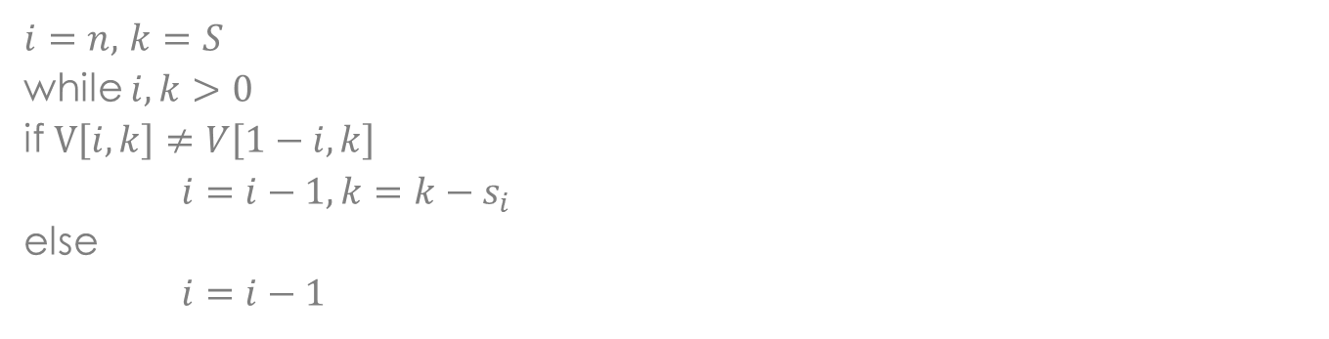
Example
Items ($s_{i}$, $v_{i}$)
1: (2, 3)
2: (3, 4)
3: (4, 5)
4: (5, 6)
$i=n,$ $k=S$
while $i,k>0$
if $V\left[i,k\right]≠V\left[1−i, k\right]$
$i=i−1, k=k−s_{i}$
else
$i=i−1$
i\s | 0 | 1 | 2 | 3 | 4 | 5
0 | 0 | 0 | 0 | 0 | 0 | 0
1 | 0 | 0 | 3 | 3 | 3 | 3
2 | 0 | 0 | 3 | 4 | 4 | 7
3 | 0 | 0 | 3 | 4 | 5 | 7
4 | 0 | 0 | 3 | 4 | 5 | 7
Notes:
$i$ = 4
$k$ = 5
$$v_{i}=6$$
$s_{i}$ = 5
$$V\left[i,k\right]=7$$
$$V\left[i−1,k\right]=7$$

Slide 36
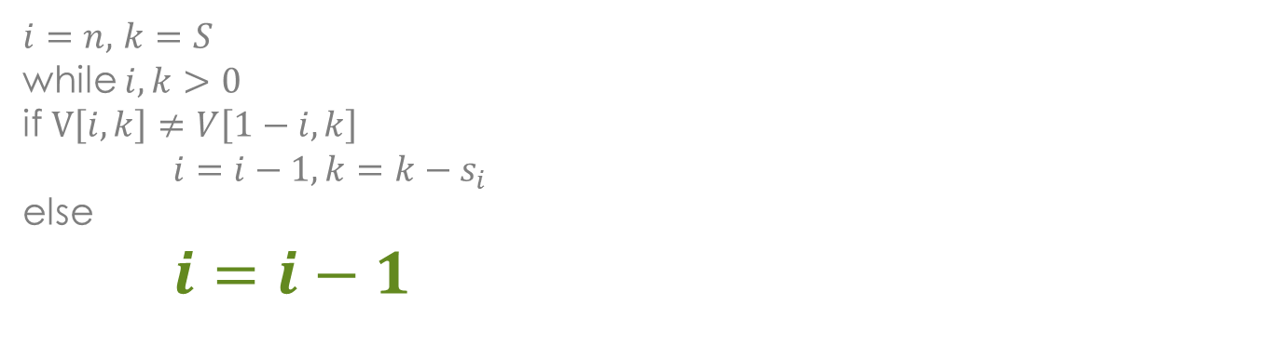
Example
Items ($s_{i}$, $v_{i}$)
1: (2, 3)
2: (3, 4)
3: (4, 5)
4: (5, 6)
$i=n,$ $k=S$
while $i,k>0$
if $V\left[i,k\right]≠V\left[1−i, k\right]$
$i=i−1, k=k−s_{i}$
else
$i=i−1$
i\s | 0 | 1 | 2 | 3 | 4 | 5
0 | 0 | 0 | 0 | 0 | 0 | 0
1 | 0 | 0 | 3 | 3 | 3 | 3
2 | 0 | 0 | 3 | 4 | 4 | 7
3 | 0 | 0 | 3 | 4 | 5 | 7
4 | 0 | 0 | 3 | 4 | 5 | 7
Notes:
$i$ = 4
$k$ = 5
$$v_{i}=6$$
$s_{i}$ = 5
$$V\left[i,k\right]=7$$
$$V\left[i−1,k\right]=7$$

Slide 37
Example
Items ($s_{i}$, $v_{i}$)
1: (2, 3)
2: (3, 4)
3: (4, 5)
4: (5, 6)
$i=n,$ $k=S$
while $i,k>0$
if $V\left[i,k\right]≠V\left[1−i, k\right]$
$i=i−1, k=k−s_{i}$
else
$i=i−1$
i\s | 0 | 1 | 2 | 3 | 4 | 5
0 | 0 | 0 | 0 | 0 | 0 | 0
1 | 0 | 0 | 3 | 3 | 3 | 3
2 | 0 | 0 | 3 | 4 | 4 | 7
3 | 0 | 0 | 3 | 4 | 5 | 7
4 | 0 | 0 | 3 | 4 | 5 | 7
Notes:
$i$ = 3
$k$ = 5
$$v_{i}=6$$
$s_{i}$ = 4
$$V\left[i,k\right]=7$$
$$V\left[i−1,k\right]=7$$

Slide 38
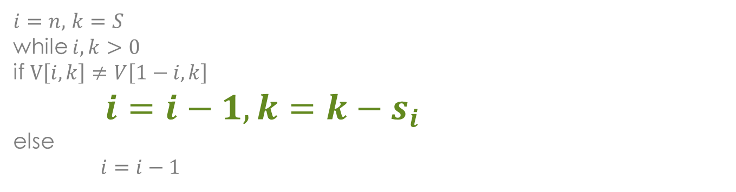
Example
Items ($s_{i}$, $v_{i}$)
1: (2, 3)
2: (3, 4)
3: (4, 5)
4: (5, 6)
$i=n,$ $k=S$
while $i,k>0$
if $V\left[i,k\right]≠V\left[1−i, k\right]$
$i=i−1, k=k−s_{i}$
else
$i=i−1$
i\s | 0 | 1 | 2 | 3 | 4 | 5
0 | 0 | 0 | 0 | 0 | 0 | 0
1 | 0 | 0 | 3 | 3 | 3 | 3
2 | 0 | 0 | 3 | 4 | 4 | 7
3 | 0 | 0 | 3 | 4 | 5 | 7
4 | 0 | 0 | 3 | 4 | 5 | 7
Notes:
$i$ = 1
$k$ = 5
$$v_{i}=4$$
$s_{i}$ = 3
$$V\left[i,k\right]=7$$
$$V\left[i−1,k\right]=3$$
$$k−s_{i}=2$$

Slide 39
Example
Items ($s_{i}$, $v_{i}$)
1: (2, 3)
2: (3, 4)
3: (4, 5)
4: (5, 6)
$i=n,$ $k=S$
while $i,k>0$
if $V\left[i,k\right]≠V\left[1−i, k\right]$
$i=i−1, k=k−s_{i}$
else
$i=i−1$
i\s | 0 | 1 | 2 | 3 | 4 | 5
0 | 0 | 0 | 0 | 0 | 0 | 0
1 | 0 | 0 | 3 | 3 | 3 | 3
2 | 0 | 0 | 3 | 4 | 4 | 7
3 | 0 | 0 | 3 | 4 | 5 | 7
4 | 0 | 0 | 3 | 4 | 5 | 7
Notes:
$i$ = 1
$k$ = 2
$$v_{i}=3$$
$s_{i}$ = 2
$$V\left[i,k\right]=3$$
$$V\left[i−1,k\right]=0$$
$$k−s_{i}=0$$

Slide 40
Example
Items ($s_{i}$, $v_{i}$)
1: (2, 3)
2: (3, 4)
3: (4, 5)
4: (5, 6)
$i=n,$ $k=S$
while $i,k>0$
if $V\left[i,k\right]≠V\left[1−i, k\right]$
$i=i−1, k=k−s_{i}$
else
$i=i−1$
i\s | 0 | 1 | 2 | 3 | 4 | 5
0 | 0 | 0 | 0 | 0 | 0 | 0
1 | 0 | 0 | 3 | 3 | 3 | 3
2 | 0 | 0 | 3 | 4 | 4 | 7
3 | 0 | 0 | 3 | 4 | 5 | 7
4 | 0 | 0 | 3 | 4 | 5 | 7
Notes:
$i$ = 0
$k$ = 0
The optimal knapsack should contain {1, 2}

Slide 41

Example
Items ($s_{i}$, $v_{i}$)
1: (2, 3)
2: (3, 4)
3: (4, 5)
4: (5, 6)
The optimal knapsack should contain {1,2} = 7
i\s | 0 | 1 | 2 | 3 | 4 | 5
0 | 0 | 0 | 0 | 0 | 0 | 0
1 | 0 | 0 | 3 | 3 | 3 | 3
2 | 0 | 0 | 3 | 4 | 4 | 7
3 | 0 | 0 | 3 | 4 | 5 | 7
4 | 0 | 0 | 3 | 4 | 5 | 7
Notes:
$i$ = 0
$k$ = 0
The optimal knapsack should contain {1, 2}

Slide 42
Knapsack Problem
Common Applications
Resource allocation with financial constraints
Construction and scoring of heterogeneous test
Selection of capital investments

