Slide 1
Information Security Fundamentals Unit -1 CIA Triad

Slide 2
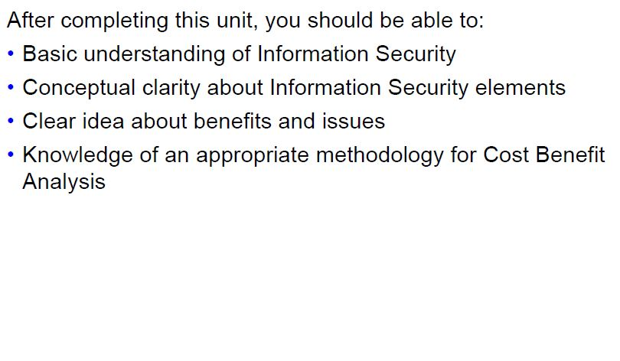
Unit Objectives:-

Slide 3
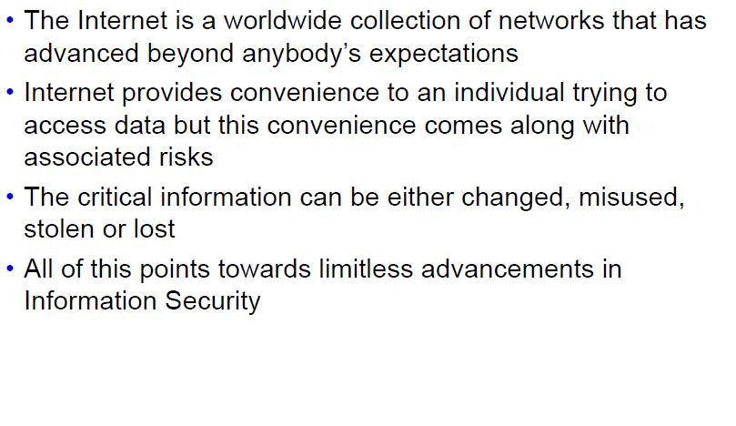
Background

Slide 4
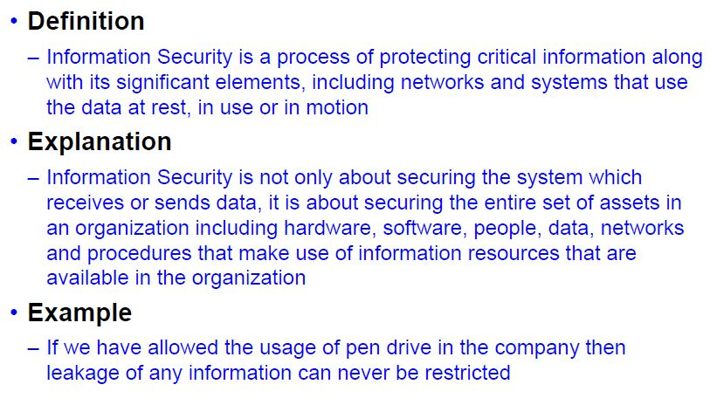
Introduction to Information Security

Slide 5
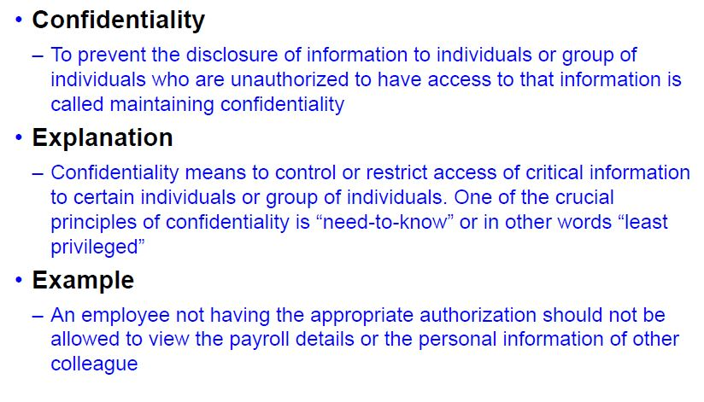
Elements of Information Security - 1

Slide 6
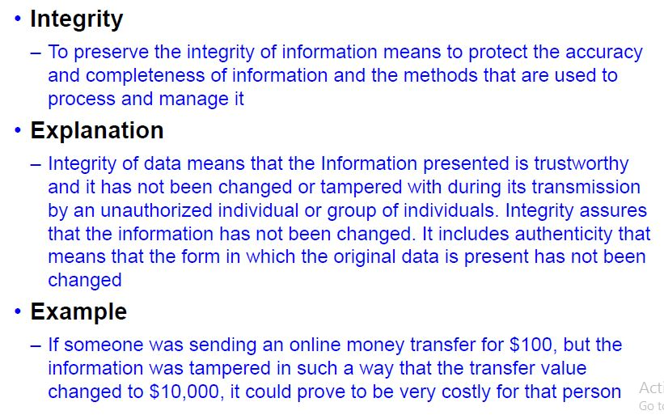
Elements of Information Security -2

Slide 7
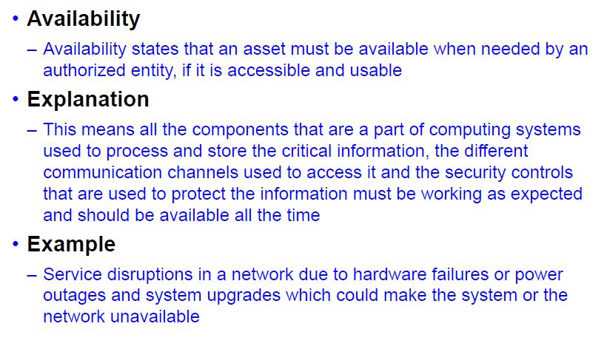
Elements of Information Security - 3

Slide 8
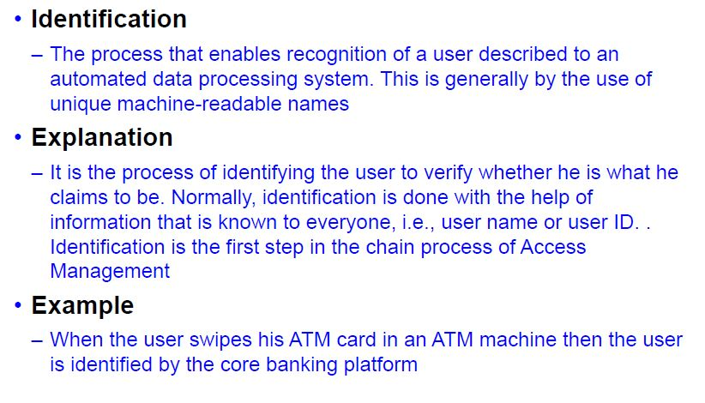
Elements of Information Security - 4

Slide 9
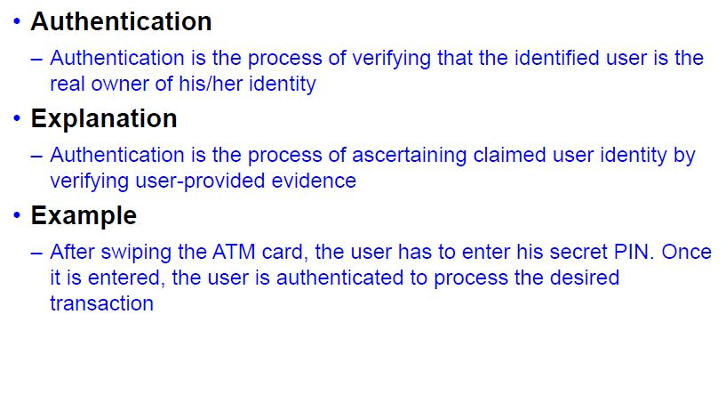
Elements of Information Security - 5

Slide 10
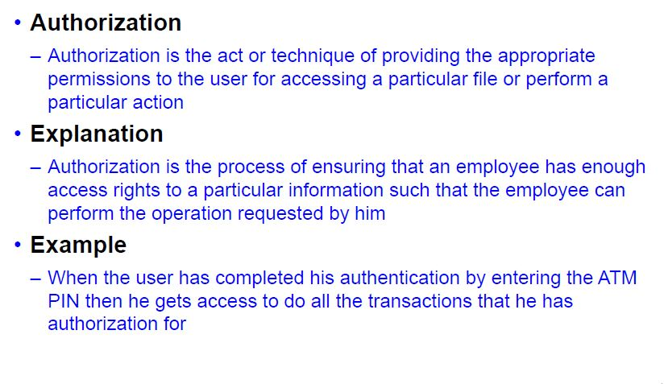
Elements of Information Security - 6

Slide 11
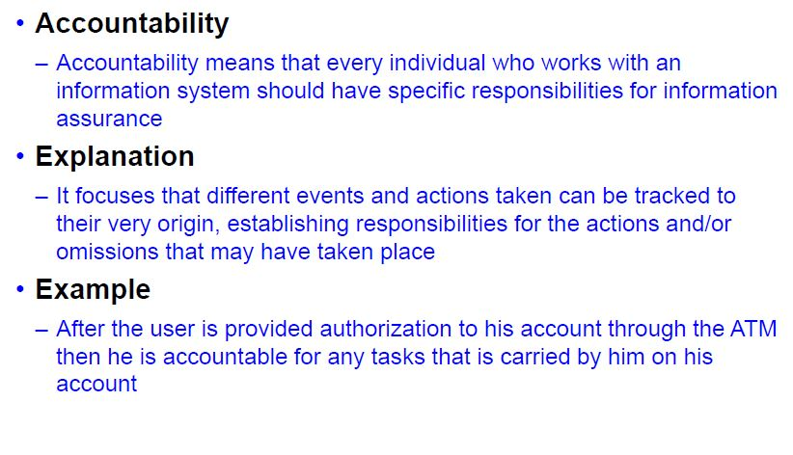
Elements of Information Security - 7

Slide 12
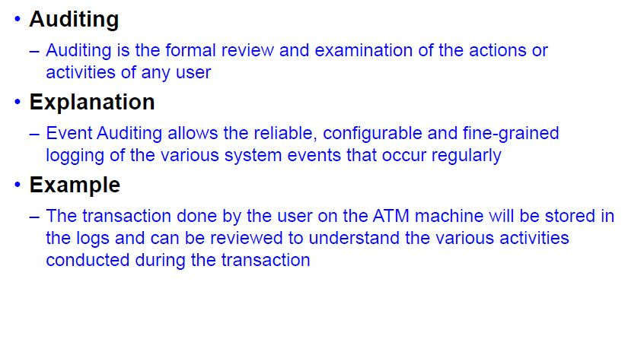
Elements of Information Security - 8

Slide 13
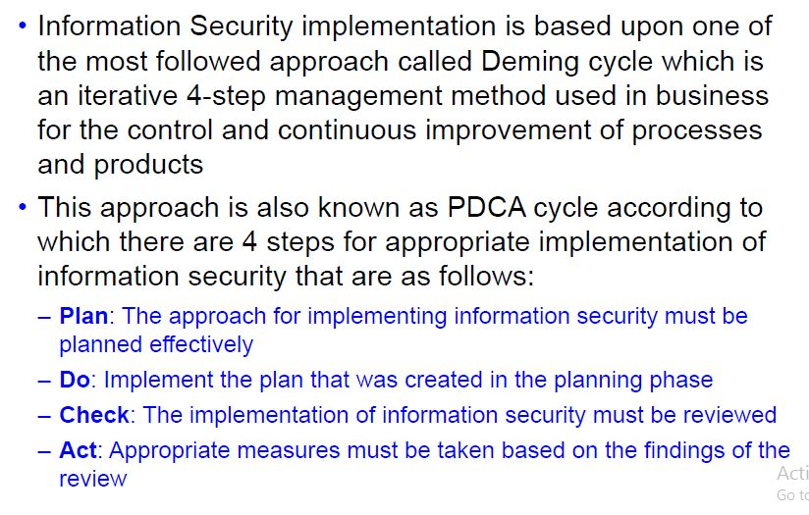
Implementing Information Security

Slide 14
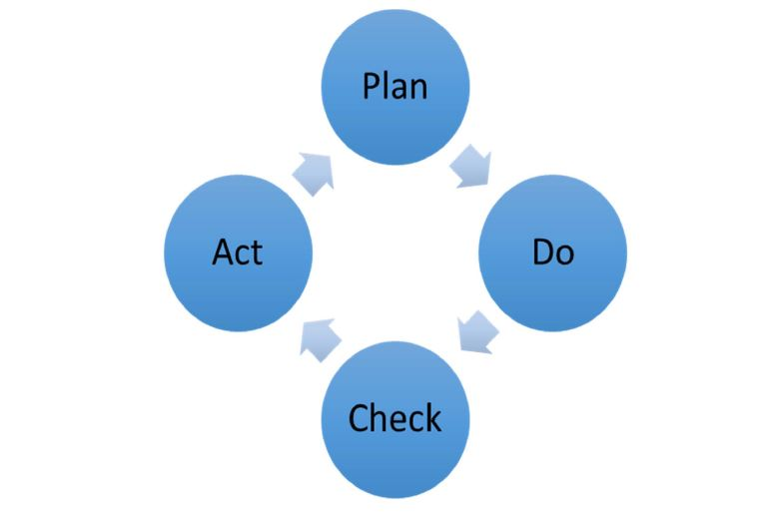
PDCA Cycle

Slide 15
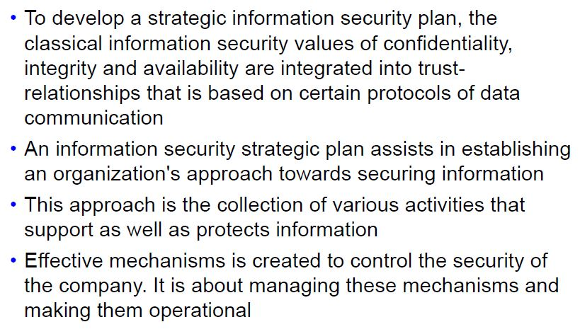
Developing an Information Security Strategy

Slide 16
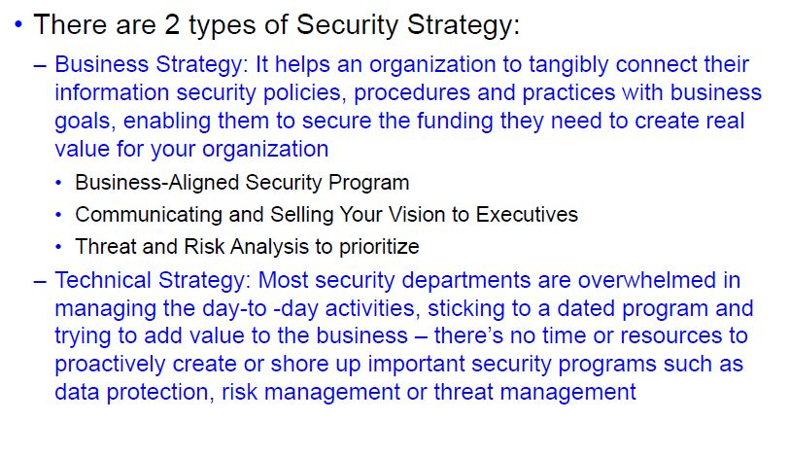
Types of Security Strategy

Slide 17
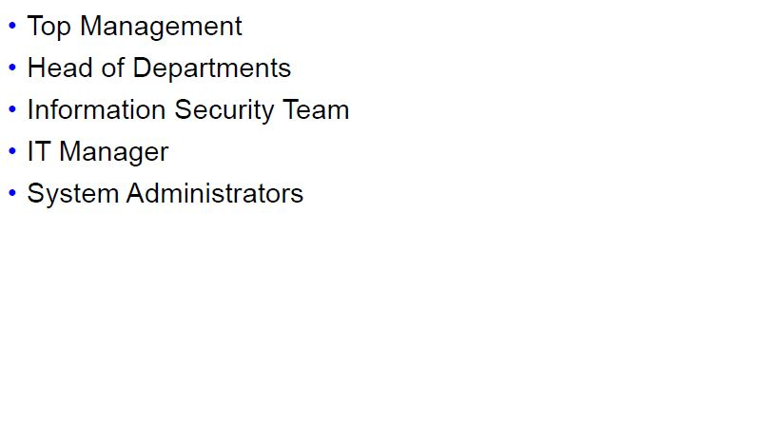
Stakeholders of Security Strategy

Slide 18
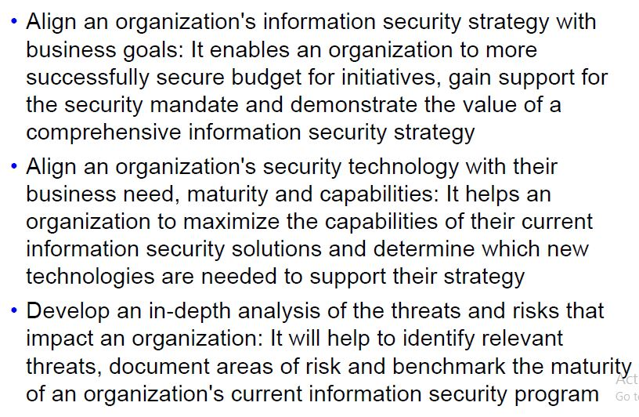
Considerations for Security Strategy

Slide 19
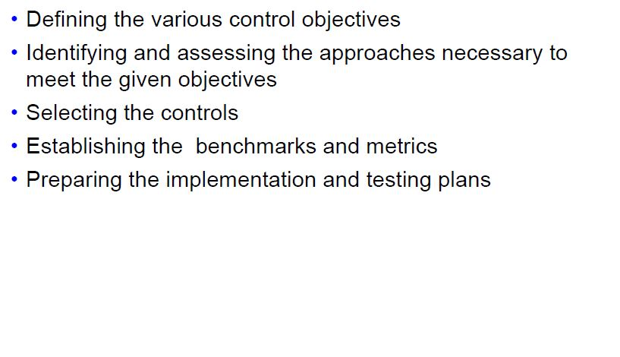
Steps of Security Strategy

Slide 20
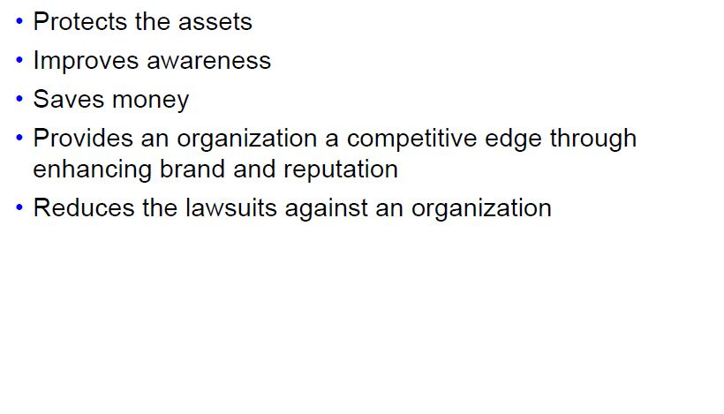
Information Security Benefits

Slide 21
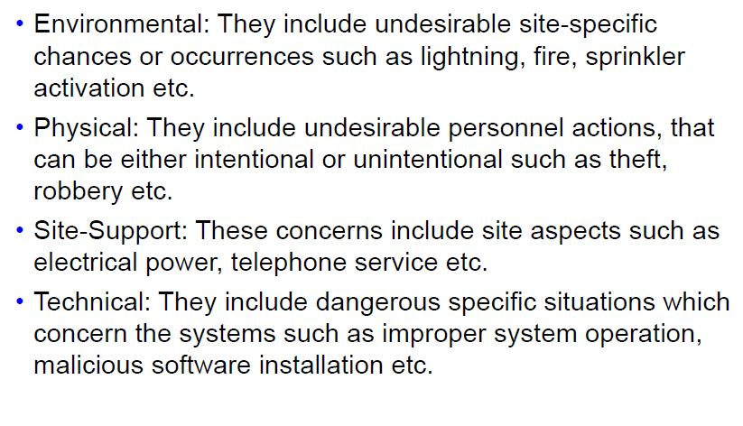
Threat and Vulnerability Types

Slide 22
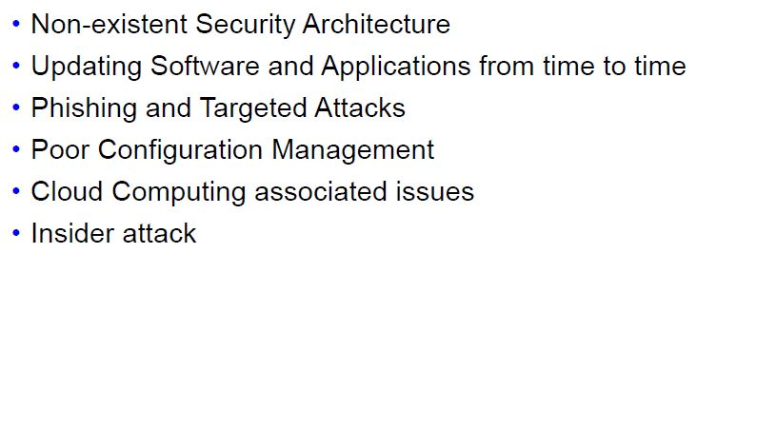
Information Security Issues

Slide 23
Cost Benefit Analysis
“It is best to think of the cost-benefit approach as a way of organizing thought rather than as a substitute for it.” — Michael Drummond

Slide 24
Hey Boss, we need more security. I think we should get the new Acme 2000 Hacker Abolisher
We always seem to need more security! Don’t we have enough?
S
M

Slide 25
Trust me, we will be more secure!
What are my alternatives?
What is it going to cost?
S
M
What is the added value?

Slide 26
Alternatives?
Value?
S

Slide 27
Problem
Security managers lack structured cost-benefit methods to evaluate and compare alternative security solutions.
Notes:
A solution to this problem would have to have 3 elements:
Cost
Benefit
Consistent evaluation across different solutions

Slide 28
Cost Benefit Analysis (CBA)
Organizations employ countermeasures, or safeguards, to protect information assets. In selecting the proper countermeasures, it makes good business sense to find a countermeasure that is also the most cost-effective. Determining the most cost-effective countermeasure is called a cost/benefit analysis.
CBA determines whether or not a control alternative is worth its associated cost
CBAs may be calculated before a control or safeguard is implemented Or calculated after controls have been implemented and have been functioning for a time
A cost/benefit analysis looks at the ALE, the annual cost of the safeguard, and the ALE after the countermeasure is installed to determine whether the costs show a benefit for the organization.
Value of Countermeasure = ALE (without countermeasure) – Cost (safeguard) – ALE (with countermeasure)

Slide 29
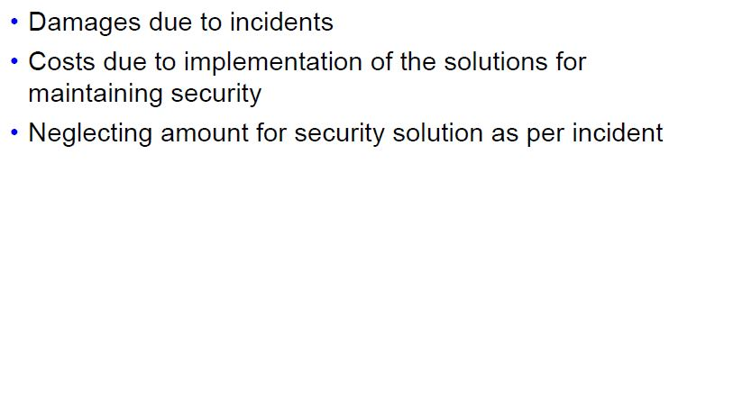
Cost Benefit Analysis (CBA)- Requirements

Slide 30
CBA Requirements Contd..
Damages due to incidents:
It is dealt by an organization in a certain time period because of different type of incidents and can be calculated by providing an average cost for every incident and then finding the product between the cost and number of incidents.
Costs due to implementation of the solutions for maintaining security:
It is the implementation and operational cost for every security solution such as IPS/IDS, VPN, etc.
Neglecting amount of security solution as per incident:
It can be calculated from the specifications which are provided. Its value can also be known approximately by asking owners and the security solution operators from time to time.

Slide 31
Exposure factor (EF)
The frequency of occurrence is used to estimate the percentage of loss on a particular asset because of a threat.
Also called the exposure factor (EF), this value recognizes that a threat does not result in a total loss.
For example, a fiber-optic cable running between two buildings being cut by a maintenance worker affects only the cable and the productivity for its cut, which might be only 20% of the organization's infrastructure. For this asset, the EF would be 0.20 for calculations.

Slide 32
Single-Loss Expectancy (SLE)
This is the amount of the potential loss for a specific threat.
SLE = asset value x EF

Slide 33
Annualized Rate of Occurrence (ARO)
The annualized rate of occurrence (ARO) is the ratio of the estimated possibility that the threat will take place in a 1-year time frame.
The ARO can be expressed as 0.0 if the threat will never occur, through 1.0 if the threat will always occur.
For example, the ARO for a workstation virus might be set to 1.0, whereas a power outage to the network operations center that might occur once every 4 years would have an ARO of 0.25.

Slide 34
Annualized Loss Expectancy (ALE)
Tells the analyst the maximum amount that should be spent on the countermeasure to prevent the threat from occurring.
If the countermeasure costs more than the ALE, it can indicate a risk that the organization might take.
ALE = SLE x ARO
or
ALE = asset value x EF X ARO

Slide 35
ACS (Annual cost of Safeguard)
Factors that affect the cost of a safeguard:
Cost of development or acquisition of hardware, software, and services
Training fees
Cost of implementation
Service and maintenance costs
Value of countermeasure = ALE(prior) – ACS - ALE(post)
ALE (prior to control) is the annualized loss expectancy of the risk before the implementation of the control
ALE (post-control) is the ALE examined after the control has been in place for a period of time

Slide 36
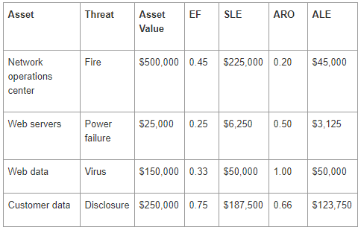
Example

Slide 37
Example Contd.
Let's say that the cost of a universal power supply (UPS)—to purchase and operate—is $1,000 per year.
Even with the UPS, the exposure factor (EF) is reduced to 5% (0.05) because a power outage that lasts longer than the UPS can supply power is possible.
The utility reports that an outage that will last longer than the UPS occurs once every 5 years, reducing the annual rate of occurrence (ARO) to 20% (0.20).

Slide 38
Example Contd.
ALE (with UPS) = Cost (Web server) x EF x ARO
ALE (with UPS) = $25,000 x 0.05 x 0.20
ALE (with UPS) = $250
With the UPS, the ALE is now $250. Using that for the cost/benefit analysis, you can calculate the following:
Value of countermeasure = $3,125 – $1,000 – $250
Value of countermeasure = $1,875
With the value of the countermeasure at $1,875 and the cost at $1,000, the benefit of $875 per year for the countermeasure makes it a benefit for the organization.

Slide 39
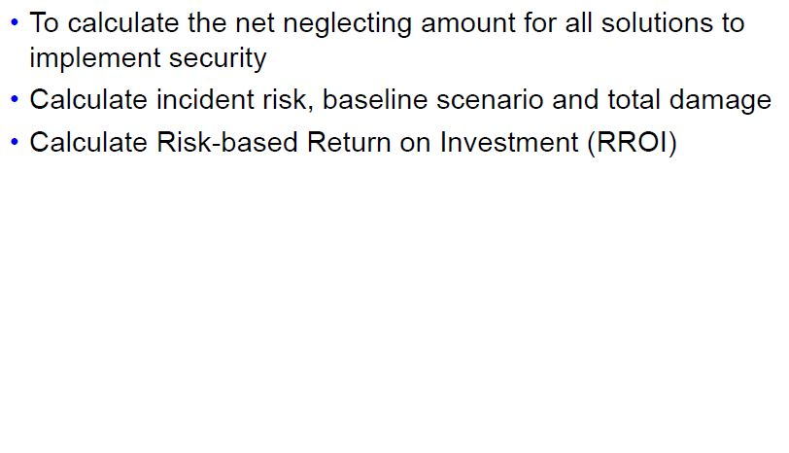
Cost Benefit Analysis (CBA)- Phases

Slide 40
1. Calculate net neglecting amount for all solutions to implement security
The frequency of unsuccessful attacks is first estimated to estimate the presented risk from each type of incident ultimately.
This frequency can be assessed with the help of neglecting amounts, the rate at which particular type of incidents are able to bypass the currently implemented Information Security solutions.
Identifying the net neglecting amount for all the security solutions require making assumptions about how the countermeasures support and combine each other, like, each countermeasure acts as an independent filter on attacks. In this case the overall neglecting amount is the product of the individual neglecting amounts.

Slide 41
2. Calculate incident risk, baseline scenario and total damage
The damage caused by an incident can be known from organizational procedures and processes that have been triggered by an incident which has occurred, such as lost of productivity or root compromises due to stoppage of work.
Also mitigation activities are also a part of the cost focused towards reducing the loss associated to incident such as server scanning on detection of a virus.
Organizations that do not track cost can still estimate the damage for each incident type by estimating an average cost and multiplying this by the number of incidents
The incident risk is estimated by the incident type and the corresponding price

Slide 42
Example of Cost-Benefit Analysis Calculation
Eg. 1: Dropping an iPad and breaking the screen
Asset value: $700
Exposure factor: 50%
SLE = $700 x 50% = $350
ARO(without countermeasure) = 25% chance of damaging
ARO(with countermeasure) = 5% chance of damaging
ALE (prior) = 25% x $350 = $87.50
ALE (post) = 5% x $350 = $17.50
CBA (cost of safeguard = $30)
CBA = ALE(prior) – ALE(post) – ACS
CBA = 87.50 – 17.50 – 30.00 = $40
Value of countermeasure = ALE(prior) – ACS - ALE(post)

Slide 43
Example of Cost-Benefit Analysis Calculation
Unprotected customer database
Asset value: $200,000
Exposure factor: 25%
SLE = $200,000 x 25% = $50,000
ARO(without countermeasure) = 75% chance of occurring
ARO(with countermeasure) = 10% chance of occurring
ALE (prior) = 75% x $50,000 = $37,500
ALE (post) = 10% x $50,000 = $5,000
CBA (ACS = $5,000)
CBA = ALE(prior) – ALE(post) – ACS
CBA = $37,500 – $5,000 – $5,000 = $27,500
Value of countermeasure = ALE(prior) – ACS - ALE(post)

Slide 44
Thank You !!!!

